Slide 1


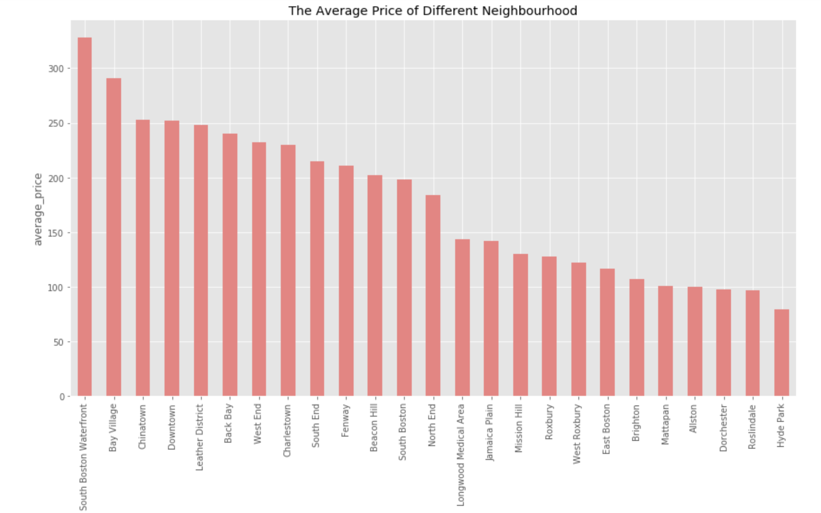
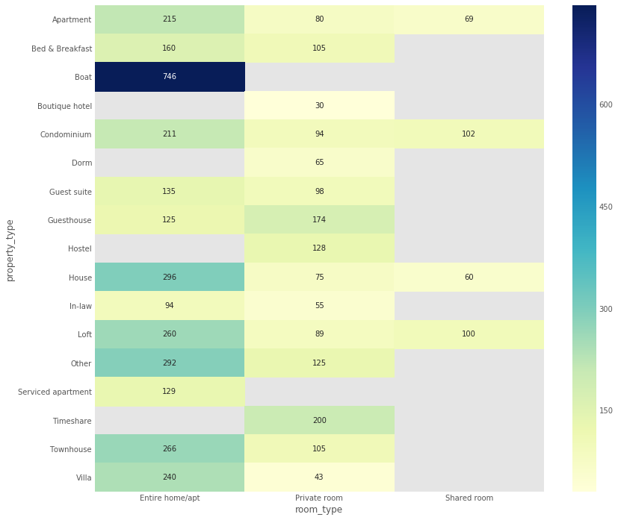
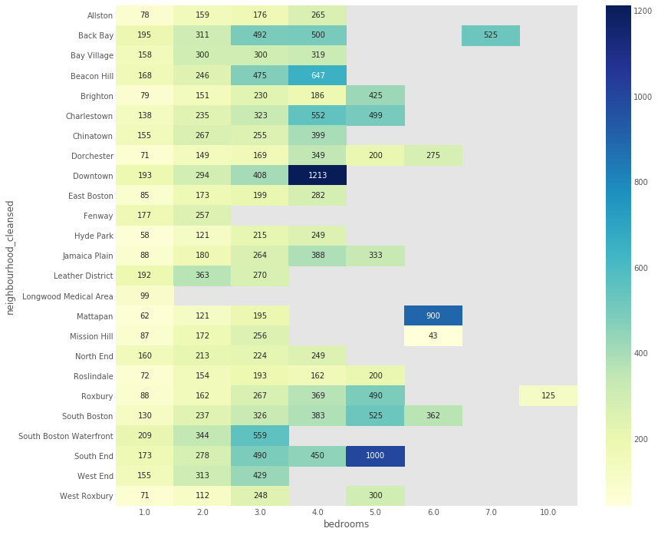
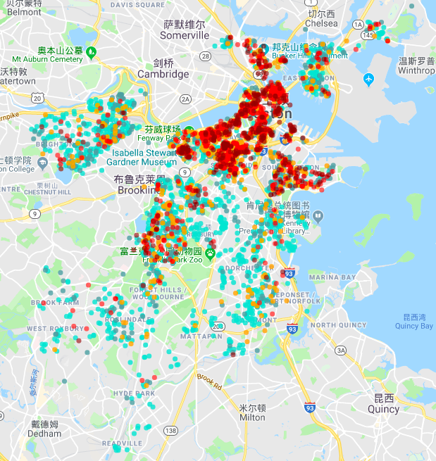
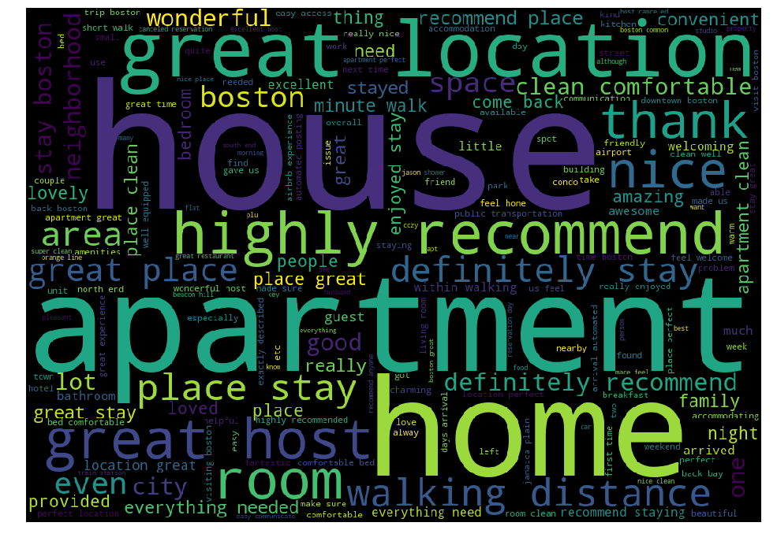
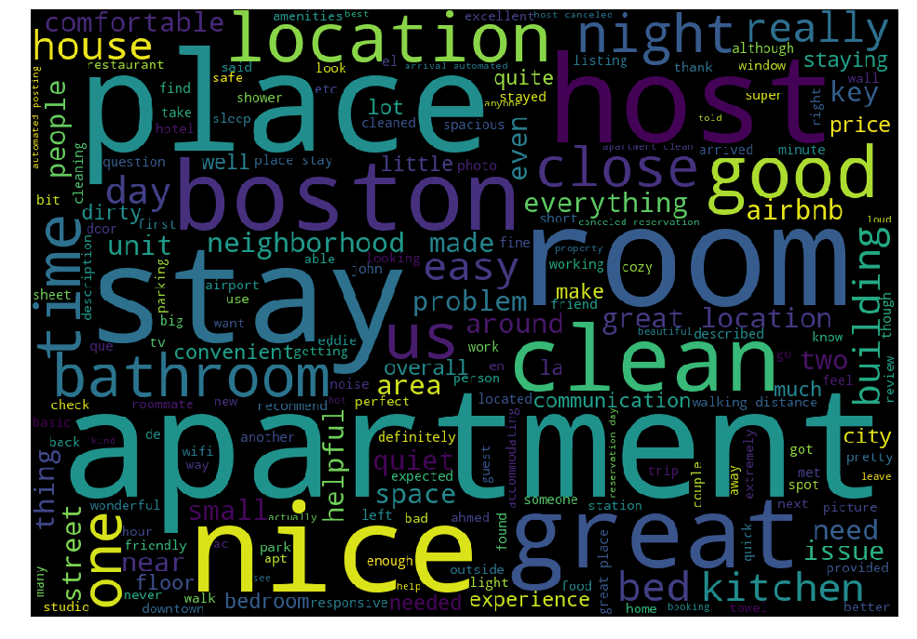
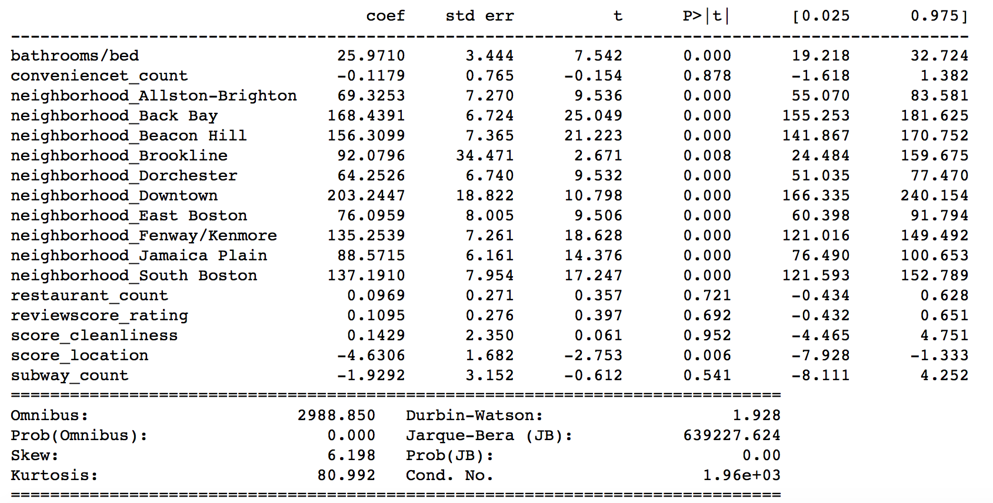
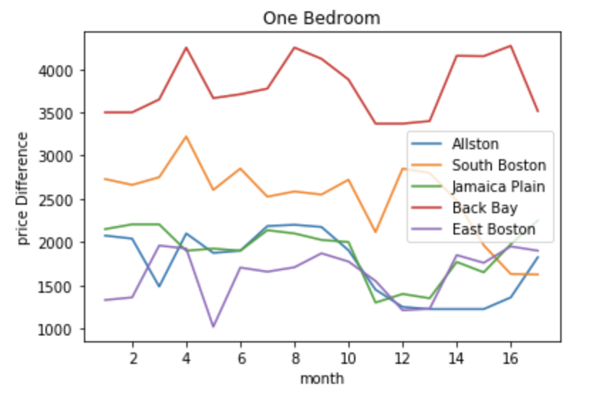
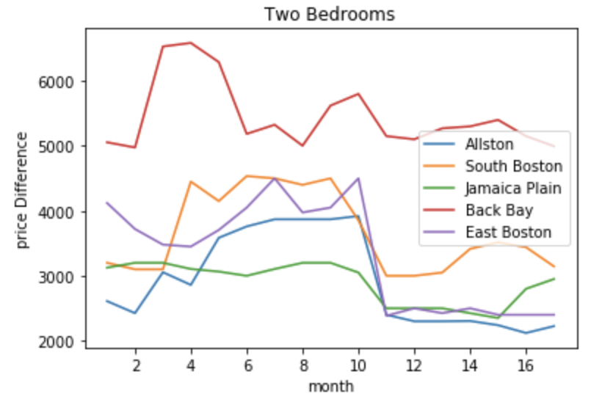
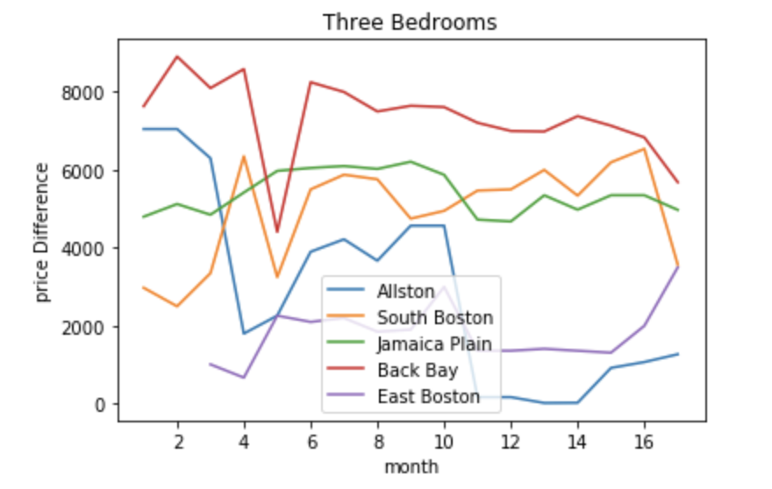
Airbnb Price Analysis in Boston
Jiali Ge, Jingjun Wang, Xintong Hao CS506 Boston University
https://github.com/ivyoo00/Airbnb-v.s.-Zillow-in-Boston
Data Library
Factors of influencing the Airbnb price in Boston
Relationship between the benefits of Airbnb and neighbourhood
Airbnb​: ​http://insideairbnb.com/get-the-data.html 1) listings.csv: Details of all the listings in Boston.
2) reviews.csv​ : Reveiws for each listing.
3) tomslee_airbnb_boston_0282_2016-01-16.csv :​Airbnb Data Collection​ from Jan/2016 to July/2017 by Tom Slee.
Zillow :https://www.zillow.com/research/data/
Median rents price/square foot by property type and bedroom count.
Google Places API​
The prices of listings in Airbnb depend upon the room type, property type, number of bedrooms and neighborhoods. It can be seen that the type of entire house with maximum number of bedrooms in specific neighborhoods like like Back Bay, Beacon Hill, Downtown and South End has the highest price.
As a investor, investigate houses in area like Back Bay and South Boston can get higher
return, while houses in Allston and East Boston is better for regular monthly renting.
Relationship between reviews, ratings and room price
Boston Airbnb Price Map
Price Range($): ● [ , 100), ● [100, 150),
● [150, 200), ● [200, 300), ● [ 300, )
Compared with their top 50 words, we can figure out some differences between them. In the word cloud of lower rating, they still have many positive words in it, but they also have some negative words like ‘issue’, ‘problem’, ‘noise’, ‘never’ and ‘dirty’.
OLS Linear Model of Airbnb Price
​comments with score > 95​
​comments with score < 80​
Features: ​['neighborhood', 'bathrooms/bed', 'review_score_rating', 'score_location', 'score_cleanliness', 'restaurant_count', 'convenience_count', 'subway_count']
Leading factor: neighborhood.
Positive: # of bed, # of restaurants, score of cleanliness.
Negative: # of convenience store (convenience stores are more likely concentrated in the poorer neighborhoods.), score of review (travelers are more strict with high price home.)
Price difference for different time period between Zillow and Airbnb
Highest rental price: Back Bay. Peak season: April , Off-season: Jan, Feb
1-bedroom
2-bedroom
3-bedroom

