Slide 1





Modeling and Parallel Simulation of Multicore Architectures with Manifold
The Manifold Team
School of Electrical and Computer Engineering and School of Computer Science
Georgia Institute of Technology
Atlanta, GA. 30332
Sponsors
Notes:
1

Slide 2
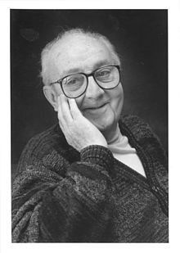
Motivation
“Remember that all models are wrong; the practical question is how wrong do they have to be to not be useful.”
Box, G. E. P., and Draper, N. R., (1987), Empirical Model Building and Response Surfaces, John Wiley & Sons, New York, NY.
George E. P. Box, 2011
George E. P. Box, 2011

Slide 3
Manifold@GT
Faculty
Tom Conte (SCS)
George Riley (ECE)
S. Yalamanchili (ECE)
Research Staff
Jun Wang (ECE)
Collaborators
Genie Hsieh (Sandia)
Saibal Mukhopadhyay (ECE)
Hyesoon Kim (SCS)
Arun Rodrigues (Sandia)
Graduate Students
Jesse Beu
Rishiraj Bheda
Zhenjiang Dong
Chad Kersey
Elizabeth Lynch
Jason Poovey
Mitchelle Rasquinha
William Song
He Xiao
Peng Xu
…+ many other contributors
3

Slide 4
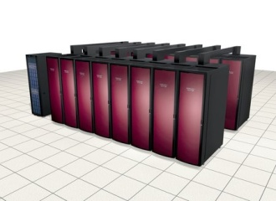
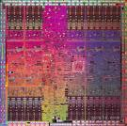
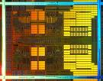
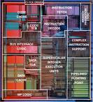
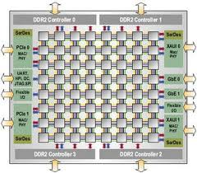
Modeling and Simulation Demands
Cray XT3
GTX200: 240 cores
Thermal
Complexity
Shanghai: Quad Core
Power
Pentium: single core
Tilera: 100 cores
Packaging
Scope
System complexity is outpacing simulation capacity
Cannot perform analysis at scale
The problem is getting worse faster → Simulation Wall
Today - islands of simulators and simulation systems
Customized interactions
Difficult to leverage individual investments
4

Slide 5
Spectrum of Solutions
Lowest performance
Lowest cost
Highest performance
Highest cost
Software simulations: single processor
(e.g., GEM5)
Software Simulation: Parallel
(e.g., Manifold, COTSon)
Accelerated Simulation
(e.g., FAST)
FPGA-Based Prototyping
(e.g., RAMP)
Custom Prototyping
Simple Premise: Use parallel machines to simulate/emulate parallel machines
Leverage mature point tools via standardized API for common services
Event management, time management, synchronization
Learn from the PDES community
Cull the design space prior to committing to hardware prototyping or hardware acceleration strategies
5

Slide 6
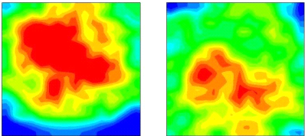
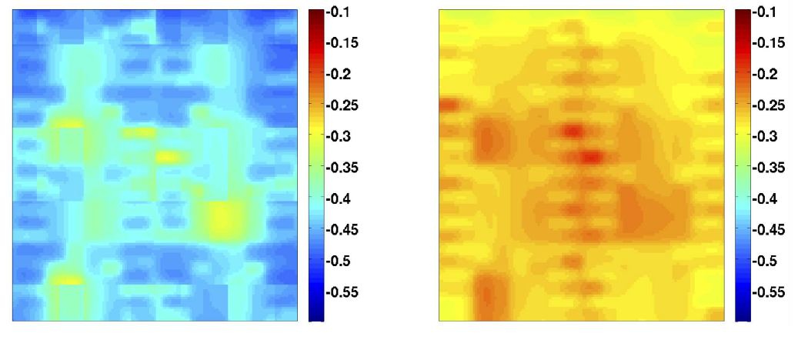

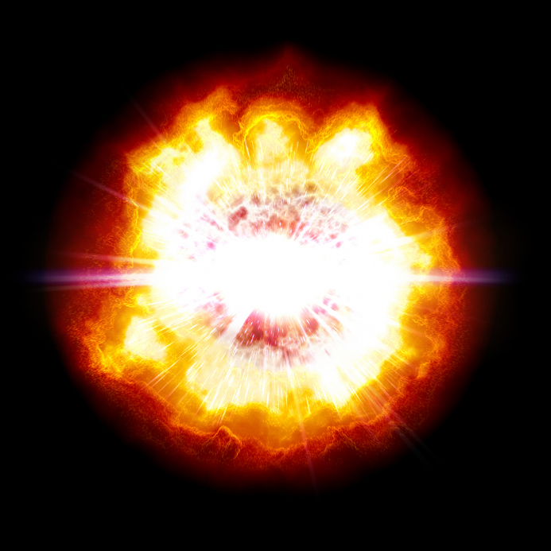
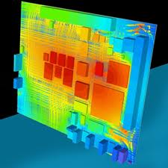

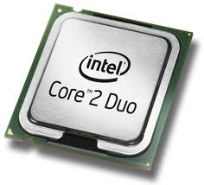
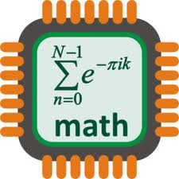
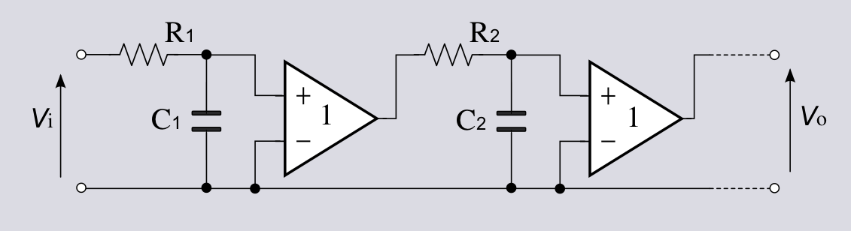
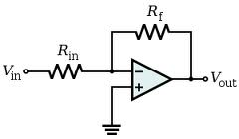
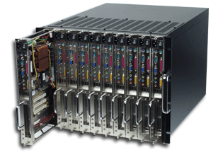
Manifold: The Big Picture
A composable parallel simulation system for heterogeneous, many core systems.
0.4
bzip2-program
0.35
gromacs
Component-based and extensible
Mixed discrete event and time stepped simulation
From full system HW/SW models to abstract timing models
From detailed cycle-level to high level analytic models
Integration of third party tools
dynamic power [W]
milc
0.3
0.25
0.2
Core degradation
0
0.05
0.1
0.15
0.2
0.25
0.3
time [sec]
Models
Physical Models
Power
Energy
Thermal
Reliability
Logical Process (LP)
Component
Component
Link
Component
Component
Component Timing/Functional Models
Parallel Simulation Kernel
Manifold Kernel
Manifold Kernel
Inter-Kernel API
Parallel Hardware Test-bed
www.manifold.gatech.edu

Slide 7

A Typical Single OS Domain Model
Applications
QSim
Linux
Virtual Core
VC
VC
VC
Logical Process (LP)
LP
LP
CPU
CPU
CPU
CPU
CPU
CPU
L1$
L1$
L1$
L1$
L1$
L1$
L2$
L2$
L2$
Physical phenomena
R
R
R
router
router
router
Parallel Simulation Kernel (PSK)
PSK
PSK
PSK
Single Socket/Board model → scaling across multiple sockets
Similar efforts: Graphite, GEM5/SST, Sniper, etc.
7

Slide 8

Simulation Infrastructure Challenges
Microarch Simulator
Physical Models (power, thermal, etc.)
Applications & OS
Scalability
Processors are parallel and tools are not → not sustainable
Multi-disciplinary
Functional + Timing + Physical models
Need to model complete systems
Cores, networks, memories, software at scale
Islands of expertise
Ability to integrate point tools → best of breed models
Composability
Easily construct the simulator you need
Tile
Tile
Tile
Tile
Tile
Tile
Tile
Tile
Tile
Tile

Slide 9
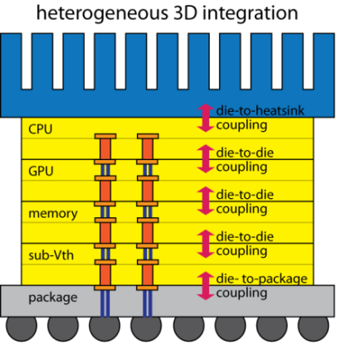
Goal
Not to provide a simulator, but
Make it easy to construct a validated simulator at the fidelity and scale you want, and
Provide base library of components to build useful multicore simulators
Microarchitecture
and Workload Execution
Thermal Coupling
and Cooling
Novel Cooling Technology
μarchitecture
Thermal Field Modeling
Power Distr. Network
Power Management
Algorithms
Power Dissipation
Degradation
and Recovery

Slide 10
Tutorial Schedule
 | Topical Description
15 minutes | Introduction and Overview
30 minutes | Execution Model and Software Organization
90 min | Component Models
15 minutes | Break
30 minutes | Building and Running Simulations
45 minutes | Energy Introspector: Integration of Physical Models
15 minutes | Some Example Simulators

Slide 11
Outline
Introduction
Execution Model and System Architecture
Multicore Emulator Front-End
Component Models
Cores
Network
Memory System
Building and Running Manifold Simulations
Physical Modeling: Energy Introspector
Some Example Simulators

