Slide 1
QSim¹: Overview
Thread safe multicore x86 emulation library using QEMU²
C++ API for instantiating, controlling, and instrumenting emulated CPUs
Guest environment runs:
Lightly modified Linux kernel
Unmodified 32-bit x86 binaries
Instruction-level execution control
Instruction-level instrumentation
Qsimlib : for creating multithreaded emulators
QSimServer: for serving parallel/distributed simulations
¹C. Kersey, A. Rodrigues, and S. Yalamanchili, “ A Universal Parallel Front-End for Execution-Driven Microarchitecture Simulation,” HIPEAC Workshop on Rapid Simulation and Performance Evaluation: Methods and Tools, January 2012
²F. Bellard, “QEMU Open Source Processor Emulator,” http://www.qemu.org/
1

Slide 2
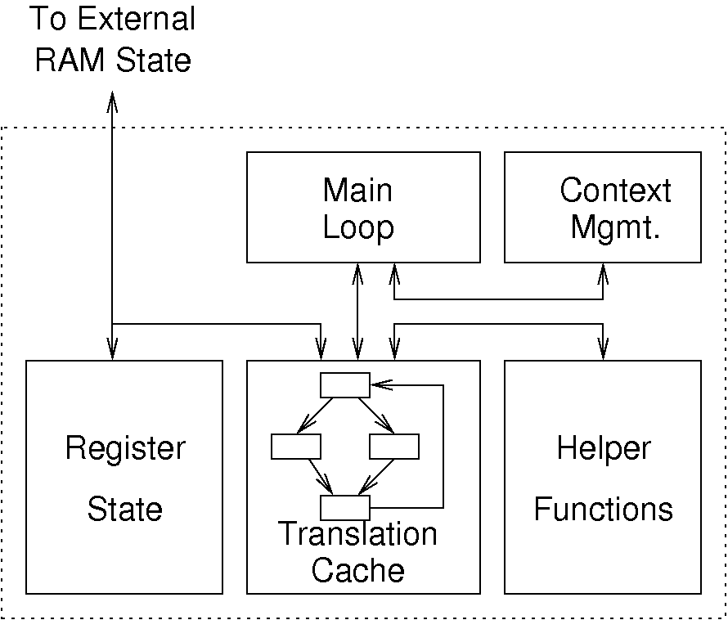
QSim Architecture: QEMU Core
QEMU Core
Emulation performed through dynamic binary translation.
Code from translation cache can call helper functions
Instrument code cache
QSim's QEMU CPU library uses external Guest RAM state.
Allows sharing between multiple instances
Synchronization allows multiple ordinary QEMU CPUs or a single QEMU CPU performing an atomic memory operation to run.
2

Slide 3
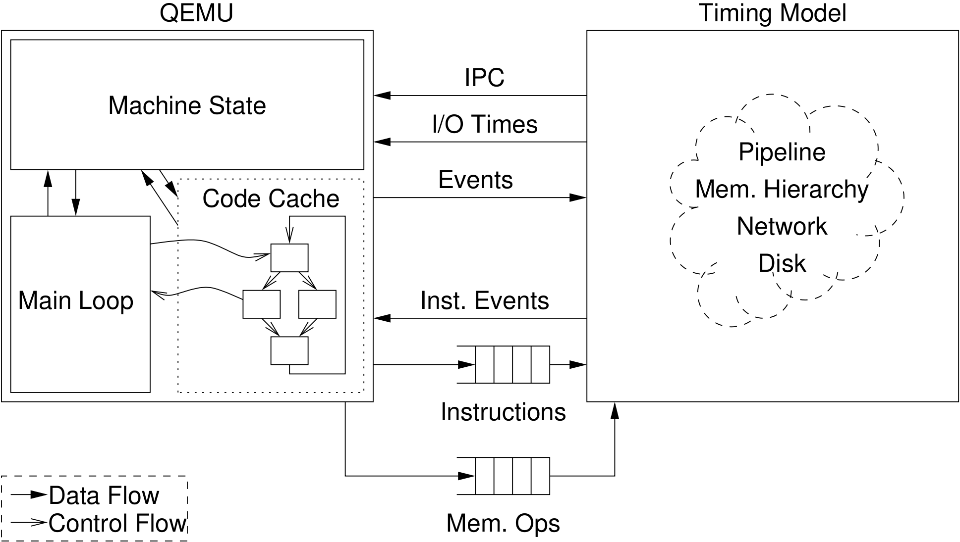
QSim Architecture: Timing Model Interface
Instrumentation of the translation cache
Timing model feedback – backpressure from hardware events
Synchronized advance of functional and timing models rather than roll-back and recovery
Memory and instruction information

Slide 4
QSim Multicore Emulator
Functional front-end for microarchitecture simulation
Runs unmodified x86 (32-bit) binaries on lightly-modified Linux kernel.
Provides callback interface for execution events
Callbacks generated for all instructions, including OS
Optional callbacks for instruction read during translation
Support for distributed memory.
Based on QEMU dynamic binary translator
Inserts calls to callback functions into translation cache
Adds support for precise instruction counting
User-mode threading
Notes:
4

Slide 5
How it Works: Block Diagram

Slide 6
Getting, Building, and Installing QSim
Latest version supported by Zesto core model and remote API:
http://www.cdkersey.com/qsim-web/releases/qsim-0.1.5.tar.bz2
Latest release (preferred for new core models):
https://github.com/cdkersey/qsim/archive/0.2.1.tar.gz
Current development tree (API is stable):
https://github.com/cdkersey/qsim
INSTALL file in source tree: step-by-step installation instructions.
Benchmarks (pre-compiled applications) at:
http://www.cdkersey.com/qsim-web/releases/qsim-benchmarks-0.1.1.tar.bz2

Slide 7
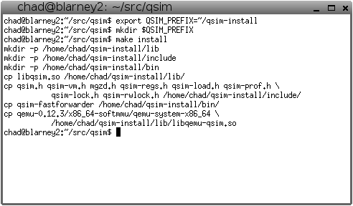

Slide 8
Using QSim: Application Requirements
Applications must be:
Linux ELF Binaries
All libraries included
All required input data included
Most included benchmarks statically linked
qsim-load expects a .tar file with a runme.sh
$NCPUS is the number of emulated HW threads
fmm/runme.sh
#!/sbin/ash
echo $NCPUS > ncpus
cat input.top \
ncpus input.bot \
> input
./FMM < input
barnes/runme.sh
#!/sbin/ash
echo $NCPUS >> input
./BARNES < input
radiosity/runme.sh
#!/sbin/ash
./RADIOSITY \
-ae 5000.0 \
-en 0.050 \
-bf 0.10 \
-batch -room \
-p $NCPUS

Slide 9
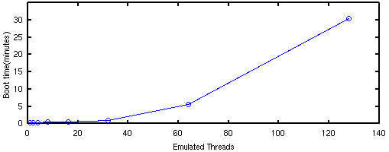
Using QSim: Saved States
OS Boot for large number of CPUs takes a long time even at high (~10MIPS) simulation speeds
Use state files to checkpoint already-booted CPU state
mkstate.sh script for generating state files.
Script that runs qsim-fastforwarder program

Slide 10
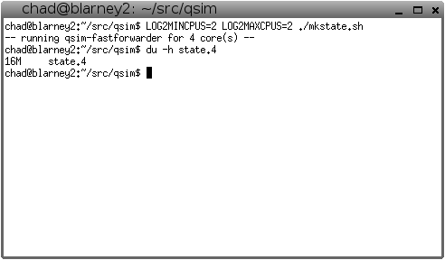

Slide 11
Using QSim: Application Start/End Markers
Need to mark "region of interest" in applications.
This is done through "magic" instructions.
CPUID instruction with special register values:
%rax = 0xaaaaaaaa for application start
%rax = 0xfa11dead for application end
#ifdef QSIM
#define APP_START() do { \
__asm__ __volatile__("cpuid;"::"a"(0xaaaaaaaa));\
} while(0)
#define APP_END() do { \
__asm__ __volatile__("cpuid;"::"a"(0xfa11dead));\
} while(0)
#endif

Slide 12
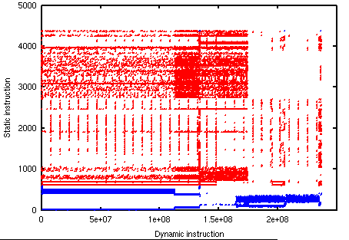
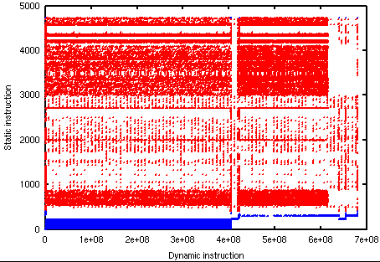

Using QSim: Applications and the OS
"Emulates all OS instructions" means exactly that:
Timer interrupts are necessary and the scheduler does run.
Quite a bit lot of time is spent handling page faults.
Can query and filter out OS instructions if they are considered irrelevant:
OSDomain::getProt(core) == OSDomain::PROT_KERNEL

Slide 13
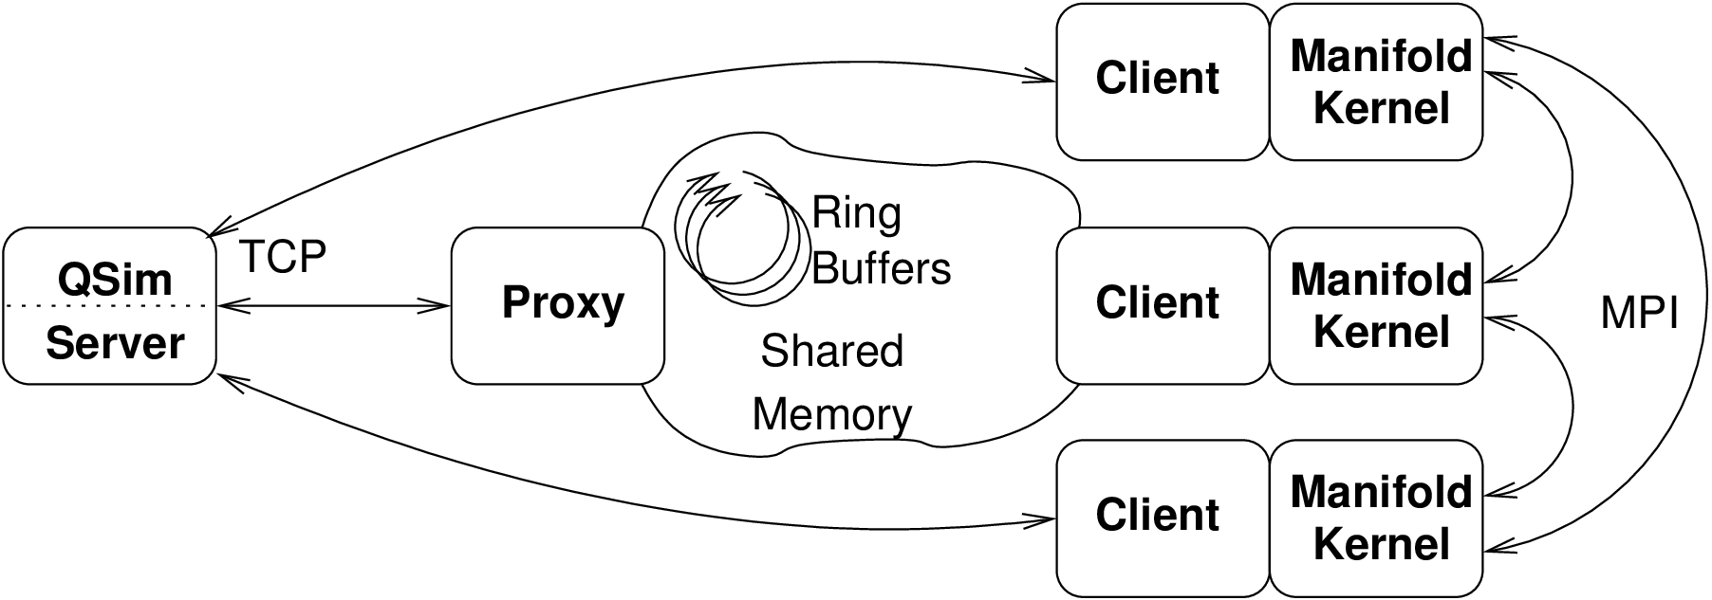
QSim Remote API: The Server and Proxy
A subset of the QSim API is provided for operation over a network.
Server performs functional simulation; client performs timing model.
Client API looks like QSim API:
One thread per client.
Proxy acts as intermediary between clients and server.
Third program that hides network latency.
Necessary because client library uses blocking I/O.

Slide 14
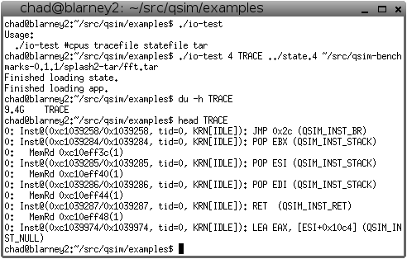

Slide 15
QSim API: Basic Functionality
OSDomain Func. | Purpose
get_prot(core) | Get protection level (KERN, USER)
get_idle(core) | Is the core running the kernel idle loop?
run(core, n) | Run the selected core for n instructions.
timer_interrupt() | Interrupt all CPUs. (required)
Callback Setters
set_mem_callback(obj, f) | Memory accesses (loads, stores)
set_atomic_callback(obj, f) | Atomic read/modify/write operations
set_inst_callback(obj, f) | All instructions
set_reg_callback(obj, f) | Register reads/writes
set_int_callback(obj, f) | Interrupts, including exceptions
set_trans_callback(obj, f) | Reads into QEmu translation cache
set_app_start_callback(obj, f) | Beginning of application (start marker)
set_app_end_callback(obj, f) | End of application (end marker)
For full details, including callback prototypes, see user guide.

Slide 16
QSim API: Timer Interrupt
Information about time not communicated back to QSim from the timing model.
Periodic interrupts simulating PIT events are the only timing information that reaches the OS.
OSDomain::timer_interrupt() must be called periodically (~1-10ms to sim time) for the entire OSDomain
Not setting the timer interrupt leads to scheduled threads never running.

Slide 17
QSim API: Simple Sample Program
class TraceWriter
{private: OSDomain &osd; ostream &trf;
public: bool done;
TraceWriter(OSDomain &osd, ostream &trf) :
osd(osd), trf(trf), done(false)
{ osd.set_inst_cb(this, &TraceWriter::inst_cb);
osd.set_app_end_cb(this, &TraceWriter::app_end_cb); }
void inst_cb(int c, uint64_t v, uint64_t p, uint8_t l,
const uint8_t *b, enum inst_type t)
{ trf << std::dec << c << ',' << v << ',' << p << ',' << t << endl; }
int app_end_cb(int c) { done = true; return 1; } };
int main(int argc, char** argv)
{ ofstream trace(argv[3]); // Arg 3 : trace file
OSDomain osd(argv[1]); // Arg 1 : state file
load_file(osd, argv[2]); // Arg 2 : benchmark
TraceWriter tw(osd, trace);
while (!tw.done)
{ for (unsigned i = 0; i < 100; ++i)
for (unsigned j = 0; j < osd.get_n(); ++j)
osd.run(j, 10000);
osd.timer_interrupt(); }
trace.close();
return 0; }

Slide 18
Outline
Introduction
Execution Model and System Architecture
Multicore Emulator Front-End
Component Models
Cores
Network
Memory System
Building and Running Manifold Simulations
Physical Modeling: Energy Introspector
Some Example Simulators

Slide 19
Additional Slides

Slide 20
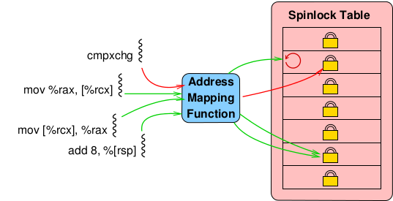
How it Works: Lock Table
QSim is a thread-safe library.
Each simulated CPU is a QEmu instance.
RAM state is shared.
Memory has readers/writer lock semantics
1 thread executing an atomic OR
any number of threads executing ordinary memory operations
This can be applied on a per-address basis
We build a table of spinlocks
Spinlock code appropriated from Linux kernel.

