Slide 1
Back-end Timing Models
Core Models
Interconnection Network
Memory System
Coherence Cache Hierarchy
DRAM Controller

Slide 2
Core Models
Zesto – cycle-level x86 processor model
SPX – a light pipe-lined model
SimpleProc – a 1-IPC model

Slide 3
Zesto* Overview
x86 instructions6
Oracle
(functional)
Detailed pipeline model
(superscalar / OOO pipeline)
recovery info
memory requests
and replies
cache
Consists of an oracle and a detailed pipeline
Oracle is an “execution-at-fetch” functional simulator; fetched instructions are first passed to oracle
Pipeline has 5 stages
Very detailed; slow (10’s of KIPS)
Ported to Manifold as a component
*G. Loh, etc., “Zesto: a cycle-level simulator for highly detailed microarchitecture exploration,” International Symposium on Performance Analysis of Software and Systems (ISPASS), pp53-64, 2009

Slide 4
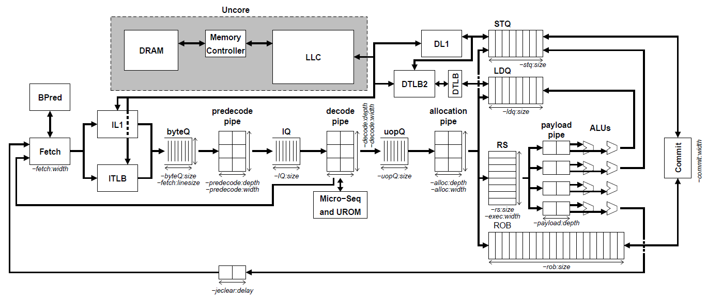
Zesto
X86 based timing model derived from Zesto cycle-level simulator
IA 32 support

Slide 5
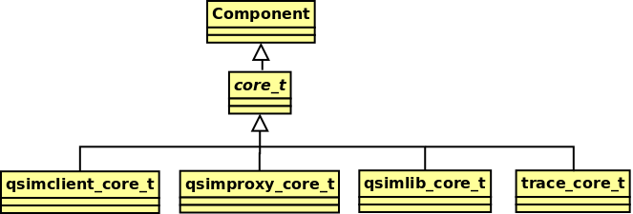
Zesto Interface
Front-end interfaces
Cache request
Event handler (for cache response)
Clocked function
Multiple instances with different front-end interfaces

Slide 6
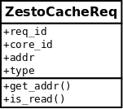
Zesto Interface
ZestoCacheReq
event handler for cache response
class core_t {
public:
...
void cache_response_handler(int, ZestoCacheReq*);
...
};

Slide 7
Zesto Interface
Clocked function
must be registered with a clock
Zesto does not register this function, so it must be registered in the simulator program.
void core_t :: tick()
{
//get the pipeline going
commit->step();
exec->LDST_exec();
...
alloc->step();
decode->step();
fetch->step();
...
}

Slide 8
Simplified Pipeline eXecution (SPX) <A simpler, lighter core model for out-of-order and in-order pipelines>

Slide 9
SPX
SPX is an abbreviated core model that support both out-of-order and in-order executions.
Purpose: Detail vs. Speed
For less core-sensitive simulations (i.e., memory/network traffic analysis), detailed core implementation may be unnecessary.
Physics simulations need longer observation time (in real seconds) than typical architectural simulations
e.g., temperature doesn’t change much for several hundreds million clock cycles (or several hundred milliseconds) of simulation.
The SPX model provides enough details to model out-of-order and in-order executions, and other optional behaviors are all abbreviated (e.g., predictions)
The SPX requires Qsim Library for detailed instruction information.
Queue model is not currently supported.
SPX uses direct Qsim callback functions.

Slide 10
Modeled Components in SPX
InstQ: A queue that fetches the instructions from Qsim.
RF: Register file that tracks only dependency; behaves more like RAT.
Dependency for general register files and flags are maintained.
RS: Dependency status tracker.
It does not have an actual table like scoreboard.
When an instruction is ready (cleared from dependency), it is put in the ReadyQ.
In-order execution is modeled with 1-entry RS.
EX (FU): Multi-ported execution units.
Each FU is defined with latency and issue rate.
ROB: Re-order buffer for out-of-order execution
An instruction can be broken into multiple sub-instructions (e.g., u-ops), and ROB commits the instruction when all sub-instructions are completed.
LDQ/STQ: Load and store queues
These queues check memory dependency between ST/LD instructions.

Slide 11
Out-of-order Pipeline
Translation to SPX instruction
Qsim Lib
Callbacks
InstQ
Allocate if Available
Allocate if ST
And Available
Schedule When Commit
Writeback
ROB
Resolve Dependency
Allocate if Available
Allocate if LD
And Available
RF
RS
LDQ
STQ
Reg. Dep.
Status
Update
Mem. Dep.
CheckWhen Allocate
Update
FU Port Binding
Store Fwd
EX
Schedule
Update
FU
FU
FU
Cache Resp.
Cache Req. After EX
Cache Req. After Commit

Slide 12
In-order Pipeline
Translation to SPX instruction
Qsim Lib
Callbacks
InstQ
Allocate if ST
And Available
Resolve Dependency
Allocate if Available
Allocate if LD
And Available
RF
threadQ
LDQ
STQ
Reg. Dep.
Status
Update
Mem. Dep.
CheckWhen Allocate
Update
FU Port Binding
Store Fwd
EX
Schedule
FU
Writeback
Schedule
FU
Cache Resp.
Cache Req. After EX
Cache Req. After EX

Slide 13
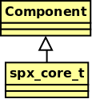
SPX Interface
Front-end
Cache request
Event handler (for cache response)
Clocked function

Slide 14
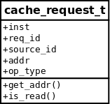
SPX Interface
cache_reqest_t
event handler for cache response
class spx_core_t {
public:
...
void handle_cache_response(int, cache_reqest_t*);
...
};
void spx_core_t :: tick()
{
...
}
clocked function
must be registered with a clock
SPX does not register this function, so it must be registered in the simulator program.

Slide 15
SimpleProc
1-IPC: in general one instruction is executed every cycle
MSHR limits number of outstanding cache requests

Slide 16
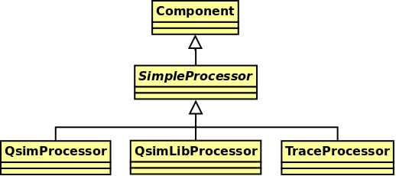
SimpleProc Interface
Front-end
Cache request
Event handler (for cache response)
Clocked function

Slide 17

SimpleProc Interface
CacheReq
event handler for cache response
class SimpleProcessor {
public:
...
void handle_cache_response(int, CacheReq*);
...
};
void SimpleProcessor :: tick()
{
...
}
clocked function
must be registered with a clock
SimpleProc does not register this function, so it must be registered in the simulator program.

Slide 18
Outline
Introduction
Execution Model and System Architecture
Multicore Emulator Front-End
Component Models
Cores
Network
Memory System
Building and Running Manifold Simulations
Physical Modeling: Energy Introspector
Some Example Simulators

