Slide 1
Back-end Timing Models
Core Models
Interconnection Network
Memory System
Coherence Cache
DRAM Controller

Slide 2
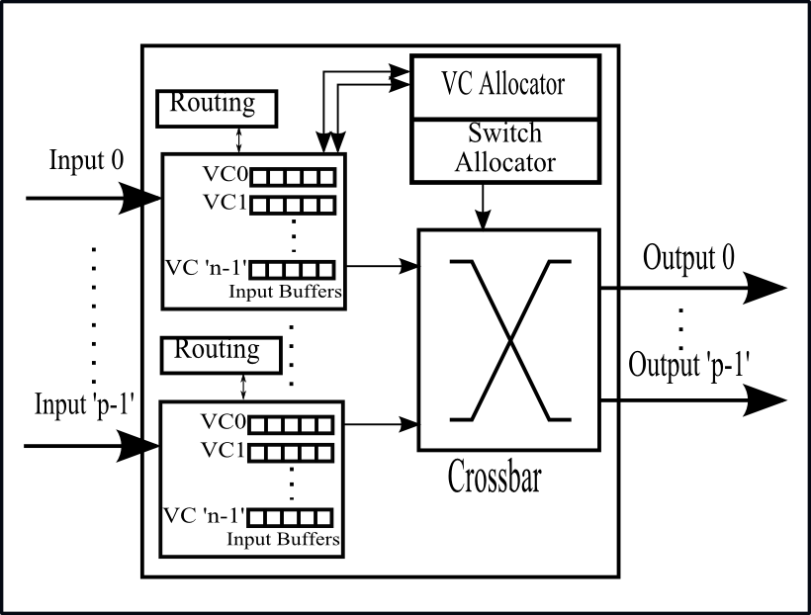
The Network Simulator - IRIS
Virtual channels
Ring and torus
Request-reply network
Single-flit and multiflit packets
Credit-based flow control
Must instantiate a network interface
Basic router/switch designed to enable design space exploration
Ease of changing VC & switch allocators, buffering, routing function, selection functions, etc.
Topology generators for Ring and Tori
You can write your own
2

Slide 3
Iris Interface
User creates an Iris network using one of the following:
template<typename T> Ring<T>* create_ring();
template<typename T> Torus<T>* create_torus();
parameters:
Clock& clk – clock for the network
ring_init_params* or torus_init_params* - parameters for the ring or torus
Terminal_to_net_mapping* - object that maps terminal address to network address
SimulatedLen<T>* - object that computes a packet's simulated length
VnetAssign<T>* - object that determines a packet's virtual network
int ni_credit_type – type of credit messages between NI and terminal
vector<int>* node_lp – LP assignment of the routers

Slide 4
Iris Interface
NIs and routers are created internally
NIs and routers are registered to the clock internally
NIs can be accessed through get_interface_id(), or get_interfaces()
Each NI can connect to one terminal (e.g., cache)
Router is encapsulated

Slide 5
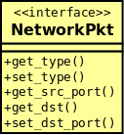
Iris Network Interface
A template class:
template<typename T> class GenNetworkInterface
T is the type of packets sent to the network
Network packet interface

Slide 6
Outline
Introduction
Execution Model and System Architecture
Multicore Emulator Front-End
Component Models
Cores
Network
Memory System
Building and Running Manifold Simulations
Physical Modeling: Energy Introspector
Some Example Simulators

