Slide 1
Multi-core Systems and Coherence Hierarchies
Coherence hierarchy issues
Several architecture specific implementations
Design complexity
Complex hierarchy state encodings
Many more transient states
Solution: Coherence Realm* Encapsulation
Define communication interface between users and monitors
Enables layering of coherence
Enables heterogeneity within a protocol

Slide 2
Manager-Client Pairing (MCP)*
*J. G. Beu, M. C. Rosier and T. M. Conte, “Manager-Client Pairing: A Framework for Implementing Coherence Hierarchies,” Proceedings of the 44th Annual International Symposium on Microarchitecture (MICRO-44), (Porto Alegre, Brazil), Dec., 2011.

Slide 3
Division of Labor
Client Agent (think cache)
Permission holder (Coherence State)
Obtains permission via acquire requests
Act as a gateway in hierarchical coherence (see algorithm)
Manager Agent (think directory)
Monitor of coherence realm
Records sharers, owner, etc.
Manages permission propagation
Process acquire requests
Allocates/de-allocates permissions to/from clients
Handles external requests from other realms

Slide 4
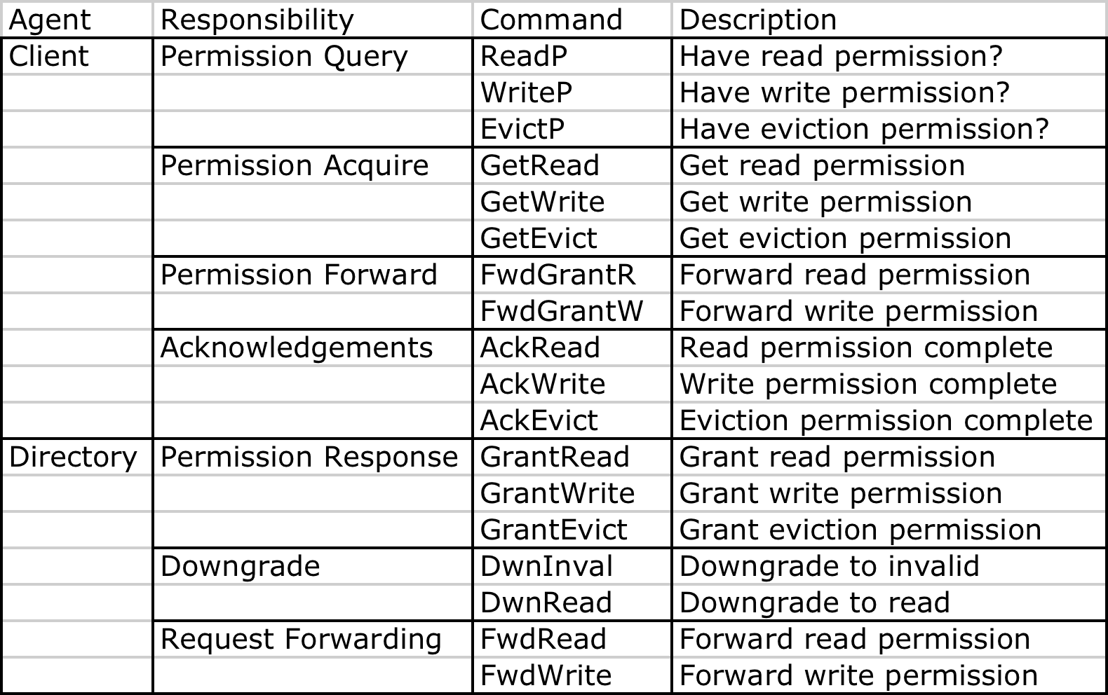
Base Functions

Slide 5
Special Functions
Client: Eviction Permissions?
Evict_P and GetEvict
Why? What if in M/O state?
Directory is making assumptions about client’s role
That client will fwd data to other caches
Client needs to inform directory before giving up ownership
Manager: Downgrade (DwnInval and DwnRead)
Realm A has in the M state
Realm B asks for permission
Asks for write permission, A needs to become invalid
Asks for read permission, A only needs to give up exclusivity but can keep a copy

Slide 6
Permission Hierarchy Algorithm

Slide 7
Example – Realm Read Hit

Slide 8
Example – Realm Write Miss

Slide 9
Cache Model and Interface
A cache model has two interfaces:
The processor-cache interface and
The cache-network interface.
The Processor-Cache Interface
On the process-cache interface, the processor sends requests to the cache and the cache sends responds back.
Message from processor
The processor model's request is supposed to implement the following two functions:
1. get_addr(). This function returns a 64-bit integer that is the memory address for which the cache request is made.
2. is_read(). This function returns true if the request is a read(load), and false if it is a write(store).
The cache model's event handler for the processor-cache interface should be a templated function similar to the following:
template<typename T>
void my_cache_req_handler(int, T*);
The templated type T is the type of the request from the processor.
Message to processor
Currently it is required that the cache model sends back to the processor the same data type that it gets from the processor. Therefore, if the processor sends type T to the cache, then the cache must respond with the same type T.

Slide 10
Cache-Network Interface
If the cache model is not directly connected to the interconnection network, it can send/receive its own data type. If it is connected to the network, then it should send/receive manifold::uarch::NetworkPacket
The cache model's own data should be serialized and stored in the member variable (an array) data of NetworkPacket. The simplest way to do this is just using byte-wise copy:
MyDataType* obj;
NetworkPacket* pkt = new NetworkPacket();
*((MyDataType*)pkt->data) = obj;
A cache model could send two types of messages over the network:
1. Cache-to-cache messages, such as coherence messages.
2. Cache-to-memory messages.
Both are carried by NetworkPacket.

Slide 11
Cache-Network Interface….
A cache model also receives two types of messages: from another cache or from memory. The event handler for its network input should be a templated function as follows:
template<typename T>
void my_net_handler(int, manifold::uarch::NetworkPacket*);
where the template parameter T is the data type from memory controller and is supposed to define the following two functions:
get_addr(). This functions returns a 64-bit integer that is the memory address for which the cache request is made.
is_read(). This function returns true if the request is a read(load), and false if it is a write(store). Pseudo code for the cache model's event handler for the cache-network interface is given below:
template<typename T>
void my_net_handler(int, manifold::uarch::NetworkPacket* pkt)
{
IF pkt->type == coherence message THEN
MyCohMsg* coh = new MyCohMsg();
*coh = *((MyCohMsg*)(pkt->data));
process(coh);
ELSE IF pkt->type == memory message THEN
T objT = *((T*)(pkt->data));
MyMemMsg* mem = new MyMemMsg;
Set the member values of mem with objT;
process(mem);
END IF
}

Slide 12
CaffDRAM Overview
Processor
CaffDRAM is a cycle accurate DRAM timing simulator. This simulator is JEDEC compliant and models various timing parameters pertaining to resource contention within the DRAM main memory.
Cache
Integrated DDRx Memory Controller
Memory System
Memory Bus

Slide 13
Memory Organization
Memory Controller
CH 1
CH2
CH N
RANK 1
RANK 2
RANK 3
RANK 4
*A Single DIMM Module may consist of “one” or “two” Ranks depending upon its pin configuration. Each Side of a DIMM module is one “RANK” . A single “RANK” usually consists of 8 “x8” chips corresponding to a Data Bus width of 64 bits

Slide 14
DRAM Scheduling
Command Generator
DRAM Configuration
DRAM Policies
Channel Bus Scheduler
Delay Parameters
Incoming
Request
Request Queue
Rank Scheduler
SPD
(Serial Presence Detect)
Bank Scheduler

Slide 15
Rank I/O Devices Contention Modeling
Rank Scheduler responsible for “I/O Device” resource contention
* On every “Read” multiple internal bursts are required to form a Longer burst on the data bus.
* On every “Write” data direction is reversed and these devices act as buffers for incoming data.
I/O Devices in use = Busy for “t_CCD” cycles
t_CCD = 2 beats for DDR = 1 memory cycle
t_CCD = 4 beats for DDR2 = 2 memory cycles
t_CCD = 8 beats for DDR3 = 4 memory cycles
Rank I/O Device
Single Rank

Slide 16
Bank Contention Modeling
Bank Scheduler responsible for “Multiple Row Conflict”
within a bank
An Active Row
A Bank when accessed on a memory request
activates a row which fills in the “sense amplifiers”
with data from that row
This operation takes time = t_RCD
After time t_RCD, data from the “addressed columns”
may be accessed.
After time = t_CAS (a.k.a. t_CL) data is placed on
the Channel Data Bus
Sense Amplifiers
(Each Bank has a set of sense Amplifiers
shared by each row in a bank)

Slide 17
Bank Contention Modeling….
Previously Active Row
Newly accessed row within same bank
causing resource conflict
Row Activation = Bank busy for “t_RAS” cycles
Bank Precharge = Bank busy for “t_RP” cycles
*If a subsequent access is made to the same open row, the request can proceed
immediately after the first without having to wait for t_RAS. In case of a different row
the timing protocol must be followed

Slide 18
CaffDRAM Interface
* A memory controller has one interface: the memory controller-network interface. It sends/receives NetworkPacket which carries the memory requests and responses.
* The requests are defined in the cache model, therefore, the memory controller does not have the definition. For this reason, the event handler should be a template function as follows:
template<typename T>
void handler(int, manifold::uarch::NetworkPacket* pkt)
{
T* request = (T*)(pkt->data);
bool isRead = request->is_read();
uint64_t addr = request->get_addr();
...
}

Slide 19
CaffDRAM Interface….
As can be seen, the request from cache is supposed to implement the following two functions:
get_addr(). This functions returns a 64-bit integer that is the memory address for which the cache request is made.
is_read(). This function returns true if the request is a read(load), and false if it is a write(store).
For response, the memory controller model can reuse the data type of the cache's requests, or it can define its own. In the latter case, the data type must also support the same two functions above.
Message Types
The responses sent by the memory controller model use a message type (the type filed of NetworkPacket) that should be different from other message types. Therefore, the memory controller developer should not hard code the message type value. Instead, the type should be set in the constructor or an access function. The system model builder is responsible for setting the types.

