Slide 1

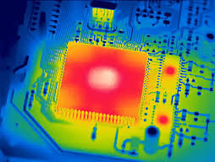
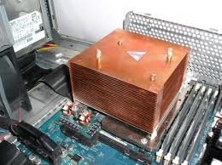

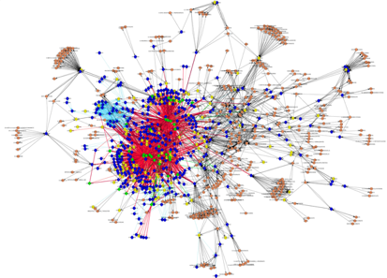
What can Manifold Enable?
Manifold enables cross-disciplinary evaluations
Applications ←→ Power ←→ Thermal ←→ Cooling
Multi-scale simulation → cycle-level to functional
Tradeoff studies
Large Graphs
imaging1.com
www.commons.wikimedia.org
Performance
Energy/Power
Reliability

Slide 2
Some Example Simulators
Power capping studies
Reliability studies
Workload ←→ Cooling interaction

Slide 3
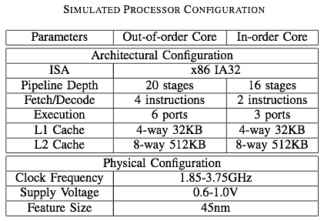
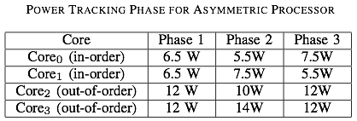
Power Capping: Simulation Model
Controller gain is adjusted every 5 ms
Each core has its own core and power budget – two OOO and two IO cores.
Power Targets

Slide 4
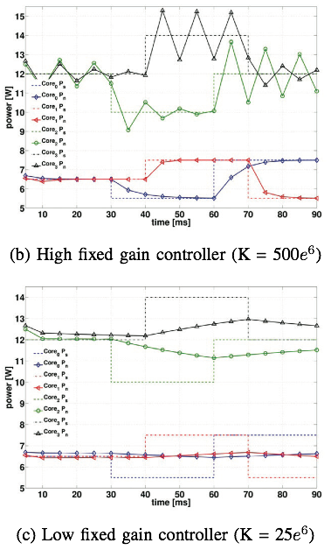
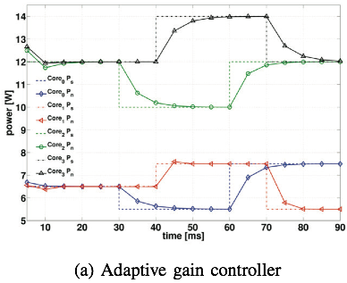
Power Capping Controller
New set point
High fixed-gain controller over-reacts to high power cores, whereas low fixed-gain control is slow to react to low power cores.
N. Almoosa, W. Song, Y. Wardi, and S. Yalamanchili, “A Power Capping Controller for Multicore Processors,” American Control Conf., June 2012.

Slide 5
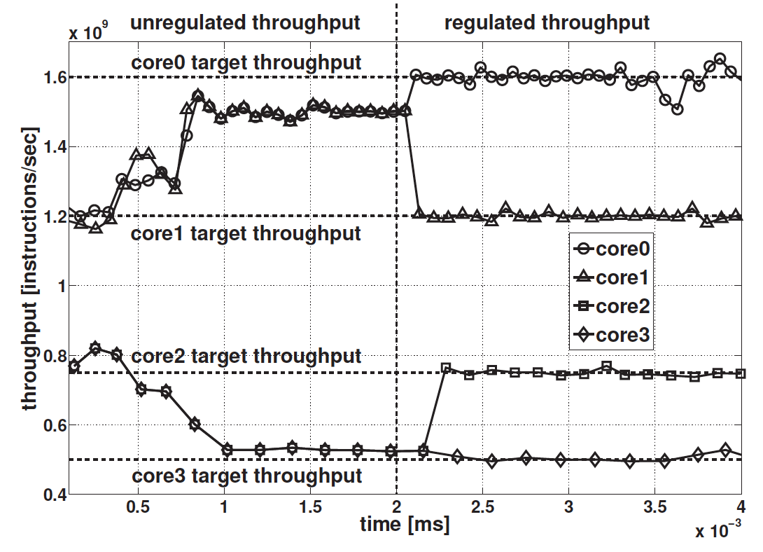
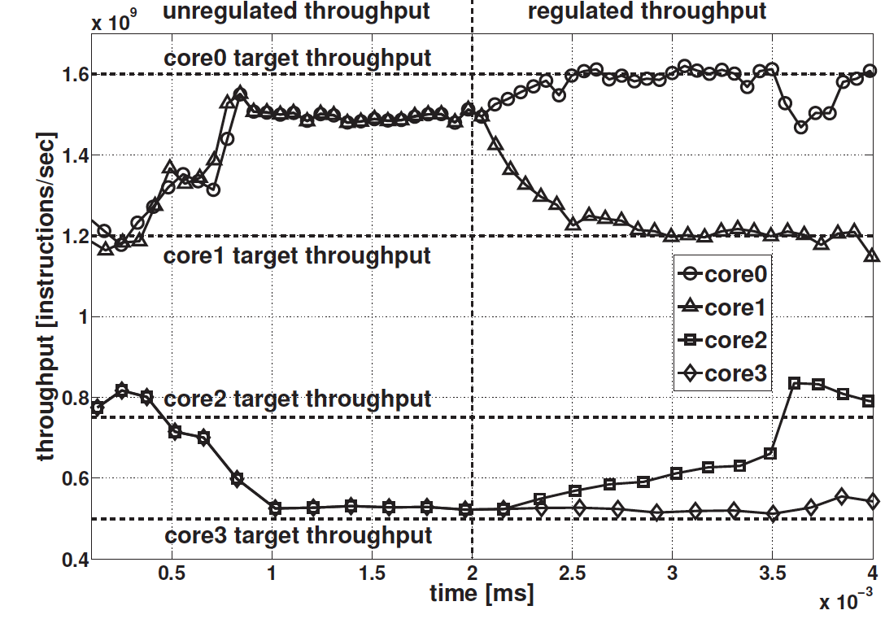
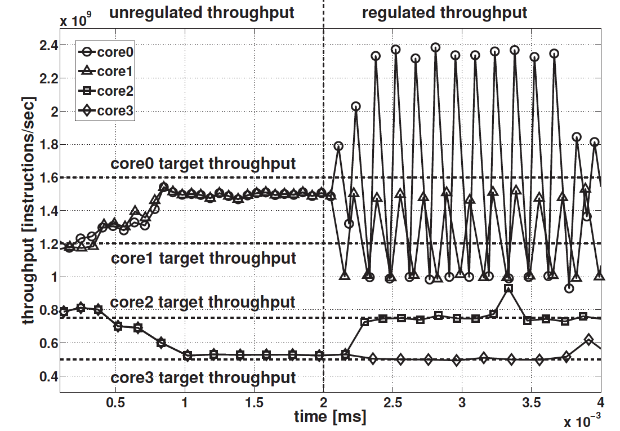
Throughput Regulation: Adaptive
High fixed-gain controller over-reacts to high power cores, whereas low fixed-gain control is slow to react to low power cores.
N. Almoosa, W. Song, Y. Wardi, and S. Yalamanchili, “Throughput Regulation on Multicore Processors via IPA,” 2012 IEEE 51st Annual Conference on Decision and Control (CDC)

Slide 6
Adaptation to Aging and Reliability
64-core asymmetric processor floor plan
NVF: Nominal Voltage Frequency
LVF: Low Voltage Frequency
HVF: High Voltage Frequency
Failure probability comparison between per-core race-to-idle executions (left) and continuous low-voltage executions (right)
Transient race-to-idle executions vs. continuous executions

Slide 7
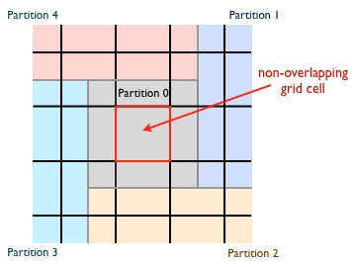
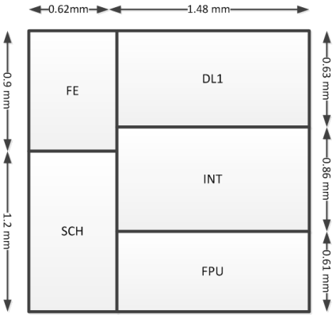
Workload-Cooling Interaction
Thermal Grids: 50x50
Sampling Period: 1us
Steady-State Analysis
2.1mm x 2.1mm
FPU
SCH
SCH
FPU
FPU
SCH
SCH
FPU
INT
FE
FE
INT
INT
FE
FE
INT
DL1
DL1
DL1
DL1
FE
DL1
FE
DL1
FE
DL1
FE
DL1
SCH
INT
SCH
INT
SCH
INT
SCH
INT
FPU
FPU
FPU
FPU
FPU
SCH
SCH
FPU
FPU
SCH
SCH
FPU
16 symmetric cores
INT
FE
FE
INT
INT
FE
FE
INT
DL1
DL1
DL1
DL1
FE
DL1
FE
DL1
FE
DL1
FE
DL1
SCH
INT
SCH
INT
SCH
INT
SCH
INT
Ambient:
Temperature: 300K
FPU
FPU
FPU
FPU
8.4mm x 8.4mm
Nehalem-like, OoO cores;
3GHz, 1.0V, max temp 100◦C
DL1: 128KB, 4096 sets, 64B
IL1: 32KB, 256 sets, 32B, 4 cycles;
L2 & Network Cache Layer:
L2 (per core): 2MB, 4096 sets, 128B, 35 cycles;
DRAM: 1GB, 50ns access time (for performance model)
CORE DIE
MICROFLUIDICS
SRAM
Coolant/Configuration | A | B | C
Flow rate (ml/min) | 7 | 42 | 84
Top Heat Coeff (W/um²-K) | 2.05e-8 | 5.71e-8 | 8.01e-8
Bot. Heat Coeff (W/um²-K) | 1.69e-8 | 4.72e-8 | 6.63e-8

Slide 8
Impact of Flow Rate & Workload on Energy Efficiency
Memory bound applications benefit more than computation bound applications
Overall energy improvement
4.9%-17.1% over 12X increase in flow rate
4.0%-14.1% over 6X increase in flow rate
Does not include pumping power

Slide 9
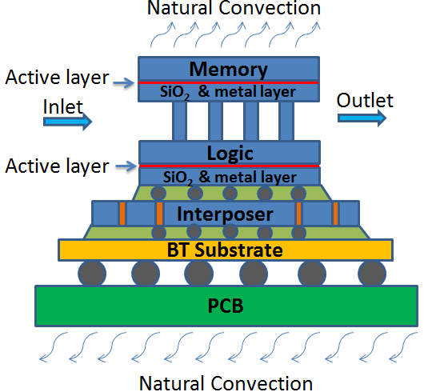
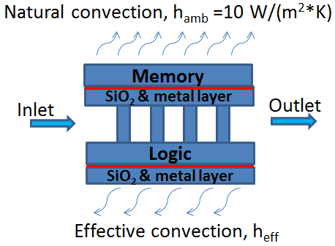
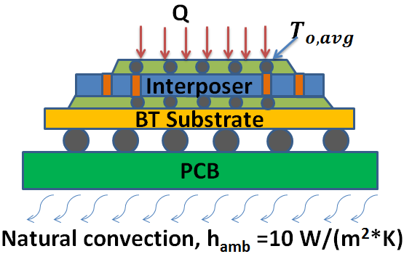
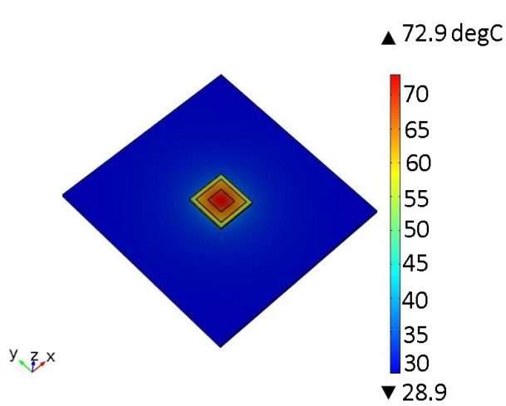
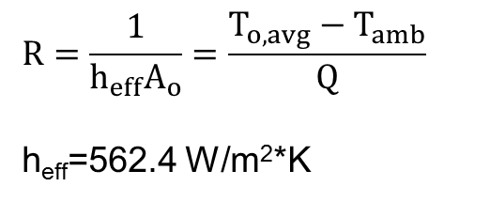
3D Stacked ICs Structure Model
3D stacked ICs structure
Simplified structure
Effective heat transfer coefficient is obtained by FE model on the left:
h_{eff}=562.4 W/m²*K
Conduction FE model and temperature results
Z. Wan et. al., IEEE Therminic 2013, Berlin, 25. -27. Septemeber 2013 (accepted)

Slide 10
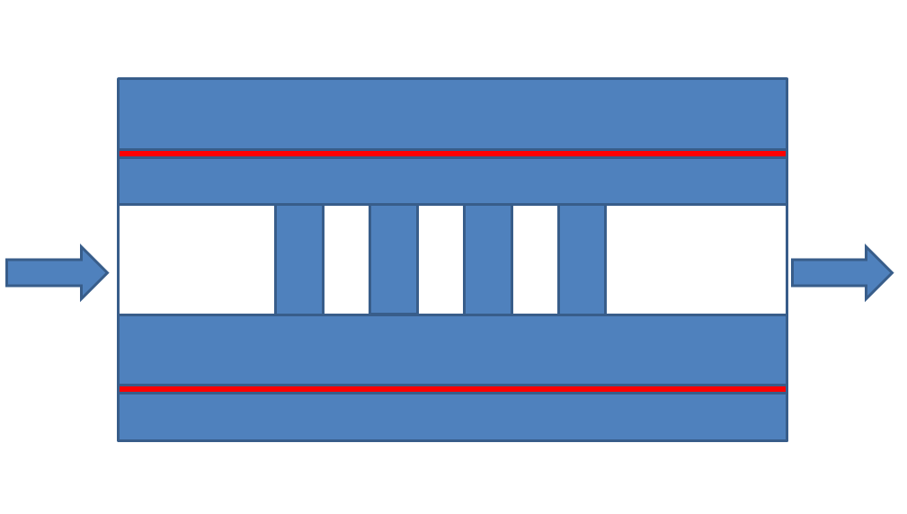
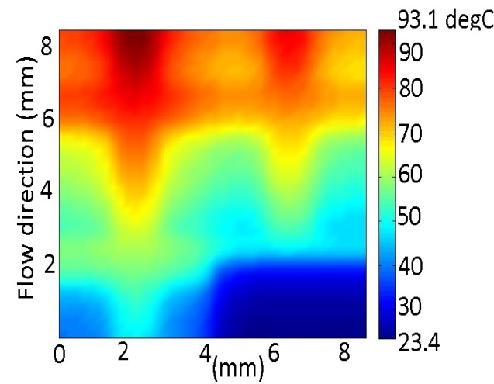
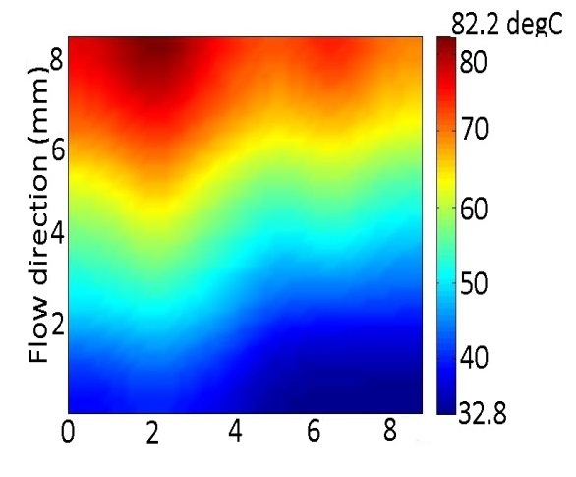
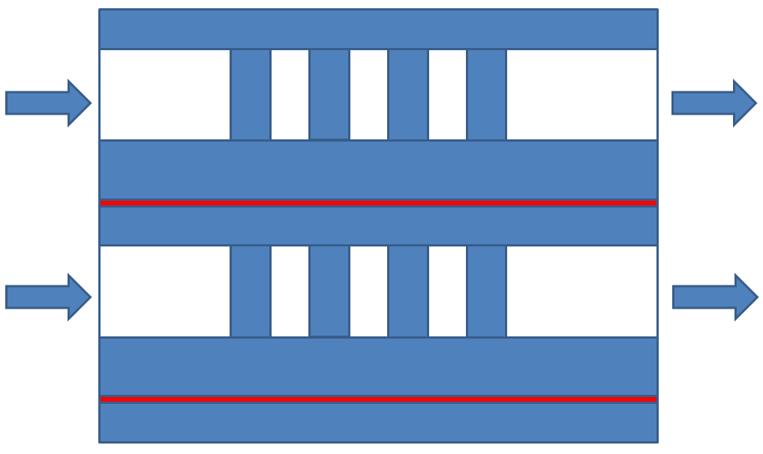
Case Study with Different Microgap Configurations
Microgap configurations
Logic tier
Memory tier
Configuration 1: One microgap
Temperature results: One microgap, logic tier at bottom and memory tier on the top
Results for different cases
Pump power:0.03 W | Configuration |  |  | T_{max,logic} (℃) | T_{max,memory} (℃)
 | Micro-gap | Top | Bottom
Case 1 | 1 | M | L | 93.1 | 82.2
Case 2 | 1 | L | M | 114.9 | 77.1
Case 3 | 2 | M | L | 87.7 | 54.8
Case 4 | 2 | L | M | 72.7 | 58.3
Configuration 2: Two microgaps

Slide 11
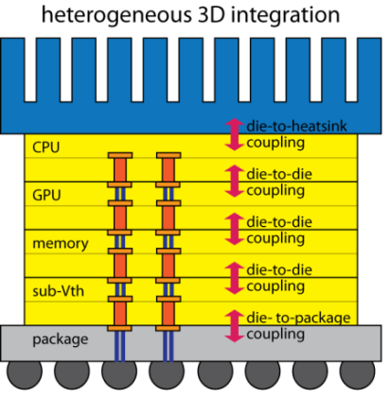
Summary
www.manifold.gatech.edu
Not to provide a simulator, but
Composable simulation infrastructure for constructing multicore simulators, and
Provide base library of components to build useful simulators
Microarchitecture
and Workload Execution
Thermal Coupling
and Cooling
Novel Cooling Technology
μarchitecture
Thermal Field Modeling
Power Distr. Network
Power Management
Algorithms
Power Dissipation
Degradation
and Recovery

