Slide 1


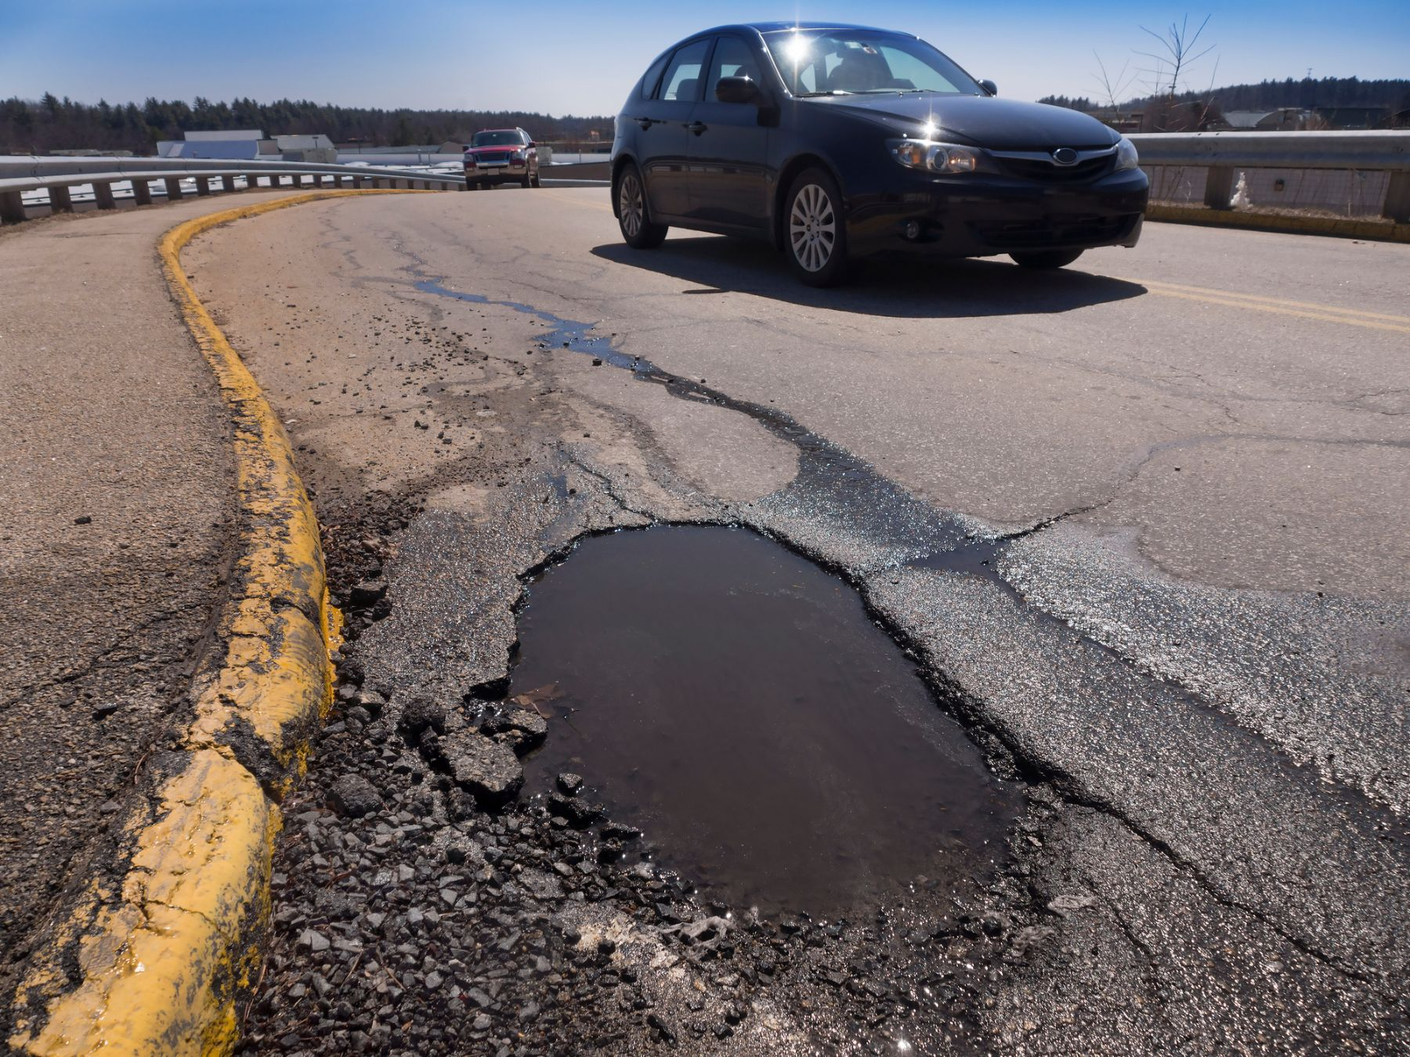
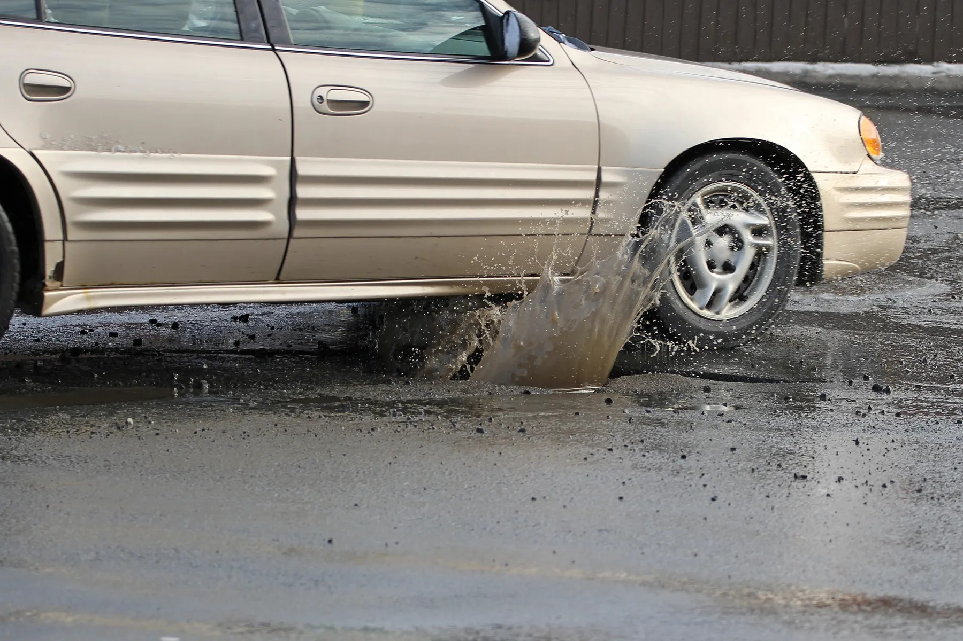
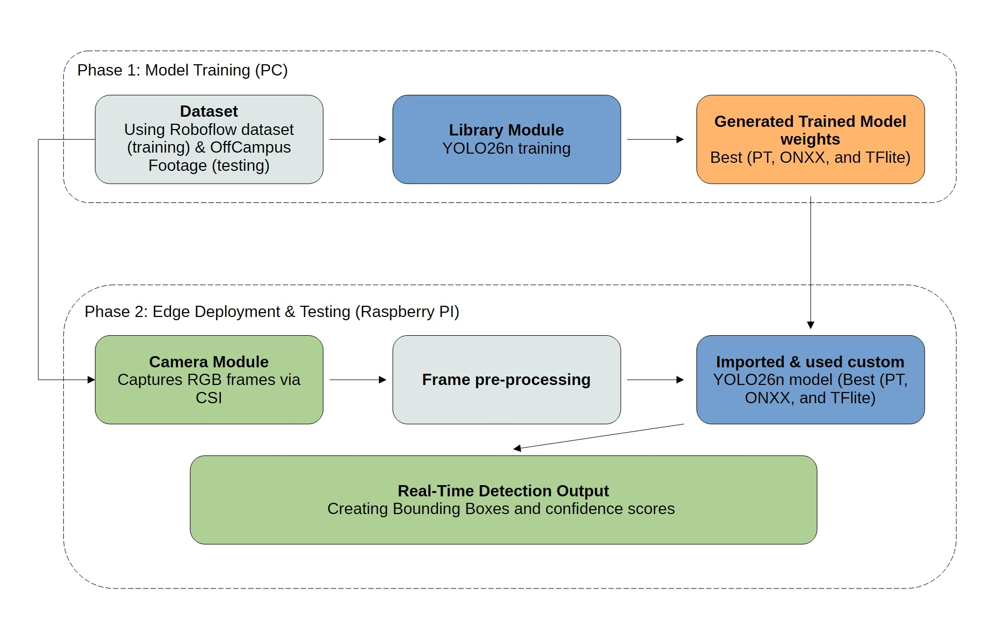
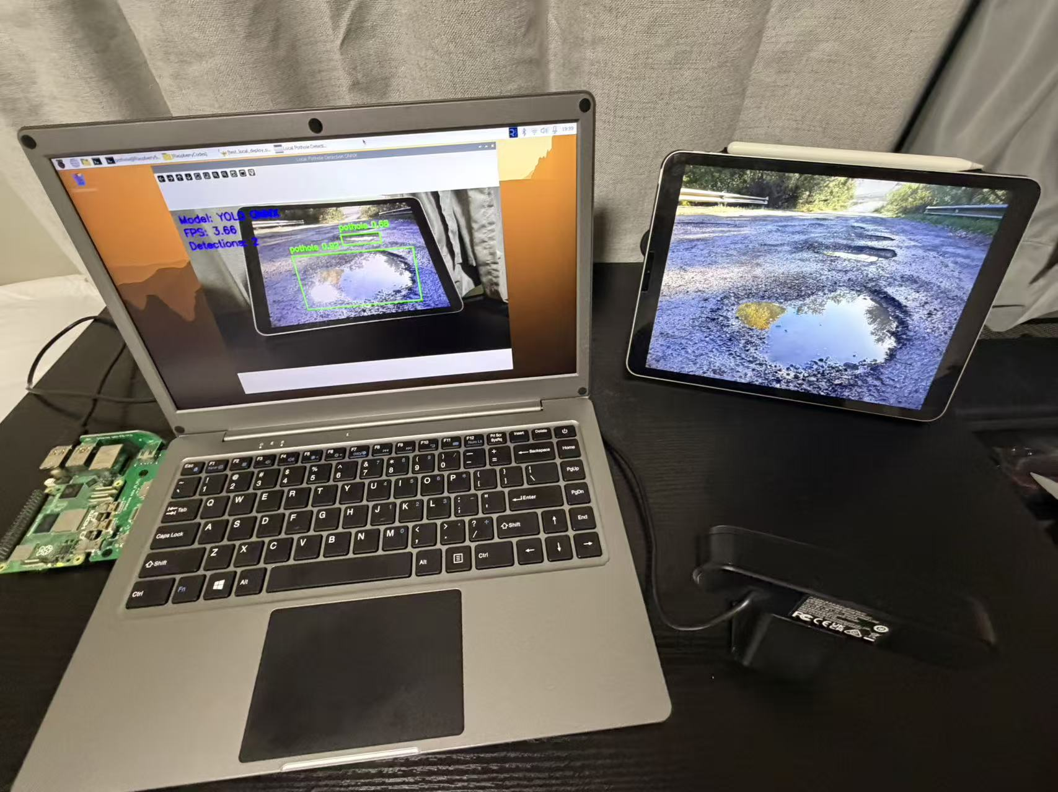
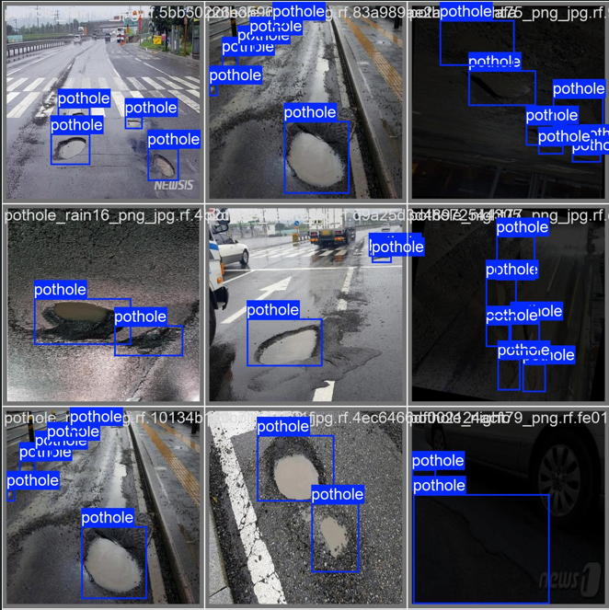
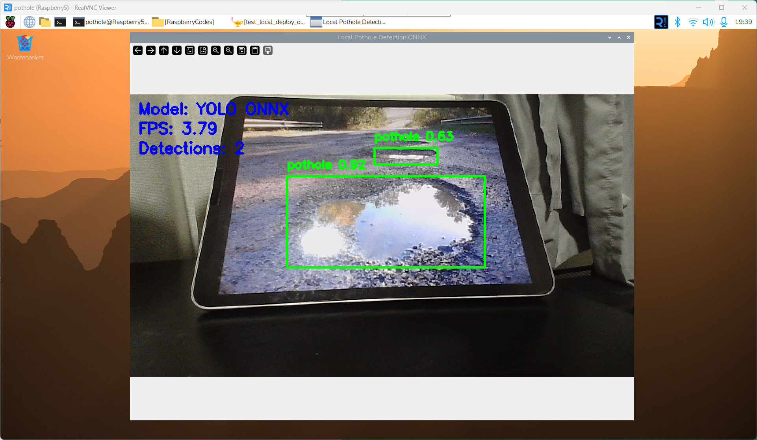
Portable Hybrid Edge-AI System for Pothole Detection Xinyang Zhang, Osama Najeeb, Avishek Mukherjee, Ph.D. Department of Electrical and Computer Engineering and Computer Science University of Detroit Mercy
Background & Motivation
Proposed Methods
Detection Results
Figure 1: Example pothole scenes illustrating road hazards and vehicle impact.
Potholes are a major road hazard in Detroit and can cause serious damage to vehicle tires, suspension, and alignment. Manual inspection methods are slow, labor-intensive, and difficult to scale. To address this problem, we developed a portable camera-based pothole detection system that uses lightweight deep learning models for real-time monitoring on edge-oriented hardware.
Figure 2: System Architecture.
Figure 3: Detection Results
Model Selection & Deployment Comparison
Conclusion
Research Question
Model | Params (M) | GFLOPs | mAP50 | mAP50-95 | Infer (ms)
YOLOv8n | 3.01 | 8.1 | 81% | 51.3% | 0.5
YOLOv8s | 11.13 | 28.4 | 82% | 52.3% | 1.2
YOLO26n | 2.38 | 5.2 | 84% | 54.3% | 0.8
YOLO26m | 20.35 | 67.8 | 83% | 51.0% | 2.9
Overall, YOLOv26n was selected as the primary deployment model because it provided the best balance between accuracy and efficiency among the tested lightweight detectors. ONNX was the most effective local deployment format on Raspberry Pi 5, while the hybrid approach achieved the best overall real-time performance with the highest FPS and lowest latency. These results demonstrate that lightweight pothole detection can be deployed effectively in a Raspberry Pi–centered system, while also highlighting the practical trade-off between fully local inference and hybrid real-time responsiveness.
Can a lightweight pothole detection model be integrated into a practical real-time monitoring system using Raspberry Pi 5 and a hybrid inference pipeline, while maintaining a good balance between detection accuracy and deployment efficiency?
Table 1: Comparison of Lightweight Detection Models.
Table 1 reports our experimental results, while Params and GFLOPs are taken from the corresponding references [1]–[4]. YOLO26n was selected as the primary deployment model because it achieved the best balance between accuracy and efficiency. Table 2 compares deployment performance on Raspberry Pi 5. ONNX was the strongest local option, while hybrid deployment delivered the best overall real-time responsiveness.
Key Challenge
Real-Time Latency: The system must process live video streams quickly enough for practical monitoring, but edge hardware has limited compute resources.
Accuracy–Efficiency Trade-off: Lightweight models are faster and easier to deploy, but detection accuracy must remain strong enough for real pothole scenarios.
Generalization to Real Roads: The model must handle real-world road conditions, including lighting variation, motion blur, camera angle changes, and small distant potholes.
References
[1] M. Yaseen, “What is YOLOv8: An In-Depth Exploration of the Internal Features of the Next-Generation Object Detector,” arXiv preprint arXiv:2408.15857, 2024.
[2] R. Sapkota, R. H. Cheppally, A. Sharda, and M. Karkee, “YOLO26: Key Architectural Enhancements and Performance Benchmarking for Real-Time Object Detection,” arXiv preprint arXiv:2509.25164, 2025.
[3] L. Wang, Y. Wang, and Y. Cui, “A systematic literature review of lightweight YOLO models for object detection,” PeerJ Computer Science, 2025.
[4] L. Alashrafi, A. H. Al-Hababi, M. A. Harfoushi, and M. A. M. Alhaddad, “Benchmarking Lightweight YOLO Object Detectors for Real-Time Applications,” Sensors, vol. 25, no. 19, 6140, 2025.
Method | Latency(ms) | FPS | Total Detections (15 s video)
PT Local | 285.88 | 3.52 | 261
ONNX Local | 199.98 | 5.02 | 281
TFLite Local | 336.94 | 2.97 | 105
Hybrid | 47.93 | 22.55 | 282
Table 2: Deployment Performance Comparison on Raspberry Pi 5
Notes:
This poster template was created by Dr. Najor (Dept. of Biology)

