Slide 1

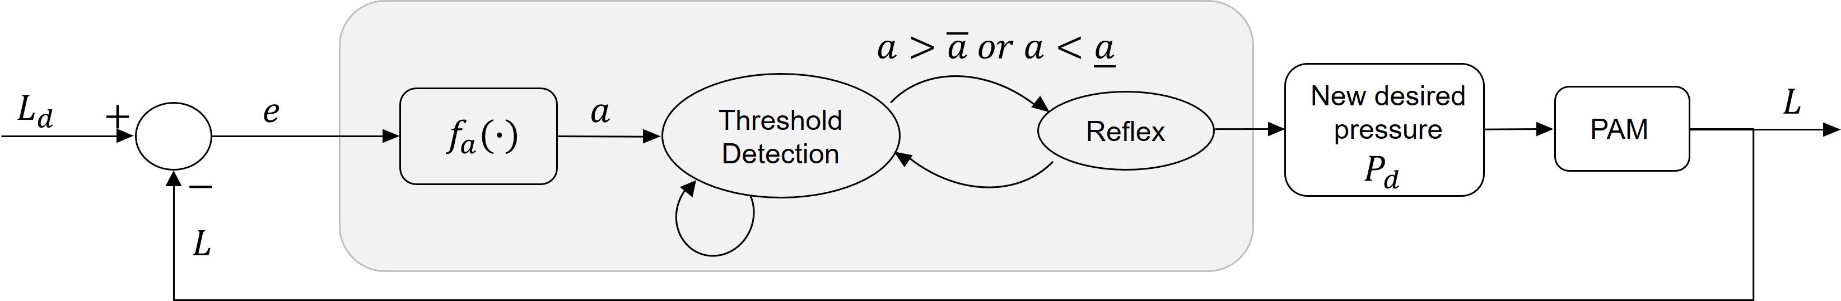
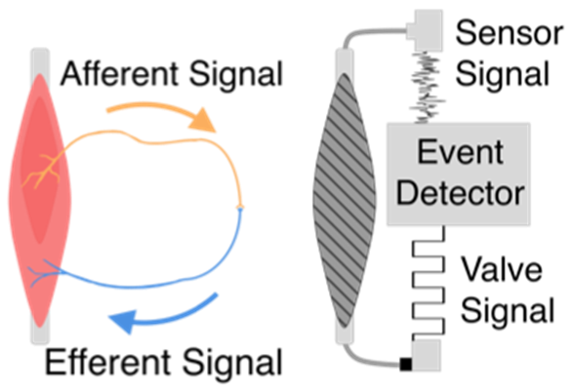
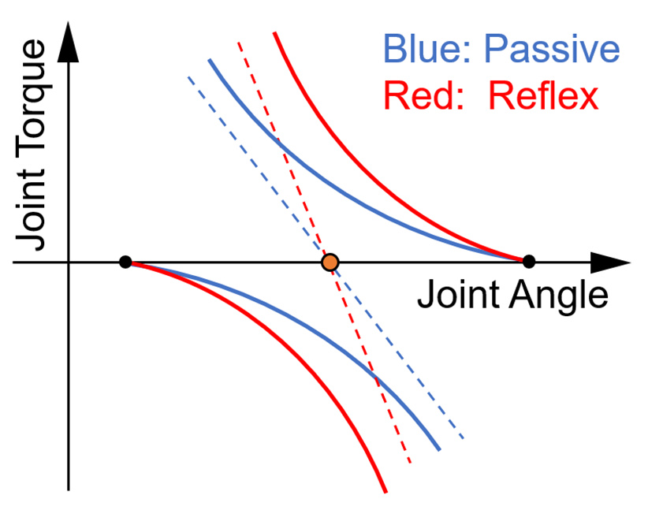
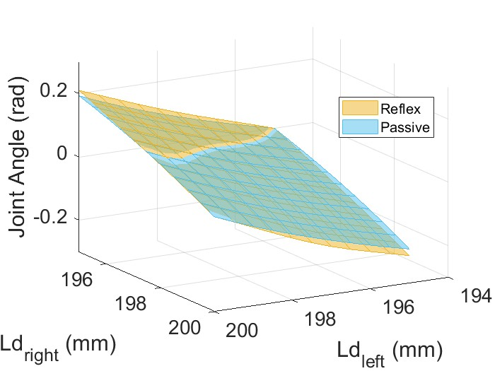
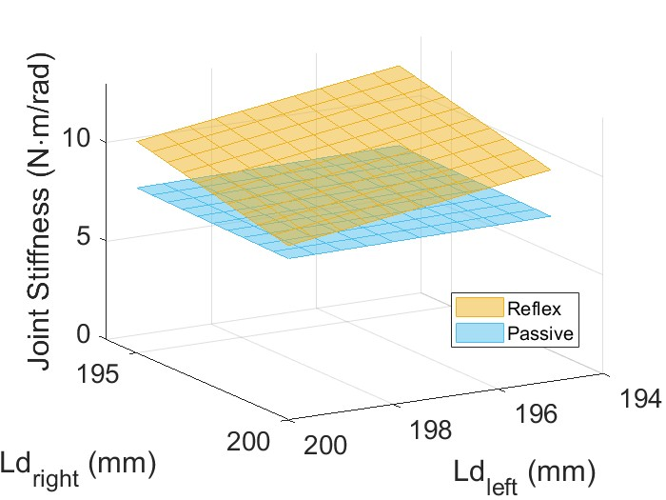
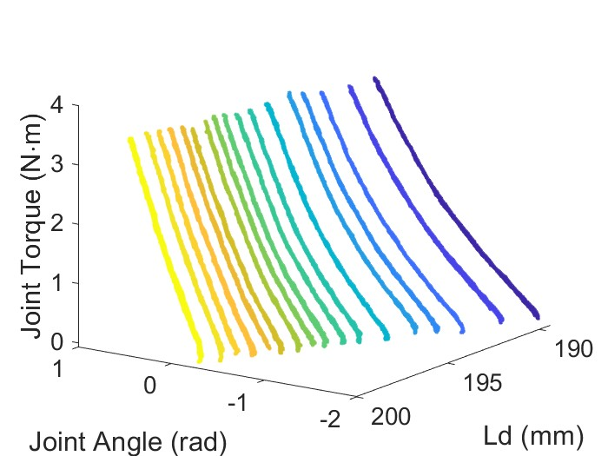
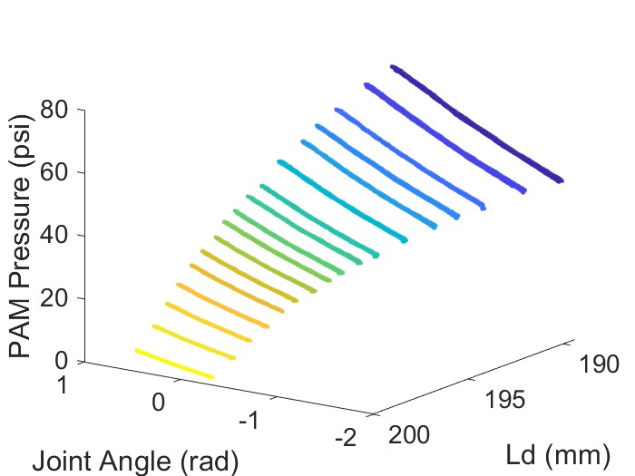
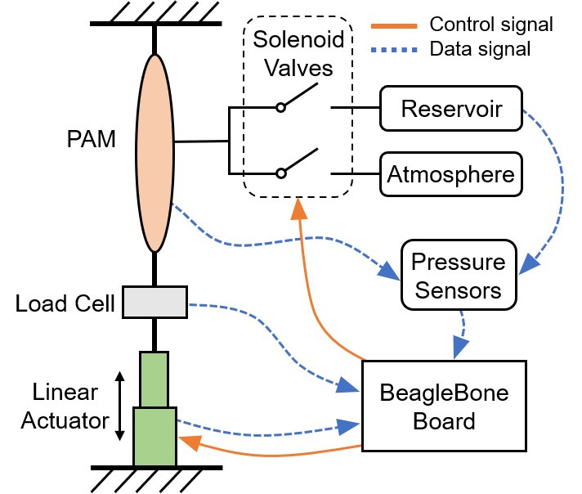
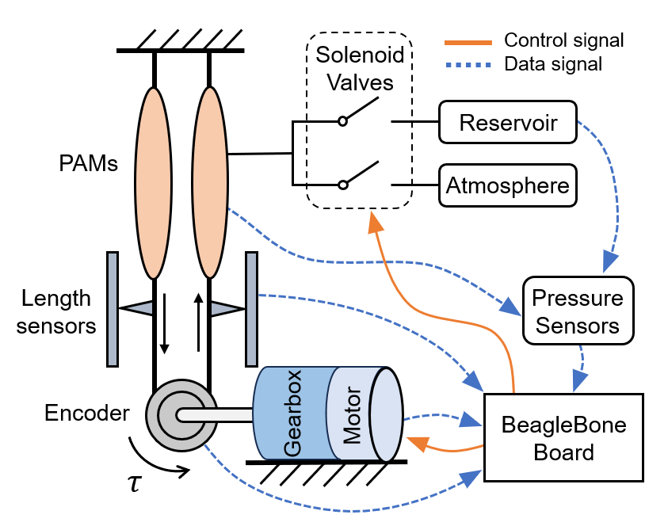
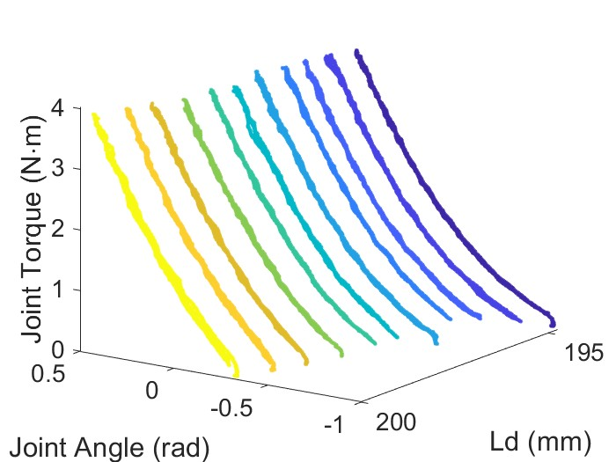
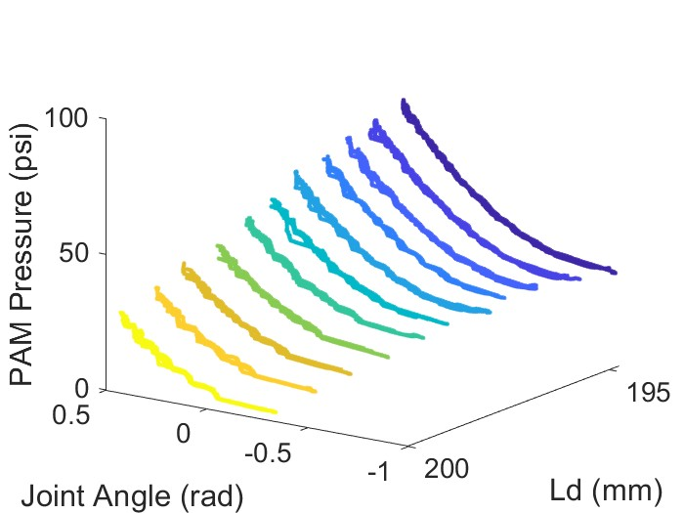
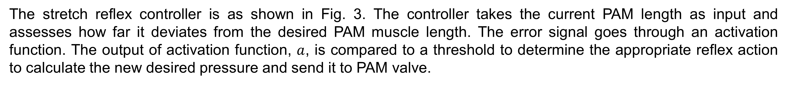
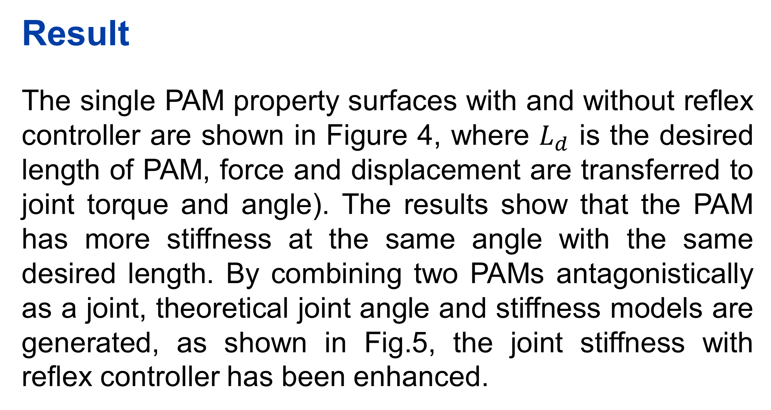
Spinal-like stretch reflex enhances impedance modulation range for antagonistic pneumatic artificial muscles
Xinyao Wang, Tuo Liu, Jonathan Realmuto
Department of Mechanical Engineering, University of California Riverside, CA,USA
Introduction
In physiology, proprioceptors called spindles, located in the belly of muscles, facilitate physical interactions by sensing self-movement and body position and eliciting muscle contractions in response to stretch. This phenomenon called the stretch reflex [1], serves as a low-level feedback loop. Muscles governed by the stretch reflex act as non-linear springs, adjusting resting lengths while maintaining constant non-linear stiffness [2].
The stretch reflex controller is as shown in Fig. 3. The controller takes the current PAM length as input and assesses how far it deviates from the desired PAM muscle length. The error signal goes through an activation function. The output of activation function, $a$, is compared to a threshold to determine the appropriate reflex action to calculate the new desired pressure and send it to PAM valve.
(a)
(b)
Figure 3. The stretch reflex controller flowchart. Threshold crossings result in feed-forward reflex actions, when the reflex action is completed the reflex finite-state machine returns to the 'threshold detection' state.
Result
The single PAM property surfaces with and without reflex controller are shown in Figure 4, where $L_{d}$ is the desired length of PAM, force and displacement are transferred to joint torque and angle). The results show that the PAM has more stiffness at the same angle with the same desired length. By combining two PAMs antagonistically as a joint, theoretical joint angle and stiffness models are generated, as shown in Fig.5, the joint stiffness with reflex controller has been enhanced.
Figure 1. Conceptual illustrates of the proposed reflex method. (a) The artificial reflex mimics the biological reflex loop with an event detection algorithm that directly triggers the valve state.. (b) Comparison of the net stiffness (dashed lines) with (red curves) and without (blue curves) the artificial reflex.
Setups and Methods
Data and actuators are collected and controlled by a BeagleBone Board.
The single PAM experimental platform consists of a PAM in series with a load cell and a linear actuator.
The antagonistic experimental platform consists of two PAMs configured in opposition coupled via a shaft that is equipped with an encoder and connected to a high bandwidth DC motor
(a)
(b)
Figure 5. Comparison of theoretical surfaces with and without reflex controller. (a) Joint angle comparison. (b) Joint stiffness comparison.
Conclusion
We developed a stretch reflex controller that can enhance the PAM stiffness while keep the same equilibrium point. The most novel point is that we can design different pressure function to change the stiffness value as we want,
(a)
(b)
(c)
(d)
References
[1] Uwe Windhorst. “Muscle proprioceptive feedback and spinal networks”. In: Brain research bulletin 73.4-6 (2007), pp. 155–202.
[2] P. Matthews. “A study of certain factors influencing the stretch reflex of the decerebrate cat”. In: The Journal of physiology 147.3 (1959), p. 547.
Figure 2. Experiment setups. (a) Single pneumatic muscle property test setup. (b) Antagonistic setup for system identification.
Figure 4. 3D surfaces of PAM properties for force (joint torque), and displacement (joint angle) with different desired length.
This research was supported by NSF award CMMI 2221315.

Slide 2
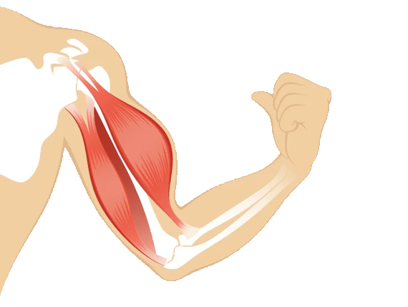
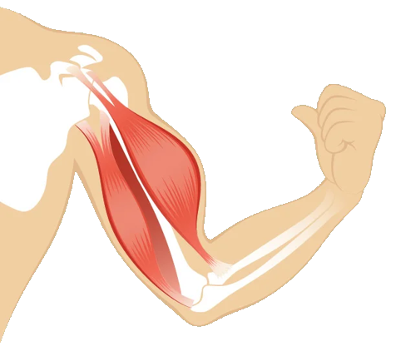
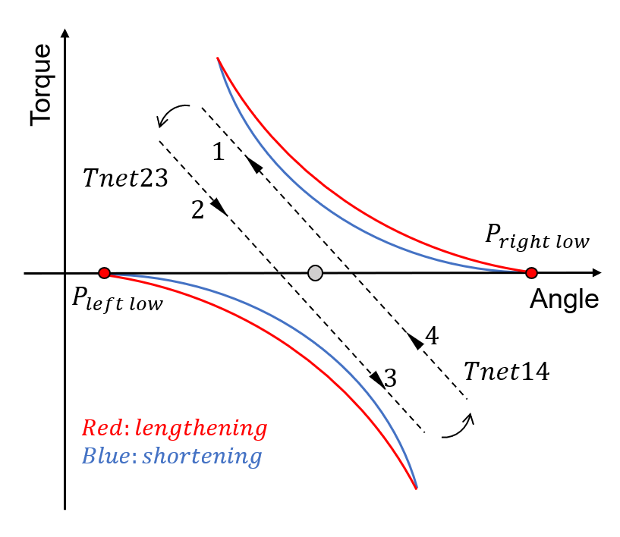
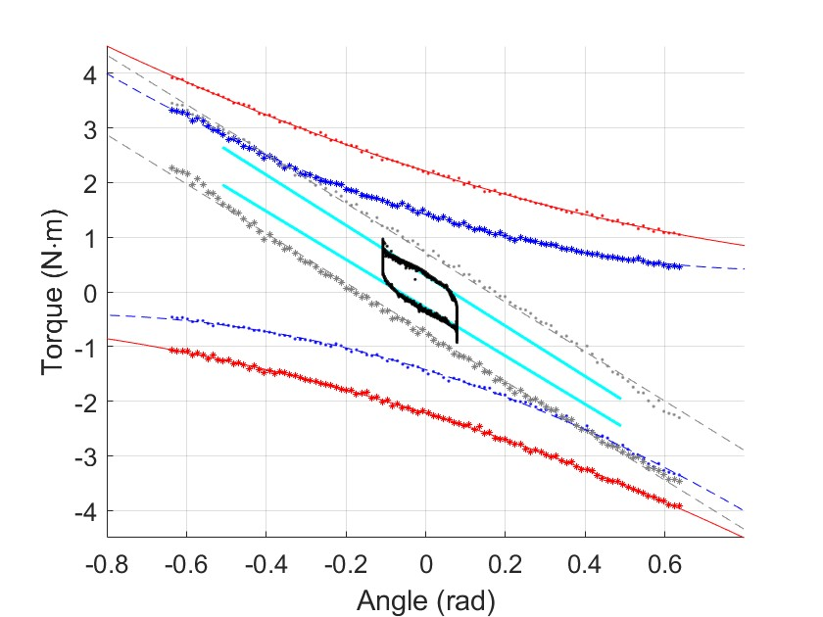
































$$L_{d}$$
$$+$$
$$e$$
$$a$$
$$a∉[\overline{a},\underline{a}]$$
$$P_{d}$$
$$L$$
$$−$$
$$f_{a}(∙)$$
Threshold
Detection
Reflex
$$f_{P_{d}}(∙)$$
PAM
Refractory
$$T_{r}$$
Pneumatic Actuators
Load Cell
Linear Actuator
Encoder
Motor
$$θ$$
Torque
$$1$$
$$K_{2}$$
$$Tnet23$$
$$2$$
$$P_{right low}$$
$$K_{1}$$
$$P_{left low}$$
$$4$$
Angle
$$K_{d},θ_{d}$$
Generative Model
$$L_{d}$$
$$+$$
$$−$$
$$L$$
Sensors
Antagonistic PAMs
Human & Environment
$$Red:lengthening$$
$$Blue:shortening$$
$$3$$
$$Tnet14$$
$$e$$
$$u$$
Valves
$$θ$$
Reflex Controller
$K_{d},θ_{d}$: Desired Impedance
$L_{d}$, $L$: Desired and actual length
$p$: Reflex parameters
$u$: Valve command
PAM: Pneumatic artificial muscle
(a)
(b)
Figure 3. Force-deflection curves for antagonistically configured contraction-type soft pneumatic muscle. (a) theoretical curves. (b) curves comparing with experimental hysteresis loop and stiffness.

