Slide 1
IMT 561 · Data Visualization: Design and Development · Spring 2026
HWK 4: Interactive Visualization
Two Creative Clocks for the Gym Treadmill
Xinyi (Christie) Dong
GitHub Repo: github.com/Xinyi-Christie-Dong/Christie-imt-561-homeworks
Live Site: xinyi-christie-dong.github.io/Christie-imt-561-homeworks

Slide 2
Context of Use
💬 Personal interest:
I go to the gym regularly and find treadmill sessions mentally draining — the built-in timer just counts up, giving no sense of what that time means. I wanted to design a clock that makes the same effort feel rewarding and even fun.
🏃
🎯
✅
Who & Where
Problem
Solution
Gym-goers on a treadmill. Displayed on a screen mounted in front of the machine, replacing the default digital timer.
Treadmill sessions feel long and monotonous. A generic timer gives no sense of achievement — just numbers counting up.
Two clocks that make time meaningful: one through calories as food earned, one through a game world where terrain warps time itself.

Slide 3
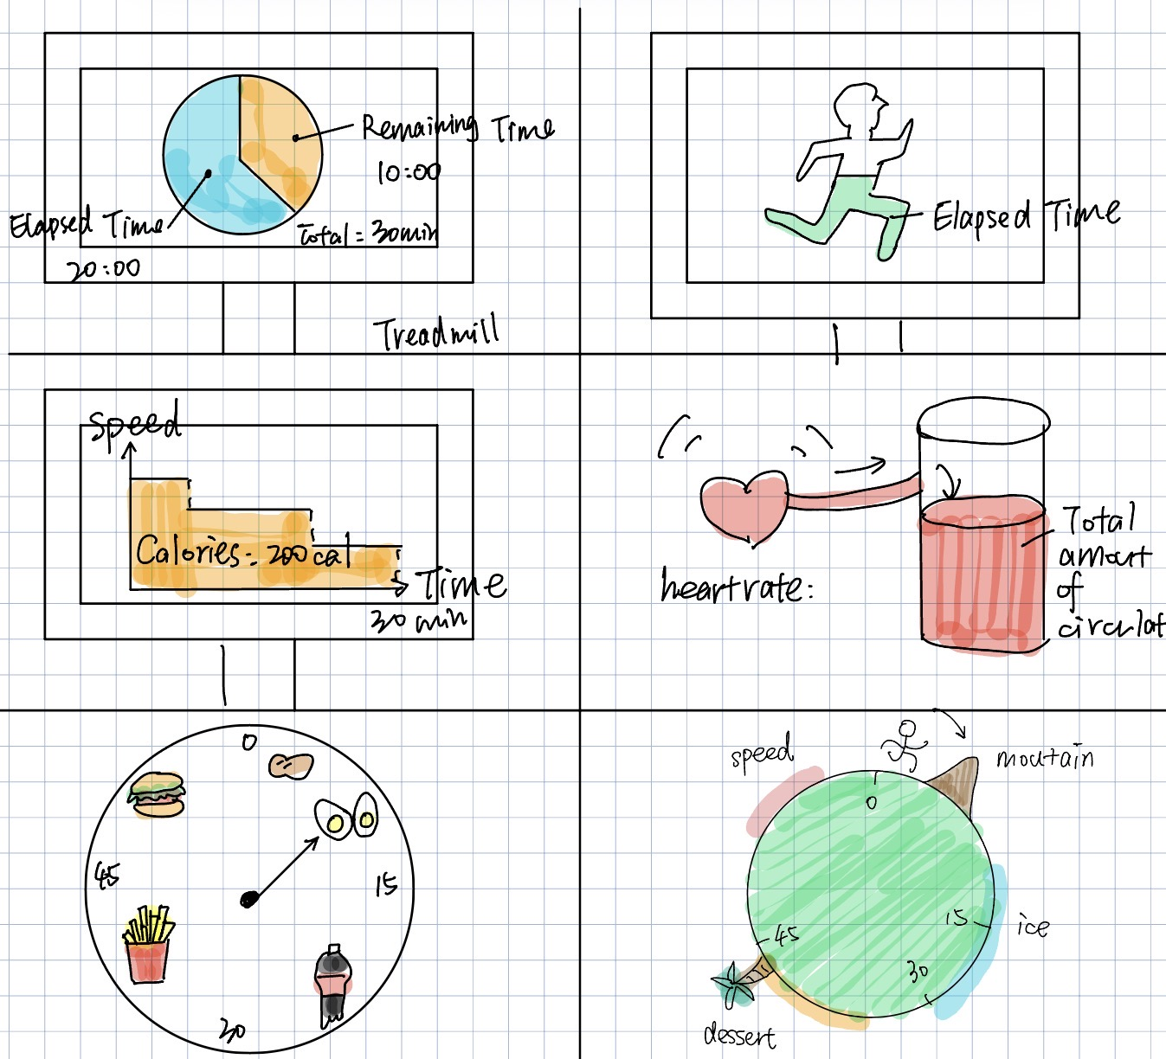
10 Hand-Drawn Sketches
① Pie timer
② Runner tracker
③ Speed/calorie chart
④ Heart rate fill
⑤ Food dial → Clock 1
⑥ Planet terrain → Clock 2

Slide 4
Clock 1 — Treadmill Calorie Clock
🥜
Food icons at calorie-equivalent positions (~8 kcal/min) — turns time into a motivational food goal
🔴
Only the food the minute hand reaches activates; others gray — uses pre-attentive processing
⏱️
Three time channels: minute hand + second hand + digital readout for glancing and precision
🔄
Laps Burned panel counts each food earned across laps — motivation builds over time
📝 Feedback received & applied:
→ Sketch ⑤: Food Dial
• Food icons overlapped tick marks → moved outside ring • Dark background felt heavy → switched to light mode • Calorie labels too small → enlarged + bold on active food

Slide 5
Clock 2 — Mario Planet Treadmill Clock
🌍
Non-linear ring: terrain zones warp arc size — 30 min ≠ halfway. Encodes subjective effort, not just time
⛰️
5 zones: Plain (1×), Mountain (0.5×), Ice (2×), Desert (0.7×), Monster (3×)
👾
Monster zone: pixel-art Goomba chases Mario — creates narrative tension that resets each lap
🔀
Click to shuffle zones — same 60 min looks completely different with different effort layout
📝 Feedback received & applied:
→ Sketch ⑥: Planet Terrain
• Dark space background felt disconnected → light sky gradient • Gap between ring and planet body → shrunk ring to remove gap • Boost zone felt generic → replaced with Goomba monster chase mechanic

Slide 6
Why the Two Designs Are Structurally Different
Clock 1 — Calorie Clock
Clock 2 — Mario Planet Clock
Shape
Circular dial — classic clock form
Shape
Circular planet — non-clock form
Time encoding
Linear — minutes evenly spaced
Time encoding
Non-linear — zones warp the ring
VS
Visual variable
Position (hand) + color (active food)
Visual variable
Arc length + character motion
Interaction
Space to start/pause; R to reset
Interaction
Click to shuffle terrain layout
Narrative
Static icons — you run toward food
Narrative
Dynamic — Goomba chases Mario
Key question
What have I burned so far?
Key question
How does effort warp time?

Slide 7
Links
💻 GitHub Repository
https://github.com/Xinyi-Christie-Dong/Christie-imt-561-homeworks
🌐 Deployed Site
https://xinyi-christie-dong.github.io/Christie-imt-561-homeworks/?tab=tab1
Xinyi (Christie) Dong · IMT 561 · Spring 2026

