Slide 1
Data Pipeline
Baseline Model Running
Preliminary Results
Next Steps
Contribution Breakdown
Datasets
Table 1. Key NASA satellite products and ERA5 (Fifth generation ECMWF) atmospheric reanalysis datasets used in this study.
 | Product | Source | Variable | Temporal Coverage | Temporal Resolution | Spatial Resolution | Reference
Fire Activity | MCD64A1 | NASA | Burned Area | 11/2000-present | Monthly | 500 m | Giglio et al., 2018
Vegetation Productivity | MOD13A2 | NASA | EVI¹ | 02/2000-present | 16-Day | 1000 m | Didan et al., 2015
 | MOD13A2 | NASA | NDVI² | 02/2000-present | 16-Day | 1000 m | Didan et al., 2015
 | MOD15A2H | NASA | LAI³ | 02/2000-present | 8-Day | 500 m | Myneni et al., 2021
Fire Weather | ERA5 Land | ECMWF | Precipitation | 01/1950-present | Monthly | 0.1° (~ 1100 m) | Hersbach et al., 2020
 |  |  | Surface Temperature
 |  |  | Soil Moisture
 |  |  | Wind Speed
 |  |  | VPD⁴
EVI¹ = Enhanced Vegetation Index; NDVI² = Normalized Difference Vegetation Index; LAI³ = Leaf Area Index; VPD⁴ = Vapor Pressure Deficit

Slide 2
Data Pipeline
Baseline Model Running
Preliminary Results
Next Steps
Contribution Breakdown
Post-Processing Workflow
Pre-process, Extract, Download
Google Earth Engine (GEE)
Re-project
ArcGIS Pro
All datasets to the same resolution and coordinate grid
NASA Products
Interpolate, Resample, Grid Alignment
ERA5 Datasets
Python, Climate Data Operators (CDO)
Python
Download

Slide 3
Data Pipeline
Baseline Model Running
Preliminary Results
Next Steps
Contribution Breakdown
Post-Processing Results
Table 2. Summary of Post-Processed Datasets and Their Temporal and Spatial Characteristics.
Variable | Temporal Coverage | Temporal Resolution | Spatial Resolution | Post-Process Datasets
Burned Area | 01/2001-12/2024 | Monthly | 0.1° | MCD64A1_BurnedFraction_01x01_2001_2024_monthly.nc
EVI | 01/2001-12/2024 | Monthly | 0.1° | MOD13A2_EVI_01x01_2001_2024_monthly.nc
NDVI |  |  |  | MOD13A2_NDVI_01x01_2001_2024_monthly.nc
LAI |  |  |  | MOD15A2H_LAI_01x01_2001_2024_monthly.nc
Precipitation | 01/1950-12/2024 | Monthly | 0.1° | ERA5_Land_precip_m_1950_2024_monthly_01x01.nc
Surface Temperature
 |  |  |  | ERA5_Land_skt_k_1950_2024_monthly_01x01.nc
 |  |  |  | ERA5_Land_swvl1_percentage_1950_2024_monthly_01x01.nc
Soil Moisture
 |  |  |  | ERA5_Land_WindSpeed_mpers_1950_2024_Monthly_01x01.nc
Wind Speed
 |  |  |  | ERA5_Land_VPD_kpa_1950_2024_monthly_01x01.nc
VPD

Slide 4
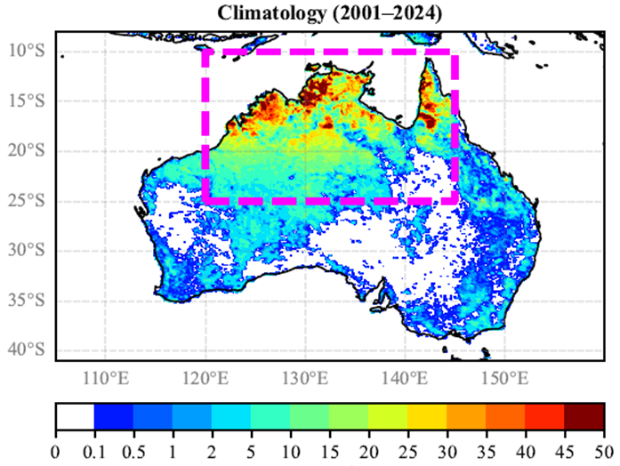
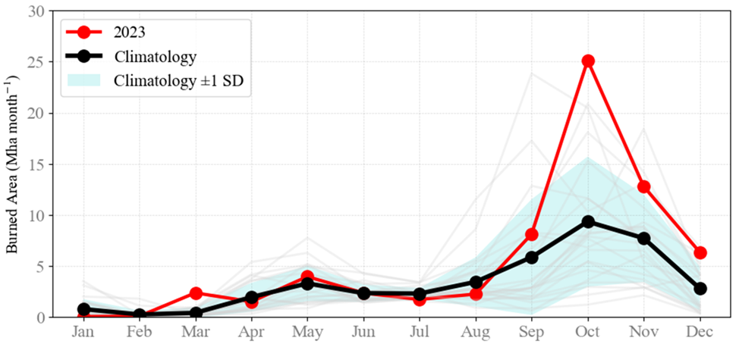
Data Pipeline
Baseline Model Running
Preliminary Results
Next Steps
Contribution Breakdown
Climatology of Burned Area (Northern Australia)
The left panel shows the spatial distribution of mean annual burned area across Australia during 2001–2024, highlighting extensive fire activity in the northern savanna region (outlined by the magenta box is the region we focus on). Warm colors indicate areas with a higher fraction of land burned annually, whereas cool colors denote regions with limited fire occurrence. The right panel presents the monthly climatology of burned area (black line) and its interannual variability (shaded region representing ±1 standard deviation) for Northern Australia, compared with observations from 2023 (red line). Fire activity typically peaks during the late dry season (September–November), with 2023 showing a markedly higher-than-average burned area in October.

Slide 5
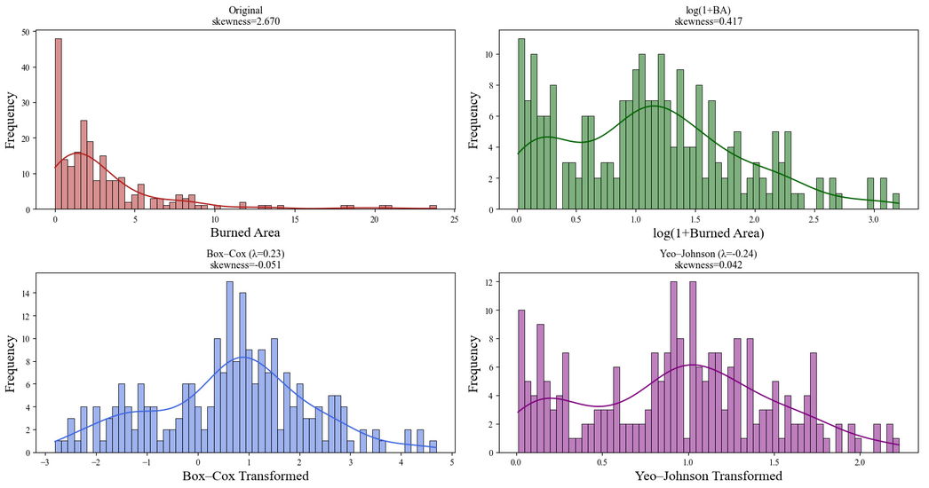
Data Pipeline
Baseline Model Running
Preliminary Results
Next Steps
Contribution Breakdown
Post-Processing Results
The top-left panel shows the original burned-area distribution, which is highly right-skewed (skewness = 2.67) and dominated by small-fire events. The top-right panel presents the log(1 + x)–transformed data, where skewness is substantially reduced (to 0.42), resulting in a more symmetrical distribution. The bottom panels illustrate two additional transformations applied to the same dataset for comparison, each aiming to mitigate skewness and improve data normality.
Extreme data imbalance between instances of fire and no-fire is observed. If the data with a large proportion of no-fire instances are directly used for model training, it is highly likely to mislead model outputs to converge into zero values.

Slide 6
Data Pipeline
Baseline Model Running
Preliminary Results
Next Steps
Contribution Breakdown
LSTM Model Setting
Model Name | DualAttentionFire
Architecture | LSTM with Dual Attention (Temporal + Feature)
Sequence Length | 12 months (input time steps)
Hidden Dimension | 64
Number of Layers | 1
Attention Mechanisms | Temporal attention (per feature) Feature attention (across features)
Activation Function | tanh (for attention scoring)
Target Transformation | log₁₊(y) = log(1 + Burned Area)
Loss Function | Mean Squared Error (MSE) on log-transformed target
Regularization | Weight decay only
Normalization | StandardScaler (z-score on features)

Slide 7
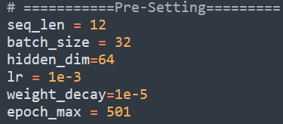
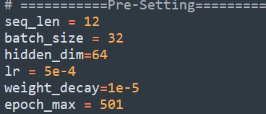
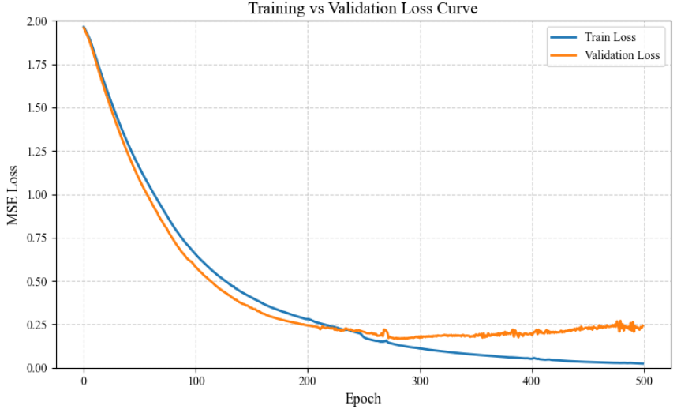
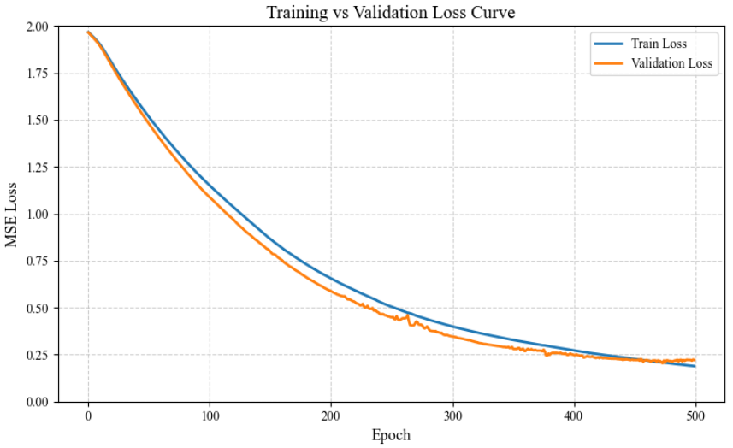
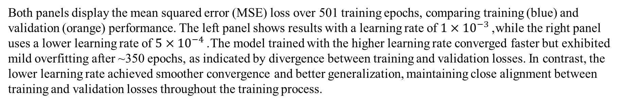
Data Pipeline
Baseline Model Running
Preliminary Results
Next Steps
Contribution Breakdown
Model Results

Slide 8
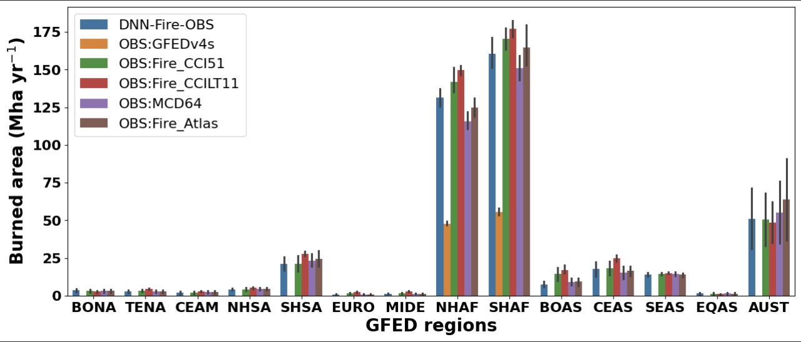
Data Pipeline
Baseline Model Running
Preliminary Results
Next Steps
Contribution Breakdown
DNN Model Setting
DRAFT: Implementation of a PyTorch-based DNN Wildfire model to replicate the functionality of the original TensorFlow wildfire surrogate model

