Slide 1

IEEE/CVF Conference on CVPR, 2023
Mapping Degeneration Meets Label Evolution:
Training an Infrared Small Target Detection Network with Single Point Supervision
Xinyi Ying, Li Liu, Yingqian Wang, Ruojing Li, Nuo Chen, Zaiping Lin, Weidong Sheng, Shilin Zhou
National University of Defense Technology

Slide 2

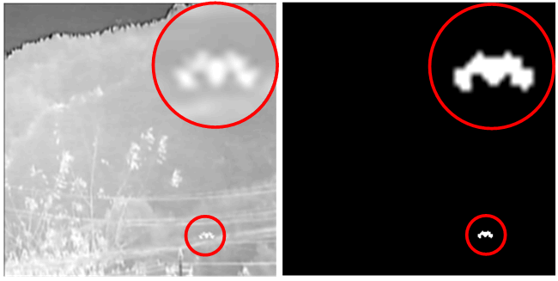
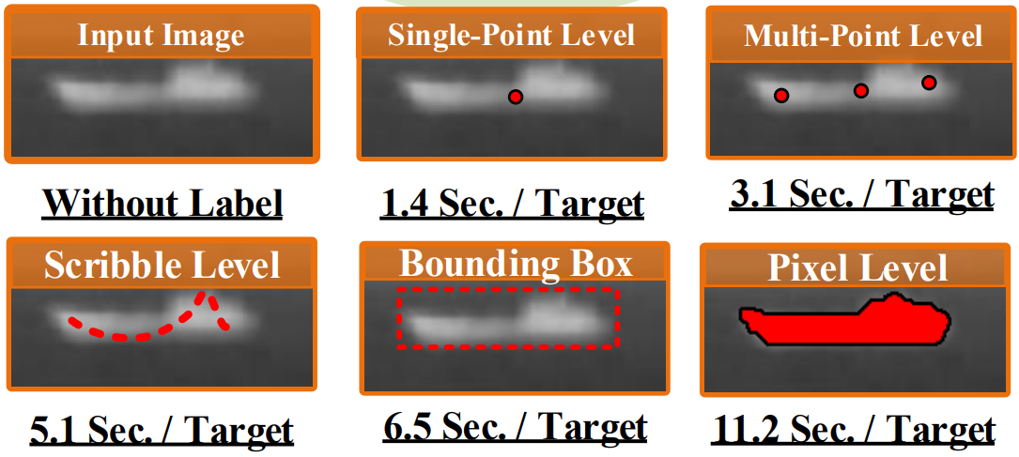
LESPS for SIRST with single point supervision
Single-frame Infrared small Target Detection (SIRST)
Annotation efficiency [C1]
Fully-supervised training is highly labor expensive.
We develop the first framework to achieve SIRST detection with only single-point labels for supervision.
[C1] Monte Carlo Linear Clustering with Single-Point Supervision is Enough for Infrared Small Target Detection, Arxiv 2023

Slide 3
LESPS for SIRST with single point supervision
Contributions:
We present the first study of weakly supervised SIRST detection, and introduce Label Evolution with Single Point Supervision (LESPS) that can significantly reduce the annotation cost.
We discover the mapping degeneration phenomenon, and leverage this phenomenon to automatically regress pixel-level pseudo labels from the given point labels via the proposed LESPS.
Experimental results show that our framework can be applied to different existing SIRST detection networks, and enable them to achieve comparable detection performance as compared to their fully supervised counterparts (75% of IoU and 95% of Pd).

Slide 4
LESPS for SIRST with single point supervision
Mapping degeneration under point supervision
1. Special imaging mechanism of infrared systems.
2. High local contrast of infrared small targets.
Region-to-region Mapping
3. Easy-to-hard learning property of CNNs
Degeneration
Notes:
CNNs always tend to segment a cluster of pixels near the targets (region-to-region mapping) with low confidence at the early stage, and then gradually learn to predict GT point labels (region-to-point mapping) with high confidence.

Slide 5
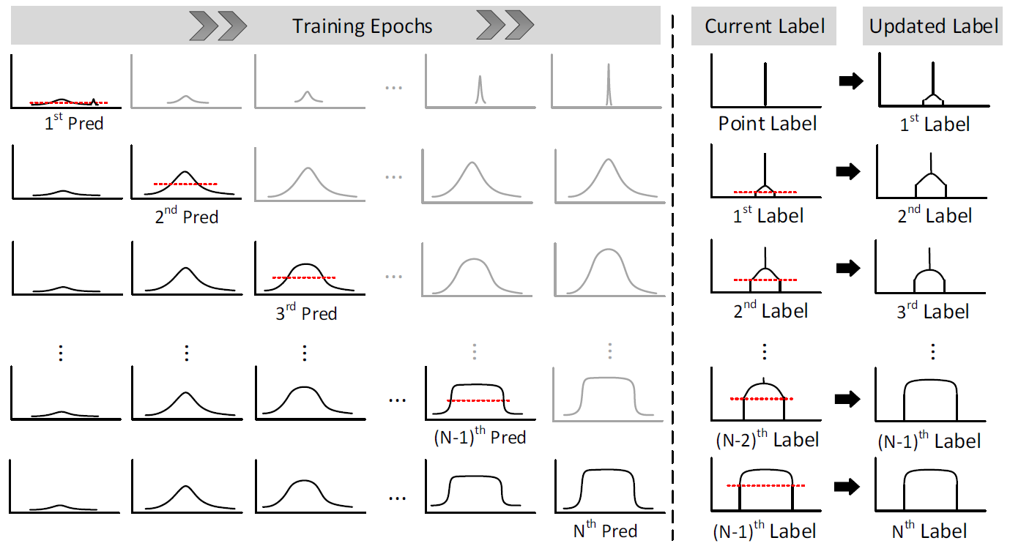
LESPS for SIRST with single point supervision
Label evolution with single point supervision

Slide 6
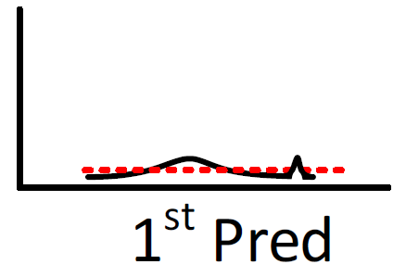

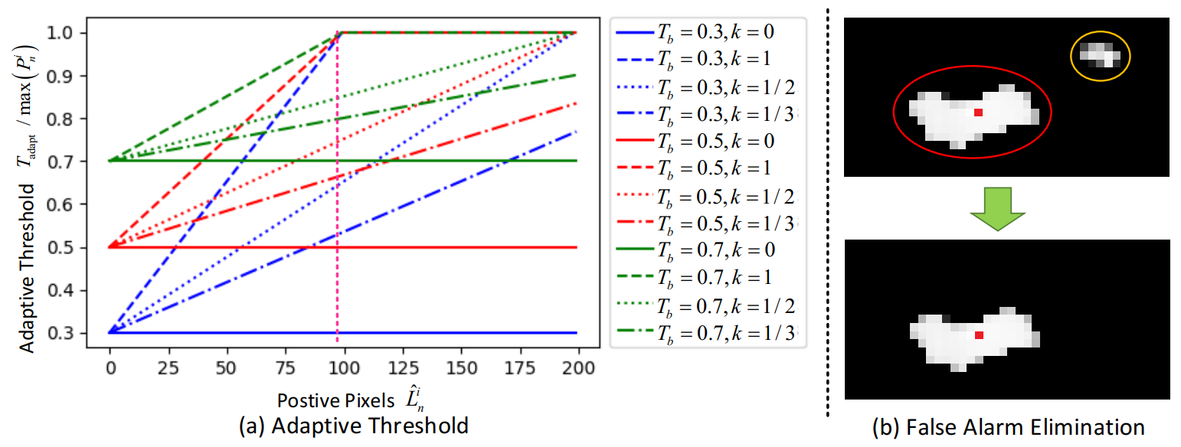
LESPS for SIRST with single point supervision
Label evolution with single point supervision
1. Candidate Pixel extraction.
2. False alarm elimination.
1st Pred
1st Pred
Point Label
Extract pixels higher than red dotted line (adaptive threshold)
Exclude false alarms (yellow dotted circles) that have no intersection with labels.

Slide 7
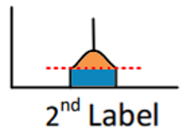
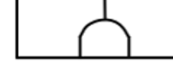
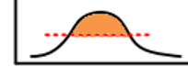
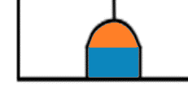
LESPS for SIRST with single point supervision
Label evolution with single point supervision
3. Label Update.
3rd Pred
2nd Label
3rd Label
Average weighted summation between network predictions and current labels.
Three Convergence Conditions of LESPS
1. Average weighted summation between predictions and labels promotes CNNs to converge as predictions approximate labels.
2. Pixel-adaptive threshold increases with the increase of positive pixels in updated labels, which slows down or suspends the label update.
3. CNNs grow to mature as label evolution introduces more target information for training, and CNNs gradually learn to distinguish targets from backgrounds.

Slide 8
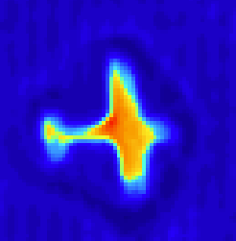
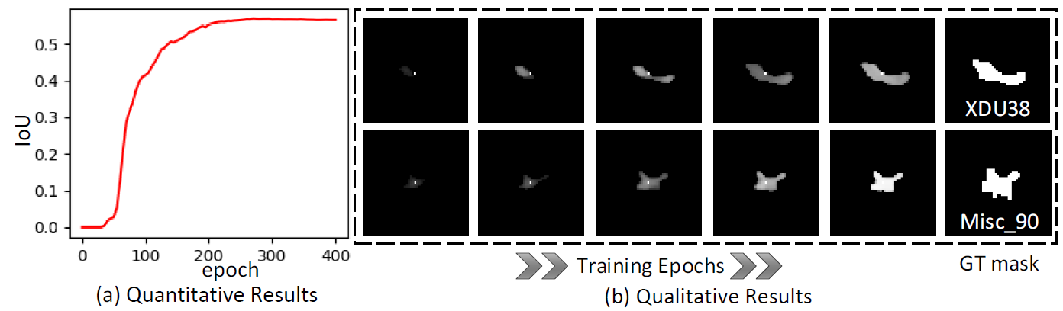
LESPS for SIRST with single point supervision
Model Analyses
Mapping Degeneration
Label
Evolution
Region-to-region Mapping
SIRST
Region-to-point Mapping

Slide 9
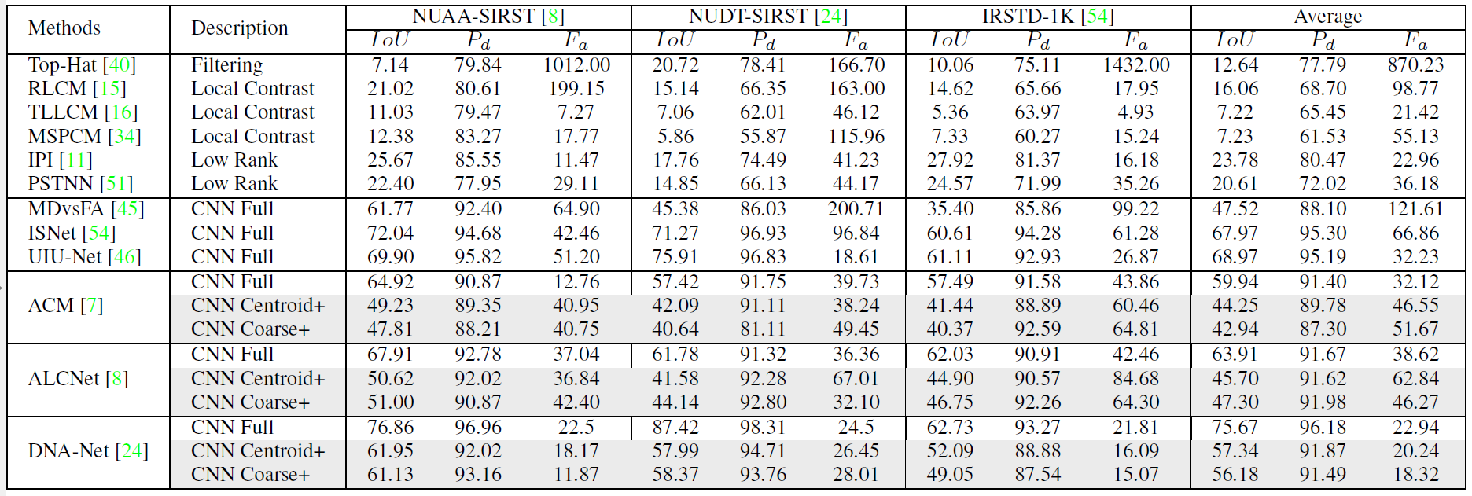
LESPS for SIRST with single point supervision
Quantitative results
Table 1: IoU×10², Pd×10² and Fa×10⁶ values achieved by different methods.

Slide 10
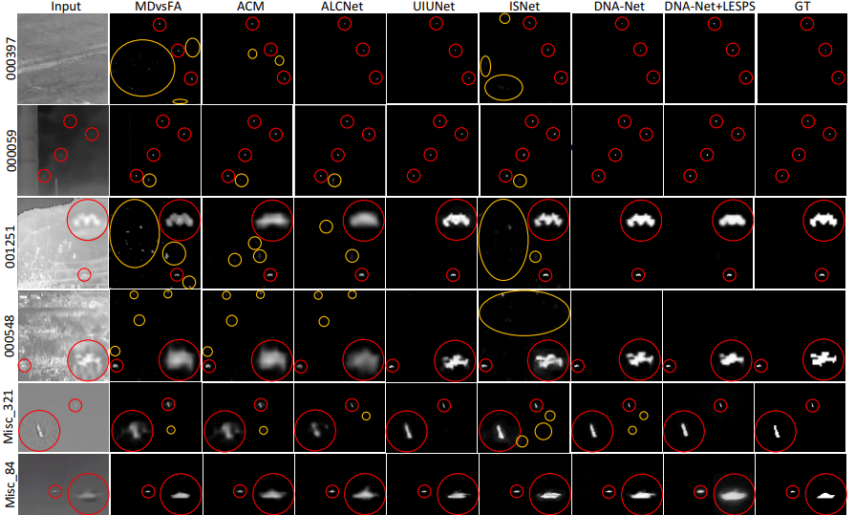
LESPS for SIRST with single point supervision
Qualitative results

Slide 11

LESPS for SIRST with single point supervision
Codes and models are available in https://github.com/XinyiYing/LESPS
An open-source and easy-to-use toolbox for infrared small target detction.
BasicIRSTD is available in
https://github.com/XinyiYing/BasicIRSTD

Slide 12

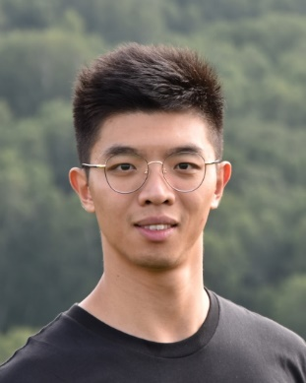
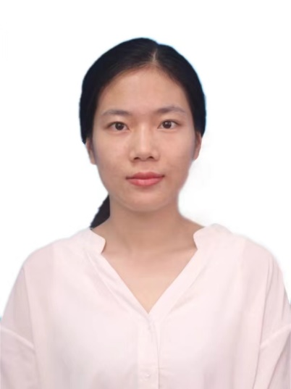



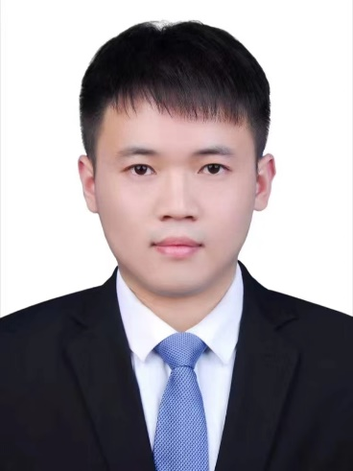
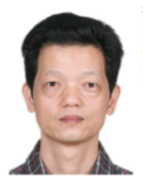
Biographies
Xinyi Ying is currently working towards her Ph.D. degree with the College of Electronic Science and Technology, National University of Defense Technology. Her research interests mainly focus on high-level vision, particularly on small object detection.
Email: yingxinyi18@nudt.edu.cn
Li Liu
Yingqian Wang
Ruojing Li
Nuo Chen
Zaiping Lin
Weidong Sheng
Shilin Zhou

