Slide 1
Movie Tracker
Notes:
Hello
Introduce topic
Looked at other languages, but going to focus on Python & Java for this presentation for the sake of time

Slide 2
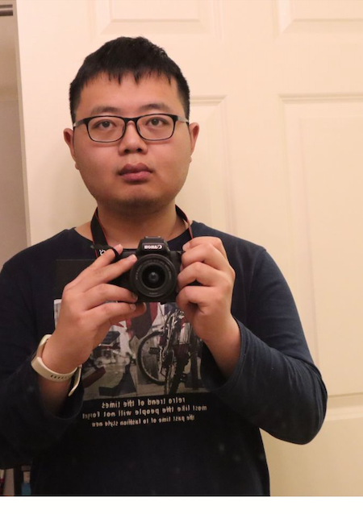
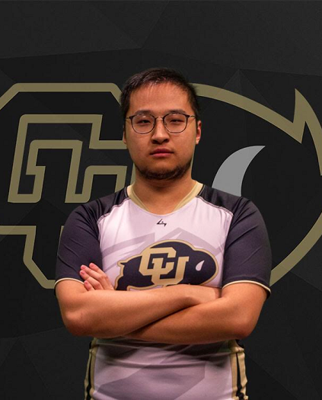
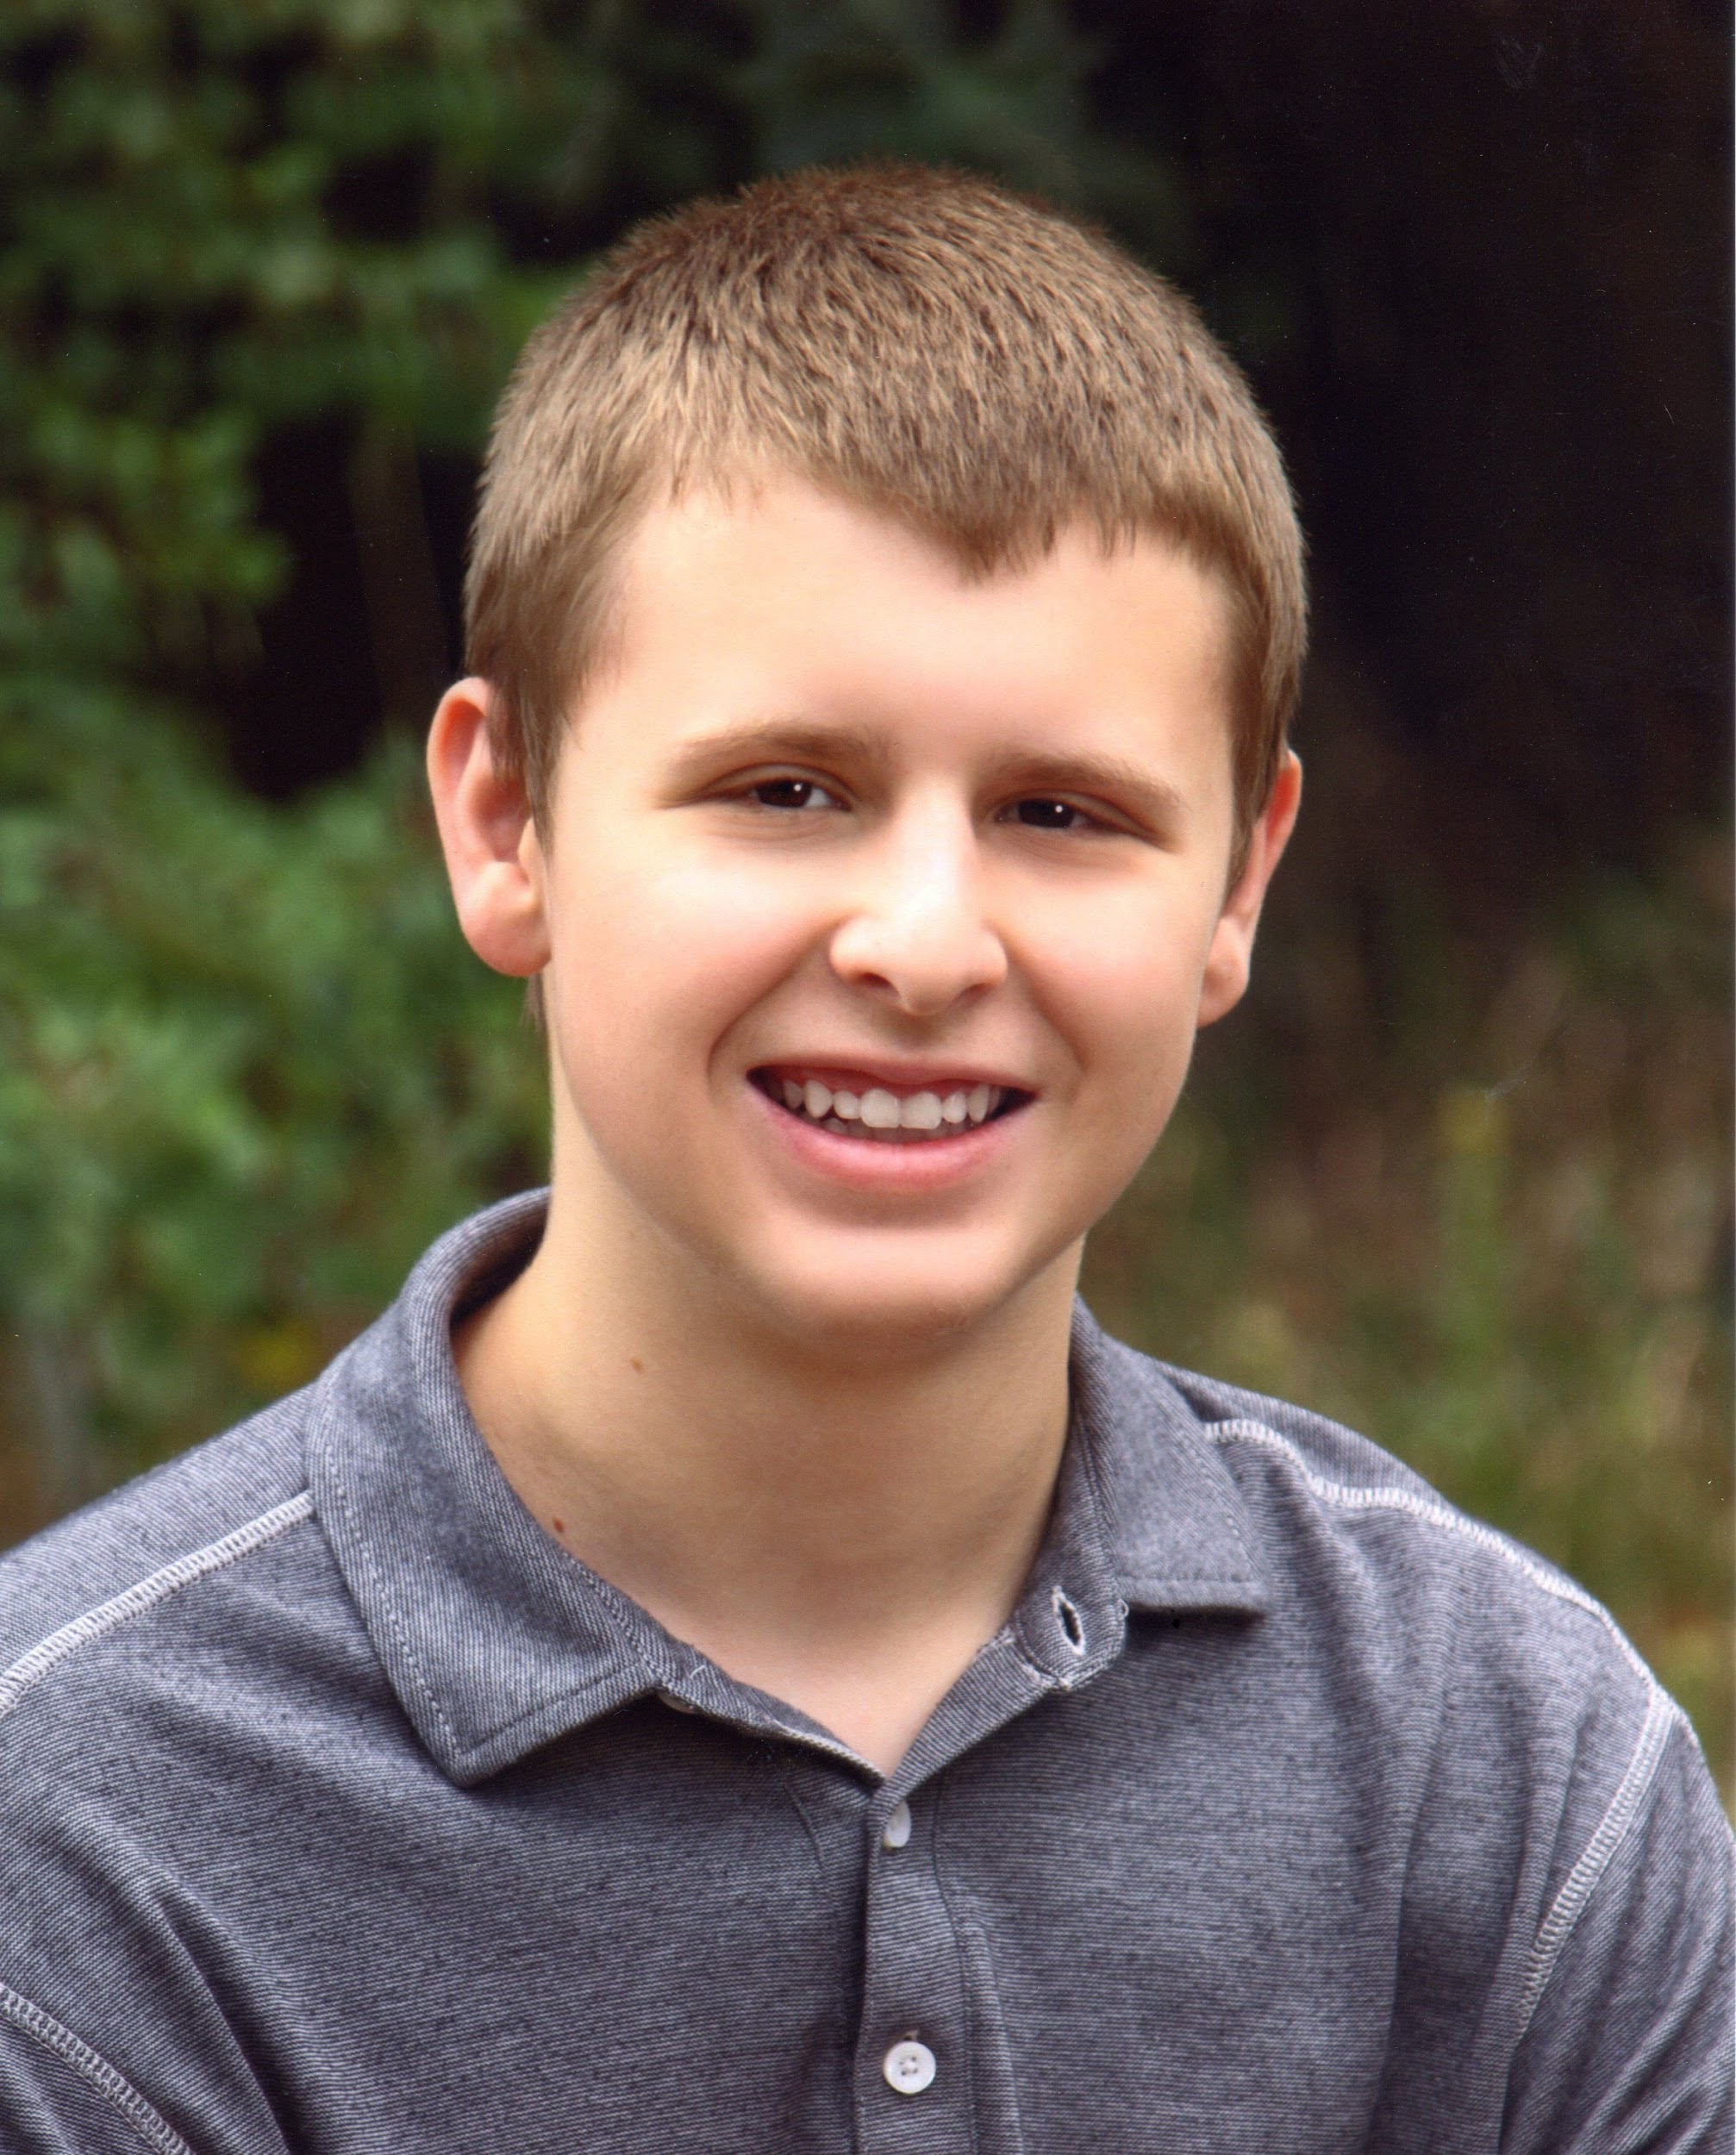
Intro to Team
Xinyu Jiang
Qiuyang Wang
Vlad Zhdanov
Notes:
Name and Year
Order:
Vlad
Qiuyang
Xinyu

Slide 3
Responsibilities

Slide 4
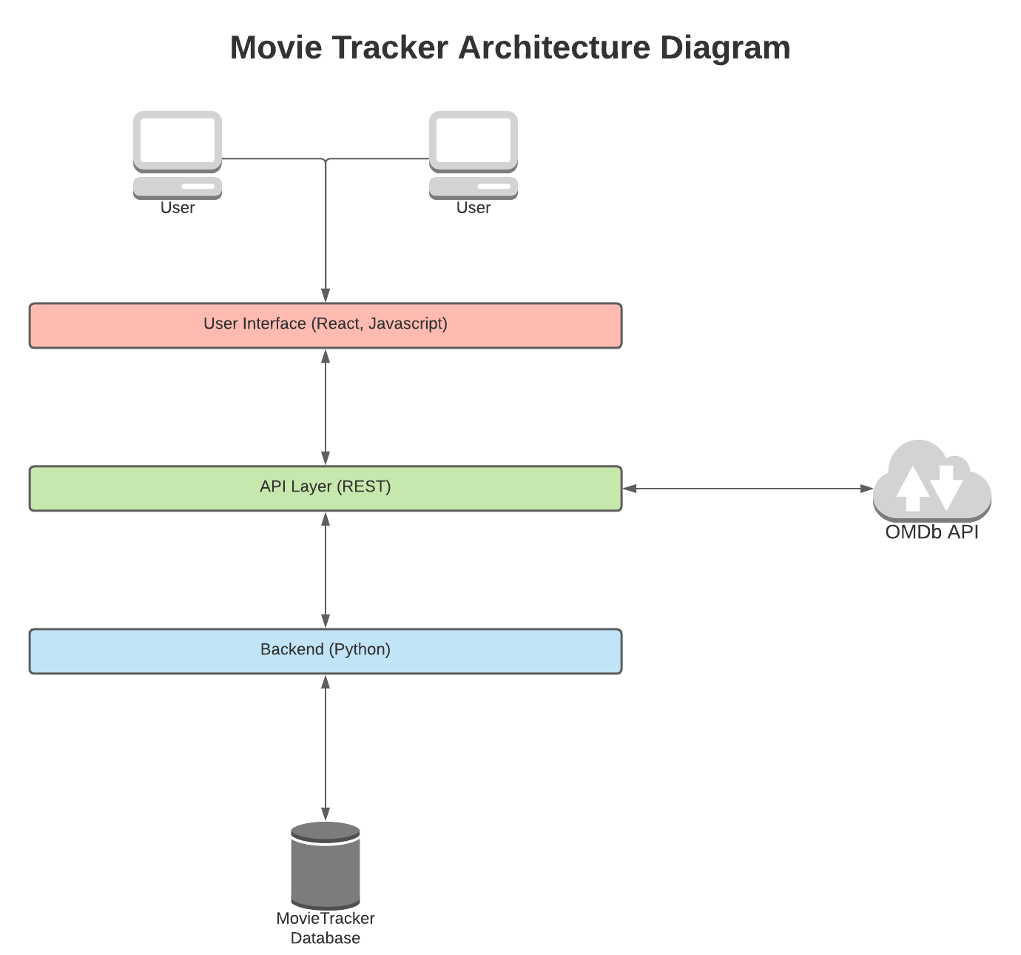
Technologies
Frontend: React
API: REST/Flask
Backend: Python
Database: SQLite
External:
Open Movie Database (OMDb) API

