Slide 1
Dynamic Spec Web App
Xinyu Gao
Notes:
Internship project in this summer

Slide 2
Outline
Intuition-problem with existing app
Introduction to new web app
Next steps
What I learnt from this internship
Notes:
My presentation will cover the following topics

Slide 3
Intuition-problem with existing app
One pager vs Spec
Cannot update one pager and spec simultaneously
Pager.docx -> Save as pdf
Spec.docx -> Save as pdf
https://mpog.org/quality/our-measures/
 | One Pager | Spec
Section1 | ✔️ | ✔️
Section2 |  | ✔️
Section3 | ✔️ | ✔️
Section4 |  | ✔️
Notes:
the information about measures are available in two documents, one pager and specification.
One pager: quick summary
Spec: detailed definition. ->subset
Currently, each one pager and spec are saved in two different word document.
If QI coordinators would like to update one pager, they'll have to update two separately
It is likely for the pager to be inconsistent with spec
My goal is to build an app to replace these word documents to manage measure definition changes.

Slide 4
Introduction to new web app
Public view
Private(logged-in) view
Notes:
This new application has two portions:

Slide 5
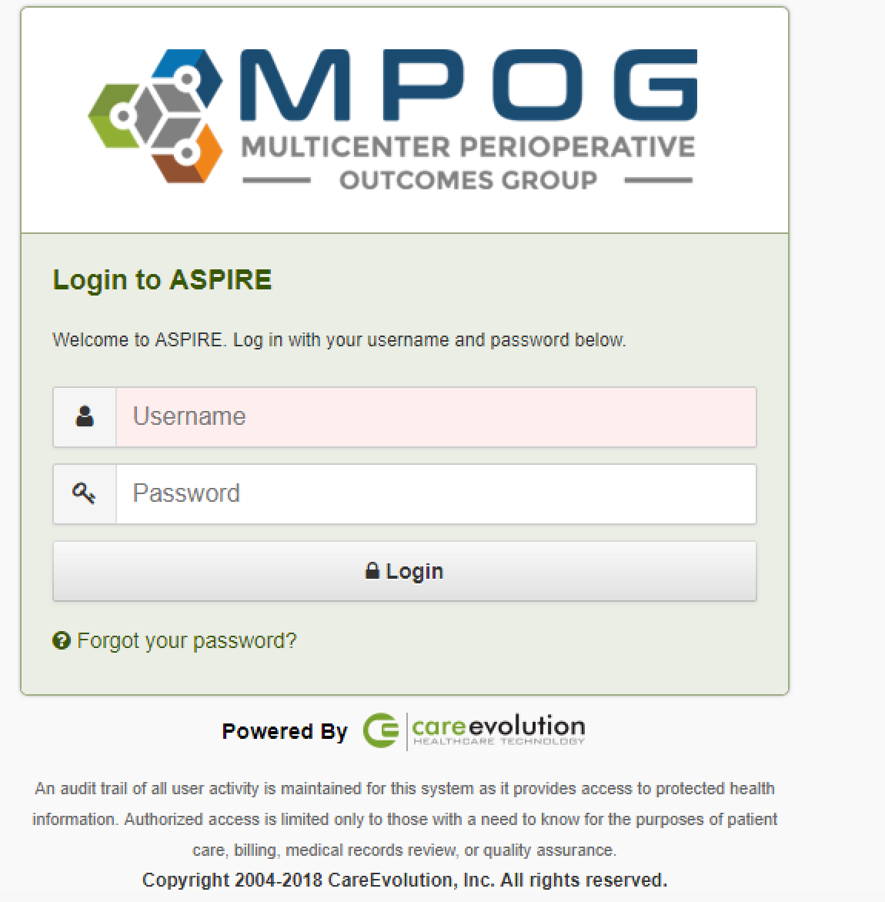
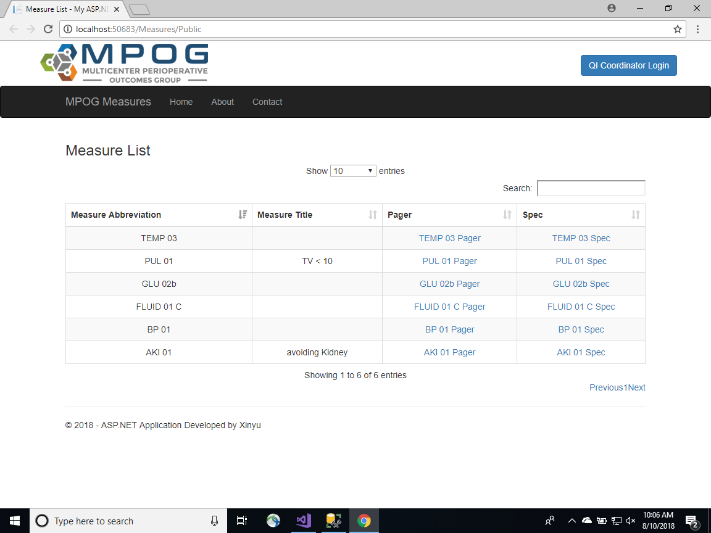
Public View
Main page
Notes:
This is the public page for anyone to view
all published measures sorted in descending order of the measure name
and links to their pager and spec. On the top right corner is the login button for QI coordinators.

Slide 6
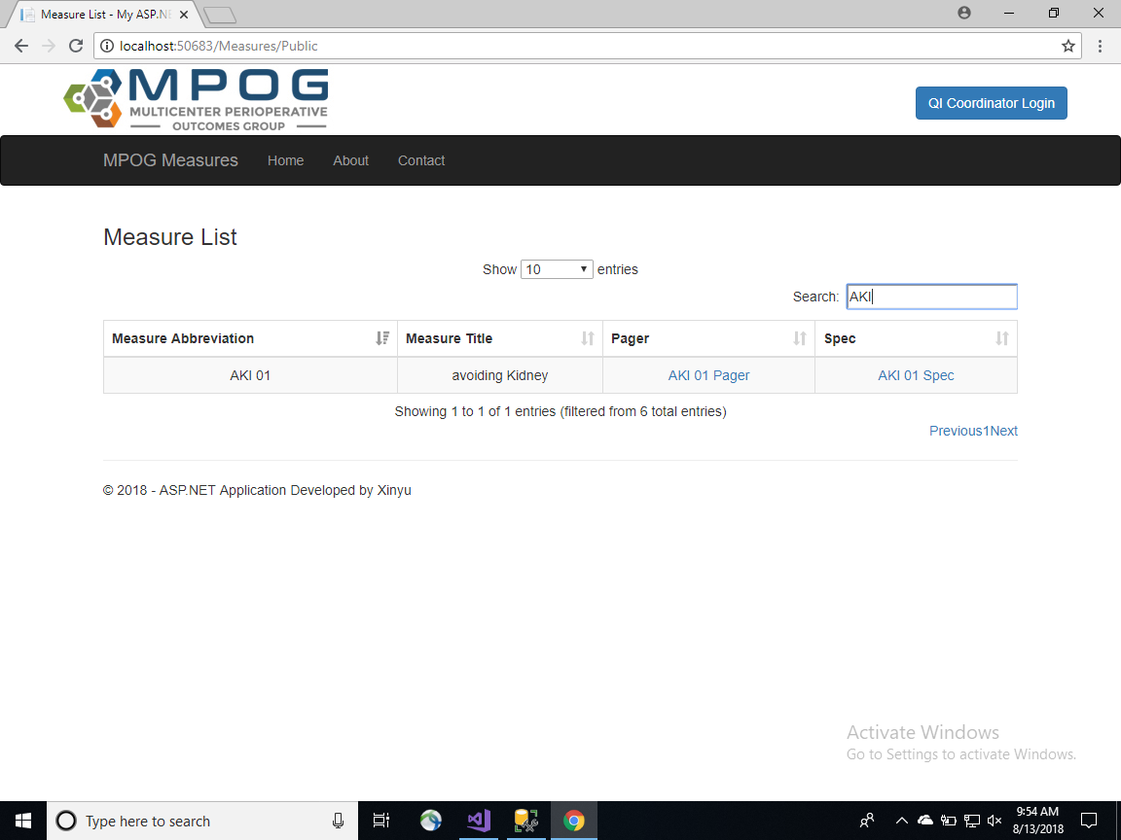
Public View
Filter
Notes:
If the list is too long to view, we can search in the search box to filter a specific measure we would like to view
enter aki and we get measure aki-01

Slide 7
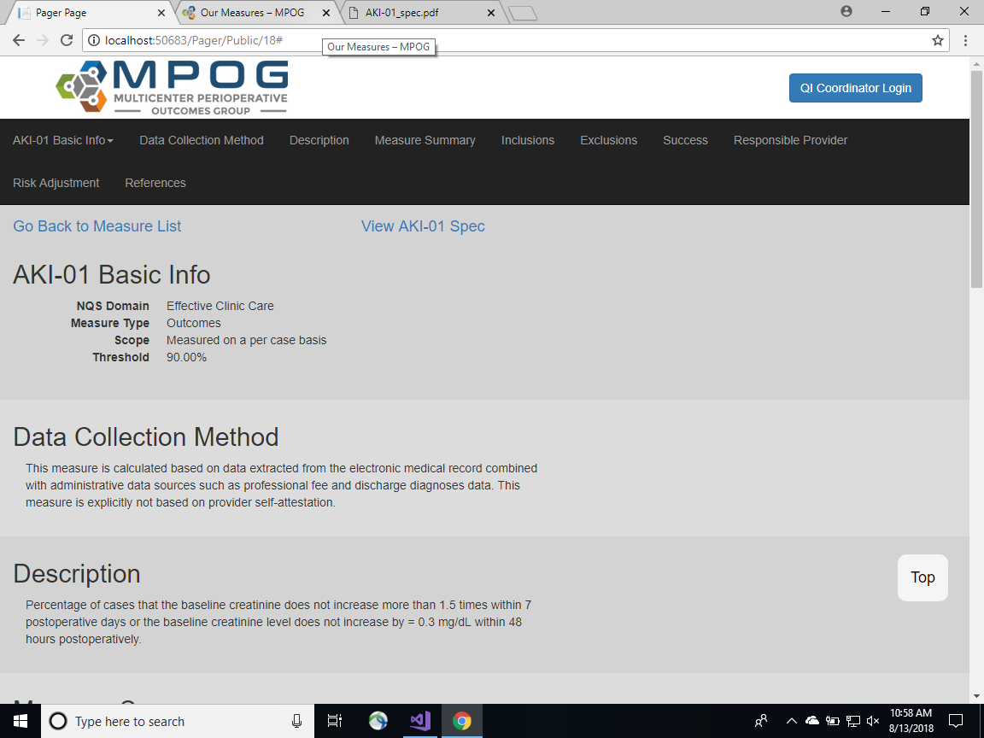
Public View
Published Version of One Pager
Notes:
if we click on pager link, we will see the published version of one pager. The top links are for going back to measure list and view the corresponding published version of spec

Slide 8
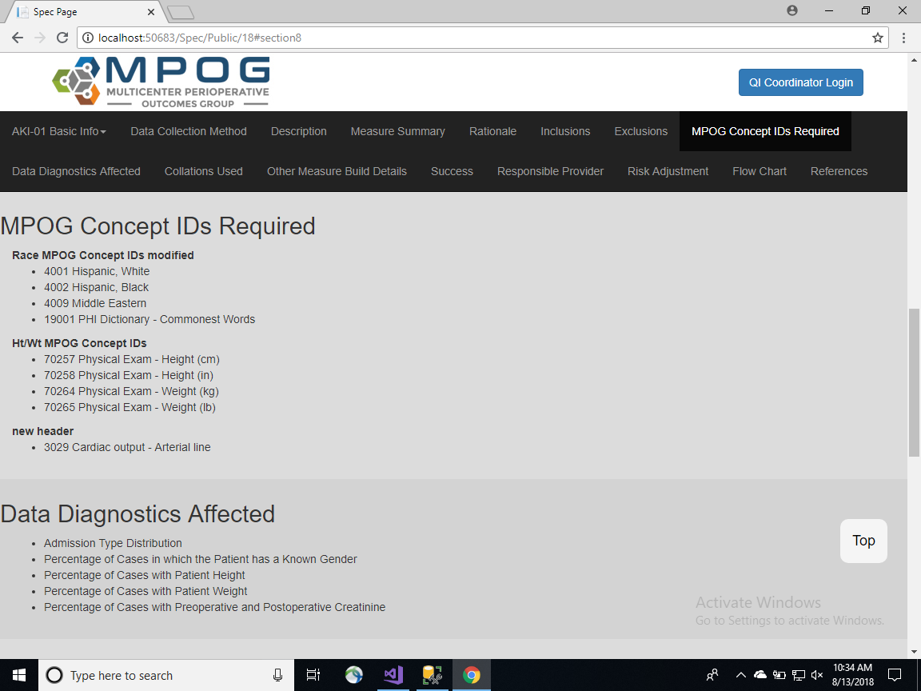
Public View
Published Version of Spec
Notes:
This is the published version of spec.
As we scroll down the page, the corresponding section in the header area will be highlighted, if we click on the header, we will see the corresponding section content below.
There is also a top button to jump to top of this page.

Slide 9
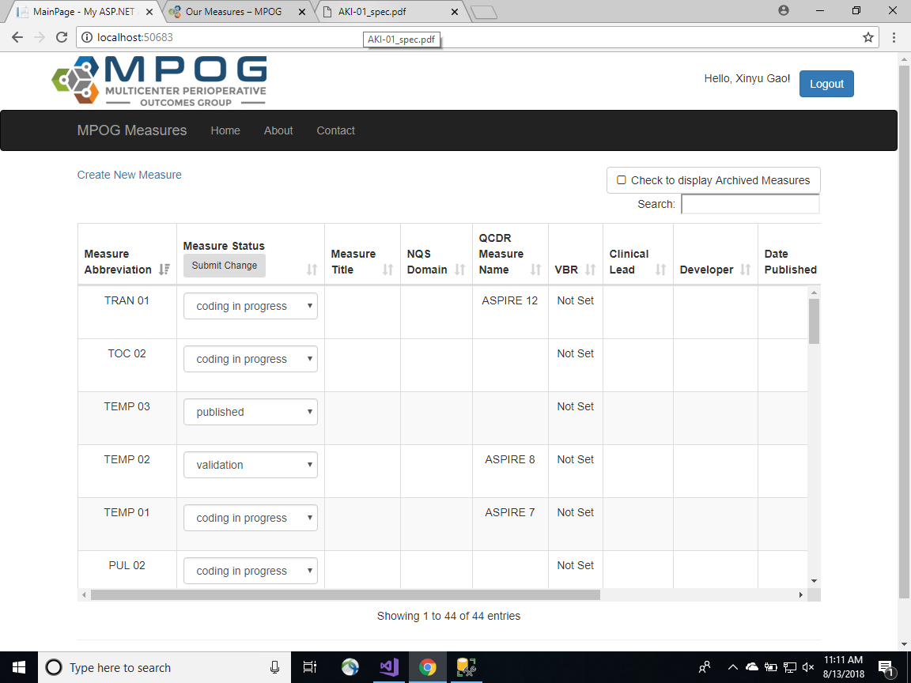
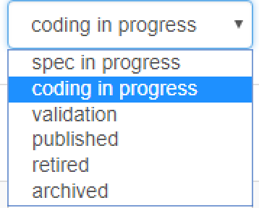
Private View
Fixed header
QI coordinator
Notes:
Let's take a look at the private version for QI coordinators.
First it's the main page, we can see that compared to the public version, in the private mode we have more fields including measure status, nqs domain, clinical lead, etc.
In this page we can manage the measure status by changing the selected item in the dropdownlist.
When we choose to archive a measure, by default it won't be displayed, but after we click the check to display archived measure,

Slide 10
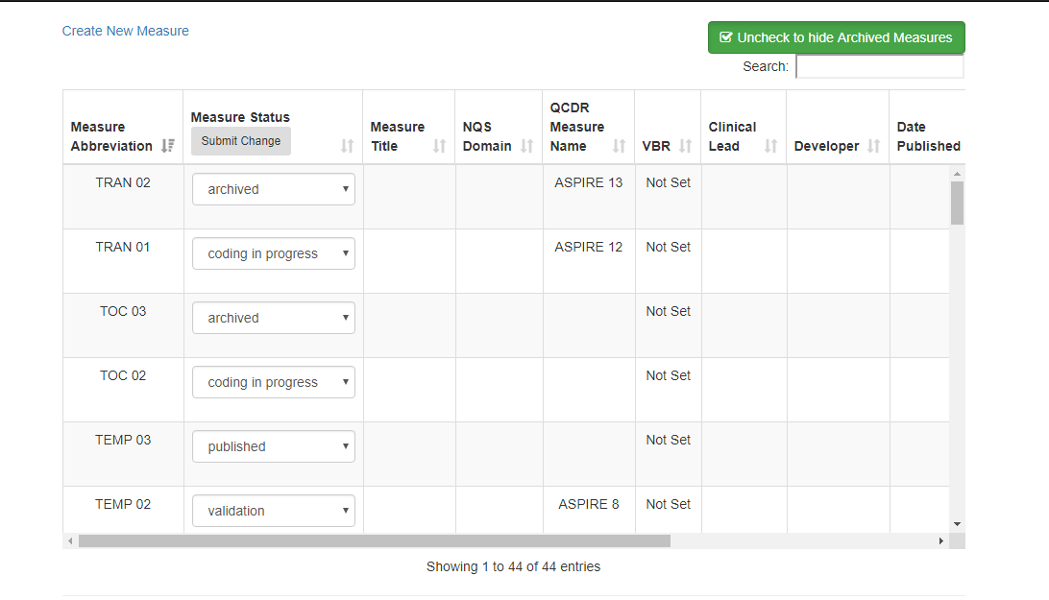
Private View
Manage Status
Notes:
we can see that all the archived measures are listed. Then we click this unchecked to hide archived measure they will be hidden again.

Slide 11
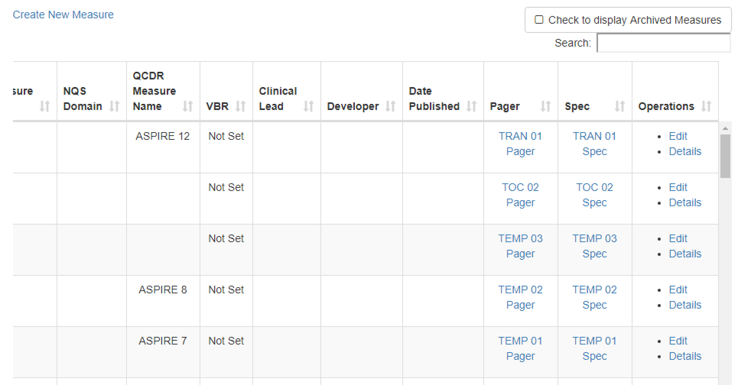
Private View
Operations
Notes:
The operations on this page besides what we talked before, are create new measures, edit existing measures and view the measure details.

Slide 12
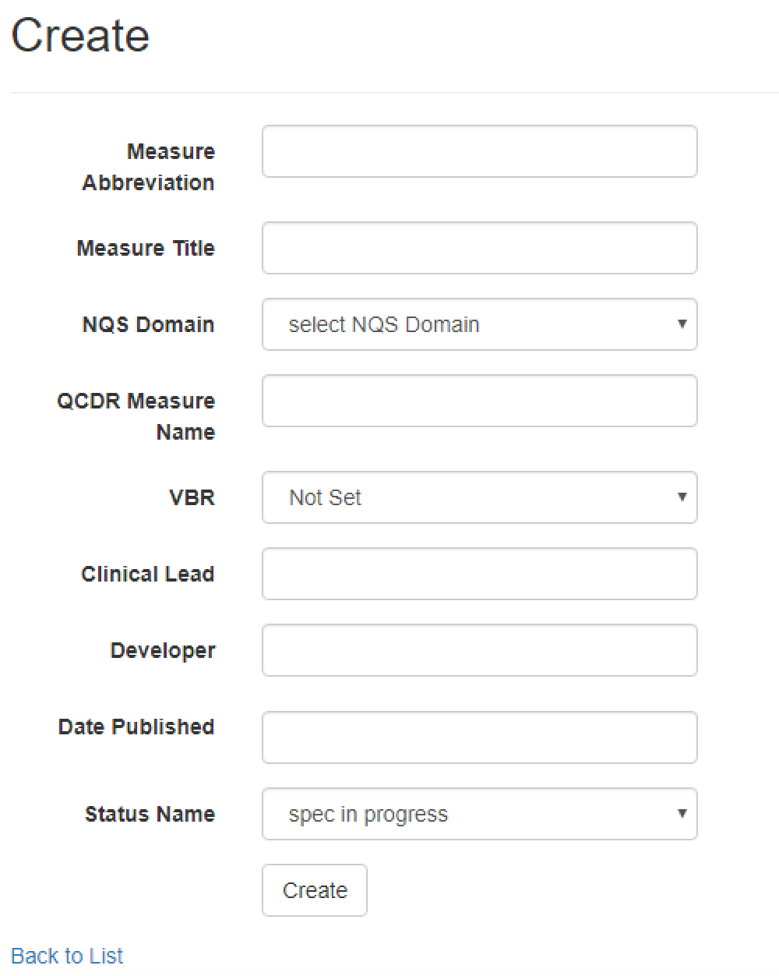
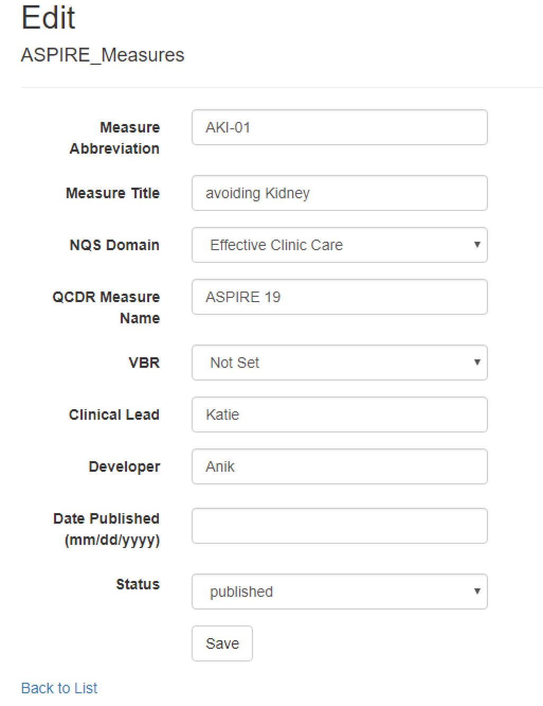
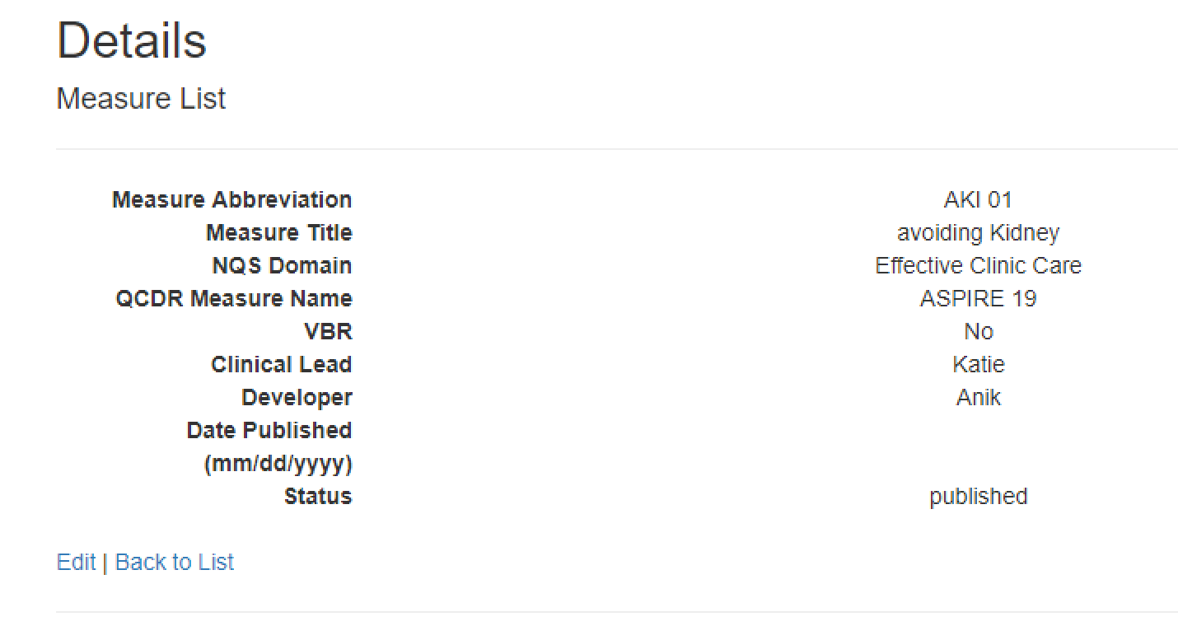
Private View
Create
Edit
Details
Notes:
Here are the three pages of the creating measure, edit measure and viewing measuredetails.
Notice that the edit link on the details page is the same as clicking the edit in the main page

Slide 13
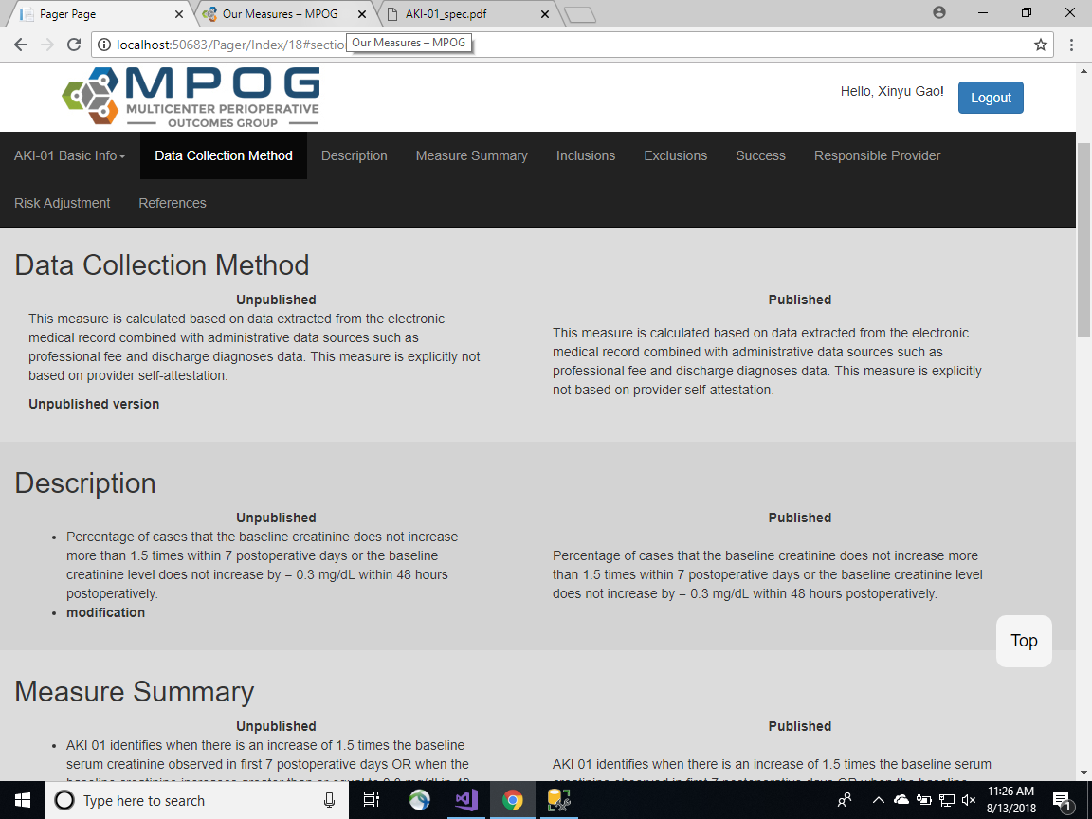
Private View-One Pager and Spec
View One Pager
Notes:
Here let's take a look at the one pager page for QI coordinators private mode.
First it's the view page for one pager.
In this page we have two versions of this pager: unpublished one and published one

Slide 14
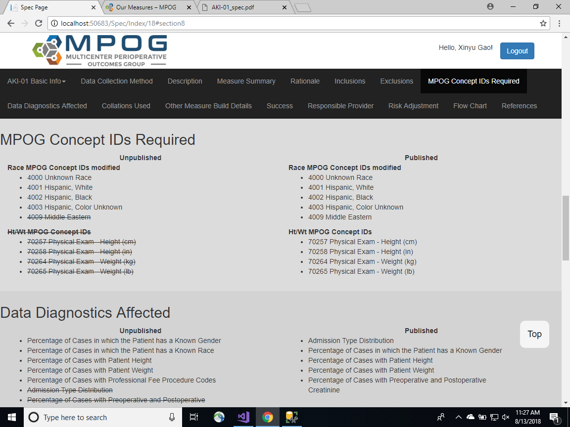
Private View-One Pager and Spec
View Spec
Notes:
It's the same for the spec page.

Slide 15
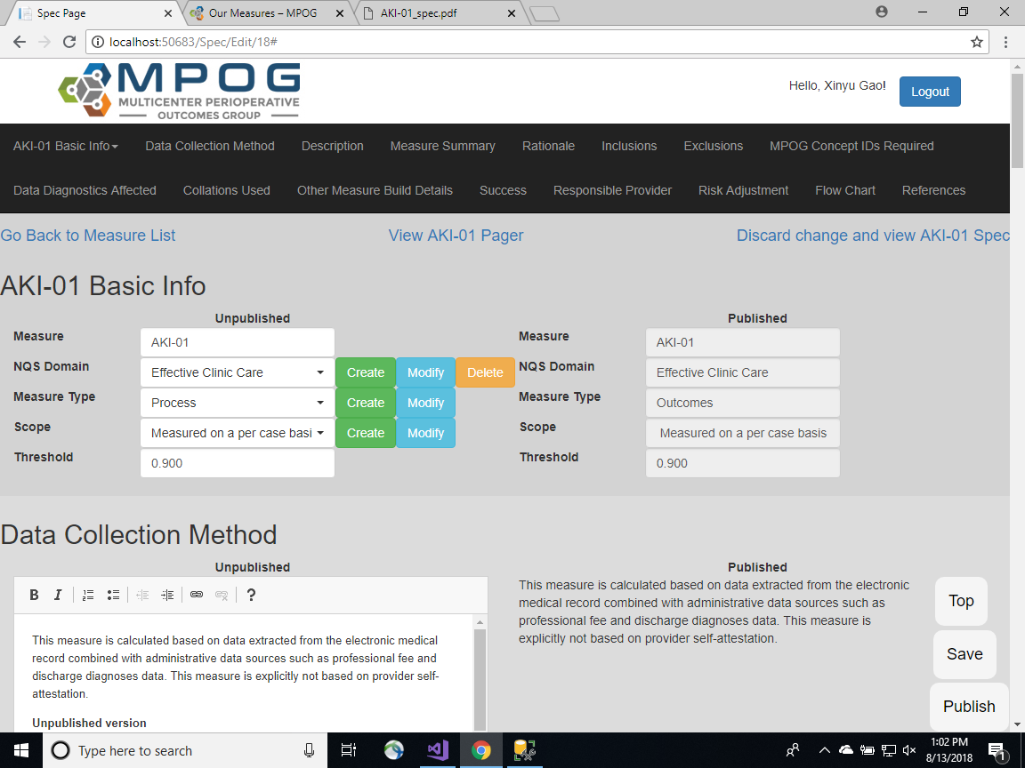
Private View-One Pager and Spec
Edit One Pager and Spec on the same page.
Notes:
But when we click edit to edit whether one pager or spec, we will be redirected to the same page for editing
The unpublished part can be edit while the published version is view-only.

Slide 16
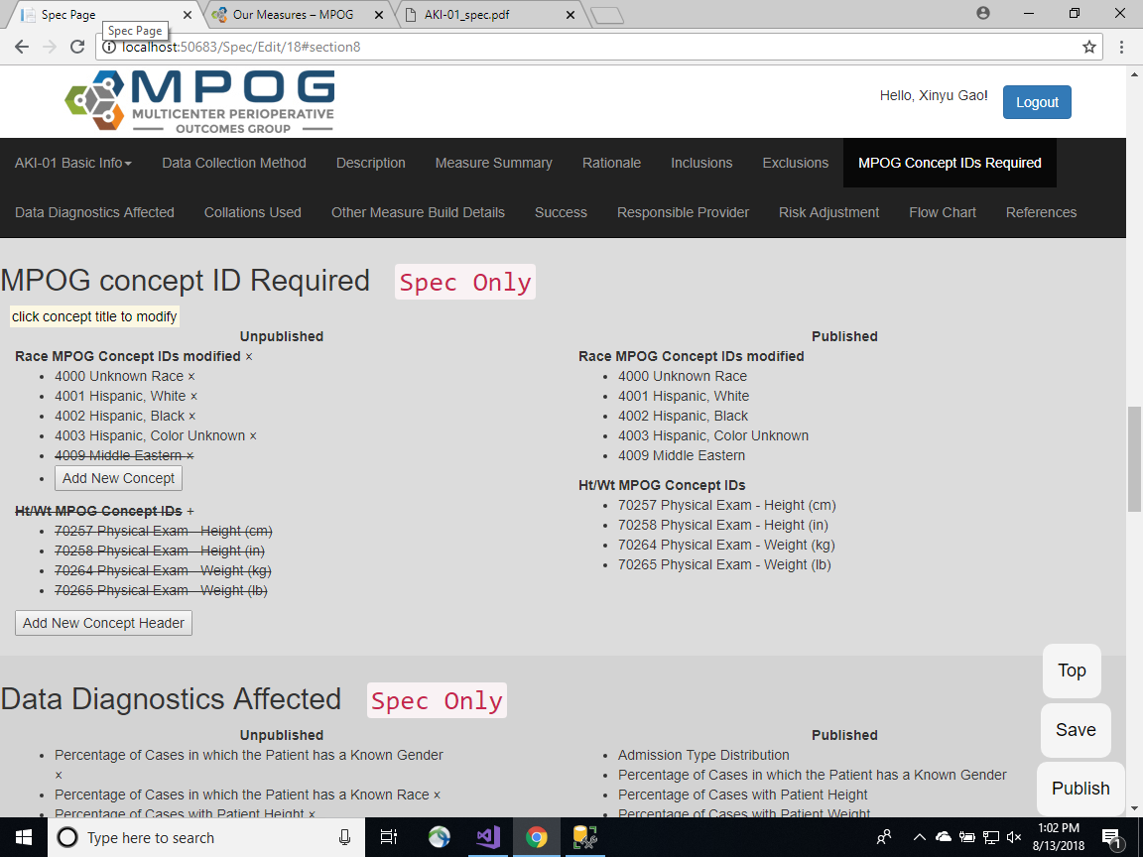
Private View-One Pager and Spec
Edit One Pager and Spec on the same page.
Notes:
As the one pager and spec share same editing page, all the sections that only belong to spec are marked as Spec only
And the top, save and publish buttons are fixed as we scroll down the page.

Slide 17
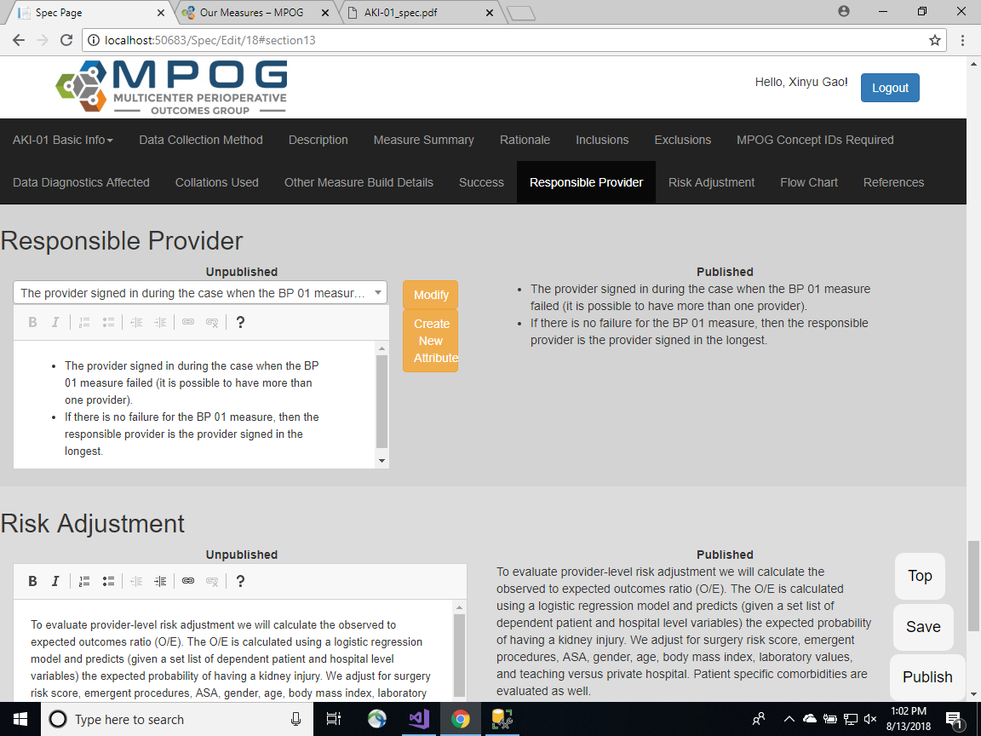
Private View-One Pager and Spec
Edit One Pager and Spec on the same page.
Save vs Publish
Notes:
The top button is the same as what we talked about before, which is jump to the top of the pager. And here comes the difference between save and publish:
If we click the save button, changes are saved but not published, but if we click the publish button, all the changes made are both saved and published

Slide 18
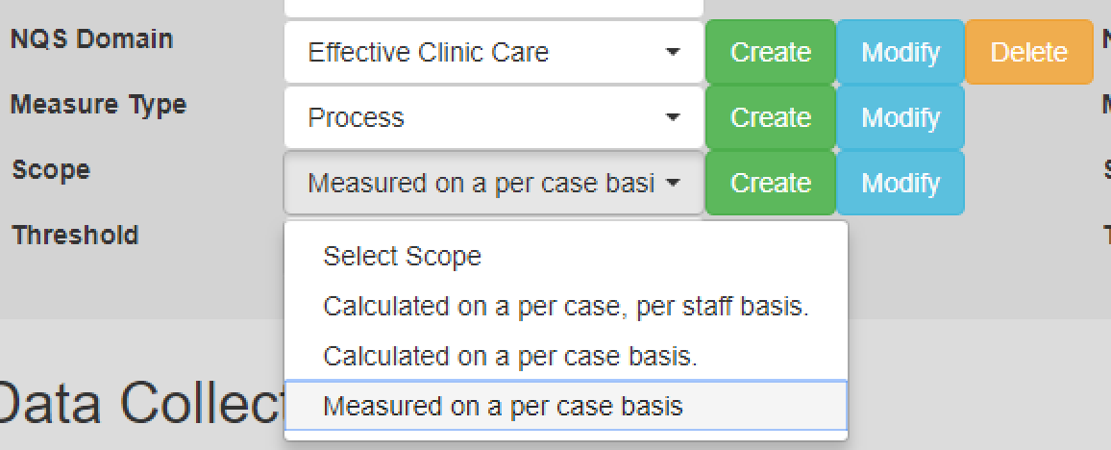
Sections with drop down list
NQS Domain/Measure Type/Scope
Notes:
For the fields with drop down list, like the nqs domain, measure type and scope, we can create and modify the content of the selected option.

Slide 19
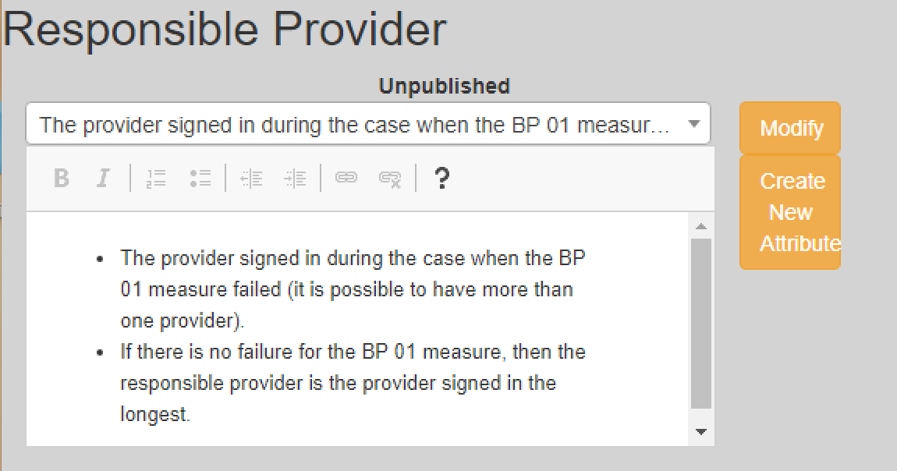
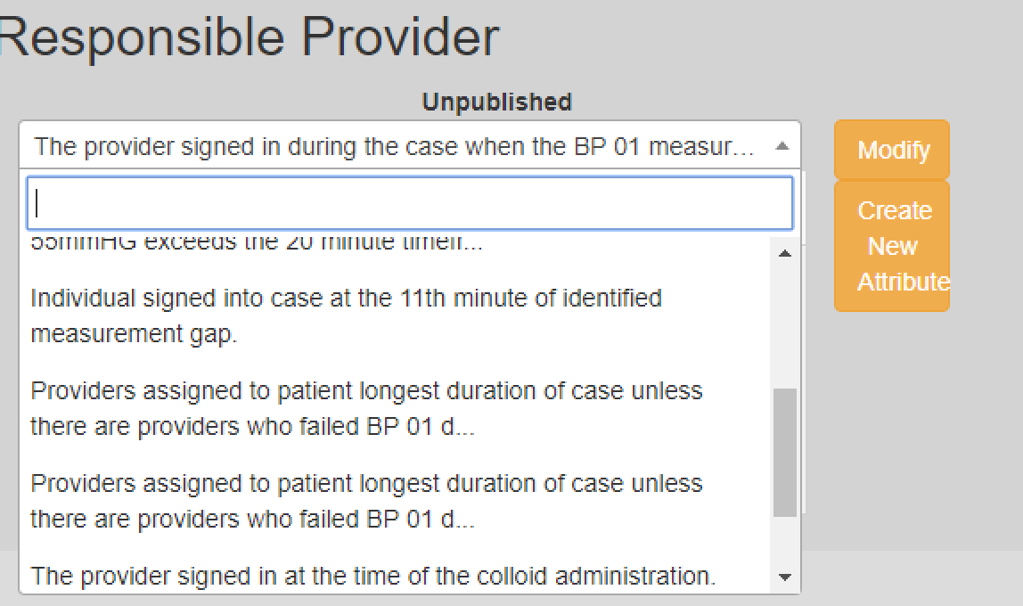
Sections with drop down list
Responsible Provider
Search bar
Notes:
For responsible provider, as the text of the responsible provider is usually much longer than that of the previous three sections, and there are more categories of responsible providers, we can do a search on this dropdown list to filter the specific option.

Slide 20
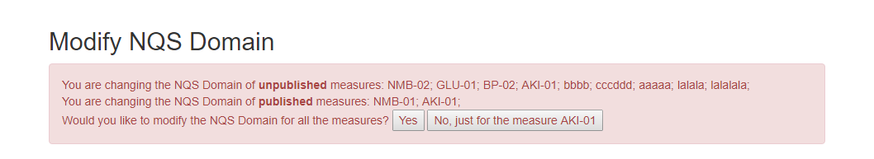
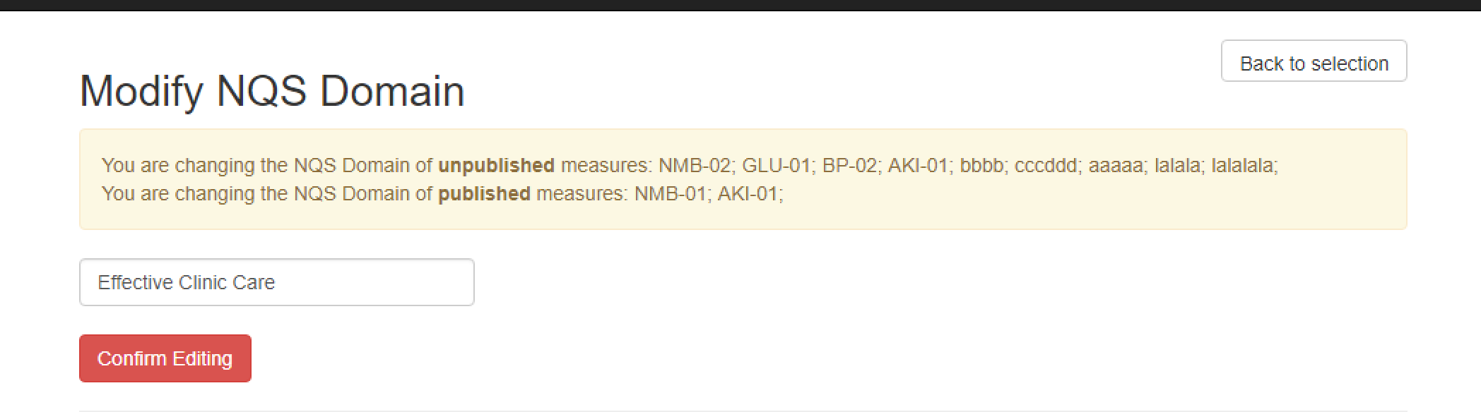
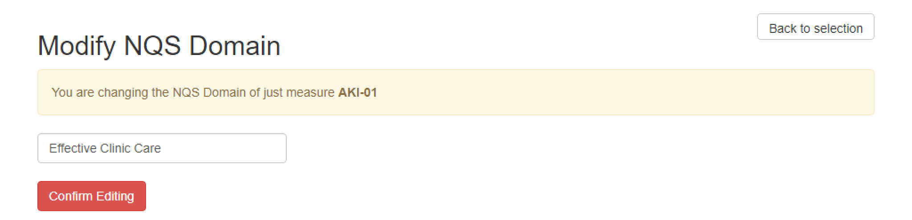
Modify Sections with drop down list
Change for all vs change only this one
Notes:
To modify the sections, we have two choices: take NQS domain as a example, we can change the domain for all measures that use this domain, or we can only change the domain for this specific measure. It's the same for other sections we talked about before.

Slide 21
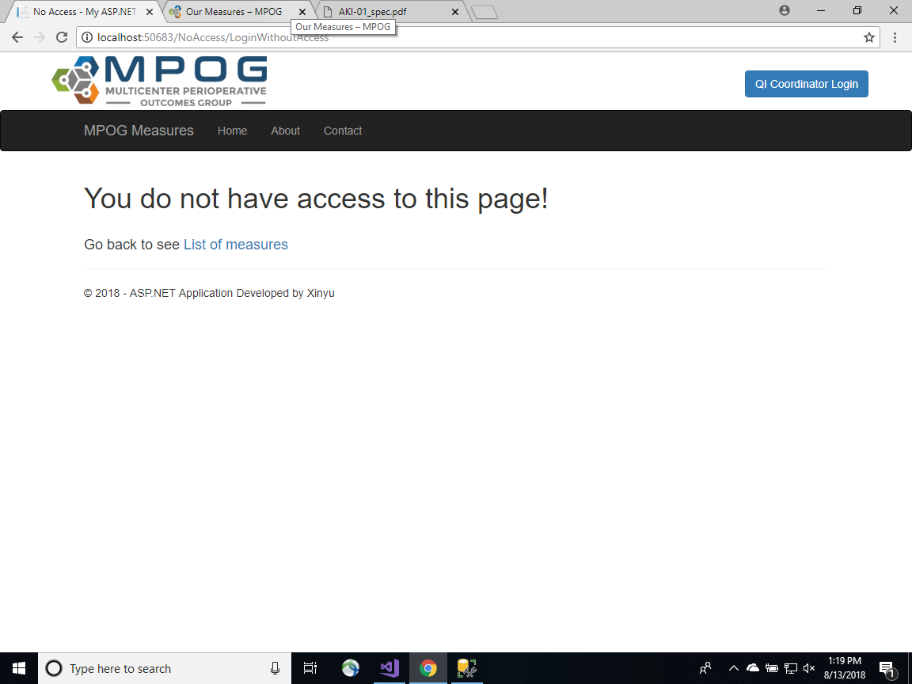
Permission
Enter the url for operations that need authentication:
Notes:
Last part is the permission issue. If some unauthenticated users use the same url as the url for QI coordinators, they will be redirected to this no access page, which will ensure the security of our web application.

Slide 22
Next Steps
Log
Clone measure
All the content of measure AKI 02 is the same as AKI 01
Marked difference between unpublished version and pubished version
Changed section | Previous content | Current Content | Changed User | Changed date | Published
Data collection method | aaaa | bbbb | Xinyu Gao | 08/05/2018 | Yes
Notes:
That's what I've got here, and there are still some features that I haven't finished
the first one is measure modification log, recording the updating log for each measure is very helpful for both QI coordinators and other viewers.
The second requirement is measure clone. For example, if the content of measure AKI02 is the same as AKI01 except the measure name, then it is very convenient for QI coordinators to click a clone button to copy all the content instead of manually copy paste each section.
The third feature that we would like to have is the marked difference between unpublished version and published version, so QI coordinators can see the difference clearly, especially when the text is very long.

Slide 23
What I learned
asp.net MVC framework
Frontend: JavaScript, HTML, CSS
Backend: C#
SQL Server database
Notes:
In this internship I learnt a lot, for example, I learnt to use asp.net MVC framework to quickly develop a web app.
I also used ... for front end programming and C# for backend programming. What's more, I learnt how to interact with SQL server database.

Slide 24
Questions?

Slide 25
Thank you!

