Slide 1
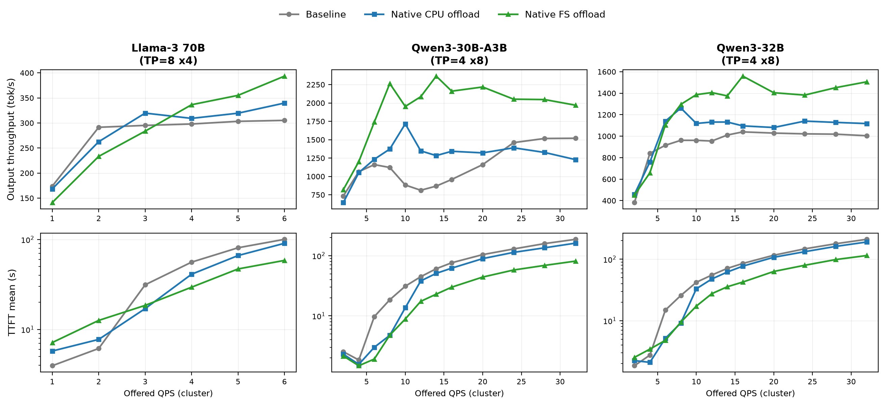
Tiered Prefix-Cache KV-Offloading on 32x Intel Arc Pro B60 - Baseline vs CPU vs FS
vLLM v0.26.0 - shared-prefix workload, Poisson load ladder - cluster-aggregate throughput / per-request latency
Key findings
Qwen3-30B-A3B - FS wins
- FS best across the full 2-32 ladder; +30% tok/s and -57% TTFT vs baseline at 32 QPS, ~85% tier-hit.
Qwen3-32B - FS wins
- FS best across the full 2-32 ladder; +50% tok/s and -46% TTFT vs baseline at 32 QPS, ~87% tier-hit.
Llama-3 70B - load-dependent
- Baseline best at light load (<=2 QPS): offload round-trip not yet amortized.
- FS wins from ~4 QPS up; +29% tok/s and -42% TTFT vs baseline at 6 QPS, ~68% tier-hit.
Bottom line
- Native FS offload is the recommended tier for sustained load on all three models.
- Benefit scales with offered load and prefix-reuse working set; PCIe-bound (no Xe-Link), so it pays off once recompute pressure exceeds transfer cost.

