Slide 1
Engineering Planning and Project Management
CEE 9510
Lecturer: Kevin McGuire P. Eng., M. Eng., PMP

Slide 2
Your instructor
UNB 1991
UWO 2006
PMP 2005
Construction in T.O. – 2 years
Siemens in London – 14 years (automotive)
Honeywell in London – 5 years (construction)
V.O.N. – 4 years
Fanshawe College connection
UWO Continuing Studies connection

Slide 3
The Course Outline
Lets take a few minutes and review the course outline so we all have the same understanding regarding this course.
What are your expectations?
How proficient is the group with Owl Sakai
Finalizing the course dates

Slide 4
You have a knack for engineering, but do you have a knack for PM work?
At this point in your academic careers, you have established that you are intelligent.
But do you have a feel for everything it takes to be successful in the workplace?
The Knack

Slide 5
Here is what it really takes to be a Project Manager….
Cat Herding & the Running of the Squirrels

Slide 6
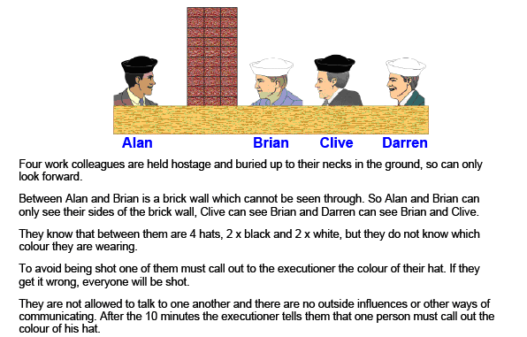
The best PM candidates in our class will solve this riddle the quickest….
Who calls out the color of their hat? I can tell you that the man in this group
of 4 who does shout it out is the best PM candidate. Why do I say that?

Slide 7
The Convoy Concept
This concept is finally taking hold in many of the more steadfast industries. We will discuss it briefly.
In particular doctors and engineers are seeing the benefit in professional project management in their activities. That can at times mean managing parts of the scientific research that have traditionally been looked at in only the most ad hoc manners.

Slide 8
What is a Project?
The best definition of this I have seen is:
A project is not a process. A project is a collection of tasks organized to have defined start and finish with the purpose of creating a product or service. It is an undertaking that is unique, temporary, and which will be progressively elaborated as it proceeds but which has a pre-defined set of objectives.

Slide 9
What are the objectives of Project Management work?
The first challenge of project management is to make sure that a project is delivered within defined constraints. (timing, resources, money)
The second, more ambitious challenge is the optimized allocation and integration of inputs needed to meet pre-defined objectives.

Slide 10
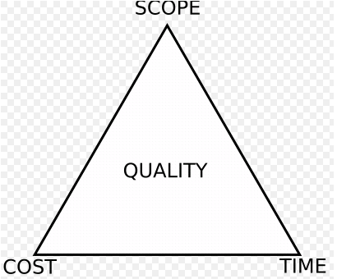
The Triple Constraint
The time constraint refers to the amount of time available to complete a project. The cost constraint refers to the budgeted amount available for the project. The scope constraint refers to what must be done to produce the project's end result (and not done).
These three constraints are often competing constraints: increased scope typically means increased time and increased cost, a tight time constraint could mean increased costs and reduced scope, and a tight budget could mean increased time and reduced scope.

Slide 11
Enterprise Environmental Factors
Enterprise environmental factors refer to both internal and external environmental factors that surround or influence a project’s success.
They can arise from any of the enterprises involved in the project and are generally an input to most planning processes.
Typical enterprise environmental factors include:
  Organizational culture, structure, and process
  Infrastructure
  Company work authorization systems
  Marketplace conditions
  Stakeholder risk tolerances
  Political climate
  Organization’s established communication channels
  Existing Human resources and personnel administration

Slide 12
The Role of the Project Manager
The project manager is the person assigned by the performing organization to achieve the project objectives.
He or she is different from the functional manager or operations manager for an area. Those individuals are focused on management oversight for an administrative area or are responsible for a facet of the core business.
In addition to authority by virtue of position, the project manager needs to possess the following characteristics:
  Knowledge – what the PM knows about project management
  Performance – what the PM can get done while applying their knowledge
  Personal – attitude, character, and leadership

Slide 13
Why are projects important?
The product life cycle shortens with improved efficiencies. Constant innovation is therefore required. Ad hoc efforts fail in the face of organized competition (e.g. electronics, automotive)
Product launch windows are narrow. (The concept of selling product A while developing product B)
Increasingly complex and technical products. (Consumer demand)

Slide 14
Why are projects important?
Emergence of global markets (Canada these days is more and more a medium tech country often fulfilling the role of integrating the high technology of Germany, Japan and the USA with cost effective labor markets)
We are in a sustained economic period of low inflation. (Low inflation limits corporations from raising prices to increase profits. The only other option is managing costs)

Slide 15
Big Time Project Management – Portfolio Management
A portfolio refers to a collection of projects or programs that are grouped together to facilitate effective management of that work to meet strategic business objectives.
Example is infrastructure firm that groups its similar infrastructure projects together to facilitate managing for a “best return on investment” Example all wind projects grouped together in a program, all solar grouped together in another program, all roads grouped together in a third. The manager of all these programs is the portfolio manager.
Portfolio management refers to the central alignment of one or more portfolios. It focuses on ensuring alignment of projects with organizational strategies.

Slide 16
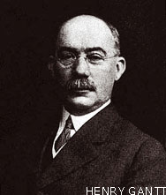
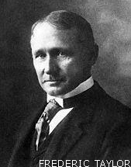
Project Management – A Chronology
As a discipline, project management developed from different fields of application including construction, engineering, and defense.
In the United States, the forefather of project management is Henry Gantt . He is best remembered for the development of the Gantt chart and contributing to the early development of work breakdown structure tools. His most important contributions occurred between 1910 and 1920.
Even more fundamental in the development of project management was Frederick Winslow Taylor. In his paper The Principles of Scientific Management in 1911 Taylor argued that decisions based upon tradition and rules of thumb should be replaced by precise procedures developed after careful study of an individual at work.
Scientific management is a method in management theory which determines changes to improve labor productivity and its detailed application in the workplace led to - for the first time - application of charts to plan and track projects as workers efforts became standardized.

Slide 17
Project Management in the modern era
Prior to the 1950s, projects were managed on an ad hoc basis using mostly Gantt Charts.
In the 1950's CPM (Critical Path Method) developed as a joint venture by both DuPont Corporation and Remington Rand Corporation for managing plant maintenance projects.
The PERT chart (Program Evaluation and Review Technique), an important derivative of the Gantt chart was developed by Booz Allen Hamilton Inc. & Lockheed Corp. in 1958 for the Polaris nuclear submarine program.
In 1969, the Project Management Institute (PMI) was formed to serve the interest of the project management industry. The premise of PMI is that the tools and techniques of project management are common even among the widespread application of projects from the software industry to the construction industry.

Slide 18
Taylor's Principles of Scientific Management
Replace rule-of-thumb work methods with methods based on a scientific study of the tasks.
Scientifically select, train, and develop each employee rather than passively leaving them to train themselves.
Detailed instruction and supervision of each worker in the performance of that worker's discrete task.
Divide work nearly equally between managers and workers, so that the managers apply scientific management principles to planning the work and the workers actually perform the tasks
These 4 principles proposed by Taylor standardized the way any employee's work effort could be evaluated. They paved the way for planning time and resource allocation tool development – Gantt & PERT etc.

Slide 19
Scientific Management General Approach
Select workers with appropriate abilities for each job.
Train each for a standard task.
Plan work and eliminate work interruptions.
Apply wage incentives for increase output

Slide 20
Scientific Management Basic Elements
Labor is defined and authority/responsibility is legitimized / official
Positions placed in hierarchy and under authority of higher level
Selection is based upon technical competence, training or experience
Actions and decisions are recorded to allow continuity and memory
Management is different from ownership of the organization
Managers follow rules/procedures to enable reliable/predictable behavior

Slide 21
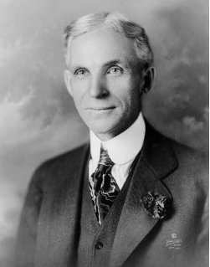
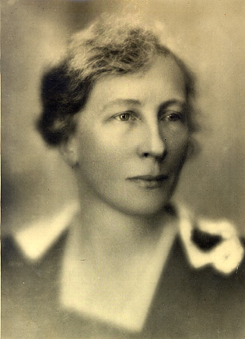
Players in the History of Project Management
Henry Ford's mass production of large numbers of inexpensive automobiles using the moving assembly line coupled with high wages for his workers is known as Fordism. (Cars were available in any color as long as it was black)
Frank and Lillian Gilbreths were scientists who sought to teach managers that all aspects of the workplace should be constantly questioned, and improvements constantly adopted. Their emphasis on the "one best way" predates the development of continuous quality improvement (CQI). The late 20th century understanding that repeated motions can lead to workers experiencing repetitive motion injuries is also attributed to their pioneering work. (Frank Gilbreth was also the first to propose that a surgical nurse should hand instruments to the surgeon as called for – saving arguably millions of lives by applying better motion management to a problem). Motion studies therefore became complemented to time studies – ironically borrowed from the construction industry.
Henry Ford 1863-1947
Lillian Gilbreths 1878-1972
Notes:
Ford industrialization drives need for projects from himself and his competitors. Ford is one of the first industrialists to work with such high capital costs that

Slide 22
Scientific Management – A Chronology
Scientific management was the first attempt to systematically treat management and process improvement as a scientific problem.
Scientific management contributed to vastly better industrial process management.
With the advancement of statistical methods, the scientific management approach was improved and became referred to as quality control in 1920s and 1930s.
During the 1940s and 1950s, the body of knowledge for doing scientific management evolved into Operations Research and management cybernetics.
. In the 1980s we had total quality management then, in 2007 Six Sigma and Lean manufacturing can be seen as new names for scientific management.
Shigeo Shingo, one of the creators of Lean Management who devoted his life to scientific management, says that the Toyota Production System and Japanese management culture in general should be seen as scientific management.

Slide 23
Selected Well Known Scientific Management Concepts
cybernetics: Its focus is how anything (digital, mechanical or biological) processes information, reacts to information, and changes or can be changed to better accomplish the first two tasks
Six Sigma is a set of practices originally developed by Motorola to systematically improve processes by eliminating defects. It asserts that:
1) Continuous efforts to reduce variation in process outputs is key to business success.
2) Manufacturing and business processes can be measured, analyzed, improved and controlled.
3) Succeeding at achieving sustained quality improvement requires commitment from the entire organization, particularly from top-level management
Lean Manufacturing: Derived from Toyota best practices it is dedicating to reducing waste by now famous methods such as kanban, kaizen, poke-yoke, usage of just in time automation etc.

Slide 24
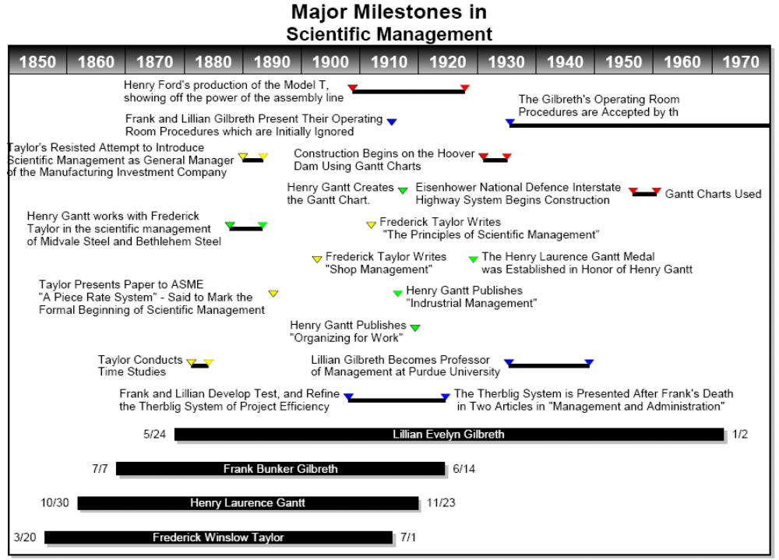
Notes:
Read therblig on wikipedia

Slide 25
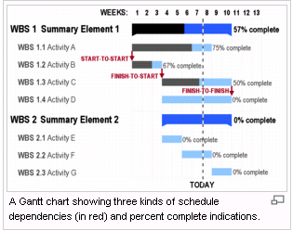
Gantt Chart

Slide 26
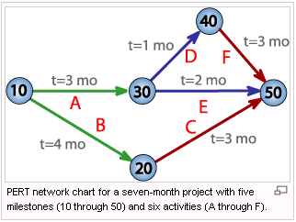
PERT Chart

Slide 27
Work Breakdown Structure
A Work Breakdown Structure (WBS) is a fundamental project management technique for defining and organizing the total scope of a project, using a hierarchical tree structure.
The first two levels of the WBS (the root node and Level 2) define a set of planned outcomes that collectively and exclusively represent 100% of the project scope
A well-designed WBS describes planned outcomes instead of planned actions.
A well-designed WBS makes it easy to assign any project activity to one and only one terminal element of the WBS.

Slide 28
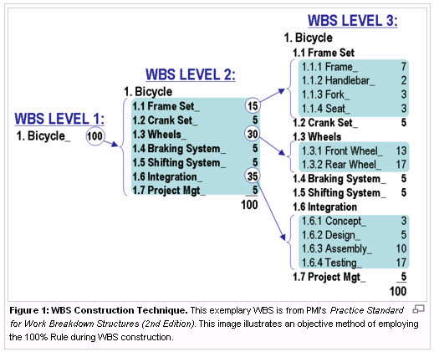
Work Breakdown Structure

Slide 29
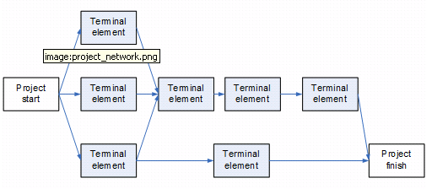
Network Diagrams
The work breakdown structure or the product breakdown structure show the "part-whole" relations. In contrast, the project network shows the "before-after" relations.

Slide 30
Mass Production Methods
Mass production is ideally suited to serve large, relatively homogeneous populations of consumers, whose demand would satisfy the long production runs required by this method of manufacturing.
Mass production is capital intensive, as it uses a high proportion of machinery in relation to workers.
The machinery that is needed to set up a mass production line is so expensive that there must be some assurance that the product is to be successful so the company can get a return on its investment.
As a consequence mass production projects require clear understanding of the consumer (marketing) as well as careful implementation planning (project management).

Slide 31
Selected Mass Production Benchmarks in History
During the renaissance the Venice arsenal would produce 1 ship per day. 16,000 people were employed.
In the 1400's Johannes Gutenberg published the Bible.
During the Industrial Revolution the Portsmouth Block Mills manufactured ships pulleys for the British Navy
During the 1860's the Springfield Armory began mass producing guns using interchangeable parts.
Mass production improved the day to day quality of consumer's lives and generated a desire for more unique and complex products. Increasingly more sophisticated derivatives of modern project management were used to deliver on these desires.

Slide 32
Project Management Governing Bodies
The Project Management Institute (PMI), incorporated in 1969, was founded by five volunteers, with its headquarters in Newtown Square, outside Philadelphia, Pennsylvania. It has published a number of standards related to project management, and manages several levels of project management certification.
The standard Project Management Body of Knowledge (PMBOK) guide, currently in its third edition, is the only ANSI standard for project management.
There is presently no ISO project management standard, but the International Project Management Association in co-ordination with PMI is in the process of writing one.
As of 2006, PMI reported over 220,010 members and over 180,000 PMP certificants in 175 countries.

Slide 33
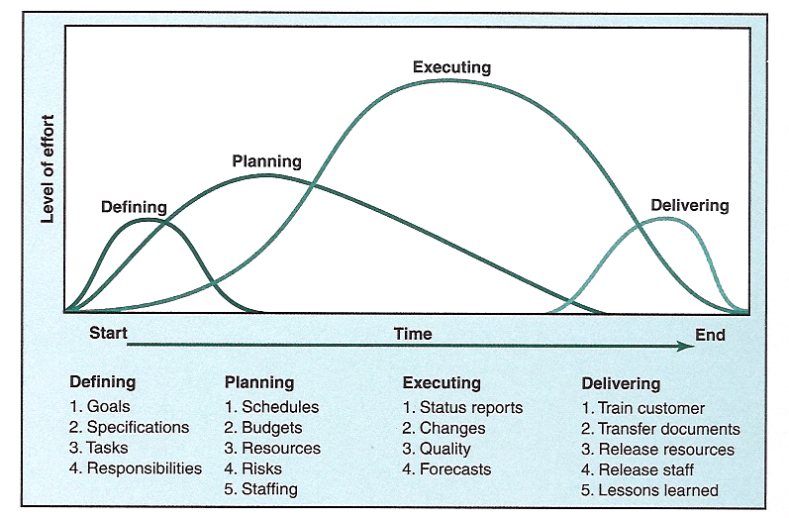
Initiating, Planning, Executing, Controlling, and Closing

Slide 34
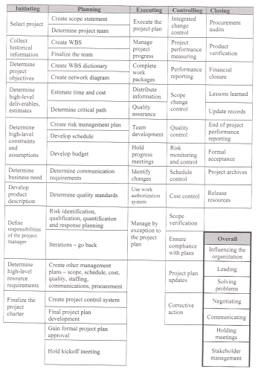
Project Activities

Slide 35
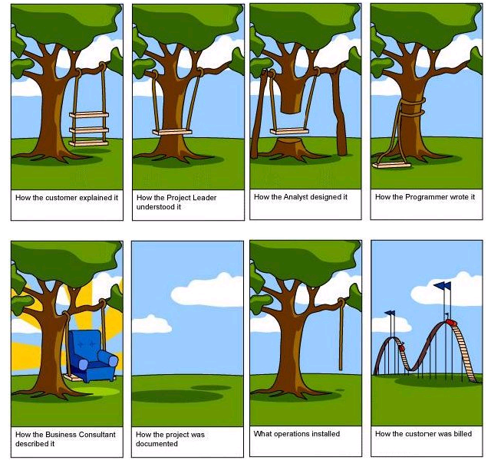
Project Communication is Vital

Slide 36
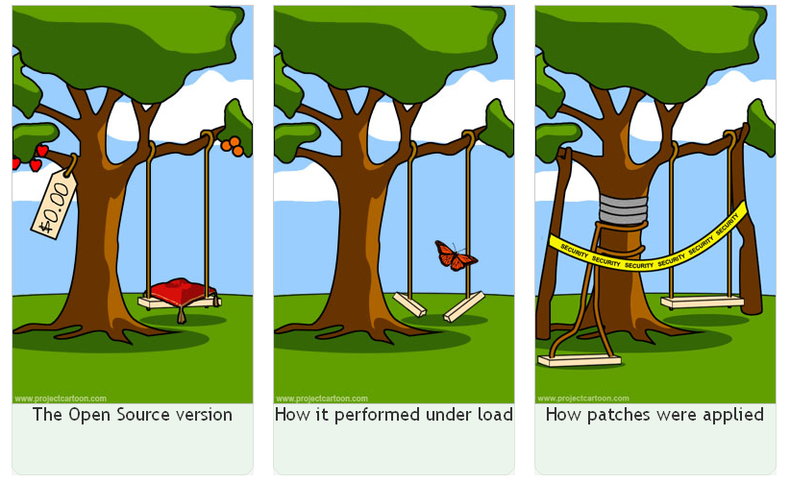
Project Communication is Vital

Slide 37
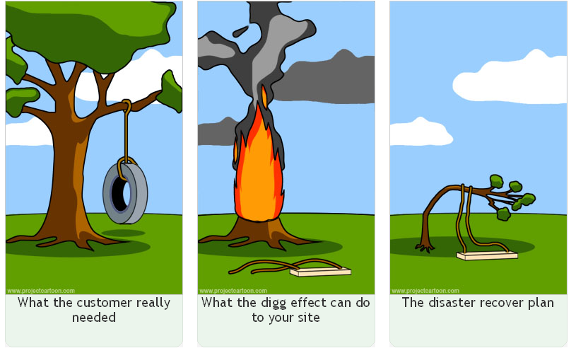
Project Communication is Vital

Slide 38
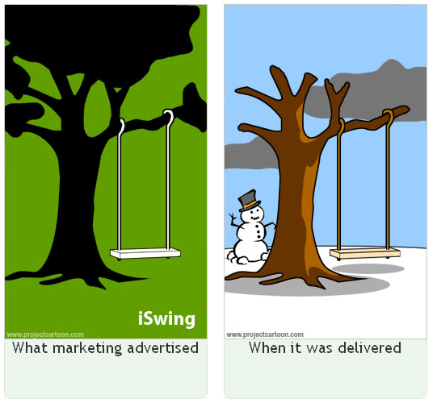
Project Communication is Vital

Slide 39
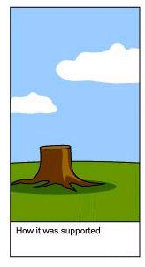
Project Communication is Vital

Slide 40
The 2009 Polish Conference
Greatest benefits of formal PM practices identified and summarized in report.
Intangible benefits are what customers see, and they are very attracted to them.
Lets go through the curb and pavement example

Slide 41
Future Trends in Project Management
An increase in the scope of project management and system integration. (Driven by the downsizing of middle management and its replacement by project management).
  strategic as opposed to tactical
  increased PM responsibility via flat organizations
  companies far more project oriented
Increasing discipline in the way projects are managed.
  standardization via enterprise project management
  standardization via external review techniques – Project management office.
More multicultural projects (The value of Spanish and Mandarin now as well as French) .
Greater Risk management emphasis
More outsourcing of projects to expert project management companies.

Slide 42
Project Manager vs. Manager
PM’s generally are entry level management positions.
Except in highly projectized organizations, PM’s typically do not have “ownership” of the employees they apply.
Again except in functional organizations PM’s do not do salary reviews, schedule vacation, or dole out discipline. This is the job of the manager.
Project Managers are typically privy to significant amounts of confidential information, both human resource and financial related. This is similar to managers financially, but wrt personel, the access is more tightly controlled.
The project manager does more than 90% of the day to day management of the employee typically. This includes setting priorities for the group and following up on them.

Slide 43
Project Stakeholders
All suppliers, customers, colleagues, sponsors, experts, interested outside influences are project stakeholders and it is the PM’s job to manage all of them.
Without total stakeholder satisfaction, the project is measured as a failure. This is an important distinction, and it explains why the Project Management Institute generally quotes a figure of only 26% of projects being classified as successes. Certainly in the great majority of cases the good or service was delivered as expected, but due to stakeholder dissatisfaction success cannot be claimed. Interestingly the figure drops to only 10% for pharmaceutical trial projects.

Slide 44
Project Management in London
Many industries use professional project management practices in London as evidenced by the 400+ members of the Project Management Institute residing locally.
PMI SWOC or PMI Southwestern Ontario Chapter is an active group that advocates for the market penetration of professional project management practices here in London.
They along with other organizations such as Fanshawe College and UWO provide education for the practitioners in our area.
Many companies and in fact many sectors do not appear to be as highly evolved as others. This reflects a well know maturity gap in project management methods at different firms. One of the purposes of this course is to add to the commonality of practices locally.

Slide 45
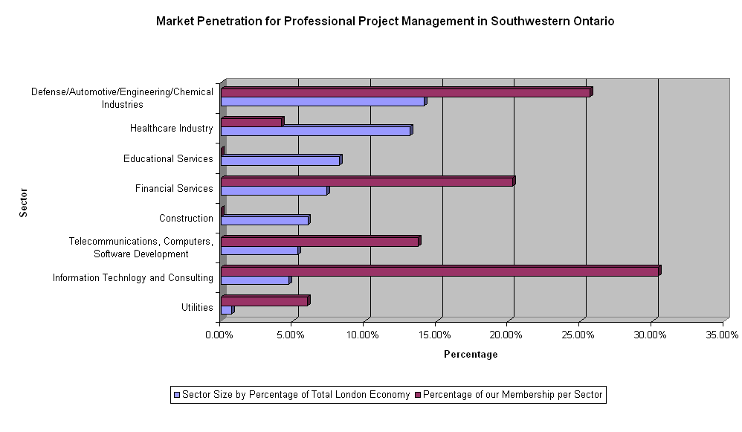
Project Management in London

Slide 46
Project Management in London
All 3 of these sectors are significantly projectized, frequently deploying matrix business organizations. The best way to organize Project Management is through a PM Office.

