Slide 1
Engineering Planning and Project Management
Lecture 10
Communication Management

Slide 2
Williams Machine Tool Company (mechanical)– Can communication break through a culture of laziness?
Split up into your groups and read the handout from Best Practices in Project Management P 145 and P 146. then answer the following question:
Faced with this level of apathy and laziness, what communication strategies can you employ as a manager to get your point across? Can a PM fulfill this function as well? Why/why not?

Slide 3
Brig. General Henry Martyn Robert – author of Robert’s Rules of Order
While codes of parliamentary procedure in the English speaking world can generally be traced back to the British parliament, they were first written down for American application by Union Army Brigadier General Henry Martyn Robert in 1876.
Subsequently they have come to be largely accepted in certain circles of the Canadian business community.
They are not typically applied in working level engineering or even project management meetings, but as your career evolves and develops, you are likely to run into them somewhere.
Their purpose is to allow for the correct information to be presented, debate to flow naturally, and time to be managed effectively. Some meetings would never end without them!

Slide 4
Robert’s Rules of Order
Also sometimes referred to as the rules of parliamentary procedure. A derivative is used in the Canadian House of Commons.
You are likely to use these rules at meetings during your career if you serve on PEO type committees, serve on not-for-profit boards of directors, or successfully negotiate your way up to the director level and beyond in the business community.
Like demonstrating good manners, maturity, or having an engaging mind, the ability to use the rules can be a mark of class in the workplace.
While most of you will not have exposure early in in your careers, it is worth learning the procedures, because when you opportunity first presents itself, you want to be able to go with the flow.

Slide 5
Robert’s Rules – The Flow of Order
Obtain the floor (the right to speak) by being the first to stand when the person speaking has finished; state Mr./Madam Chairman. Raising your hand means nothing, and standing while another has the floor is out of order! Must be recognized by the Chair before speaking!
Debate can not begin until the Chair has stated the motion or resolution and asked "are you ready for the question?" If no one rises, the chair calls for the vote!
Before the motion is stated by the Chair (the question) members may suggest modification of the motion; the mover can modify as he pleases, or even withdraw the motion without consent of the seconder; if mover modifies, the seconder can withdraw the second.
The "immediately pending question" is the last question stated by the Chair! Motion/Resolution - Amendment - Motion to Postpone

Slide 6
Robert’s Rules – The Flow of Order (cont.)
The member moving the "immediately pending question" is entitled to preference to the floor!
No member can speak twice to the same issue until everyone else wishing to speak has spoken to it once!
All remarks must be directed to the Chair. Remarks must be courteous in language and deportment - avoid all personalities, never allude to others by name or to motives!
The agenda and all committee reports are merely recommendations! When presented to the assembly and the question is stated, debate begins and changes occur!

Slide 7
Robert’s Rules of Order – What good are they?
Robert’s Rules of Order provide for common rules and procedures of deliberation and debate in order to place the whole membership on the same footing and speaking the same language. The conduct of ALL business is controlled by the general will of the whole membership - the right of the deliberate majority to decide. Complementary is the right of at least a strong minority to require the majority to be deliberate - to act according to its considered judgment AFTER a full and fair "working through" of the issues involved. Robert's Rules provides for constructive and democratic meetings, to help, not hinder, the business of the assembly. Under no circumstances should "undue strictness" be allowed to intimidate members or limit full participation.

Slide 8
Robert’s Rules of Order
Point of Privilege: Pertains to noise, personal comfort, etc. - may interrupt only if necessary!
Parliamentary Inquiry: Inquire as to the correct motion - to accomplish a desired result, or raise a point of order
Point of Information: Generally applies to information desired from the speaker: "I should like to ask the (speaker) a question."
Orders of the Day (Agenda): A call to adhere to the agenda (a deviation from the agenda requires Suspending the Rules)
Point of Order: Infraction of the rules, or improper decorum in speaking. Must be raised immediately after the error is made

Slide 9
Robert’s Rules of Order (cont.)
Main Motion: Brings new business (the next item on the agenda) before the assembly
Divide the Question: Divides a motion into two or more separate motions (must be able to stand on their own)
Consider by Paragraph: Adoption of paper is held until all paragraphs are debated and amended and entire paper is satisfactory; after all paragraphs are considered, the entire paper is then open to amendment, and paragraphs may be further amended. Any Preamble can not be considered until debate on the body of the paper has ceased.
Amend: Inserting or striking out words or paragraphs, or substituting whole paragraphs or resolutions
Withdraw/Modify Motion: Applies only after question is stated; mover can accept an amendment without obtaining the floor

Slide 10
Robert’s Rules of Order (cont.)
Commit /Refer/Recommit to Committee: State the committee to receive the question or resolution; if no committee exists include size of committee desired and method of selecting the members (election or appointment).
Extend Debate: Applies only to the immediately pending question; extends until a certain time or for a certain period of time
Limit Debate: Closing debate at a certain time, or limiting to a certain period of time
Postpone to a Certain Time: State the time the motion or agenda item will be resumed
Object to Consideration: Objection must be stated before discussion or another motion is stated

Slide 11
Robert’s Rules of Order (cont.)
Lay on the Table: Temporarily suspends further consideration/action on pending question; may be made after motion to close debate has carried or is pending
Take from the Table: Resumes consideration of item previously "laid on the table" - state the motion to take from the table
Reconsider: Can be made only by one on the prevailing side who has changed position or view
Postpone Indefinitely: Kills the question/resolution for this session - exception: the motion to reconsider can be made this session
Previous Question: Closes debate if successful - may be moved to "Close Debate" if preferred

Slide 12
Robert’s Rules of Order (cont.)
Informal Consideration: Move that the assembly go into "Committee of the Whole" - informal debate as if in committee; this committee may limit number or length of speeches or close debate by other means by a 2/3 vote. All votes, however, are formal.
Appeal Decision of the Chair: Appeal for the assembly to decide - must be made before other business is resumed; NOT debatable if relates to decorum, violation of rules or order of business
Suspend the Rules: Allows a violation of the assembly's own rules (except Constitution); the object of the suspension must be specified

Slide 13
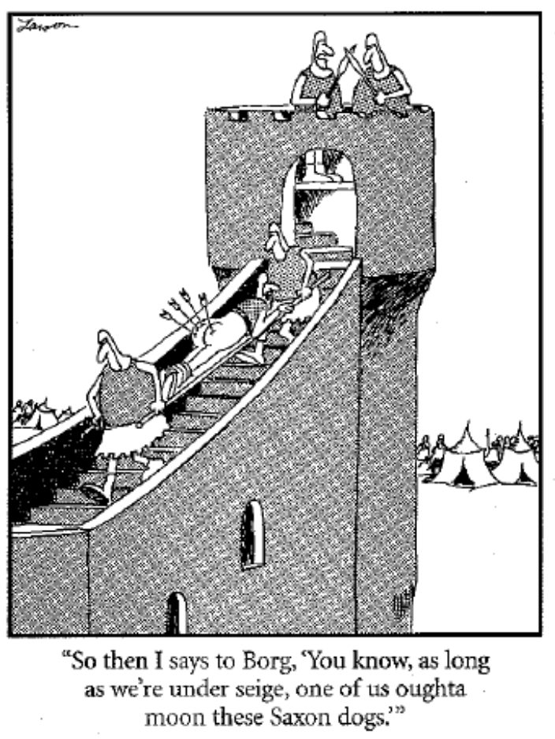
Conflict Management and Resolution

Slide 14
Conflict Management
Conflict is a process that begins when you perceive that someone has frustrated or is about to frustrate a major concern of yours.
Conflict contains a dynamic aspect. Conflicts evolve.
Further, the one time causes of a conflict may change over time. The reasons why two individuals or groups developed a conflict initially may no longer have any validity – but they are still stuck in conflict.
Because conflict is dynamic and evolving, once a conflict has occurred, the reasons behind it may no longer matter.
Conflict is perceptual in nature. In other words it doesn't really matter if one party wronged the other or not, so long as one party perceives the wronging to have occurred.

Slide 15
Goal Oriented Conflict
This type of conflict is associated with:
disagreements regarding end results desired
project scope outcomes
performance specifications and criteria
project priorities and objectives
It is fueled by vague or incomplete goals that allow project members to make their own interpretations.
Often this type of conflict brings to light the hidden agenda that individual team members might have regarding their role in the project and how they perceive their ideal role in the work ahead.

Slide 16
Administrative Conflict
This type of conflict is associated with:
management hierarchy
organizational structure
company philosophy
They often center on who has authority or administrative control for functions, project tasks, and decisions.
Matrix organizational structures frequently breed this type of conflict due to the fact that each team member has two bosses.

Slide 17
Interpersonal Conflict
These types of conflicts are associated with personality differences among project team members or may even involve other stakeholders.
Interpersonal conflict sources include:
different work ethics
different behavioral styles
egos
personalities that do not mesh easily

Slide 18
How Conflict is Perceived and Addressed
There are three schools of thought regarding conflict. They are:
traditional
behavioral
interactionist
These 3 schools of thought vary dramatically in terms of how they view conflict, and how it should be dealt with.

Slide 19
The Traditional View of Conflict
The Traditionalist view of conflict is to view it as having a negative effect on organizations.
Those that adhere to this theory perceive all conflict to be bad. They believe that when conflict occurs it should be resolved as quickly and painlessly as possible.
The emphasis of traditionalists is conflict suppression and elimination.
This type of conflict management can have a very strong cultural bias. Japanese business practices frequently promote this type of conflict resolution where saving face is a prime consideration.

Slide 20
The Behavioral View of Conflict
Behavioralists regard conflict as a natural and inevitable part of organizational life.
Different points of view among functional departments including their having differing goals, attitudes, and beliefs are natural and permanent states among members of a company.
Behavioralists' solution for conflict is to accept it and manage it effectively rather than try to eliminate or suppress it.

Slide 21
The Interactionist View of Conflict
Interactionists, like behaviorists, believe that conflict is inevitable.
However, interactionists see conflict as a benefit to an organization, and actually encourage a controlled amount of it to develop.
Conflict in this view is seen to prevent an organization from becoming stagnant
Conflict is theorized to introduce an element of tension that produces innovation, creativity, and higher productivity.
Interactionists see a balance in conflict being required where too little leads to inertia and too much leads to chaos.

Slide 22
Sources of Conflict in the Project
Project conflict arises out of multiple sources including but not limited to:
violations of group or organizational norms
disagreement over project goals
personal slights and threats to job security
ambition and ego
etc...........
These can generally be summarized by dividing them into 2 separate types:
Organizational causes
Interpersonal causes

Slide 23
Organizational Causes of Conflict
Some of the more common causes of organizational conflict include:
reward systems
scarce resources
uncertainty
different mind sets among departments

Slide 24
Organizational Causes of Conflict – Reward Systems
Reward systems are competitive processes some organizations have set up that pit one group or functional department against another.
As an example, when functional managers are evaluated on the performance of their sub-ordinates within the department, they are loath to allow their best workers to become involved in project work for any length of time. In these cases typically the functional manager reserves his best workers for department work, and makes his lesser performers available for project work. This also creates a justifiable tension between the project manager and the functional manger whom he perceives as putting his interests ahead of the organization.

Slide 25
Organizational Causes of Conflict – Scarce Resources
Organizations are typically characterized by several different groups vying for access to the same resources at any given time.
As long as scarce resources are the natural state within organizations, groups will be in conflict as they seek to gain an advantage in their distribution.

Slide 26
Organizational Causes of Conflict - Uncertainty
In the project environment of a weak matrix company, it is easy to see how it can be unclear who may be in charge of any particular task as the lines for the formal channels of authority are blurred.
Project managers and their teams can find themselves in the fragile position of having a lot of autonomy, but also responsibility to the functional heads that provide the resources.
Generally when an employee is in this state of organizational conflict by structural definition, the employee will most likely side with the 1 of the 2 nominal "bosses" he or she has that has "power of the performance appraisal". In other words the one who has has the greatest immediate impact on the employee's pay cheque.

Slide 27
Organizational Causes of Conflict
-Different mind sets among departments-
Different mind sets develop among different functional departments because they have different primary interests. Marketing cares about sales, finance cares about margins, R&D cares about the product content etc.;
What is interesting is that typically new members of a functional group adopt the attitudes and outlook prevailing within the group. Thus if there are biases against finance as "bean-counters", or R&D guys as being unlimited in their desire to add cost via product features, these prevailing attitudes are perpetuated.

Slide 28
Interpersonal Causes of Conflict
Some of the more common causes of interpersonal conflict include:
misconceptions regarding the behavior of others
faulty communication
personal grudges

Slide 29
Interpersonal Causes of Conflict
-misconceptions regarding the behavior of others-
When people perceive their interests have been thwarted by another individual or group they can sometimes suspect a hidden agenda or personal vendetta.
Sometimes it is paranoia, and sometimes it is not. Often people will think that others are simply doing what is most politically or personally expedient for them.
Sometimes the position is "he or she doesn't like me or he or she doesn't understand". This is often used as a defense mechanism when people cannot see that 2 reasonable people can look at the same situation and draw different conclusions.
Most of us like the safe defense mechanism because it allows for us to not challenge ourselves with the possibility that others might be correct and there could be a flaw in our logic.
People with weak egos most often fall into this trap.

Slide 30
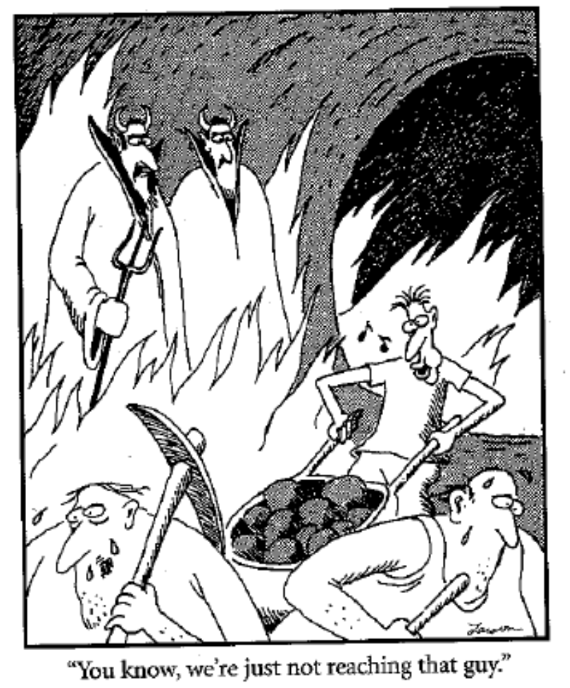

Slide 31
Interpersonal Causes of Conflict
-Faulty Communication-
This conflict is often caused by communicating in a manner that is ambiguous resulting in different interpretations.
It can also be caused by differing values related to unintentionally communicating in ways that anger or annoy other parties. Some team members can handle tough love type conversations and respond with improved performance. Others will see it as destructive or unfair. It is important to note that in this case it is not so much the content of the communication as the style.

Slide 32
Interpersonal Causes of Conflict
-personal grudges-
These attitudes arise out of long term experiences or lessons taught at some time in the past.
Often these attitudes can be sub-consciously held.

Slide 33
Sources of Conflicts in Projects and their Ranking by Intensity Level
In order below, based upon data from PMBOK, are the most common sources of project conflict:
schedules
project priorities
resources
technical opinions
administrative procedures
cost
personality
PMBOK takes their data from various sources beyond the 2 studies referenced in the text. As such you will notice a slight reordering from our text reference.
Many project managers think that personality is the main cause of conflict on projects. It only becomes personality when the root cause of the conflict is not resolved. Personality is very frequently the first diagnosis.

Slide 34
Methods of Conflict Resolution
As published in PMBOK, the main problem solving techniques for conflict resolution in project management are:
Confronting (Solving the real problem)
Compromising (Finding solutions that bring some degree of satisfaction to both parties)
Withdrawal or Avoidance (Retreating or Postponing a decision)
Smoothing (Emphasizing areas of agreement rather than differences of opinion)
Forcing (Pushing one viewpoint at the expense of another)
These techniques comprise a stronger set than that proposed by the course text.

Slide 35
Methods of Conflict Resolution
First among these methods is confronting the source of conflict wherever possible.

Slide 36
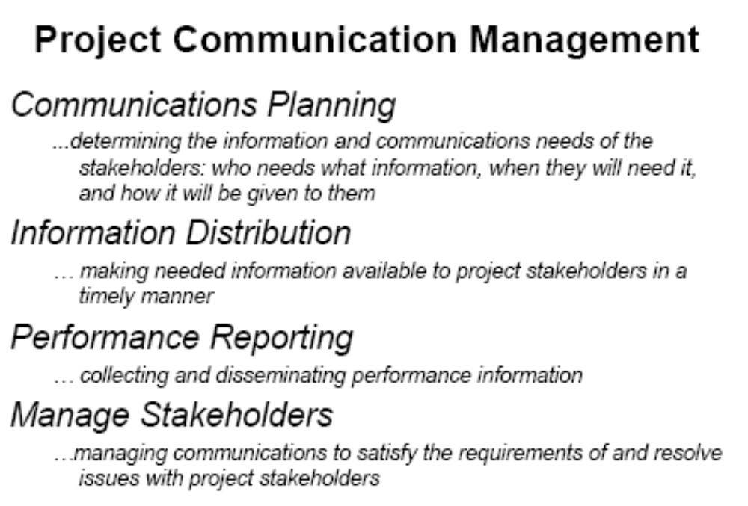
Communication Processes in PMBOK

Slide 37
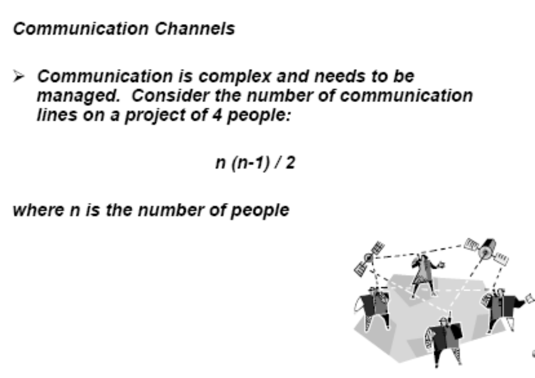
Communication models

Slide 38
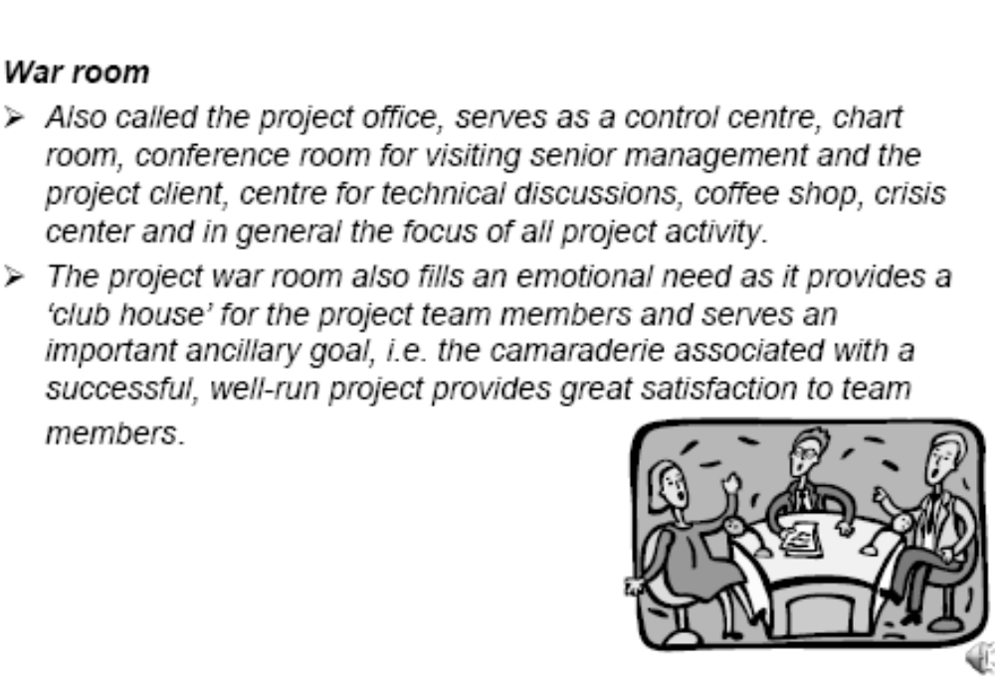
The War room

Slide 39
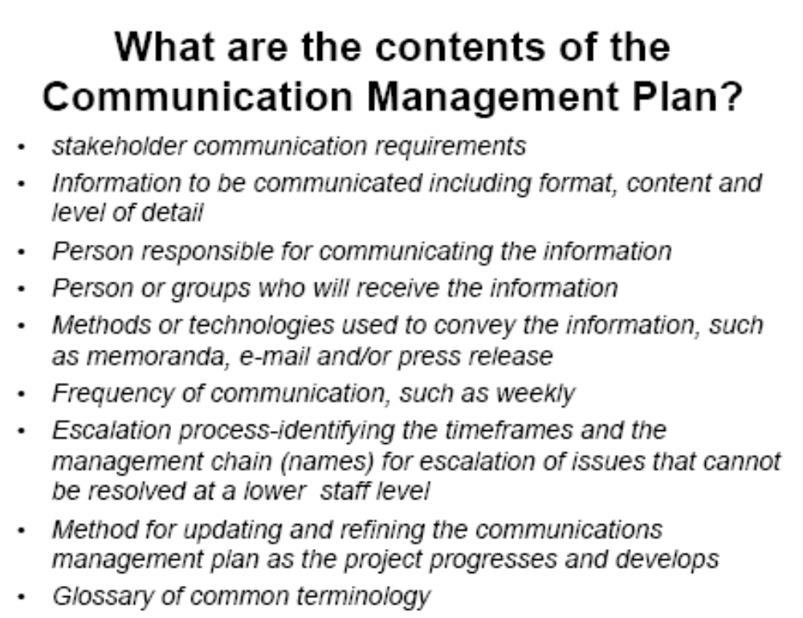
Communication Management Plan

Slide 40
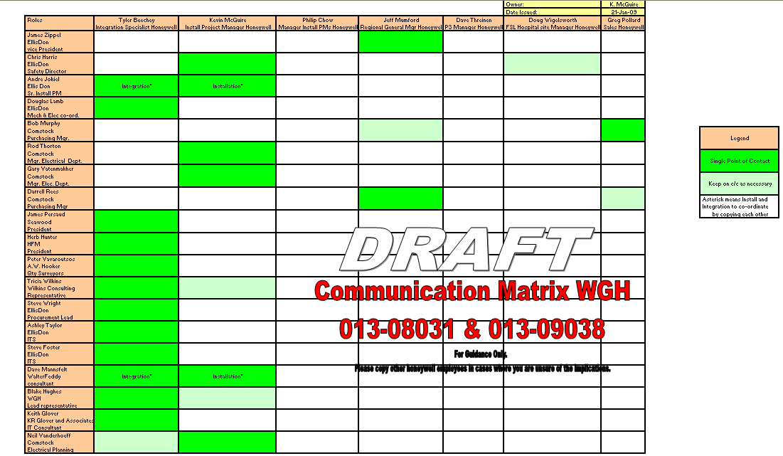
Sample Communication Matrix

Slide 41
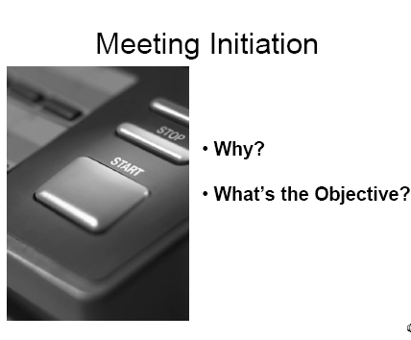
Meetings……….To have or not to have? That is the question.

Slide 42
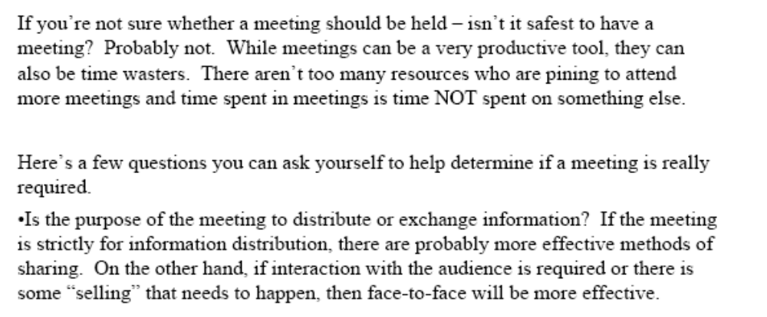
Meetings…determination criteria

Slide 43
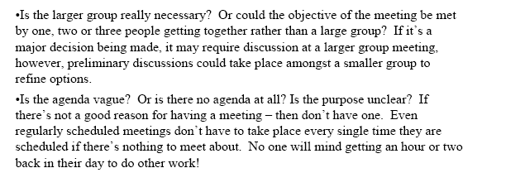
Meetings….determination criteria cont.

Slide 44
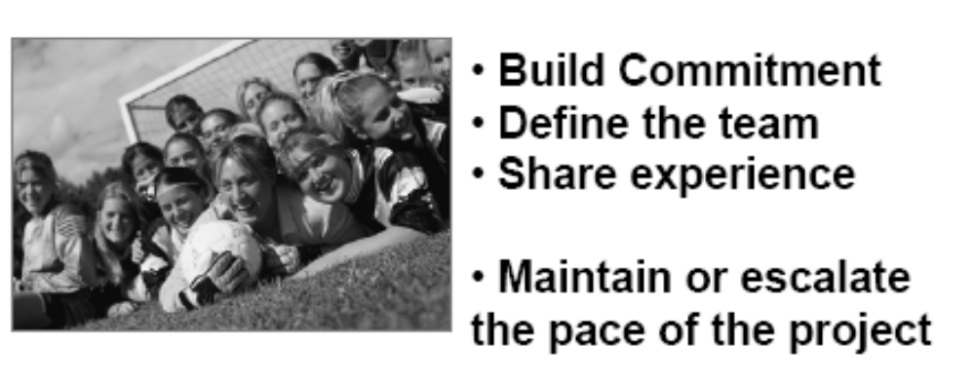
Good reasons to meet

Slide 45
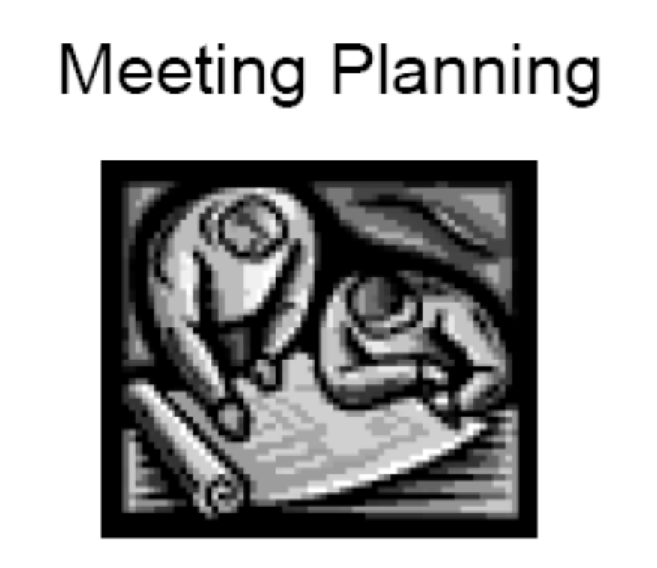
Meeting Planning
Various disciplines in PM work have to be considered when planning
the meeting. Questions from each area of the PMBOK should be asked.

Slide 46
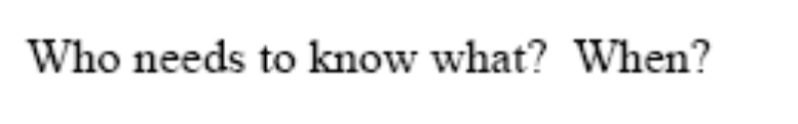

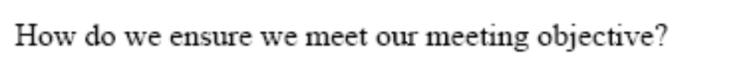
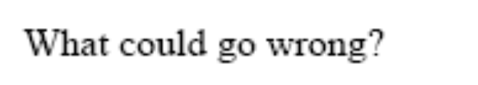
Meeting Planning Questions

Slide 47
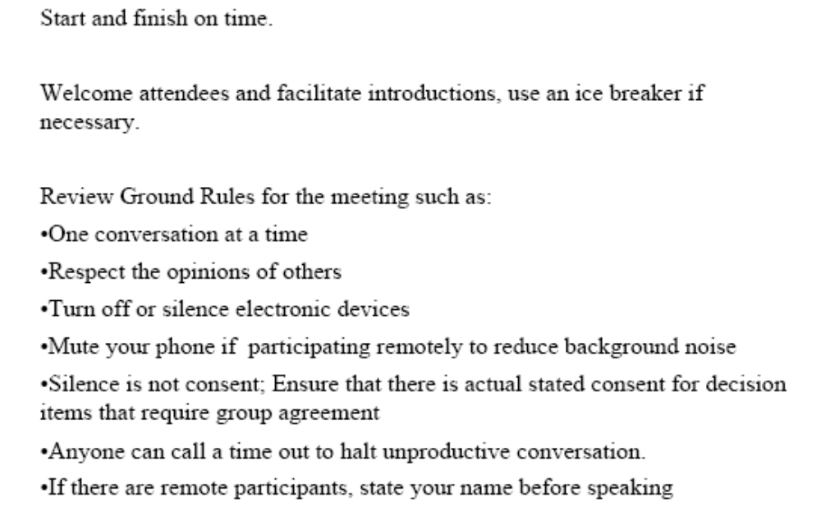
Accepted Meeting Execution Practices

Slide 48
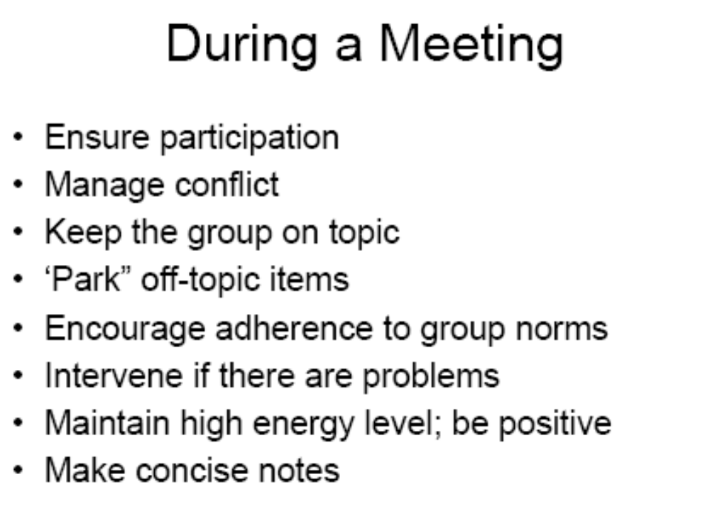
Accepted Meeting Execution Practices (cont.)

Slide 49
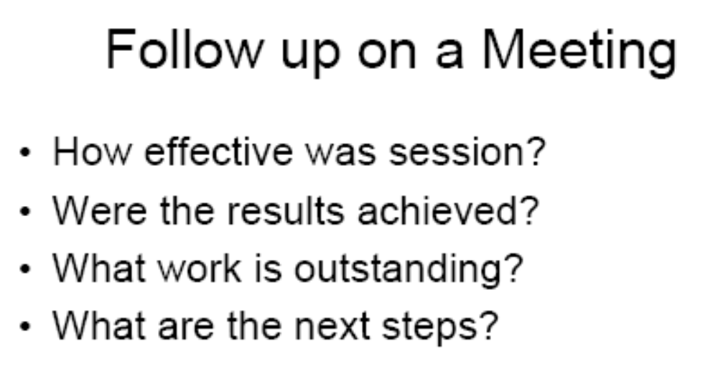
Meeting Closeout item

Slide 50
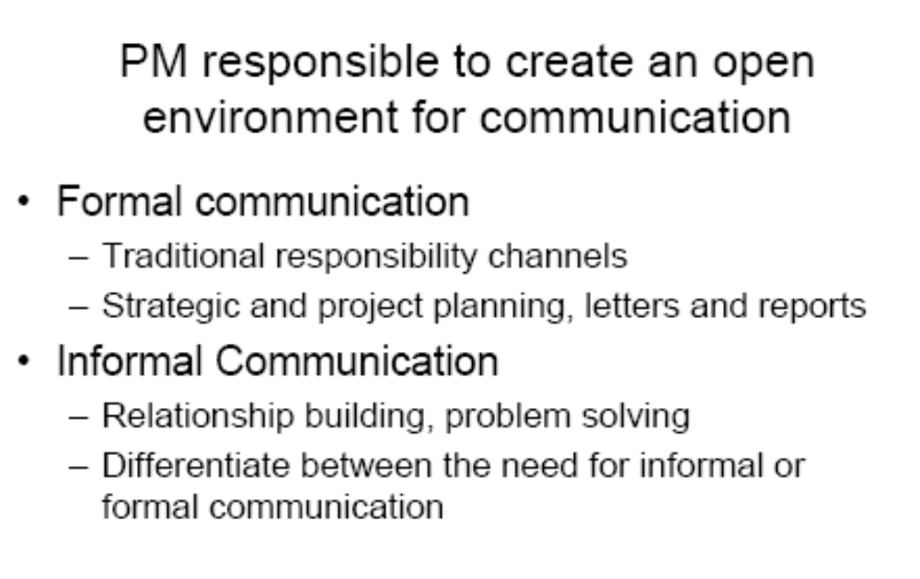
Project Management Communication Essentials

Slide 51
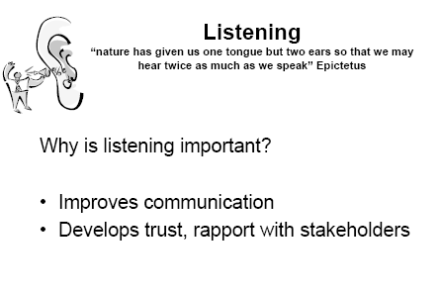
Listen! Listen! Listen!

Slide 52
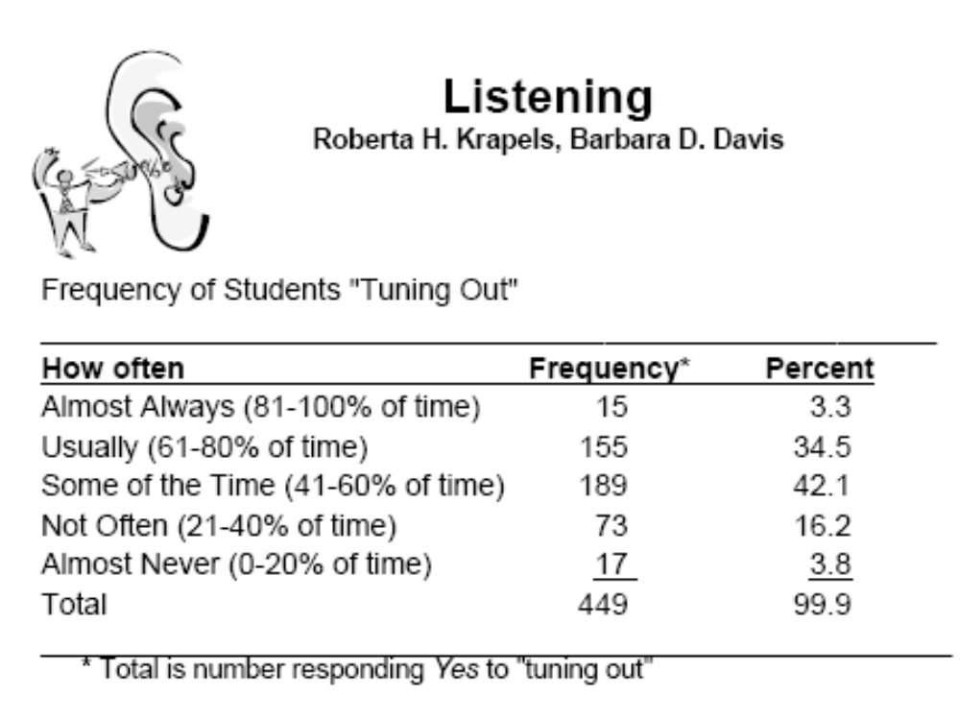
How many of you are tuning me out right now?

Slide 53
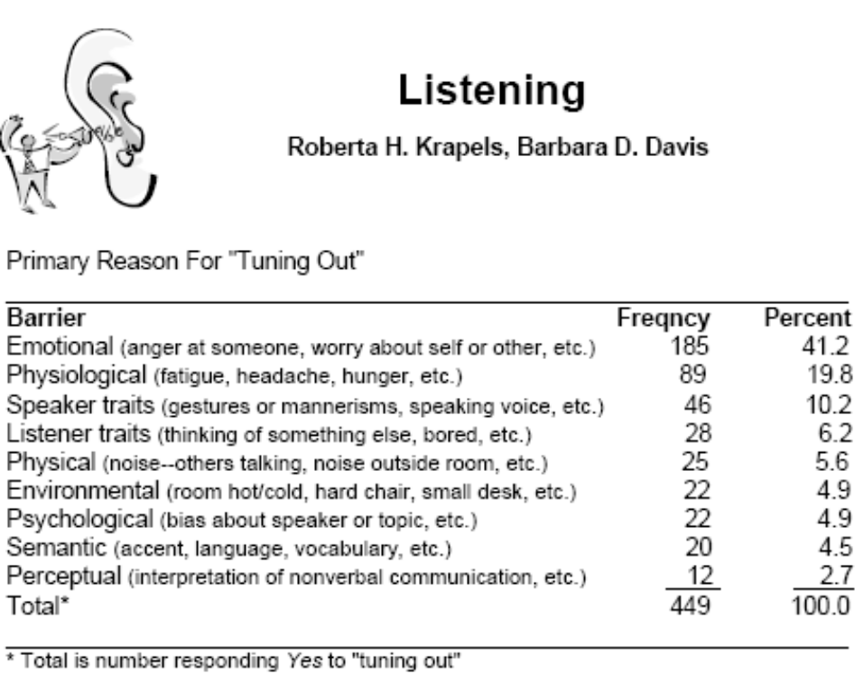
But WHY are you not listening to me?

Slide 54
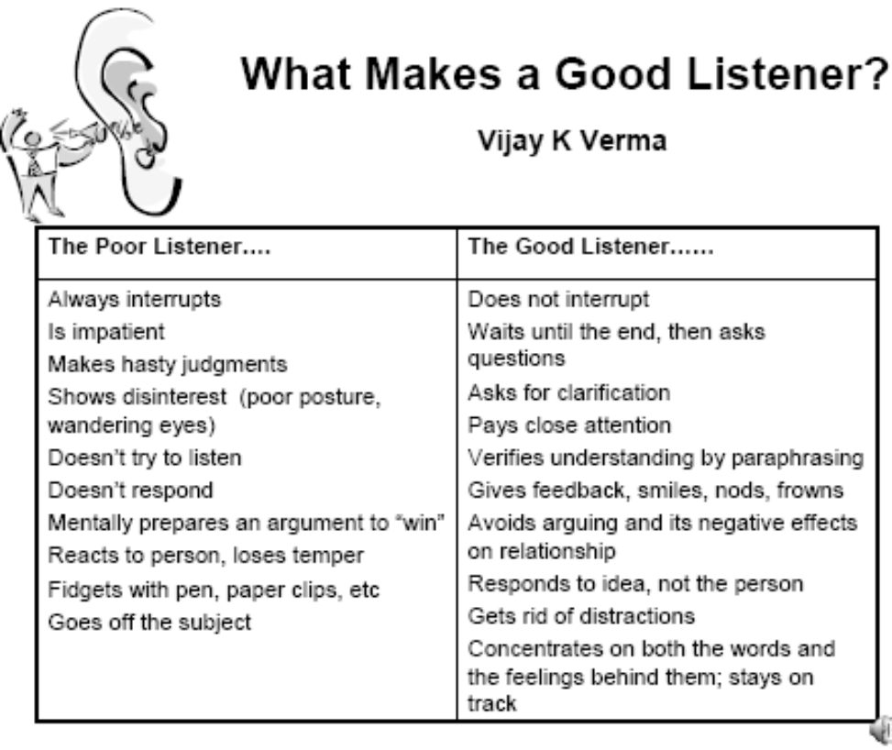
Listen to me now, hear me later.

Slide 55
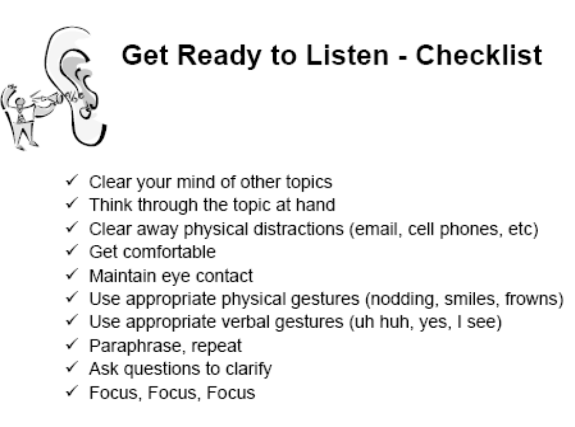
Run down this list every now and then when you really need to focus

Slide 56
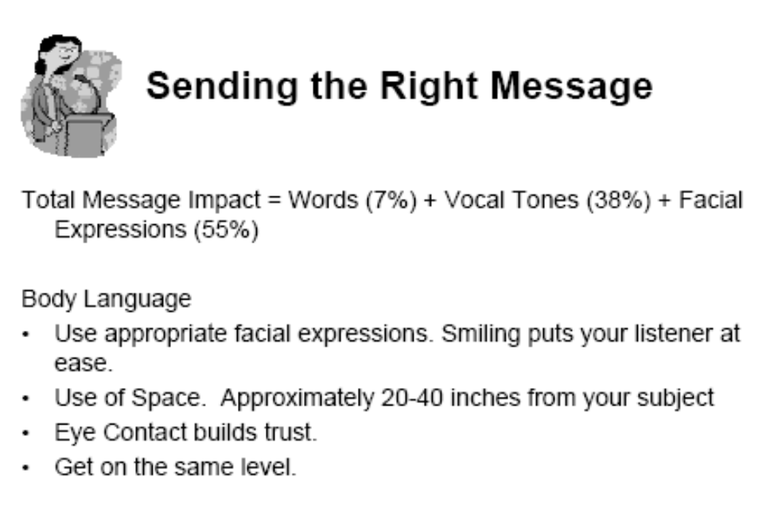
Be culturally recognizable!

Slide 57
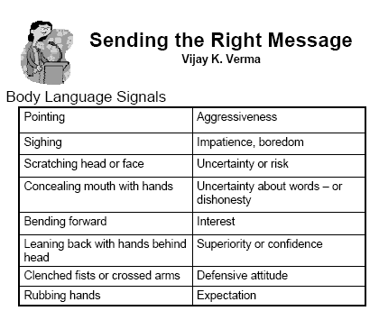
And here is what you are really saying….

Slide 58
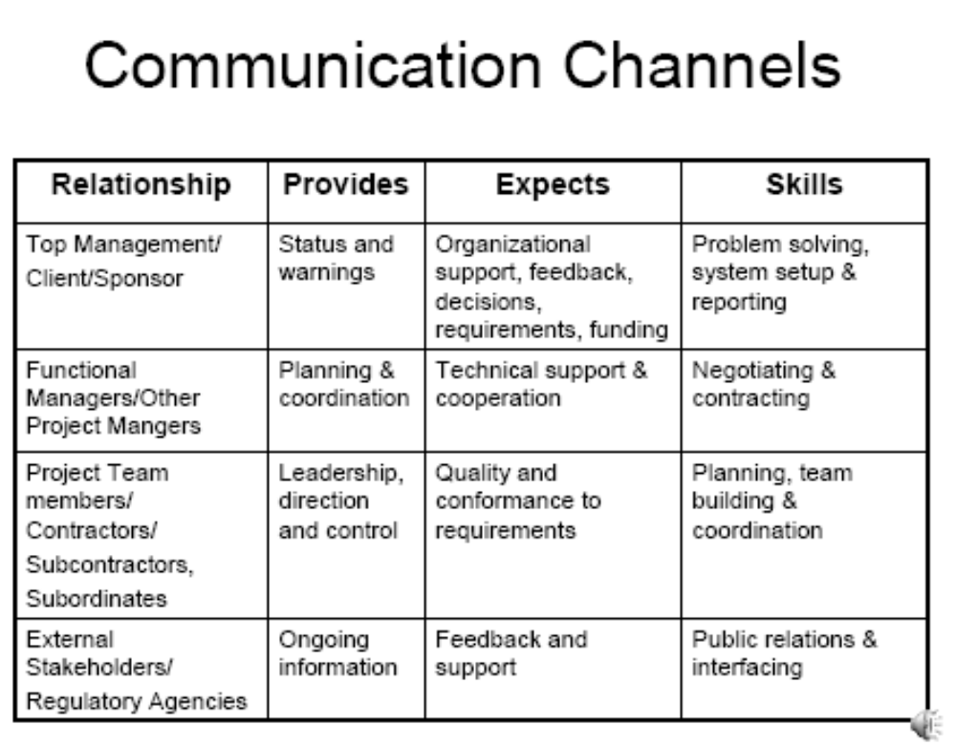
The people you see all need different communication from you

