Slide 1
Engineering Planning and Project Management
Lecture 11
Risk Management

Slide 2
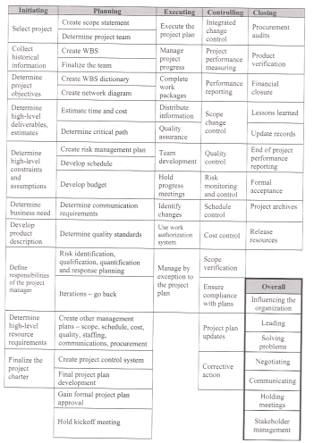

Slide 3
How is Risk Defined?
Any event that can negatively effect the viability of a project.
Risk comes in many sizes and shapes. The idea about risk management is to minimize the impact of the negative event. In order to do that the project team has to follow these steps:
identify the possibility for a risk event
rate the probability and impact of this event
find solutions to deal with this event

Slide 4
Risk Management
Risk Management has to deal with these events throughout the life of a project. Risk can happen at any stage and in any form. The difference between successful projects and those who fail lies in the preparedness of the team to deal with risk events. Not that one project has risk, the other doesn't.
In this lecture we will cover various likely sources for risk to occur. Then we will cover how the team can prepare themselves for this risk so that the impact is minimized or eliminated.

Slide 5
Project Risk is based this simple equation:
Risk = Probability of event x impact of event
So any risk events have to be evaluated in two terms. The likelihood for the event to happen (usually in Percent) and the impact the event will have ($, time delay).
Notes:
RPN = #1*#2*#3
Likelihood(1-10)
Severity(1-10)
Detectability(1-10)
Design Validation Plan & Report

Slide 6
Example “Juan’s Cottage”
The impact of a tornado hitting this building in August has certainly a detrimental effect. But considering the likelihood of that happening is so low, this risk can usually omitted in the risk assessment.
But on the other hand the effects of a strong thunderstorm happening in the middle of summer before the roof was on the building and floods the basement has a much higher likelihood of occurring.

Slide 7
Example “Juan’s Cottage” (Mitigation and Elimination)
Hence in this case and the ones like it, it is prudent for the project team to come up with a plan to mitigate or eliminate the effect of this risk.
In this case the team could decide to put all efforts in getting the roof on first, before placing the windows and doors.

Slide 8
Side Note: Risk and Opportunity
Risk and opportunity are mirror images of unforeseen project events. Opportunity has a positive outcome to the project while risk has adverse effects on the project.
Opportunities are best handled outside of the Risk Management process. The same methods apply, just for a different outcome.

Slide 9
Goal of Risk Management
The goal is to minimize the exposure of the company to the unpleasant outcome of the risk event.

Slide 10
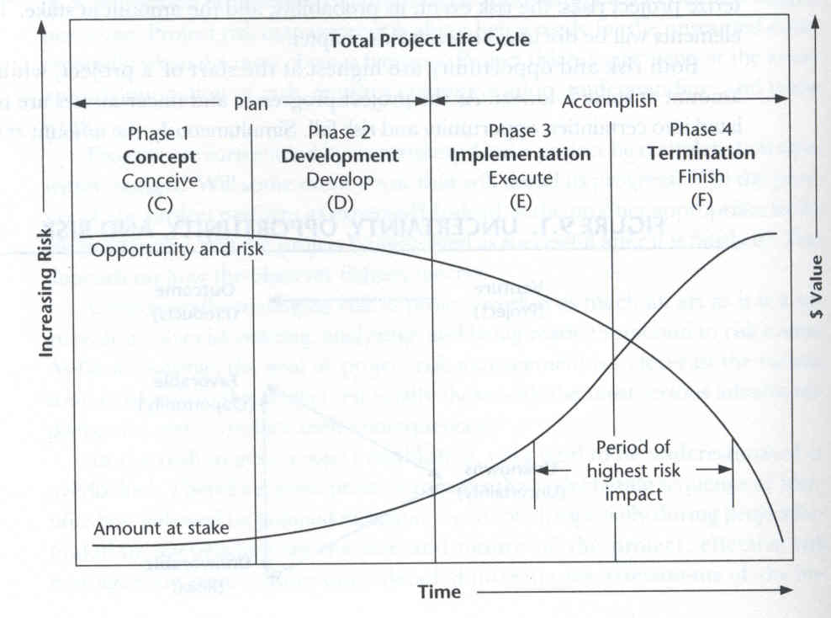
Risk vs. Amount at Stake
This graph shows the impact of risk in a typical project (refer to total project lifecycle, during execution the impact of risk is higher than during the planning/designing phase while the value of opportunity and risk is higher during the planning phase).

Slide 11
Risk and the Spend Curve
Note that the time frame of highest risk is during the early phases of execution. The risk level is still quite high and the exposure of the company is increasing due to the increase in resources and money spent on the project. On the other hand during the early planning stages the exposure is still low due to the minimum man hours and resources spent. During this time management and the team can usually live with a higher level of uncertainty. However expectations are that during the implementation phase the level of risk reduces and the "Total" of risk times exposure is expected to be fairly low. This should come naturally during the progress of the project. Since during this time the basic questions like "Will the design work?", "Will the customer like the result?" "Will the manufacturing concept we chose work?" is usually answered.

Slide 12
Typical ways for the team to come up with their list of risks:
brainstorm meetings
expert opinion (risky in itself, due to bias)
multiple assessments (team knows more than any individual)
previous history (storm signals from last projects, e.g. management unwilling to make decisions, customer engineer notoriously not available, engineering changes specification half way through, …).

Slide 13
Risk Management
Risk Management is a four-stage process:
Risk Identification
The process of determining the specific risk factor s that can reasonably be expected to affect your project
Analysis of the probability and consequences
The potential impact of these risk factors, determined by how likely they are to occur and the effect they would have the project if they did occur.
Risk mitigation strategies
Steps taken to minimize the potential impact of those risk factors deemed sufficiently threatening to the project.
Control and Documentation
Creating a knowledge base for future projects based on the lessons learned

Slide 14
1) Risk Identification
starts by classifying the risk into one of the following classes of risk: financial, technology, resources, time (contractual, execution risk, …)
This list offers a common (but not complete) list of risks any project typically phases:
absenteeism
staff re-assignment by management
resignation
tasks take longer than anticipated
initial specifications are not as well written as expected
changes to the project have a bigger effect than expected

Slide 15
TYPICAL RISK FACTORS
1. FINANCIAL RISKS
2. TECHNICAL RISKS
3. COMMERCIAL RISKS
4. EXECUTION RISKS
5. CONTRACTUAL OR LEGAL RISKS

Slide 16
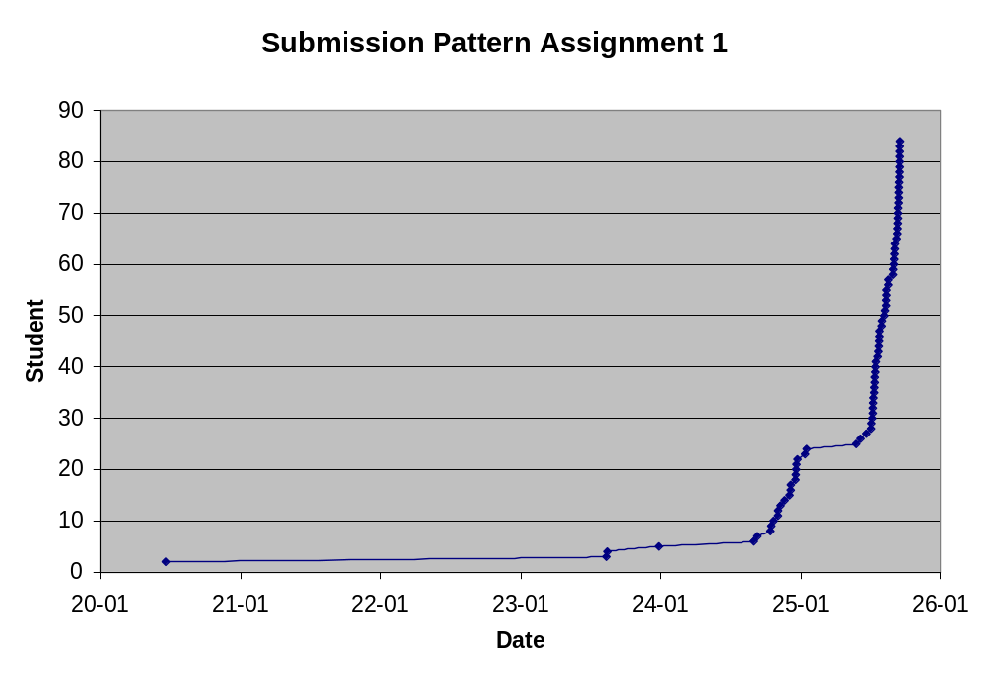

Slide 17
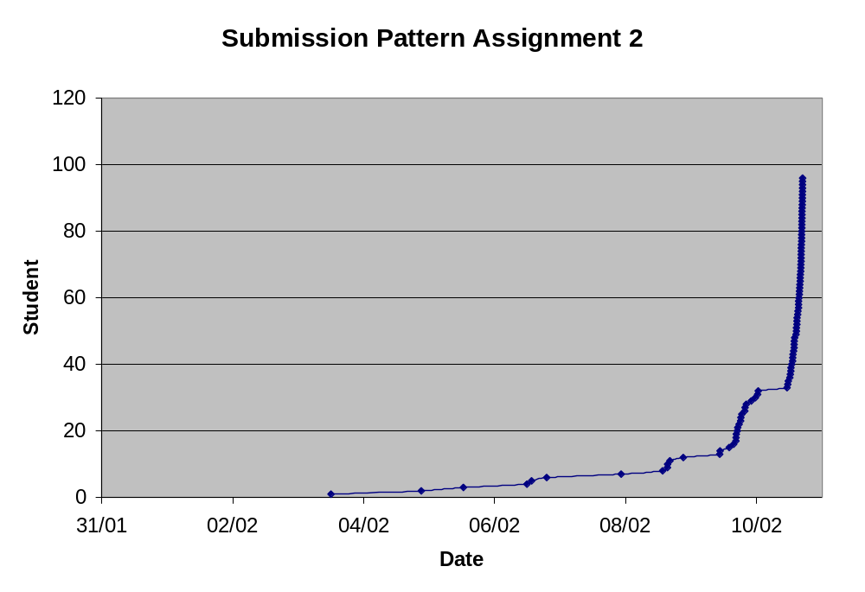

Slide 18
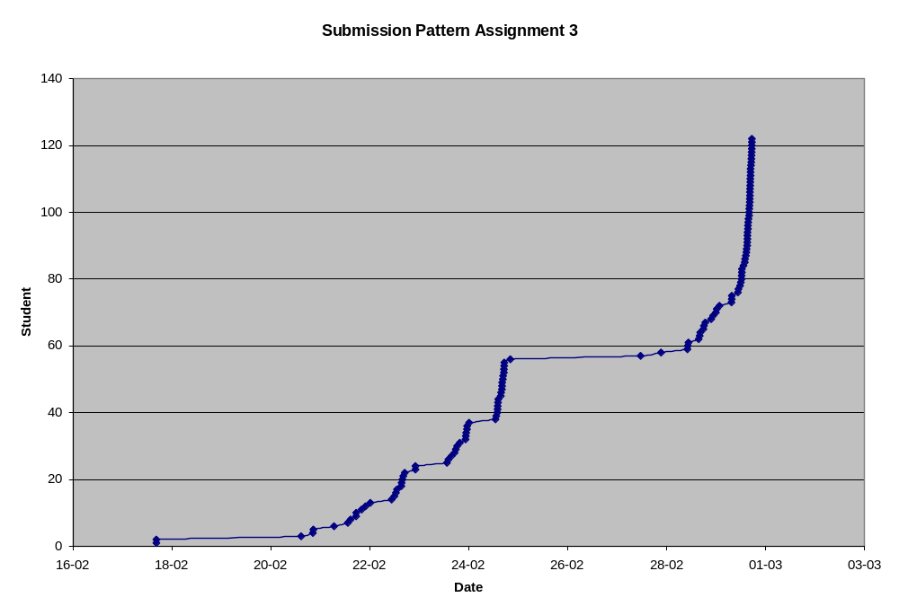

Slide 19
2) Analysis of Probability and Consequences
The next step is to assign a reasonable value to the likelihood and consequence the risk has.
There are two ways to do it:
- team assessment
- Quantitative method
We can construct a risk impact matrix (likelihood on x axis, impact on y, low medium high right top).

Slide 20
Quantitative Risk Analysis
Tools and Techniques for quantitative risk analysis:
1) Data Gathering and Representation techniques
Interviewing to quantify the probability and impact of risks on project objectives. The information gathered depends on the circumstance, but most likely will include the optimistic (low), pessimistic (high), and most likely scenarios for the risk event.
Probability distributions can be used to represent uncertain events, such as the outcome of a test.
Expert judgment, experts validate data and techniques.

Slide 21
Quantitative Risk Analysis
Tools and Techniques for quantitative risk analysis:
2) Quantitative Risk Analysis and Modeling Techniques
Sensitivity Analysis helps to determine which risks have the most potential impact on the project. It examines the extent to which the uncertainty of each project element affects the objective being examined when all other uncertain elements are held at their baseline values.
Expected monetary value analysis (EMV) analysis is a statistical concept that calculates the average outcome when the future includes scenarios that may or may not happen. EMV is calculated by multiplying the value of each possible outcome by its probability of occurrence, and adding them together. This is usually done in a decision tree analysis.
Decision tree analysis is usually structured using a decision tree diagram that describes a situation under consideration and the implications of each of the available choices and possible scenarios.
Modeling and Simulation. Here the Monte Carlo technique is typically used, this iterative process is usually performed by a computer that calculates the outcomes of a set of events with the input of randomized values from a probability distribution function. A probability distribution is calculated.

Slide 22
Building Juan’s Cottage
Is it better to buy copper wiring and water piping now, or wait until the summer, when it needs to be installed saving the storage cost? A total of 750lbs of copper have to be purchased. Storage cost is $100.

Slide 23
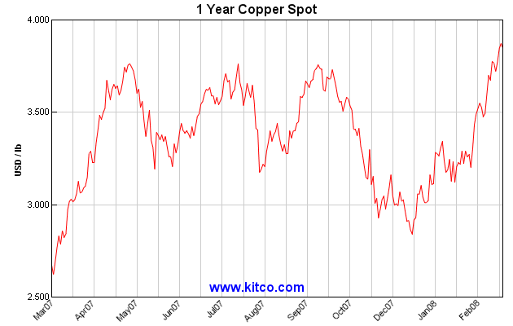
Copper Historical Prices

Slide 24
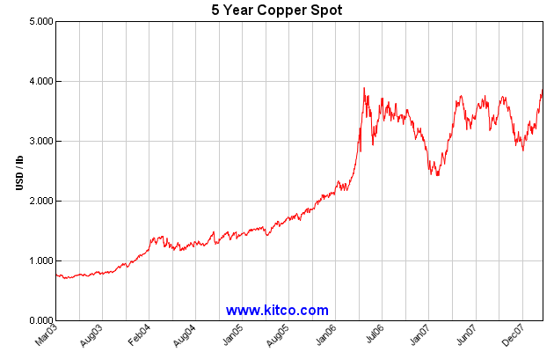
Copper Historical Prices (cont)

Slide 25
Assumptions
Copper will cost 4.5$/lbs in the summer, 90% probability.
Copper will cost 3$/lbs in the summer, 10% probability
Storage cost for the timeframe: $100.

Slide 26
Expected monetary value analysis (EMV)
90%
High Copper Price
$3375*90%=$3037.5
$4.5/lbs*750lbs=$3375
Buy later
10%
Low Copper Price
$2250*10%=$225
Buy now or later?
$3/lbs*750lbs=$2250
EMV for “Buy later” is $3262.5
100%
Buy now
$2950
($3.8/lbs*750lbs+$100)*100%=$2950
EMV for “Buy now” is $2950
With these assumptions it is better to buy the wiring and
piping now and store it for the timeframe.

Slide 27
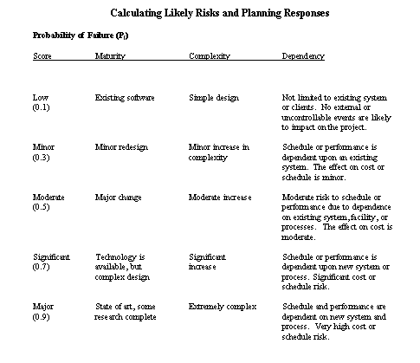
QUANTITATIVE RISK ASSESSMENT CALCULATIONS

Slide 28
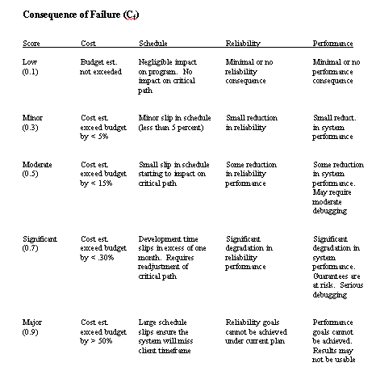
continued ...

Slide 29
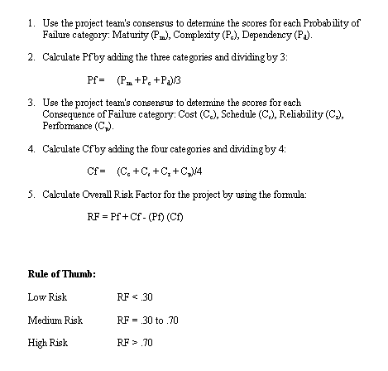
continued...

Slide 30
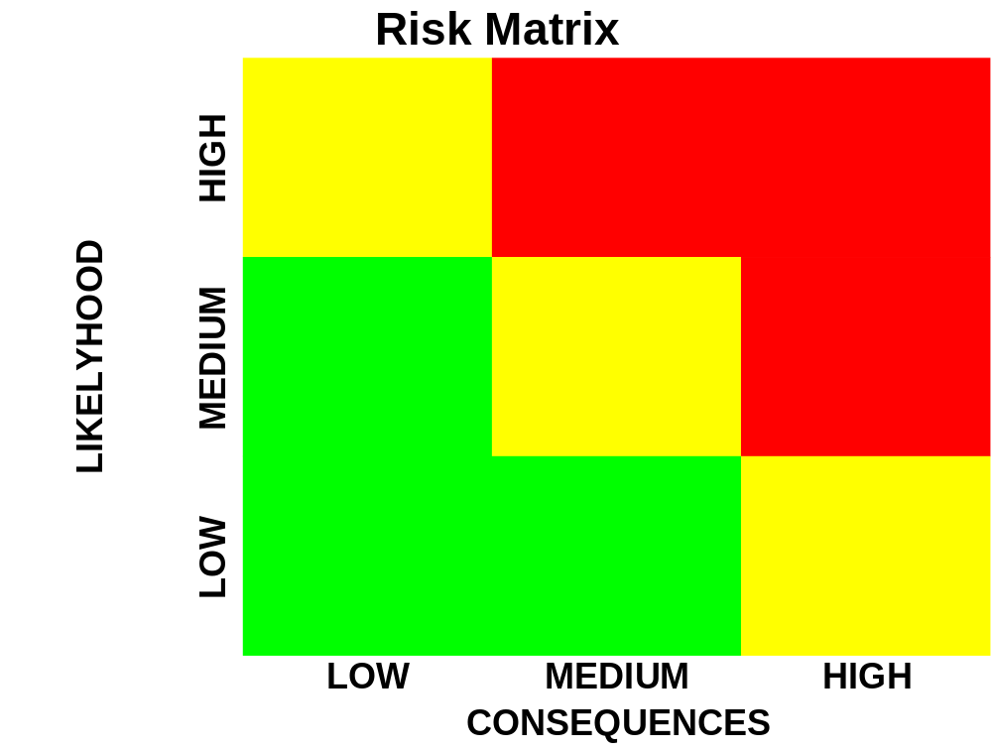
Red Risk: highest impact potential, a plan has to be worked out in advance of the event from happening to mitigate the effects
Yellow Risk: usually a team decision if a mitigation strategy has to be in place
Green Risk: be aware....

Slide 31
Example:
The project you are working on develops a new strategy game for Windows 2008. Your team has identified several risks during the brainstorming session:
Loss of lead programmer
Technical failure
Budget cut halve way through
Competitor first to market
Microsoft changes operating system to next level before game is complete
Task:
Classify each risk into one of the 5 risk categories
Rate the Consequences of each risk happening
Rate the likelihood of each risk

Slide 32
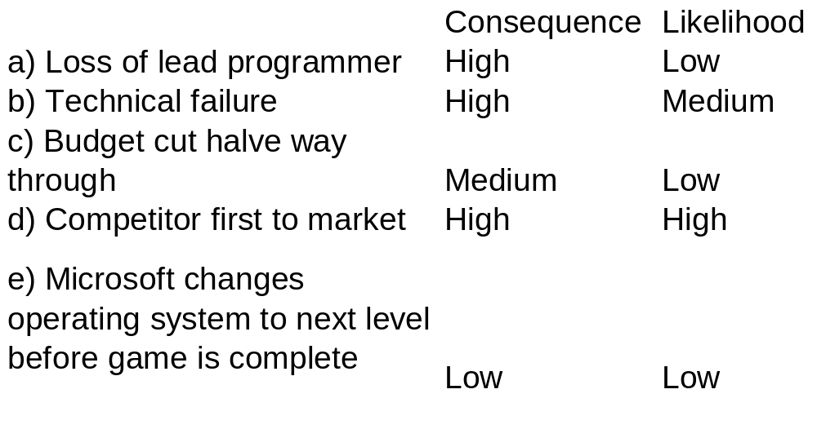
D
C
B
E
A

Slide 33
3) Risk Mitigation Strategies
The next stage in risk management is the development of effective risk mitigation strategies. There are four possible alternatives a project organization can adopt to address risk:
Accept Risk
Minimize Risk
Share Risk
Transfer Risk
Contingency Reserve
Other strategies
Notes:
Final！！！

Slide 34
a) Accept Risk
One option that a project team must always consider is whether the risk is sufficiently strong that any action is warranted. Any number of risks of a relative minor nature may be present at any point in time. However because the likelihood of their occurrence is so small or the consequences of their impact are so minor, they may be judged acceptable and ignored.
For example the record industry spends millions every year in developing, producing, and promoting new recording artists. Knowing full well that less than 5% are profitable. Hence, a high degree of commercial risk is embedded in the system itself and must be accepted in order to operate in the industry.

Slide 35

Repairing Endeavour is too risky, says NASA
12:59 17 August 2007
New Scientist Space and Reuters
A small, deep gash in space shuttle Endeavour's heat shield poses no threat to the ship and does not need repair, NASA said on Thursday after studying the problem for nearly a week.
NASA officials considered sending astronauts out to patch the 8-centimetre (3-inch) gash in the shuttle's belly, but decided Endeavour was all right and it was better not to interfere with the heat shield, mission management team chairman John Shannon said.
"[The hole] does not constitute a risk to the crew, it is not expected to cause any damage to the vehicle structure," he said in a briefing at Johnson Space Center in Houston, Texas, US. "You have something you know you can live with, why would you take the risk of the [spacewalk] to change that?"

Slide 36

b) Minimize Risk
Strategies to minimize risk are the next option. Consider the Dash 8 mid-range turboprop airplane build by Bombardier. Each aircraft contains millions of individual parts , most of which must be acquired from vendors. The risk for the plane if one of the parts malfunctions is too great. Therefore most aircraft manufacturers insist that all significant vendors maintain direct contact with the companies quality department. The aircraft companies also insist on interfering with the production process in order to ensure that the resulting quality meets expectations. But because the company cannot manufacture all parts of an aircraft, they seek to minimize risk through supplier selection, quality standards and audits.

Slide 37
c) Share Risk
Risk may be allocated proportionally among multiple members of the project.
Two of the examples of sharing risk is the research and development done through the European Space Agency (ESA) and the Airbus consortium. Due to the tremendous barriers to entry, no one country in the European Union has the capital resources and technical skills to undertake the development of the Ariane rocket for satellite delivery or the creation of a new airframe to compete with Boing. ESA and Airbus partners from a number of countries have jointly pooled their resources and at the same time, agreed to jointly share the risk inherent in the venture.

Slide 38
d) Transfer Risk
In some circumstances, when it is impossible to change the nature of the risk, it may be possible to shift the risk to another party.
For example a good method to prevent excessive budget overruns is a fixed-price-contract. They establish a price upfront, should the project slip, the vendor must carry the full burden of the overrun.
Alternatively, if the goal is to ensure functionality (quality and performance), the concept of liquidated damages is used. Liquidated damages represent project penalty clauses that kick in at mutually agreed-on points in the development and implementation.

Slide 39
e) Use of Contingency Reserves
Contingency reserves are among the most common methods to mitigate risks. They are defined as the specific provision for unforeseen elements of cost within the defined project scope. In construction projects it is not uncommon to set aside 10-15% of the construction price in a contingency fund. In other fields, however, this practice is not done, due to the fact that the team might fear that the customer or management might see it as a sign of poor planning or inadequate scope definition.
There are two types of contingencies:
Task Contingency
is used to offset schedule overruns, budget cuts or other unforeseen circumstances accruing to individual tasks or work packages. These budget reserves are managed by the project manager. Naturally, as the project moves forward, it may be possible to reduce budget reserve requirements for task contingency because of the progression of the work. As a task is completed, the reserve left for that task cannot be accessed anymore.
Managerial Contingency
is an additional safety buffer applied at the project level. They are used in instances where the customer changes the scope halve way through the development process. "Acts of God", natural disasters or the like are unforeseeable by definition. In these cases Management (not the project manager) has access to this contingency fund.
Notes:
2 types !!!

Slide 40
f) Other Mitigation Strategies
In addition to the above set of mitigation strategies, many organizations adopt a practical approach to minimizing risk through e.g. mentoring new project managers and team members. In a mentoring program, junior or inexperienced personnel is paired with senior/experienced personnel in order to help them learn best practices.
Another method involves cross-training project team personnel so that they are capable of filling in for each other in the case of an emergency. Cross-training requires that members of the project team learn not only their own duties but also the roles that another team members are expected to perform.

Slide 41
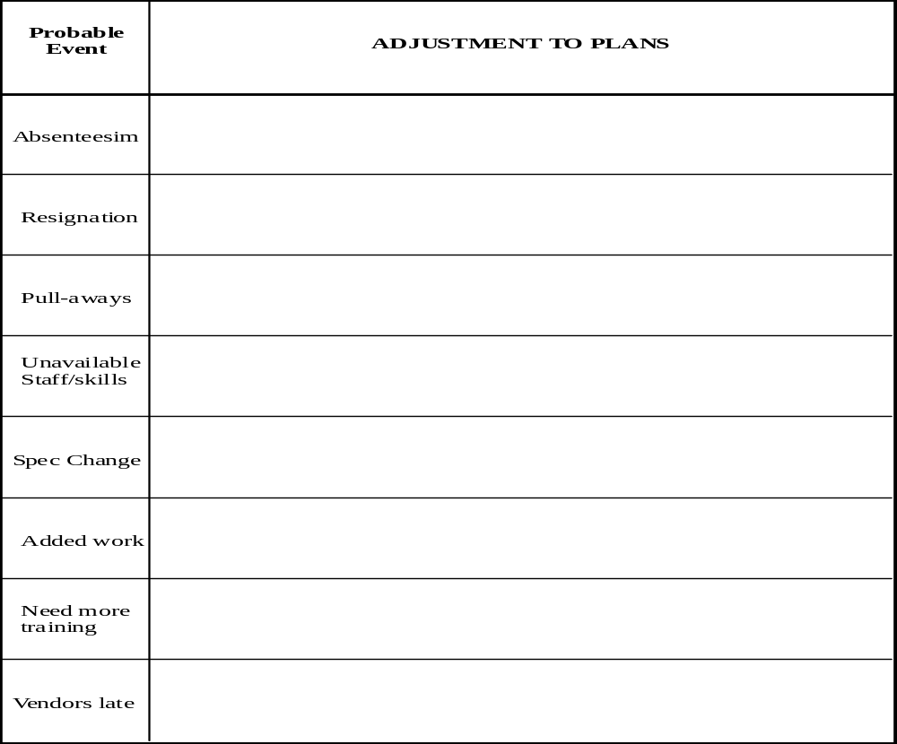
CONTINGENCY DOCUMENT FOR ADJUSTMENTS TO PROJECT PLAN

Slide 42
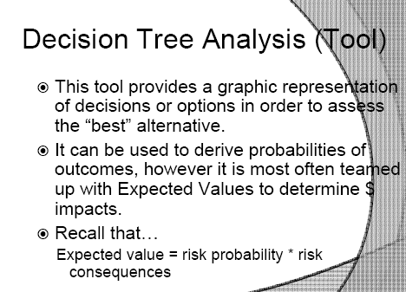
Decision Tree Analysis Tool

Slide 43
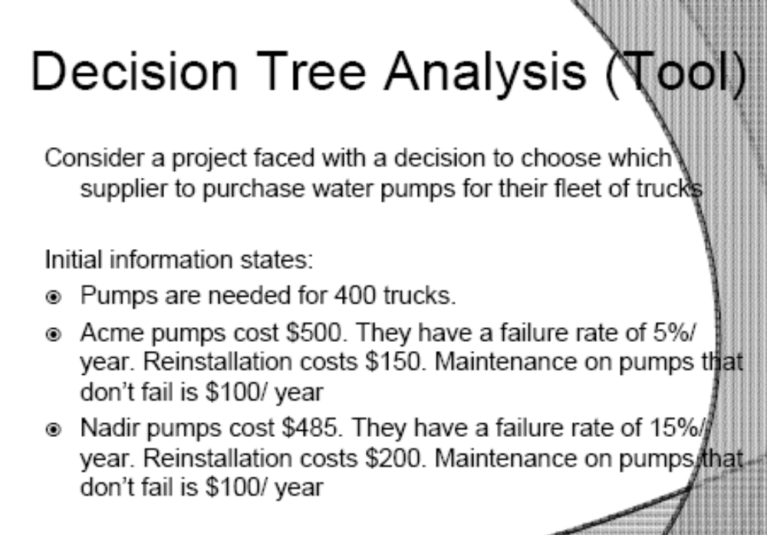
Decision Tree Analysis example

Slide 44
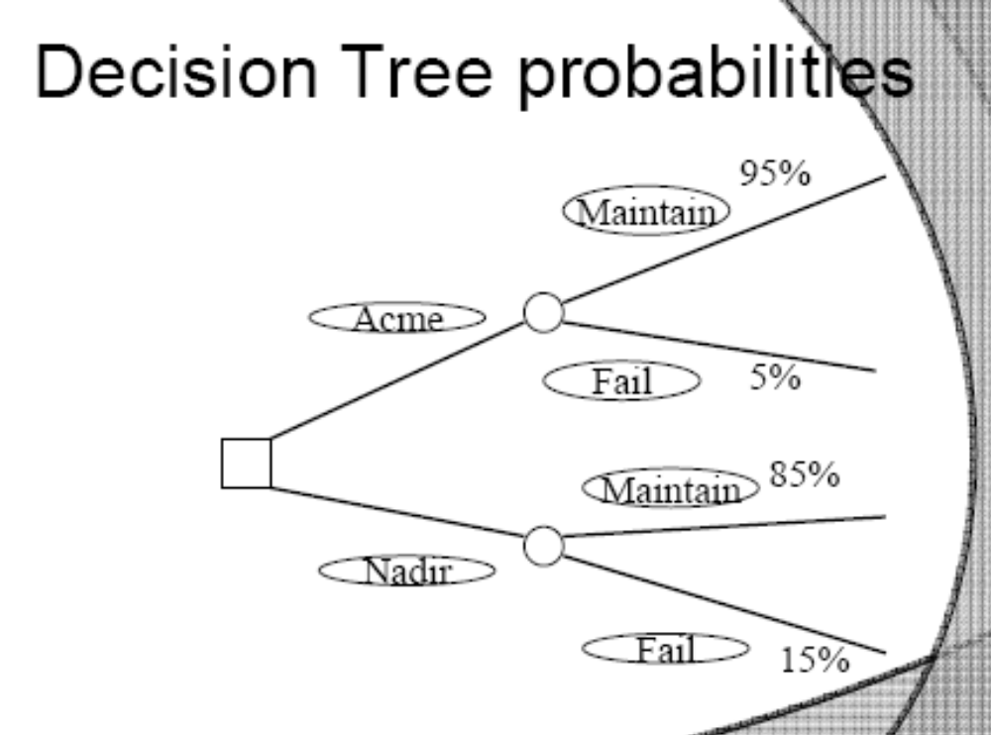
Decision tree example (cont.)

Slide 45
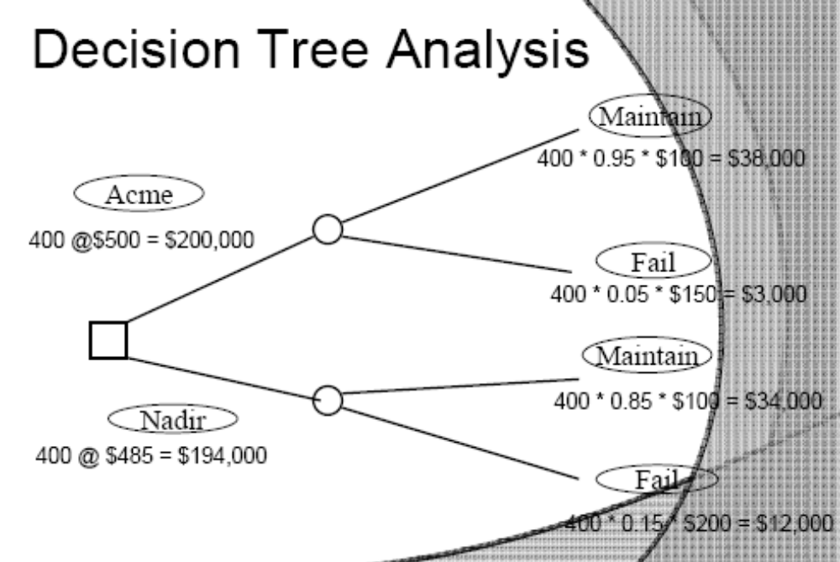
Decision Tree Analysis Example (cont.)

Slide 46
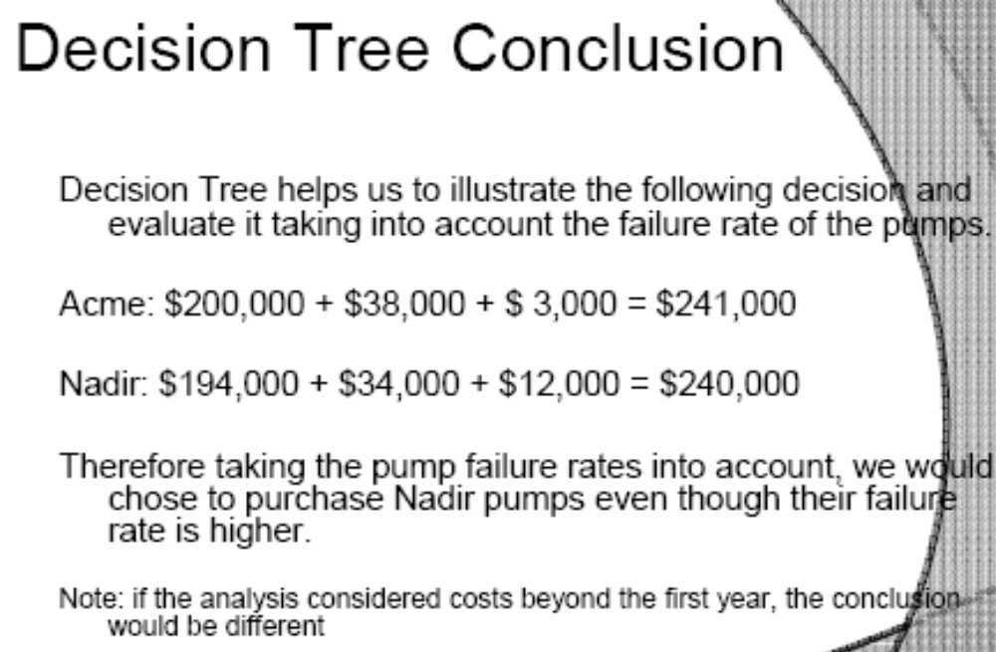
Decision Tree Example conclusion

