Slide 1
Engineering Planning and Project Management
Lecture 12
Project Procurement Management

Slide 2
Bid Tendering documents
See the handout provided in WebCT entitled Bid Documents. Familiarize yourself with the general sections included in the sample contract the supplier is expected to ultimately sign. Be prepared to answer questions from this sample document in class and on the final exam.
As we learn in the PMBOK, what is another name for “owner”?
If there are issued for tender project prints and an issued for tender specification in addition to the base contract document, what would the order of precedence be for these 3 items? What is order of precedence?

Slide 3
Tendering and Project Execution
See the handout provided in WebCT entitled Tendering and Project Execution. Familiarize yourself with the 13 questions at the end of the handout and be prepared to answer questions in class and on the final exam.

Slide 4
Bidding Mistakes and how the Law handles them
See the handout provided in WebCT entitled Bidding Mistakes -what the law says. Familiarize yourself and be prepared to answer questions in class and on the final exam.

Slide 5
Bidding Mistakes and how the Supreme Court reset the game
See the handout provided in WebCT entitled Bidding Mistakes –and the Supreme Court of Canada. Familiarize yourself and be prepared to answer questions in class and on the final exam.

Slide 6
The 5 Elements of any contract
Offer
Acceptance
Legal Object
Legal Right
Consideration
As we saw on the 2 previous slides, typically the single most important procurements and contractual arrangements on a project relate to the tendering and selection of trades. Capital purchases are also extremely important though. Either way an understanding of contracts is essential for any PM.

Slide 7
Obligation to Accept the Low
There is no obligation on the part of owners to accept the lowest bid, though this is the norm. Owners also consider known track record and their overall confidence in your ability to perform.

Slide 8
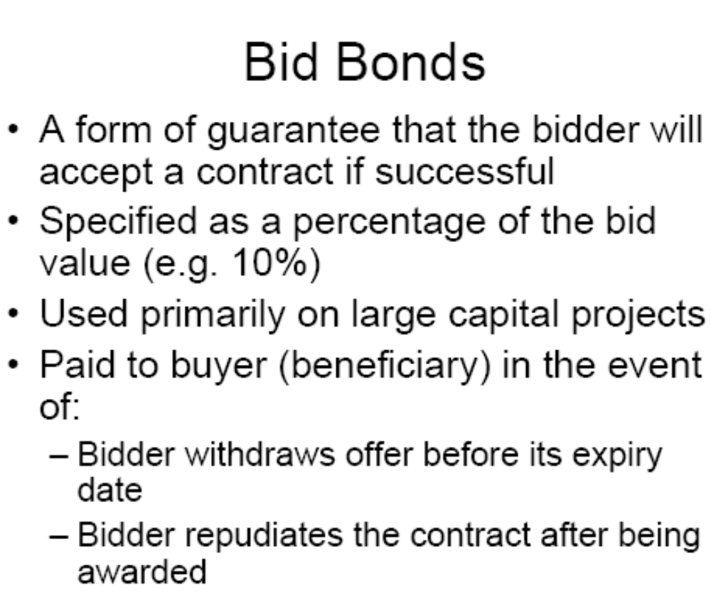
Bid Bonds

Slide 9
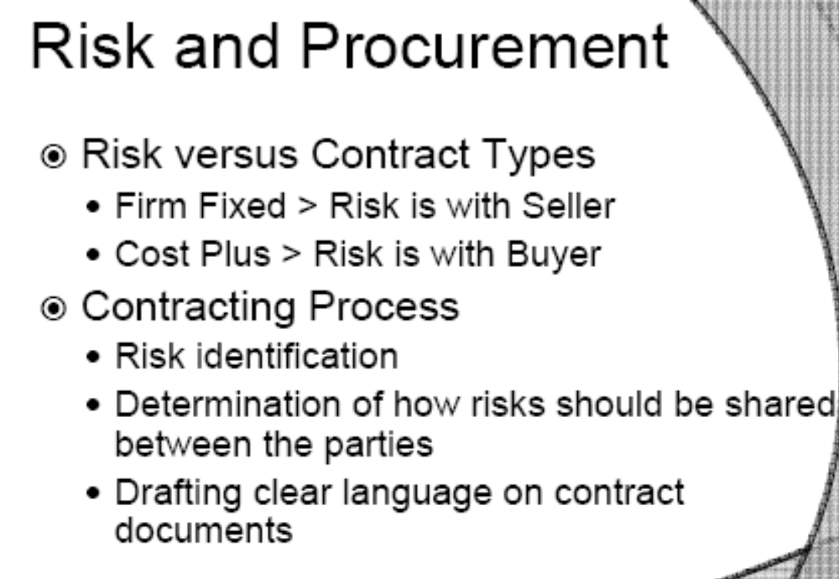
Distribution of Risk vs Contract Type

Slide 10
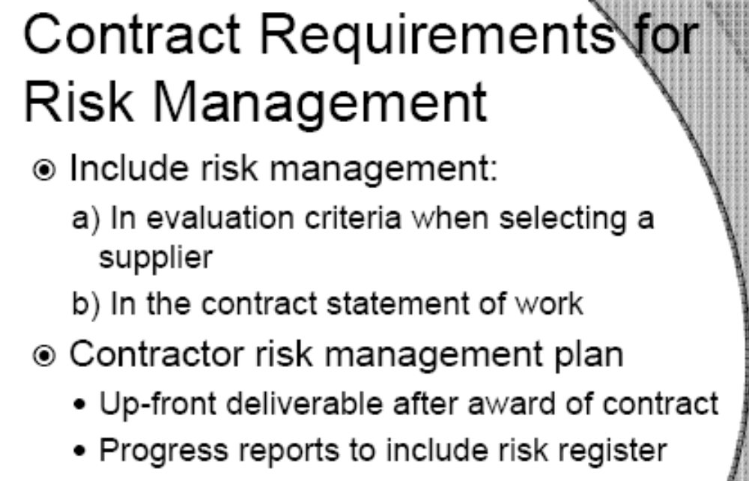
Contract Requirements for Risk Management

Slide 11
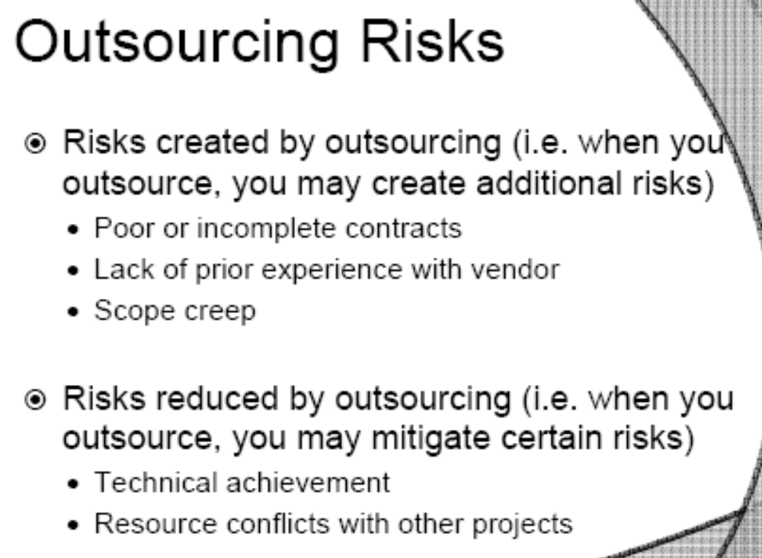
Outsourcing Risks in Procurement Management

Slide 12
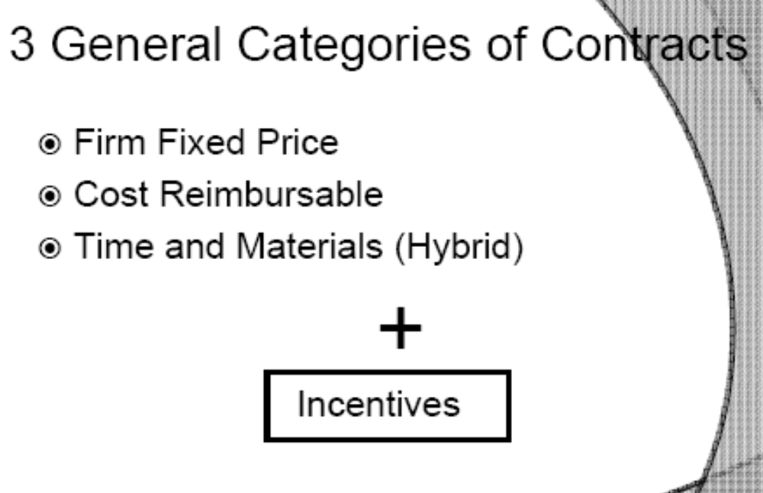
Categories of Contracts

Slide 13
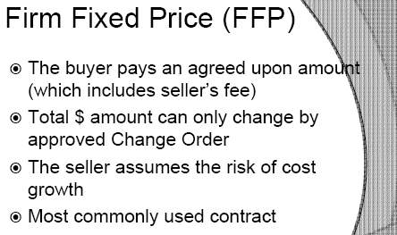
Firm Fixed Price

Slide 14
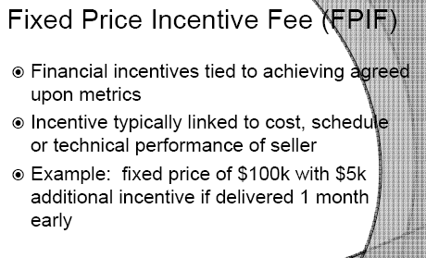
Fixed Price Incentive Fee

Slide 15
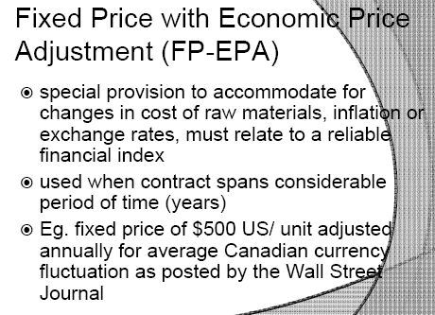
Fixed Price with Economic Price Adjustment

Slide 16
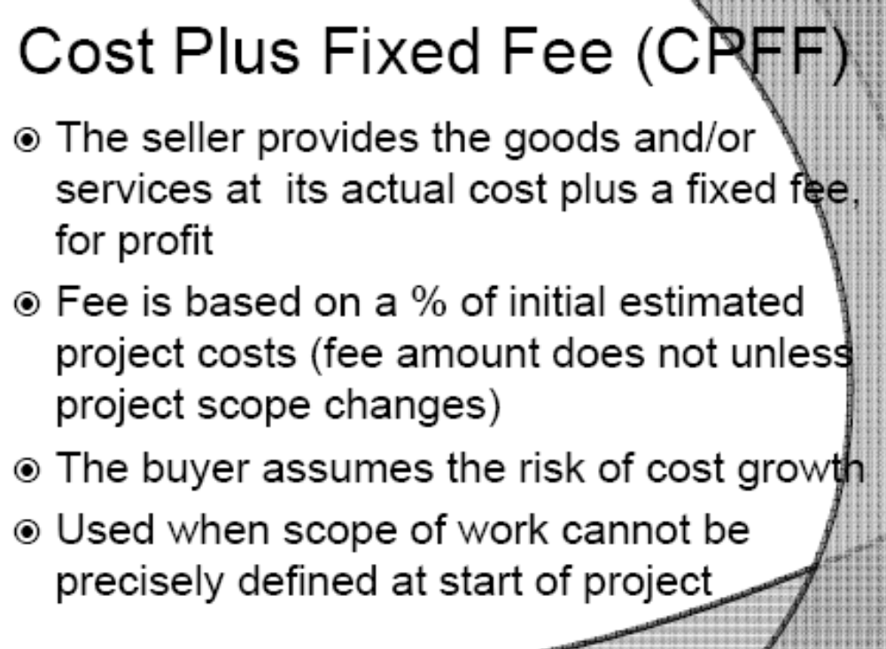
Cost Plus Fixed Fee

Slide 17
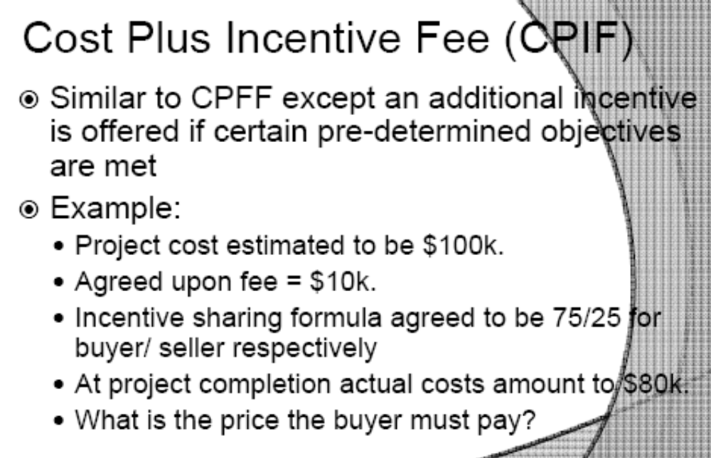
Cost Plus Incentive Fee

Slide 18
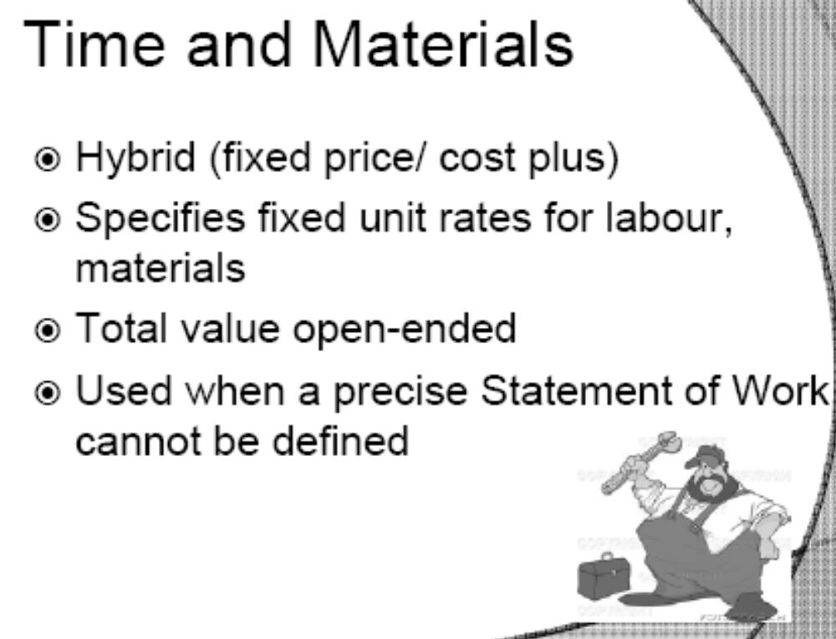
Time and Materials

Slide 19
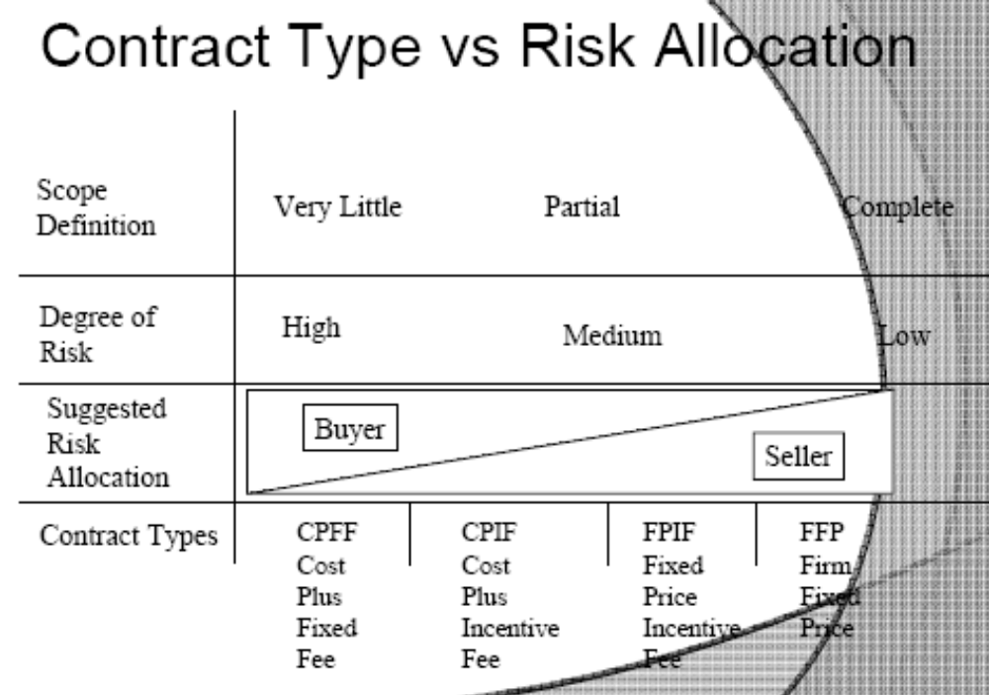
Contract Type vs. Risk Allocation(important!!!

Slide 20
Review for the final
Are there any topics we would like to review?

