Slide 1
Engineering Planning and Project Management
CEE 9510
Lecturer: Kevin McGuire P. Eng., M. Eng., PMP
Project Life Cycle and Organization

Slide 2
How is a company managed?
From the top down in a classical military hierarchy (one person on the top has all the power)
Upper Management develops vision statements
Middle Management makes mission statements out of that
Missions in turn get broken down into Objectives for projects and departments.
They are then broken down into Strategies, Goals and Initiatives
Notes:
Management by Objectives is not adopted by all companies yet.

Slide 3
Vision shown on example of GE
GE Vision Statement: 'We bring good things to life'
Vision
GE Women Network Mission Statement:
The Women's Network is a voluntary organization with the mission of fostering professional women's development to grow, attract and retain successful women throughout GE. Development is focused on leadership, advancement and career-broadening opportunities through a variety of tools including information, education and networking with other women to learn best practices.
Mission
Objectives
Objectives:
- find at a min 100 mentors per year
identify high potential candidates to management
increase the retention of high potential women by 10%
Strategies Goals Initiative
Strategies: expand sales in Asian countries
Goals: 15% ROI, $1 dividend, unit cost down 5%, maintain public image
Initiative: Product Cost Improvement Initiative (PCII),
Product Development Initiative (PDI)

Slide 4
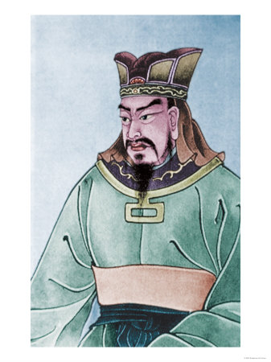
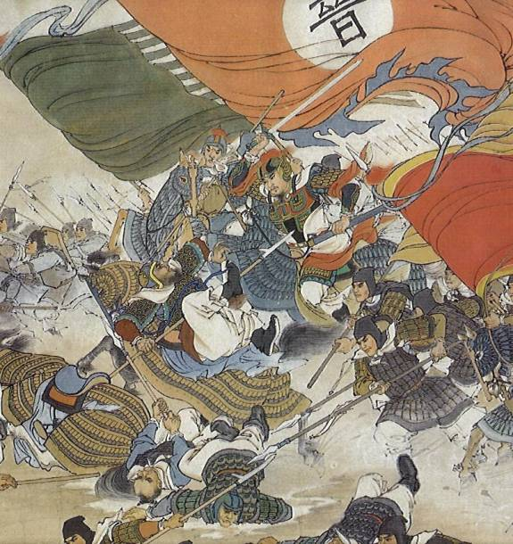
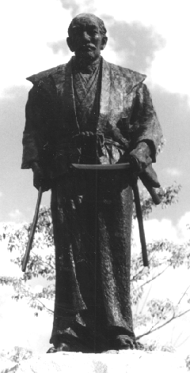
"Strategy without tactics is the slowest route to victory. Tactics without strategy is the noise before defeat."
Sun Tzu - Chinese military strategist; 544-496 BC

Slide 5
Organizational Structure
Functional Organizations
Project Organizations
Matrix Organizations

Slide 6
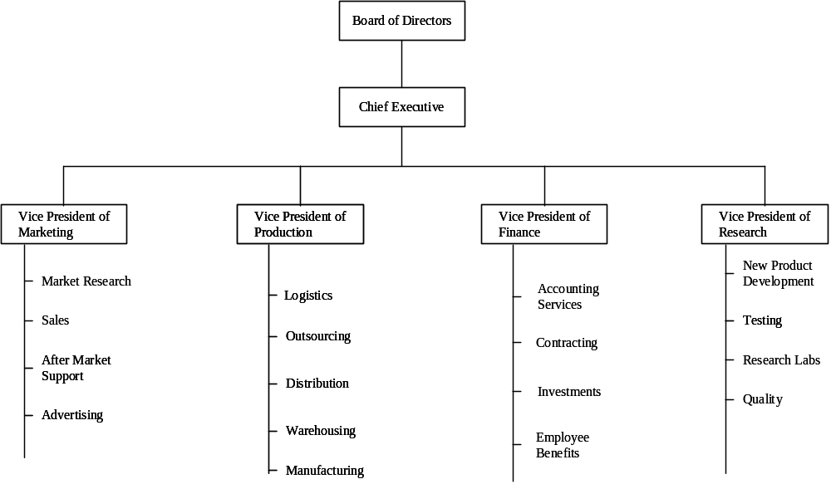
Functional Organization
Project Expediter
Project Coordinator
Notes:
Fanshawe having 2 "Project Management courses" : MGMT-6020 Project Management

Slide 7
Strengths and Weaknesses of Functional Organizations
Strengths for PM
Projects are developed within the basic functional structure of the organization, requiring no disruption or change of the firm's design
Enables the development of in-depth knowledge and intellectual capital
Allows for standard career paths. Project team members only perform their duties as needed while maintaining maximum connection with their functional group
Weaknesses for PM
It is difficult to achieve cross-functional cooperation
Lack of customer focus
Projects generally take longer to complete due to structural problems, slower communication, lack of direct ownership of the project, and competing priorities among the functional departments
Projects may be sub-optimized due to varying interest or commitment across functional boundaries.
Notes:
Example: 3 PM courses in Fanshawe this semester. In different department.

Slide 8
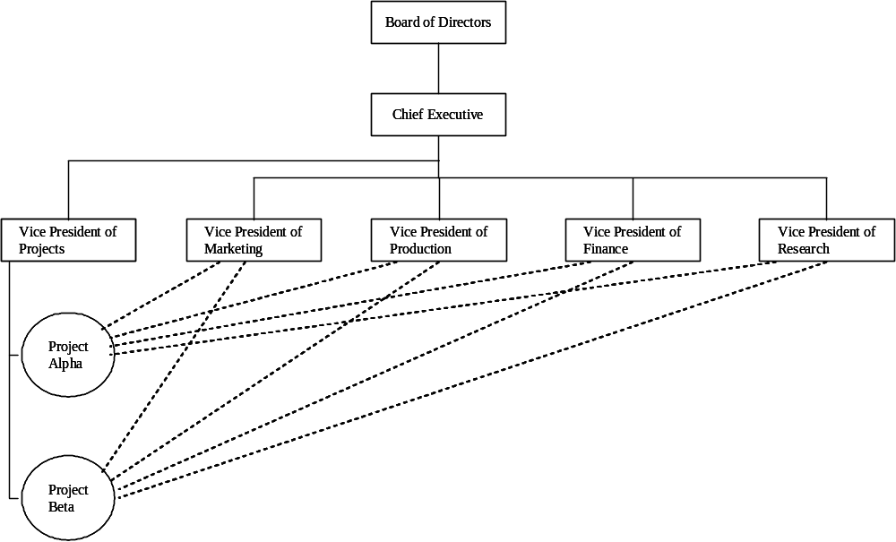
Project Organizations

Slide 9
Strengths and Weaknesses
Strengths for PM
Assigns authority solely to the PM
Leads to improved communication across the organization and among functional groups
Promotes effective and speedy decision making
Promotes the creation of cadres of PM experts
Encourages rapid response to market opportunities
Weaknesses for PM
Setting up and maintaining teams can be expensive
Potential for project team members to develop loyalty to the project rather than the overall organization
Difficult to maintain a pooled supply of intellectual capital
Concern among project team members about their future once the project ends.

Slide 10
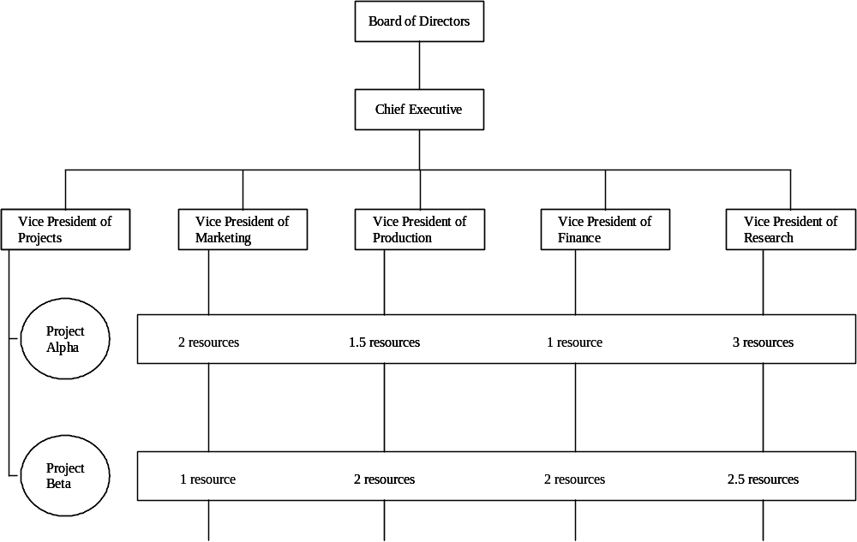
Matrix Organizations

Slide 11
Creating an organization with 2 bosses may seem awkward, but there are important advantages to this approach if certain conditions are met:
There is pressure to share scarce resources across product or project opportunities.
There is a need to emphasize two or more different types of output.
E.g. the company may need to promote it's technical competence (using a functional structure) while continually creating new products (project structure)
The environment of the organization is complex and dynamic.
When firms face complexity and rapidly changing environmental pressures the matrix organization is flexible to accommodate this change.
Notes:
disciplinary boss = pay raise, hire fire
project boss = is the one you work for day to day

Slide 12
Strengths and Weaknesses of Matrix Organizations
Strengths for PM
Suited to dynamic environments
Emphasizes the dual importance of project management and functional efficiency
Promotes coordination across functional units
Maximizes scarce resources between competing project and functional responsibilities
Weaknesses for PM
Dual hierarchies mean two bosses
Requires significant time to be spent negotiating the sharing of critical resources between projects and departments
Can be frustrating for workers caught between competing project and functional demands

Slide 13
Stakeholder Management
Identifying Project Stakeholders
What is a "stakeholder"?
Project Stakeholders are defined as:
Individuals or groups who have an active stake in the project and can potentially impact it's development.

Slide 14
Identifying Project Stakeholders
Internal:
Management
Accountant
Team members
External:
Clients
Competitors
Suppliers
Environmental, political, consumer, and other groups
Notes:
stakeholder is umbrella.

Slide 15
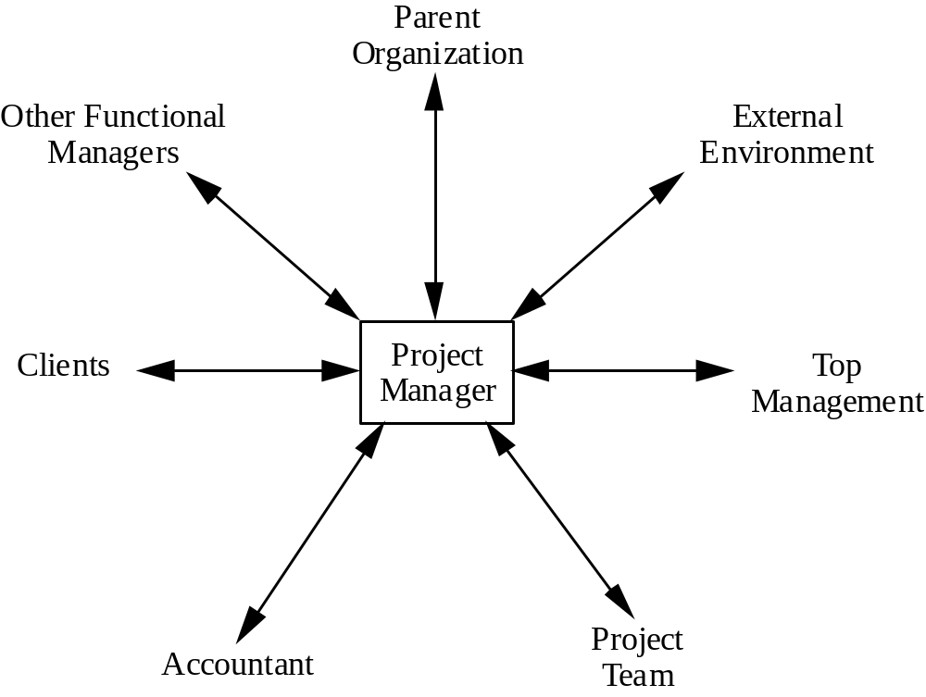
Stakeholder Relationships
communication paths= n(n-1)/2
n= number of communication participants

Slide 16
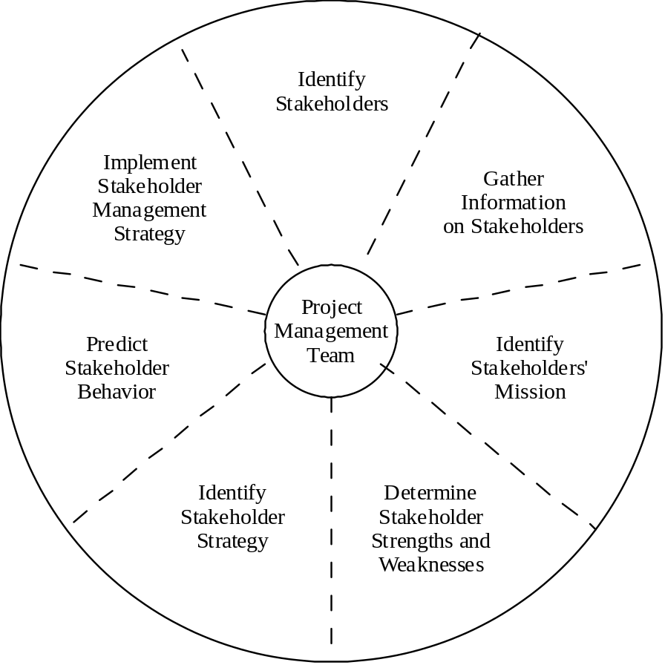
Manage Stakeholders

Slide 17
Organizational Culture
Each organization develops its own unique outlook, operating policies, procedures, patterns of thinking, attitudes, norms of behavior. They are often as unique as a fingerprint. No two organizations no matter how similar in size, products, operating environment, profitability, ... are the same.
Notes:
consider high school to fanshawe culture of staff.

Slide 18
What is Organizational Culture?
Defined as:
The solution to external and internal problems that has worked consistently for a group and that is therefore taught to new members as the correct way to perceive, think about and feel in relation to these problems
Notes:
Start with a cage containing five monkeys.
Inside the cage, hang a banana on a string and place a set of stairs under it.
Before long, a monkey will go to the stairs and start to climb towards the banana.
As soon as he touches the stairs, spray all of the monkeys with cold water.
After a while, another monkey makes an attempt with the same result - all the monkeys are sprayed with cold water.
Pretty soon, when another monkey tries to climb the stairs, the other monkeys will try to prevent it.
Now, turn off the cold water.
Remove one monkey from the cage and replace it with a new one.
The new monkey sees the banana and wants to climb the stairs.
To his surprise and horror, all of the other monkeys attack him.
After another attempt and attack, he knows that if he tries to climb the stairs, he will be assaulted.
Next, remove another of the original five monkeys and replace it with a new one.
The newcomer goes to the stairs and is attacked.
The previous newcomer takes part in the punishment with enthusiasm.
Again, replace a third original monkey with a new one.
The new one makes it to the stairs and is attacked as well.
Two of the four monkeys that beat him have no idea why they were not permitted to climb the stairs, or why they are participating in the beating of the newest monkey.
After replacing the fourth and fifth original monkeys, all the monkeys that have been sprayed with cold water have been replaced.
Nevertheless, no monkey ever again approaches the stairs.
Why not?
Because as far as they know that's the way it's always been around here.
And that's how company policy begins ...

Slide 19
Monkey and Banana Story
Start with a cage containing five monkeys.
Inside the cage, hang a banana on a string and place a set of stairs under it.
Before long, a monkey will go to the stairs and start to climb towards the banana.
As soon as he touches the stairs, spray all of the monkeys with cold water.
After a while, another monkey makes an attempt with the same result - all the monkeys are sprayed with cold water.
Pretty soon, when another monkey tries to climb the stairs, the other monkeys will try to prevent it.
Now, turn off the cold water.
Remove one monkey from the cage and replace it with a new one.
The new monkey sees the banana and wants to climb the stairs.
To his surprise and horror, all of the other monkeys attack him.
After another attempt and attack, he knows that if he tries to climb the stairs, he will be assaulted.
Next, remove another of the original five monkeys and replace it with a new one.
The newcomer goes to the stairs and is attacked.
The previous newcomer takes part in the punishment with enthusiasm.
Again, replace a third original monkey with a new one.
The new one makes it to the stairs and is attacked as well.
Two of the four monkeys that beat him have no idea why they were not permitted to climb the stairs, or why they are participating in the beating of the newest monkey.
After replacing the fourth and fifth original monkeys, all the monkeys that have been sprayed with cold water have been replaced.
Nevertheless, no monkey ever again approaches the stairs.
Why not?
Because as far as they know that's the way it's always been around here.
And that's how company policy begins ...

Slide 20
The Creativity Story
(or 10 ways to murder creativity)
Again not a story, instead a sardonic view of the way that organizations typically approach managing people and projects, which of course kills the creative incentive and capabilities of creative people. Do you recognize the model?
Always pretend to know more than everybody around you.
Get employees to fill in time sheets.
Run daily checks on progress of everyone's work.
Ensure that highly qualified people do mundane work for long periods.
Put barriers up between departments.
Don't speak personally to employees, except when announcing increased targets, shortened deadlines and tightened cost restraints.
Ask for a 200-page document to justify every new idea.
Call lots of meetings.
Place the biggest emphasis on the budget.
Buy lots of computers.

Slide 21
Key factors that affect the development of a culture
technology (use of email, telephone, meetings)
environment (automotive, aerospace, government, CO2 emissions regulations, government subsidies)
geographical location (Daimler-Chrysler merger failure, Mexican or Chinese LCC)
reward systems (hourly pay, salary, bonus)
rules and procedures (rule: 40 hrs/wk, really expected: 45 hrs)
key organizational members (founder of the organization forms culture, Bill Gates)
critical incidents (become part of the company's lore, either for good or for bad)

Slide 22
How does Culture Affect Projects?
Department interaction
Cultures favoring cooperation between functional groups and new projects are much more successful than those that adopt a disinterested or even adversarial relationship.
Employee commitment to goals
Projects depend on the commitment and motivation of the team members.
Team members have to understand the why in order to be motivated.
Project planning
"Padding" of duration estimates when it is not accepted to be late, but to plan poorly
Performance evaluation
When a culture sends the signal that the goal of the firm is to create innovative new products, it reinforces a project management culture that is aggressive and offers potentially high payoffs (and the occasional significant loss!).

Slide 23
Summary
Understand how effective project management contributes to achieving strategic objectives
Recognize three components of the corporate strategy model: formulation, implementation and evaluation
See the importance of identifying critical project stakeholders and managing them within the context of project development
Recognize the strengths and weaknesses of the three basic forms of organization structure and their implications for managing projects
Understand key concepts of corporate culture and how cultures are formed
Recognize the positive effects of a supportive organizational culture on project management practices versus those of a culture that works against project management

Slide 24
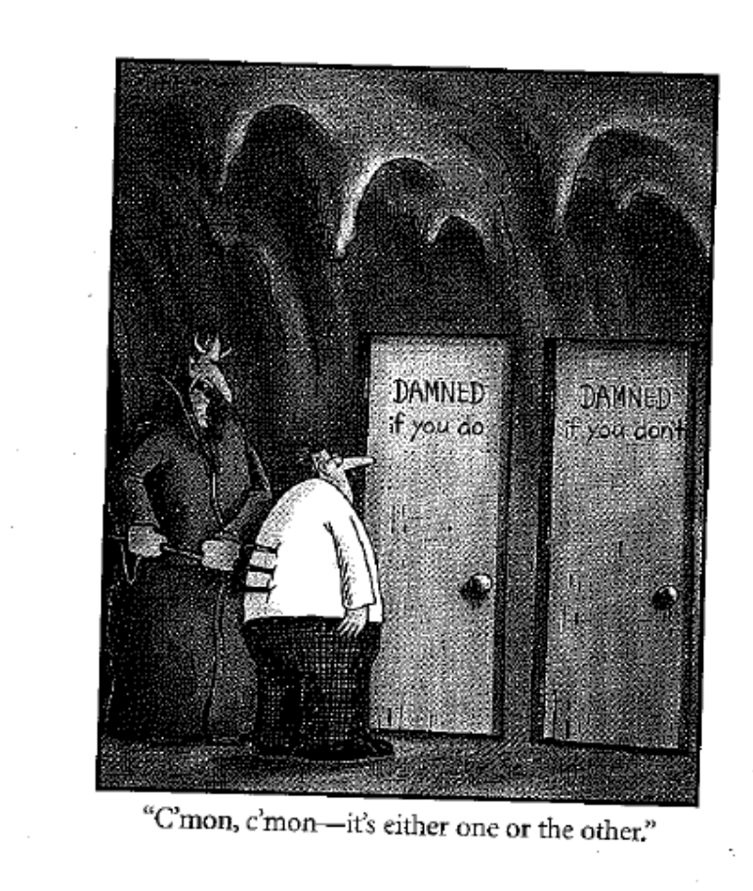

Slide 25
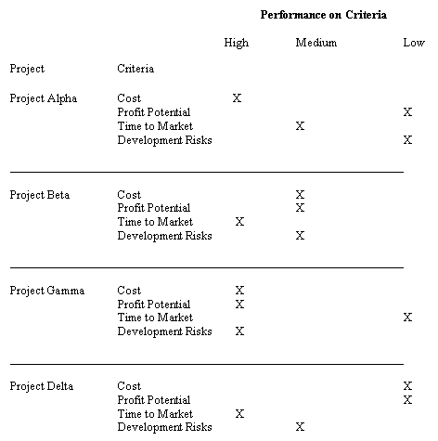
Selection Model - Checklist

Slide 26
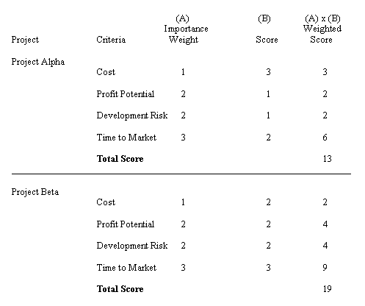
Selection Model – Simple Scoring Model

Slide 27
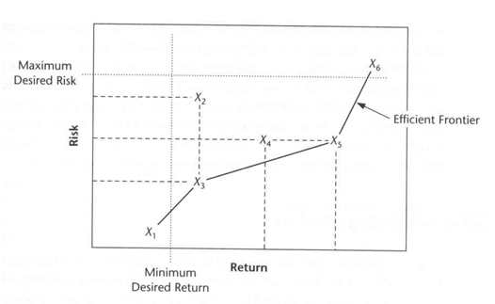
Selection Model – Profile Model
X₃ or X₅ could be the best. It depends on the firm's tolerance of risk.
Which Project is most desirable? Why?

Slide 28
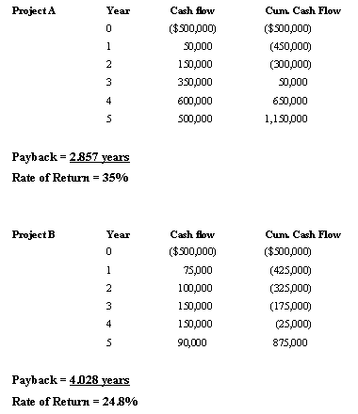
Selection Model - Payback Period
1/payback = RoR

Slide 29
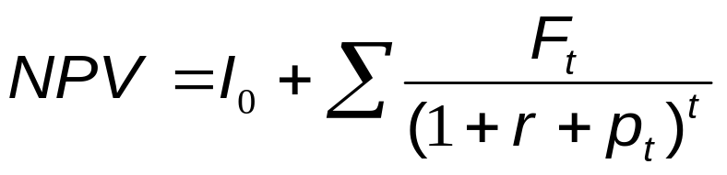
Selection Model – Net Present Value
This is the most common model for financial decision making project selections.
A positive Net Present Value (NPV) indicates the firm will make money.
The simplified formula for NPV is:
Where: F_{t} = the net cash flow for the period t
r = the required rate of return
I = the initial cash investment (cash outlay at time o)
p_{t} = inflation rate during period t

Slide 30
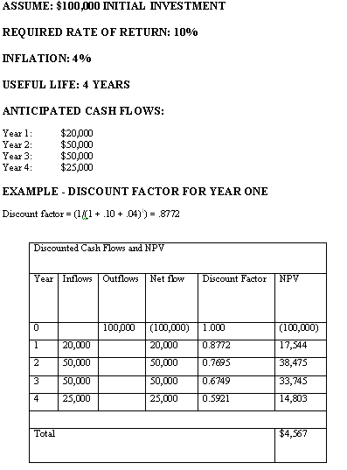
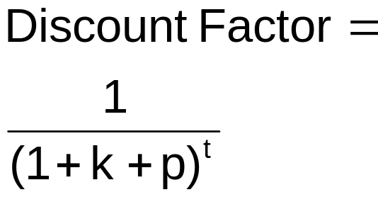
Net Present Value - Example
k= required rate of return
p= Inflation
Discount Factor = 1/((1+0.10+0.04)^0)=1

Slide 31
Net Present Value - Example
Discount Factor = 1/((1+0.10+0.04)^1)=0.8772

Slide 32
Net Present Value - Example
Discount Factor = 1/((1+0.10+0.04)^2)=0.7695

Slide 33
Net Present Value - Example
Discount Factor = 1/((1+0.10+0.04)^3)=0.6750

Slide 34
Net Present Value - Example
Discount Factor = 1/((1+0.10+0.04)^4)=0.5921

Slide 35
Net Present Value - Example
k= required rate of return
p= Inflation
Discount Factor = 1/((1+0.10+0.04)^4)=0.5921
+ve good proj.

Slide 36
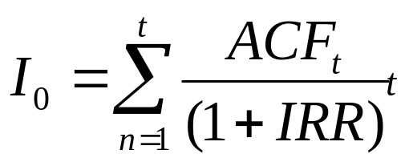
Selection Method – Internal Rate of Return
The Internal Rate of Return (IRR) method asks the simple question: What rate of return will the project earn? It must meet some minimum threshold.
Under this model the project must meet some rate applied to all projects under consideration.
IRR is defined as:
Where:
ACFt = The annual after tax cash flow for time period t
IO = The initial cash outlay
n = The project's expected life
IRR = The project's Internal Rate of Return
t = Life of project

Slide 37
Example
Suppose that a project required an initial cash investment of $5000 and was expected to generate inflows of $2500, $2000, and $2000 for the next three years. What is the internal rate of return for this project?
Solution: Answering this requires four steps:
Pick an arbitrary discount rate and use it to determine the net present value of the stream of cash inflows.
Compare the present value of the inflows with the initial investment; if they are equal, you have found IRR.
If the present value is larger (or less than) than the initial investment, select a higher (or lower) discount rate for the computation.
Determine the present value of the inflows and compare it with the initial investment. Continue to repeat steps 2-4 until you have determined the IRR.

Slide 38
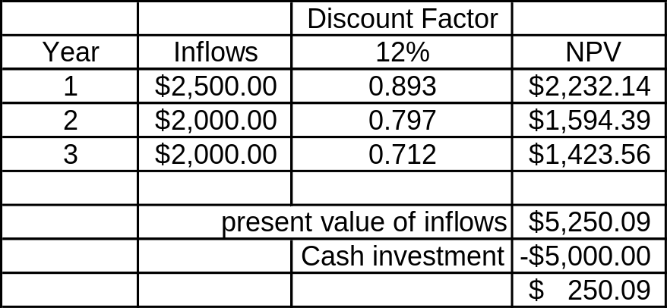
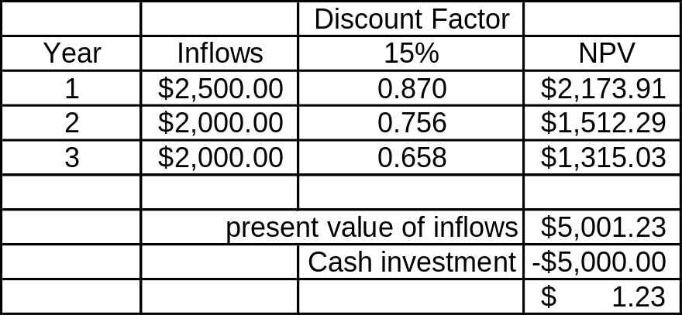
Example solution
Decision: Present Value at 12% is $250.09, which is too high. Try a higher discount rate. Next Step: Try 15%

Slide 39
Financial Models – other simple concepts sometimes used
Payback period – The number of periods it takes to recover your investment in the project before you start accumulating profit.
Benefit Cost Ratio (BCR) – A slight misnomer. Could also probably be more accurately called Revenue Cost Ratio though you will never hear it called that. It represents as the name implies a ratio of Costs to Benefits and when greater than 1, can be considered grounds for project approval.
Opportunity Cost - The opportunity given up by choosing one project over another. For example Project A has a NPV of $45k and Project B has a NPV of $105k, the opportunity cost of choosing Project B is $45k. Often this cost model is applied to underscore a scarcity of resources allowing for only one or the other project to be selected.
Discount factor – the reciprocal of the discount rate, it is equal to (1/ (1 + k +p)^{t}) . This factor is used in NPV and IRR calculations

Slide 40
Comparison among Screening and Modeling Types
It is important to understand that you cannot compare two projects being modeled using different financial models to come to a decision regarding the project viability. ie You cannot evaluate Project A with IRR analysis and Project B with NPV analysis and expect to be able to draw a conclusion about which is more viable.

Slide 41
Public Private Partnerships
Public–private partnership (P3) describes a government service or private business venture which is funded and operated through a partnership of government and one or more private sector companies. These schemes are sometimes referred to as a P3.
P3 involves a contract between a public-sector authority and a private party, in which the private party provides a public service or project and assumes substantial financial, technical and operational risk in the project. In some types of P3, the cost of using the service s borne exclusively by the users of the service and not by the taxpayer.
In other types (notably the private finance initiative), capital investment is made by the private sector on the strength of a contract with government to provide agreed services and the cost of providing the service is borne wholly or in part by the government

Slide 42
Public Private Partnerships (cont)
Government contributions to a P3 may also be in kind (notably the transfer of existing assets).
In projects that are aimed at creating public goods like in the infrastructure sector, the government may provide a capital subsidy in the form of a one-time grant, so as to make it more attractive to the private investors. In some other cases, the government may support the project by providing revenue subsidies, including tax breaks or by providing guaranteed annual revenues for a fixed period.
Typically, a private-sector consortium forms a special company called a "special purpose vehicle" (SPV) to develop, build, maintain and operate the asset for the contracted period. In cases where the government has invested in the project, it is typically (but not always) allotted an equity share in the SPV.

Slide 43
Public Private Partnerships (cont)
The consortium is usually made up of a building contractor, a maintenance company and bank lender(s).
It is the SPV that signs the contract with the government and with subcontractors to build the facility and then maintain it.
In the infrastructure sector, complex arrangements and contracts that guarantee and secure the cash flows and make P3 projects prime candidates for project financing.
A typical P3 example would be a hospital building financed and constructed by a private developer and then leased to the hospital authority. The private developer then acts as landlord, providing housekeeping and other non-medical services while the hospital itself provides medical services.

Slide 44
The origins of P3
Pressure to change the standard model of public procurement arose initially from concerns about the level of public debt, which grew rapidly during the macroeconomic dislocation of the 1970s and 1980s. Governments sought to encourage private investment in infrastructure, initially on the basis of accounting fallacies arising from the fact that public accounts did not distinguish between recurrent and capital expenditures
Public financing of Mega Projects had previously resulted in grossly inflated cost structures as the contractors had very little incentive to do a good job and every reason to waste tax payer dollars for their own benefit. Classic examples include Montreal’s Olympic Stadium and Mirabel Airport.

