Slide 1
Engineering Planning and Project Management
CEE 9510
Lecturer: Kevin McGuire P. Eng., M. Eng., PMP
Lecture 3
Project Management Processes

Slide 2
Project Management Methodologies Rockwell Automation (Mech. Eng.)
Page 199 – 204 PM Best Practices;
  Read the article
  Discuss briefly in groups
  Answer the following questions and present to class
Q1: No detail is given for the execution phase. Rockwell is a huge company. Do you think they are going too far in trying to make “one size fits all” – to the point where they cannot standardize execution?
Q2: Based upon the methodology described herein, is it possible to have too much project management methodology in a company in your opinion? If so, how would you know if your company were suffering from that condition?

Slide 3
Project Management Methodologies – Sherwin Williams (Chem. Eng.)
Page 204 – 208 PM Best Practices;
  Read the article
  Discuss briefly in groups
  Answer the following questions and present to class
Q1: What do you think a portfolio would look like for Sherwin Williams? What alignments do they likely have? How would you set up the company?
Q2: How would you define project management maturity in general?
Notes:
Management by Objectives is not adopted by all companies yet.

Slide 4
Project Management Methodologies – Perot Systems (Computer Eng.)
Page 208 – 213 PM Best Practices;
  Read the article
  Discuss briefly in groups
  Answer the following questions and present to class
Q1: Can you see any clear correlations between the “top-down” and “bottom-up” efforts made by Perot or do they seem mutually exclusive? They must correlate! How? Where?
Q2: Describe some benefits in rolling out this methodology that are perhaps not mentioned in the article.

Slide 5
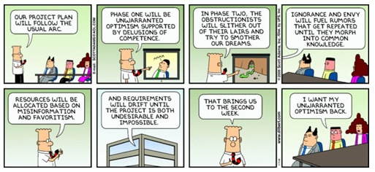
Std. misconception re project phases: Optimism, then reduction in confidence, then unavoidable pessimism………

Slide 6
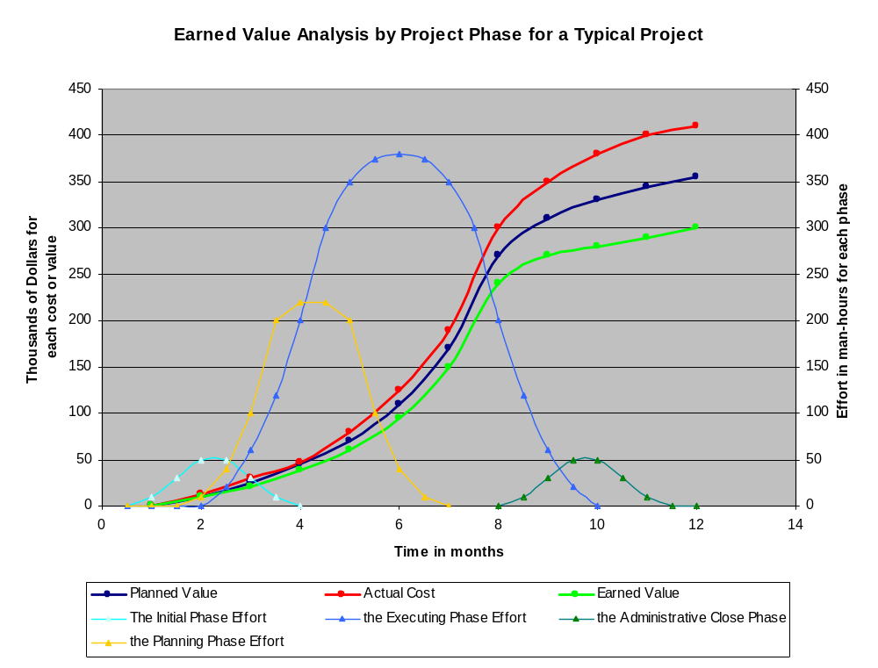
The 5 Phases of a Project (note monitoring and controlling take place across all 4 other phases)

Slide 7
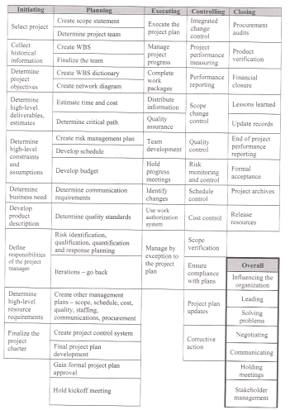
Notes:
这页重点！！！

Slide 8
1. Initiating
Collect historical information
Determine project objectives
Determine high level deliverables
Determine high level constraints
Determine high level assumptions
Determine business need
Determine product description

Slide 9
1. Initiating (continued)
Determine high level resource requirements
Define project manager role
Finalize the project charter

Slide 10
2. Planning
Create scope statement
Determine project team
Create work breakdown structure (WBS)
Create WBS dictionary
Create network diagram
Estimate time and cost
Determine critical path

Slide 11
2. Planning (continued)
Create risk management plan
Develop schedule
Develop budget
Determine communication requirements
Determine quality standards
Risk planning – all aspects
Create first level project plans i.e. scope, quality, communications, schedule, procurement, etc.;

Slide 12
2. Planning (continued)
Create project control system
Final project plan development
Gain formal project plan approval

Slide 13
3. Executing
Execute the project plan
Manage the project progress
Complete work packages
Distribute information
Quality assurance
Team development

Slide 14
3. Executing (continued)
Hold progress meetings
Identify changes
Use work authorization systems
Manage by exception to the project plan

Slide 15
4. Monitoring and Controlling
Integrated change control
Project performance measuring
Performance reporting
Scope change control
Quality control
Risk monitoring and control
Schedule control
Cost control

Slide 16
4. Monitoring and Controlling (cont.)
Scope verification
Ensure compliance with plans
Project plan updates
Corrective actions

Slide 17
5. Closing
Procurement audits
Product verification
Financial closure
Lessons learned
Update records
End of project performance reporting

Slide 18
5. Closing (continued)
Formal acceptance
Project archives
Release resources

Slide 19
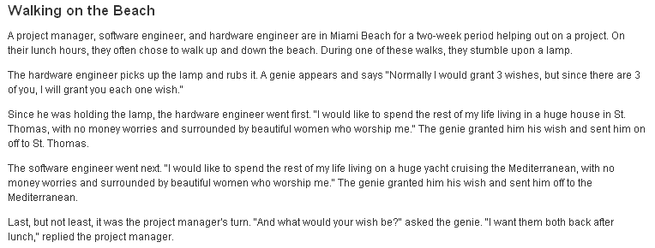
The true nature of a PM……..

Slide 20
Other PM activities performed across all phases of the project
Influencing the organization
Leading
Solving problems
Negotiating
Communicating
Holding meetings
Stakeholder management

Slide 21
Now lets change gears a bit…lets talk about project portfolios….
So far this week, we have been talking in general terms about everything that is done in each project.
Now, lets talk about what projects a company should have and what they shouldn’t have in order to properly align themselves with what they are good at so they can make money.

Slide 22
Project Selection
Companies need methods known as Selection Models in order to decide what projects they should work on.
Companies simply have too many alternatives for choosing work. The application of a selection model whittles down the project alternatives to those that are most attractive to the firm – if any.
There are two general types of selection models. They all fall under headings of either screening models or financial models.
Financial models are better in many ways, but are plagued by a lack of knowledge concerning future economic factors such as inflation.
Screening can be a cheaper and faster strategy, but runs the risk of using too much gut information, and not enough solid facts.

Slide 23
Project Portfolio Management
A portfolio of projects is the name given to a collection of projects overseen by the same leadership.
Projects are managed concurrently in most businesses and they share a common strategic purpose (or at least they should).
Project portfolios consist of projects that need access to the same scarce resources.
The concept of portfolio management holds that companies should not manage projects as independent entities.
The concept implies that project selection has a direction beyond simply screening and financially modeling each project on a case by case basis. There is a corporate strategy for which ones to even look at.

Slide 24
Project Portfolio Direction
Several criteria are used for the evaluation of project opportunities:
Cost: Project types with lower development costs are more favorable.
Opportunity: The potential financial return for certain project types is a big driver.
Top Management Pressure: Everybody is better at certain things, and managers like most to be involved in things they clearly understand.
Risk: Less risky projects are more likely to be funded. This is generally balanced against opportunity.
Strategic fit: Projects consisting of products that fit most neatly into the existing portfolio are highly prioritized.
Portfolio balance: Offsetting risky initiatives by funding other projects is an insurance policy many companies use.

Slide 25
Realignment and Reprioritization
When new projects are added, companies must again re-examine their priorities. They must understand if the strategic direction of the company is unchanged. Does the company now need to cancel other projects for example?
If the strategic direction of the company has changed, then this is also the right time for companies to reprioritize corporate goals and objectives. In this sense portfolio management therefore means managing overall company strategy.

Slide 26
Portfolio Management – Classic Industry Examples
Pharmaceuticals – Long lead times and extremely low success rates for product development projects (~0.002% of all projects undertaken) mandate that pharmaceutical companies such as Pfizer and Merck continuously practice sophisticated project management. If one drug fails to make it to the commercialization point, other possibilities must be right behind it.
Automotive – This is an industry that in many ways is a fashion victim. Companies are forced to continuously have the latest styles and technologies at extremely high levels of quality or risk market disapproval. As a consequence the practice of design to cost projects throughout the industry is an enormous effort annually. Low profit margins even in good times is another driving factor.

Slide 27
Keys to Successful Portfolio Management
Flexible Structure and Freedom of Communication – Companies that are low-burocracy / high innovation are more successful at executing a project portfolio strategy.
Low Cost Mini-Project Probes – Companies that practice portfolio management either by entering new markets on small scales or flooding existing markets with multiple innovation concepts risk gaining tremendous market advantages in what they learn prior to getting in big with a project.
Time Paced Transition – Knowing the product life cycle can be critical. Getting out of one process and into the next innovative project is a function of marketing.

Slide 28
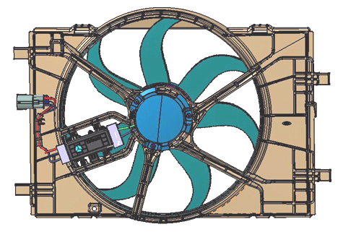

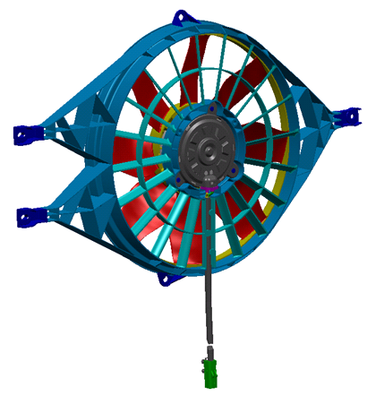
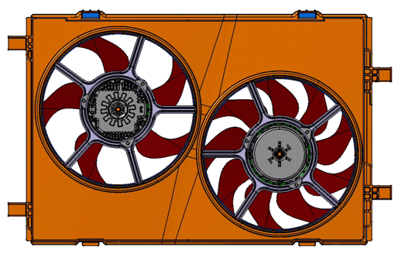
Project Portfolio - A well aligned example

Slide 29
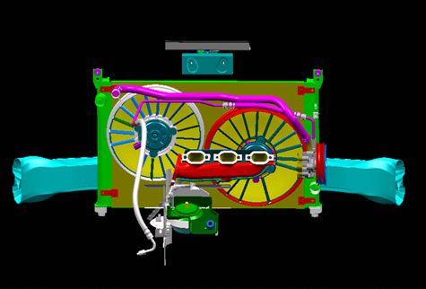

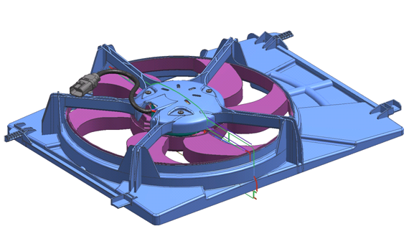
Project Portfolio – A poorly aligned example

