Slide 1
Engineering Planning and Project Management
CEE 9510
Lecturer: Kevin McGuire P. Eng., M. Eng., PMP
Lecture 4
Project Integration Management

Slide 2
Integrated Processes – DTE Energy links cpi to the PM’s pay cheque
Page 269 – 270 PM Best Practices;
  Read the article
  Discuss briefly in groups. Identify what terms you do not understand.
  Answer the following questions and present to class
Q1: In your opinion are Project Managers typically motivated by money to perform their work more efficiently? Is anyone? Is everyone?
Q2: In the absence of earned value analysis how would a project manager, or for that matter an academic doing research effectively communicate progress?

Slide 3
The Project Charter
Sometimes known as the Statement of Work (SOW)
A project charter is the document that gives the specific project manager the authority to proceed with the project.
A project charter is the document that formally recognizes the existence of a project.
A project charter provides the goals and objectives of the project.
Every project must have a project charter to be a project.
The project charter is the document against which success or failure of the project will be measured.

Slide 4
Characteristics of all Project Charters
Created by a manager or director who is external to the project and higher in the corporate hierarchy.
Created during the defining or (as in PMBOK) the initiating phase of the project.
Broad enough so that it does not NEED to change as the project changes.
An output of scope initiation.
Owned and applied by the project manager if and as necessary post executive approval.

Slide 5
Contents of a Project Charter
Project Title and Description (What is the project?)
Project manager assigned and authority level (Who is given authority to lead the project and to what degree do they have decision making responsibility for cost, resources, and timing – the Triple constraint)
Objectives (What Triple constraint numerical criteria will be used to measure project success?)
Business Case (Why is the project being done?)
Product Description and Deliverables (What are the specific deliverables that are wanted and what will be the end result of the project.)
Signature noting Approval to Proceed (a person high enough on the organization chart that everyone will indirectly report to).

Slide 6
Supplementary contents also often included
The nomination of key technical resources. This gives the PM the authority to work with specific skilled individuals.
A rough pre-released scope statement.
The methodology to be applied. For example it may clearly state PMBOK methodology or perhaps the home grown modified PMBOK methods a company may apply. If so it usually has a name and it should be stated.
The portfolio alignment the project will be a part of. This would then mandate the project to be monitored for consistent content with a particular family of other programs and projects that the company has either completed or will complete.

Slide 7
Discussion Exercise
Case: An aviation electronics manufacturing firm requests the design and execution of an experiment (DOE) to determine the influences of various system parameters upon the solderability of their surface mount devices on a printed circuit board they manufacture. The project is to be contractually assigned to the company you work for as a project manager. Based upon the DOE results, the project is to also include system upgrades as necessary to achieve their 6 sigma process control targets for soldering.
1. Write out the project charter making up relevant details as necessary.
2. What special charter considerations should be made for the execution of corrections identified by the DOE? Should more than 1 charter be issued in this case? Why?
3. Should the cost of quality be considered in this case? How? Can the charter be issued without making this consideration?
4. As the project is contractual, is a charter necessary?

Slide 8
Question to the Class
You have created the project charter, but could not get it approved. Your manager and his boss have asked that the project begin immediately. Which of the following is the BEST thing to do:
  Set up an integrated change control process
  Show your manager the impact of proceeding without approval
  Focus on completing projects that have a signed charter
  Start work only on the critical path tasks.

Slide 9
Question to the Class
You have created the project charter, but could not get it approved. Your manager and his boss have asked that the project begin immediately. Which of the following is the BEST thing to do:
  Set up an integrated change control process
  Show your manager the impact of proceeding without approval
  Focus on completing projects that have a signed charter
  Start work only on the critical path tasks.
Answer: B The best thing to do would be to evaluate the impact. This is the only choice that prevents future problems - always the best choice. The other choices just pretend the problem does not exist.

Slide 10
Teamwork
Now lets introduce some concepts associated with making a functioning project team now that you have the authority to actually assemble one……..

Slide 11
The Co-Located Team
This team is easiest to deal with, because much of what needs to be done is simply good, sound fundamentals.
Always be polite, check your ego, and do not micromanage. Let the team feel the freedom of their assigned task. Hold your team accountable for results as well, but even this interaction can be accomplished politely and professionally…; Being well liked will help your project results.
As PM you should in general not exclusively talk shop. Be friendly, but maintain the dignity of your position. A few kind words about a colleague’s interests is an excellent ice breaker to almost any interaction. Then you can proceed on to business.
Do not be overbearing. A perception of arrogance from the team towards you can be fatal as they will all retreat into a work to rule posture.

Slide 12
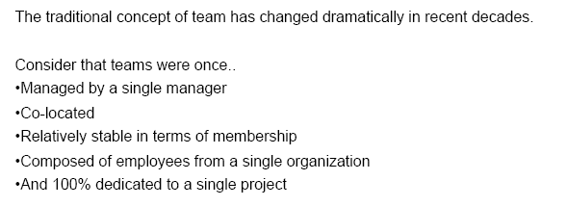

Project Teamwork is Evolving…

Slide 13
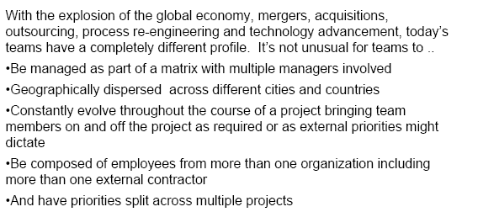
…And this is the way it is heading….

Slide 14
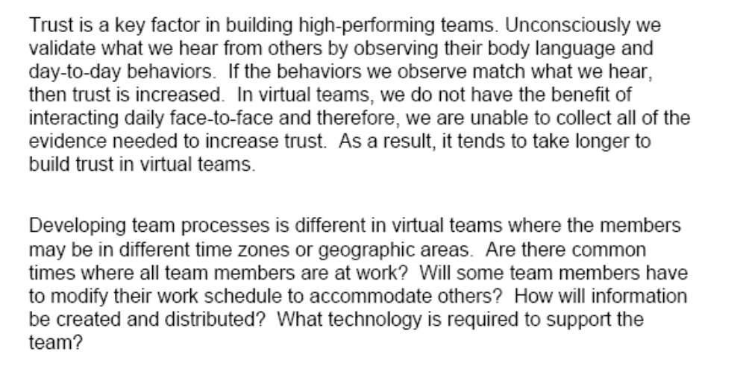
Trust is key

Slide 15
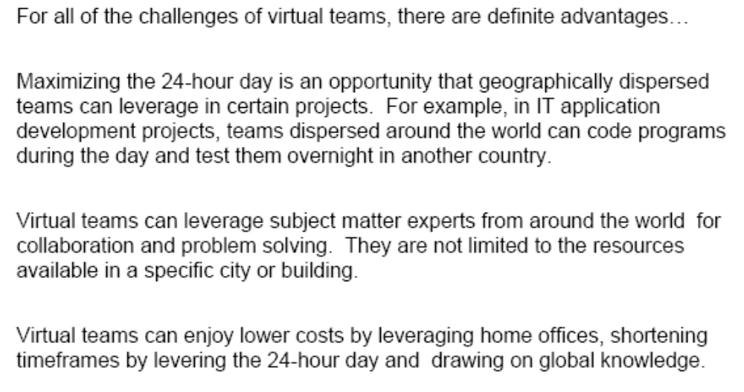
The Advantages presented by Virtual Teams

Slide 16
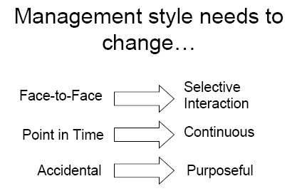
Virtual teams and Communication Styles

Slide 17
Performance Reporting
Now that you have the team up and running, somebody is going to ask you how well they are doing. We will touch on these concepts later in the course, but for now simply consider that they will ask you about time, money, and scope. On the next series of slides we will detail some elementary information regarding how this is best done.

Slide 18
Performance Reporting for the Finances of the Project
The most effective and most interesting way to report out the progress of your team is through EVA which we will learn later on in the course.
It is important however to know that often management can want more details. As such if technology permits, and if the document is with me the evening this lecture, I can demonstrate what a more detailed performance report truly looks like.
I will reinforce this with you many times throughout the course: Project Managers manage costs – not prices, not profits – COSTS. That said the reason I mention it now is because so many other financial concepts roll out of costs that you get dragged into them. Things such as margins, markups, billings, revenue, deviations, etc. They are all important concepts and will mean something very specific to you one day, but for now remember the PM’s job is to manage COSTS.

Slide 19
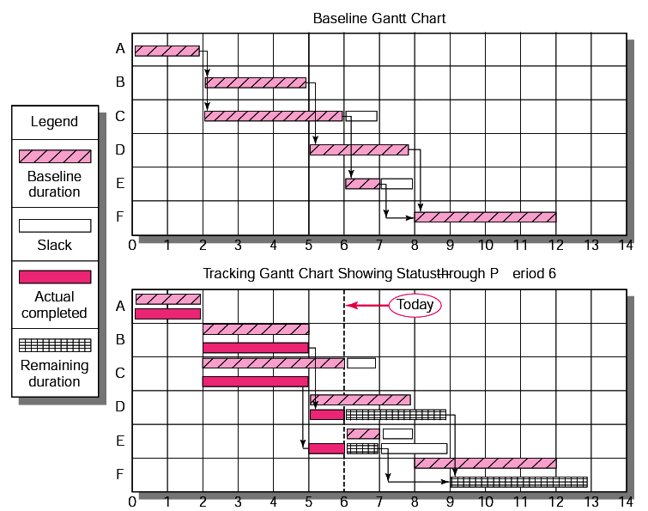
Baseline Gantt Chart Performance Reporting for Time

Slide 20
Coaching, Rewarding, and Recognition
So…well done…the team is functioning and you are making money. Now is the time to say Thank You to a few of these people….
But first, lets review a few basic concepts regarding making people want to be fantastic at what they do.

Slide 21

Coaching

Slide 22
Coaching
Different strokes for different folks…. The evolution of a team member
High
Performer
Bored
Knowledge
Disillusioned
team member
New Team
Member
Motivation

Slide 23
Coaching
Different strokes for different folks…. The evolution of a team member
High
Performer
Bored
Knowledge
Disillusioned
team member
New Team
Member
Motivation

Slide 24

Coaching
Different strokes for different folks…. The evolution of a team member
High
Performer
Bored
Knowledge
Disillusioned
team member
New Team
Member
Motivation

Slide 25

Coaching
Knowledge
Expectations
Motivation

Slide 26
The Coaching Session
Be Prepared
Clarify expectations
Communicate Observations
Be specific
Use appropriate language – stick to the WHAT, avoid the WHO
Manage your body language (make eye contact, smile)
Plan for improvement

Slide 27
The Coaching Session
Be Prepared
Clarify expectations
Communicate Observations
Be specific
Use appropriate language – stick to the WHAT, avoid the WHO
Manage your body language (make eye contact, smile)
Plan for improvement

Slide 28

Rewards and Recognition
“Formal management actions that promote or reinforce desired behavior”

Slide 29

Rewards and Recognition
Identify

Slide 30

Rewards and Recognition
Choosing appropriate rewards

Slide 31

Rewards and Recognition
Choosing the time to award

Slide 32
Change Management
Now the team is chosen, we have set out on our tasks, results are coming back very positively, we have even adjusted the play of some of our team and rewarded others. Fantastic! What could go wrong from here?
Suddenly the financials are coming back not as rosy and we are overshooting timing as well…..Time to investigate if we are handling change management properly….

Slide 33

Causes of Changes
Technological uncertainty
When the project team learns more about the nature of the deliverable
  Project scope changes
  Implementation of contingency plans
  Improvement changes
A mandate

Slide 34
Scope Creep - Definition
“Scope Creep in project management refers to uncontrolled changes in a project’s scope.
Typically, the scope increases by adding both new products and new features of already approved products. As a result, the project drifts away from its original purpose. Because of the tendency to look at only one dimension of a project, scope creep can also result in a project overrunning its original budget and schedule, as more is to be done at the same cost and in the same time (which is usually unrealistic, given a stretched original budget and schedule).
Scope creep can be a result of:
poor change control
lack of proper identification what products and features are required to bring about the achievement of project objectives in the first place.
weak project manager or executive sponsor"
Notes:
Important!!

Slide 35
Scope Creep - Bad
Scope Creep is the expression used by project managers and/or vendors who are under pressure to constantly deliver in excess of what was originally agreed. Scope creep normally results from a failure to establish the clear requirements of the business users. As these begin to solidify the scope of the original plan can start to move - and continue to move. If the project manager is not alert to this (all too common) phenomenon, the requirements will constantly change thus ensuring that the projects spends years on delivering nothing, as they are continually reviewing and altering direction.
Scope Creep - do not allow it to happen to you!”

Slide 36
Factors having the maximum impact on project productivity
People
Work
Low staff experience or skill
Low staff morale
Low availability/ experience of supervisors
Overtime staff fatigue
Poor clarity/incomplete requirements/ specifications
Work-scope changes generated externally to project
Work-scope changes generated internally to project

Slide 37
Scope Creep - Natural
“Scope creep is the pejorative name we give to the natural process by which clients discover what they really want.”
-Hal Helms-
“When we suddenly realize that our project's scope has expanded far beyond its initial boundaries — when we have that how-did-we-ever-get-here feeling — we're experiencing the downside of scope creep. Preventing scope creep starts with understanding how it happens.”
-Rick Brenner-

Slide 38
Scope Creep – A Lack of Creativity
“The unknown
  Projects are ventures into unknown territory. Sometimes we underestimate the complexity of the problem we've tackled.”
-Rick Brenner-

Slide 39
Integrated Change Control
Inputs
Project management plan
Work Performance information
Change Requests
Enterprise Environmental Factors
Organizational Process Assets
Tools &
Techniques
Change Control Meetings
Expert judgment
Outputs
Change Request Status Updates
Project Management Plan Updates
Project Document Updates

Slide 40
Five Principles of a Formal Change Program
All contracts specify formal change process
All changes require formal change order
All change orders approved in writing by client and project organization
Project manager is always consulted
The approved change order becomes part of the master plan

Slide 41
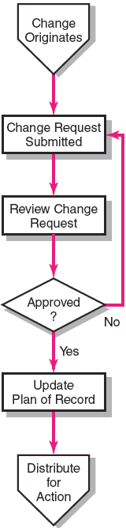
The Change Control Process

Slide 42
Step 1: A Practical Approach
Analysis
A situation is identified
A problem is uncovered
Is this a problem?
Whose problem is it?
Is someone trying to make their problem the project’s problem?
  I bid too low so you will have to change the scope.
  I under budgeted the project so you will have to find ways to decrease costs.

Slide 43
Step 2: A Practical Approach
Analysis
Problem characteristics are identified
A problem is uncovered
What are the characteristics of the problem?
Are there obvious solutions?
Is someone clearly responsible for the problem, i.e. someone left information off of a drawing?

Slide 44
Step 3: A Practical Approach
Analysis
Problem characteristics are identified
Alternatives are proposed
What are the various options and what is the impact of each option?
Who must take responsibility for developing the solution and implementing the solution?

Slide 45
Step 4: A Practical Approach
Analysis
Alternatives are proposed
No change in project’s scope
Change to the project's scope
If the solution is within the scope, issue an Instruction
If the solution is not within the scope determine whether the change is scope is essential or desirable.

Slide 46
Step 5: A Practical Approach
Analysis
Change is required
Change is essential to project success
Change is desirable, enhancing project success
If the solution is desirable, issue a Contemplated Change Request
If the solution is essential, issue a Change Directive.

Slide 47
Step 6a: A Practical Approach
Change is desirable, enhancing project success
Analysis
Quote for the additional cost or credit is produced by those responsible for the work
Quote is or is not accepted following negotiation
Analysis

Slide 48
Step 6b: A Practical Approach
Change is essential to project success
Analysis
Work begins;
Quote for the additional cost or credit is produced by those responsible for the work
Quote is accepted following negotiation
Analysis

Slide 49
Step 7: A Practical Approach
Quote is accepted following negotiation
A Change Order is prepared and issued
All is right with the world
The amount and schedule of the contract are modified.

