Slide 1
Engineering Planning and Project Management
CEE 9510
Lecturer: Kevin McGuire P. Eng., M. Eng., PMP
Lecture 5
Project Scope Management

Slide 2
Scope Management – Churchill Downs Inc. on Managing Project Scope Changes
Page 423 – 426 PM Best Practices;
  Read the article
  Discuss briefly in groups. Identify what terms you do not understand.
  Answer the following questions and present to class
Q1: In step 4 if the hardware is not changing, and the software is not changing, then what aspect of the project might be changing that would require formal change management?
Q2: What do you think the typical relationship is between the project manager and the officials in the project management office (PMO)? Is it co-operative? Adversarial? Explain your reasoning.

Slide 3
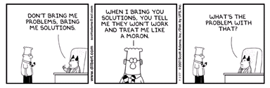
Project Constraints
Before you can define the scope of a project, you have to know and understand the enterprise environmental factors that place natural limits to the scope in place.
Constraints are factors that limit the team's options on things such as resources, budget, and schedule.
Constraints are inputs to many aspects of project management.
Management identifies some, project managers others, with the team and other stakeholders identifying even more.

Slide 4
Scope Statement
A Scope statement is the first document produced in the planning phase of a project being managed and should include:
the project objectives
the project deliverables
the project milestones
the project technical requirements
the project limits and exclusions
a signed off approval of a review of the document with the customer
a signed off approval of a review of the document with corporate management
Notes:
Important！！

Slide 5
Scope Statement Example
Project Scope is a definition of the end result or mission of the project. Here is the management and customer approved scope of one project I worked on as PM at one point in my career:
To design, develop and DV/PV validate the GMX 322 Diesel Cadillac 850 Watt IRBL Cooling Fan Assembly (fan, shroud, motor, TOC clip, warning label) and associated final assembly line with a SOP of January 3, 2009, at SV London manufacturing site, with a demand of 18,000 units/year maximum. The customer is DMMI.
The design and development of the electric motor is to be held over in every way from the 850 Watt E-70 BMW IRBL application with the possible exception of the connector and lead length which may need re-specification.

Slide 6
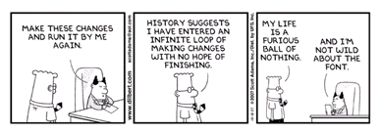
Scope Statement Negotiation
The Scope statement can be hard to gain approval on from all stakeholders. People like to debate the wording, but successful sign off on this item is critical to project success.

Slide 7
Scope Management Plan
A Project Scope Management Plan can be driven by project progressive elaboration. Items get near the edge of the scope, and then eventually wander out.
This is the document that describes how scope and scope changes will be managed.
A scope management plan provides advantages. In particular less scope creep, fewer scope changes, less scope conflict, improved communications, and customer satisfaction are achieved.
The plan is often executed as an extension of the Management by Objectives (MBO) Philosophy which says an organization should:
    Establish unambiguous and realistic objectives
    Periodically evaluate if objectives are being met
    Take corrective action

Slide 8
Scope Verification
Definition of scope verification: The process of formalizing acceptance of the project scope by the stakeholders.
Scope verification consists of some or all of the following and is completed at the end of each project phase:
Reviewing work to ensure it is correctly completed and is satisfactory
Conducting inspections, reviews, and audits
Determining whether results conform to requirements
Documenting completion of deliverables
Gaining formal sign off
Scope verification is similar to quality control, but QC relates to the correctness of the work, while scope verification relates to customer acceptance of the work.
Notes:
Important！！！

Slide 9
Work Breakdown Structure
Definition: A work breakdown structure (WBS) is a deliverable oriented grouping of project components that organizes and defines the total scope of the project.
The WBS is the project scope broken down into smaller manageable pieces.
Project managers cannot, in fact nobody can, manage projects. PM's manage pieces of projects.
A WBS looks like a company organization chart, particularly one under development and not yet broken down into its lowest levels, but it is not.
The WBS is the tool used to decompose a scope to a manageable level.
Notes:
Project broke down 5-8 hours pieces

Slide 10
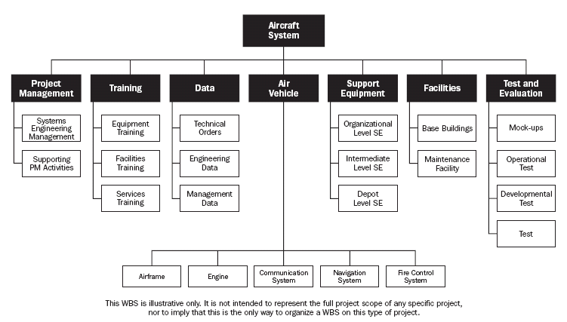
Sample WBS Structure – But not yet at a manageable level

Slide 11
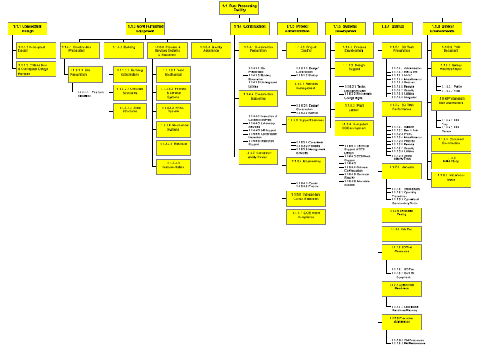
Completed WBS Example

Slide 12
Completed WBS Example

Slide 13
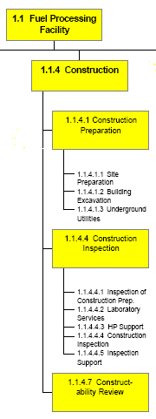
Completed WBS Example - Close Up
Gaps are sometimes left in the numbering sequence if the WBS is being derived from a standard WBS template the company uses. For example in this case we see no activity related to a hypothetical 1.1.4.5 "Review Site Selection with Concerned Citizens Groups"

Slide 14
Characteristics of a WBS
Tasks at the lowest level should take between 8 and 80 man*hours to complete. This is the correct level of detail required for people to manage.
The WBS is not a simple list of tasks, that you can then roll into a Gantt chart!
A WBS demonstrates the flow of work for a project and allows the team to view it. A simple list does not.
A WBS is the correct illustration for generating stakeholder buy-in for a project.

Slide 15
Rules for Creating a WBS
A WBS is created by the full project team.
The first level is completed before the project is broken down further
Each level of the WBS is a smaller segment of the level above
The entire project is included in each of the higher levels, however eventually some levels will be broken down more than others.
Work toward the project deliverables
Work not included in the WBS, is not part of the project.
Break down the project into work packages that can be realistically and confidently estimated.
Break down the project to a point where it can no longer be logically subdivided, can be completed quickly, and has a meaningful deliverable.
Break down the project into packages that can be completed without interruption. (no additional information required)

Slide 16
Question
For which of the following can work breakdown structure be used?
Communicating with the customer
Showing calendar dates for each task
Showing the functional managers for each team member
Showing the business need for the project

Slide 17
Question
For which of the following can work breakdown structure be used?
Communicating with the customer
Showing calendar dates for each task
Showing the functional managers for each team member
Showing the business need for the project
Answer: A A WBS does not show dates or work assignments. (choices B and C). Those are included on the Gannt chart and possibly in the communications plan. The business need (choice D) is shown in the project charter.

Slide 18
Work Packages
The lowest level the project manager will manage is called the work package, also sometimes called the activity.
The person completing the work package may break it down further, but the PM will only track the work to the work package level.
On very large projects work packages may exceed the 8-80 hour rule of thumb, being even many hundreds of hours in duration.
When the rule of thumb duration is exceeded for work packages, it is often in a scenario where a project manager is working for another project manager. i.e. in subcontractor situations common in the construction and manufacturing industries.

Slide 19
Why the WBS is so Important
Estimating
Staffing
WBS
Risk
Network
Diagramming

Slide 20
WBS Dictionary - explained
The WBS Dictionary is the Taxonomy for the WBS Activities
Used to control what work is done and when
Used to prevent scope creep
Used to understand the effort for each task
Physically the WBS dictionary is written when the WBS work packages are posted on a wall or white board in a logical sequence relative to one another to reflect the flow of work. When they are removed in numerical order, the WBS Dictionary is generated
Entries in the dictionary are referred to as task descriptions
Frequently they are arranged on color coded work packages to clearly identify the hierarchy of the task.

Slide 21
WBS Dictionary – one entry illustrated
WBS Dictionary (Task Description)
Project name____ | Task # __1.2.7______ | Date Issued______ | Person Assigned___
Task Description (what work is authorized)
Quantified Objectives (See the description in the Project Charter)
Product Description (what is the end result of the work package?)
Acceptance Criteria (how will the team member be able to check their work?)
Deliverables (See the description in the project charter)
Assumptions
Resources assigned
Duration
Cost
Due Date
Interdependencies: Before this task______ After this task_________
Approved by: Project Manager____________________ Date ________

Slide 22
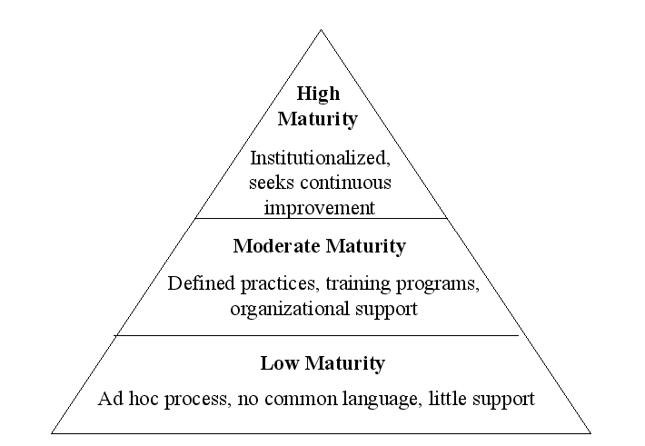
Project Management Maturity

Slide 23
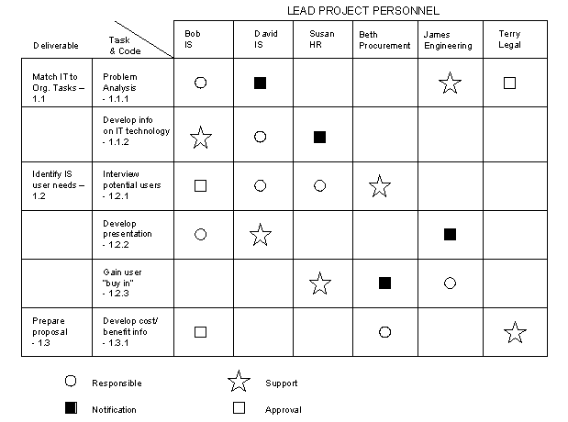
Responsibility Assignment Matrix

Slide 24
Work Authorization
Once the scope has been decomposed into useful work packages, the next natural step is to get formal agreement between stakeholders regarding project content known as the work authorization. If the client is external, this likely includes the contract signoff.
Project management contracts to be valid require and consist of at least:
Possessing the legal right to contract
Being of legal age to contract
Being of sound mind at the time of signing
Valid and Legal Consideration for both parties
A legal scope of work
Offer and acceptance

Slide 25
Work Authorization
Project management contracts also likely contain many of the following:
Excusable delays
Allowable costs
Statements of liquidated damages (non-performance clauses)
Criteria for Inspection
Responsibility for correction of defects
Dispute resolution mechanisms

Slide 26
Question
A project manager new to project management has asked why they should bother using a work breakdown structure (WBS) on their project. The BEST response would be:
Tell them it will prevent work from slipping through the cracks.
Tell them that one is not needed
Tell them it is required if the project involves contracts
Tell them it is the only way to identify risks

Slide 27
Question
A project manager new to project management has asked why they should bother using a work breakdown structure (WBS) on their project. The BEST response would be:
Tell them it will prevent work from slipping through the cracks.
Tell them that one is not needed
Tell them it is required if the project involves contracts
Tell them it is the only way to identify risks
Answer: A Though risks should be identified by a task or work package, risks can also be identified by interview. therefore choice D is an incorrect statement and not the best answer. Choice C is not generally true. The WBS is needed for all projects, not just contractually obligated projects. Preventing work from slipping through the cracks is ONE of the reasons the tool is used.

Slide 28
Scope Reporting
Scope reporting consists of regular updates regarding cost, schedule, and technical performance. Typical documents include:
  S-Curves (graphical display of costs vs. project schedule)
  Earned Value Analysis: Reports project status in terms of both costs and time – The budgeted value of work performed regardless of actual costs incurred.
  Variance or exception reports – documenting any slippages in time, cost, or resources
  Schedule status: Updates on schedule adherence
  Technical performance status: Updates on technical challenges and solutions
  The parties receiving these documents could be any stakeholders that need to know.

Slide 29
Control Systems
Configuration Control – Tracks the emerging scope vs. the baseline scope as status changes and new circumstances alter conditions.
Design Control - This relates to systems that monitor the project's scope, schedule, and cost during the design phase.
Trend Monitoring - This is the process of tracking the estimated costs, schedules, and resources needed against those planned.
Document Control – Ensures that important documentation is compiled and disseminated in an orderly and timely fashion.
Acquisition Control - Monitors systems used to acquire necessary project equipment, materials, or services.
Specification Control - Ensures that project specifications are prepared clearly, communicated to all, and only changed with proper authorization.

Slide 30
Question
During project execution, a project team delivers a project deliverable to the customer. However the customer neither acknowledges the deliverable nor replies to the project manager's requests for verification such that proper scope control cannot be executed. What is the BEST thing to do?
  Continue with the project
  Document the situation
  Contact management for help
  Call a meeting of the team

Slide 31
Question
During project execution, a project team delivers a project deliverable to the customer. However the customer neither acknowledges the deliverable nor replies to the project manager's requests for verification such that proper scope control cannot be executed. What is the BEST thing to do?
  Continue with the project
  Document the situation
  Contact management for help
  Call a meeting of the team
Answer C Choices A, B, and D are all control activities. This situation asks how to prevent the problem. This would have been done in planning, as the project deliverables are defined in scope planning (Choice C).

Slide 32
Project Closeout
Effective Scope management also includes appropriate planning for a project's termination
Closeout information can be important because:
The more thorough the closeout project records, the less likely the company could be held liable for alleged violations.
It is a great source of lessons learned.
It facilitates project auditing tasks by showing the flow of expenses in and out of various project accounts.

Slide 33
Tracking Project Closeout
Closeout documentation a project leader may choose to track includes the following:
Historical records that can be used to predict trends, feasibility, or highlight problem areas for similar future projects.
Post-project analysis reports of cost, schedule adherence, and technical specification performance.
Financial accounting analysis documents that show how funds were dispersed on the project.

