Slide 1
Engineering Planning and Project Management
Lecture 7
Project Cost Management

Slide 2
Examples – the role of the PMO (a. Star Alliance b. Jefferson County Co.) Information Technology
Read the descriptions on P448-P453 regarding Project Management Offices from Project Management Best Practices. Break into your groups and prepare answers to the following questions:
Question 1: If the PM meets with the PMO monthly, do you think these checklists are going to be enough to understand how well the project is doing? What other information would you recommend the PM supply?
Question 2: These examples relate to Information Technology type projects. Do you think the role of the PMO has the same potential to assist in traditional Civil, Chemical, Mechanical engineering firms? Why or why not?

Slide 3
How Engineering Consulting Firms Look at Costs
Overhead is everything over and above the de facto hourly rate to the engineer. For example if an engineer earns $80k/yr over 2000 hrs/yr, that implies he makes $40/hr (assume 2 weeks holidays and 8 hour days). The reality however is that the typical overhead for this engineer is 2.3x that in a large firm. A $92/hr charge out rate is pretty normal to cover costs only. (pensions, CPP, WSIB, dental and medical, etc)
Allowable profit on the project will dictate what the billoout rate should be. For example if the contract allows for 25% profit, the bill out rate would be $92*1.25 = $115/hr.
“utilization rate” or “absorbtion in the job rate” varies by engineering firm as well as their relative lelve of business activity. For example an engineer charging 80% of his time internally to booked projects is typical, however if the company is extremely busy, a figure of 97% would not be unheard of.
Typically engineering firms are highly projectized with engineers assigned to jobs and booking their hours there as opposed to working in a department and charging their hours in a more indirect manner – ie to the department.

Slide 4
Earned Value Analysis
Earned Value Analysis is a point in time technique used for tracking project progress thus far. It is also a great tool for predicting the performance of the project moving forward.
Fundamentally the concept is simple. " What have we spent so far, and what are the value of goods and services we have received in return so far"?
Usually it is very simple for the project manager to calculate this. He adds up his purchase orders to vendors + his expenses – these are his actual costs, and he compares them to what he received in return – this is his earned value.
Your first instinct upon reading that last note should be " But the project manager should always get exactly what he pays for!!" Yes that is true, but what he gets does not always solve the problem it was intended to solve or to the degree that was desired. So, some estimating of earned value is usually required. It is generally done by estimating the percent complete for each individual work breakdown package and summing it up vs. expectations.
EVA is generally tracked for senior management in large corporations by the project management office (PMO).

Slide 5
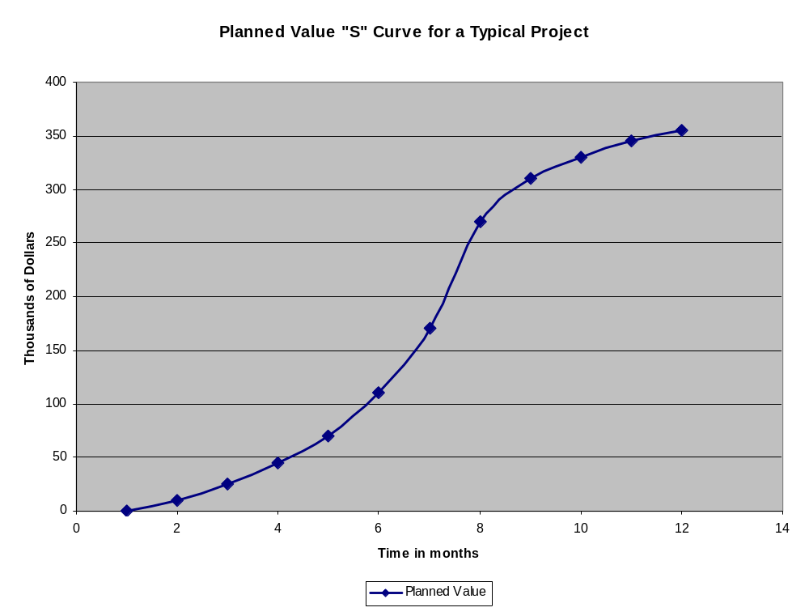

Slide 6
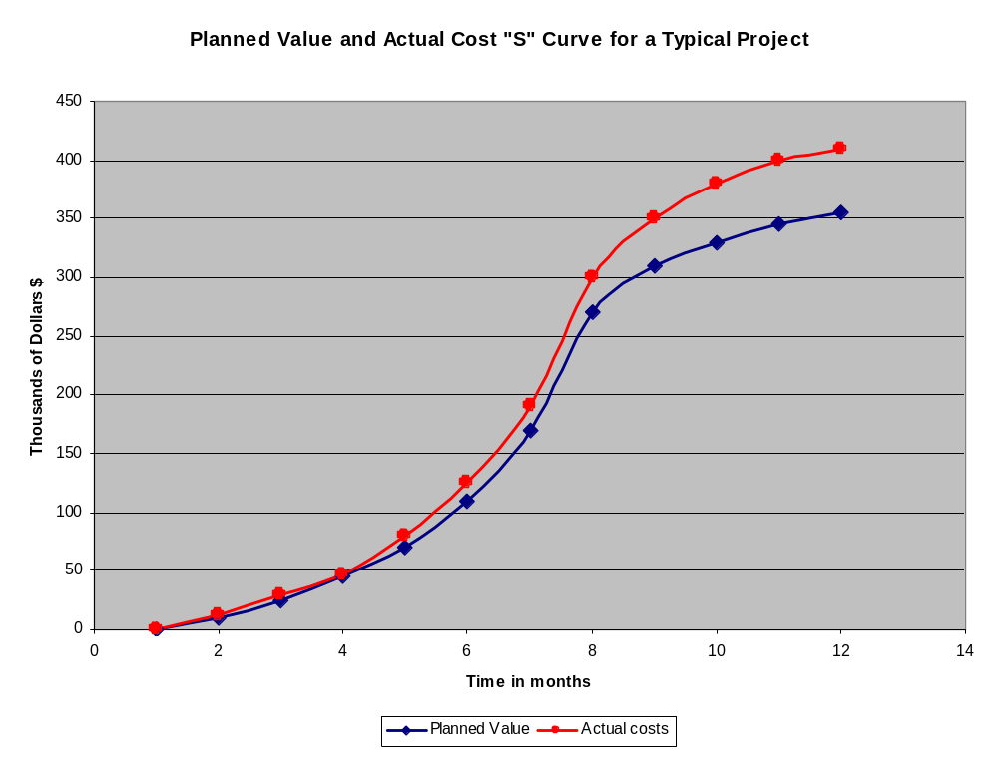

Slide 7
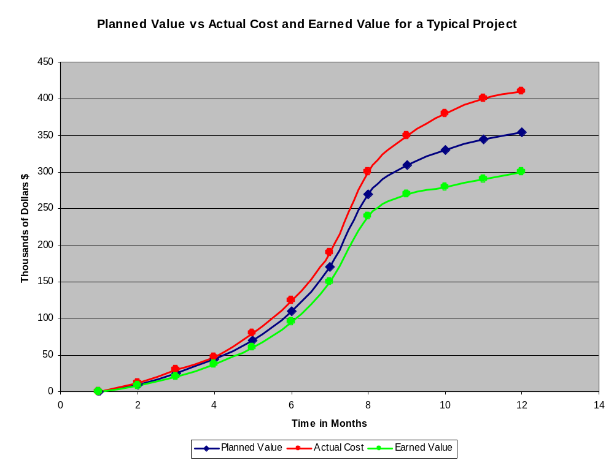

Slide 8
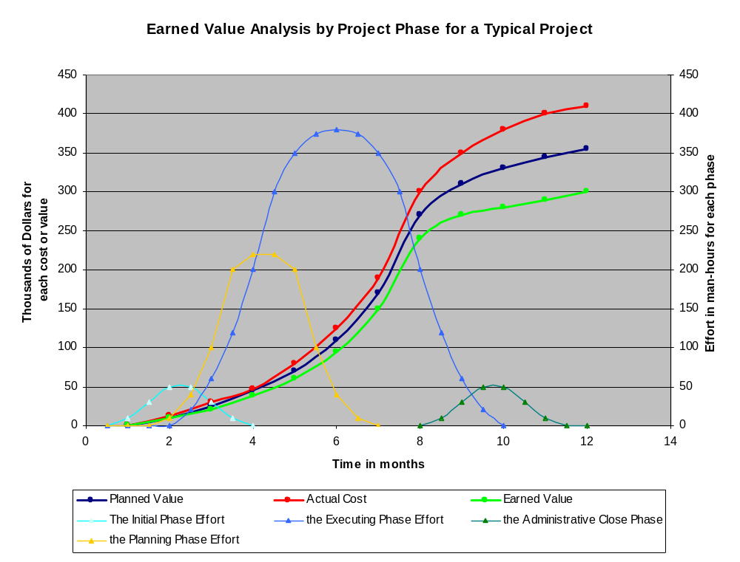

Slide 9
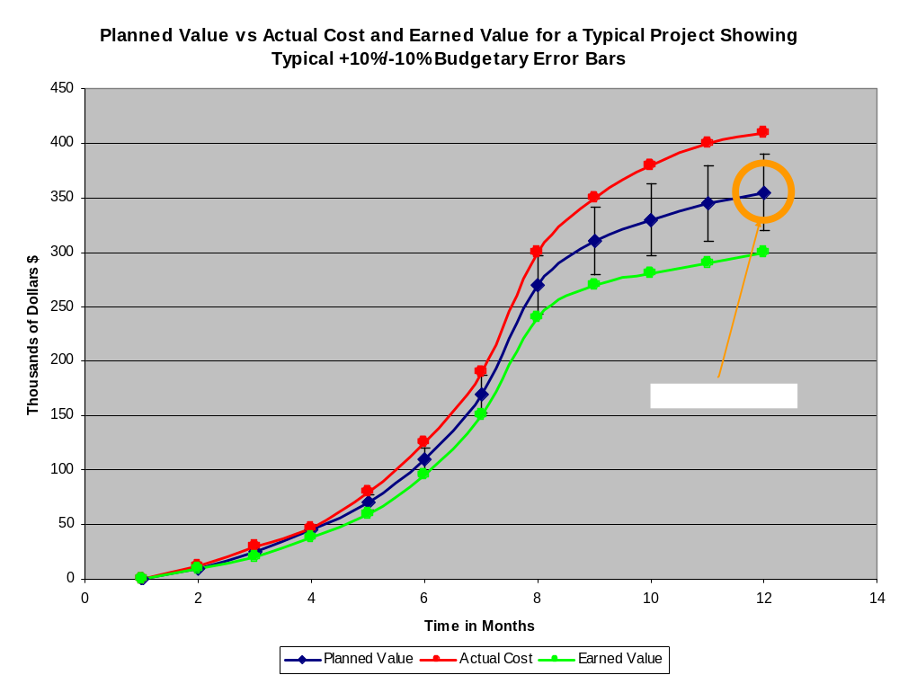
Notes:
Project budget

Slide 10
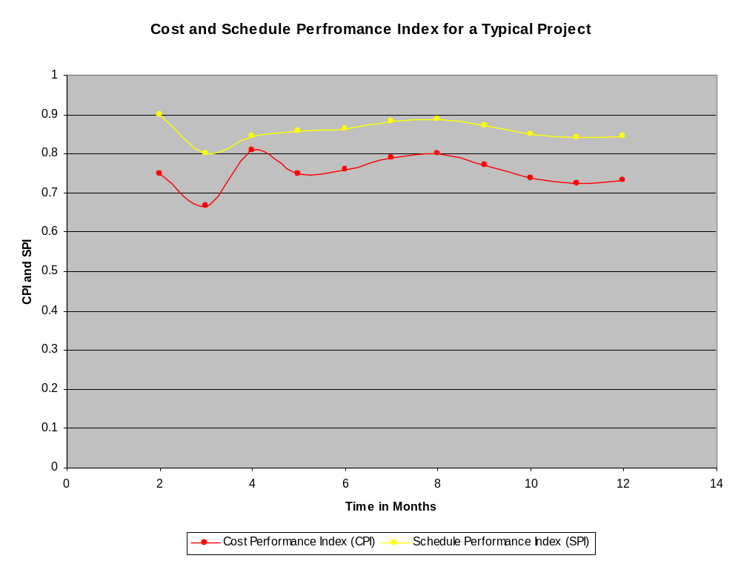

Slide 11
Acronym Definitions in Earned Value Analysis
EV – Earned Value
PV – Planned Value
AC – Actual cost
CV – Cost Variance
SV – Schedule Variance
CPI – Cost Performance Index
SPI – Schedule Performance Index
ETC – Estimate to Completion
BAC – Budget at Completion
VAC – Variance at Completion

Slide 12
Basic Calculations in Earned Value Analysis
CPI = EV / AC
SPI = EV / PV
CV = EV – AC
SV = EV - PV
VAC = BAC – EAC
CPI and SPI greater than 1 is good. Less than 1 means the project is either tracking over budget or tracking late.
CV, SV, and VAC being positive is good. This means the project is either being delivered ahead of schedule or under budget.

Slide 13
More Advanced Calculations in Earned Value Analysis
EAC = AC + (BAC - EV) Formula 1
EAC = AC + (BAC – EV) / CPI Formula 2
EAC = BAC / CPI Formula 3
ETC = EAC – AC
EAC Formula 1 is used when actual to date plus remaining budget is the criteria. Used when current variances are thought to be "atypical" of the future.
EAC Formula 2 is used when actual to date plus remaining budget modified by performance is the criteria. Used when current variances are thought to be typical of the future.
EAC Formula 3 is used if no variances from BAC have occurred or you will continue at the same rate of spending.

Slide 14
EVA Calculation Fence Building Example
You are the project manager to build a fence for a farm. The farm has 4 sides. It is expected that each side will take one month to build. Each side is budgeted to cost $1000. You will build them one at a time. During project execution you run into a series of risks, some of which turn out to be opportunities. Your progress is observed to be as follows:
End of month 1: 1 fence built. Cost is $800.
End of month 2: 1.5 fences built total. Total cost thus far is $ 2200
End of month 3: 3.25 fences built total. Total cost thus far is $3100
A) What are the CV, SV, and calculated CPI,SPI for month 1? month 3?
B) What is the EAC if the CPI can be considered typical moving forward from month 3? What is the VAC? What are both these values if it is considered atypical and that costs should align with budgets moving forward?
C) In month 3 is the project on schedule? Is it on budget in month 3? Will it be at completion? Plot the project performance.
Notes:
BAC = 4000
Month 1
EV:1000; PV: 1000; AC: 800
Month 2
EV:1500; PV: 2000; AC:2200
Month 3：
EV:3250 PV:3000; AC:3100

Slide 15
EVA Calculation Fence Building Example
Answers:
A)
month 1:
CPI = EV / AC = 1000/800 = 1.25
SPI = EV / PV = 1000/1000 = 1.00
CV = EV – AC = 1000 - 800 = $200
SV = EV – PV = 1000 - 1000 = $0
month 3:
CPI = EV / AC = 3250/3100 = 1.05
SPI = EV / PV = 3250/3000 = 1.08
CV = EV – AC = 3250 - 3100 = $150
SV = EV – PV = 3250 - 3000 = $250 (What does this physically mean?)

Slide 16
EVA Calculation Fence Building Example
Answers:
B)
EAC = AC + (BAC – EV) / CPI = 3100 + (4000-3250)/1.05 = $3814
VAC = BAC – EAC = 4000 - 3814 = $186 (CPI typical in month 3)
EAC = AC + (BAC – EV) = 3100 + (4000-3250)/1.00 = $3850
VAC = BAC – EAC = 4000 - 3850 = $150 (CPI atypical in month 3)
C)
Yes, it is on budget and schedule as far as we can see in month 3. Both CPI and SPI are 1 or greater in both cases. And if CPI in month 3 is seen as typical, then we can assume that it will be on time and on budget by project end as well. Likewise for if it is atypical at CPI=1. But, if we had been asked the same question regarding our prediction for maintaining both project timing and project budget at completion in month 2, we would have seen a different story..............

Slide 17
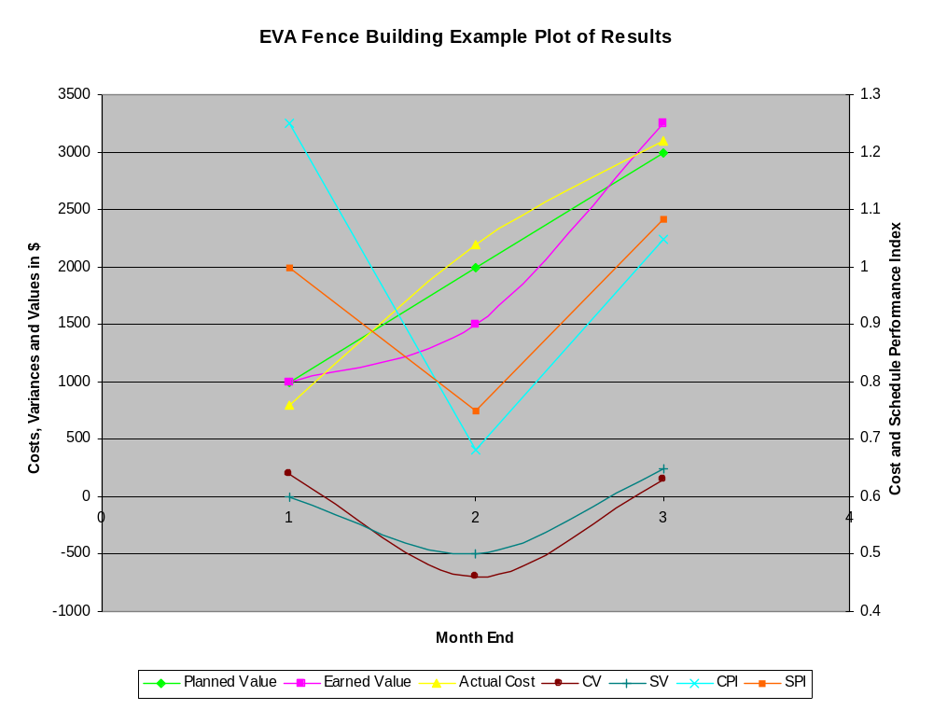

Slide 18
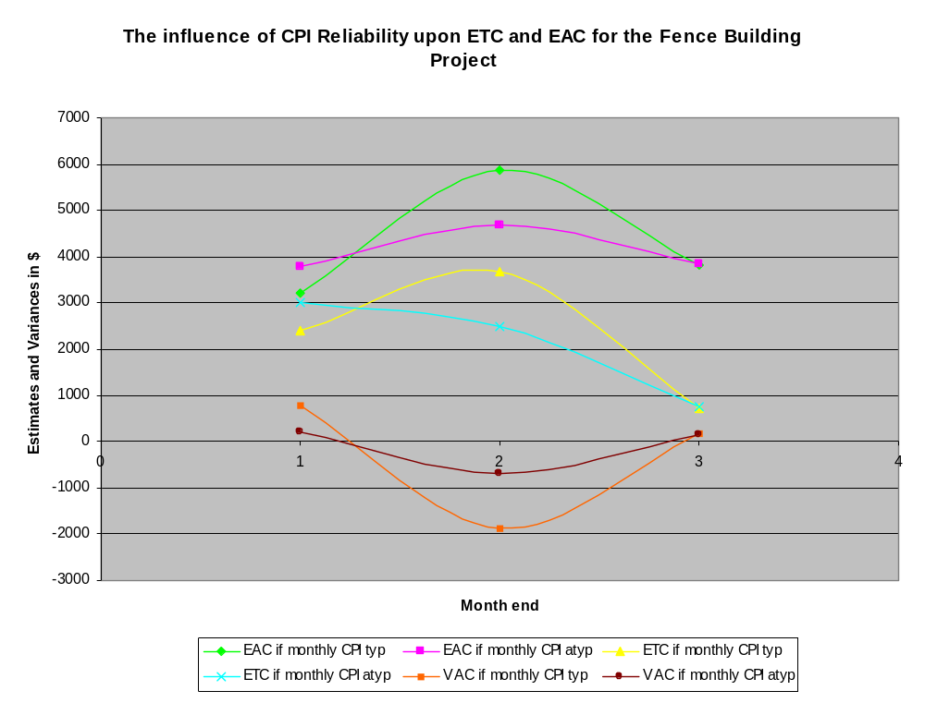

Slide 19
Calculating the Earned Value - EV
The planned budget for each work package is multiplied by the percentage completed in order to determine the earned value to date for the work packages, as well as the overall project.
An example calculation is shown below for week 30:
8*1 + 28*1 + 30*0.50 +14*0 = $51,000 = EV in week 30
Duration (wks) | 5 | 10 | 15 | 20 | 25 | 30 | 35 | 40 | 45 | Wk30 %complete
Design ($k) | 6 | 2 |  |  |  |  |  |  |  | 100
Engineer ($k) |  | 4 | 8 | 8 | 8 |  |  |  |  | 100
Install ($k) |  |  |  | 4 | 20 | 6 |  |  |  | 50
Test ($k) |  |  |  |  |  | 2 | 6 | 4 | 2 | 0
Total ($k) | 6 | 6 | 8 | 12 | 28 | 8 | 6 | 4 | 2
Cumulative ($k) | 6 | 12 | 20 | 32 | 60 | 68 | 74 | 78 | 80

Slide 20
Application of Earned Value to a Task
Method 1 – As applied earlier in the discussion. Percentage complete is multiplied by value of the task to determine the earned value thus far.
Method 2 – There is no earned value until the task is complete. The only two levels of earned value ever applied to a task are $0 or the full value of the activity.
Method 3 – The 50%-50% method. 50% of the value of an activity is assumed earned at the outset of the activity, and 50% of an activity is assumed earned at the completion of an activity. The advantage here is that method 1 is so tough to predict near the back end of an activity.
All methods are valid. You can even use a mix in your project so long as you clearly state you are doing so. Watch for this wrinkle on your tests!

Slide 21
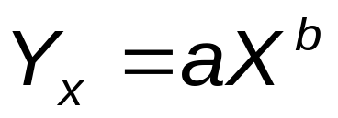
Learning Curves in Cost Estimation
When a series of tasks is being scheduled that are all unrelated it is normal to assume that the nth activity takes as much time as the first.
But as soon as a task gets repeated, the question of the learning curve needs to be answered. Some research supports the idea that performance improves by a fixed percentage each time production doubles. E.g. programming a certain code takes 20hrs the first time, but only 15 hrs the second time. That means that there is a learning rate of 0.75.
Time and cost estimates follow a well defined formula:
where:
Y_{x} = time required for the x unit of output
a = time required for the initial unit of output
X = number of units being produced, and
b = slope of learning curve, represented as: log decimal learning rate/log2

Slide 22
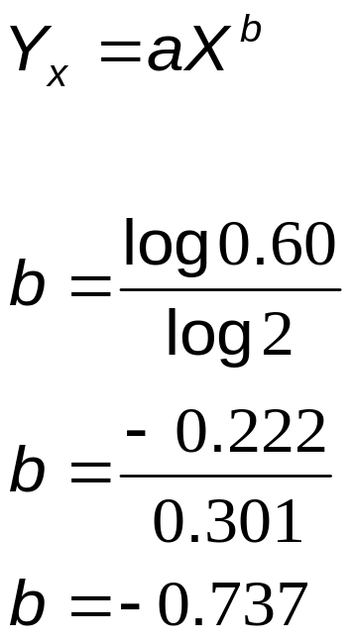
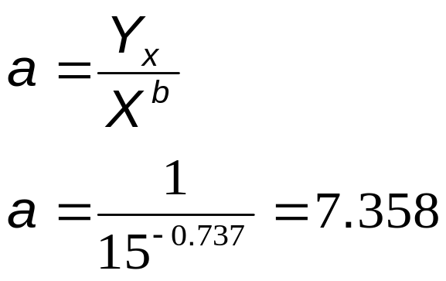
Example of a Learning Curve
In an construction environment a worker must perform a total of 15 activities. The time estimated to perform the last iteration is 1 hr, and we know that the learning rate for this highly repetitive activity is 0.60.
Calculate the time necessary to complete the first activity.
Note that the difference between the first time and the 15th iteration of a task the duration estimation changes from over 7 hrs to 1 hr. This can be significant for a project's budget if there are several repetitive tasks!

Slide 23
Sunk Costs
Sunk costs are non-recoverable costs a project has spent at any time in the project up to the point of its completion.
With extremely unsuccessful projects, the temptation is often taken that sunk costs should be considered when additional funding is being considered to fix an unfinished project that requires new funding. Sunk costs should never be considered in establishing future budgets. They have no bearing on future earned value, planned value, or actual cost once a new baseline is established.

Slide 24
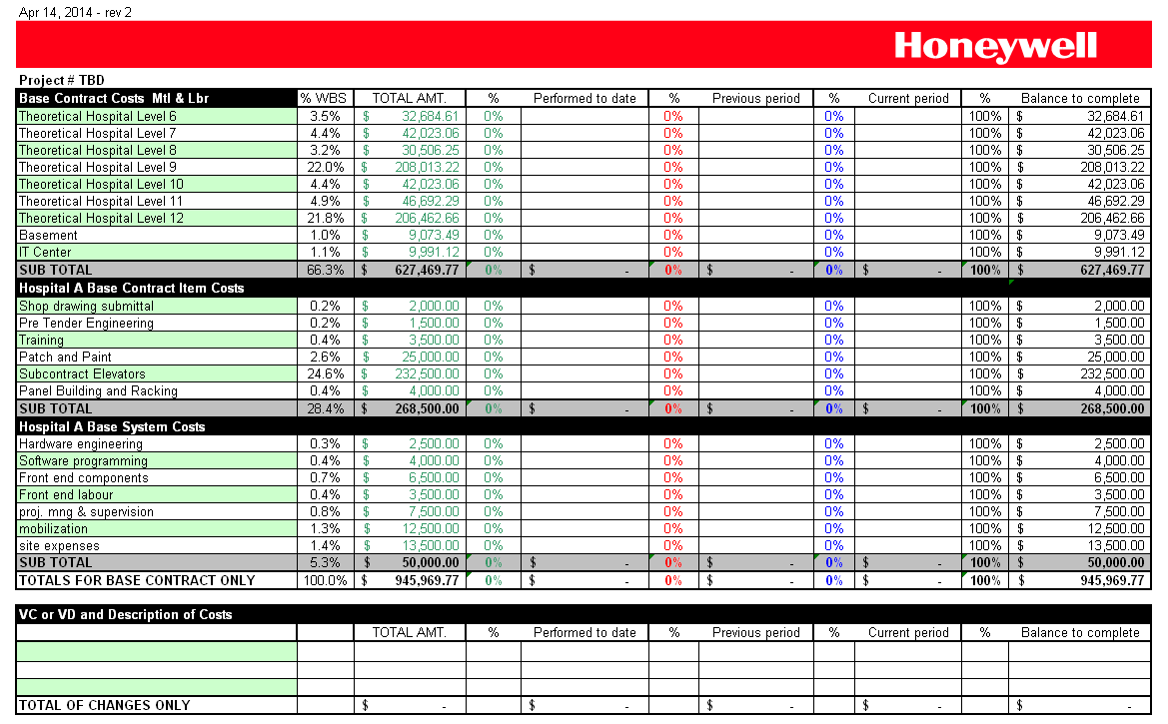
Sample Statement of Value

Slide 25
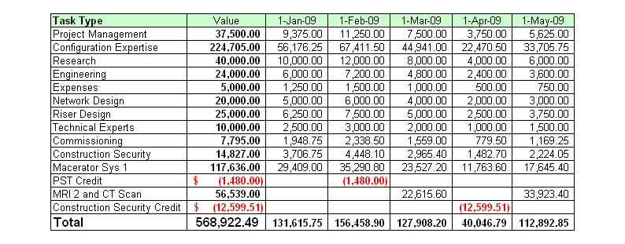
Sample Progressive Billing

Slide 26
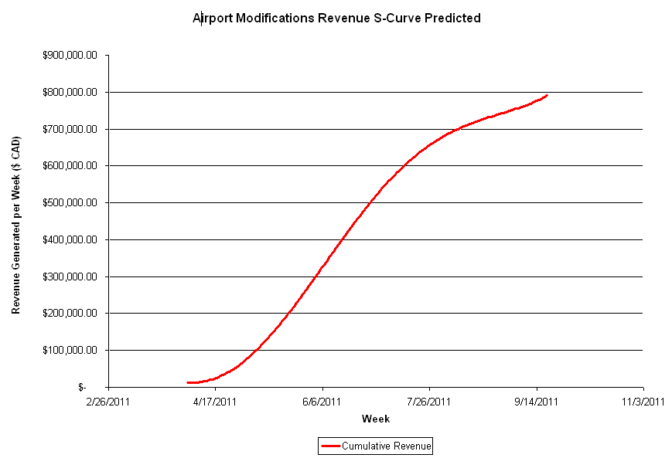
Revenue Generation

Slide 27
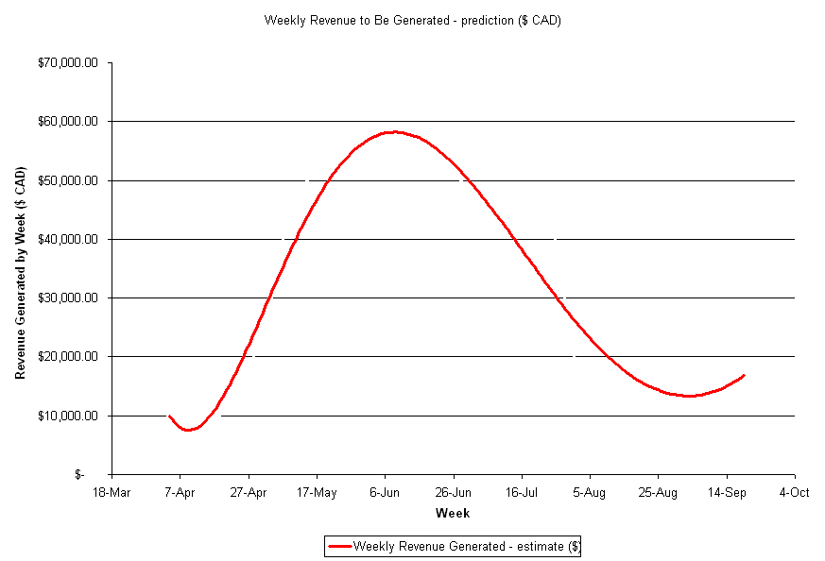
Revenue Generation by Week

Slide 28
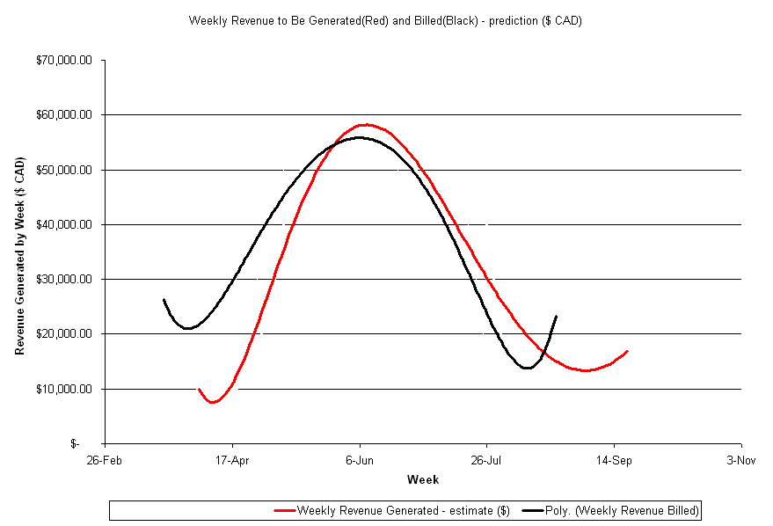
Cash Flow - Getting Ahead on Billing

Slide 29
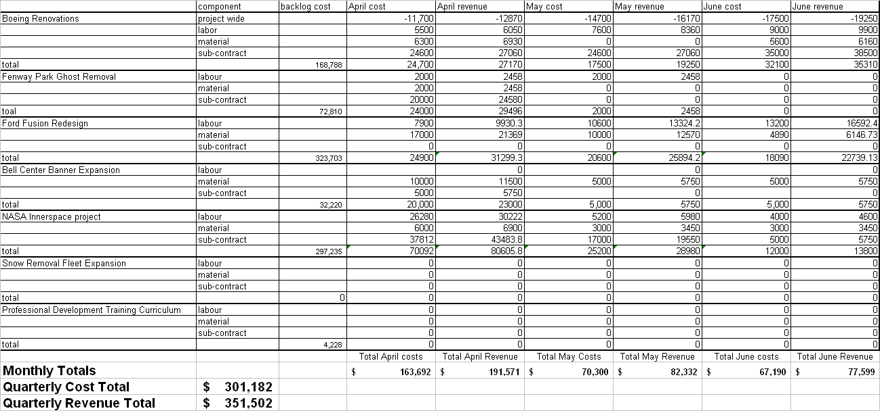
Forecasting for Wall St. and Bay St.

