Slide 1
Engineering Planning and Project Management
Lecture 8
Project Quality Management

Slide 2
Visteon Corporation – Project Management in Automotive Engineering
Read pages 130-138 in Project Management Best Practices, break into your groups, and answer the following questions:
Question 1: The very last 3 words of this printout appear to be the goal that Visteon is trying to achieve: “exceeding customer expectations”. What do we call “exceeding customer expectations” in Project Management?
Question 2: We learned by studying the history of Project Management that Ford Motor Company played a huge role due to its progress in implementing scientific management practices. In reading this passage, do you see evidence of the inheritors of this legendary corporate culture still pushing their company forward in this regard? What examples can you comment upon? Do you see it in their products today?

Slide 3
Quality Control
Inputs
Project management plan
Quality metrics
Quality checklists
Work Performance Measurements
Approved change Requests
Deliverables
Organizational Process Assets
Tools &
Techniques
Cause and effect diagram
Control charts
Flowcharting
Histogram
Pareto chart
Run chart
Scatter diagram
Statistical sampling
Inspection
Approved Change Request review
Outputs
Quality control measurements
Validated changes
Validated deliverables
Organizational Process Assets updates
Change Requests
Project Management Plan Updates
Project Document Updates

Slide 4
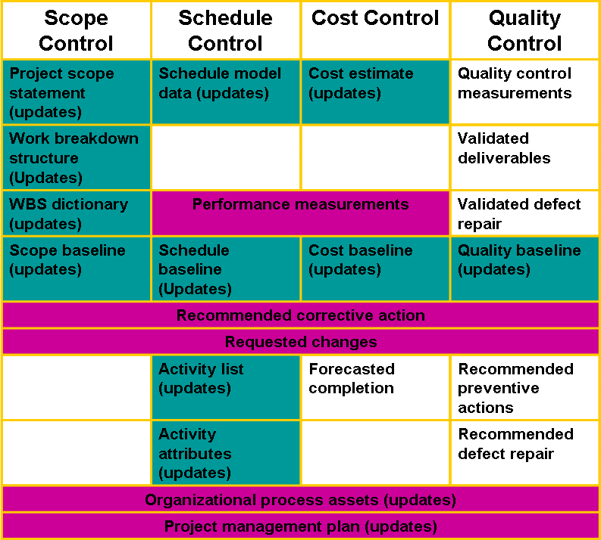
Continuing Studies at Western
The University of Western Ontario

Slide 5
Project Monitoring System for Control
Information System Structure: What data are collected?
  Current status of project (schedule and cost)
  Remaining cost to compete project
  Date that project will be complete
  Potential problems to be addressed now
  Out-of-control activities requiring intervention
  Cost and/or schedule overruns and the reasons for them
  Forecast of overruns at time of project completion

Slide 6
Project Monitoring System… (cont’d)
Information System Structure (cont’d)
  Collecting data and analysis
    Who will collect project data?
    How will data be collected?
    When will the data be collected?
    Who will compile and analyze the data?
  Reports and reporting
    Who will receive the reports?
    How will the reports be transmitted?
    When will the reports be distributed?

Slide 7
Project Progress Report Format
Progress since last report
Current status of project
  Schedule
  Cost
  Scope
Cumulative trends
Problems and issues since last report
  Actions and resolution of earlier problems
  New variances and problems identified
Corrective action planned

Slide 8
The Project Control Process
Control
  The process of comparing actual performance against plan to identify deviations, evaluate courses of action, and take appropriate corrective action.
Project Control Steps
  Setting a baseline plan.
  Measuring progress and performance.
  Comparing plan against actual.
  Taking actions

Slide 9
Monitoring Time Performance
Tools used to catch negative variances from plan and communicate project schedule status:
  Tracking and baseline Gantt charts
    Show expected, actual, and trend data for event duration performance.
  Control charts
    Plot the difference in scheduled time on the critical path with the actual point on the critical path.

Slide 10
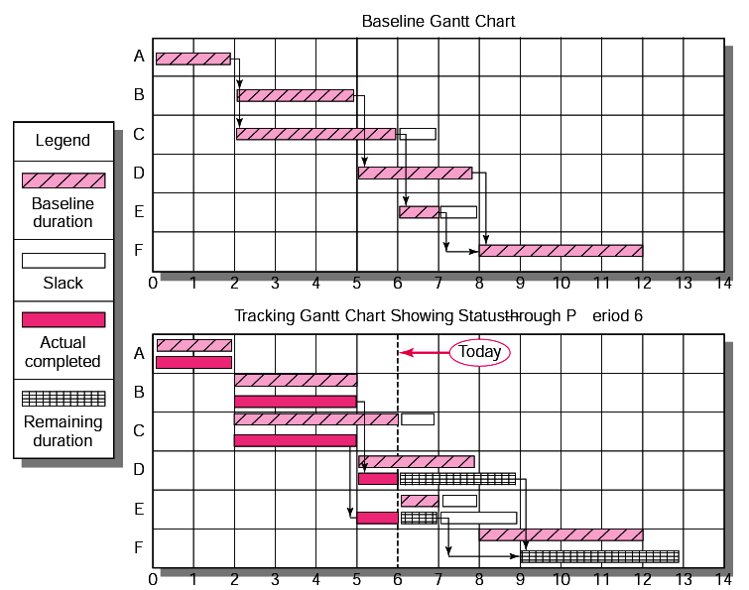

Slide 11
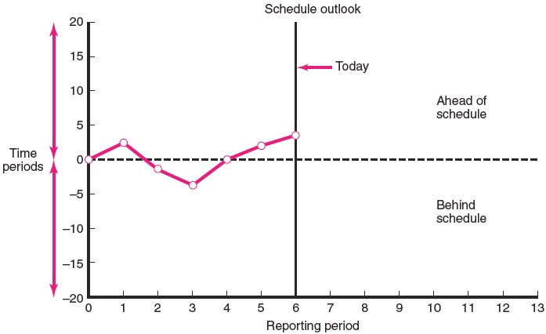
Project Schedule Control Chart

Slide 12
Disparity Among Monitoring Systems
Time-Phase Baseline Plan
  Corrects the failure of most monitoring systems to connect a project’s actual performance to its schedule and forecast budget.

Slide 13
Disparity Among Monitoring Systems (cont’d.)
Earned Value Cost/Schedule System
  An integrated project management system based on the earned value concept that uses a time-phased budget baseline to compare actual and planned schedule and costs.

Slide 14
Developing an Integrated Cost/Schedule System
Define the work using a WBS.
  Scope
  Work packages
  Deliverables
  Organization units
  Resources
  Budgets

Slide 15
Developing an Integrated Cost/Schedule System (cont’d.)
Develop work and resource schedules.
  Schedule resource to activities
  Time-phase work packages into a network
Develop a time-phased budget using work packages included in an activity.
  Accumulate budgets (PV).
Multiply percent complete times original budget (EV).
Compute the schedule variance (EV-PV) and the cost variance (EV-AC).

Slide 16
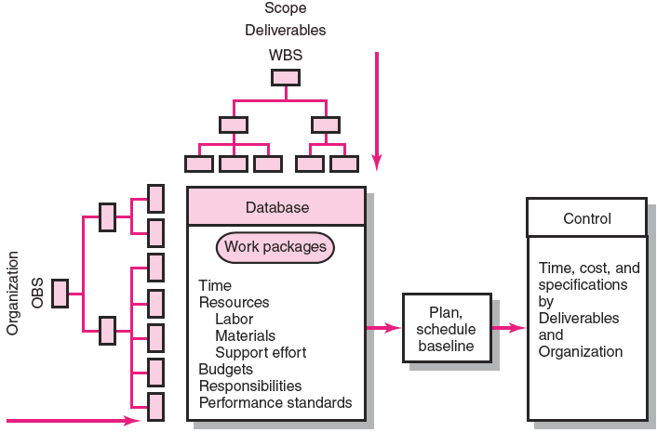
Project Management System Overview

Slide 17
Development of Project Baselines
Purposes of a Baseline (PV)
  An anchor point for measuring performance
    A planned cost and expected schedule against which actual cost and schedule are measured.
    A basis for cash flows and awarding progress payments.
    A summation of time-phased budgets (cost accounts as summed work packages) along a project timeline.
What Costs Are Included in Baselines?
  Labor, Equipment, Materials
  Project direct overhead costs (DOC)

Slide 18
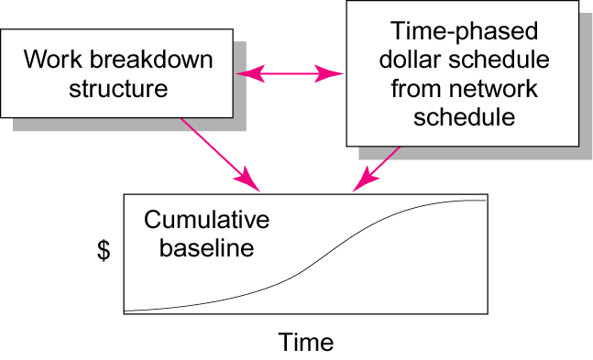
Baseline Data Relationships

Slide 19
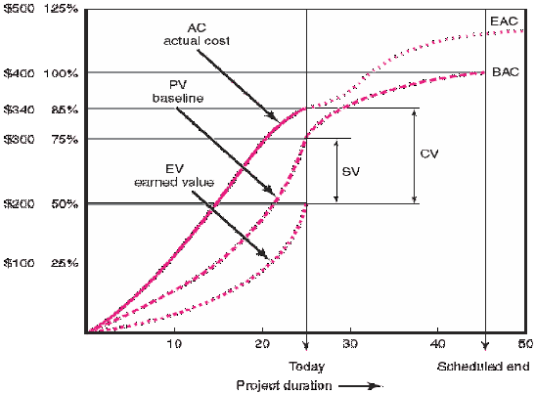
Cost/Schedule Graph

Slide 20
Schedule Control
“Doing it right is no excuse for not meeting the schedule”

Slide 21
Please Welcome our guest
Dr. Shokry Rashwan
BIM Models

