Slide 1
Engineering Planning and Project Management
Lecture 9
Project Human Resource Management

Slide 2
Myers Briggs Personality Types
Note the 2 handouts supplied today, both the BMTI definitions as well as the most common PM types found among PM students in Continuing Studies at UWO.
What is your personality type? Make careful note of what you might want to adjust should you get an opportunity to pursue Project Management, this sub-topic of our Engineering profession.

Slide 3
Why do we study Project Management at UWO?
Earlier in the course it might have been mentioned that you study it because only 26% of projects are successful in the business world and that many of them are run by engineers.
A second and equally acceptable answer is that you do it because the other courses in your curriculum are like applications. This course is like your operating system. Without a set of operating conditions in which to run your applications, your entire set of calculations will not execute.

Slide 4
Negotiation – Fundamentals of your Mindset
Separate the people from the problem. All of us have egos. All of us have fears and insecurities. Don't tap into the other guy's. You will throw both sides of the negotiation out of control.
Stick to business. Keep the personalities out of it. This is not the time for a charm offensive. Nobody will buy it.
Put yourself in their shoes. Nobody likes to be directly attacked. This is an extremely ineffective strategy more accurately referred to as counter-productive.

Slide 5
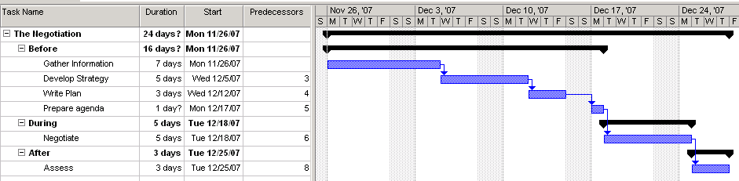
Negotiation – The basics in getting ready
Negotiations are win-win or no win.
Talk money last if possible.
Negotiations always begin well in advance of the actual discussions.
The most important thing to know about any negotiation you go into is what the other side wants and how to give it to them. You already know what you want.
Negotiations are not just about the money. They are about the complete compensation package.
There are 3 stages in the negotiation process. Before, During, and After. Before always should be the biggest.

Slide 6
Gather Information about the other side
Vital interests
Goals, costs, strategies, positions, needs
Product strengths
Concession patterns
Tactics
Bottom line
Corporate deadlines and time constraints
Budget – how much can they afford?
Geographic limitations
Also know your company position, the players in the negotiation, and who holds the power. Note that people behind the scenes hold influence.

Slide 7
Develop Strategy
Aim high. Aim for more than one possible scenario that is win-win.
Be realistic.
Arrange your objectives in priority.
Know your bottom line.
Are deadlock or termination options for you in the negotiation? Are they tolerable outcomes?
Which items are desirable and which items are expendable for you?
Have several red herrings available.
Have an idea how you are going to help the other side negotiate within their organization.
Determine where your interests and the other side's interests intersect.
Anticipate and brainstorm what questions you might be asked and how to potentially deal with them.

Slide 8
Write your Negotiation Plan and Prepare an Agenda
Your plan includes:
your interests, the interests you expect the other side to have, your desired outcomes, your estimates of the other sides desired outcomes, your authority limits in relation to possible outcomes, the other sides authority limits in relation to possible outcomes, any additional information either you or the other side might require such as a fact sheet.
Your agenda includes:
The goal of the meeting
The published in advance (if to your advantage) duration of the meeting.
The invitees
The meeting location

Slide 9
Negotiations - Questions
When entering a negotiation, every negotiator needs to ask 3 questions:
  How much power do I have?
  What sort of time pressures are there?
  Do I trust my opponent?

Slide 10
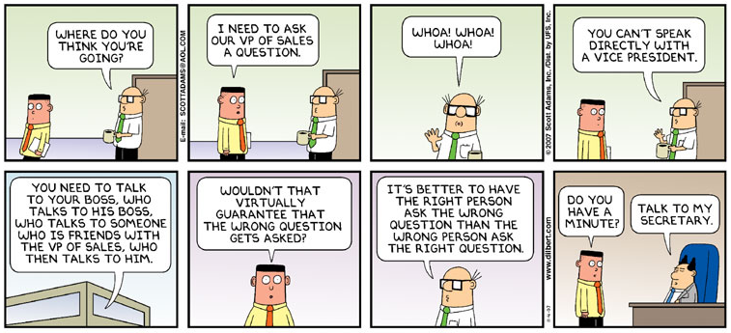
Negotiation - Questions

Slide 11
Negotiation - Questions
Question: Unlike the Dilbert cartoon, who is in charge of a conversation generally? The person asking the questions, or the person giving the answers?

Slide 12
Negotiation - Questions
Question: Unlike the Dilbert cartoon, who is in charge of a conversation generally? The person asking the questions, or the person giving the answers?
Answer: Generally the person asking the questions, because they control the direction of the conversation. You want to ask the majority of the questions in any negotiation regardless of your relative positions. For example this is equally true when negotiating your salary. Remember also that people are conditioned from birth to answer questions. They will provide useful information in a negotiation if you can think quickly regarding what to do next with what you are handed.
One way or another though, you need to politely try to gain the advantage of directing the discussion. It is a key to your success. Just knowing when your counterpart is doing it to you is empowering as well. So be patient. You will get your turn.

Slide 13
Negotiations – Advanced questioning techniques
Generally people resist being interrogated, so if you are going to ask the majority of the questions, remember the fact regarding negotiations that they must conclude in a win-win situation. This implies that some of your questions may need to be rhetorical or provide advantage to the other side. Keep this in mind, or you will lose control of the questioning.
One technique which is effective, but dangerous is the concept of asking a series of rhetorical questions that provide the same yes or no answer. If asked quickly, politely, and professionally they can provide a useful technique:
  Are you available at that time?
  And is the equipment available at that time?
  And are the workers available at that time?
  How about supervision?
  Then perhaps we should consider moving the paint line on Saturday.

Slide 14
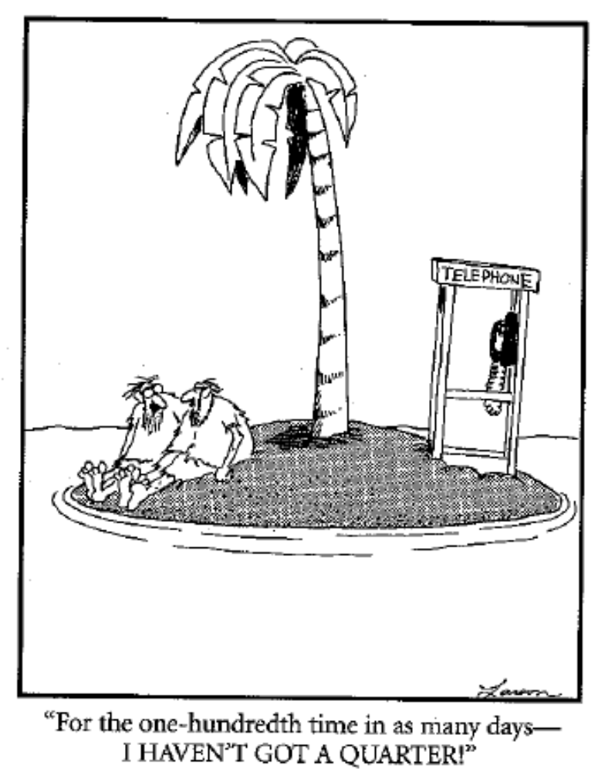

Slide 15
Negotiation – Language and Communication
When you want to establish your power early in the negotiation:
"I'm sorry, but my colleagues and I cannot settle for that."
When you want to invoke the power of legitimacy:
"It doesn't apply in this case." or "That has never been the standard for this type of application."
When you want the other party to state their opening position:
"What are you looking for in these negotiations?"
When you want to find out how much authority the other party has:
"Do you have the authority to commit to that without checking it out at head office?"
When you don't want to say no outright for fear of breaking down discussions:
"Let's set that aside for now. Lets come back to it."

Slide 16
Negotiation – Language and Communication
When you want to sound a little incompetent:
"I get these things confused. Is this what we just agreed upon?"
When you want to buy time and apply pressure:
"Let me take that to my director. I'll be right back."
When you want to propose instead of demand:
"May I suggest this alternative?"
When you want to appease the other party:
"Good point. I'm glad you asked that."
When you want the other party to save face:
"I absolutely cannot budge on price, but here is what I can do..."
When you want to uncover the other side's needs:
"What do you think?" "What would you like to see happen?"

Slide 17
Negotiation – Not the words, but what they are saying
"To tell you the truth..." (lying)
"To be brutally honest..." (lying)
"Off the record....." (nothing is ever off the record. The negotiation is always on.)
"Just between you and I...." (a secret is something you tell only one other person. Think about it)
"I'd love to, but....." (no they wouldn't)
"Oh, before I forget..." (Listen carefully to what comes next, that is set up lingo)
Congruence - When a person's words and body gestures are in sync, there is congruence. When they are out of sink, the listener will, often sub-consciously, interpret the meaning of the communication based upon non-verbal signals and body language.

Slide 18
Get Ready! You never know when it is going to be game on! – The Salaries Dilemma
Scenario: Sally was over at the printer in her open office area today when she accidentally picked up a printed copy of the salaries in her group one of the cost accountants had run off for the director of the department. Sneaking a peak while she looked for her printout, she noted that she was the 3rd highest paid in her department of 6 people all of whom had the same job title and description: Project Manager. Furthermore she noted the 2 ahead of her were the weakest in the group!! Infuriated she stormed into the manager's office and demanded a meeting. The manager, somewhat put off, decided to have a little fun and hear her out. After a half hour of chapter and verse regarding how important she was, the manager had enough, and politely ended the meeting. Later that year, at the same time as all her colleagues, Sally was given her 2% annual raise and thanked for another year well done.
Question: Assuming Sally came by the printout ethically, what could she have done differently to correct her standing in the company?

Slide 19
The Salaries Dilemma Question answered
Answer: Negotiate a raise. No blackmail or outrage required here. She should have asked questions regarding the performance of the other employees and tried to get a commitment from her boss regarding how she could improve her standing. She could have complimented him on his insight in perceiving the 2 above her as being good employees and offered her concurrence. She could have asked what the other employees were delivering in their projects and how she could match their performance. She should have said nothing up front about ever having seen the document. This was her power, and she emotionally handed it back to the one person who could have helped her improve her position – her boss.

Slide 20
Power and Negotiation – A Discussion
Compare and contrast what you understand presently regarding negotiating a project to provide a $5 million water purification system to a brewery – a new customer - on behalf of your company vs. negotiating a reduction in the rent you pay to your parents.
in each case:
  How much power do you have?
  What sort of time pressures are there?
  Do you trust your opponent?
  Which negotiation is more difficult? Are you surprised? Was that your first impression?

Slide 21
CONSTRAINTS ON PROJECTS
As described in the very beginning, all projects are running in an environment of constraints.
1. TECHNICAL CONSTRAINTS
2. PHYSICAL CONSTRAINTS
3. RESOURCE CONSTRAINTS
  PEOPLE
  MATERIALS
  MONEY
  EQUIPMENT
In this lecture we look in detail at the resource constraints.

Slide 22
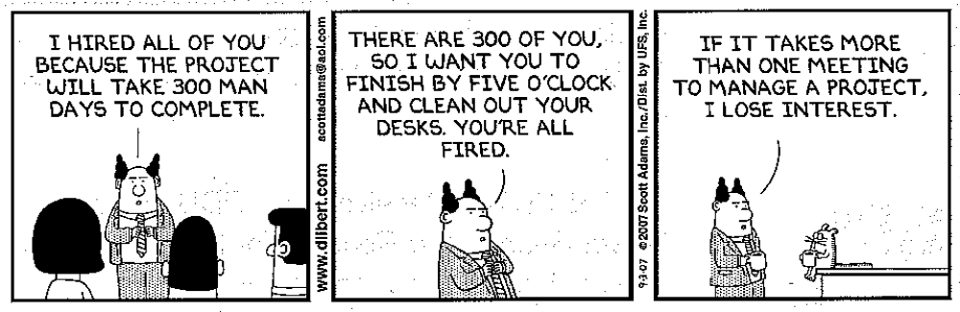

Slide 23
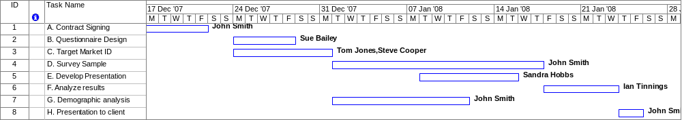
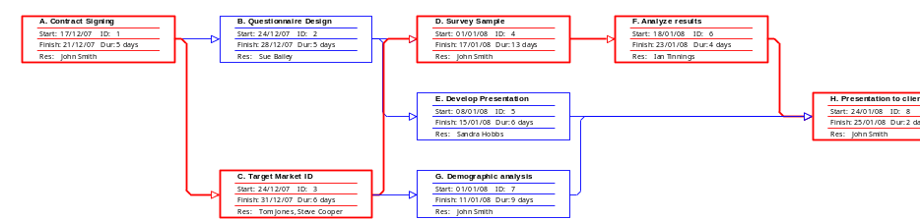
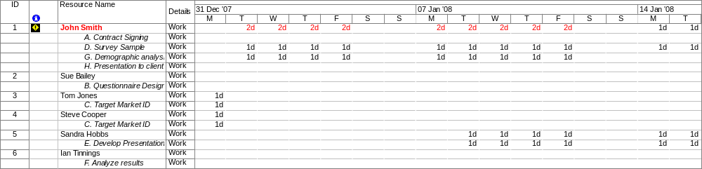
Resource Loading Chart showing Over-allocation

Slide 24
Resource Leveling
Resource Leveling (smoothing) has two objectives:
To determine the resource requirements so that they will be available at the right time
To allow each activity to be scheduled with the smoothest possible transition across resource usage levels.

Slide 25
Rules of Thumb when solving resource leveling problems
Activities with the smallest amount of slack
Activities with the smallest duration
Activities with the lowest activity identification number (e.g. those that start earliest in the WBS)
Activities with the most successor tasks
Activities requiring the most resources

Slide 26
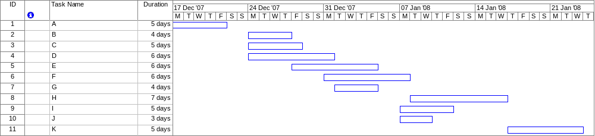
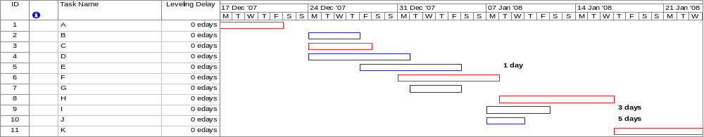
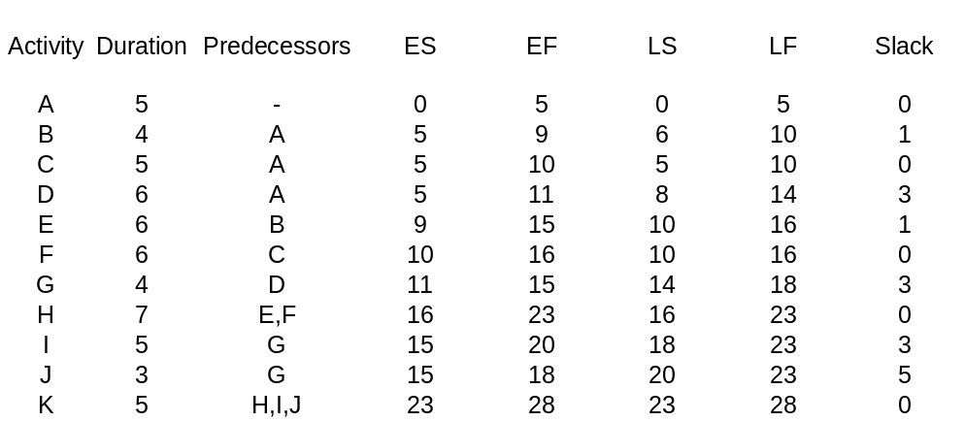

Slide 27
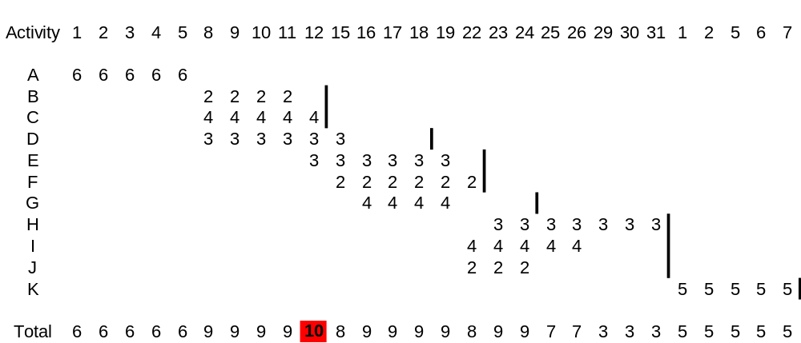
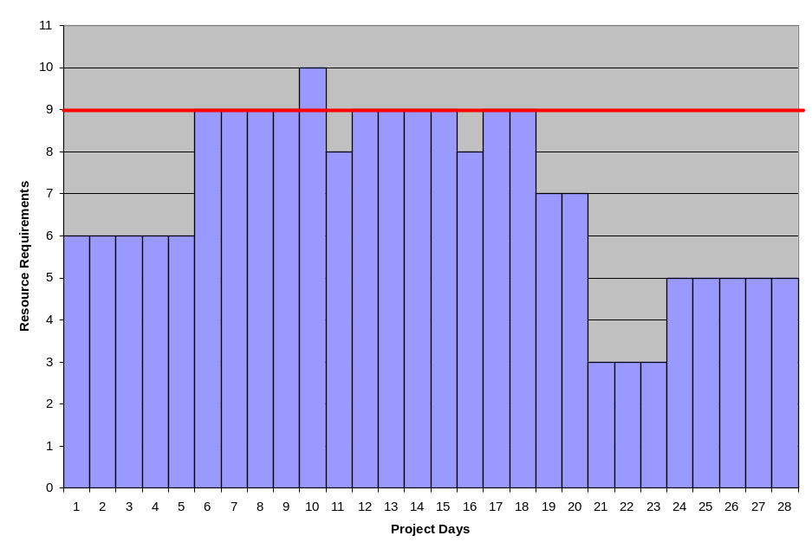
Resource level limit: 9 hrs/day
Before Resource Leveling

Slide 28
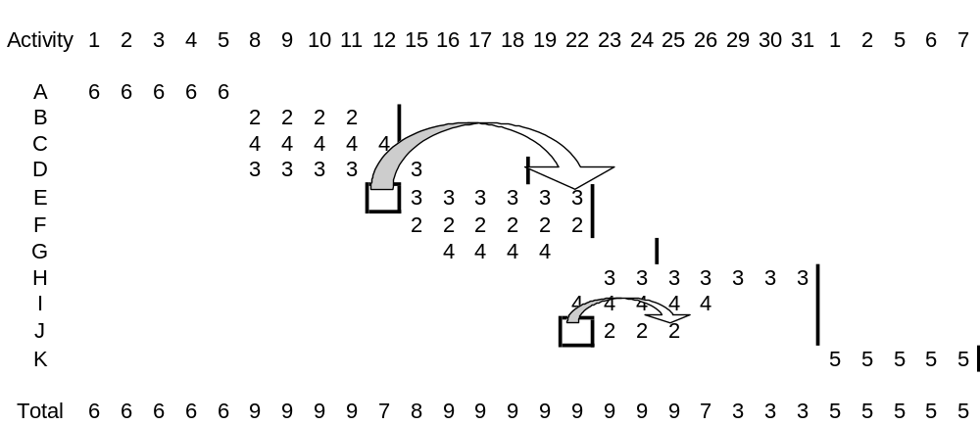
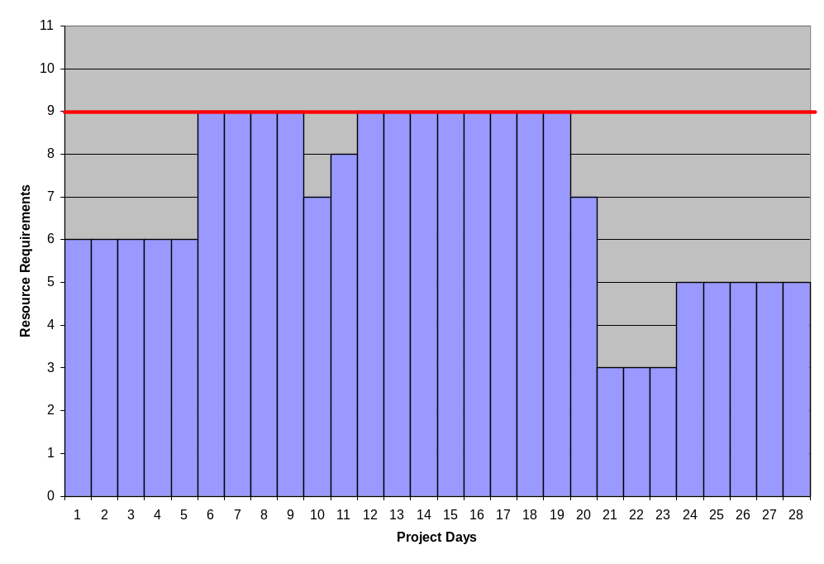
After Resource Leveling

Slide 29
Resource Loading Charts
Are used to display the amount of resources required as a function
of time on a graph. Each activity is typically represented in the charts as a block.

Slide 30
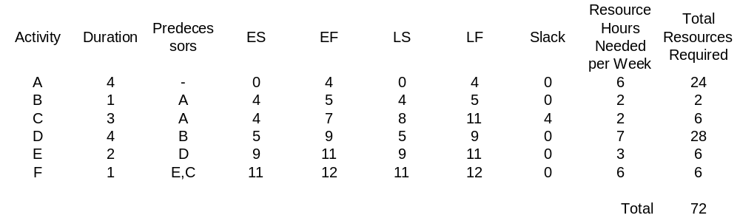
Sample Project Network
4 B 5
Res = 2
5 D 9
Res = 7
9 E 11
Res = 3
0 A 4
Res = 6
11 F 12
Res = 6
4 C 7
Res = 2
Resource level limit: 8 hrs/day
Task C is the only one with slack available.
Remember first to level those tasks with the smallest amount of slack.
All tasks are on critical path, except C. Therefore they all have priority over C

Slide 31
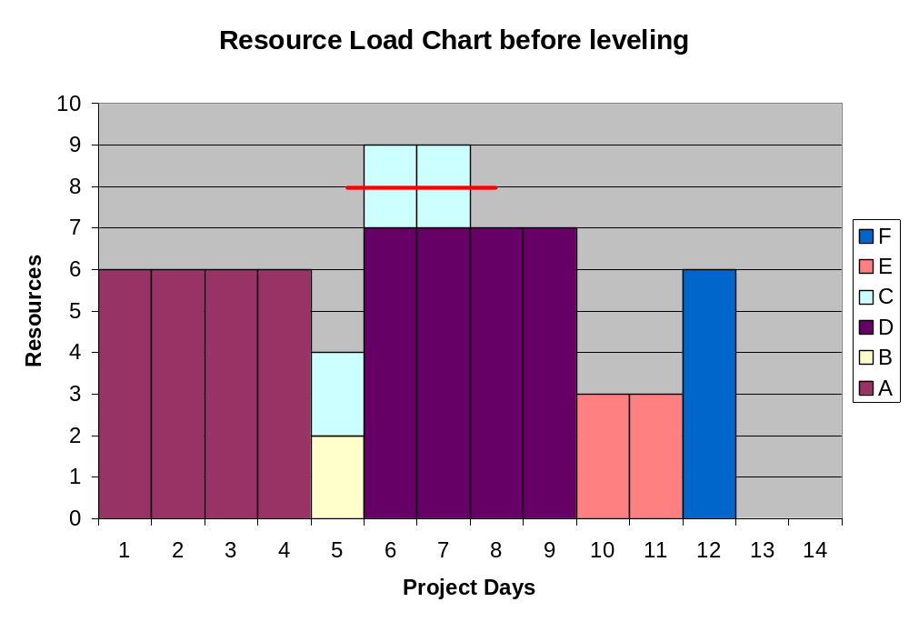
C is the only task available for leveling => find new home for it.

Slide 32
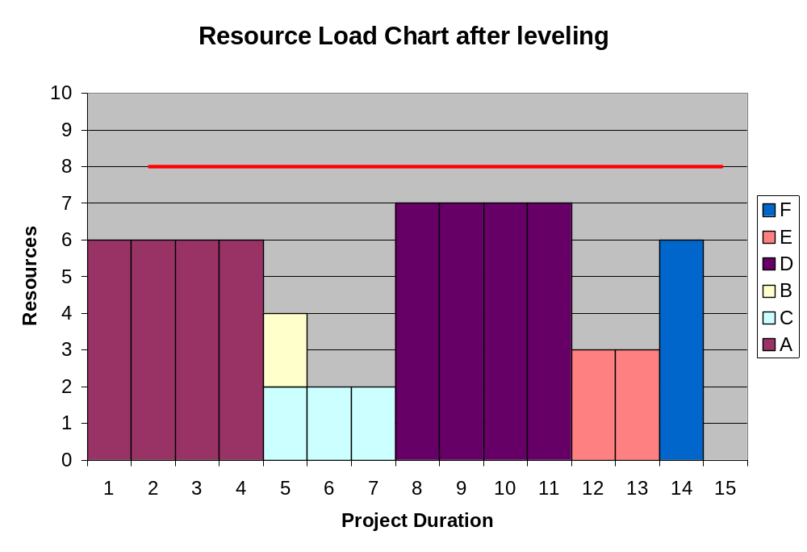
How can we let the project finish on the original end day (12)?

Slide 33
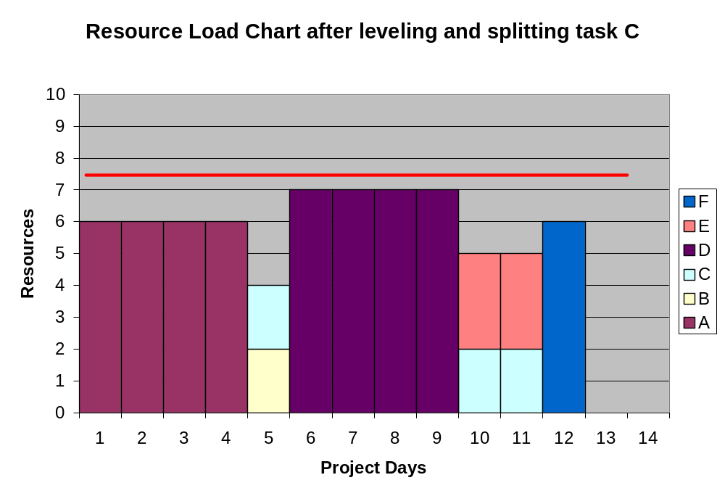

Slide 34
Splitting a task
Means interrupting the continuous stream of work on an activity at some point in it's progress and applying that resource to another activity. Then returning to the original task.
Splitting can be useful provided there are no excessive costs associated with splitting the task. For example, large start-up or shutdown costs make splitting an unattractive option.
It has to be able to split the task.

Slide 35
Resource Allocation across multiple projects
The main challenge is one of interdependency: Any resource allocation decisions made in one project are likely to have ramifications in other projects.
Some of the more common problems with interdependency among projects:
  inefficient use of resources
  resource bottlenecks
  ripple effects
  heightened pressure on personnel to multitask
Any system used to optimize the complex problems with multi-project resource allocation has to consider the need, as much as possible, and to minimize the negative effects of the three key factors:
  Schedule slippage
  Resource Utilization
  In-Process Inventory (WIP)

Slide 36
1. Schedule Slippage
For many projects this is more than the realization that the project will be late. In many industries this can result in serious financial penalties. It is not uncommon for companies to charge thousands of dollars in penalty clauses for each day a project is delayed.
In these cases it is very important to consider the priority level a project gets based on the impact of schedule slippage for each individual project

Slide 37
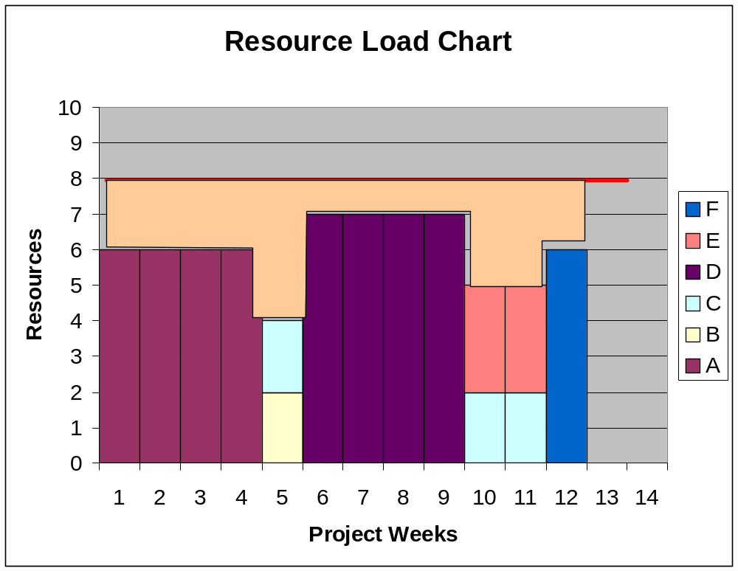
2. Resource Utilization
The goal of every company is to use the existing resources as efficiently as possible. Adding resources can be expensive and may not be necessary. The tan area in the chart shows the available resources not used in the current project. To maximize resource utilization, the available resources would be assigned to other, concurrent projects thereby improving the overall efficiency with which we use project resources.
Unused Resources

Slide 38
3. In-Process Inventory
The third standard for analyzing the optimal use of multi project resources is to consider their impact on In-Process inventory. In-Process inventory represents the amount of work waiting to be completed but delayed due to unavailable resources. For example an automotive company may find several resources delayed because it only has one set of climate chambers for testing. The projects stack up behind this resource bottleneck and represent the company's In-Process inventory of projects.
Excessive In-Process inventory is often caused by a lack of available resources and represents the kinds of trade-off decisions companies have to make in multi project environments. Does it make sense to hire more resources? Is the bottleneck only temporary leading to inefficient resource allocation later on?

Slide 39
Resolving Resource Decisions in Multi-project Environments
There are several methods for resolving resource allocation problems:
"First in Line" or "first come-first served" is the simplest rule of thumb for allocating resources. It is easy to employ, it simply follows the master project calendar. The earliest project gets scheduled first. This method ignores any other important information such as priority, emergency situations, preference due to higher commercial success of other projects.
Greatest Resource Demand
With this decision rule the project with the highest demand of resources get scheduled first. Then the remaining projects are being examined and scheduled according to their level of resource demand. The logic in this method is that in this way the resource bottlenecks will show up very quickly and it is being used as a starting point for potential additional resource allocation.

Slide 40
continued...
Greatest Resource Utilization
Is a variation on the above rule. This rule schedules the project first that uses the most types of resources. E.g. a company wants to run three projects A, B, and C across a resource pool made up of programmers, system analyst and networking staff. Project A utilizes a lot of programmers. Project B utilizes all three resource types, but much less. Using this rule, a company will prioritize project B above A in order to ensure that all resources are being utilized to the greatest extend.
Minimum Late Finish Time
This rule prioritizes projects on the basis of finish dates. The one with the earliest late finish date will be prioritized. Remember that the late finish date is the latest an activity can finish without compromising the overall critical path. The goal is to examine those project activities that have extra slack time (shown as a later late finish date) and prioritize activities with minimal slack (= early late finish date)

Slide 41
continued...
Mathematical Programming
The common objectives that such models seek to maximize are:
Minimize total development time for all projects
Minimize resource utilization across all projects
Minimize total lateness across all projects
While mathematical programming is a worthy approach to resolving the constrained resource problem, it tends to be limited due to the complexity of the problem. The large number of variables and the time necessary to generate a sufficiently small set of options.

Slide 42
The Personal Side of Leveling
Employees often have preferences regarding where they work and what they work on. The PM has influence regarding this but it is wise to smooth any rough waters associated with reassignment.
Additionally it is important in highly projectized businesses that people understand the full reason of their reassignment when it relates to resource leveling as it alleviates fears that reassignment might be work performance related or that there may not be enough work moving forward. Just the opposite typically!

Slide 43
Summary regarding Resource Management
Resource management in projects is a problem that is frequently overlooked by novice project managers or in firms that have not devoted enough time to understanding the full nature of the project management challenge they face.
As noted, it is common to develop project plans and schedules under the assumption of unlimited resources as if the organization can always find the trained personnel and other resources necessary to support project activities. This practice inevitably leads to schedule slippages and extra costs as the reality of resource availability overshadow the optimism of initial scheduling.
Use resource management to avoid these downfalls.

Slide 44
Leadership and Emotional Intelligence
Self Awareness – Implies having a deep understanding of one's own strengths, weaknesses, ego needs, drives, and motives. Have a clear perspective of one's self.
Self Regulation – A key ability in successful leaders is their ability to keep themselves under control. Think before you act.
Motivation – Effective project leaders are consistently highly motivated individuals. They are driven to achieve their maximum potential and they recognize that in order to be successful, they must also work with members of the project team to generate the maximum performance from each of them.
Empathy – A strong leader must show willingness to consider other team member's feelings in the process of making an informed decision.
Social Skill – A strong leader has the ability to manage relationships, and manage relationships with purpose, when it comes to relationships with his team.

Slide 45
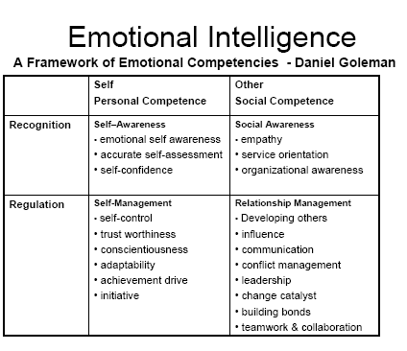
Emotional Intelligence

Slide 46
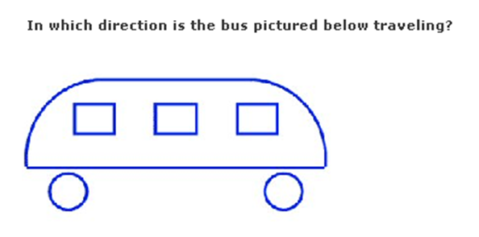
Keep it simple should be your default in dealing with People

Slide 47

Hierarchy of the Project Team’s Needs – True for all humans

Slide 48
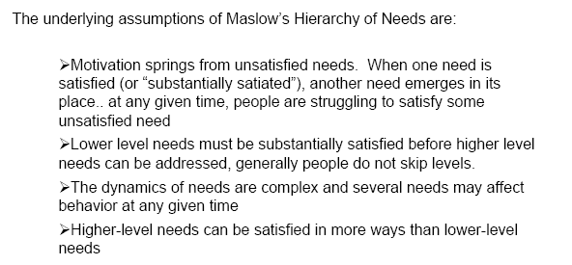
Maslow’s Hierarchy of Needs

Slide 49
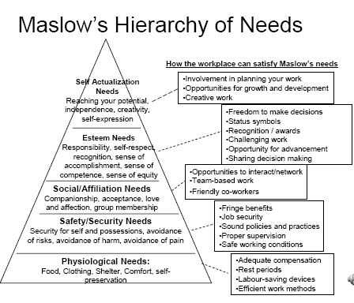
Maslow’s Hierarchy of Needs

Slide 50
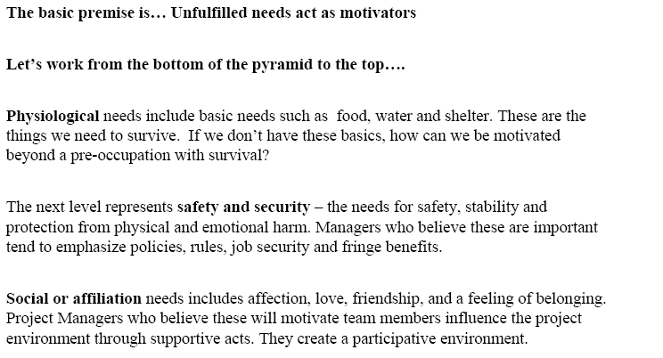
Analysis of Maslow’s Hierarchy of Needs

Slide 51
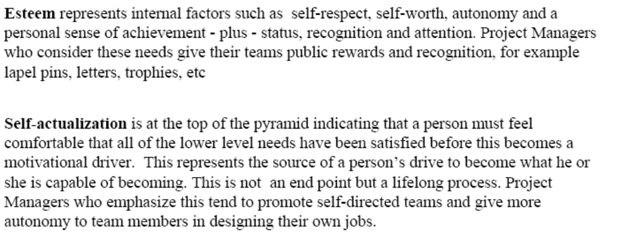
Maslow’s Needs continued….

Slide 52
Training Staff
After completing the work breakdown structure, create a matrix of training needs for the employees on staff. Keep it current and make sure it is budgeted.
Do not overlook broad training topics such as safety, privacy, quality etc. in favor of specialized technical training. The development of both soft and hard skills is necessary.
Do not be shy about sharing project management training information. This can only help you. Do not be concerned that the staff may become “on to you”.
Make sure the training of staff is in the project schedule.
Consider staff training events for periods when activities are split or where resources are going to be lost to other projects if they are not kept busy.

Slide 53
Team Goals and Accountability
The effort of generating work breakdown structure if it is never looked at again is a waste. It must be strictly adhered to. The consequences for straying from it must be real.
Work breakdown structure must be physically disseminated to the staff if it is to be respected. Else it is just the project manager’s dream.
When project goals are not met, rewards should not be given, the reigns may need to be tightened, and the overall sense of liberal laissez faire management may need to be re-evaluated.
If it turns out costs, deadlines, and configuarations are missed due to team member absence of discipline, then it is the project manager’s responsibility to re-instill that discipline. It can make the spot a lonely job at times, but life can be like that.
All of this too is a mute point if the project goals are not understood. If the team member is unaware of his goals, both wbs, as well as training, and any other identified intangible ones, then it is the PMs job to define and communicate them.

