Slide 1

Western University Canada
Engineering Grad Studies

Slide 2



Slide 3



Slide 4

This is the general look of the experience. It is generally streaming video with characters you will come to know. You will communicate via multiple choice dialogue boxes. The experience is multi-media as well and we strongly suggest you provide your phone number and e-mail address to continue the experience when you are off line. The experience has a lot of interactive animation as well such as for example Gantt chart sequences. The story has multiple paths through it depending upon your decisions.

Slide 5

Mental contest
Played on a computer
Use game design principles/technology
For a purpose other then entertainment

Slide 6

Educational Goal
  Develop affinity and skills in young PM’s
Target Audience
  Students technical/business studies
  Employees with PM ambitions

Slide 7

You will receive an automated e-mail with a software code from the Sharkworld “Game master”. Follow the link to the game site.
Go to register
Put in the code and the game will start.
If you leave the game at any point, you go back in the same way except instead of selecting register you put in your e-mail address and password when prompted.
Remember to give your country code (01) with your cell phone number when prompted. Also I recommend you apply an e-mail address other than your Western one, say a g-mail or hotmail etc so you do not have the risk of e-mail from the other characters going to your junk folder or being stopped by a fire wall.

Slide 8

contact the gamemaster via the support tab at sharkworldgame.com

Slide 9
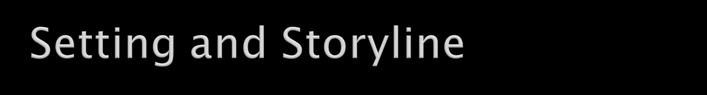
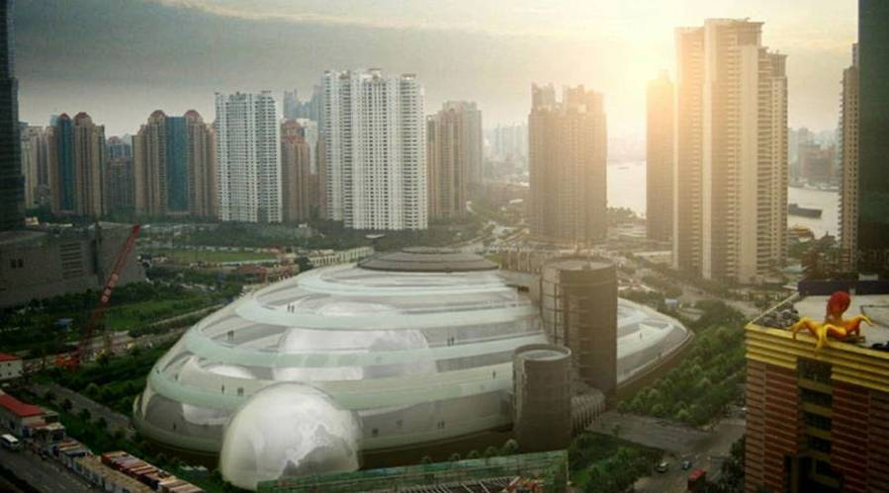
A Shark-attraction park in Shanghai
Player = Project Manager
Game continues 24/7

Slide 10


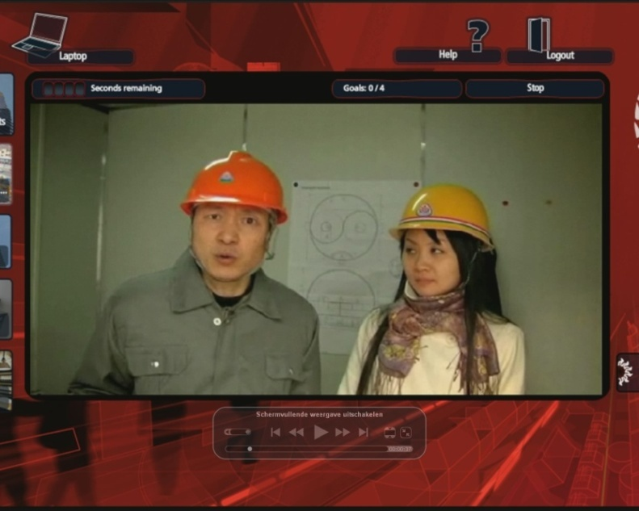
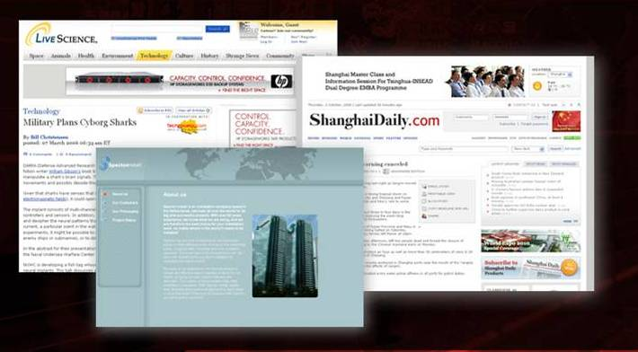
“Suspension of disbelief”

Slide 11

Once you have logged into the game, you will see you are dropped into the middle of Shanghai with a laptop, an apartment and many new colleagues.
You will get e-mail via your game laptop and via your real laptop. You will get text messages and e-mails on your cell phone. You will need to be on your toes.
The game lasts at least 3 hours. You are locked out of the game for two brief periods after each of first two thirds. If you are not invited back in after a couple of hours, just log back in with your code and you will be taken to where you left.

Slide 12

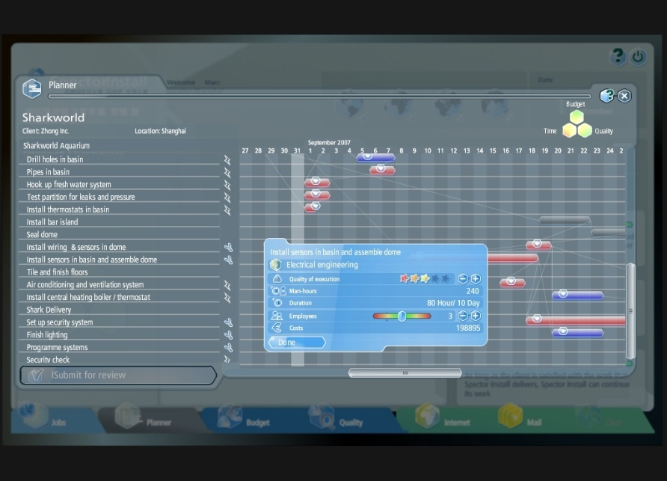
Examples: planning, risk analysis, budgeting

Slide 13

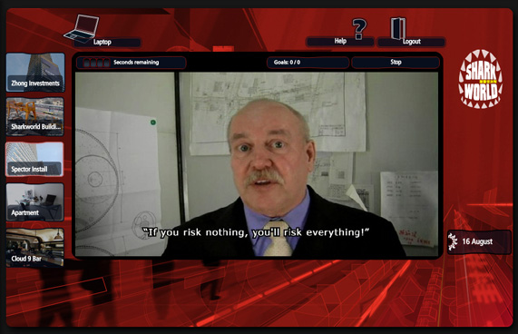
Interactive conversations to train social skills

Slide 14

Hard project parameters
Player has to make project decisions that affect time, quality and budget
Dilemmas (cost, time, quality)
Please be clear you will not see a running tally of how well you are scoring but rather an update after each third of the game where 40% is very good and 50% is excellent in each category. Set expectations to 40% in each category here. You will get your scores via e-mail from the Sharkworld “gamemaster” after each third of the game.

Slide 15

Soft project parameters
  Client satisfaction
  Boss satisfaction
  Team satisfaction
Stakeholders goals shift
Players have to find a delicate balance..see next slide
Please be clear, you will not see a running tally of how well you are scoring but rather an update after each section where 40% is very good and 50% is excellent in each category. Set expectations to 40% in each category here.

Slide 16
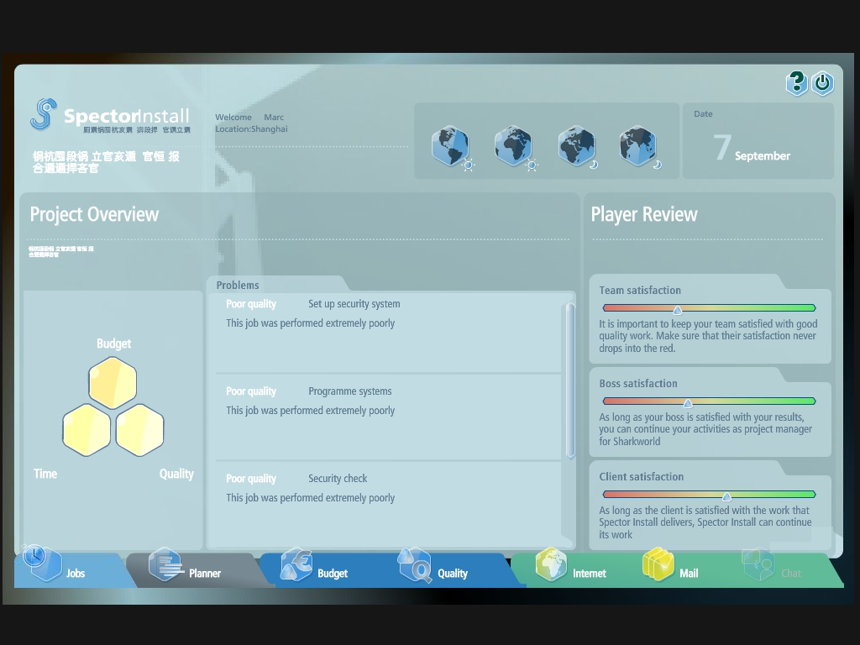

Slide 17

As in life, you never know exactly why you were scored the way you were. But also as in life you have been given the guidelines. Stick to PMBOK theory to maximize your score. The game is fully compliant to theory. So, if at the end, 2 or 3 of your six scores are below 40% which is your target, and you are left with that “Well, was it something I said?” feeling, the answer is very likely: YES. Do not dwell on your score. Your assignment will be largely marked based upon your assessment of the experience and only partly on your game scores.

Slide 18


