Slide 1
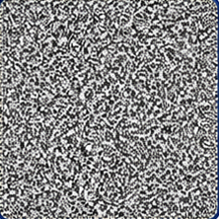
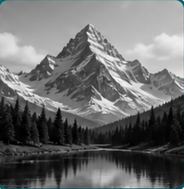
optimize θ
Notes:
Candidate C fidelity-v2 editable delivery.
Canonical source: source/semantic_figure.json
Selected-candidate map: source/selected_candidate_map.json
Asset manifest: source/asset_manifest.json
The Candidate C visual reference is not embedded as a whole-slide image.
Two exact image atoms are independent, replaceable picture shapes; they are not pixel-editable or scientific evidence.
Frames, generator layers, plots, connectors, explicit arrowheads, and labels are native editable PowerPoint objects.
Gradient and alpha styling remain native PowerPoint shape styling; equation artwork remains raster-free SVG objects.
Visual-reference reconstruction and automated checks do not establish scientific correctness or final researcher approval.
[Sources]
- source/selected_candidate_map.json — hash-bound visual direction map.
- source/asset_manifest.json — exact crop provenance and release policy.
- source/raster_atoms/noise-content.png — exact replaceable synthetic visual atom 2b9e18b06a576b43ebd3135a5732293f8a98d8bb10b217799e86b4016a5d71c2.
- source/raster_atoms/reconstruction-content.png — exact replaceable synthetic visual atom cedf344e8719184d921bb22a2f99dc57a70f38a71aa05c5f0c3e37d199d5d225.
- source/math/eq_z.svg — locally rendered raster-free vector equation.
- source/math/eq_generator.svg — locally rendered raster-free vector equation.
- source/math/eq_xhat.svg — locally rendered raster-free vector equation.
- source/math/eq_operator.svg — locally rendered raster-free vector equation.
- source/math/eq_yhat.svg — locally rendered raster-free vector equation.
- source/math/eq_y.svg — locally rendered raster-free vector equation.
- source/math/eq_loss.svg — locally rendered raster-free vector equation.
- source/math/eq_objective.svg — locally rendered raster-free vector equation.
- source/math/eq_reconstruction.svg — locally rendered raster-free vector equation.

