Slide 1
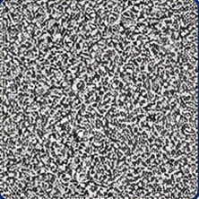
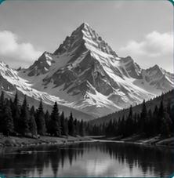
optimize θ
Notes:
Candidate C high-fidelity hybrid editable figure.
Canonical source: source/hybrid_figure.json
Raster modules are deliberately bounded, cropped, and replaceable:
- noise-raster-atom: assets/noise.png
- reconstruction-raster-atom: assets/reconstruction.png
Authoritative equations (embedded SVG with retained LaTeX):
- eq_z: z
- eq_generator: G_{\theta}
- eq_xhat: \hat{x}
- eq_operator: A
- eq_yhat: \hat{y}
- eq_y: y
- eq_loss: \lVert\hat{y}-y\rVert_{2}^{2}
- eq_objective: \theta^{\ast}=\operatorname*{arg\,min}_{\theta}\left\lVert A G_{\theta}(z)-y\right\rVert_{2}^{2}
- eq_reconstruction: \hat{x}=G_{\theta^{\ast}}(z)
No full-canvas raster is present; frames, network, plots, labels, connectors, and arrowheads are native objects.
[Sources]
- assets/noise.png — local publication-safe figure module.
- assets/reconstruction.png — local publication-safe figure module.
- equations/eq_z.svg — locally rendered vector equation.
- equations/eq_generator.svg — locally rendered vector equation.
- equations/eq_xhat.svg — locally rendered vector equation.
- equations/eq_operator.svg — locally rendered vector equation.
- equations/eq_yhat.svg — locally rendered vector equation.
- equations/eq_y.svg — locally rendered vector equation.
- equations/eq_loss.svg — locally rendered vector equation.
- equations/eq_objective.svg — locally rendered vector equation.
- equations/eq_reconstruction.svg — locally rendered vector equation.

