Slide 1
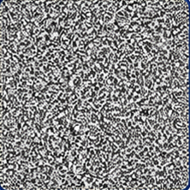
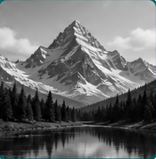
optimize θ
Notes:
Candidate C region-first fidelity review package.
Canonical source: source/semantic_figure.json
Selected-candidate map: source/selected_candidate_map.json
Asset manifest: source/asset_manifest.json
Candidate C is not embedded as a whole-slide image. Overlay and reference crops are not embedded.
Two exact image atoms are independent, replaceable picture shapes; they are not pixel-editable or scientific evidence.
All frames, generator layers, plots, connectors, arrowheads, and labels are native PowerPoint objects.
Equations are locally rendered vector SVG objects whose target boxes preserve intrinsic viewBox ratios.
This segmented review draft does not establish final scientific approval.
[Sources]
- source/selected_candidate_map.json — hash-bound eight-region visual direction map.
- source/asset_manifest.json — exact crop provenance and release policy.
- source/raster_atoms/noise-content.png — exact replaceable synthetic visual atom 2b9e18b06a576b43ebd3135a5732293f8a98d8bb10b217799e86b4016a5d71c2.
- source/raster_atoms/reconstruction-content.png — exact replaceable synthetic visual atom cedf344e8719184d921bb22a2f99dc57a70f38a71aa05c5f0c3e37d199d5d225.
- source/math/eq_z.svg — locally rendered vector equation.
- source/math/eq_generator.svg — locally rendered vector equation.
- source/math/eq_xhat.svg — locally rendered vector equation.
- source/math/eq_operator.svg — locally rendered vector equation.
- source/math/eq_yhat.svg — locally rendered vector equation.
- source/math/eq_y.svg — locally rendered vector equation.
- source/math/eq_loss.svg — locally rendered vector equation.
- source/math/eq_objective.svg — locally rendered vector equation.
- source/math/eq_reconstruction.svg — locally rendered vector equation.

