Slide 1
PROJECT 8
Spark caching
is a tradeoff
A distributed PageRank experiment on two local Spark workers
Research question
When repeated work reuses the same RDD, when does caching repay its materialization cost?
2 workers
6 iterations
12 runs
Notes:
Introduce the project as an experiment, not as a claim that caching always improves total runtime.
The key question is what happens after the first materialization when the same links RDD is reused.

Slide 2
SCOPE
The project targets four observable requirements
01
Distributed execution
One driver plus two local Spark workers in local-cluster mode.
02
Iterative workload
PageRank reuses the same adjacency-list RDD across six iterations.
03
Controlled comparison
Same graph, partitions, workers and iteration count with cache on or off.
04
Evidence
Logs, Spark UI stages, raw timings, checksum and sequential reference.
The experiment is intentionally small enough to run on one laptop, but still exposes Spark stages, partitions and persistence.
Notes:
Walk through the four things the teacher will look for: actual distributed components, an iterative workload, a fair cache comparison, and observable correctness/performance evidence.

Slide 3
ARCHITECTURE
One shared RDD feeds repeated stages
Worker 1
Executor
Deterministic
edge list
Spark driver
Worker 2
Executor
links RDD
MEMORY_ONLY
Metrics +
rank output
same input each run
cache toggle
same resources
The driver repeats join -> contribution -> reduce. Only the links RDD is intentionally persisted.
Notes:
Point out that the worker processes are real local Spark workers, while all components still share one physical laptop.
The links RDD is the reusable part. The rank vector changes every iteration.

Slide 4
MECHANISM
Caching changes the cost of the second and later iterations
Without persistence
With MEMORY_ONLY
Each iteration can recompute the shared links lineage.
Materialize once, then reuse cached partitions.
Read + group
Join
Reduce
Read + group
Cached links
Join
RDD lineage still exists for recovery. Cache changes reuse, not correctness.
The expected benefit appears in subsequent iterations. Total runtime also includes materialization and Spark startup.
Notes:
This is the core design idea from the RDD paper: persistence stores partitions for reuse, while lineage remains available for recomputation.
Make clear that caching does not change the PageRank answer. It changes when work is paid.

Slide 5
WORKLOAD
PageRank makes repeated reuse visible
Per-iteration computation
Rank recurrence
rank_new(v) = 0.15 / N
+ 0.85 * sum(rank(u) / out_degree(u))
1
Join links with current ranks
2
Split rank across outgoing edges
3
Reduce contributions by node
Why cache helps
4
Materialize new ranks
The graph structure stays fixed.
The rank vector changes.
Caching only the reusable side isolates the mechanism.
Notes:
The graph is fixed across iterations, so links is the natural target for persistence.
The rank vector changes each time, so caching the final result would not answer the same question.

Slide 6
EXPERIMENT
The comparison holds the resource budget fixed
Factor
Small
Medium
Large
Control
Edges
2,000
10,000
30,000
same seed
Cache
off / on
off / on
off / on
only toggle
Iterations
6
6
6
same
Partitions
4
4
4
same
Workers
2
2
2
same
Repeats
2
2
2
variation
Initial materialization is measured separately from the five later iterations.
Notes:
Stress that cached and uncached runs have the same input, same partitions, same two-worker budget, and same six iterations.
The separation between first materialization and later iterations is required by the assignment and is essential for interpretation.

Slide 7
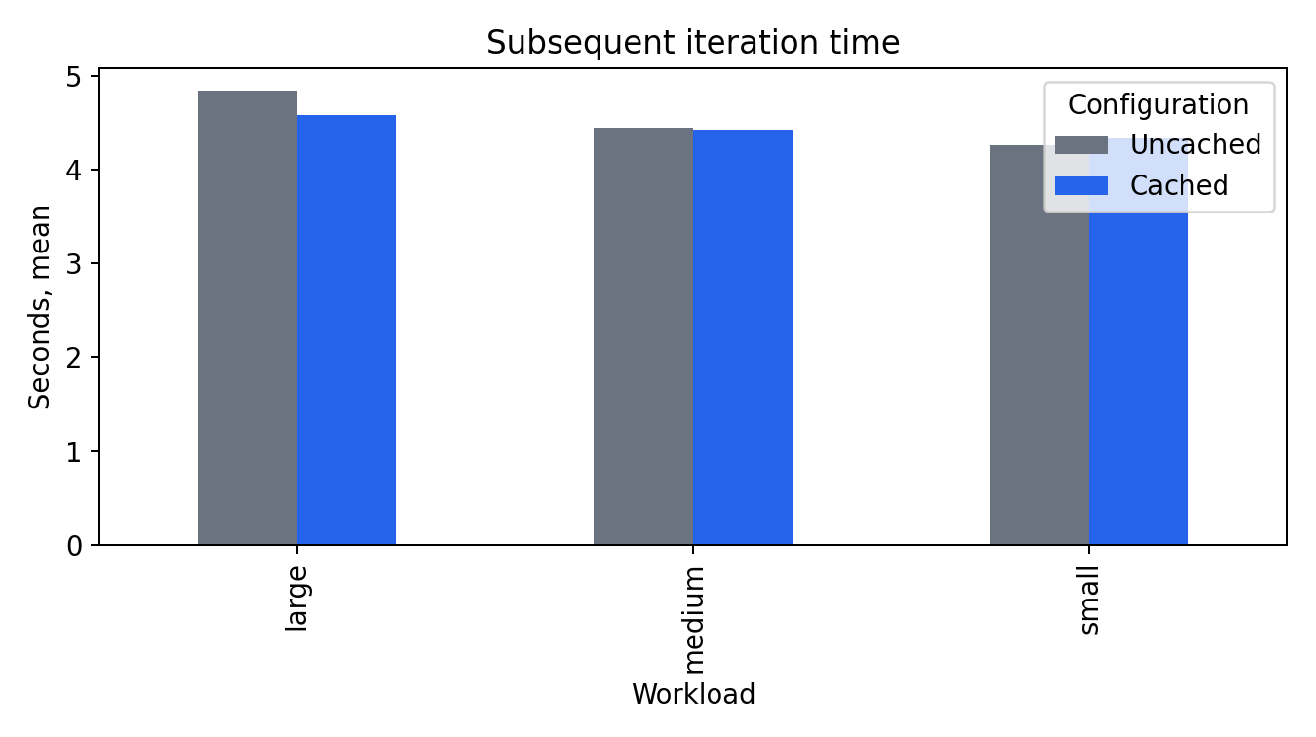
RESULT
Caching helps later iterations most on the largest input
Subsequent iterations
2,000 edges
0.984x
10,000 edges
1.005x
30,000 edges
1.056x
Cached time is lower when the repeated work is large enough to repay persistence.
Notes:
Read the result as a mechanism result: caching lowers later iteration time on the large workload.
The small workload is a useful counterexample. It prevents an overclaim that caching always helps.

Slide 8
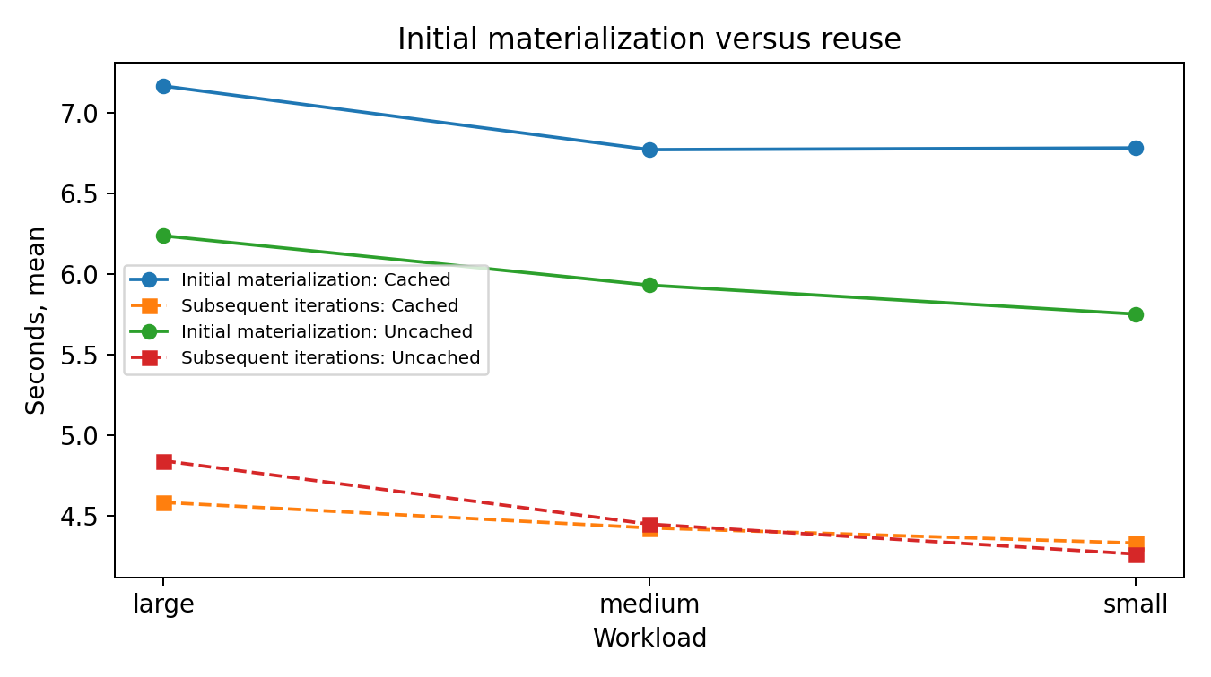
RESULT
Materialization cost explains the small-data slowdown
Small
Cached total runtime is higher because the first materialization dominates.
Medium
Later iteration times are almost identical.
Large
Cached later iterations are faster and total time is slightly lower.
A slowdown is a valid distributed-systems result when the mechanism cost is visible and explained.
Notes:
This slide answers the “why did caching not always win?” question.
The teacher explicitly allows a carefully explained slowdown as a valid result.

Slide 9
EVIDENCE
Correctness and observability are part of the result
Correctness
Runtime evidence
Distributed evidence
Sequential reference
max error: 4.99e-13
checksum: 1.0
Per-iteration timings
materialization separated
mean +/- standard deviation
Spark UI URL
partitions and stages
MEMORY_ONLY storage level
Every figure is traceable to raw JSON and raw_runs.csv.
The code also keeps the local-cluster setting explicit so the single-laptop limitation is not hidden.
Notes:
Correctness is independent of caching: both configurations agree with the same sequential reference.
The logs and raw results prove what was measured and make the figures reproducible.

Slide 10
READING
The result connects directly to RDD persistence and lineage
From the paper
In this project
RDDs expose a fault-tolerant abstraction for in-memory cluster computing. Persistence can reuse computed partitions. Lineage provides a path for recomputation when a partition is lost.
links.persist(MEMORY_ONLY) stores the shared graph partitions. The local two-worker deployment measures reuse and makes the lineage-based recovery assumption explicit, without claiming multi-machine scale.
Reading: Zaharia et al., NSDI 2012 | Current API: Apache Spark RDD Programming Guide
Notes:
The project does not reproduce the entire paper. It implements one idea accurately and states its simplifications.
The key connection is persistence for reuse plus lineage for recovery.

Slide 11
CLOSE
The repository is ready for the demo and final submission
Included
Still required after presenting
README with setup and commands
3-4 page report with references
Spark code and local-cluster launcher
Presentation demo and speaker notes
Correctness checker and sample input
AI-use and external-code disclosure
Raw JSON / CSV results and scripts
After 26 Oct: add feedback changes
Main takeaway: caching pays when repeated reuse is large enough to amortize materialization.
Notes:
Close with the main takeaway and show the demo if time allows.
The only intentionally pending item is the actual feedback after the scheduled presentation. It must be filled before the final 5 November submission.

