Slide 1
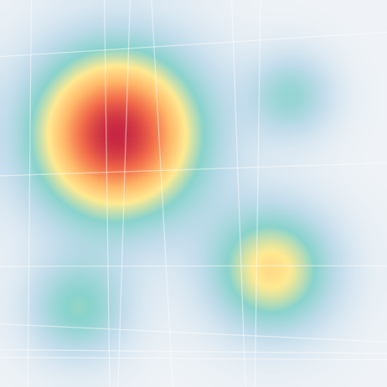
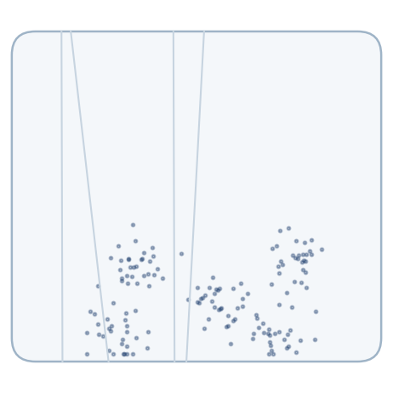
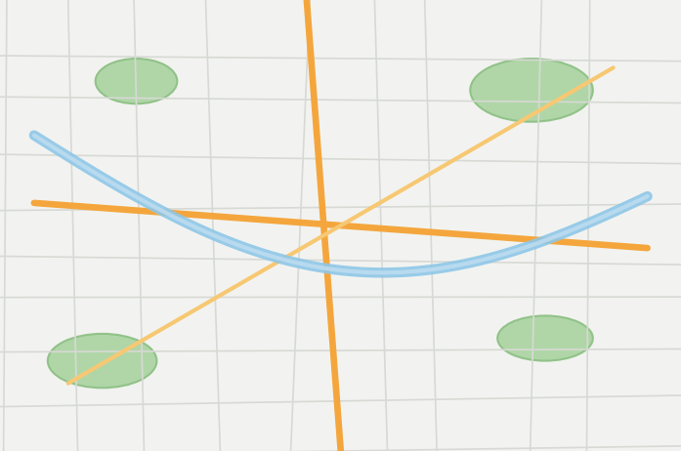
Motivation
Notes / Future Text
Coverage / RSRP Map
Traffic / RRC
PRB Utilization
Population Density
OSM Region Features
Outage Impact
Analysis
No single data source is sufficient.
1

Slide 2
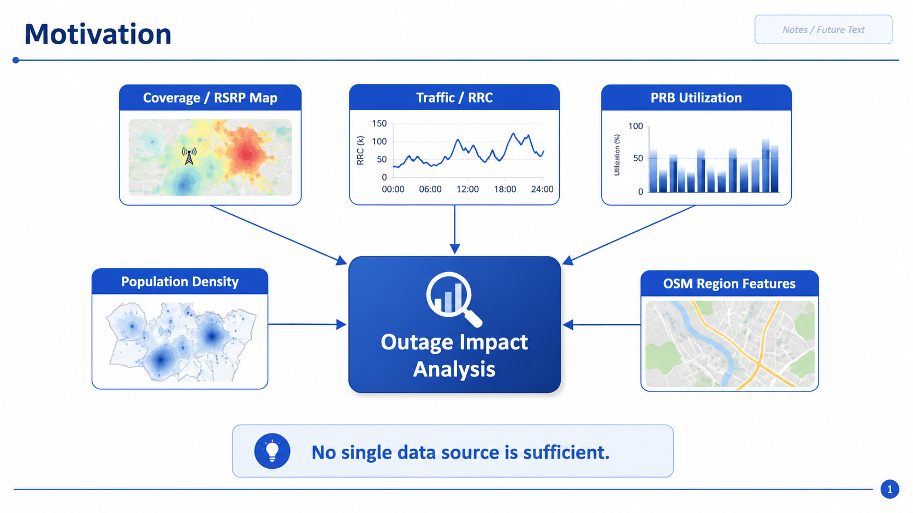

Slide 3
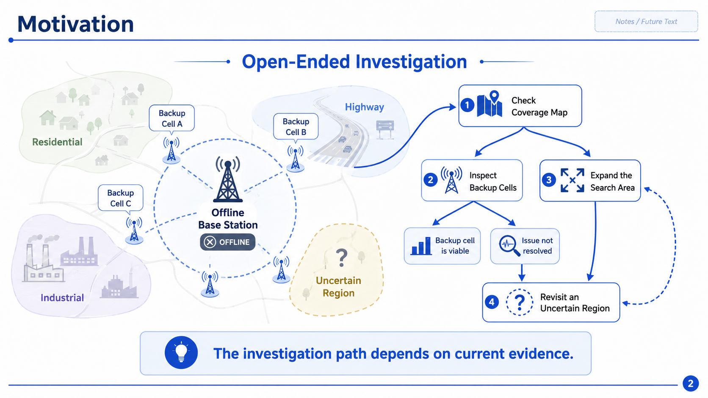

Slide 4
