Slide 1
Base Station Outage —
User Impact Analysis
Weekly Progress Update
Weekly advisor meeting · [Your name] · [Date]

Slide 2
Agenda
Last Week
Recap of the direction given and what came out of it
1
Research Plan
Problem framing + phase-by-phase detail: Miss match in ground truth label, and the outage analysis output determine
2
This Week
Finish ticket data distribution
3
Next Steps
Focus for the coming week
4
Base Station Outage — User Impact Analysis · Weekly Progress Update

Slide 3
Last Week — Recap & Direction
Direction From Last Week
Where It Landed
Dive into the data
Explore the KPI, coverage, ticket and attribute sources first-hand to understand their real structure, gaps and quirks.
The exploration was turned into a concrete, phased research plan (v3):
Clear input → output definition
Data inventory across all four sources
Risk register for known data pitfalls
A 5-phase plan (Phase 0 → Phase 4)
1
Frame the problem
Work out how to approach and solve outage user-impact estimation end to end, before building agentic system.
2
Base Station Outage — User Impact Analysis · Weekly Progress Update

Slide 4
Research Plan — Problem Framing & Roadmap
Problem Framing
Phased Roadmap
Phase 0: Data exploration
A full pass of the ticket data distribution (severity, area type, time-duration, coverage)
0
Input
query: USID, planned time duration, full outage/partial outage
KPI: 15 min data, cell level (RRCConnect, PRBUtilization, Throughput, Volume, +)
KPI database: require background and selection policy. Trade-off for query
Coverage: Rhea api: constrain (limited search round)
Attribute data: Frequency band, location, technology, Area type (Rural/suburban/urban)
Cost function
Ground truth label: severity level
Phase 1: Manual trace of one ticket
Going from input to output in different cases
1
Phase 2
Batch metrics + severity calibration
2
Phase 3
Output design & system build
3
Reasoning process
Coverage hole
Back-up neighbor absorption fraction
Service degrade based on rsrp
Congestion analysis based on PRButilization
Estimation of RRC loss
Output: impact analysis
User average loss (no service)
User degrade (UE throughput)
KPI distribution
……
Phase 4
Validation & iteration
4
Notes:
Online mode:
Input: query: USID, outage time_bin, outage cell
Coverage: Rhea api (Cost function)
Todo: KPI database study, define the constrains, and the Cost function
Output:
User average loss (no service)
User degrade (UE throughput)
KPI distribution
Offline mode:
Ground truth: the only ground truth is KPI data.
AI: adaptively work on KPI selection and query.

Slide 5
Research Plan — Problem Framing & Roadmap
Problem Framing
Online Reasoning process
query: USID, planned time duration, full outage/partial outage
KPI: Query from snowflake, can be fine-grained to 15 min data, cell level, have query limit
Coverage: Rhea api, have limited times for access
Attribute data: Frequency band, location, technology, Area type (Rural/suburban/urban)
Output
The number and locations of Users who completely lost service.
The number and locations of Users who got service degrade
Online mode Input
Query: USID, outage time bines, outage cells
KPI: Query from snowflake, can be fine-grained to 15 min data, cell level, have query limit
Coverage: Rhea api, have limited times for access
Attribute data: Frequency band, location, technology, Area type (Rural/suburban/urban)
Offline mode
Online ground truth: ticket data where there are existing detected KPI fluctuation or completely loss.
Notes:
Online mode:
Input: query: USID, outage time_bin, outage cell
Coverage: Rhea api (Cost function)
Todo: KPI database study, define the constrains, and the Cost function (need to define the cost function and the )
Output:
User average loss (no service)
User degrade (UE throughput)
KPI distribution
User：
Offline mode:
Ground truth: the only ground truth is KPI data.
AI: adaptively work on KPI selection and query.

Slide 6
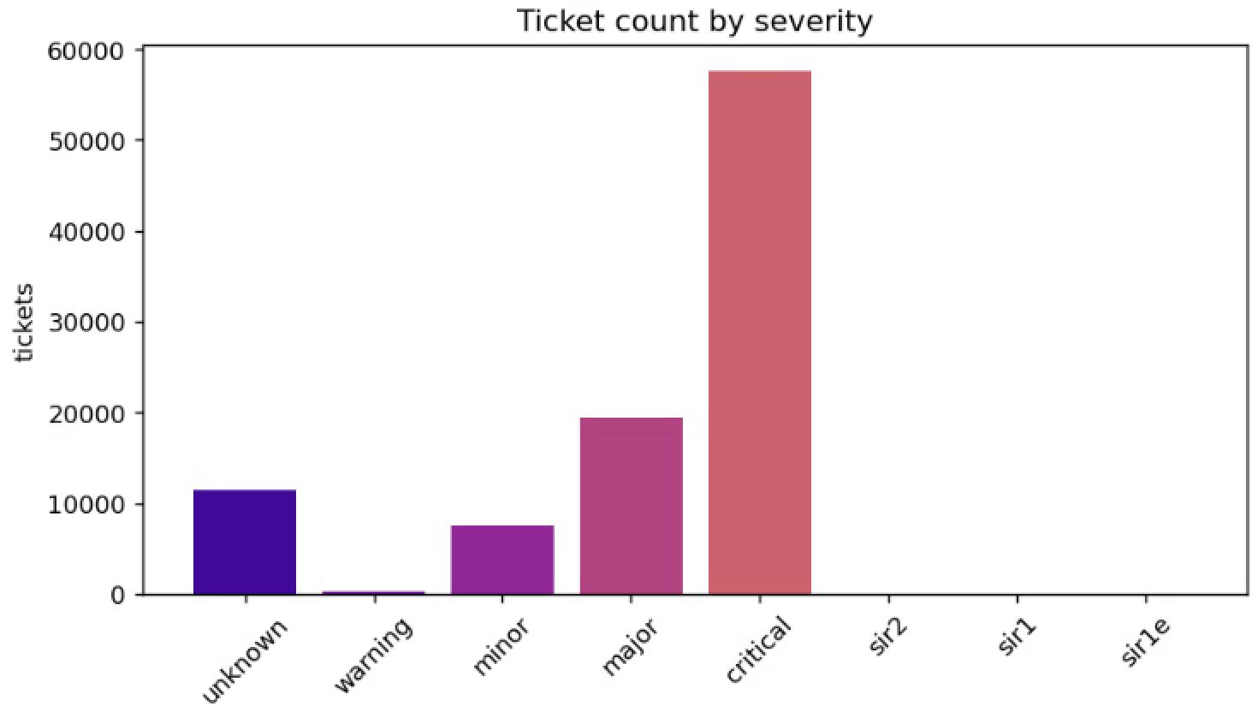
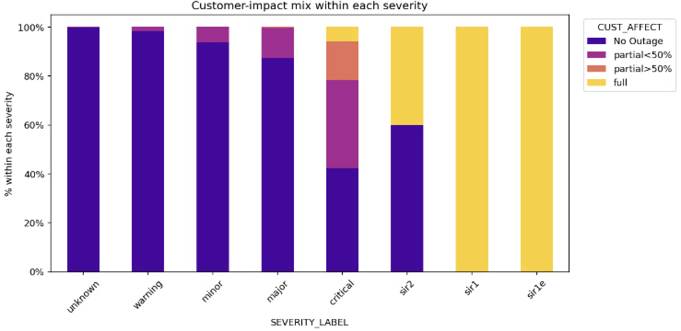
Phase 0 — Data Exploration & Cleaning
Distribution
Ticket-data figures & tables
0.1 Ticket data (about 130000 tickets after 2026)
Distributions: severity (8 levels), Full outage/Partial outage, duration, Area type.
0.2 Cascade detection
Per ticket, flag other BS down within ±2h and ~2–3× footprint radius. Tag is_cascade + linked tickets.
0.4 KPI sampling
1-week pre-alarm series, Full/Partial outage (in ticket data, it’s column name is Customer Affect)
0.5 Coverage sampling( about 2000 )
Coarsely scan the coverage data to derive the typical coverage extent (footprint radius) for each area_type — urban, suburban, and rural.
Ticket with level 5 (critical) severity have most cases, when the Cust_Affect shows no outage, it will still have critical data.

Slide 7
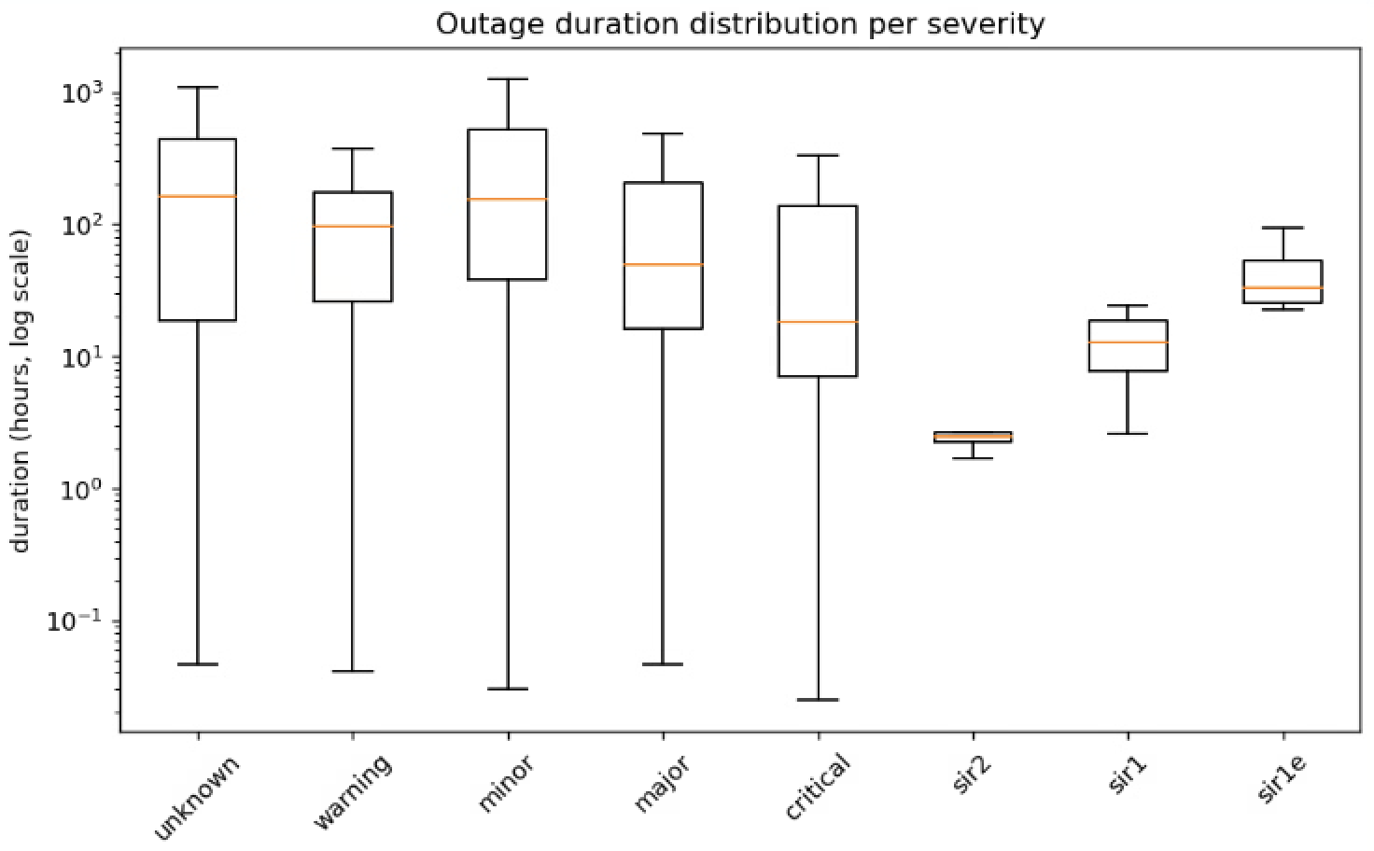
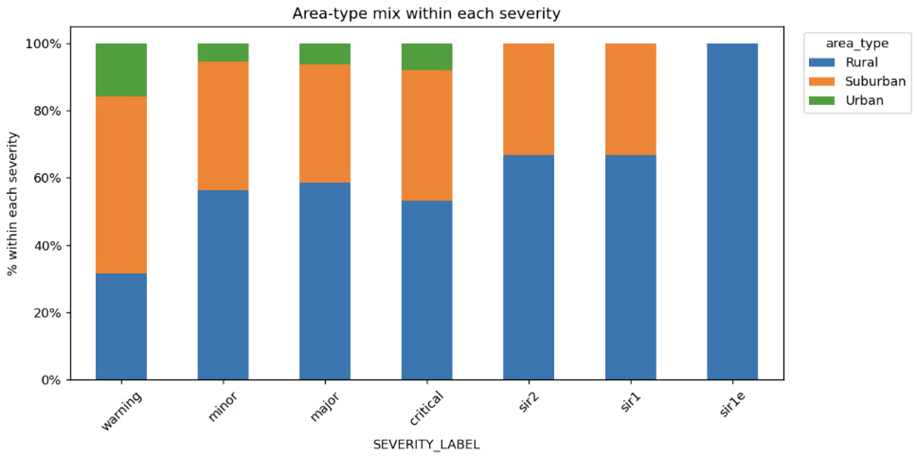
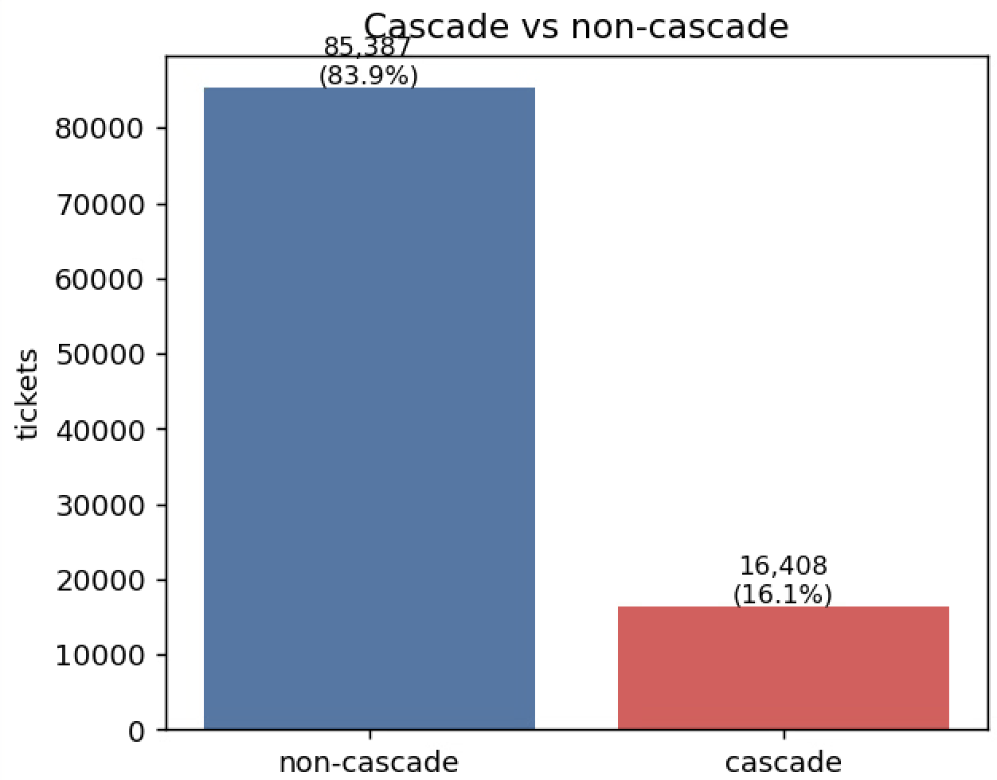
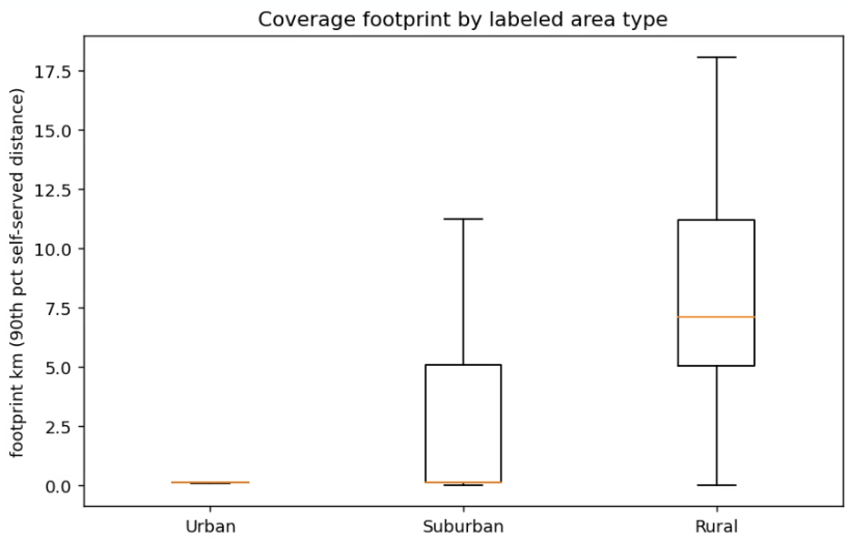
Phase 0 — Data Exploration & Cleaning
Ticket-data figures & tables
Rhea data query start point:
Urban: 5 km
Suburban: 10km
Rural: 15 km

Slide 8
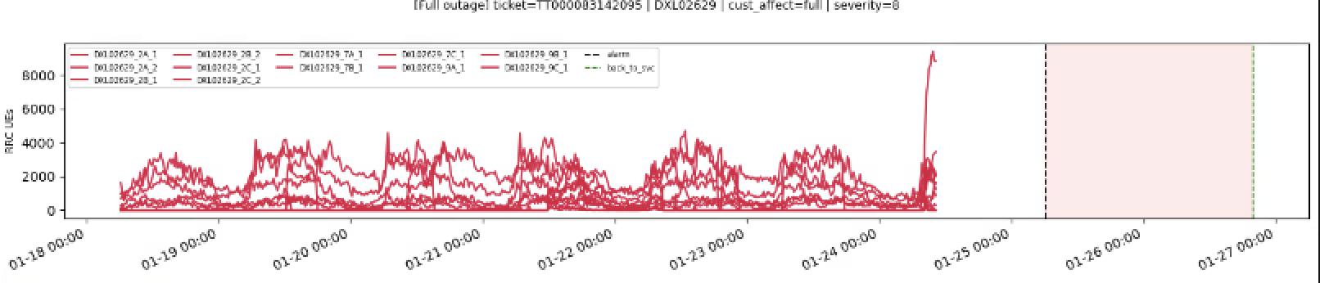
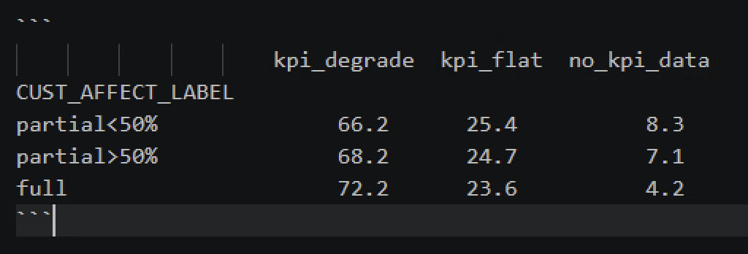
Phase 0 — Data Exploration & Cleaning
KPI data plotting and Matching with severity level
Fig. a sample with full outage

Slide 9
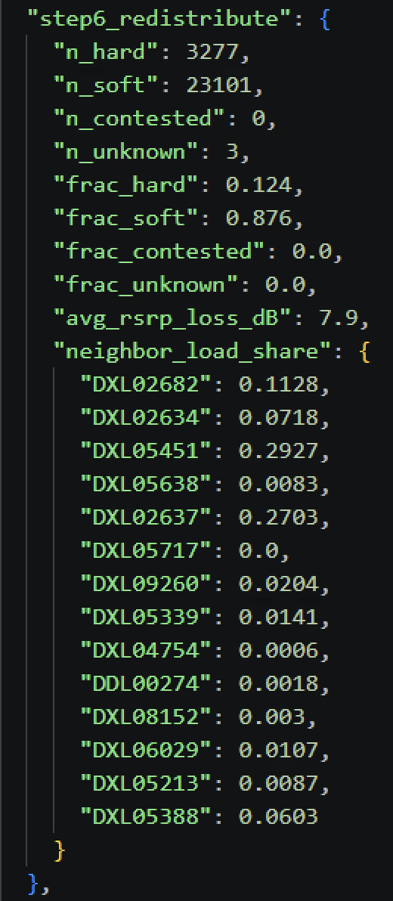
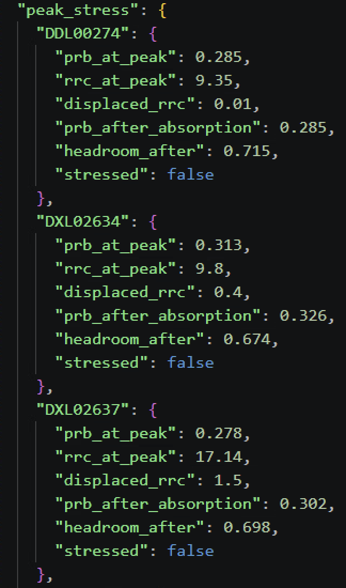
Phase 1 — Single-Ticket Manual Trace
Steps & what to analyse
Full-outage use case — figures & tables
1.1 Coverage continuity
Search radius start from area_type suggest
Coarse-grained to fine-grained query Rhea data
Get the back up USID information
1.2 KPI baseline
4-week baseline by time-of-day × day-of-week → expected RRC / throughput / volume.
1.3 Neighbor capacity
Determine neighbor capacity by PRBUtilization, use the coverage fraction to estimate how much traffic will each neighbor absorb. (When the neighbor KPI is null, assume this USID is down.)

Slide 10
Phase 2–4 — Calibration, Build & Validation
Phase 2 · Calibration
Phase 3 · Build
Phase 4 · Validation
2.0 Severity mismatch
Understand RRC → 8-level mapping; analyse mismatch cases.
3.1 Output schema
Coverage · KPI baseline · traffic · strain · context.
Hold-out set
20%, stratified by severity × outage level.
2.1 Batch metrics
Coverage, user-hours-lost, traffic loss, neighbour pressure.
3.2 Eval criteria
Severity accuracy, KPI consistency, expert scoring.
Evaluate
Apply the locked evaluation criteria.
2.2 Metrics ↔ severity
Which metrics discriminate; flag mismatches.
3.3 Text generation
Expert-written few-shot (not problem detail).
Stratified accuracy
By environment / level / equipment / cascade.
2.3 Output direction
Decide how severity is used in the output.
3.4 End-to-end test
Full pipeline run + edge cases.
Error patterns
Find systematic failures; iterate.
Base Station Outage — User Impact Analysis · Weekly Progress Update

Slide 11
This Week — Progress & Gaps
Done
Still Open
Research plan finalized (v3)
Problem definition, data inventory, risk register, 5-phase roadmap.
Phase 0.1 — Ticket data analysis (started)
Equipment-type split (drop COW); severity & customer-affecting distributions.
Phase 1 — Full-outage use case
Traced one full-outage ticket end-to-end through the analysis chain.
Phase 1 — Remaining traces (cross-severity, partial)
Base Station Outage — User Impact Analysis · Weekly Progress Update

Slide 12
Next Steps
Finish Phase 0 data exploration
Cascade detection, KPI sampling (10–15 tickets), and coverage-sampling validation across urban / suburban / rural sites.
1
Extend Phase 1 traces
Add cross-severity and partial-degradation tickets; lock in the analysis logic before batching.
2
Confirm open data questions
Verify availability of back_to_service / resolved timestamps needed for outage-duration calculations.
3
Base Station Outage — User Impact Analysis · Weekly Progress Update

