Slide 1
USID Outage Impact Assessment
Presenter: Xinyue Zheng
Collaborator:

Slide 2
Problem: Assessing the Impact of Cellular Base Station Outages
Scenario:
A cellular base station goes offline (maintenance or failure)
OFFLINE
Q1
How severe is the impact?
Q2
Where does the impact occur?
Customer care calls increase significantly
Which geographic zones are most affected?
→ Accurate pre-assessment enables proactive planning and resource allocation
Affected users
Unaffected users
Tower
PROBLEM FORMULATION — HOW WE MODEL IT
INPUT — Multimodal feature data
LABEL — Operational proxy
Per-USID KPI data
Customer care calls
Temporal
KPI
Historical throughput & volume · Hourly traffic profiles
volume · Δ increment
during & post outage window
Spatial
Rhea
Geospatial signal measurements
→
RSRP, SINR, RSRQ at each geographic coordinate · Coverage across service area
OUTPUT — Severity level
Static
ATTR
USID static attributes
L1
L2
L3
L4
L5
Physical & spectrum attributes · tower height, 4G/5G, …
· · · extensible to additional modalities
5-class · boundaries defined by domain knowledge

Slide 3



Limitations with Manual Expert Assessment
Scale
Speed
Traceability
Thousands of base stations
Parallel assessments required
Engineers become bottleneck
Fast turnaround required
Manual analysis takes hours
Missed scheduling windows
Reasoning not recorded
Hard to reproduce decisions
Weak post-incident audit
Manual expertise is effective, but not scalable, fast, or auditable

Slide 4
From Manual to Autonomous
How should we automate the assessment? Three natural approaches:
Our approach
①
Train a
specialized model
②
Fine-tune
a large LLM
③
Off-the-shelf
LLM agents
✗
Requires large labelled dataset (thousands to hundreds of thousands)
✗
Requires domain-specific labelled data (hundreds to thousands)
✓
Can leverage few-shot examples without retraining.
✗
Poor generalization to new tasks
✗
Expensive and time-consuming to adapt
✓
Prompt- and rule-driven reasoning offers traceability
✗
Low interpretability, fully black-box
✗
Limited control over reasoning process，still remains data-driven
✓
Domain rules explicitly injected via prompts → behavior stays aligned with expert knowledge
✓
Modular and easily adaptable
We shift from data-driven prediction to structured, rule-guided reasoning

Slide 5
Single Agent vs Multi-agents
Single-agent struggles with…
Multi-agent enables…
✗
Context overload
✓
Decomposed context
All modalities handled in a single prompt → degraded reasoning
Each agent operates on a focused subset of information
✗
Lack of specialization
✓
Specialized reasoning
→
Different sub-tasks hard to optimized via one agent jointly
Each agent focuses on one aspect
✗
No intermediate verification
✓
Enables structured verification
No mechanism to check reasoning during the process
Per-agent checks + cross-agent validation become possible and keeps consistency
Decomposing the problem by modality enables both better reasoning and stronger auditability

Slide 6
How to make the most of Agents
Prompt Engineering
Context Engineering
Harness Engineering
Tell the model what to do
Give the model the right information
Control how the system executes
Enable reliable multi-step workflows
"The bottleneck shifts from input design to execution control"

Slide 7
What is Harness Engineering?
"Harness Engineering is the design of the execution system around an LLM"
Agent + Harness = whole system
Not just providing information, but controlling execution
Orchestration
Execution Modules
Verification & Control
State & Memory
Predefined workflows
Dependency management across steps
Specialized agents or tools
Each handles a specific subtask
Validation and evaluation
Error detection and correction
Intermediate results
Persistent storage (e.g., logs or memory systems)
"A harness turns an LLM into a reliable system"

Slide 8


System overview
Harness
Orchestrate & dispatch agents
Enforce verification & rerun logic
Output result
Input prompt
Prompt parser
preprocess
Analysis agents
KPI analysis agent
Attribute analysis agent
Coverage & load agent
Geo-correlation agent
Ruess-memory MCP server
Run-store MCP server
data exchange via MCP
data exchange via MCP
Final assessment agent
Verification & reflection agents
Cross agent verifier
Reflector
agent
: Per-agent verification agent
: work-flow

Slide 9

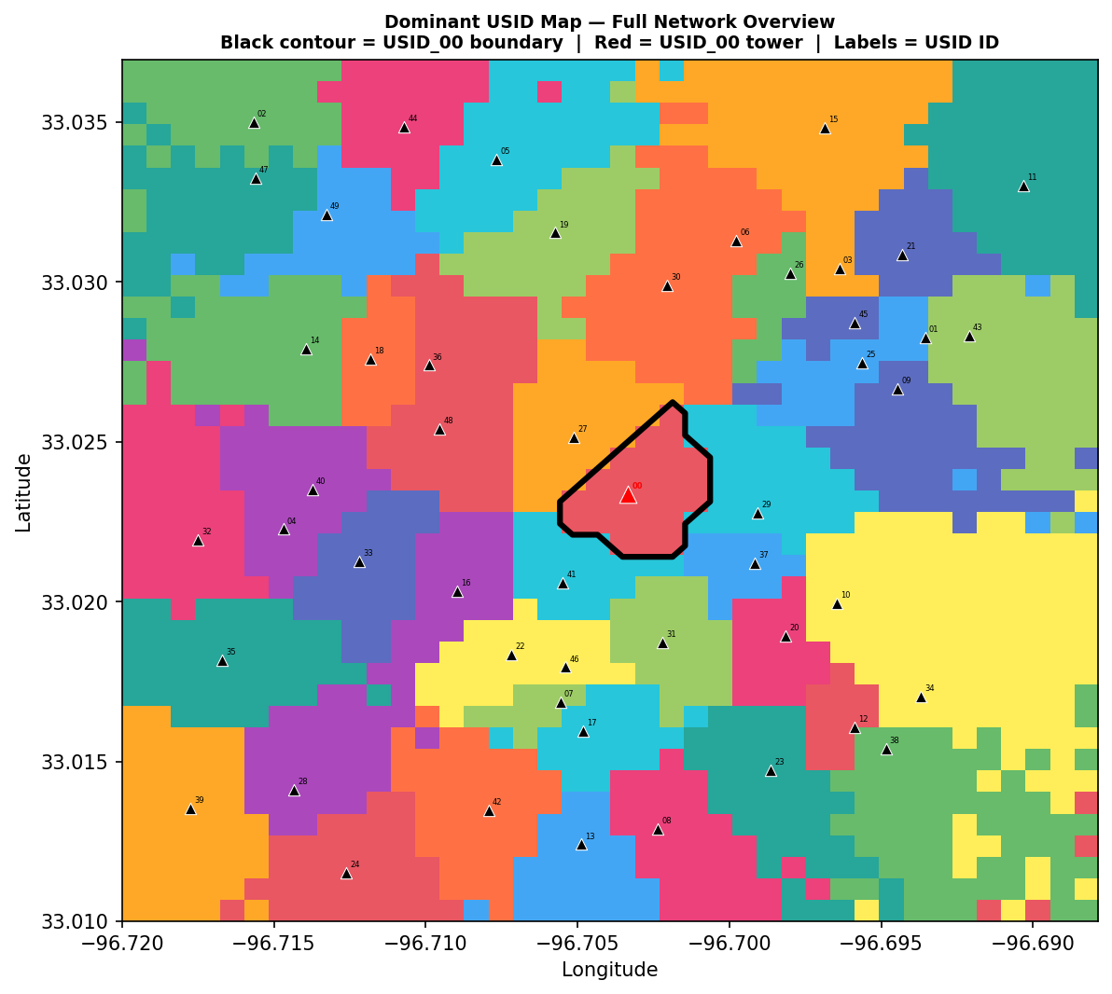
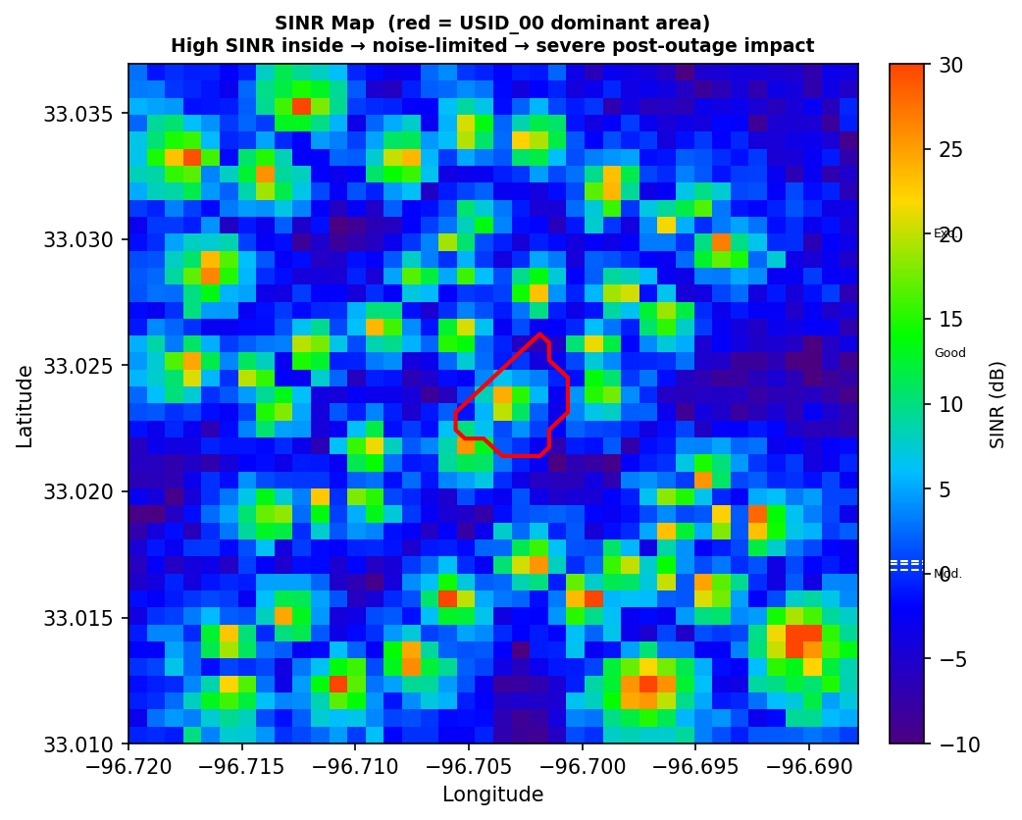
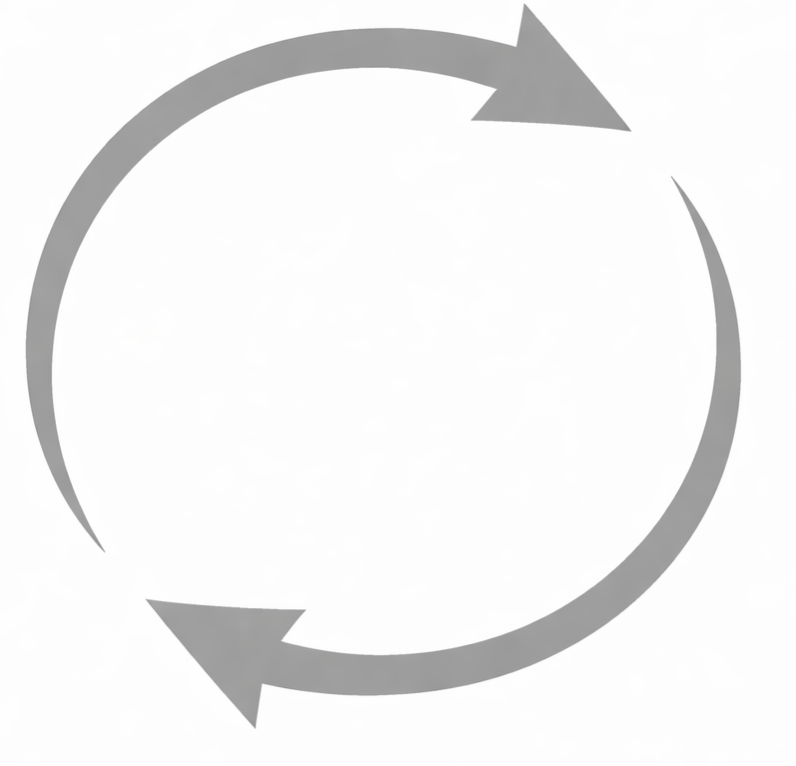
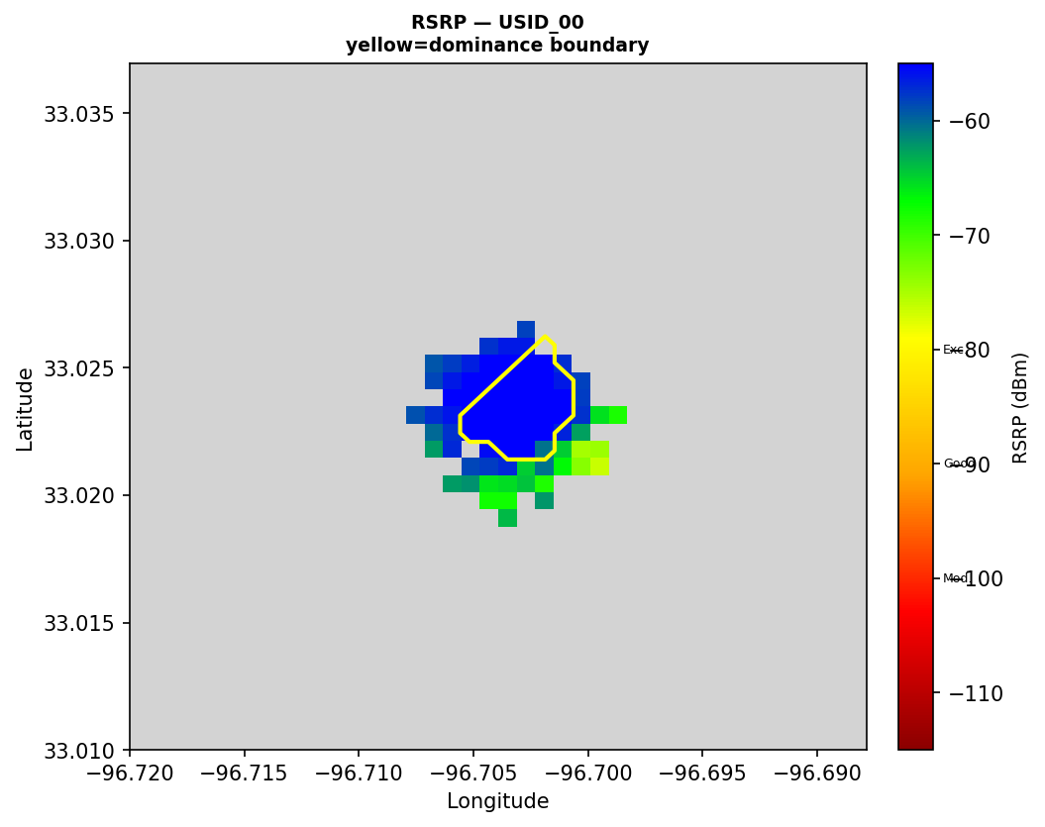

Preprocessing
Computes every numeric fact about signal quality, coverage, and KPI pattern— pure Python, no AI, fully auditable.
processed data stored
Harness
Numeric facts
Trigger preprocess; input USID, shutdown window
Statistics fact of USIDs’ signal quality, coverage file
Preprocess
Fetch Raw data via MCP server
Compute stats and maps
USIDs’ KPI pattern file
Signal map artifacts
Raw Data: Rhea raw data, KPI data, USID attribute
Dominance map
Run-store MCP server
Store via MCP server
SINR heat map
RSRP coverage map
databases

Slide 10
Analysis Agent Architecture — Shared Pattern
All analysis agents share the same execution pattern — only inputs, task focus, and outputs differ
Harness:
Trigger the Analysis agent
Pass → proceed to next step
Fail → force rerun (≤ 2×)
Persistent fail → escalate to human
Fail/Pass
Analysis agent
RunStore MCP
read / write
Rules Memory MCP
fetch input
Store analyses file
domain rules
Learned lessons
analysis result
Checking agent
Each analysis agent receives an analysis skill.md injected by harness:
How to query input data
How to query domain rules
Task definition
Reasoning format
Checking agent verifies based on check skill.md:
reasoning chain self-consistency
rule application correctness
conclusion matches evidence

Slide 11
Multi-Perspective Analysis Agents
Different agents plug into the same harness to analyse risk from complementary dimensions
Coverage
& Load
Attribute
KPI
Geo
Correlation
Final
Assessment
INPUT
INPUT
INPUT
INPUT
INPUT
RSRP, SINR, coverage maps, signal stats file
Statistics fact file
USIDs' KPI pattern file
All maps (incl. real map) + upstream results
All files from previous steps
TASK
TASK
TASK
TASK
TASK
Can backup cells absorb redistributed users without overload?
Evaluate each backup cell's hardware capacity & flag 5G downgrade risk
Forecast hourly traffic load during shutdown & identify saturation and peak-collision risks
Divide coverage area into geographic zones and assign impact severity by signal & land use
Synthesise all evidence to determine overall outage severity
OUTPUT
OUTPUT
OUTPUT
OUTPUT
OUTPUT
Per-backup overload risk & load redistribution verdict
Downgrade risk & capacity description
Saturation risk & peak-collision risk
Zone-level severity
Overall severity level
All agents plug into the same harness with domain-specific reasoning — verification pattern identical across all

Slide 12
Cross-Agent Verifier
Verifies that all agent verdicts are mutually consistent — conflicts are detected and resolved before final assessment
Harness
Conflict resolution logic from harness
Minor conflict → apply priority rules from domain knowledge then continue Major conflict → rerun both agents
trigger after all agents pass
3cross-checks defined by domain knowledge
1
Consistency between load analysis and traffic forecast
read all
analysis files
RunStore MCP
Fetch all analysis files
Store verification file
2
Consistency between signal coverage and hardware capacity
save verification
result
4
Alignment between geographic severity and network risk
Rules Memory MCP
Domain knowledge rules & learned lessons

Slide 13
Reflector
Distils lessons from each verified run · appends to warm tier for future agents to learn from · only runs after full PASS
Harness
Why this matters
Lessons accumulate across runs — future agents benefit from past edge cases without retraining. The system improves through experience, not gradient updates.
trigger only after full PASS
Looks for
Edge cases near thresholds in rules
RunStore MCP
read all
findings
all agent findings
+ verifier results
Rules applied ambiguously or inconsistently across runs
Coverage vs KPI divergence patterns
Rules Memory MCP
KPI forecast modeling judgment calls
append new
lessons
Learned lesson
(append-only)
Geo zone severity close calls
append-only · no overwrite · stays silent if no new lessons

