Slide 1
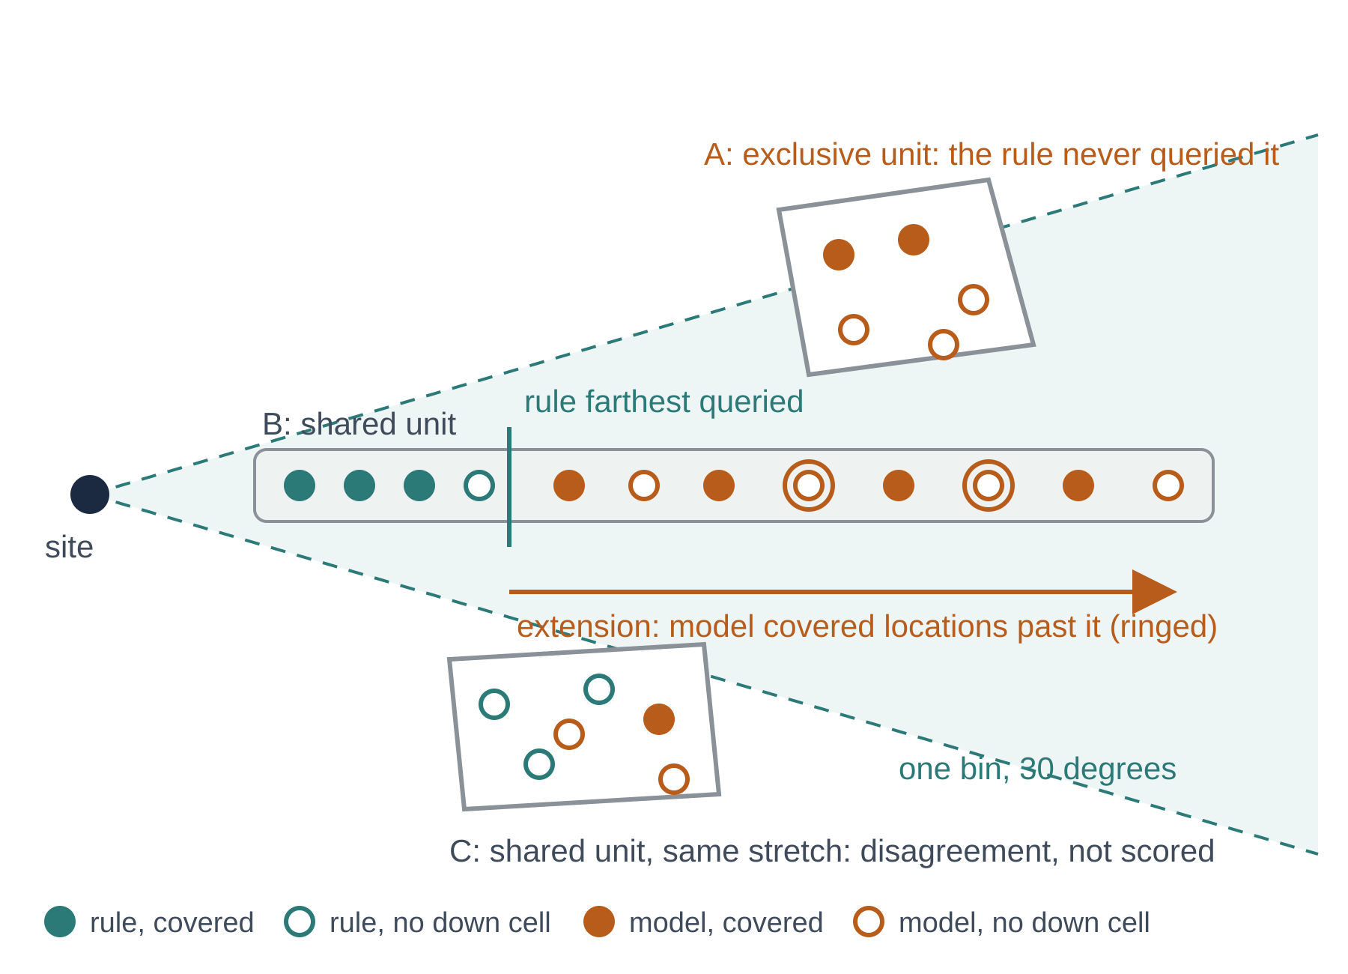
Evaluation metrics used in the case tables
metric | definition
resources | the x axis; from run.json
time, decision time | wall-clock minutes; the part spent in model calls (0 for the rule)
locations charged | grid locations sent to the coverage service
KPI cell-queries | cells named by executed KPI calls; a cell named twice counts twice
findings | counted in units, from the point records
units reached / covered / with a hole | queried at least once / a sample shows the site at or above -110 dBm / a covered location with no backup at or above -110 dBm
covered locations in reached units | how fully the reached units were mapped
territory | what one core found where the other never queried
exclusive units: covered / holes | units this core found covered and the other core never queried (A in the figure)
extension: units / locations / holes | in units both reached, this core's covered locations farther from the site than the other's farthest queried location, plus 100 m (B)
max extension (km) | the largest such distance past the other core's farthest point
progress and anytime | state at the end, including at a cap
bins closed / total | bins the completion check declared closed, 12 per site
farthest covered per site (km) | reach outward, one value per site
backups with a baseline / observed | backup cells seen in coverage results; of those, with a KPI baseline fetched
cost
locations per covered unit | locations charged over units covered: the cost of one finding
Unit = one activity area inside one 30 degree bin of one site. A unit counts as covered after one covered sample, so sampling density changes the cost, not the finding. Both exclusive measures test "the other core never queried there", so neither is sampling variance.
Notes:
Read the figure first: A is an exclusive unit, B is an extension inside a shared unit, C is the shared disagreement that is not scored. The table groups the columns of the per-case tables: resources, findings, territory, progress, cost. Hit rate (covered over queried points) is not used because it rewards staying in known coverage.

Slide 2
Case 1: one site, both cores complete
Resources
core | end reason | time (min) | decision time (min) | program time (min) | rounds | rejected rounds | locations charged | KPI calls / cell-queries
rule | complete | 35 | 0 | pending | pending | pending | 1 162 | pending
model | complete | 101 | pending | pending | pending | pending | 1 770 | pending
Findings and cost (units = site, bin, area)
core | units reached | units covered | units with a hole | covered locations in reached units | locations per covered unit | bins closed / total
rule | pending | pending | pending | 270 | pending | pending
model | pending | pending | pending | 285 | pending | pending
Territory and anytime (each core against the other)
core | exclusive units: covered / holes | extension: units / locations / holes | max extension (km) | farthest covered per site (km) | backups with a baseline / observed
rule | pending | pending | pending | pending | pending
model | pending | pending | pending | pending | pending
Map (from the area-level script): activity areas; both cores' queried locations by colour; covered filled; holes marked; extension locations ringed; final active area per core and site.
Same completion specification reached by both. The model took about three times the time and 1.5 times the locations for 15 more covered locations; whether those lie in units or extensions the rule never queried is the pending territory row.
Notes:
Known values are from the run records as reported on 2 November; pending cells come from the area-level comparison script (Prompt_Copilot_Area_Level_Comparison_2026-11-02.md). The map goes in the dashed box.

Slide 3
Case 2: one site, both cores complete
Resources
core | end reason | time (min) | decision time (min) | program time (min) | rounds | rejected rounds | locations charged | KPI calls / cell-queries
rule | complete | 32 | 0 | pending | pending | pending | 514 | pending
model | complete | 60 | pending | pending | pending | pending | 1 815 | pending
Findings and cost (units = site, bin, area)
core | units reached | units covered | units with a hole | covered locations in reached units | locations per covered unit | bins closed / total
rule | pending | pending | pending | 168 | pending | pending
model | pending | pending | pending | 186 | pending | pending
Territory and anytime (each core against the other)
core | exclusive units: covered / holes | extension: units / locations / holes | max extension (km) | farthest covered per site (km) | backups with a baseline / observed
rule | pending | pending | pending | pending | pending
model | pending | pending | pending | pending | pending
Map (from the area-level script): activity areas; both cores' queried locations by colour; covered filled; holes marked; extension locations ringed; final active area per core and site.
Same specification reached by both. The model took twice the time and 3.5 times the locations for 18 more covered locations; the territory row says whether they are new ground.
Notes:
Known values are from the run records as reported on 2 November; pending cells come from the area-level comparison script (Prompt_Copilot_Area_Level_Comparison_2026-11-02.md). The map goes in the dashed box.

Slide 4
Case 3: four sites, 17 cells, both cores at the time cap
Resources
core | end reason | time (min) | decision time (min) | program time (min) | rounds | rejected rounds | locations charged | KPI calls / cell-queries
rule | time cap (2 h) | 120 | 0 | pending | pending | pending | 1 592 | pending
model | time cap (2 h) | 120 | pending | pending | pending | pending | 4 121 | pending
Findings and cost (units = site, bin, area)
core | units reached | units covered | units with a hole | covered locations in reached units | locations per covered unit | bins closed / total
rule | pending | pending | pending | 1 455 | pending | pending
model | pending | pending | pending | 3 154 | pending | pending
Territory and anytime (each core against the other)
core | exclusive units: covered / holes | extension: units / locations / holes | max extension (km) | farthest covered per site (km) | backups with a baseline / observed
rule | pending | pending | pending | pending | pending
model | pending | pending | pending | pending | pending
Map (from the area-level script): activity areas; both cores' queried locations by colour; covered filled; holes marked; extension locations ringed; final active area per core and site.
Neither finished. At equal time the model charged 2.6 times the locations and found 2.2 times the covered locations. The program-time column says whether the rule's lower point count is the check cost; the territory row says where the model's extra findings lie.
Notes:
Known values are from the run records as reported on 2 November; pending cells come from the area-level comparison script (Prompt_Copilot_Area_Level_Comparison_2026-11-02.md). The map goes in the dashed box.

