Slide 1

Undergraduate Programmes
2005-6

Slide 2
About SoC
Established, 1976
Department of Computer Science (Nanyang)
• Transferred, 1979
Department of Computer Science (NUS Joint Campus)
• Reorganized, 1982
Dept of Information Systems & Computer Science (NUS)
• Expanded, School of Computing – July 1, 1998
Dept of Computer Science
Dept of Information Systems
Student population
· 1800 undergraduate students
· > 500 graduate students

Slide 3
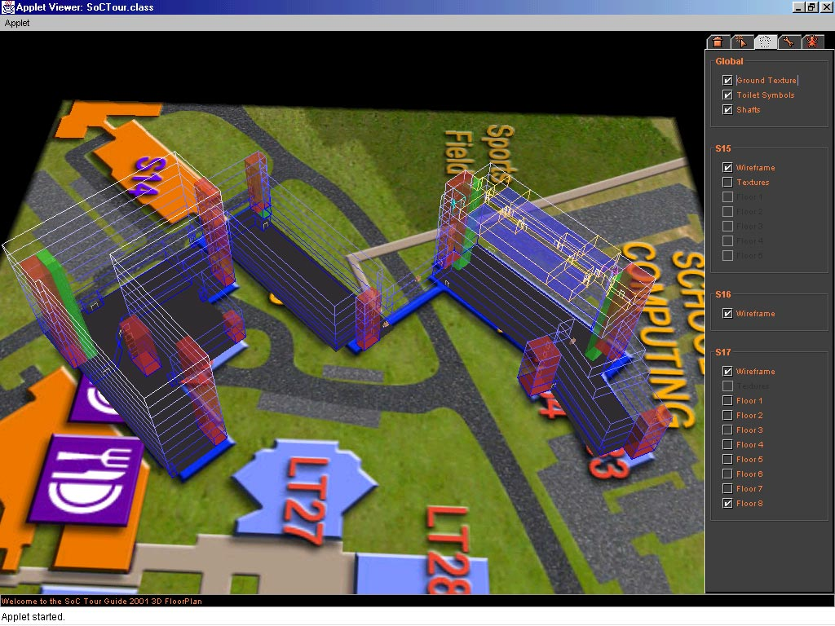

Slide 4
Undergraduate Office
Vice-Dean: Assoc Prof KHOO Siau Cheng
Assistant Dean, Undergraduate Programmes: Assoc Prof TEH Hung Chuan
Assistant Dean, Special Programmes: Assoc Prof LEE Wee Sun
Assistant Dean, Special Programmes: Mr TAN Tuck Choy, Aaron
Manager, Undergraduate Programmes : Ms TOH Mui Kiat
Senior Administrative Officer : Mr LOW Mun Bak
Management Support Officers: Mrs KWEK Wong Kay,
Ms Nur Arifah Bte Mukaral
Ms NG Lee Chin, Judy
Ms TEO Pei Pei

Slide 5
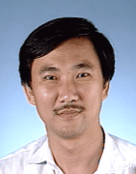
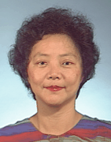
Academic Advisors (AY2005/2006)
Dr Tan Sun Teck
(S16-08-05)
Assoc Prof Yeo Gee Kin
(S15-05-12)

Slide 6
Curriculum
Based on international curriculum recommendations:
U.S. Association of Computing Machinery
IEEE Computer Society’s Computing Curriculum 2001 recommendations.
Association of Information Systems (AIS) IS Curriculum
Broad based Education

Slide 7
Degree Programmes
Undergraduate Programmes:
Bachelor of Computing (Honours) in Computational Biology
Bachelor of Computing (Honours) in Communications & Media
Bachelor of Computing (Honours) in Computer Engineering
Bachelor of Computing (Honours) in Computer Science
Bachelor of Computing (Honours) in E-Commerce
Bachelor of Computing (Honours) in Information Systems
Graduate Programmes:
Master of Computing (by Coursework)
Master of Science (by Research)
Doctor of Philosophy

Slide 8
Programme Structure
University Level Requirements (ULR)
Common for all programmes
Major Requirement
Common Essentials
  Common for all programmes
Programme Essentials
  Essentials specific to the programme
Programme Electives
  If you fail an elective, you may retake or read another elective
Unrestricted Electives (UE)

Slide 9
University Level Requirements (ULR)
For all students admitted in 2005
Modular Credits (MC)
University Level Requirements
General Education Modules (GEM)
8 MC
Singapore Studies
4 MC
Breadth: Electives outside student’s Faculty
16 MC
Total
28 MC

Slide 10
University Level Requirements (ULR)
Two subject groups within which GEMs are placed, namely,
(i) Group A: Science and Technology; and
(ii) Group B: Humanities and Social Sciences.
Compulsory to read at least one GEM from Subject Group B.
Read one Singapore Studies module with SS prefix.
For Breadth:
Electives must be from outside of the student's Faculty.
Note: No Double Counting of any module towards fulfilment of different requirements.

Slide 11
Major Requirements
Common Essentials
  CS1101/S Programming Methodology
  CS1102/S Data Structures and Algorithms
  CS1104 Computer Organization
  CS2102 or CS2102S Introduction to Database Systems
    Depending on your program requirement
  CS2103 Software Engineering
  CS2105 Computer Networks I
Programme Essentials
Each programme has its own essential modules

Slide 12
Elective Areas
Programme Elective
Courses grouped in Eight areas (A1 – A8)
  requirements based on different programmes
A1 - Programming & Software Engineering
A2 - Computer Systems
A3 - Theory & Modelling
A4 - Humans & Computers
A5 - Management of Information Systems
A6 - Business & Technology
A7 - Embedded Systems Technology
A8 - Technology Skills

Slide 13
  ULR
  Major Requirements
  Unrestricted Electives
  Modules from SoC/other Faculty to make up total modular credit requirement

Slide 14
Degree Requirements
pass at least 160 MC (approx. 40 modules) comprising:
  University Level Requirements – pass 28 MC
  School /Department Requirements Fulfil Common Essentials, Programme Essentials, Programme Electives
  Unrestricted Electives
CAP should be at least 2.0.

Slide 15
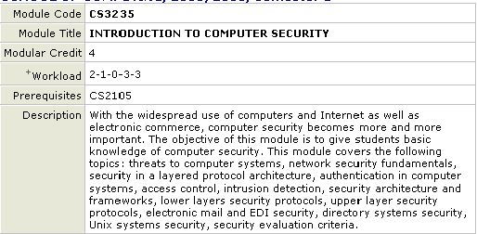
“Weight” of a module : The MC
Workload of a module
Must pass this module before taking CS3235

Slide 16
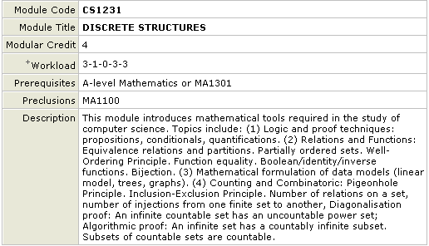
Must not have taken MA1100 before

Slide 17
Modes of Module Taking:
Taking with Credit
  Given a grade at the end of the course
  Included in calculating your performance
Taking the S/U Option
  Given either a Satisfactory or Unsatisfactory record
  Not included in calculating your performance
  Maximum of 12 MC to be counted towards your 160 MC requirement (under normal circumstances)
  Cannot convert back to grade
  Cannot exercise this option on modules required for Programme/Minor requirement.

Slide 18
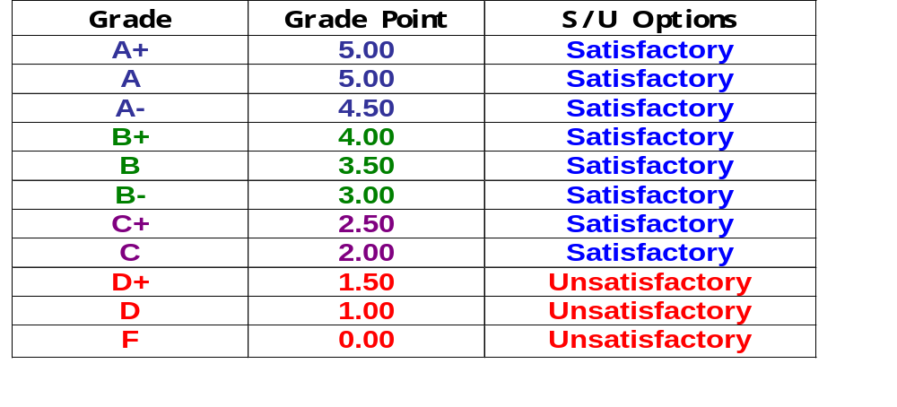
Grade, Grade Points and S/U Option
Note: A candidate who has obtained a D or higher grade cannot repeat the module.

Slide 19
Cumulative Average Point (CAP)
sum (module grade point × modular credits)
CAP = ---------------------------------------------------------------
sum (modular credits)
rounded up to 2 decimal places
To graduate, a student MUST obtain a CAP of no less than 2.00

Slide 20
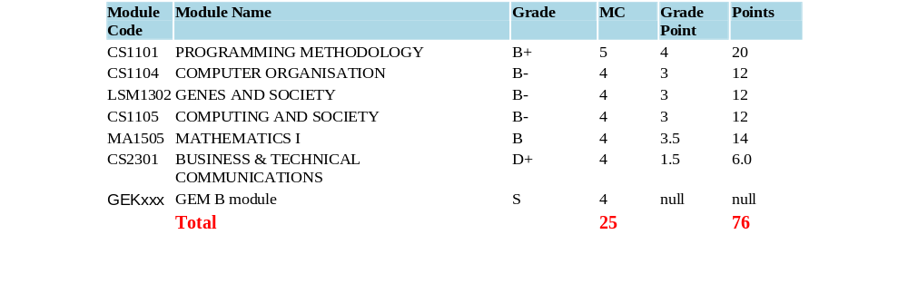
To calculate CAP:
CAP and SAP calculations (Example)
CAP = 76/25 = 3.04
SAP (Semester Average Point) = 76/25 = 3.04

Slide 21
Mind Twister
Adam is into his final semester. His CAP is 3.35, and his total MC accumulated is 142. He intends to take 20MC of modules in this semester. What should be his average grade for the final semester in order to get a CAP of 3.50? (Assuming no S/U options)
≥ (162x3.50 – 142x3.35)/20
= 4.57
Example: 4 of grade A- and 1 of grade A

Slide 22
Academic Warning, Probation and Dismissal
To continue in a programme, a student must not have:
CAP below 1.50 for two consecutive semesters; or
CAP below 2.00 for three consecutive semesters
Student receiving academic warning or under probation must
receive counselling from academic advisors.
To restore to good standing before reaching the state of dismissal:
Bring CAP to the level of 2.00 in the following semester

Slide 23
Mind Twister
Zack’s CAP is 1.49, and his total MC accumulated is 40. He intends to take 20MC of modules in the coming semester to achieve a CAP of at least 2.0. What should be his average grade for the coming semester in order to achieve that? (Assuming no S/U options)
≥ (60x2.0 – 40x1.49)/20
= 3.02
Example: 4 of grade B- and 1 of grade B

Slide 24
Programme Streaming
An opportunity to enter a four-year programme:
BComp in Communication & Media
BComp in Computer Science
BComp in E-Commerce
BComp in Information Systems
Not applicable to Computer Engineering:
Streaming done at admission. No streaming into/out thereafter.
Not applicable to Computational Biology:
Streaming before 5pm 29 July 2005. No streaming into/out thereafter.

Slide 25

Programme Streaming (…continue)
Programme streaming (except Comp. Engrg and Comp. Bio.) after 2 semesters.
Last streaming opportunity: Before the beginning of the 6th semester of study (A-level candidates)
Departments may set a quota
Other requirement as may be specified by the departments

Slide 26
CS4101 Honours Project
An independent research-inclined project under supervision of a faculty.
Essential for students seeking a First-class Honours
An option for students with CAP of 4.0 (during registration of the module)
12 MC, spanning over two semesters
Pre-requisite: Complete at least 70% of the MC requirement (112MC) for the respective degree.

Slide 27
Others
English Proficiency Modules
ET1000 - English for Academic Purpose
ES1000 - New Basic English Course
Curriculum
See http://www.comp.nus.edu.sg/undergradprog
for updates and curriculum announcements.
Curriculum in CS Dept : csit@comp.nus.edu.sg
Curriculum in IS Dept : isec@comp.nus.edu.sg
Office of Undergraduate Programmes is located at:
S16-05-08 (General Office)

Slide 28
Degree Requirements for Diploma Holders
4-year programme - pass at least 160 MC (approx. 40 modules)
  University Level Requirements – pass 28 MC
  Major Requirements Fulfil Common Essentials, Programme Essentials, Programme Electives
    CS4101 Honours Project is Compulsory
  Unrestricted Electives
3-year programme - pass at least 120 MC (approx. 30 modules)
  University Level Requirements – pass 20 MC
  Major Requirements Fulfil Common Essentials, Programme Essentials, Programme Electives
  Unrestricted Electives

Slide 29
University Level Requirements (ULR)
For diploma holders admitted in 2005
Modular Credits (MC)
University Level Requirements
General Education Modules (GEM)
8 MC
Singapore Studies
4 MC
Breadth: Electives outside student’s Faculty
8 MC (3 yr)/ 16 MC(4 yr)
Total
20 MC (3 yr)/28 MC(4 yr)

Slide 30

Programme Streaming for Diploma Holders
Programme streaming (except Comp. Engrg and Comp. Bio.) starts NOW.
Last streaming opportunity: Before the beginning of the 3th semester of study
for 4-year programme
Minimum CAP requirement (currently 3.50)
  Departments may set a quota
  Other requirement as may be specified by the departments
To remain in the 4-year programme
must maintain CAP ≥ 3.20

Slide 31
Acceptance record undertakings and authorization
Honor code
Release of liability
Student privacy policy
Acceptable use policy for IT resources
Rules relating inventions, innovations and other works
Authorisation for medical procedures/appointment of local guardian for international students

Slide 32
NUS Plagiarism Notice
All students share the responsibility for upholding the academic standards and reputation of the University. Academic honesty is a prerequisite condition in the pursuit and acquisition of knowledge. Academic dishonesty is any misrepresentation with the intent to deceive or failure to acknowledge the source or falsification of information or inaccuracy of statements or cheating at examinations/tests or inappropriate use of resources. There are many forms of academic dishonesty and plagiarism is one of them. Plagiarism is generally defined as the practice of taking someone else's work or ideas and passing them off as one's own (The New Oxford Dictionary of English). The University does not condone plagiarism.
http://www.comp.nus.edu.sg/students/plagiarism/

Slide 33
Notes
SoC Website: http://www.comp.nus.edu.sg/
Course Briefing Website: http://www.comp.nus.edu.sg/undergradprog/
Computer Accounts
  NUSNET account
    Given out during matriculation
    Email address: U05xxxxx@nus.edu.sg
  SoC UNIX account
    Next Thursday (4 August), UNIX Workshop
    Email address: leelaiye@comp.nus.edu.sg

Slide 34


