Slide 1
INFO6105 Final Project
Team KeAiJiLe:
Jingyu Wang,
Xinzhu Huang,
Yunwen Sun

Slide 2
Proposal
Due to the impact of this epidemic, the US stock market experienced a sharp decline, including technology stocks and financial stocks. The stock price even fused several times, which shocked the whole world.
We reasonably believe that when the pandemic reaches an effective suppression, the stock price will rebound too. Therefore, we will model and predict the number of infected people, so as to reasonably predict the future trend of stock price.

Slide 3
Datasets
Sources:
S&P500 History Data: Macrotrends
EFFR: Macrotrends
XAU_USD History data: Investing
COVID19 Cases: Github

Slide 4
Analysis
Analyze the most important factors that affect the stock price, which are ConfirmedCount, CuredCount, DeadCount in COVID19, historical data of gold price versus U.S. dollar price(XAU), and Fed interest rate(EFFR).
Model the stock price and perform multiple linear regression analysis to calculate the weight of each parameter.
Predict the trend of those parameters in the next three months
Forecast future stock prices based on parameters.

Slide 5
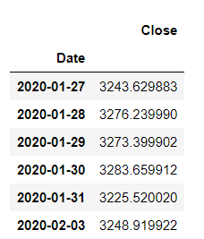
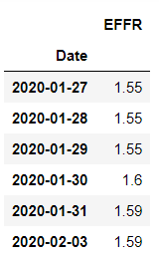
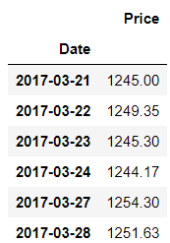
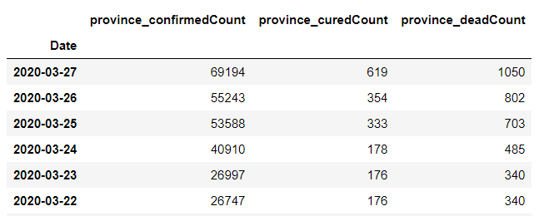
Step 1: Pre-processing data
Read in all the datasets
Drop unnecessary columns
Set date as index (one row per day)
Stock (S&P500 Index)
Effective Federal Fund Rate
XAU/USD
Covid-19 (US)

Slide 6
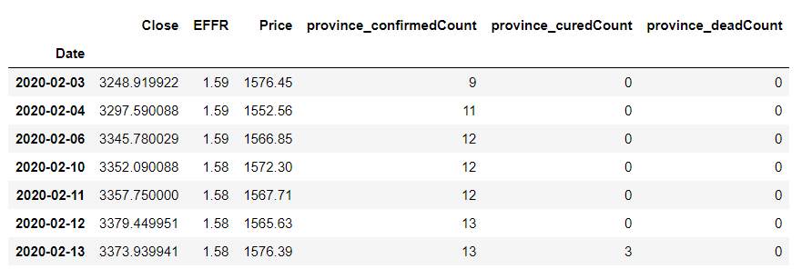
Step 1: Pre-processing data
Merge all dataframes together
Remove NaNs

Slide 7
Step 2: Linear Regression
Divide the data into “attributes” and “labels”.
X variable contains all the attributes/features and y variable contains labels.

Slide 8
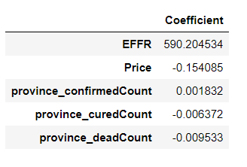
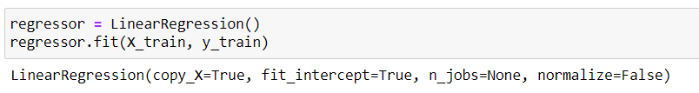
Step 2: Linear Regression
Split 80% as training and 20% as testing set
Train the model
Find the most optimal coefficients

Slide 9
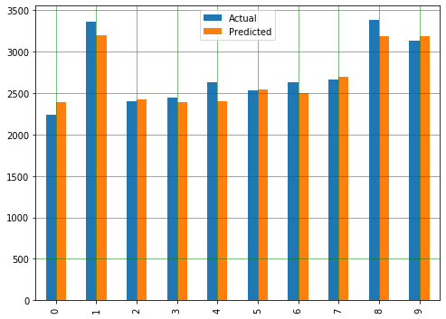
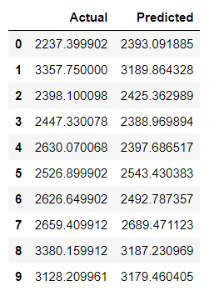

Step 2: Linear Regression
Prediction

Slide 10
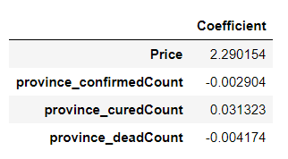
Step 2: Linear Regression
EFFR is a key feature in the prediction
EFFR is adjusted by the decision of Federal Open Market Committee (FOMC)
It is not predictable so that the outcome is not convincing
We decide not to include EFFR

Slide 11
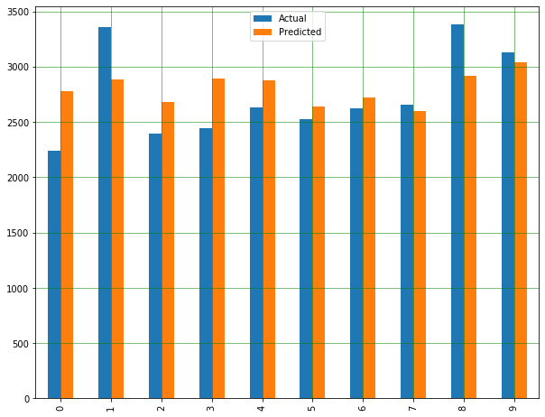
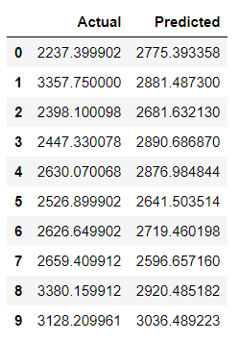

Step 2: Linear Regression
We still have a accuracy as nearly 80%

Slide 12
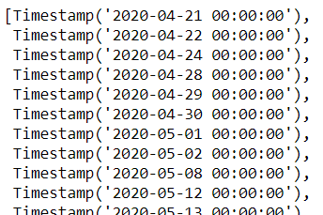
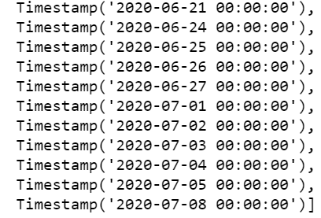
Step 3: Extend the data of attributes
Extend the date index

Slide 13
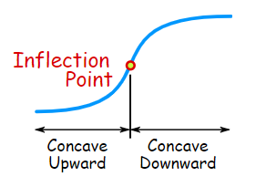
Step 3: Extend the data of attributes -- DXY
Extend the Covid-19 confirmed/cured/dead cases for an additional 3 months
Assume 4/21/2020 is the inflection point of the pandemic
The growth rate of cases will grow downward after

Slide 14
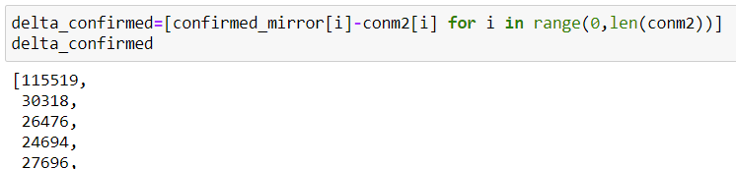
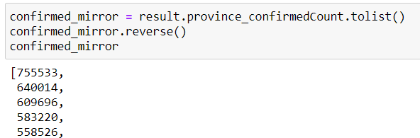
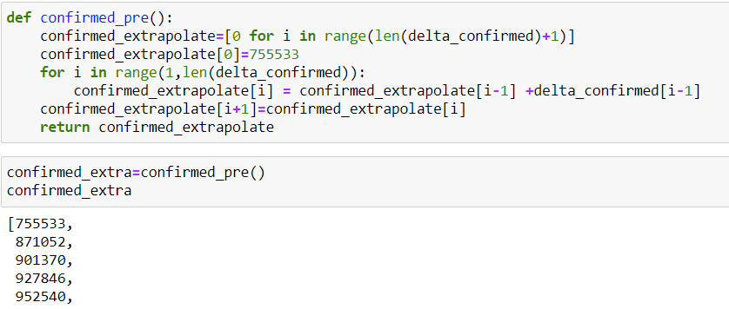
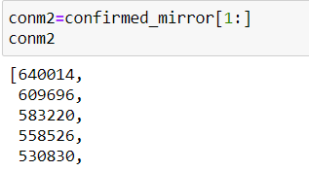
Step 3: Extend the data of attributes -- DXY
For confirmed cases

Slide 15
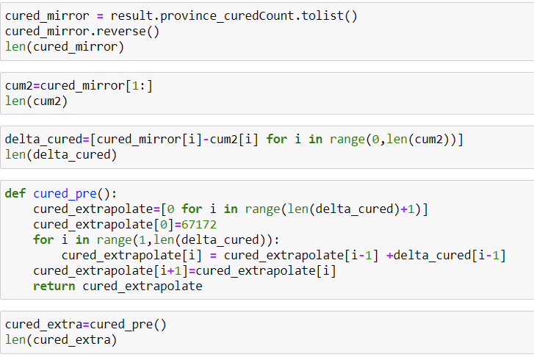
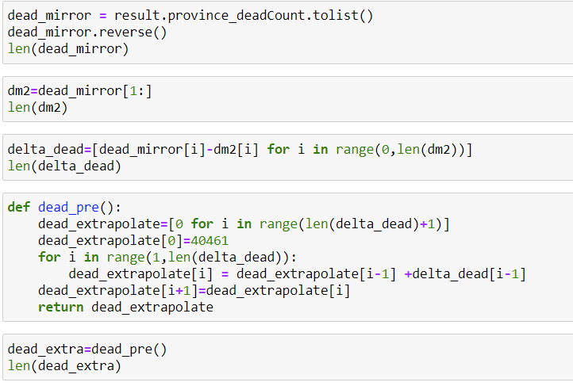
Step 3: Extend the data of attributes -- DXY
Same for cured and dead cases

Slide 16
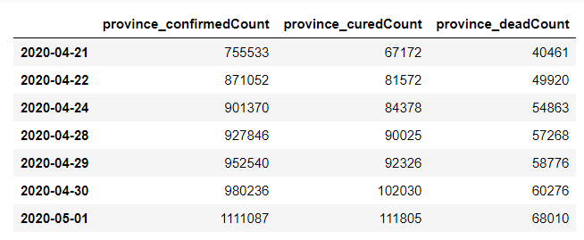
Step 3: Extend the data of attributes -- DXY
Merge extended Covid-19 cases together

Slide 17
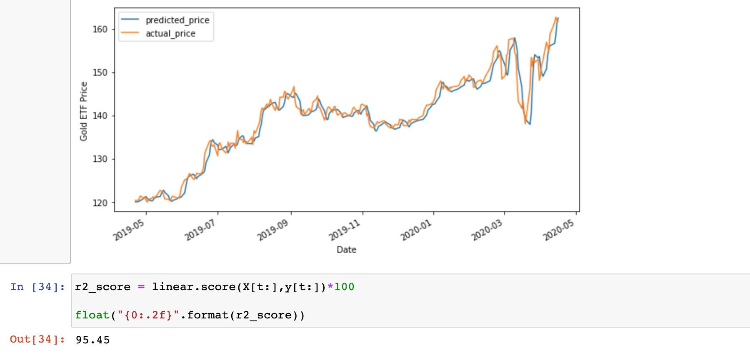
Step 3: Extend the data of attributes -- XAU
Extend fold to US dollar price
Formula: Gold ETF Price = 1.25 * 3 Days Moving Average - -0.26 * 9 Days Moving Average + 1.94

Slide 18
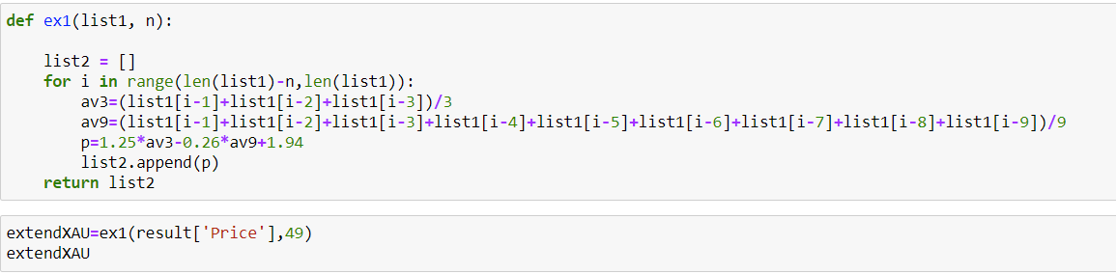
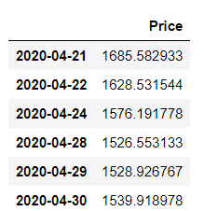
Step 3: Extend the data of attributes -- XAU
Formula:
Gold ETF Price = 1.25 * 3 Days Moving Average - -0.26 * 9 Days Moving Average + 1.94

Slide 19
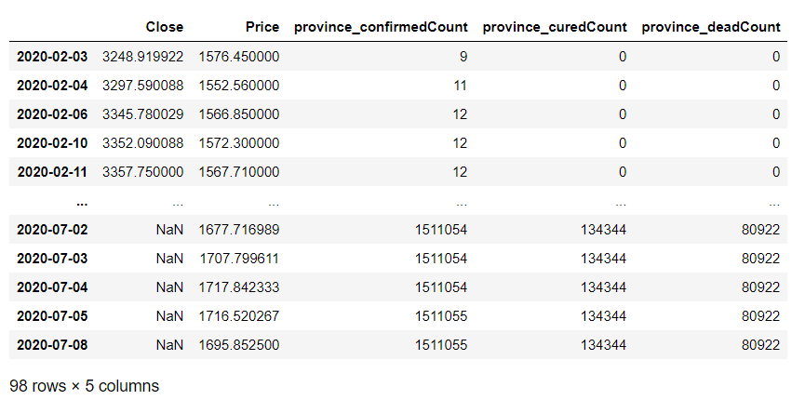
Step 3: Extend the data of attributes
Merge all extended data together

Slide 20
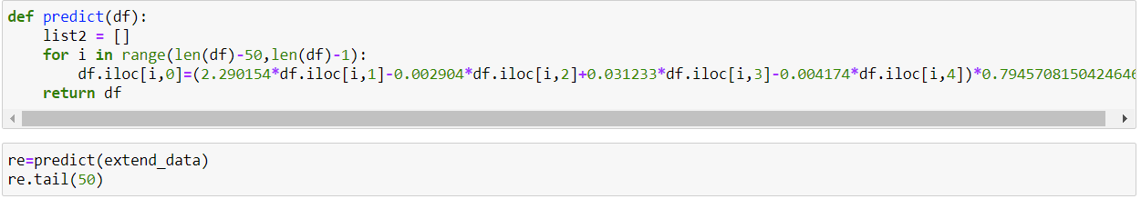
Step 4: Predict future S&P500 Index
Use tested model to predict
Accuracy is 0.79

Slide 21
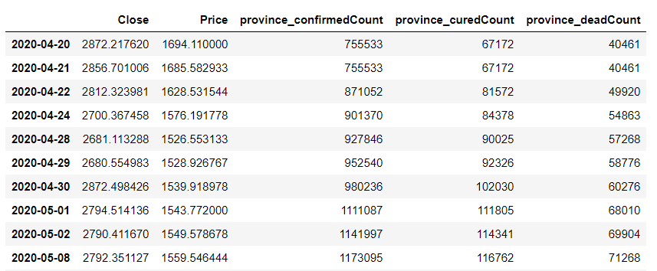
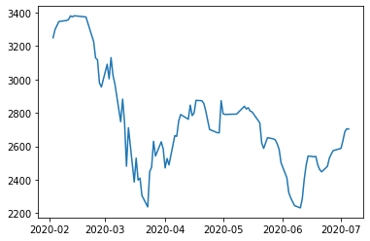
Step 4: Predict future S&P500 Index
Prediction dataframe
Prediction Plot

Slide 22
Conclusion
Stock market has been affected by the coronavirus pandemic and is experiencing a huge decline from the peak of February
Federal fund rate is a key factor impacting the stock market
FOMC can adjust the EFFR to effectively regulate the market when neccesary
There is no obvious signal of a bounce back in the stock market until July
The prediction indicates the stock market will be still under the influence of this pandemic for at least three more months

Slide 23
Room for improvements
In linear regression, the factors and data are relatively small, so the outcome may not be so accurate
The outcome is not based on the coronavirus mostly, so it is not showing the most accurate coefficient
Currently the gold price is weighted the most, and it is predicted by the current available data trend
Due to the complexity of coronavirus, we can not predict the future development of DXY, hence not able to plot the stock price so accurate

Slide 24
Reference：
COVID19 Cases: https://github.com/BlankerL/DXY-COVID-19-Data
XAU/USD - Gold Spot US Dollar: https://www.investing.com/currencies/xau-usd-historical-data
S&P500: https://finance.yahoo.com/quote/%5EGSPC/
Effective Federal Fund Rate: https://fred.stlouisfed.org/series/EFFR
Multiple Linear Regression Model: https://towardsdatascience.com/simple-and-multiple-linear-regression-in-python-c928425168f9
Gold Price Prediction: https://blog.quantinsti.com/gold-price-prediction-using-machine-learning-python/

Slide 25
Thank you!

