Slide 1
CPE 314 · FINAL DEFENSE
Campus Marketplace
with Reviews
Buy and sell campus items, review listings and contact sellers
Team 01 · BSCPE 3B · EDP 69323
Acexion B. Mahigugmaon · Glyde V. Arreglado · Tristan Dominic Urot
John Benedict Alaiza · Joshua Brian S. Enovero · Emanuelle De Paz
Notes:
We built a local campus marketplace for textbooks, electronics and furniture. A member can post an item, join a buyer waitlist, review an eligible listing and discuss the item privately with its owner. The final title is Campus Marketplace with Reviews. Start the live application before the defense begins.
Source code and evidence:
https://github.com/XionAce/cpe314-69323-capstone-team-01/blob/aea412ca00d28bd09d5ca3d970eec2d153d4344a/README.md
https://github.com/XionAce/cpe314-69323-capstone-team-01/blob/aea412ca00d28bd09d5ca3d970eec2d153d4344a/docs/design-document.md

Slide 2
Defense plan
OVERVIEW
1
Live Demo 4 min
One realistic end-to-end task
Proposed speaking plan
Demo: Acexion
Architecture: John and Glyde
Decisions: Joshua and Tristan
Tests: Emanuelle
Everyone: individual Q&A
2
Architecture Walkthrough 3 min
Class hierarchy, ER diagram, requirement-to-code map
3
Design Justification 2-3 min
Answer 1-2 instructor questions about a design choice
4
Individual Q&A 2-3 min each
Each member explains code they committed
Notes:
Use the template timing: about four minutes for the live scenario, three for architecture and two to three for design decisions. This is a proposed speaking assignment; adjust it with the team. The group segment lasts 10–12 minutes, followed by 2–3 minutes of individual questions per member. Show the app and IDE while using the slides as a guide.
Source code and evidence:
https://github.com/XionAce/cpe314-69323-capstone-team-01/blob/aea412ca00d28bd09d5ca3d970eec2d153d4344a/REQUIREMENT_MAP.md
Professor guide: https://docs.google.com/document/d/1ynsp3kZiaqj6UWWL4_iH42dc30JKsCFH/edit

Slide 3
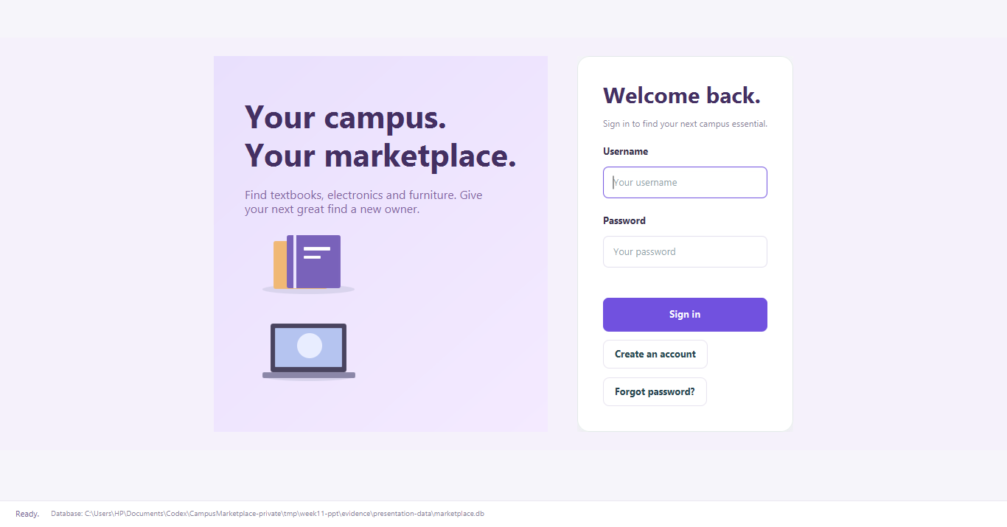
Project overview
OVERVIEW
Campus items in one place
Students need a clear way to find used campus essentials.
Members post textbooks, electronics and furniture.
Queues and reviews support buyer decisions; private chat arranges details.
FakeStoreAPI supplies electronics price references.
Notes:
The app organizes used items around member accounts and categories. A listing has its own type, observed condition, price, creation time and lifecycle state. Reviews require a buyer to join the waitlist first. Chat is separate: it can help arrange a meeting, but does not reserve the item or process a payment. Public catalog amounts have no stated currency; the seller enters the final campus PHP price manually.
Source code and evidence:
https://github.com/XionAce/cpe314-69323-capstone-team-01/blob/aea412ca00d28bd09d5ca3d970eec2d153d4344a/program/src/main/java/edu/uc/campusmarket/model/Listing.java
Screenshot: actual current application, temporary presentation database, 14 November 2026.

Slide 4
Live demo: one end-to-end task
LIVE DEMO
Scenario script · 4 minutes
Sign in and find another member’s item.
Join its waitlist, review it, then open a chat.
Request an electronics price reference.
Import the sales samples and show the changed chart.
Restart and show that saved records remain.
Edge cases to show
Empty title: reject the post.
Own item: reject the review.
API offline: retain inputs and allow manual posting.
Notes:
Prepare two accounts and a controlled demo database before the slot. First use the buyer to inspect a listing belonging to the other account. Join before reviewing; self-reviews and duplicate reviews must fail. Use two app windows for a short saved-message exchange. For the API, choose Electronics and the title monitor. When the network is unavailable, show the error without losing entered values. Demonstrate the import while navigating the UI. Keep the first six-record sample and the three-record follow-up ready. Other existing history changes the totals, so do not compare against 3,2,1 unless the history is controlled.
Source code and evidence:
https://github.com/XionAce/cpe314-69323-capstone-team-01/blob/aea412ca00d28bd09d5ca3d970eec2d153d4344a/SETUP.md
https://github.com/XionAce/cpe314-69323-capstone-team-01/blob/aea412ca00d28bd09d5ca3d970eec2d153d4344a/program/samples/sales-history.json
https://github.com/XionAce/cpe314-69323-capstone-team-01/blob/aea412ca00d28bd09d5ca3d970eec2d153d4344a/program/samples/sales-history-followup.json

Slide 5
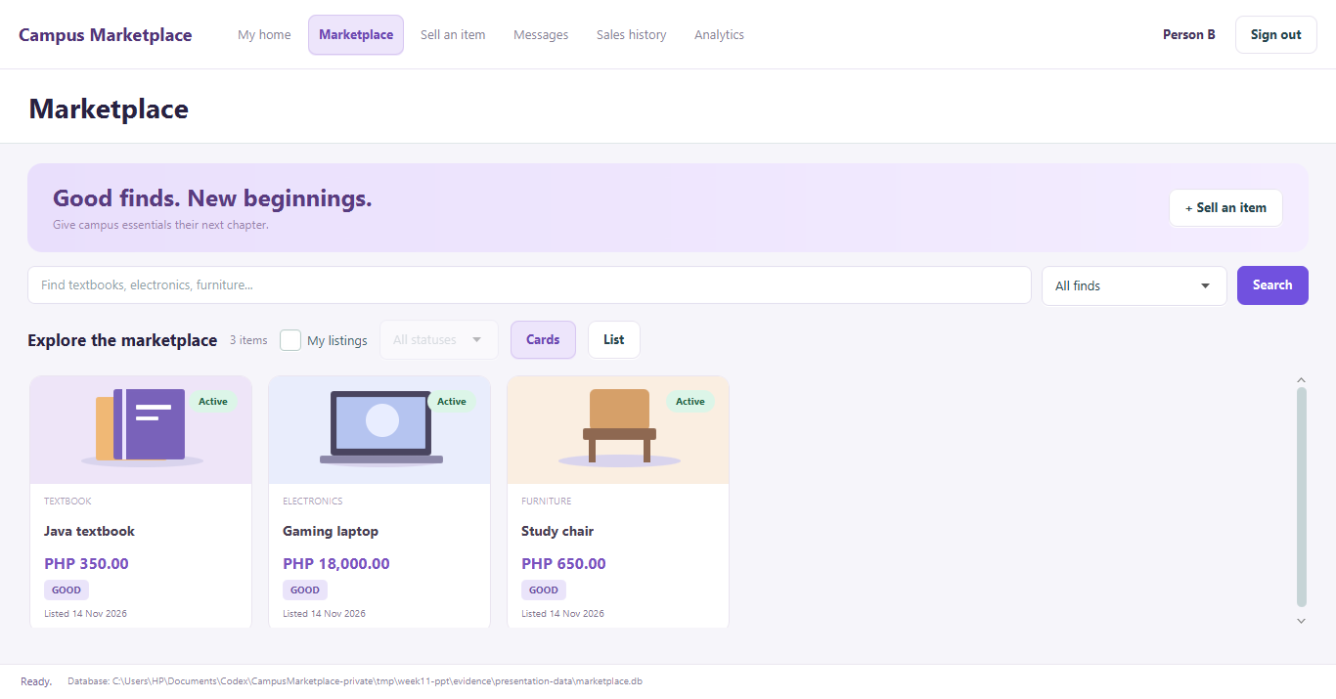
User interface: main screen
EVIDENCE: UI
Marketplace
Search by title and nested category.
Switch between cards and list views.
Select an item for reviews, waitlist or chat.
ListingTableView and ListingCards show the same controller data.
Notes:
This is a screenshot of the real program, using a new temporary database. The three cards are the seeded textbook, electronics and furniture examples. ListingTableView builds the search/list/detail area; ListingCards renders the card view from the same observable items. Search calls ListingController.refresh(). Clicking a card selects that Listing and loads details. The condition badge calls getConditionLabel(), which uses the subtype’s grading rule.
Source code and evidence:
https://github.com/XionAce/cpe314-69323-capstone-team-01/blob/aea412ca00d28bd09d5ca3d970eec2d153d4344a/program/src/main/java/edu/uc/campusmarket/ui/ListingTableView.java
https://github.com/XionAce/cpe314-69323-capstone-team-01/blob/aea412ca00d28bd09d5ca3d970eec2d153d4344a/program/src/main/java/edu/uc/campusmarket/ui/ListingCards.java
https://github.com/XionAce/cpe314-69323-capstone-team-01/blob/aea412ca00d28bd09d5ca3d970eec2d153d4344a/program/src/main/java/edu/uc/campusmarket/controller/ListingController.java

Slide 6
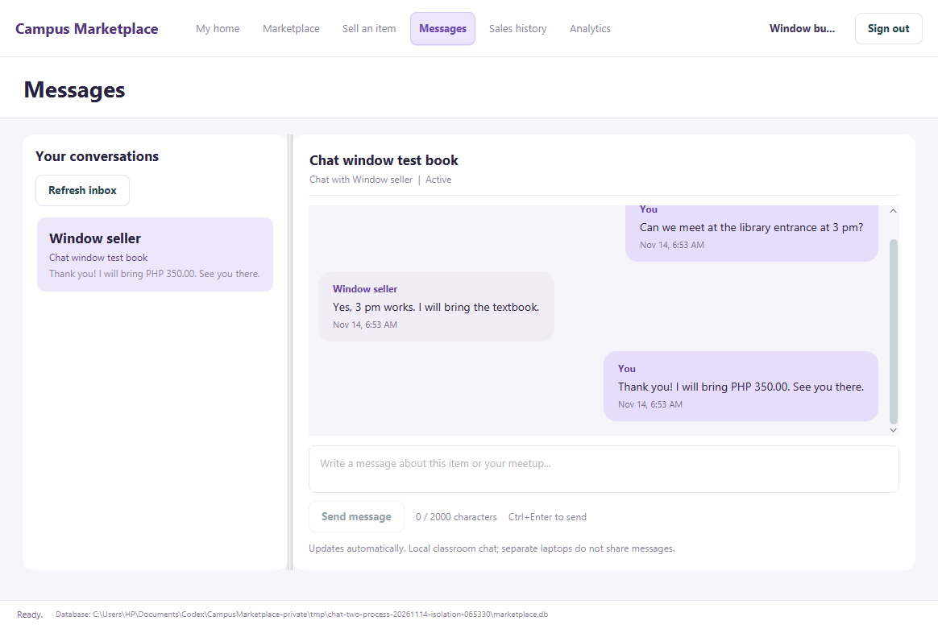
UI: second screen and controls
EVIDENCE: UI
Control | Event | Handler method
Search | Action | ListingController.refresh()
Post item | Action | ListingController.post()
Send message | Action | ChatController.send()
Import JSON | Action | AnalyticsController.importFile()
Notes:
The screenshot comes from two independent application processes using the same temporary SQLite file. A buyer opens the owner’s active listing and sends the first message. The owner replies in Messages. The normal three-second refresh shows saved replies. Each listing/buyer pair is private. A second buyer’s incoming message must not switch the seller’s selected conversation or clear its draft. The controls in the table are real event paths, not decorative buttons. ImportView opens the file chooser and passes the selected Path to AnalyticsController.importFile().
Source code and evidence:
https://github.com/XionAce/cpe314-69323-capstone-team-01/blob/aea412ca00d28bd09d5ca3d970eec2d153d4344a/program/src/main/java/edu/uc/campusmarket/ui/ChatView.java
https://github.com/XionAce/cpe314-69323-capstone-team-01/blob/aea412ca00d28bd09d5ca3d970eec2d153d4344a/program/src/main/java/edu/uc/campusmarket/controller/ChatController.java
https://github.com/XionAce/cpe314-69323-capstone-team-01/blob/aea412ca00d28bd09d5ca3d970eec2d153d4344a/program/src/main/java/edu/uc/campusmarket/ui/ListingFormView.java
https://github.com/XionAce/cpe314-69323-capstone-team-01/blob/aea412ca00d28bd09d5ca3d970eec2d153d4344a/program/src/main/java/edu/uc/campusmarket/ui/ImportView.java

Slide 7
Where each requirement lives
ARCHITECTURE
Requirement | Class / file | Where in demo
Object-oriented design | Listing + three subclasses | Compare condition grades
Data structures / recursion | MarketplaceService | Queue, recent views, category search
Automated testing · JUnit 5 | ProductCatalogClientTest; ChatServiceTest | Run suite and open assertions
Data model / SQLite / JDBC | schema.sql; ListingDao; ChatDao | Compare ERD and saved rows
API consumption · REST / JSON | ProductCatalogClient; ProductCatalogParser | Request electronics references
Event-driven GUI | ListingFormView; ChatView | Post, search and send
Concurrency | FxTaskRunner; SalesHistoryImporter | Import while navigating; cancel
Data mining | SalesAnalysis; HistoryDao | Change weekly sales frequencies
Data visualization | ChartsView; AnalyticsController | Show updated labeled bars
Notes:
Open these files in the IDE before presenting. This table follows the nine mandatory technical requirements, not the separate point-scored checklist. The model package contains Listing and the three concrete types. DAOs contain JDBC queries; services enforce rules and perform analysis; controllers coordinate work; views bind controls. Test source is under program/src/test/java. Every row must be demonstrated in the running app or opened in actual source.
Source code and evidence:
https://github.com/XionAce/cpe314-69323-capstone-team-01/blob/aea412ca00d28bd09d5ca3d970eec2d153d4344a/REQUIREMENT_MAP.md
https://github.com/XionAce/cpe314-69323-capstone-team-01/blob/aea412ca00d28bd09d5ca3d970eec2d153d4344a/program/src/main/resources/db/schema.sql

Slide 8
Class hierarchy
ARCHITECTURE
«abstract» Listing
Listing hierarchy
Listing owns common item data.
Three subclasses own different condition evidence.
Each overrides gradeCondition().
DAOs and views have separate responsibilities.
id; sellerId; categoryId
title; price; currency; status
+ getConditionLabel(): String
+ gradeCondition(): ConditionGrade
Textbook
Electronics
Furniture
missingPages; markings
coverDamaged
+ gradeCondition()
powersOn; functionalDefect
cosmeticDamage
+ gradeCondition()
stable; structuralDamage
surfaceWear
+ gradeCondition()
Notes:
Listing is abstract. Textbook grades missing pages, marking level and cover damage. Electronics grades power and defects. Furniture grades stability, structural damage and wear. The hollow triangle points to the parent. The diagram shows selected fields and methods for readability; the complete inventory is in design Section 3 and Appendix. Member, Category and result records support the model, but they are not Listing subclasses.
Source code and evidence:
https://github.com/XionAce/cpe314-69323-capstone-team-01/blob/aea412ca00d28bd09d5ca3d970eec2d153d4344a/program/src/main/java/edu/uc/campusmarket/model/Listing.java
https://github.com/XionAce/cpe314-69323-capstone-team-01/blob/aea412ca00d28bd09d5ca3d970eec2d153d4344a/program/src/main/java/edu/uc/campusmarket/model/Textbook.java
https://github.com/XionAce/cpe314-69323-capstone-team-01/blob/aea412ca00d28bd09d5ca3d970eec2d153d4344a/program/src/main/java/edu/uc/campusmarket/model/Electronics.java
https://github.com/XionAce/cpe314-69323-capstone-team-01/blob/aea412ca00d28bd09d5ca3d970eec2d153d4344a/program/src/main/java/edu/uc/campusmarket/model/Furniture.java

Slide 9
Polymorphism in action
ARCHITECTURE
// ListingCards.rebuild(): excerpt
for (Listing item : listings.items()) {
// Other card controls omitted
var grade = UiTools.label(
item.getConditionLabel(),
"condition-badge");
}
// Listing.getConditionLabel()
return hasConditionDetails()
? gradeCondition().name().replace('_', ' ')
: "Details unavailable";
One base reference
item is declared as Listing.
The actual subclass decides gradeCondition().
The card needs no instanceof checks to select a grading rule.
Notes:
These are two production excerpts, with other card controls omitted and lines reflowed for the slide. They are not a complete standalone method. ListingCards iterates actual Listing objects and asks for the condition label. The base getConditionLabel() calls gradeCondition(), and dynamic dispatch selects the Textbook, Electronics or Furniture implementation. One missing textbook page produces POOR even when the cover looks fine. Missing or conflicting saved condition rows use the safe Details unavailable label rather than an invented grade. The original method and full loop are in the linked source.
Source code and evidence:
https://github.com/XionAce/cpe314-69323-capstone-team-01/blob/aea412ca00d28bd09d5ca3d970eec2d153d4344a/program/src/main/java/edu/uc/campusmarket/ui/ListingCards.java
https://github.com/XionAce/cpe314-69323-capstone-team-01/blob/aea412ca00d28bd09d5ca3d970eec2d153d4344a/program/src/main/java/edu/uc/campusmarket/model/Listing.java
https://github.com/XionAce/cpe314-69323-capstone-team-01/blob/aea412ca00d28bd09d5ca3d970eec2d153d4344a/program/src/test/java/edu/uc/campusmarket/model/ListingTest.java

Slide 10
Data structure and recursion
ARCHITECTURE
Purposeful collections
Queue / ArrayDeque keeps buyer interest in FIFO order.
Stack keeps each member’s recent views in LIFO order.
A Map separates members’ recent histories.
The UI shows queue position and recent items.
Recursive category search
MarketplaceService.collectCategoryIds()
Add the current category, then visit each child.
A leaf makes no further recursive call.
Nested categories need no fixed depth.
Example trace: 3 → 5 → 6 → 7.
Notes:
FIFO means the first interested buyer stays ahead of later buyers; using a stack would reverse that rule. Stored joiningOrder values rebuild the queue. Leaving removes only that buyer’s row; current position counts remaining earlier entries. Recent views deliberately use the opposite order so the most recent item is first, and they last only for the service session. For recursion, trace Electronics 3, Computers 5, Laptops 6 and Gaming 7 in the seeded tree. Each call adds its ID, recurses on children and returns at a leaf. Category validation rejects cycles and missing parents before traversal. A loop with an explicit traversal stack is an alternative, but recursion directly follows this arbitrary-depth tree.
Source code and evidence:
https://github.com/XionAce/cpe314-69323-capstone-team-01/blob/aea412ca00d28bd09d5ca3d970eec2d153d4344a/program/src/main/java/edu/uc/campusmarket/service/MarketplaceService.java
https://github.com/XionAce/cpe314-69323-capstone-team-01/blob/aea412ca00d28bd09d5ca3d970eec2d153d4344a/program/src/main/java/edu/uc/campusmarket/dao/InterestDao.java

Slide 11
ER model and database schema
ARCHITECTURE
Matches SQLite
11 tables, 56 fields, 15 foreign keys.
Members.id identifies a member; Sellers.id identifies a seller profile.
One listing can receive many reviews.
Messages adds private listing conversations.
Members
1:M
Sellers
PK
id
PK
id
FK
memberId
1:M
1:M
Reviews
PK
id
Listings
FK
listingId
1:M
PK
id
FK
reviewerId
FK
sellerId
Core keys shown · full eleven-table model in design Section 4
Notes:
This is the four-table core key view, not the whole eleven-table ERD. Each line connects an actual primary key to its related foreign-key row. Members.id → Sellers.memberId; Sellers.id → Listings.sellerId; Listings.id → Reviews.listingId; Members.id → Reviews.reviewerId. One parent can have many related rows; a parent may currently have none. The complete schema also includes Categories, BuyerInterests, HistoricalSales, TextbookDetails, ElectronicsDetails, FurnitureDetails and Messages. The design’s overview and four detail views document all eleven tables, 56 columns and fifteen foreign keys. Database schema version 5 creates Messages while preserving existing accounts and data. At defense, open the actual presentation .db in a database viewer; do not compare the diagram against a different computer’s file.
Source code and evidence:
https://github.com/XionAce/cpe314-69323-capstone-team-01/blob/aea412ca00d28bd09d5ca3d970eec2d153d4344a/program/src/main/resources/db/schema.sql
https://github.com/XionAce/cpe314-69323-capstone-team-01/blob/aea412ca00d28bd09d5ca3d970eec2d153d4344a/program/src/main/java/edu/uc/campusmarket/persistence/AccountSetup.java
https://github.com/XionAce/cpe314-69323-capstone-team-01/blob/aea412ca00d28bd09d5ca3d970eec2d153d4344a/docs/design-document.md

Slide 12
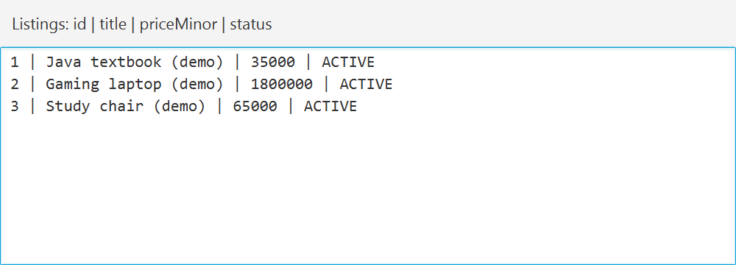
JDBC and PreparedStatement
ARCHITECTURE
// InterestDao.leave(): SQL reflowed for readability
try (Connection connection = database.open();
PreparedStatement statement =
connection.prepareStatement("""
DELETE FROM BuyerInterests
WHERE listingId = ? AND buyerId = ?
""")) {
statement.setLong(1, listingId);
statement.setLong(2, memberId);
statement.executeUpdate();
}
Real CRUD paths
Create/read/update: ListingDao.
Delete: InterestDao.leave() removes only the requesting buyer’s interest.
Values bind to ? parameters.
Notes:
The DELETE is the production InterestDao.leave() query, formatted as a Java text block for readability. listingId and memberId are bound values; they are not concatenated into the SQL. Resources close through try-with-resources. Other DAO paths create and read listings, update owner title/price and archive status, and save private messages. Removing a listing archives it as REMOVED; leaving a queue performs an actual parameterized DELETE. The screenshot is a read-only query view of real Listings rows in the temporary presentation database, not a mock DB Browser screen. Show DB Browser and the actual saved file live if requested. Prices in this table are integer minor units, so 35000 means PHP 350.00.
Source code and evidence:
https://github.com/XionAce/cpe314-69323-capstone-team-01/blob/aea412ca00d28bd09d5ca3d970eec2d153d4344a/program/src/main/java/edu/uc/campusmarket/dao/InterestDao.java
https://github.com/XionAce/cpe314-69323-capstone-team-01/blob/aea412ca00d28bd09d5ca3d970eec2d153d4344a/program/src/main/java/edu/uc/campusmarket/dao/ListingDao.java
https://github.com/XionAce/cpe314-69323-capstone-team-01/blob/aea412ca00d28bd09d5ca3d970eec2d153d4344a/program/src/main/java/edu/uc/campusmarket/dao/ChatDao.java

Slide 13
API consumption
ARCHITECTURE
Request
GET https://fakestoreapi.com/products
No API key.
Timeout: 15 seconds.
JSON fields
id and title
price and category
Reject missing or invalid field types.
Used in the form
Match electronics titles.
Show comparable price range.
Keep final PHP price manual.
Failure stays recoverable
Show timeout / HTTP / JSON errors. Keep entered values and allow manual posting.
Notes:
ProductCatalogClient performs the real HTTP request; ProductCatalogParser validates JSON; CatalogMapper chooses supported comparable products; CatalogService prepares the display range. The response price has no stated currency. We therefore do not present it as PHP and do not overwrite the seller’s entered campus price. The saved live response was HTTP 200 with twenty products, captured 13 November at 15:45 UTC; its SHA-256 matches the metadata and the parser/mapper contract test passes. The saved fixture is evidence of that request, not a substitute for a live online/offline demonstration. The original script counted one array object; corrected metadata records the decoded count of twenty without changing response bytes.
Source code and evidence:
https://github.com/XionAce/cpe314-69323-capstone-team-01/blob/aea412ca00d28bd09d5ca3d970eec2d153d4344a/program/src/main/java/edu/uc/campusmarket/api/ProductCatalogClient.java
https://github.com/XionAce/cpe314-69323-capstone-team-01/blob/aea412ca00d28bd09d5ca3d970eec2d153d4344a/program/src/main/java/edu/uc/campusmarket/api/ProductCatalogParser.java
https://github.com/XionAce/cpe314-69323-capstone-team-01/blob/aea412ca00d28bd09d5ca3d970eec2d153d4344a/program/src/main/java/edu/uc/campusmarket/service/CatalogMapper.java
https://github.com/XionAce/cpe314-69323-capstone-team-01/blob/aea412ca00d28bd09d5ca3d970eec2d153d4344a/program/src/test/resources/api/fakestore-products-capture.json
Public API: https://fakestoreapi.com/products

Slide 14
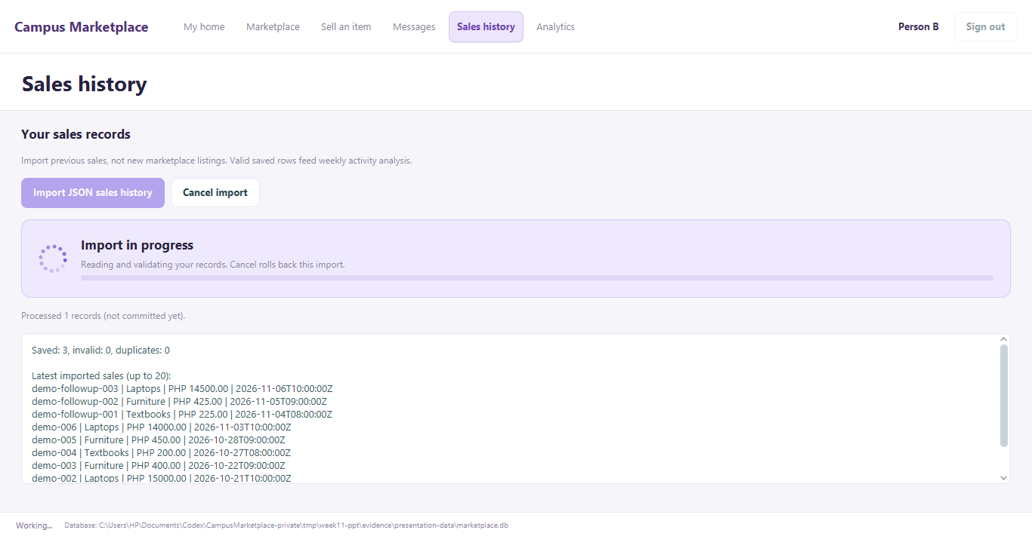
Concurrency: UI stays responsive
ARCHITECTURE
Background work
One named ExecutorService runs database, API and import work.
FxTaskRunner uses JavaFX Task.
Success/failure handlers update UI state on the JavaFX thread.
Import shows progress; cancellation rolls back unfinished rows.
Notes:
The screenshot captures an actual 50,000-row presentation import while the production worker is running. It was then cancelled, preserving the already saved nine sample sales. The spinner is bound to importingProperty(); it is not a fake animation added to the slide. App owns one named worker and shuts it down on close. FxTaskRunner runs blocking work in Task.call(); completion handlers change observable controller state on the JavaFX thread. UserSession generation and selection checks reject old results. Navigation remains available during import, while conflicting work controls are disabled. Demonstrate responsiveness live; a static screenshot alone cannot prove it.
Source code and evidence:
https://github.com/XionAce/cpe314-69323-capstone-team-01/blob/aea412ca00d28bd09d5ca3d970eec2d153d4344a/program/src/main/java/edu/uc/campusmarket/controller/FxTaskRunner.java
https://github.com/XionAce/cpe314-69323-capstone-team-01/blob/aea412ca00d28bd09d5ca3d970eec2d153d4344a/program/src/main/java/edu/uc/campusmarket/controller/AnalyticsController.java
https://github.com/XionAce/cpe314-69323-capstone-team-01/blob/aea412ca00d28bd09d5ca3d970eec2d153d4344a/program/src/main/java/edu/uc/campusmarket/ui/ImportView.java
https://github.com/XionAce/cpe314-69323-capstone-team-01/blob/aea412ca00d28bd09d5ca3d970eec2d153d4344a/program/src/main/java/edu/uc/campusmarket/service/SalesHistoryImporter.java

Slide 15
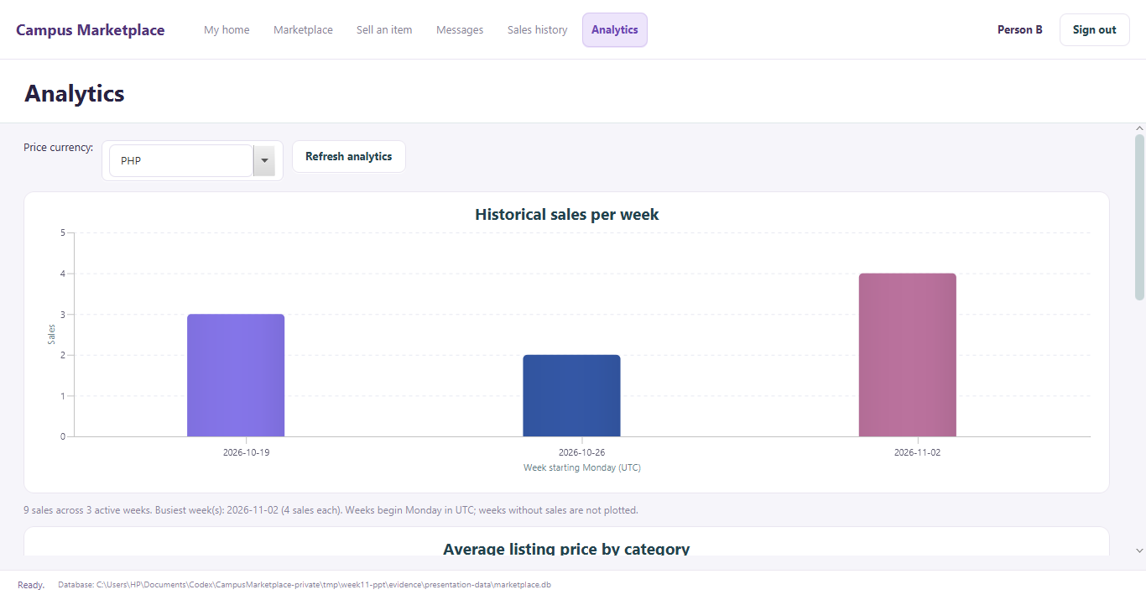
Data mining and chart
EVIDENCE: GRAPH
Java frequency analysis
HistoryDao reads saved sale times.
SalesAnalysis groups Monday-starting UTC weeks in a TreeMap.
Sample counts: 3, 2, 1.
After follow-up: 3, 2, 4.
Columns compare weekly counts.
Notes:
The six-record sample yields counts 3,2,1 for weeks starting 19 October, 26 October and 2 November 2026. The three-record follow-up changes the last count to four, so the last week becomes busiest and the total becomes nine. These are synthetic classroom records imported through the actual production importer; they are not in-app payment records or API product sales. The chart is a genuine screenshot after both imports. SalesAnalysis does the weekly grouping in Java using TreeMap; SQL only reads saved timestamps. The chart renders the returned result. Weeks with no sales are not invented, and a price chart uses a separate currency-filtered query. Change the input live and rerun; merely changing the chart label proves nothing.
Source code and evidence:
https://github.com/XionAce/cpe314-69323-capstone-team-01/blob/aea412ca00d28bd09d5ca3d970eec2d153d4344a/program/src/main/java/edu/uc/campusmarket/service/SalesAnalysis.java
https://github.com/XionAce/cpe314-69323-capstone-team-01/blob/aea412ca00d28bd09d5ca3d970eec2d153d4344a/program/src/main/java/edu/uc/campusmarket/dao/HistoryDao.java
https://github.com/XionAce/cpe314-69323-capstone-team-01/blob/aea412ca00d28bd09d5ca3d970eec2d153d4344a/program/src/main/java/edu/uc/campusmarket/ui/ChartsView.java
https://github.com/XionAce/cpe314-69323-capstone-team-01/blob/aea412ca00d28bd09d5ca3d970eec2d153d4344a/program/samples/sales-history.json
https://github.com/XionAce/cpe314-69323-capstone-team-01/blob/aea412ca00d28bd09d5ca3d970eec2d153d4344a/program/samples/sales-history-followup.json

Slide 16
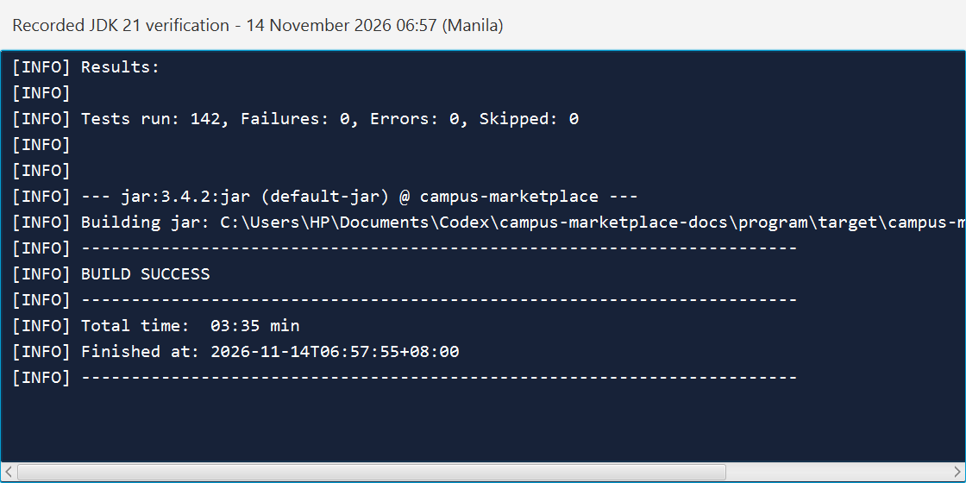
Automated tests
EVIDENCE: TESTS
142 tests passed
Class tested | Edge case covered
ListingValidationTest | Reject unsupported type / evidence
ChatServiceTest | Reject another buyer’s conversation
ProductCatalogClientTest | Handle timeout and invalid JSON
SalesHistoryImporterTest | Cancel after valid data; roll back
0 failures · 0 errors · 0 skipped
Notes:
Recorded JDK 21 verification on 14 November at 06:57:55 Manila passed 142 JUnit tests in thirteen classes, with no failures, errors or skips. The screenshot is a real read-only display of that saved Maven log, not a claim of a new live run. Tests use temporary databases and local HTTP servers. The separate two-process chat demonstration passed seventeen GUI assertions; fifty broader GUI checks belong to the earlier 13 November run, and should not be mixed into the JUnit count. Section 8 of the design lists a meaningful edge case for all thirteen test classes. Run the suite live on the presentation machine and open a real assertion, such as cancellation preserving previous rows or preventing an unrelated buyer from reading a conversation.
Source code and evidence:
https://github.com/XionAce/cpe314-69323-capstone-team-01/blob/aea412ca00d28bd09d5ca3d970eec2d153d4344a/program/src/test/java/edu/uc/campusmarket/model/ListingValidationTest.java
https://github.com/XionAce/cpe314-69323-capstone-team-01/blob/aea412ca00d28bd09d5ca3d970eec2d153d4344a/program/src/test/java/edu/uc/campusmarket/service/ChatServiceTest.java
https://github.com/XionAce/cpe314-69323-capstone-team-01/blob/aea412ca00d28bd09d5ca3d970eec2d153d4344a/program/src/test/java/edu/uc/campusmarket/service/SalesHistoryImporterTest.java
https://github.com/XionAce/cpe314-69323-capstone-team-01/blob/aea412ca00d28bd09d5ca3d970eec2d153d4344a/docs/design-document.md

Slide 17
Code quality and git history
EVIDENCE: CODE
Member | Commits | Lines added / removed | Recorded main area
John B. Alaiza | 4 | +127 / −13 | Models and validation
Acexion B. Mahigugmaon | 25 | +10,038 / −3,348 | Integration, MVC, analysis and docs
Glyde V. Arreglado | 4 | +525 / −14 | Database and persistence
Tristan D. Urot | 3 | +1,193 / −128 | Views, events and styling
Joshua B. S. Enovero | 5 | +358 / −25 | API, imports and chat rules
Emanuelle De Paz | 2 | +802 / −9 | Tests and API fixtures
PR branch vs main · 43 non-merge commits · text-line counts exclude binary files
camelCase methods · model / dao / service / controller / ui packages
Notes:
These are recorded Git statistics for non-merge commits in 6422555..aea412c, not peer scores or proof of effort. Merge commits and binary line counts are excluded. Counts include refactors and replacements, so added/deleted lines should not be treated as work quality. The source uses camelCase methods and separate packages for model, DAO, service, controller and UI. Every member should review their actual changes and be ready to explain them. A matching author identity is a history record; assigned responsibility alone does not establish who performed an edit.
Source code and evidence:
https://github.com/XionAce/cpe314-69323-capstone-team-01/blob/aea412ca00d28bd09d5ca3d970eec2d153d4344a/TEAM_INFO.md
https://github.com/XionAce/cpe314-69323-capstone-team-01/blob/aea412ca00d28bd09d5ca3d970eec2d153d4344a/REQUIREMENT_MAP.md
Git measurement: git log 6422555..aea412c --no-merges --numstat. Branch snapshot: aea412ca00d28bd09d5ca3d970eec2d153d4344a

Slide 18
Who built what
EVIDENCE: CODE
Member | Classes / files committed | Q&A focus
John B. Alaiza | ListingFactory; ListingValidationTest; ChatMessage / ChatThread / ChatSnapshot | Reject invalid item evidence
Acexion B. Mahigugmaon | App; ChatController; RefreshController; design | Keep session and refresh state safe
Glyde V. Arreglado | Database; AccountSetup; ChatDao; schema.sql | Upgrade and filter saved messages
Tristan D. Urot | ChatView; MarketplaceView; ListingTableView; CSS | Display messages without losing a draft
Joshua B. S. Enovero | ProductCatalogClient; SalesHistoryImporter; ChatService | Apply API, import and chat rules
Emanuelle De Paz | ProductCatalogClientTest; ChatServiceTest; ControllerTest | Explain a meaningful failing case
Notes:
The table names files recorded under each member’s Git identity; it does not certify individual understanding. Latest examples: John 8bacc0e and 3b9af6c; Glyde 368351d; Joshua e1c9ef2; Tristan 57a7a68; Emanuelle 41dc439; Acexion b7a2ee9 and aea412c. Earlier API/import and model/UI contributions remain in the history. Ask each member to open one of their commits, identify the changed line and explain input, rule, result and a test. The Q&A focus is preparation, not a statement that the member already passed an explanation check.
Source code and evidence:
https://github.com/XionAce/cpe314-69323-capstone-team-01/blob/aea412ca00d28bd09d5ca3d970eec2d153d4344a/docs/design-document.md
https://github.com/XionAce/cpe314-69323-capstone-team-01/blob/aea412ca00d28bd09d5ca3d970eec2d153d4344a/REQUIREMENT_MAP.md
Recorded commits: 3b9af6c, 8bacc0e, 665d922, f66a8d3
Recorded commits: aea412c, b7a2ee9, e80c4cf, 72088f5, b4feb77, a0208ff, 4dc1a9c, 65ef65b, a435981, 8f81fc8, 935659a, c00274c, e7ff854, 234da17, ec36b77, 7c2554c, 04a28d0, 3e3d6c5, 9cee52c, 23ef670, 61a7dfd, 98f2509, d69fb59, f92403b, c3871b0
Recorded commits: 368351d, 10d57ed, 9c5f51d, e44d82d
Recorded commits: 57a7a68, 507f2de, d71e56b
Recorded commits: e1c9ef2, 321dfda, ca7b4d7, ac9a812, 3445979
Recorded commits: 41dc439, 5a8d3c3

Slide 19
Design justification
DESIGN DECISIONS
FIFO buyer waitlists
Choice: Queue with saved joining order.
Alternative: Stack would favor the latest buyer.
Reason: earlier interest stays ahead.
Cost: leaving requires rebuilding the current order.
Local SQLite storage
Choice: one local database file.
Alternative: a hosted server and database.
Reason: simple local setup and saved records.
Cost: separate laptops do not share accounts or chat.
Notes:
First justify the queue by the business rule, not because the assignment mentions a data structure. A stack is correct for recent views but wrong for fair buyer order. SQLite keeps the class prototype simple and makes prepared transactions easy to inspect. The tradeoff is clear: the three-second refresh synchronizes windows using one SQLite file; it is not network messaging between computers. A shared backend would be a future architecture change, with authentication, authorization and synchronization to design. Another decision to explain if asked is separating API reference prices from PHP posting, because the external API response does not declare a currency.
Source code and evidence:
https://github.com/XionAce/cpe314-69323-capstone-team-01/blob/aea412ca00d28bd09d5ca3d970eec2d153d4344a/program/src/main/java/edu/uc/campusmarket/service/MarketplaceService.java
https://github.com/XionAce/cpe314-69323-capstone-team-01/blob/aea412ca00d28bd09d5ca3d970eec2d153d4344a/program/src/main/java/edu/uc/campusmarket/dao/InterestDao.java
https://github.com/XionAce/cpe314-69323-capstone-team-01/blob/aea412ca00d28bd09d5ca3d970eec2d153d4344a/program/src/main/java/edu/uc/campusmarket/persistence/Database.java

Slide 20
Challenges and how we solved them
REFLECTION
Challenge | What we checked | Fix or remaining action
Missing condition-detail rows | Load incomplete saved listings | Warn safely; restore the matching subtype row
Simultaneous waitlist joins | Use independent connections | Atomic INSERT … SELECT and unique constraints
Design falls behind the code | Compare types, fields and relations | Audit inventories; keep Word/PDF synchronized
Chat cannot cross laptops | Each computer has a local database | Open limitation: design a shared backend
Notes:
These are actual project issues and current limitations. Missing subtype rows previously risked an incorrect condition interpretation; the safe incomplete listing now preserves common data and shows a warning. Queue order is allocated in an atomic insert, with tests using independent connections. Documentation drift was addressed by comparing all eighty-two Java types and eleven tables against the design. Shared-device chat is implemented, but cross-laptop chat is not; do not imply that polling the local file solves that. A further tested chat fix guards programmatic inbox updates so another buyer’s new message cannot silently change the seller’s selected recipient.
Source code and evidence:
https://github.com/XionAce/cpe314-69323-capstone-team-01/blob/aea412ca00d28bd09d5ca3d970eec2d153d4344a/program/src/main/java/edu/uc/campusmarket/dao/ListingDao.java
https://github.com/XionAce/cpe314-69323-capstone-team-01/blob/aea412ca00d28bd09d5ca3d970eec2d153d4344a/program/src/main/java/edu/uc/campusmarket/dao/InterestDao.java
https://github.com/XionAce/cpe314-69323-capstone-team-01/blob/aea412ca00d28bd09d5ca3d970eec2d153d4344a/program/src/main/java/edu/uc/campusmarket/controller/ChatController.java
https://github.com/XionAce/cpe314-69323-capstone-team-01/blob/aea412ca00d28bd09d5ca3d970eec2d153d4344a/KNOWN_ISSUES.md

Slide 21
Lessons learned and future work
REFLECTION
Lessons to explain
Validate rules in services and storage, not only controls.
Review actual Git changes before individual questions.
Update the design when a feature changes the schema or classes.
Future work
Shared backend for cross-device messaging.
Optional photos and message notifications.
Paging and search for long conversation histories.
Notes:
Keep this reflection brief. Separate implemented work from proposals. Private local messaging is implemented; a hosted backend, attachments, notifications and paging are future work. The prototype does not process payments or email password recovery. Review UI rendering with very large datasets before making a capacity promise. Preserve the source/design mapping so a later change does not create a mismatch between the document and the program.
Source code and evidence:
https://github.com/XionAce/cpe314-69323-capstone-team-01/blob/aea412ca00d28bd09d5ca3d970eec2d153d4344a/KNOWN_ISSUES.md
https://github.com/XionAce/cpe314-69323-capstone-team-01/blob/aea412ca00d28bd09d5ca3d970eec2d153d4344a/REQUIREMENT_MAP.md

Slide 22
Questions
Individual Q&A: each member explains code they committed
github.com/XionAce/cpe314-69323-capstone-team-01 · Team 01
Notes:
Leave this slide visible for individual questions. Each person should explain code recorded in their own commit history, why it works, one boundary/failure case and what changes if the rule is removed. The slides and recorded checks support the defense; they do not replace the running application. Before defense, update and review PR #14, merge the verified Milestone 2 changes into main without deleting the branches, then build and run a fresh clone of main on the presentation machine. That merge and fresh-clone check are still team actions, not completed by this deck.
Source code and evidence:
https://github.com/XionAce/cpe314-69323-capstone-team-01/blob/aea412ca00d28bd09d5ca3d970eec2d153d4344a/README.md
https://github.com/XionAce/cpe314-69323-capstone-team-01/blob/aea412ca00d28bd09d5ca3d970eec2d153d4344a/SETUP.md
https://github.com/XionAce/cpe314-69323-capstone-team-01

