Slide 1
Lunch and learn
Trees bruh
Notes:
......||...#.|#||#......|.........|.|#||.|#...#.#.
.#.#.#.|.|##.|##|.||#..#||.|.....||....|#|....#|#.
..|..#.##|#..#.|##....|..#|#.||..#....#|......#|..
.......|....#|#.#|.|##.||......#.|....|##....##||.
|#|.....|.#|..#.....#...|#.#.##....#.||....##.#|#|
#|##|..|.|#||.|#|.|..#...#|.##.|#.|.....##........
.#|#..#|..|.......#..#......##||#||#.||#|.#.....||
.#.#..|.|.....|.#...|....|#..#...|.|.|..#...#.#.||
|.|||##|#.#..#|..|....|...#|..|..#.#.|.#.|#...##.|
|...#|..#.....###.#|#...##....|..||||.|.#.|#.#....
...#....#.......|...##....#|#..|...#|..#..|||.|#..
.....||.|.||#|#..||....#|.|.||.......#.|.....|....
|#.#|..#.#....##.#.|.##|..|.|.#.....#..#.....#....
#.||.#........#...|#..#|.#.#...#|||.....|.......|.
.|.|...|.|.#|...#...||.|.#.#...##......|#.....##..
###....||#.#..#.#|.##|.##..#..#|..|##|.#.|...#....
.#.#..|##..#.#..#.....|||..|.....|||.###.|..#.||#.
|..#.|.#..|##.#.|.#.....#.|..#.|.|...||..#..#|..|#
...|..#|..|.........||#....#...#..||.|....#.......
.....#.#.|...|#...####||...#...........#..#.##.#..
|#.###..#..#|#|.|..#|....##..#..|...#|#..#.##.|..#
.|##.#....#....#...#|.##...|#.||.#...|....|..|#.#.
.|..|||..|...#.|.|..........|#..|##.#.|#.|..#..|#.
|#|.#..#|...|||..|.###||.......#...|...||.|##..||.
..#.|...||#...##.....||..#|..#.#...|#..#.###.#..#.
|.||..##....#...#......#.||.|.##|.||||...|#.......
..##.#.|#..||..#......|..|#.||.|.||.|.#||.|..#.||#
.|...##|..|.#.#..##..#..#....|.#.#....#.#.|#...#||
|.|##.|||||.|.||...|.||.##..|.||..#..#..#|......#|
..#.|##....#.#....#...#....###......##..|......#..
##....#|#.#.#.#..............#...#..#|.........|..
##|||.##......#.##......#..|..#..#.#..||...|...|#|
.|....#.#.......#.#.#........|............#.||#||#
..|.|#.|...##.|.#.#.#.#...|...|...#.......|#|#.|.|
......|.####..|.....#....#|##..|.|##.....##|.|#.#.
.##..#.......###.|..#.|.|#........#..#.#.|..|#....
.|..|..#..#.#.###|#|#....||#....#.......|.....##..
..#..##..|.|....||#|#.....|#.|.###|....#||...|....
.#...|.|....##..##....|...#|.#|..#.##....#..|....|
|........#|#......|...#..#........|.|#|##|..||#...
...|#.|#..#|#..|||...#.|.|.|...##....#|#|.#.|.||..
|..#|||.#||#####.|#..#....|...#.#..|.||...|##..|..
.|...|....|...|....#........#.#..|.|....||#|.##.#.
......#||||#...|...#...|....|.||.|..|.#..#|.#.|...
.#...#||.|...|##...|..|.||..#..|.#||..#|..||#|..#.
|.|.|#.#..#|..#.###.#.|.|#.|..#.|##...#..#|#.||.#|
.#||.##..|....||#..|||.....#.#.......|.###...#...#
.|##..#||.|.|.....|....|..|#...#..||||#|.|.....#|.
|#.#.#.|#.#|#...||#.....|......||......##|....||..
.#####|#|#.#....###||#..|.#..|..|.##..|||..#|#.##.

Slide 2
Problem Definition
A lumber business cuts down trees in a 50x50 acre area.
Each acre can be either open ground (.), trees (|), or a lumberyard (#).
Every year the landscape looks different, an open area can fill with trees, a wooded acre can be converted to a lumberyard, or a lumberyard can be cleared to open ground.
The change to each acre is based entirely on the contents of that acre as well as the number of open, wooded, or lumberyard acres adjacent to it at the start of every year.

Slide 3
Rules
An open acre will become filled with trees if three or more adjacent acres contained trees. Otherwise, nothing happens.
An acre filled with trees will become a lumberyard if three or more adjacent acres were lumberyards. Otherwise, nothing happens.
An acre containing a lumberyard will remain a lumberyard if it was adjacent to at least one other lumberyard and at least one acre containing trees. Otherwise, it becomes open.
These changes happen across all acres simultaneously, each of them using the state of all acres at the beginning of the year and changing to their new form by the end of that same year. Changes that happen during the year don't affect each other.

Slide 4
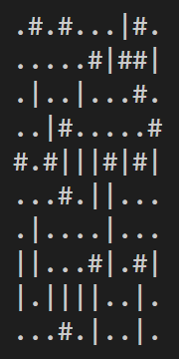
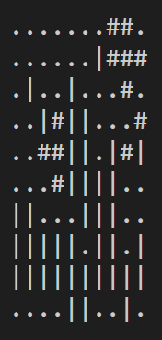
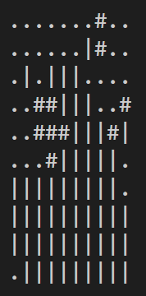
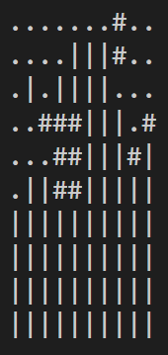
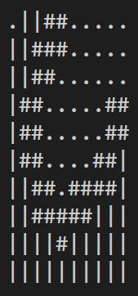
Example
Initial State
Year 1
Year 2
Year 3
Year 10
After 10 years, there are 37 wooded acres and 31 lumberyards. Multiplying the number of wooded acres by the number of lumberyards gives the total resource value after 10 years: 37*31=1147
What will the total resource value of the lumber collection area be after 10 years?
Notes:
.#.#...|#.
.....#|##|
.|..|...#.
..|#.....#
#.#|||#|#|
...#.||...
.|....|...
||...#|.#|
|.||||..|.
...#.|..|.

