Slide 1
Chap7: Floating-Point Support
CP1 in MIPS
Xie Benyi

Slide 2
Outline
Chap4: Floating-Point Support
  The Exponential/Scientific Notation

Slide 3
The Exponential/Scientific Notation
Flag * Mantissa * (Base^Exponent)
1<=...<Base
2
A Integer

Slide 4
The Exponential/Scientific Notation
93 X 10^6
X
Flag * Mantissa * (Base^Exponent)
0.93 X 10^8
1<=...<Base
2
A Integer
〇
9.3 X 10^7

Slide 5
The Exponential/Scientific Notation
Python 2.7
In [9]: math.pow( math.sqrt(10), 2 )
Out[9]: 10.000000000000002
Flag * Mantissa * (Base^Exponent)
1<=...<Base
2
A Integer
Rounding Nearest
Rounding Up
Rounding Down
Rounding Zero
Rounding Inf

Slide 6
Outline
Chap4: Floating-Point Support
  The Exponential/Scientific Notation
  The IEEE 754 Standard – Bring Order to Chaos

Slide 7
The IEEE 754 Standard
Institute of Electrical and Electronics Engineers
Internationalize @1989
Rounding
  Up Down Zero Nearest
Exceptional results
  Invalid Infinite Overflow Underflow Inexact
  Sqrt(-1) 1/0 1/3
Actions
  NaN Inf Inf Denormalized Rprsnt

Slide 8
Outline
Chap4: Floating-Point Support
  The Exponential/Scientific Notation
  The IEEE 754 Standard – Bring Order to Chaos
    The Coding Format

Slide 9
The Coding Format
Sign
Exponent 8|11
Mantissa 23|52
0
1
...
2046
2047
M==0, inf
0
-1022
...
1023
2047
M!=0, NaN
M==0, zero
M[H]==0, quiet
M!=0, Denormalized number
M[H]==1, Signaling

Slide 10
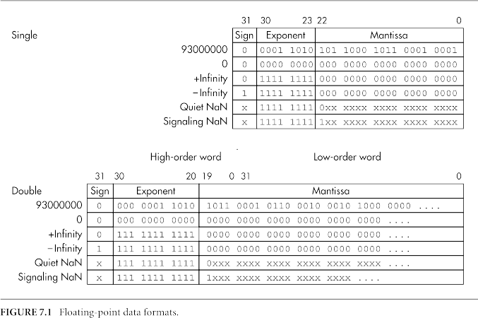
The Coding Format

Slide 11
Outline
Chap4: Floating-Point Support
  The Exponential/Scientific Notation
  The IEEE 754 Standard – Bring Order to Chaos
    The Coding Format
    2 Trade-Offs in MIPS

Slide 12
2 Trade-Offs in MIPS
Trap would limit pipeline performance.
  FPU guesses trap or not at the 1st cycle (mostly reliable).
  Obey the precise exception/Interrupts rule
    Cause EPC SR(BD)
A strict Compliance to IEEE 754 and Performance
  e.g. Denormalized number automatically written as 0.
Both trade-off details are implement-dependent.

Slide 13
Outline
Chap4: Floating-Point Support
  The Exponential/Scientific Notation
  The IEEE 754 Standard – Bring Order to Chaos
  Floating-point Registers, Control/Status Registers

Slide 14
Floating-point Registers
32 * 32-bit reg, $f0 … $f31 (MIPS-I has 16 * 64-bit reg)
SR(SR) set zero, you get MIPS-I operations.
Even/Odd reg made up a pair for math
The odd-numbered registers are only referenced when doing loads, stores, and moves between floating-point and integer registers. (E.g. Conversion among floating-point and integer)
ABIs would be addressed in section 11.2

Slide 15
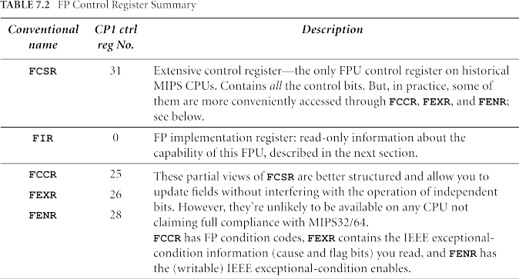
FP Control/Status Registers
Ctc1
GP
Cfc1
Auxiliary Regs

Slide 16
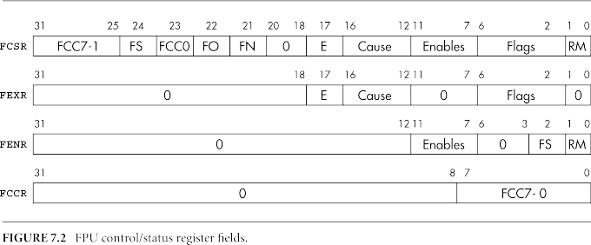
FP Control/Status Registers
Condition bits
Compare & Branch
Notes:
Disadvantage:
- Branch had to execute at integer unit
- Cant fit in pipeline well
Both branch and test Instrus contain 3-bit field that specified which of 8 possible condition bit they will set or test.
MIPS-III or Early only one CC, so set zero.

Slide 17
FP Control/Status Registers
Flush to zero/override/to nearest
Denormalized number
Notes:
Flush to zero: set it, then result to zero, can avoid a unimplemented trap
Flush override: have to set with FS, set alone not work. Will replace the oprand/input with zero
Flush to nearest: improve accuracy, some denormalized number would be forced to closest normarlized value, e.g. to smallest representable nunber

Slide 18
FP Control/Status Registers
Unimplemented Exception
Following an FPU trap
Notes:
FPU cannot perform instrus or
FPU is not confident it can compliant to IEEE 754
Unimplemented exception will leave the destination reg unaffected & FP cause undefined.

Slide 19
FP Control/Status Registers
V|Z|O|U|I
IEEE Exception Type
Notes:
V bit 4 Invalid operation
Z bit 3 Divide by zero
O bit 2 Overflow
U bit 1 underflow
I bit 0 Inexact
Cause: According to last completed FP instru
Enable: If set then trap can happen
Flag: “Sticky” version of Cause, and are the logical “or” of the exceptional results that have occurred since the register was last cleared. The Flags bits can only be zeroed again by writing FCSR or FEXR.

Slide 20
FP Control/Status Registers
Rounding Mode
0Nearest | 10 | 2↑ | 3↓
Notes:
V bit 4 Invalid operation
Z bit 3 Divide by zero
O bit 2 Overflow
U bit 1 underflow
I bit 0 Inexact
Cause: According to last completed FP instru
Enable: If set then trap can happen
Flag: “Sticky” version of Cause, and are the logical “or” of the exceptional results that have occurred since the register was last cleared. The Flags bits can only be zeroed again by writing FCSR or FEXR.

Slide 21
FP Control/Status Registers
Ctc1
GP
Cfc1
Auxiliary Regs

Slide 22
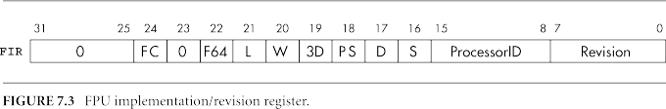
Floating-Point Implementation Reg
FC
Full convert range
F64
Full 64-bit Regs
L/W/D/S
CPU Support Long/Word/Double/Single
PS
Support Paired-single SIMD
3D
Support MIPS-3D
ProcessorID
Revision
Notes:
FC between FPs | between FP and Int without running out of bits and causing an unimplemented exception
3D&PS Details later
ProcessorID : Typically this returns the same value as the integer-side processor ID in the coprocessor zero PRId register. Perhaps more usefully, it should only ever read nonzero if there really is FPU hard- ware available to your program. Before you read it or succeed in running any floating-point operation, you or your OS needs to switch on the “coprocessor 1” enable SR(CU1) in the CP0 “status” register.
Revision : This field is at the whim of implementers; it is probably useful to make this field visible to commissioning or test engineers, and you might test it when implementing some bug workaround. Otherwise, software should studiously ignore it.

Slide 23
Outline
Chap4: Floating-Point Support
  The Exponential/Scientific Notation
  The IEEE 754 Standard – Bring Order to Chaos
  Floating-point Registers, Control/Status Registers
  Floating-point Instructions

Slide 24
FP Instructions Outline
Load/Store: FP reg <=> Mem
Move between Regs: FP reg <=> general-purpose regs
3-operand arithmetic operations
Multiply-add operations
Sign changing
Conversion operations
Conditional branch and test
Paired-single and MIPS-3D

Slide 25
Load/Store
Uninspected & unconverted
MIPS-I style operate on even regs.
MIPS-I-II CPUs: extra clock before FP load data is valid, they are not allowed to interlock that data?
“Synthetic” assembly is prefered, (e.g. l.d better than ldc1)
Must be aligned.
lwc1
lwc1
lwc1
lwc1
lwc1
ldc1
...
l.d
native
Synthetic
swc1
sdc1
...
s.d
Notes:
the “synthetic” form is easier to read and can be used for all CPUs. The assembly may use multiple instructions for CPUs that don’t implement the machine instruction. You can use a synthetic load/store operation with any addressing mode that the assembler can understand (as described in section 9.4).

Slide 26
Move between Regs
dmtc1
...
Int reg <=> FP reg
  No conversion and no exception
FP reg <=> FP reg
  Need to specify type
  No exception
  May copy all bit correctly
Conditional move
mov.d
...
movt.d
movf.d
movz.d
movn.d

Slide 27
3-Operand/Mul-Add/Sign/Conversion
3-Operand
  Can cause any IEEE exception and unimplemented trap.
Mul-Add
  Save time of rounding and renormalization.
Sign
  Only produce invalid trap (e.g. operate on NaN)
Conversion
  Can produce IEEE exception
add.d
add.d
div.d
mul.d
sub.d
add.d
madd.d
msub.d
nmadd.d
nmsub.d
add.d
abs.d
neg.d
cvt.d.s

Slide 28
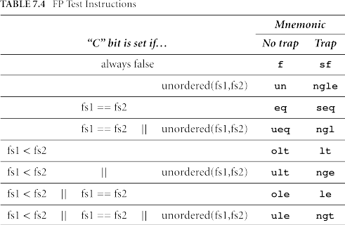
Conditional Branch and Test
FCC7-0
Conditional Brach
Test
  fs1<fs2 | fs1>fs2
  fs1==fs2
  Unordered (NaN)
bclf cc, label
bclt label
c.cond.d fs1, fs2
c.cond.d cc, fs1, fs2

Slide 29
Outline
Chap4: Floating-Point Support
  The Exponential/Scientific Notation
  The IEEE 754 Standard – Bring Order to Chaos
  Floating-point Registers, Control/Status Registers
  Floating-point Instructions
  Instruction Timing Requirements and boost

Slide 30
Instru Timing Requirements & Boost
Normal FP instrus are interlocked.
Older CPUs not. Compiler, assembler and programmer must care the sequence of instrus and following:
  Operations on FP control/status regs
  FP regs <=> general-purpose regs
  FP regs load
  Test condition and branch
Boost
  Rearrange, Smart Compiler, Visible pipeline to Prgmmer
Affect parallel
Effect late

Slide 31
Outline
Chap4: Floating-Point Support
  The Exponential/Scientific Notation
  The IEEE 754 Standard – Bring Order to Chaos
  Floating-point Registers, Control/Status Registers
  Floating-point Instructions
  Instruction Timing Requirements and boost
  Initialization and Enabling on Demand

Slide 32
Initialization & Enabling on Demand
CPU’s SR
Disable all
CPs
CPU’s SR
Disable all
CPs
Read FPU
Implementation
Reg (FIR)
Y
Switch on
FPU (CP1)
Set up FPU
Control/Status
Reg (FCSR)
Once FPU running, you have to deal with FP regs saved and restore during interrupts and context switches
  Lazy context switching
    Disable the FPU when running a new task or a interrupt routine or kernel.
    On a CU1-unusable trap, mark the task as an FP user and enable the FP before returning to it.

Slide 33
Outline
Chap4: Floating-Point Support
  The Exponential/Scientific Notation
  The IEEE 754 Standard – Bring Order to Chaos
  Floating-point Registers, Control/Status Registers
  Floating-point Instructions
  Instruction Timing Requirements and boost
  Initialization and Enabling on Demand
  Floating-Point Emulation

Slide 34
Floating-Point Emulation
Low-cost MIPS CPUs sometimes omit FPU
FP provided by software, 50-300 times slower
  Soft float by hidden library
  Trap and emulate
Compiled-in FP is much more efficient, while emulater has a high overhead on trap handler.

Slide 35
Thanks!
Questions?
Xie Benyi

Slide 36
Outline
Chap4: Floating-Point Support
  The Exponential/Scientific Notation
  The IEEE 754 Standard – Bring Order to Chaos
  Floating-point Registers, Control/Status Registers
  Floating-point Instructions
  Instruction Timing Requirements and boost
  Initialization and Enabling on Demand
  Floating-Point Emulation

