Slide 1
Chap12: Debugging MIPS Designs
Xie Benyi 8/26/18

Slide 2
Debug Communications by JTAG
JTAG
  Joint Test Action Group @1970s
  an industry standard, used after manufacture
    verifying designs
    testing printed circuit boards
IEEE Standard 1149.1-1990
  entitled Standard Test Access Port and Boundary-Scan Architecture.

Slide 3
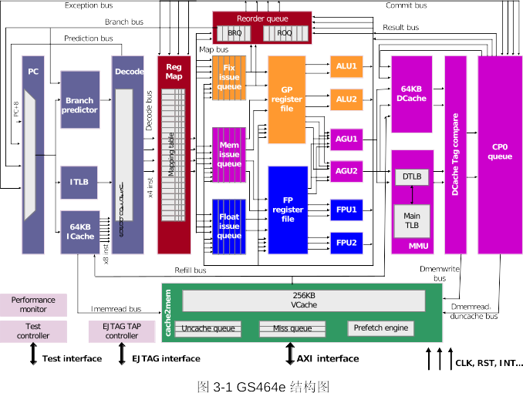

Slide 4
EJTAG & JTAG
EJTAG
  MIPS defined
  Recycle the JTAG pins in every Soc
  A foundation of non-intrusive debug and trace tools
JTAG
  A control/data enable input
  A data-in line
  A data-out line

Slide 5
Requirements
Physical communications with the host ✔
The ability to remote-control the CPU
  Map communication space into host CPU’s vaddr
Breakpoint regs
  Map into host CPU’s vaddr
A just-for-debug exception

Slide 6
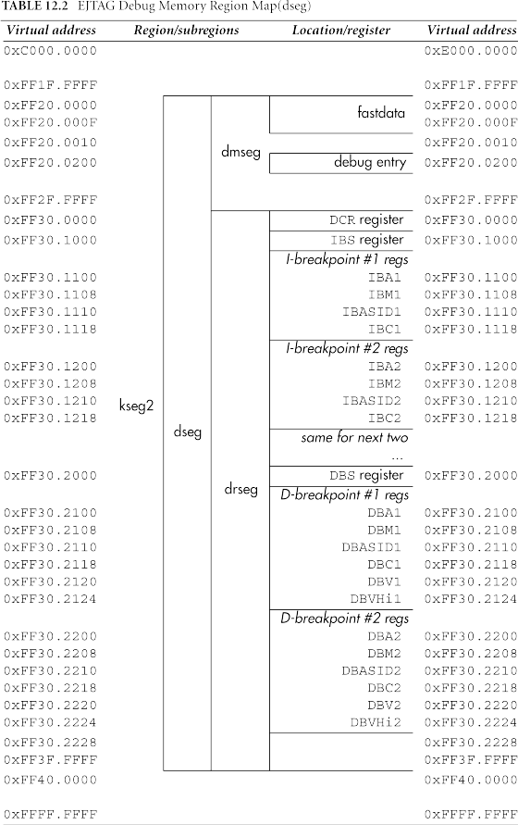
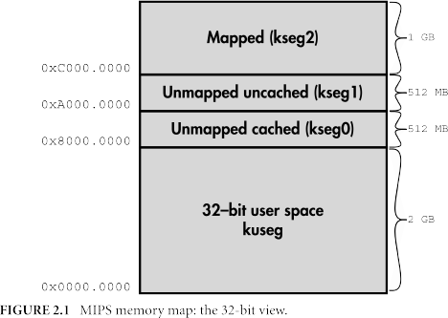
The dseg Mem Decode Region
Requirements

Slide 7
The dseg Mem Decode Region
Requirements
Requirements
Dseg – the whole debug-only memeory area
  Dmseg – probe memery region
    Fastdata – block-mode probe protocol (boost)
    Debug entry – debug exception entry point
  Drseg – debug unit’s main regs ★

Slide 8
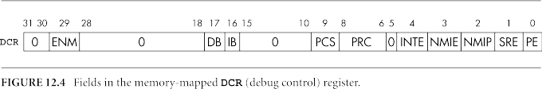
The DCR (Debug Control) Regs
Requirements
The drseg Mem Decode Region
Most bits are read-only
ENM
  (Read-Only) reports CPU endiannes

Slide 9
EJTAG Breakpoint Hardware
Requirements
The drseg Mem Decode Region
Monitoring instruction fetch, load, and store access form the CPU.
Set a breakpoint, if some access matches it for address/data, then comes a debug exception.
Working on virtual address.

Slide 10
EJTAG Breakpoint Regs
Requirements
The drseg Mem Decode Region
IBS/DBS – Status
  IBA/DBA – Address
  IBM/DBM – address Mask
  IBASID/DBASID – ASID
  IBC/DBC – Control
  DBV(Hi) - Value

Slide 11
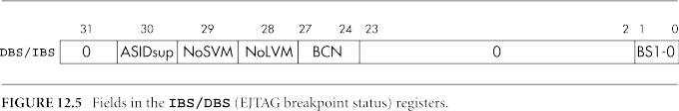
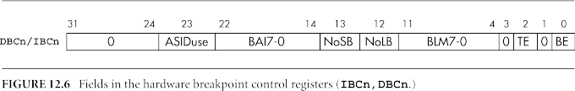
EJTAG Breakpoint Regs
Requirements
The drseg Mem Decode Region

Slide 12
EJTAG Breakpoint Regs
Requirements
The drseg Mem Decode Region

Slide 13
DBC(BAI7-0) - Byte Access Ignore
Requirements
The drseg Mem Decode Region
load/store byte x111
load/store halfword x110
load/store word x100
load/store doubleword x000
X000
X001
X010
X011
X100
X101
X110
X111

Slide 14
DBC(BAI7-0) - Byte Access Ignore
Requirements
The drseg Mem Decode Region
What if set DBM as 0111
  load/store byte x110 would hit
  load/store halfword x100 would hit
  ...
X000
X001
X010
X011
X100
X101
X110
X111

Slide 15
How to enable Breakpoints
Enable
IBC/DBC(BE)
Set IBA/DBA
&
IBM/DBM
Set IBC/DBC(ASIDuse)
&
IBASID/DBASID
Set DBV(Hi)
DBC(BLM)
//data per byte mask
Set DBC(BAI)
Set DBC(NoLB & NoSB)
// No Load Breakpoint
// No Store Breakpoint
It’s quite complicated, but logical.

Slide 16
Requirements
Physical communications with the host ✔
The ability to remote-control the CPU ✔
Breakpoint regs ✔
A just-for-debug exception

Slide 17
Debug regs in CP0
Debug
DEPC – restart address (used by deret)
DSAVE – save a general-purpose reg, so that it can use that reg as an address base to save all the others

Slide 18
Debug regs in CP0

Slide 19
Use EJTAG by Software
Debug entry at kseg1
Sdbbp calling into debug mode inside kernel
Virtual-address-only breakpoint
Be care of nested exception and other illegal place

Slide 20
MISCs.
CP0 watchpoint and break instruction
  Less functions but lots of uninterpreted bits can be implemented by software
Pdtrace
  An add-on to the EJTAG, record PC
Performance Counters

Slide 21
Chap12: Debugging MIPS Designs
THANKS!
Xie Benyi 8/26/18

