Slide 1

Body
Representative
By
Weitao Xiong
Advisor:
Prof. Hongfei Xue

Slide 2


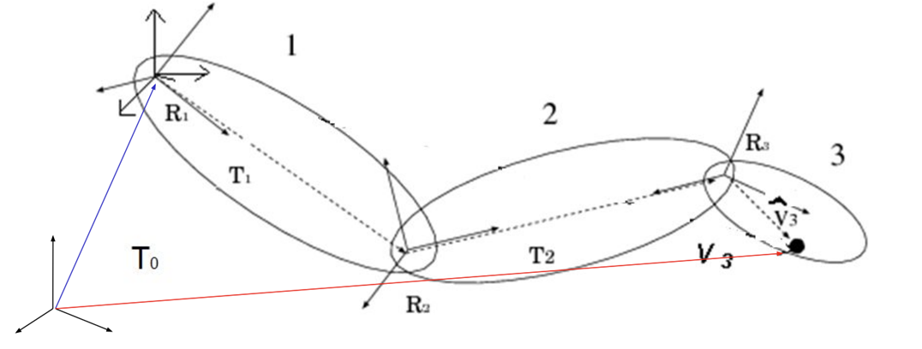
Rigid Skinning
Each skin vertex is assigned to exactly one bone
Consider a vertex 𝑗 with position 𝑣𝑗 in the object space (animated mesh) of the 𝑖th bone with transformation 𝑇𝑖. Then, the world space position of vertex 𝑗 is given by

Slide 3

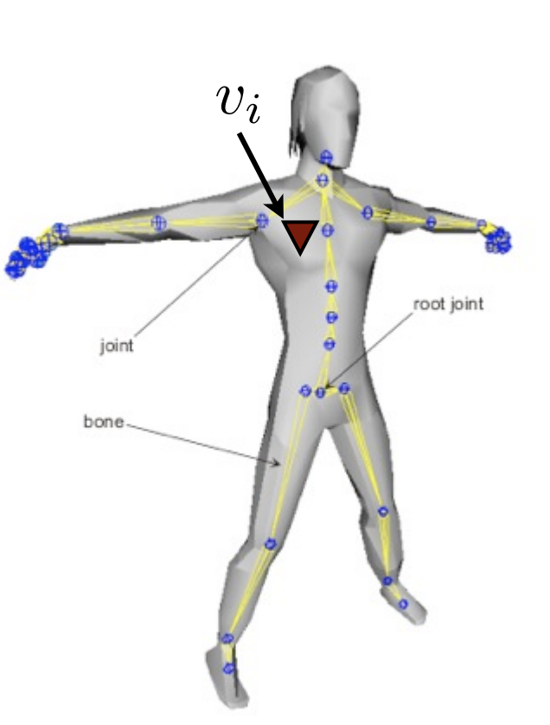
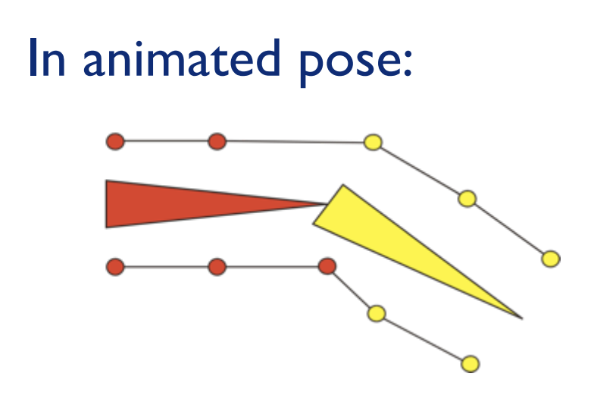

If we know the global position, then we can get joint j in animated mesh
Rigid Skinning Limitations
It will lead to unrealistic non-smooth deformations near joints

Slide 4
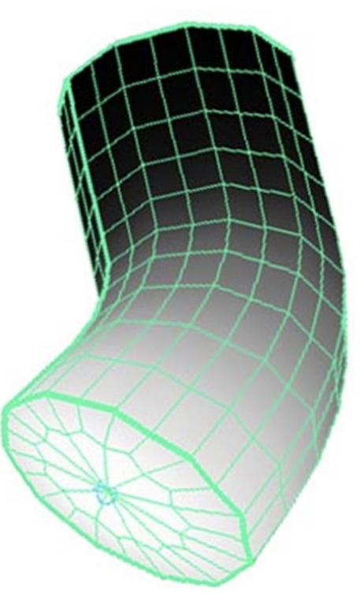
Linear Blend Skinning
Assign each skin vertex to more than one bone.
Remove the discontinuity by linearly blending vertices near the joint.

