Slide 1

Mamba and
Mamba Unet
By
Weitao Xiong
Advisor:
Prof. Hongfei Xue

Slide 2

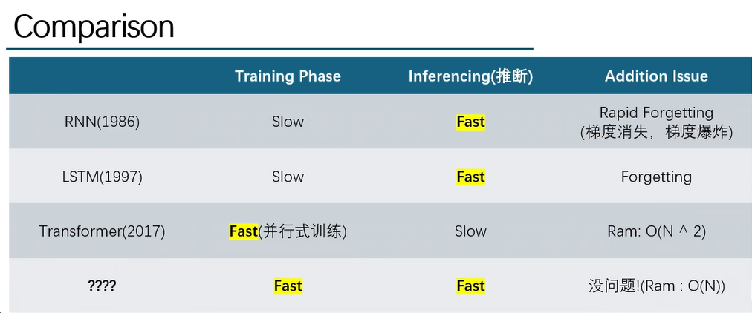
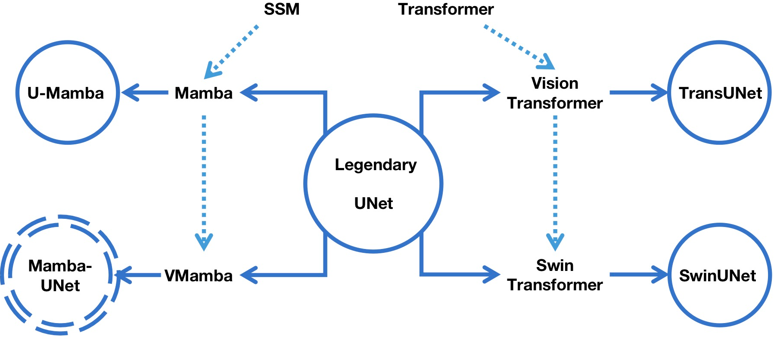
Why we need a new model?
U-Mamba (2024.1.9):
Image Segmentation
Vision Mamba (2024.1.17):
Classification
Mamba Unet(2024.2.7):
Semantic Segamentation
Mamba
(2023.12.1)

Slide 3
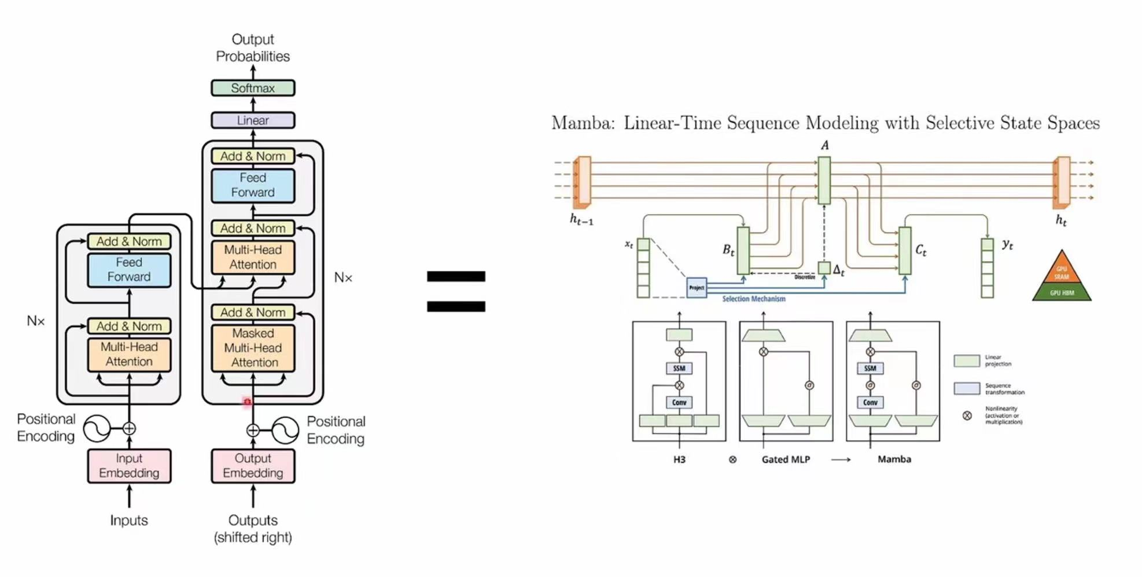
If you use Transformer Block in your model, you can just replace it with Mamba Block.

Slide 4
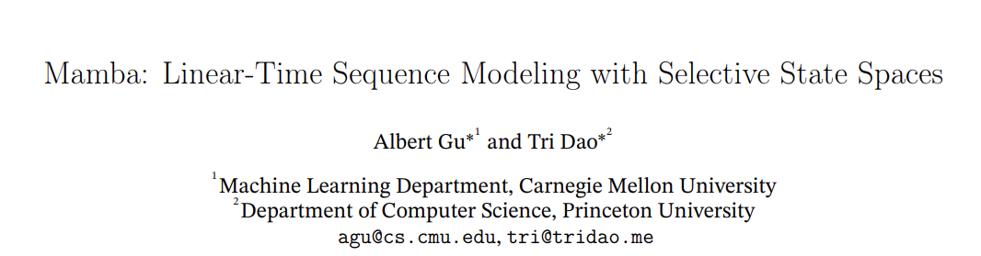
What is Mamba?
Two keywords:
Linear-Time Sequence Model
State Space Model (SSM)

Slide 5
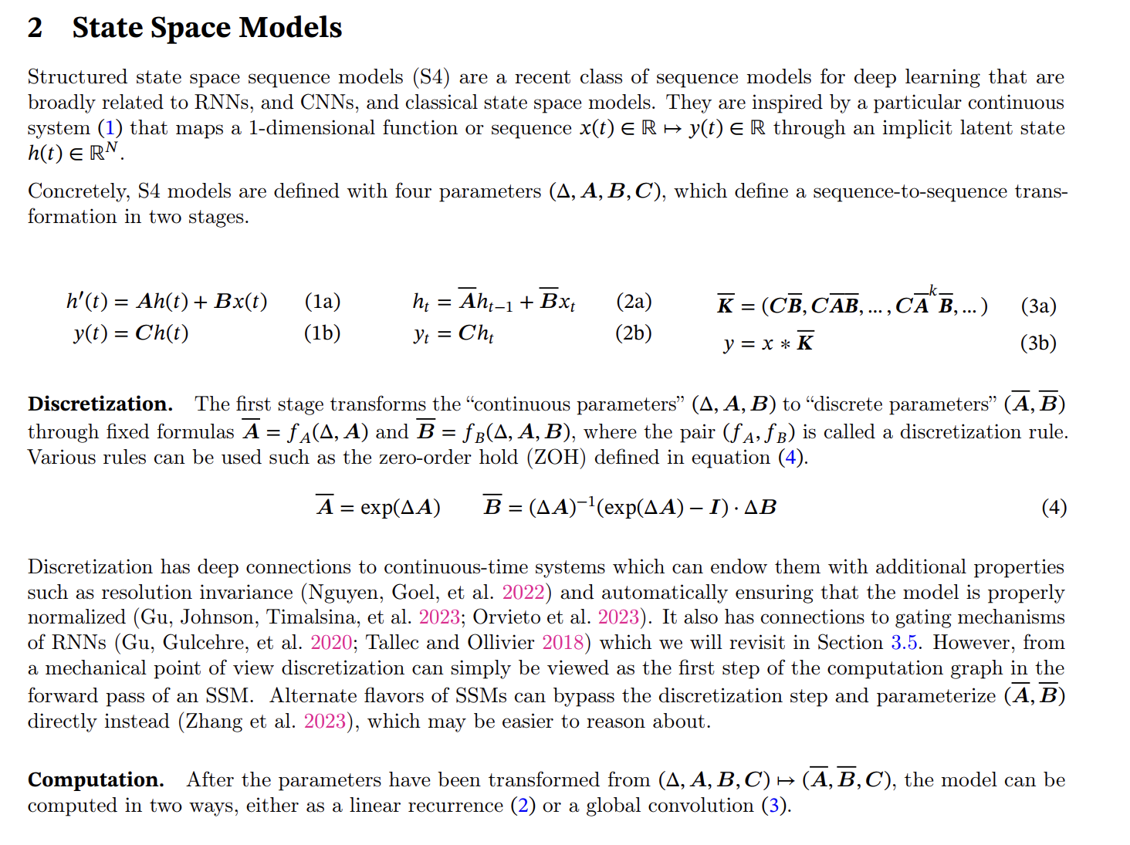
These are all core equations in this model, so we will first focus on what is State Space Model.

Slide 6
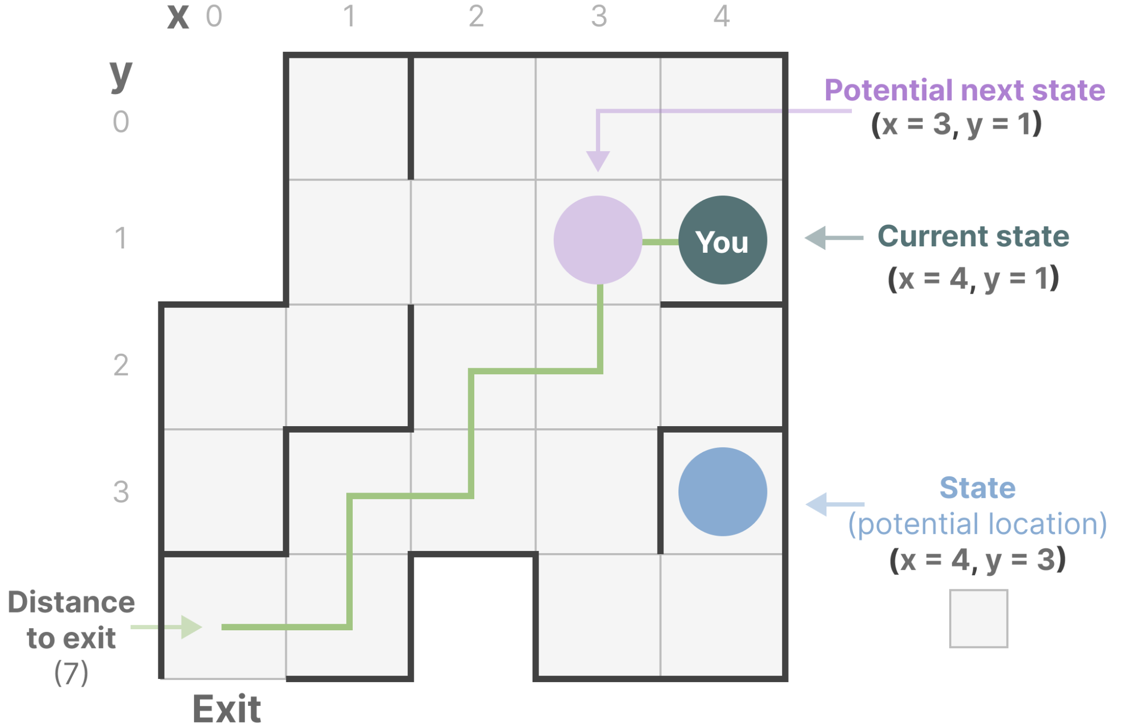
What is State Space?
State Space is a discrete space representing the set of all possible configurations of a "system".
Example:
“State Space” is the map of all possible locations (states). Each point represents a unique position in the maze with specific details, like how far you are from the exit.
“State Space Representation” is a simplified description of this map. It shows:
where you are (current state),
where you can go next (possible future states)
what changes take you to the next state (going right or left).

Slide 7
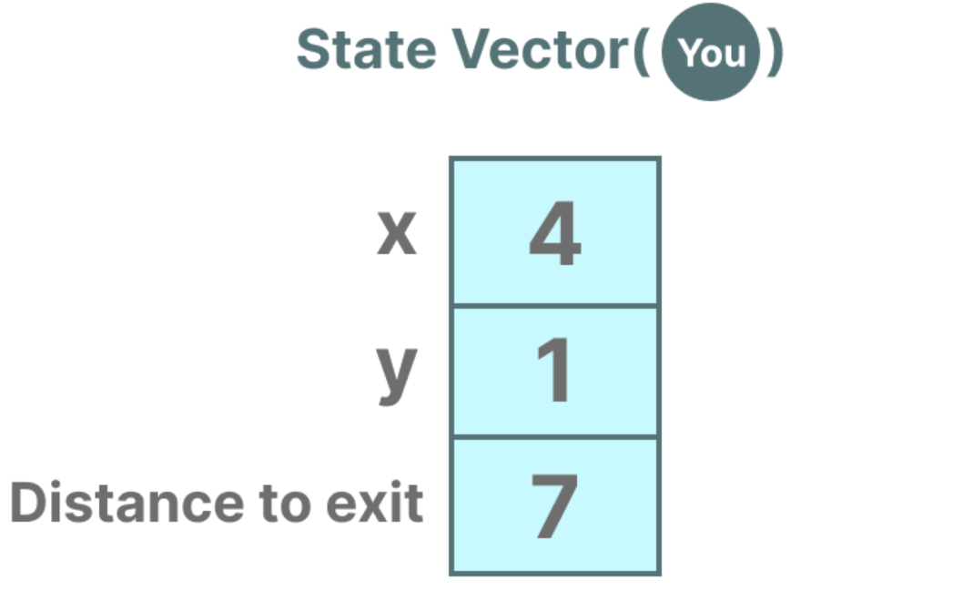
It is similar to embeddings or vectors in language models, both of them frequently used to describe the “state” of an input sequence.
In terms of neural networks, the “state” of a system is typically its hidden state and in the context of Large Language Models, one of the most important aspects of generating a new token.

Slide 8
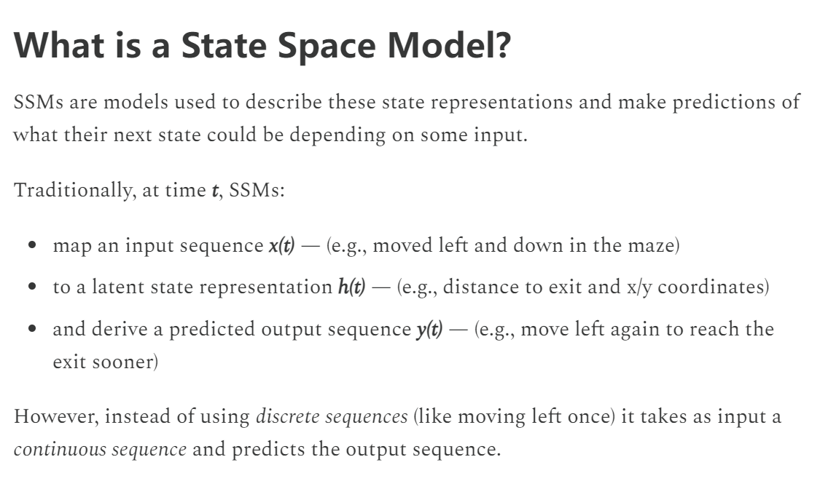
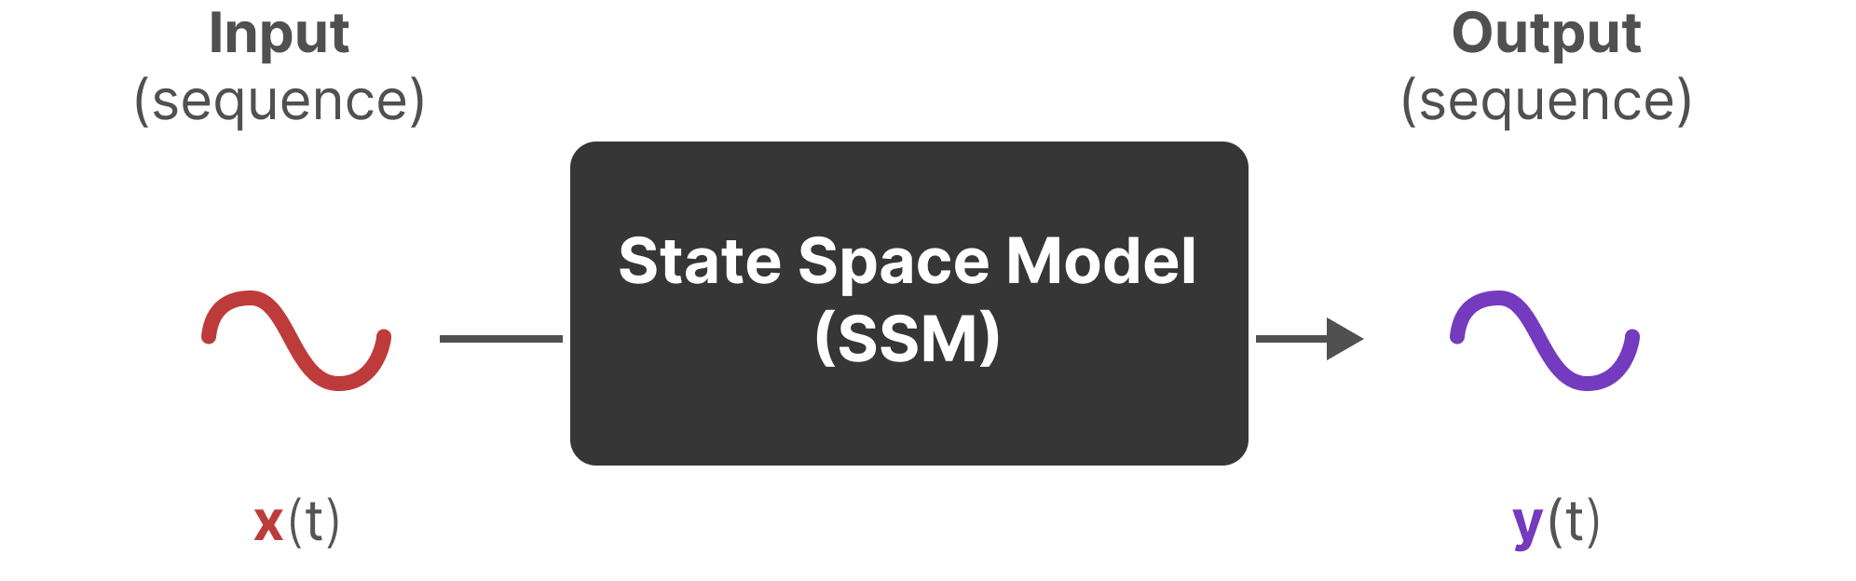
State Space Model

Slide 9
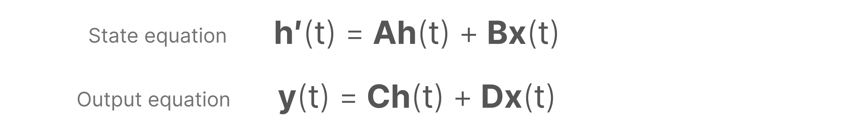
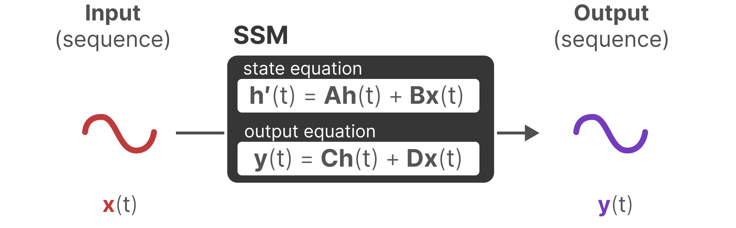
Standard equation in SSM

Slide 10
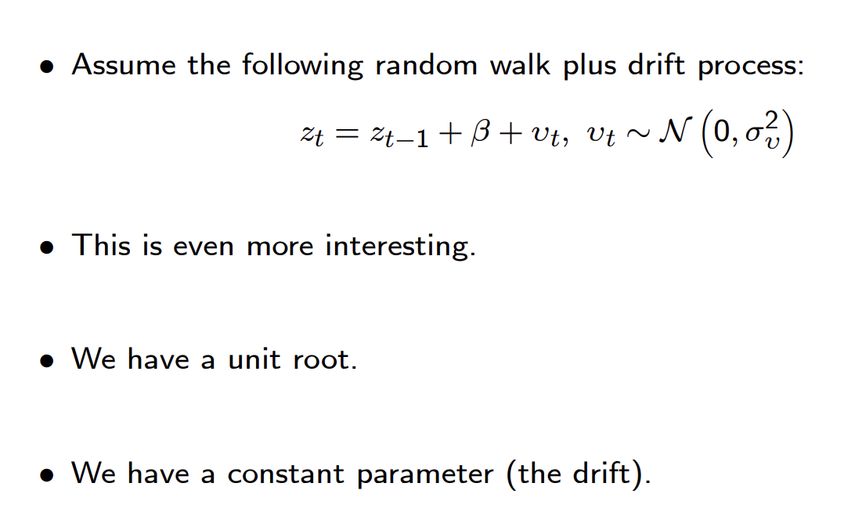
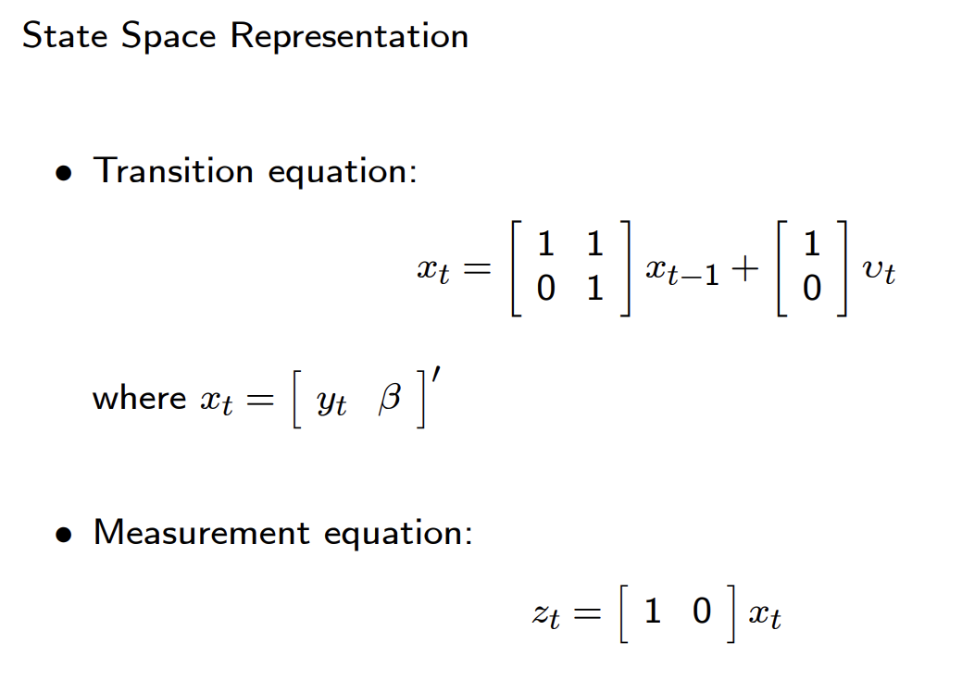
Example
State equation
Output equation

Slide 11
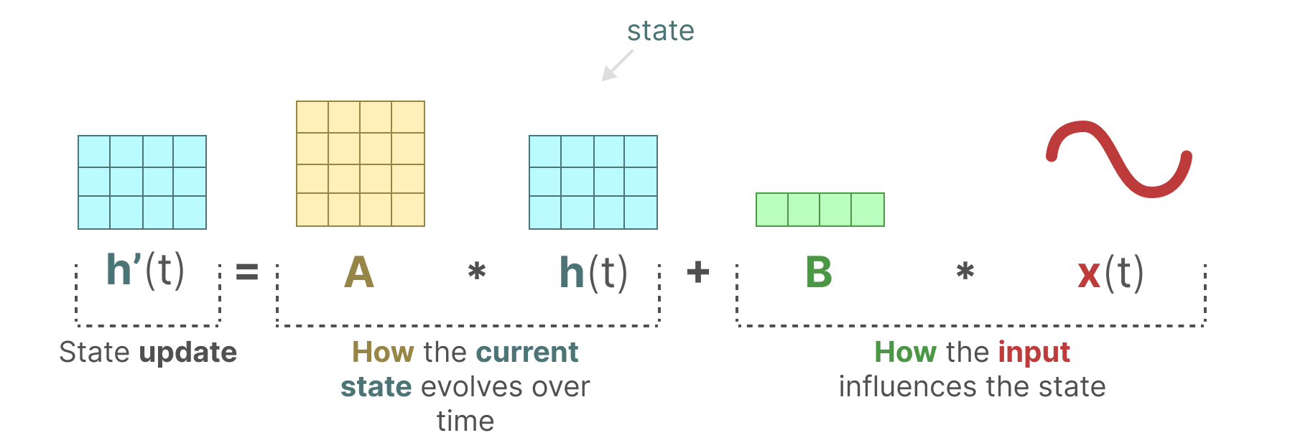
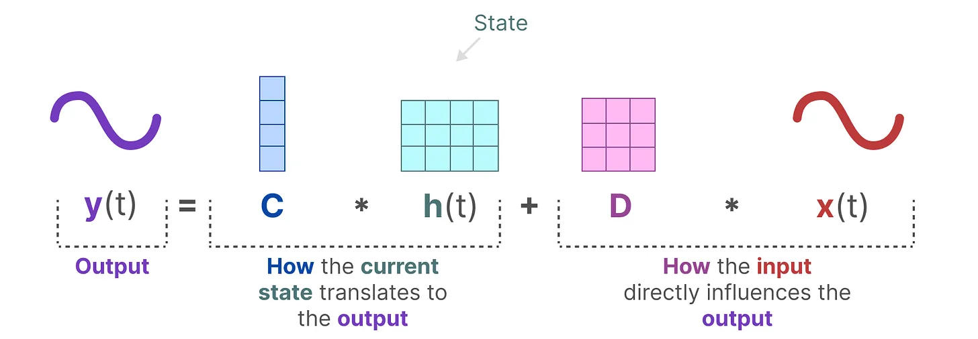

Do you think it is similar to the way you do in the Kalman filter?

Slide 12
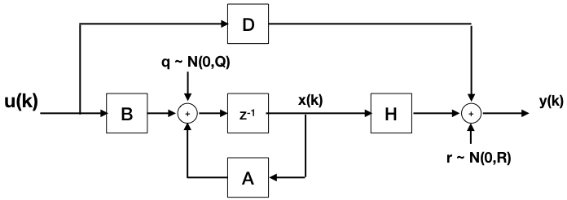
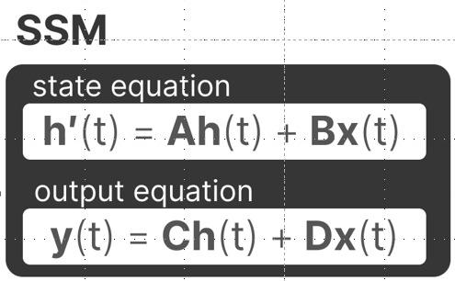

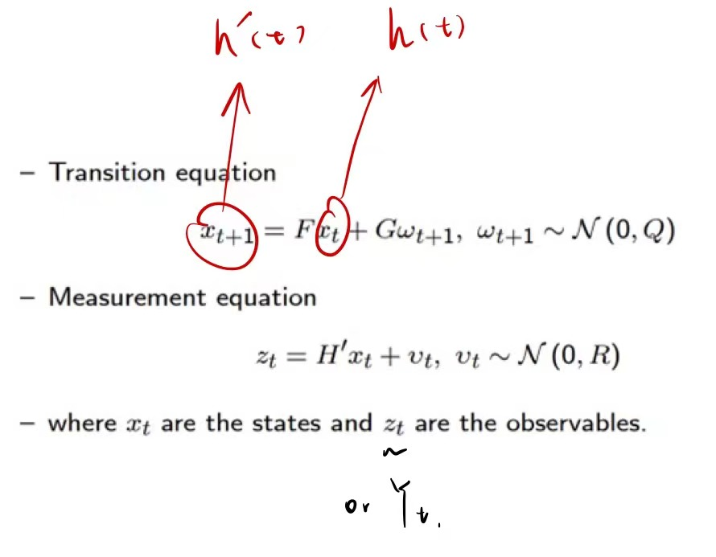
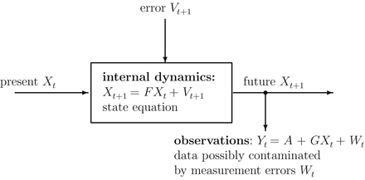
Kalman Filter using SSM

Slide 13
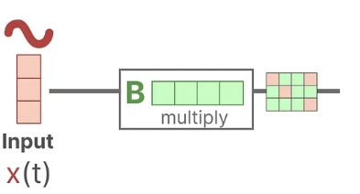
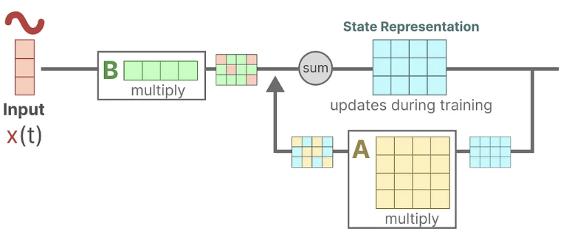
More detail about SSM
Assume we have some input signal x(t), this signal first gets multiplied by matrix B which describes how the inputs influence the system.
The updated state (akin to the hidden state of a neural network) is a latent space that contains the core “knowledge” of the environment. We multiply the state with matrix A which describes how all the internal states are connected as they represent the underlying dynamics of the system.

Slide 14
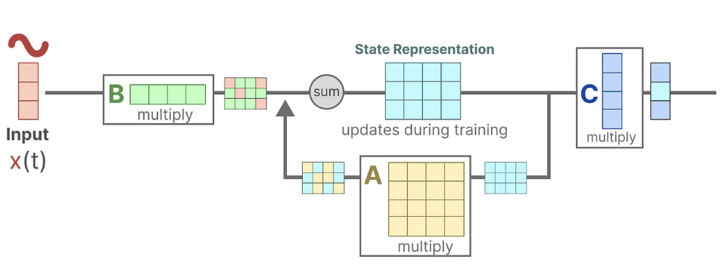
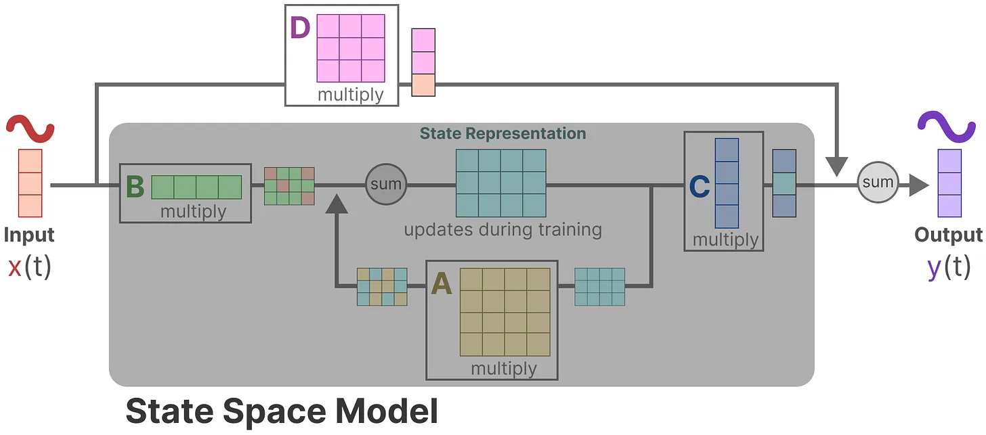
Then, we use matrix C to describe how the state can be translated to an output.
Finally, we can make use of matrix D to provide a direct signal from the input to the output. This is also often referred to as a skip-connection. The SSM is often regarded as the following without the skip-connection.

Slide 15

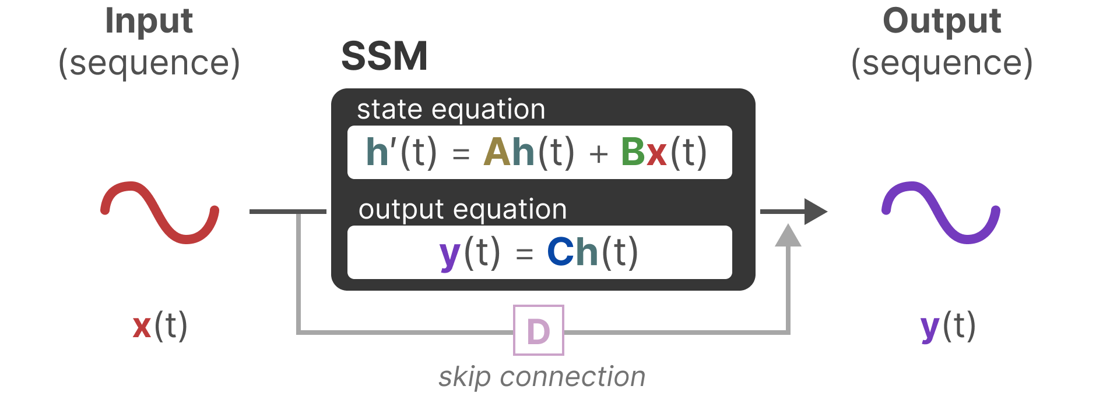
We can now focus on matrices A, B, and C as the core of the SSM.

Slide 16
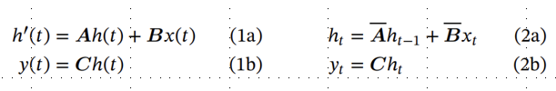
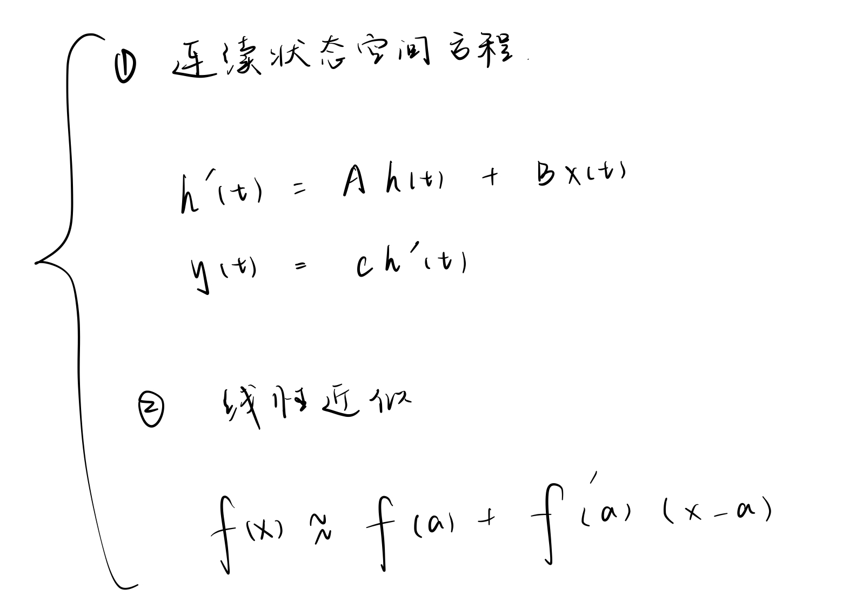

Slide 17
Discretization
As a continuous-time system, SSM is difficult to directly integrate into Deep Learning model:
Calculation Efficiency: Modern deep learning frameworks and hardware are usually designed based on discrete-time operations. Only after discretizing SSM can it be transformed into a model that can run efficiently on these frameworks and hardware.
Training Algorithms: Most deep learning training algorithms, such as gradient descent and backpropagation, are designed for discrete-time models. Discretization allows these algorithms to be directly applied to state-space models.
Practical Applications: In many practical applications, data is discrete, such as text data (word sequences), time series data (stock prices, sensor readings), etc. Discrete-time models match these data formats more naturally.
Model Complexity: The discretization process can control the complexity of the model by selecting an appropriate time step size T.

Slide 18
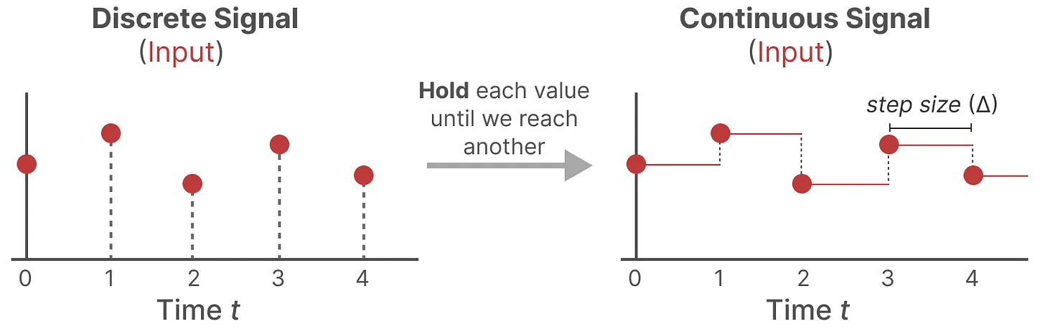

Slide 19
Reference
Gu, A., & Dao, T. (2023, December 1). Mamba: Linear-time sequence modeling with selective state spaces. arXiv.org. https://arxiv.org/abs/2312.00752
Grootendorst, M. (2024, February 19). A visual guide to Mamba and state space models. A Visual Guide to Mamba and State Space Models. https://newsletter.maartengrootendorst.com/p/a-visual-guide-to-mamba-and-state
State space models and filtering - penn arts & sciences. (n.d.). https://www.sas.upenn.edu/~jesusfv/LectureNotes_9_filtering.pdf

