Slide 1

Body
Representative
By
Weitao Xiong
Advisor:
Prof. Hongfei Xue

Slide 2


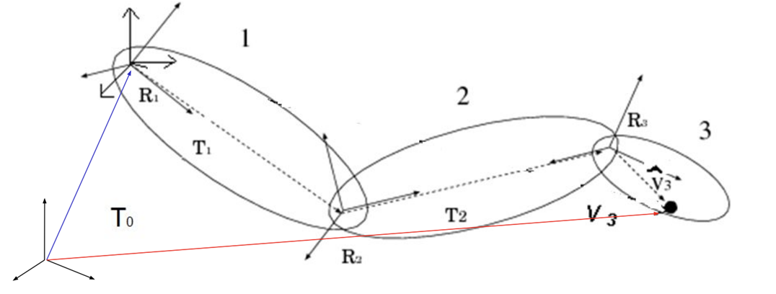
Rigid Skinning
Each skin vertex is assigned to exactly one bone
Consider a vertex 𝑗 with position 𝑣𝑗 in the object space (animated mesh) of the 𝑖th bone with transformation 𝑇𝑖. Then, the world space position of vertex 𝑗 is given by

Slide 3

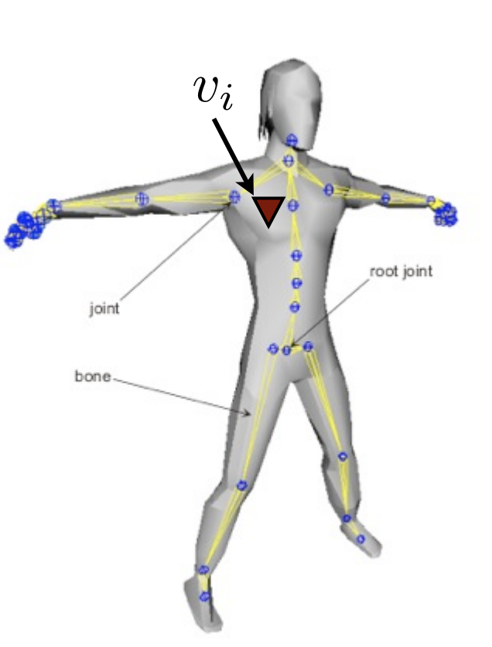
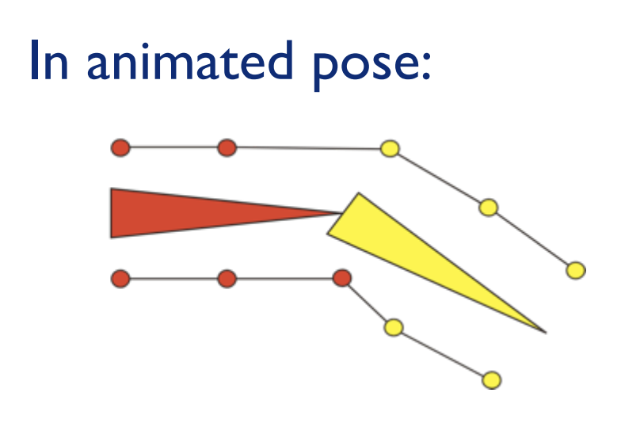

If we know the global position, then we can get joint j in animated mesh
Rigid Skinning Limitations
It will lead to unrealistic non-smooth deformations near joints

Slide 4
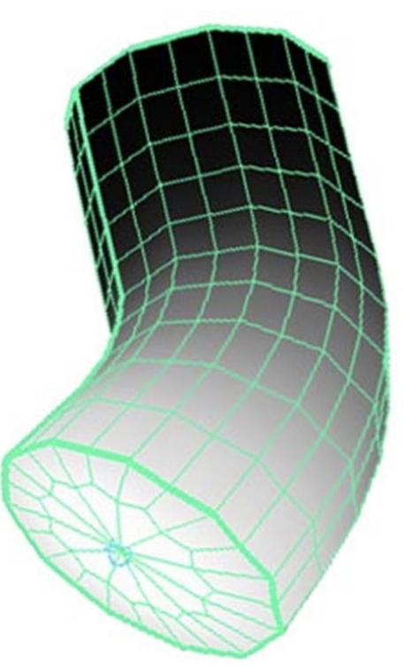

Linear Blend Skinning
Assign each skin vertex to more than one bone.
Remove the discontinuity by linearly blending vertices near the joint.
Where:
is the number of matrices.
is the vertex position.
is the weight associated.
is the transformation matrix.

Slide 5
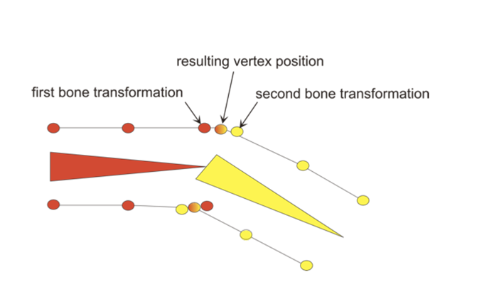
A vertex can be attached to more than one joint/bone with adjustable weights that control how much each joint affects it
Rarely more than 4

Slide 6
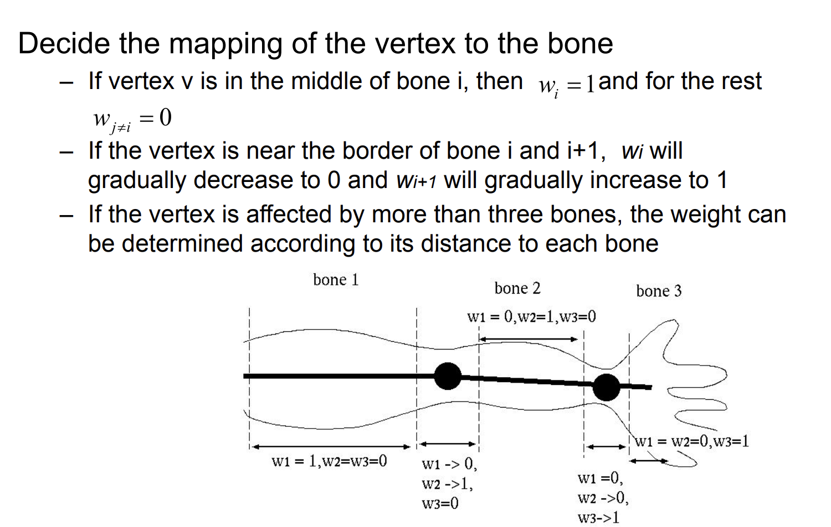
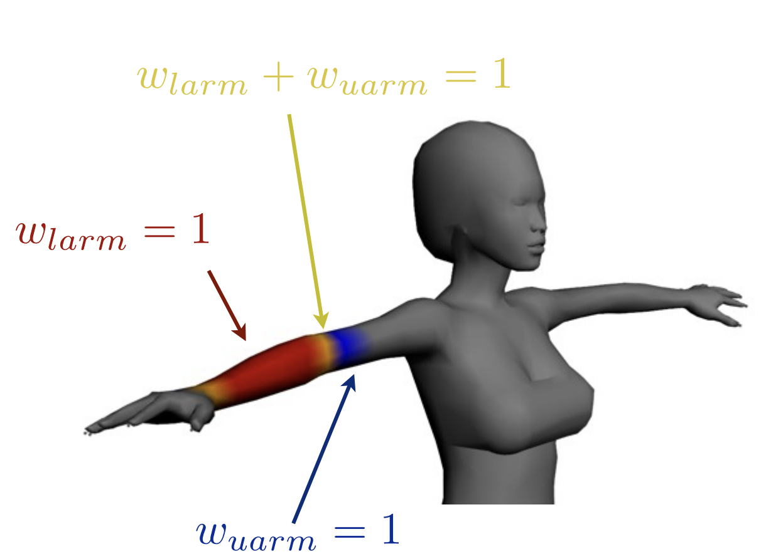
Weight

Slide 7
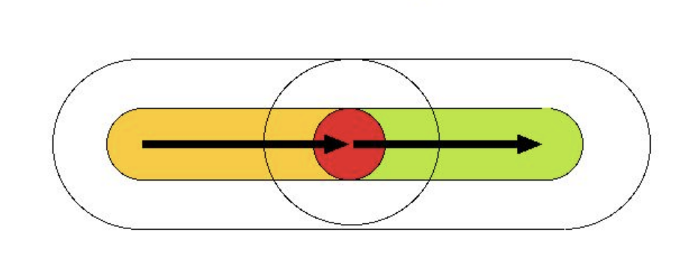
How to decide Weight？
Use the Euclidean distance
•Surround the bones with the inner and outer capsules
•If the vertex is inside only one inner capsule, the weight of the
corresponding bone is 1, and the rest are 0
Outer
Inner

Slide 8
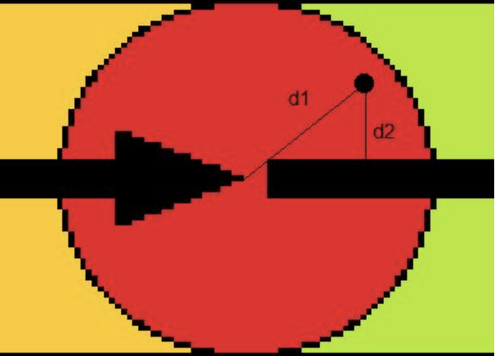
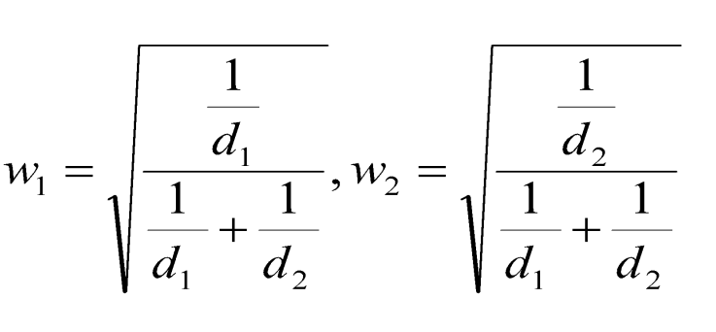
If inside multiple inner capsules, compute the distance to each
bone, and set the weights inversely proportional to the distance
with normalization

Slide 9
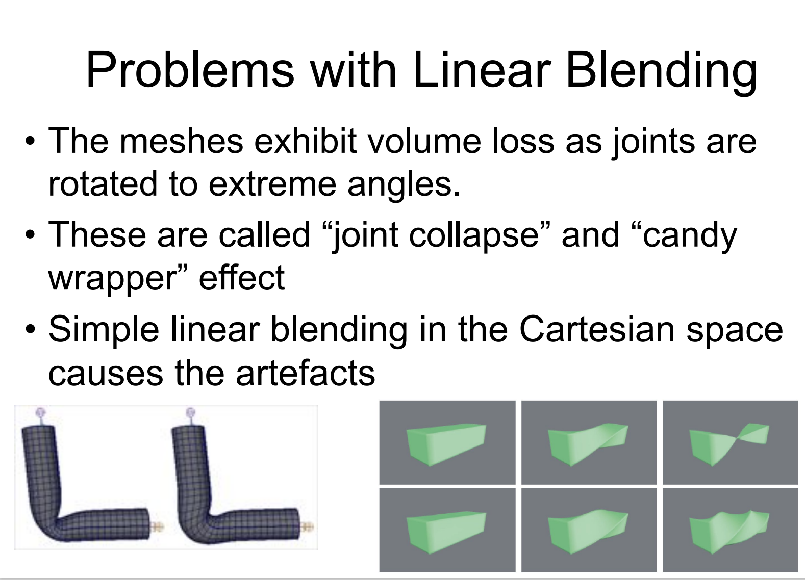
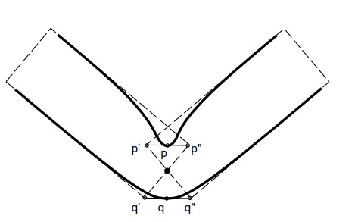

Slide 10
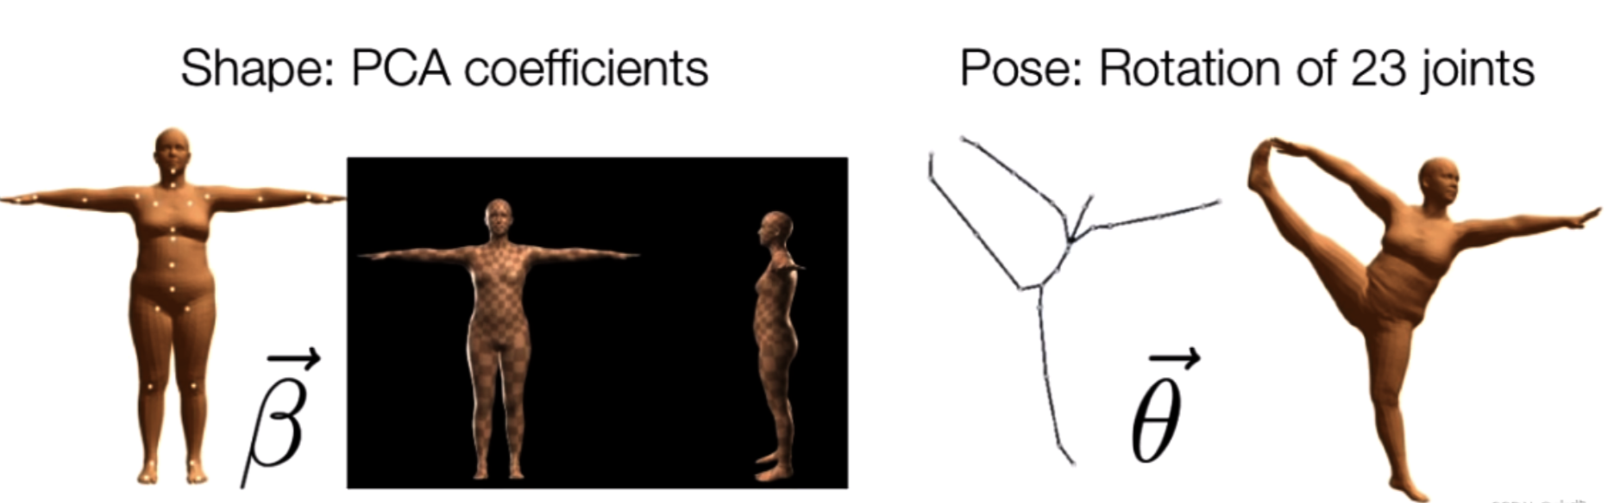
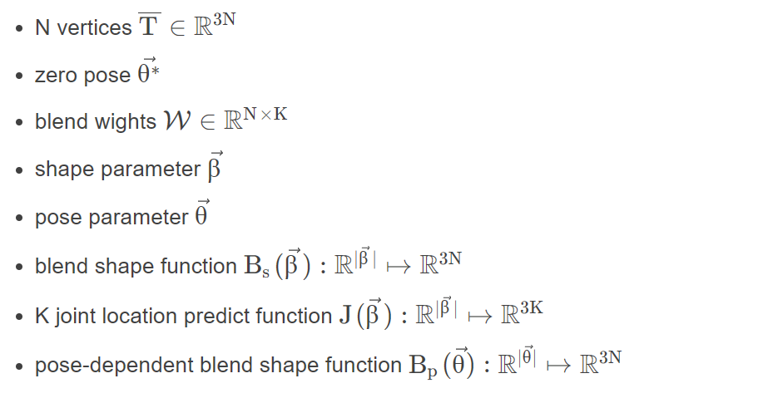
SMPL
SMPL is divided into two sets of parameters:
body shape parameters β
body pose parameters θ.
K = 23, N = 6980

Slide 11
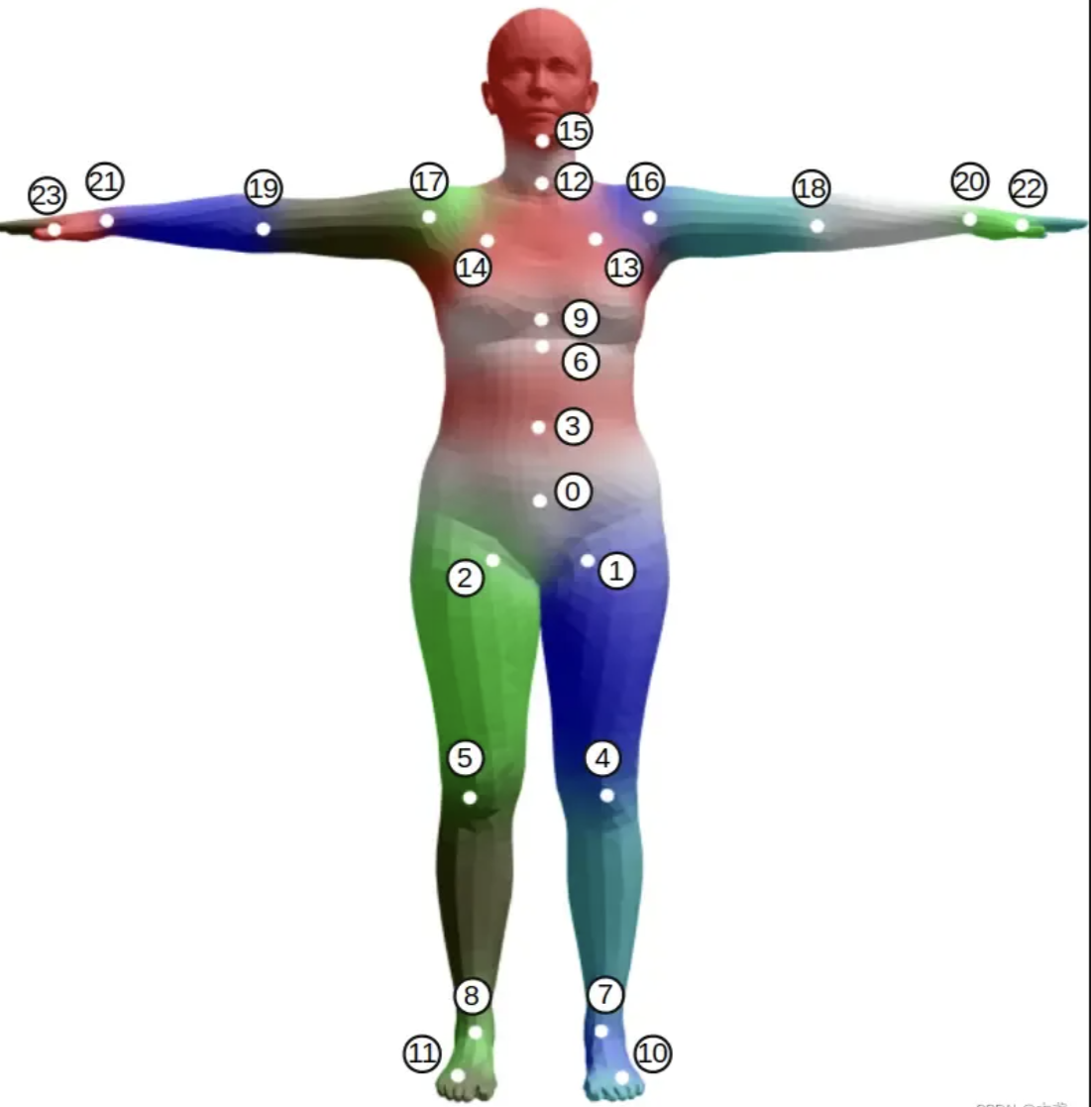
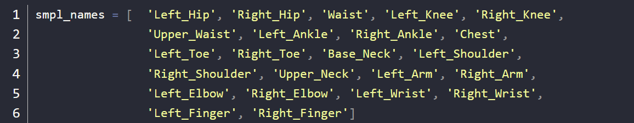
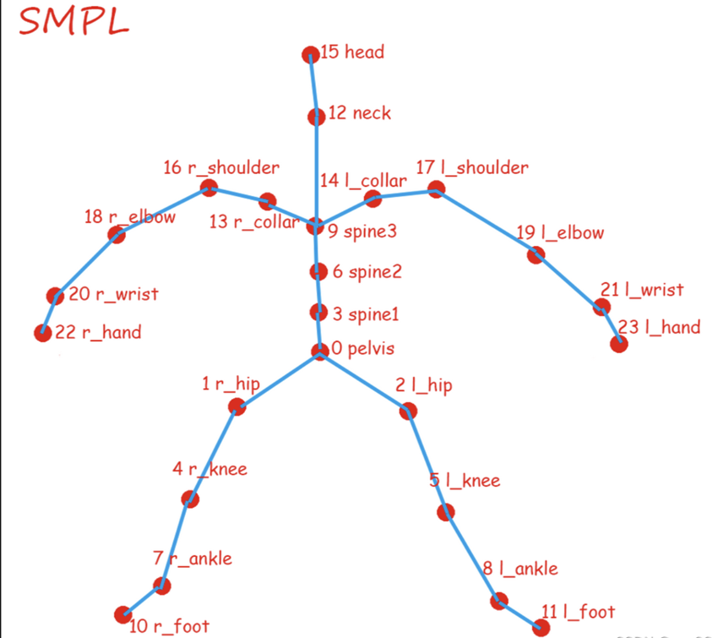
Each human body model has 10 shape parameters and 24x3=72 pose parameters. Therefore, we can represent an SMPL human body using 10+72=82 numbers.

Slide 12
