Slide 1

U-Net
By
Weitao Xiong
Advisor:
Prof. Hongfei Xue

Slide 2

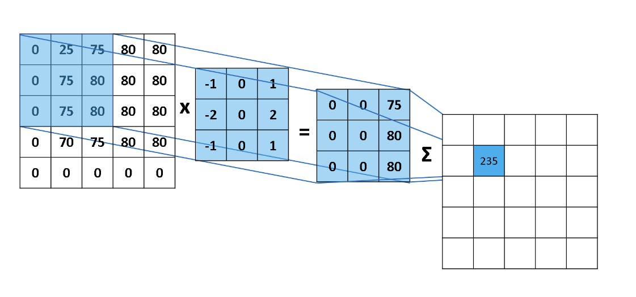
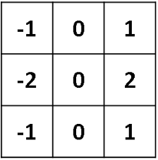
Convolution and Kernels
Convolution is a process that uses convolution kernels to extract features from images. The convolution kernel is a matrix. By designing this matrix (such as the size of the matrix and the values ​​in the matrix), the corresponding image features can be extracted, such as edge features, texture features of the image, etc.
Kernels

Slide 3
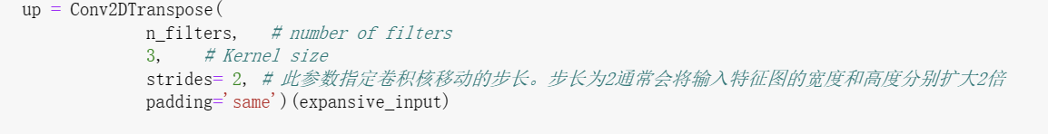
Step Size
The step size controls the distance the convolution kernel moves.

Slide 4
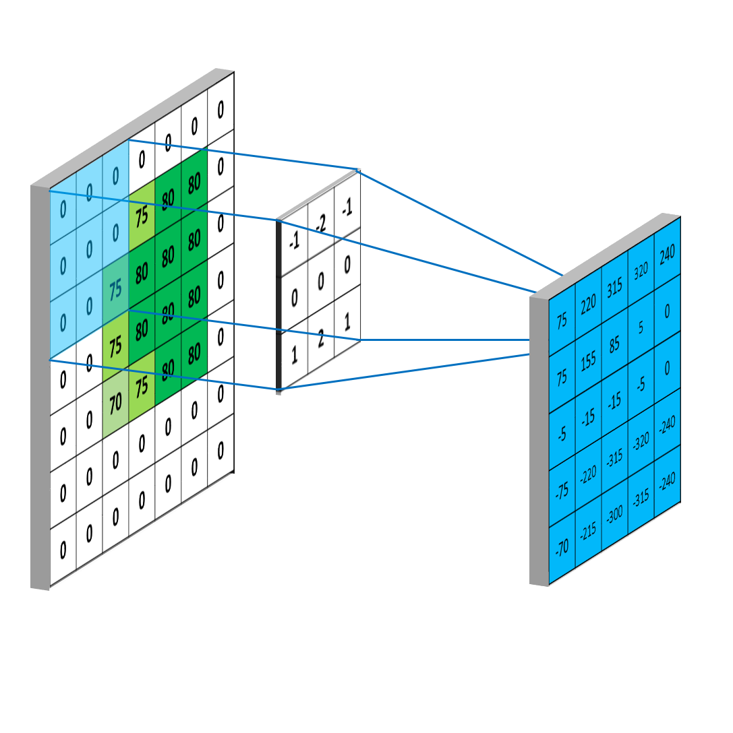
Padding
Zero-padding is used in origin image so that the resulting image doesn't shrink.

Slide 5
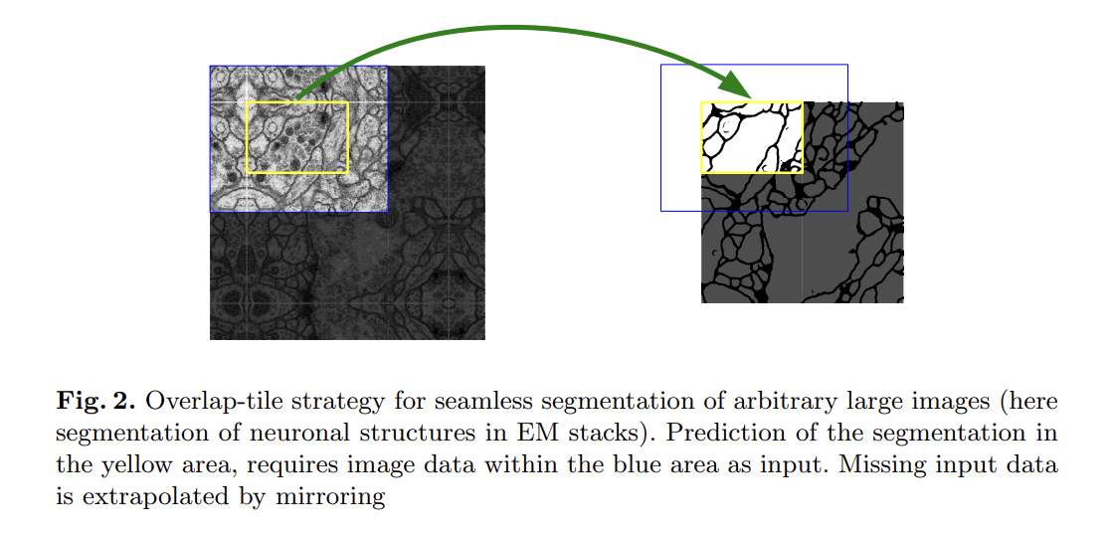
Mirror Copying padding

Slide 6
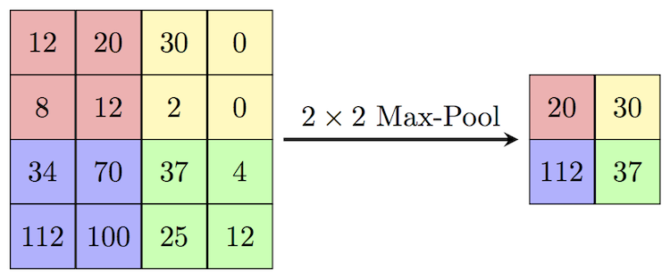
Max pooling
Max pooling is a pooling operation that selects the maximum element from the region of the feature map covered by the filter. Thus, the output after max-pooling layer would be a feature map containing the most prominent features of the previous feature map.

Slide 7
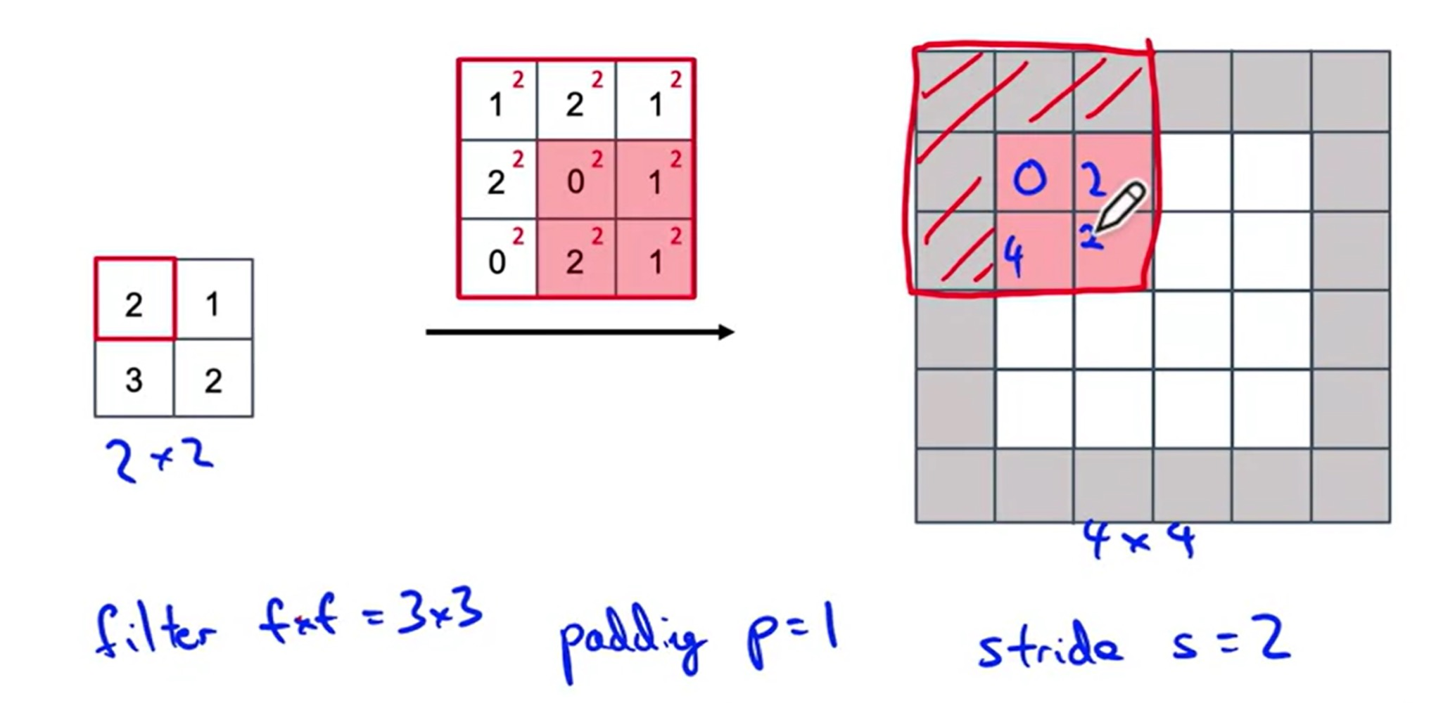
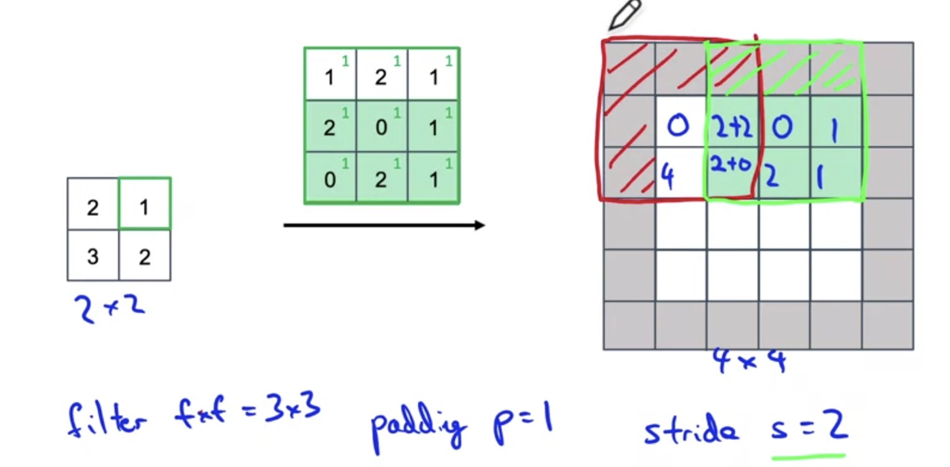
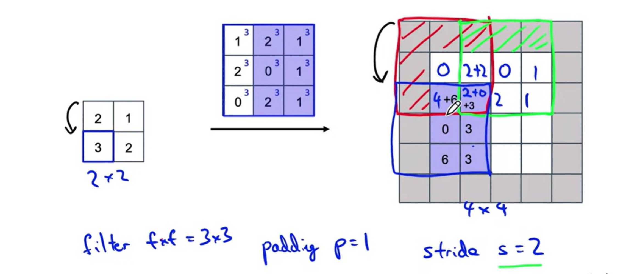
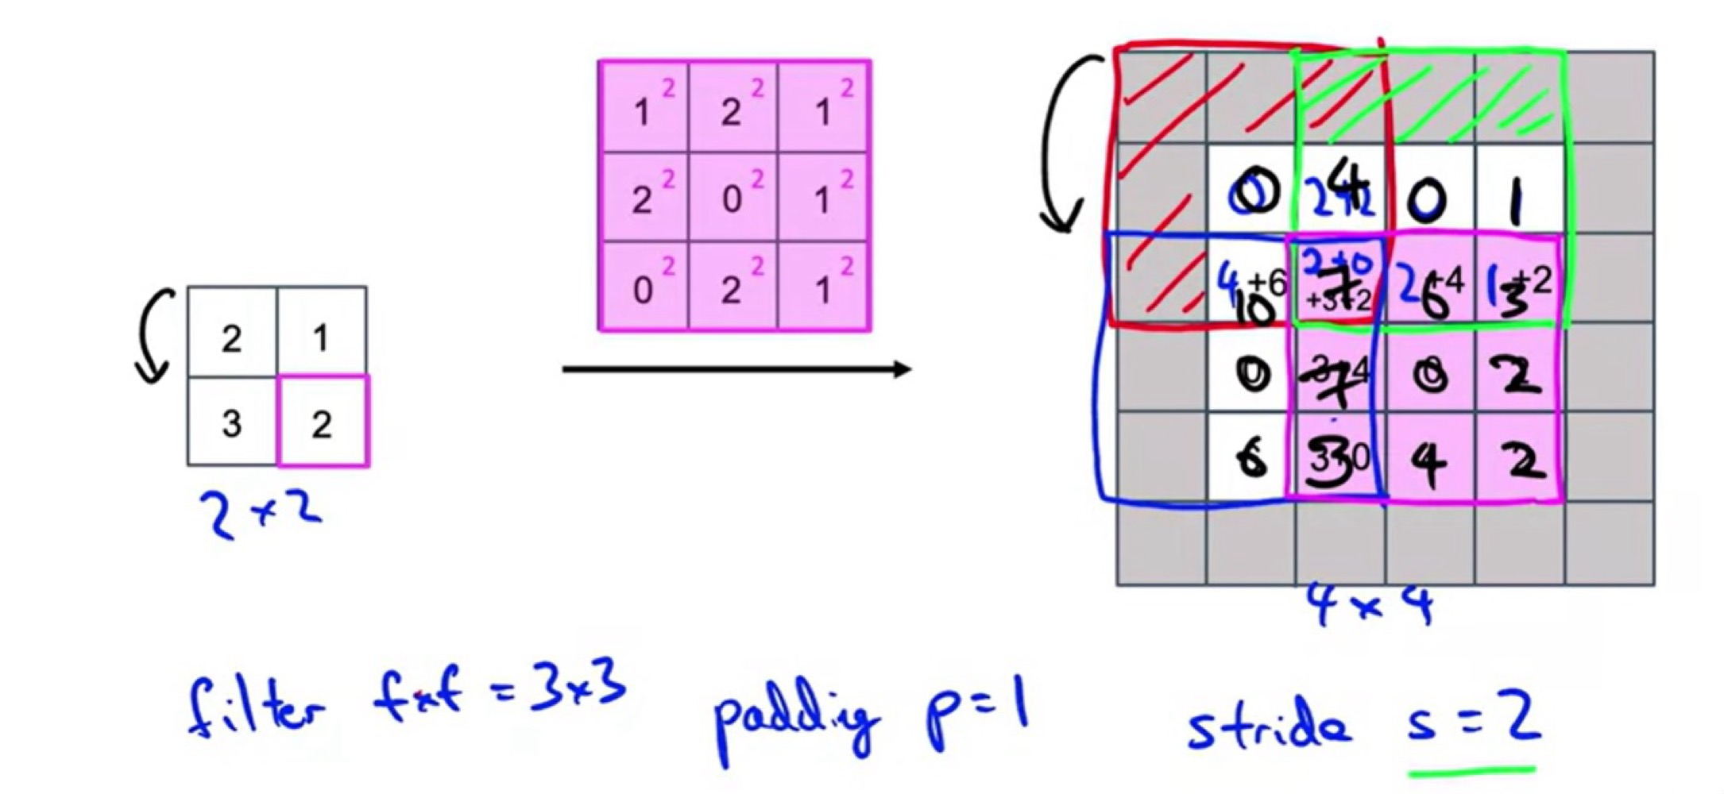
Transpose Convolution

Slide 8


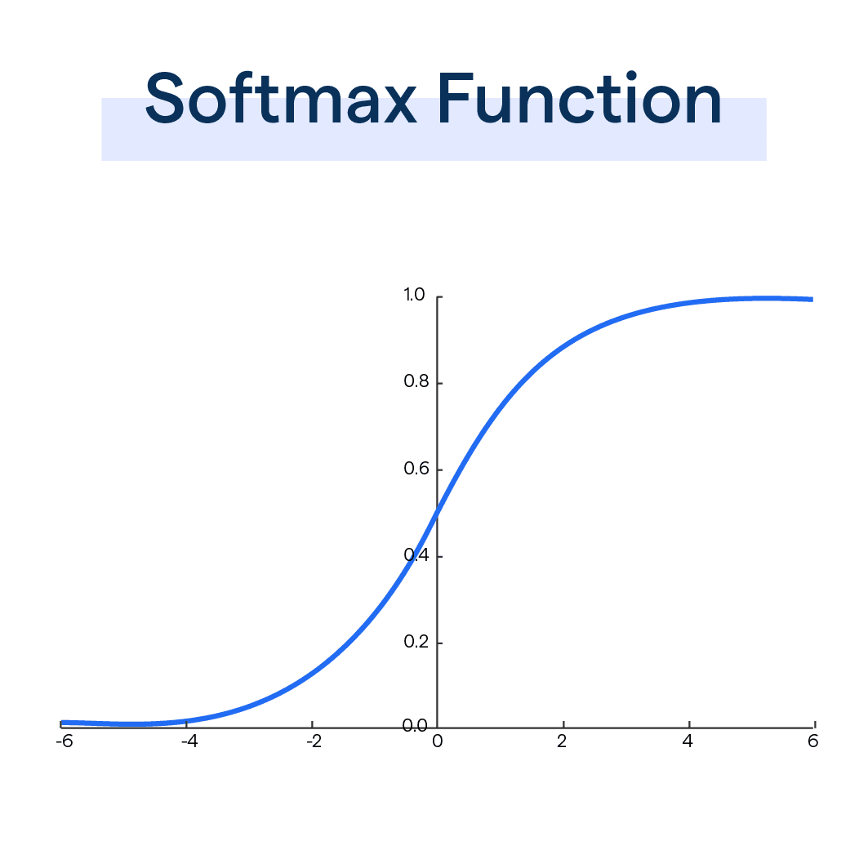
Loss Function
Estimating the degree of inconsistency between the model‘s predicted value f(x) and the true value Y.

Slide 9
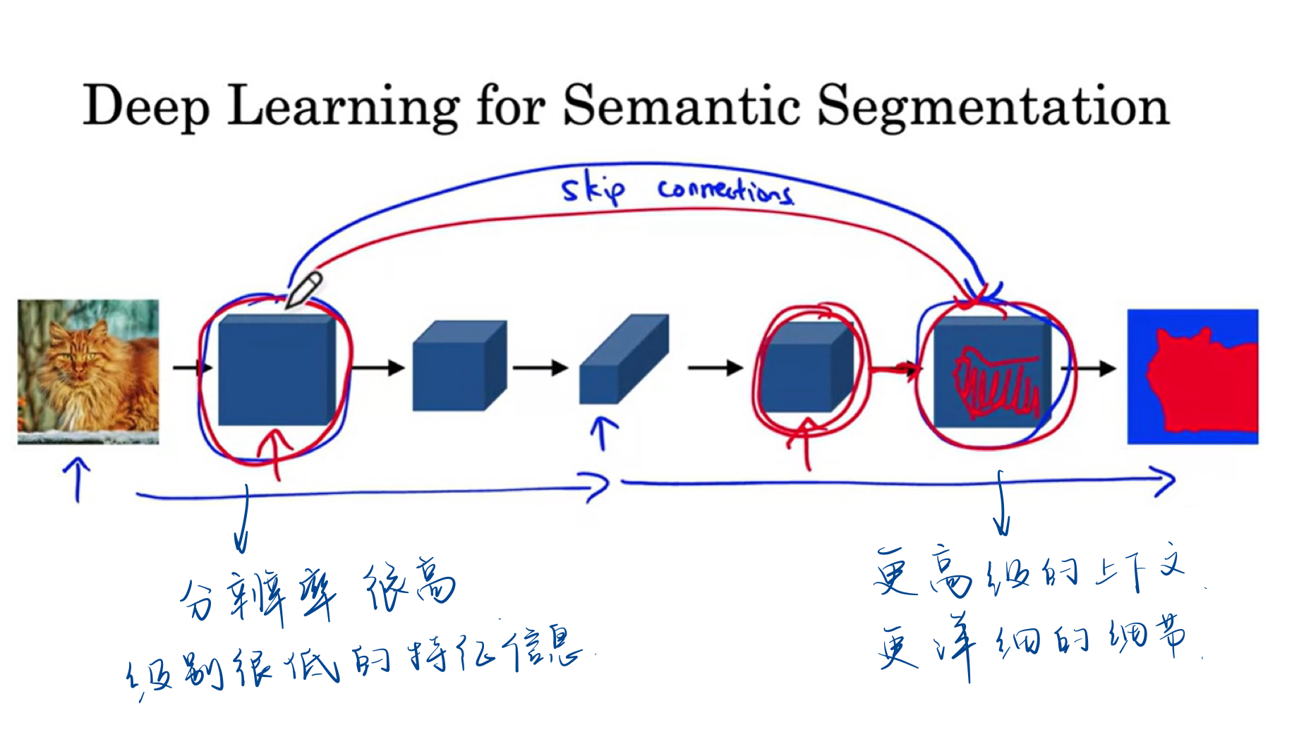

Slide 10
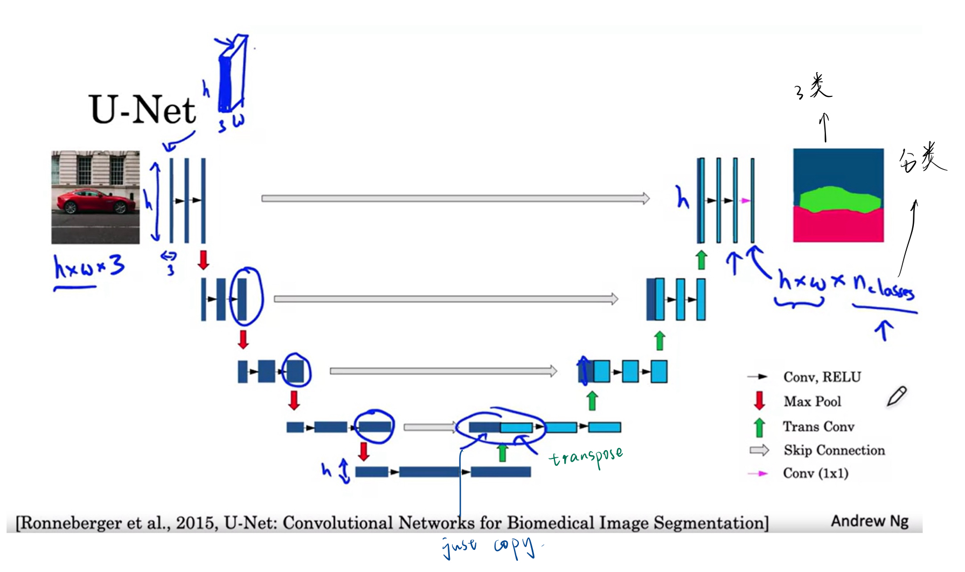
The U-Net architecture consists of two parts:
The contracting path is a sequence of convolutional and max pooling layers that downsample the input image and extract features.
The expanding path is a sequence of convolutional and upsampling layers that upsample the feature maps from the contracting path and combine them with the features from the input image to produce the final segmentation map.

Slide 11
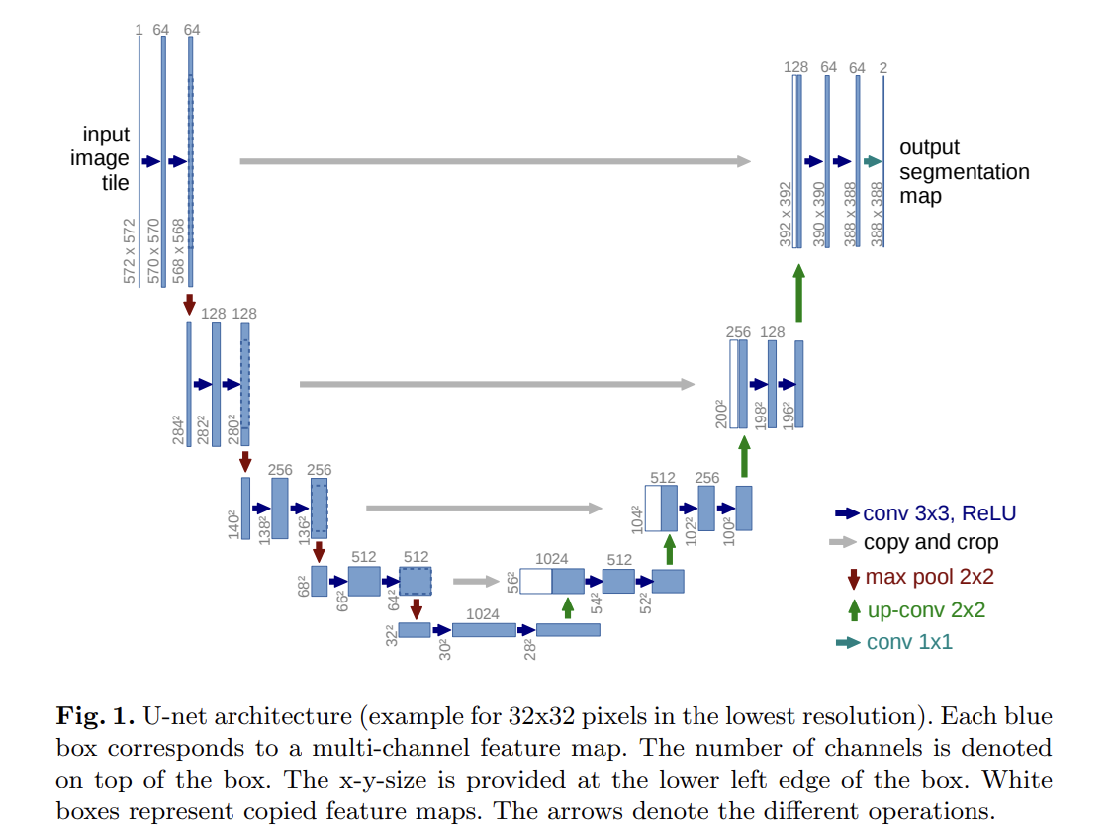
U-Net: Convolutional Networks for Biomedical Image Segmentation
https://arxiv.org/pdf/1505.04597.pdf

Slide 12
