Slide 1
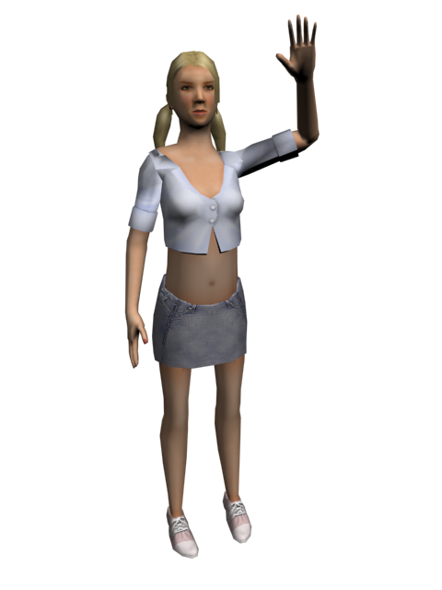
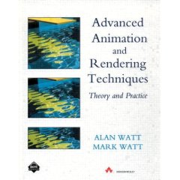
Skeletons and Skinning
Bones and Skeletons
Mesh Skinning
Chapter 17 in the textbook.

Slide 2
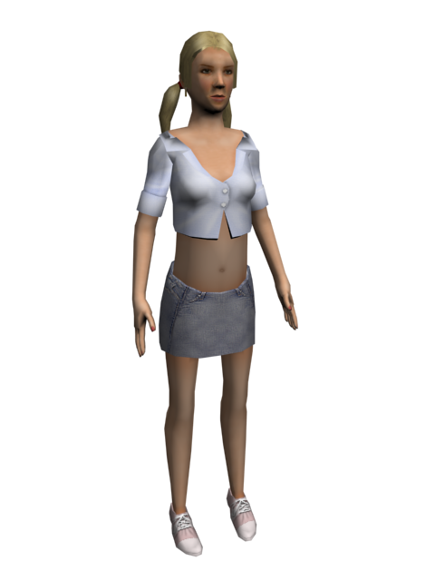
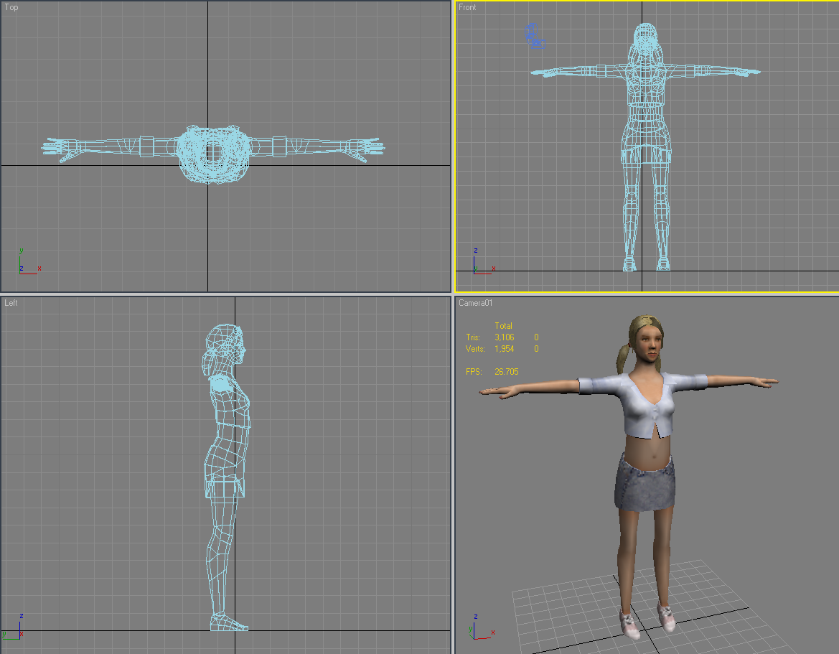
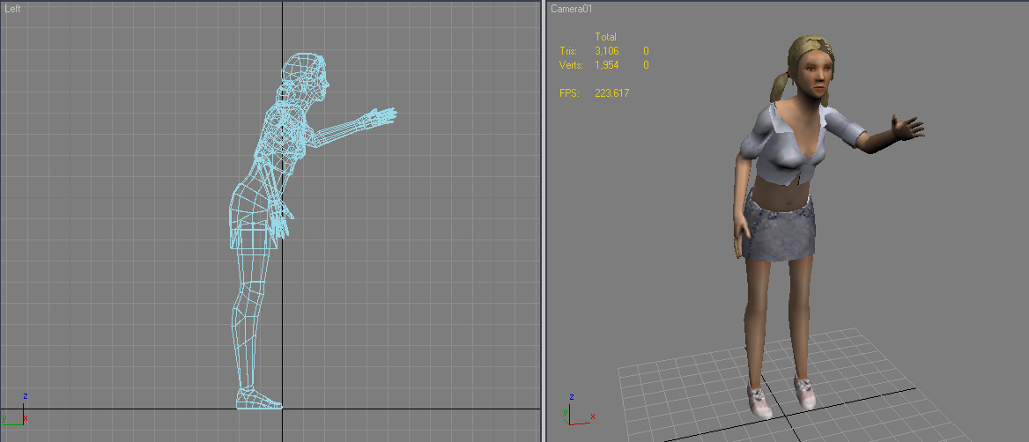
Skeletal Animation
Victoria

Slide 3
Skeletons
Skeleton: a pose-able framework of joints arranged in a tree structure. An invisible armature to manipulate the skin and other geometric data of the character
Joint: allows relative movement within the skeleton. Joints are equivalent to 4x4 matrix transformations.
  Usually defined as an offset and rotation independently
Bone: what’s the difference between a joint and a bone?
  Sometimes includes a length or actual geometry

Slide 4
DOFs
Degree of Freedom (DOF): A variable φ describing a particular axis or dimension of movement within a joint
Joints typically have around 1-6 DOFs (φ₁…φ_{N}) Can have more (up to 9 for affine)
Changing the DOF values over time results in the animation of the skeleton
Rigid body transformations: 6DOF
Arbitrary rotations: 3DOF

Slide 5
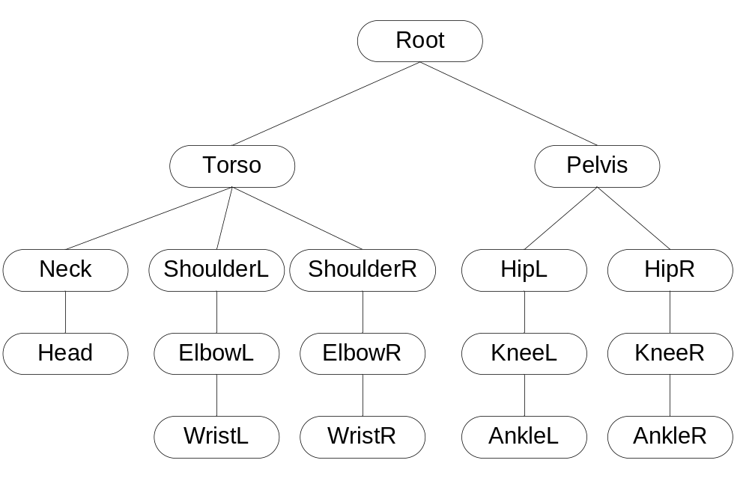
Example Joint Hierarchy

Slide 6
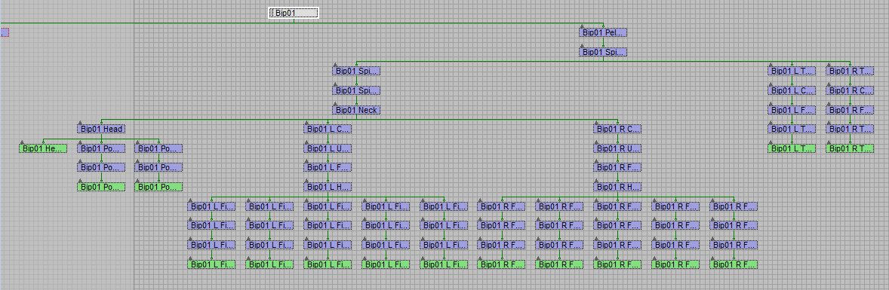
Victoria in 3DS Max

Slide 7
Joints
Core Joint Data
  DOFs (N floats)
  Base pose information
Additional Data
  Joint offset vector: r
  DOF limits (min & max value per DOF)
  Type-specific data (rotation/translation axes, constants…)
  Tree data (pointers to children, siblings, parent…)

Slide 8
Skeleton Posing Process
Specify DOF values for the skeleton
Traverse the hierarchy using forward kinematics to compute the world matrices
Use world matrices to deform skin & render
The matrices can also be used for other things such as collision detection, FX, etc.

Slide 9
Forward Kinematics
Each joint computes a local matrix M based on the DOFs and some formula representative of the joint type:
  Local matrix M = M_{joint}(φ₁,φ₂,…,φ_{N})
Then, world matrix W is computed by concatenating M with the world matrix of the parent joint
  World matrix W = W_{parent}M

Slide 10
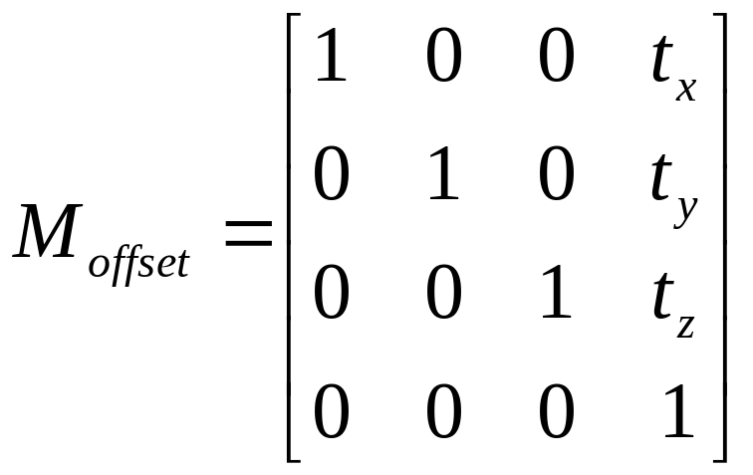
Offset Vectors for Joints
It is convenient to have a 3D offset vector r for every joint which represents its pivot point relative to its parent’s matrix
  r = <t_{x}, t_{y}, t_{z}>

Slide 11
Rotation
Usually implemented as a Quaternions
  Matricies can’t be interpolated easily, Quaternions can…
Ultimately it’s a matrix. We sometimes also have Euler angles. Sometime we have all three.

Slide 12
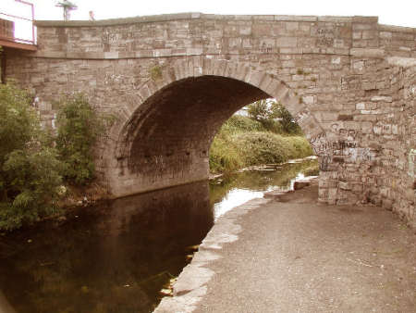
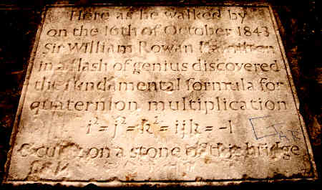
Quaternions
Quaterions are one of the most powerful ways to represent rotation
They will seem almost magical in what they do

Slide 13
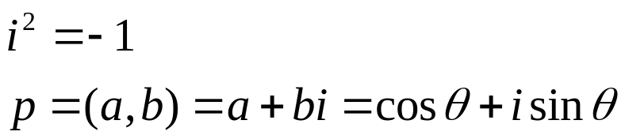
The basic idea
Imaginary
(a,b)
Complex numbers can represent 2D rotation
θ
Real
This is a completely made up mathematical concept, but it turns out to be very useful. It can represent angles with no trig functions.

Slide 14
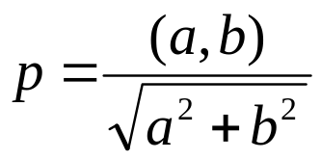
Complex Number advantages
Imaginary
(a,b)
A normalized complex number uniquely represents a rotation
Multiplying two complex numbers together add the rotation angles.
θ
Real
So, make θ into a complex number c_{θ} and ω into a complex number c_{ω}
c_{θ}c_{ω} = c_{θ+w}
Normalizing a complex number. Just like normalizing a vector.

Slide 15
Can we extend this to 3D?
Why do we care? Complex numbers represent rotation in a form that can be easily multiplied together with simple multiplication and division operations. We’d love to be able to do that in 3D with something smaller than a matrix. You can compose a rotation and orientation with a single multiplication.
Well, we have real and imaginary. Could we have even more imaginary?
Yes, we can!
William Rowan Hamilton invented quaternions in 1843 which provide a tool for rotation that easily composes and interpolates. We’ll use them a lot.

Slide 16
Quaternion Plaque on Broom Bridge in Dublin, Ireland
Here as he walked by on the 16th of October 1843 Sir William Rowan Hamilton in a flash of genius discovered the fundamental formula for quaternion multiplication
i²=j²=k²=ijk= -1
& cut it on a stone of this bridge

Slide 17
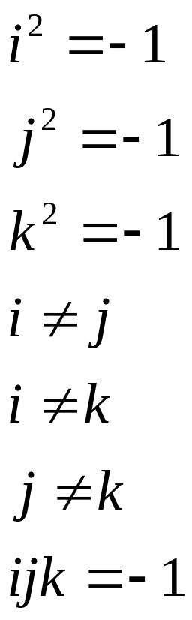
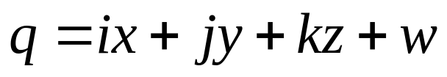

The main idea
A unit quaternion:
Think of them as 4 element vectors. To make a unit quaternion, you simply divide by the length of the vector. This is Normalizing just as in 2D and 3D vectors.

Slide 18
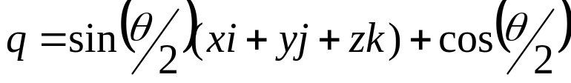
How much do we really need to know?
A quaternion represents a rotation.
q₁ * q₂ represent rotation q₂ followed by rotation q₁.
q and –q are the same rotation.
A multiplication rule exists (you can look it up)
Let (x, y, z) be a normalized vector and θ an angle
Is a rotation around (x,y,z) by θ radians
Quaterion inverse:

Slide 19
Creating a Quaternion
You’re given a Vector v and an angle to rotate around that vector of θ. The quaternion to do that will be:
public static Quaternion CreateFromAxisAngle(Vector3 axis, float angle)
{
Quaternion quaternion;
float num2 = angle * 0.5f;
float num = (float) Math.Sin((double) num2);
float num3 = (float) Math.Cos((double) num2);
quaternion.X = axis.X * num;
quaternion.Y = axis.Y * num;
quaternion.Z = axis.Z * num;
quaternion.W = num3;
return quaternion;
}

Slide 20

Composing Quaternions
Quaternion q = Quaternion.CreateFromAxisAngle(new Vector3(0, 0, 1), rx) *
Quaternion.CreateFromAxisAngle(new Vector3(0, 1, 0), ry) *
Quaternion.CreateFromAxisAngle(new Vector3(1, 0, 0), rx);
Important: Operations read right to left, not left to right!

Slide 21
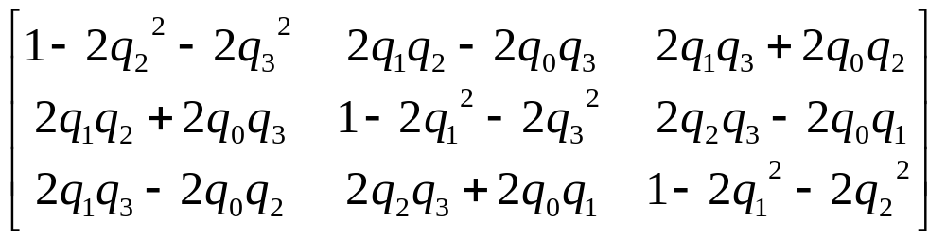
Quaternion to Rotation Matrix
Other way is messy

Slide 22
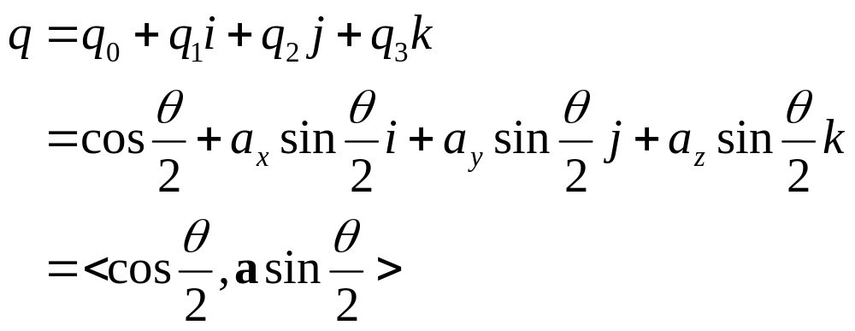
Negation Characteristics
q and –q correspond to the same orientation
  Why?

Slide 23
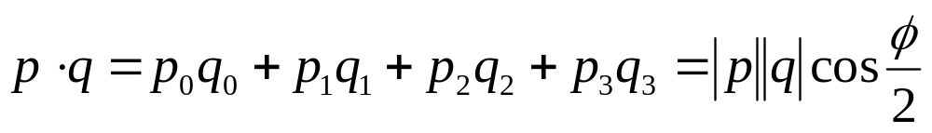
Dot Product Characteristic
Dot product is cos of ½ angle between orientations

Slide 24
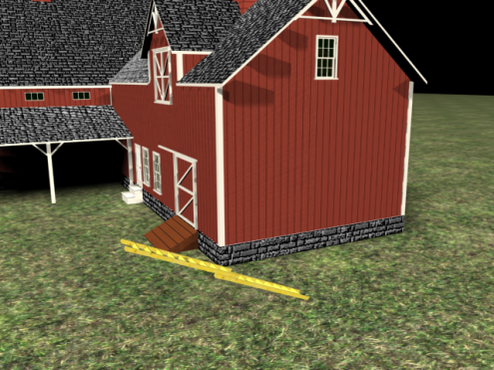
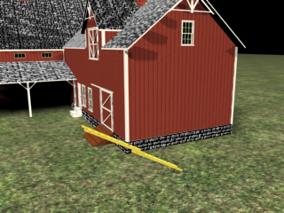
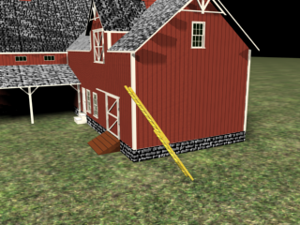
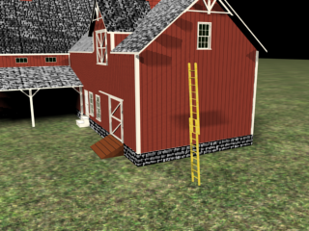
Quaterion Interpolation
One of the main reasons quaternions are so popular is that they are easy to interpolate. They are very commonly used for orientation keyframes and skeletal animation.

Slide 25
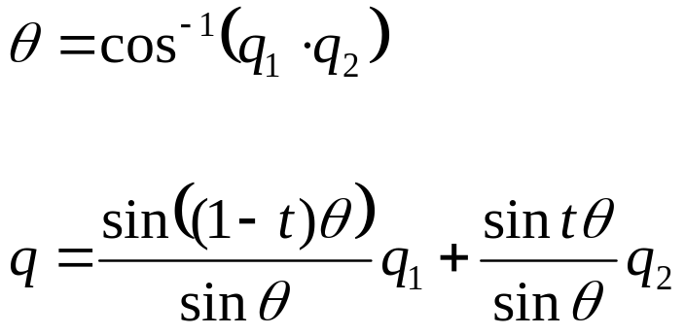
Slerp for Quaternions
Slerp is “spherical linear interpolation”
Dot product is the cosine of ½ the angle between orientations (important difference)
θ above is ½ of the angle
If cosine is < 0, the angle is greater than 180 degrees…

Slide 26
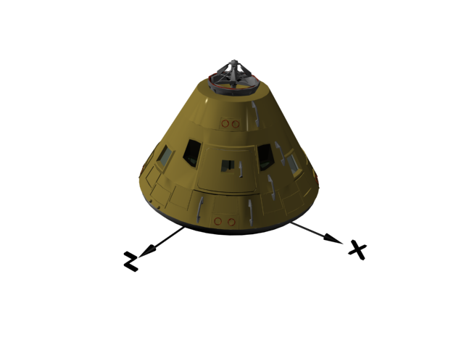
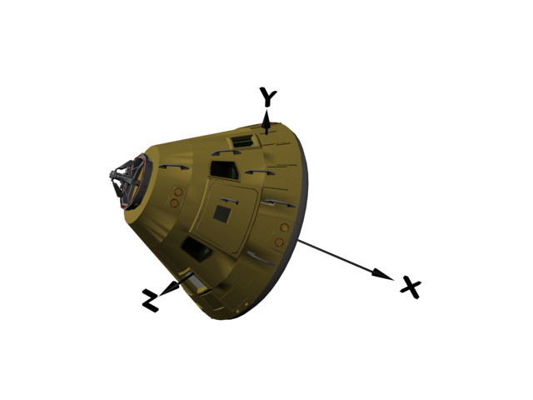
Perfect Rotations
Slerp with two quaternions will rotate from one orientation to another using a uniform angular velocity and a fixed rotation axis.

Slide 27
Going the long way around…
There’s always two possible rotations: the short way and the long way. If the cos(θ) < 0, where q is the angle between the quaternions (not the angle between the orientations), we are going the long way around. If that happens, then instead of doing Slerp(q₁, q₂, t), so Slerp(q₁, -q₂, t). Negating one quaternion will force the other path.

Slide 28
Quaternion Advantages/Disadvantages
Advantages
  Compact notation
  Composes with simple multiplication
    Very efficient and fast
  Interpolates perfectly with slerp!
  Perfect for keyframe animation
Disadvantages
  Not unique: q and –q are the same rotation and there are other redundancies.
  4 values to represent 3 things – some redundancy.

Slide 29
DOF Limits
DOF is often range limited
  Elbow could be limited from 0º to 150º

Slide 30
Skeleton Rigging
Skeleton Rigging – Setting up the skeleton for a figure
  Bones
  Joints
  DOF’s
  Limits

Slide 31
Poses
Adjust DOFs to specify the pose of the skeleton
We can define a pose Φ more formally as a vector of N numbers that maps to a set of DOFs in the skeleton
Φ = [φ₁ φ₂ … φ_{N}]

Slide 32
Joint Types
Rotational
  Hinge: 1-DOF
  Universal: 2-DOF
    Around two axis
  Ball & Socket: 3-DOF
    Euler Angles
    Quaternions
Translational
  Prismatic: 1-DOF
  Translational: 3-DOF (or any number)
Compound
  Free
  Screw
  Constraint
  Etc.
Non-Rigid
  Scale
  Shear
  Etc.
Design your own...

Slide 33
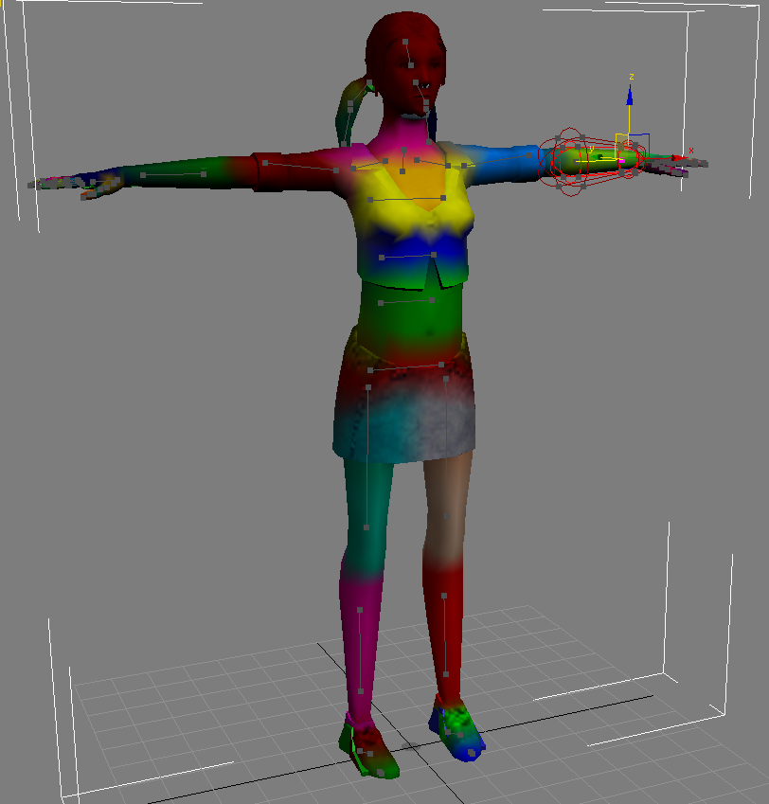
Smooth Skin Algorithm

Slide 34

Rigid Parts
Robots and mechanical creatures
  Rigid parts, no smooth skin
  Each part is transformed by its joint matrix
Every vertex of the character’s geometry is transformed by exactly one matrix
where v is defined in joint’s local space

Slide 35
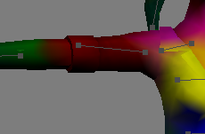
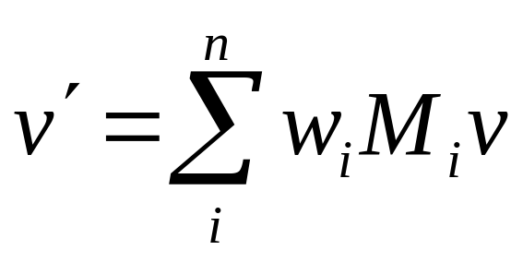
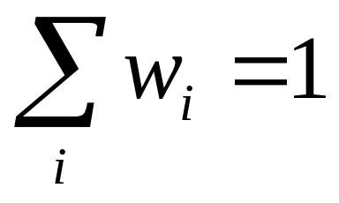



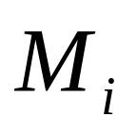
Mathematics of mesh skinning
with
Where:
is the number of matrices.
is the vertex position.
is the weight associated.
is the transformation matrix.

Slide 36
Smooth Skin
A vertex can be attached to more than one joint/bone with adjustable weights that control how much each joint affects it
  Rarely more than 4
Result is a blending of the n transformations
Algorithm names
  blended skin, skeletal subspace deformation (SSD), multi-matrix skin, matrix palette skinning…

Slide 37
Bone offset method/Vertex offset method
What space should be vertices be in?
  If in world coordinates (usually the starting place), M for each bone must be deformation from original structure
  Vertex offset method
What if vertices defined relative to bones
  (which bone?) generally this is not used.
  M is now joint manipulation relative to parent
  Bone offset method

Slide 38
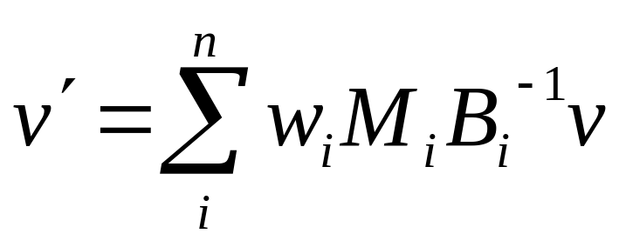
Mesh skinning with binding matrices
B_{i} is the local to world transform for bone i before we move it (the base pose)
M_{i} is the local to world transform for bone i moved
w_{i} is the bone weight for the vertex
v is the vertex before we move it
v’ is the vertex after we deform
The same operations are done on the vertex normal, but it has to be renormalized when we are done.

Slide 39
Normals
Normals must also be transformed
Options
  Recompute normals
  Do only the rotation of existing normals
Normals are also blended. But, we MUST renormalize!

Slide 40
Easy Muscles & Other Effects
Use additional joints for muscle bulges
The bicep could be a translational or scaling joint that smoothly controls some of the vertices in the upper arm.
Fun with:
  muscles, fat bulges, facial expressions, simple clothing

Slide 41
Limitations of Smooth Skin
Smooth skin is very simple and quite fast, but its quality is limited
  Joints tend to collapse as they bend more
  Very difficult to get specific control
  Unintuitive and difficult to edit
Still, it is common in games and commercial animation!
If nothing else, it is a good baseline upon which more complex schemes can be built

Slide 42
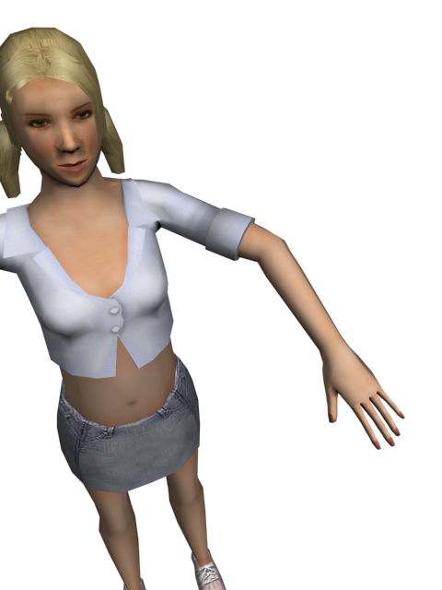
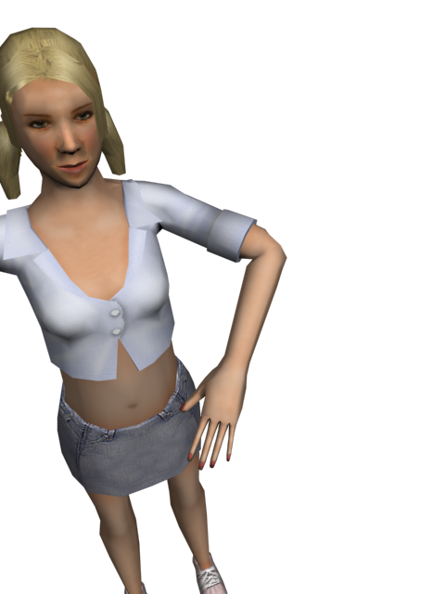

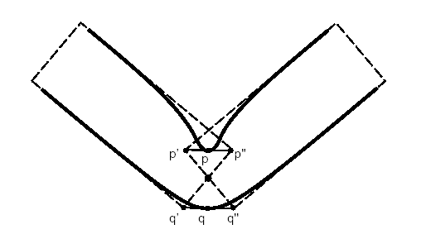
Limitations of Smooth Skin

Slide 43
Bone Links
Bone links are extra joints inserted in the skeleton to assist with the skinning
  Instead of one joint, an elbow may be 2-3 joints
  Allows each joint to limit the bend angle!
  Why does this help?

Slide 44
Shape Interpolation
An option is to model vertex positions at points in the motion
  Interpolate between the positions
  More up-front design, but better appearance
Model an elbow straight and fully bent
Use DOF to determine vertex position, then do the skinning.

Slide 45
Skin Binding
Skin binding consists of assigning the vertex weights
Binding algorithms typically involve heuristic approaches
Any ideas?

Slide 46
Smooth Skin Algorithm

Slide 47
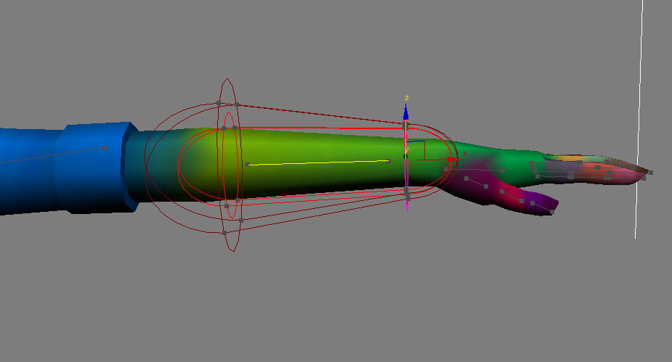
Containment Binding
Volume primitives around the bones
  Boxes, cylinders, etc.
  Vertex weights assigned based on which primitives it is in

Slide 48
Point-to-Line Mapping
Which bone is a vertex nearest?
How do we decide to attach to more than one bone/joint?

Slide 49
Delaunay Tetrahedralization
A tetrahedralization of the volume within the skin
The tetrahedra connect all of the skin verts and joint pivot points in a ‘Delaunay’ fashion
Basically segments the vertices
  How can we get weights?

Slide 50
Skin Adjustment
Mesh Smoothing: Joints attached rigidly, then weights adjusted for smoothness.
Weight Painting: Indicate weights as colors.
Direct Manipulation: Bend the joint, then drag vertices where they should be. From this, automatically calculate the weight (least squares estimate).

Slide 51
Free-Form Deformation

Slide 52
Global Deformations
A global deformation takes a point in 3D space and outputs a deformed point
v’=F(v)
A global deformation is essentially a deformation of space
Smooth skinning is a form of global deformation

Slide 53
Free-Form Deformations
Free-form deformations are a class of deformations where a low detail control mesh is used to deform a higher detail skin

Slide 54
Lattice FFDs
The original type of FFD uses a simple regular lattice placed around a region of space
The lattice is divided up into a regular grid (4x4x4 points for a cubic deformation)
When the lattice points are then moved, they describe smooth deformation in their vicinity
  We are describing moving control points of a curve!

Slide 55
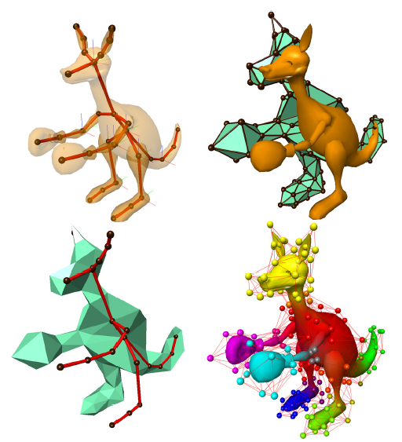
Arbitrary Topology FFDs
The concept of FFDs was later extended to allow an arbitrary topology control volume to be used

Slide 56
Axial Deformations & WIRES
Another type of deformation allows the user to place lines or curves within a skin
  When the lines or curves are moved, they distort the space around them
  Multiple lines & curves can be placed near each other and interact
This is like skeletons with curved features
  Closer to what muscles really do.

Slide 57
Surface Oriented FFDs
This modern method allows a low detail polygonal mesh to be built near the high detail skin
  Movement of the low detail mesh deforms space nearby
How is this different from arbitrary topology FFDs?

Slide 58
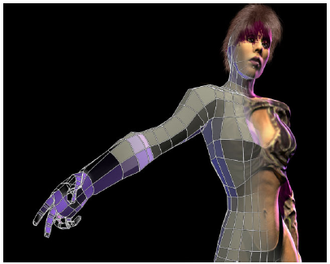
Surface Oriented FFDs

Slide 59
The general idea
Controlling a small number of low detail vertices is easier than a massive number of skin vertices

Slide 60
Body Scanning
Data input for models, deformations
Hardware examples:
  Geometry: Laser scanners
  Motion: Optical motion capture
  Materials: Gonioreflectometer
  Faces: Computer vision

Slide 61
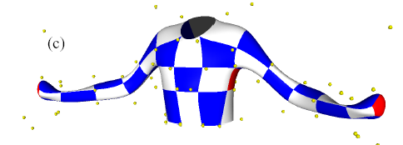
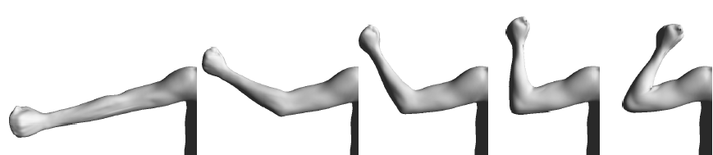
Body Scanning

Slide 62
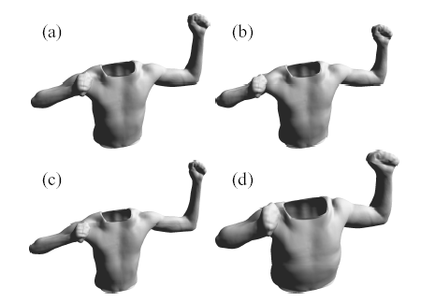
Body Scanning

Slide 63
Anatomical Modeling

Slide 64
Anatomical Modeling
A true anatomical simulation, the tissue beneath the skin must be accounted for
One can model the bones, muscle, and skin tissue as deformable bodies and then then use physical simulation to compute their motion
Various approaches exist ranging from simple approximations using basic primitives to detailed anatomical simulations

Slide 65
Skin & Muscle Simulation
Bones are essentially rigid
Muscles occupy almost all of the space between bone & skin
Although they can change shape, muscles have essentially constant volume
The rest of the space between the bone & skin is filled with fat & connective tissues
Skin is connected to fatty tissue and can usually slide freely over muscle
Skin is anisotropic as wrinkles tend to have specific orientations

Slide 66
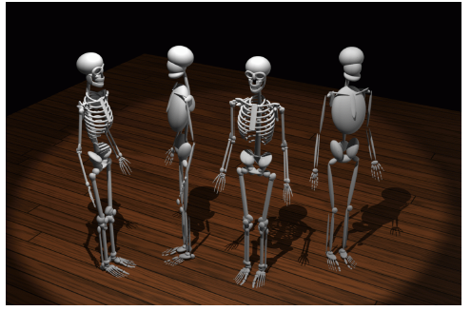
Simple Anatomical Models
Some simplified anatomical models use ellipsoids to model bones and muscles

Slide 67
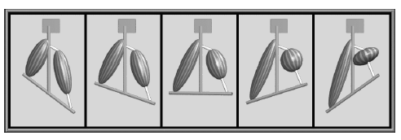
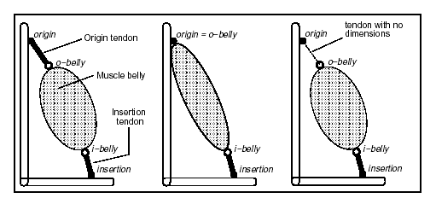
Simple Anatomical Models
Muscles are attached to bones, sometimes with tendons as well
The muscles contract in a volume preserving way, thus getting wider as they get shorter

Slide 68
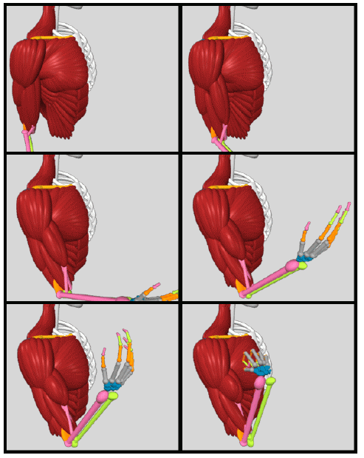
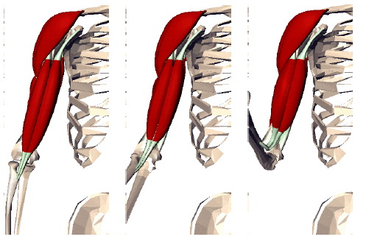
Simple Anatomical Models
Complex musculature can be built up from lots of simple primitives

Slide 69
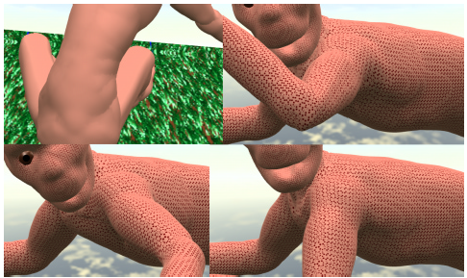
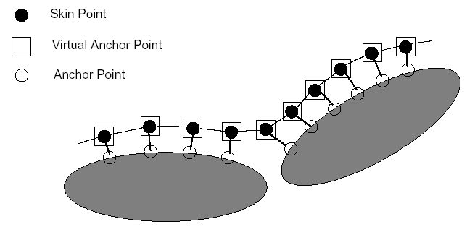
Simple Anatomical Models
Skin can be attached to the muscles with springs/dampers and physically simulated with collisions against bone & muscle

Slide 70
Detailed Anatomical Models
One can also do detailed simulations that accurately model bone & muscle geometry, as well as physical properties
This is becoming an increasing popular approach, but requires extensive set up
Check out cgcharacter.com

Slide 71
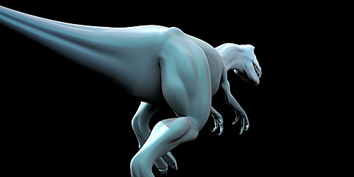
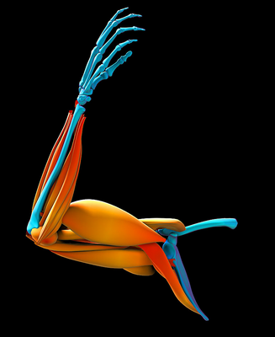
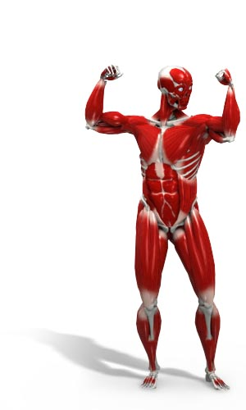
Detailed Anatomical Models

