Slide 1
Always Encrypted John Deardurff

Slide 2




John Deardurff – Premier Field Engineer
MCSA, MCSD, MCSE, MCDBA, MCITP, MCT
MBA: IT Management
MCT Regional Lead – United States
MVP: Data Platform (2016 – 2018)
John.Deardurff@Microsoft.com
www.SQLMCT.com

Slide 3
What is Encryption?
Reversible obfuscation of data
Reversal depends on a key
Plaintext is encrypted using an encryption algorithm to generate ciphertext
Only part of an overall security plan

Slide 4
Always Encrypted
Introduced in SQL Server 2016
All Editions (Service Pack1)
Allows encrypting specific columns
Client-side encryption/decryption
Based on certificate stored on client machines

Slide 5
Always Encrypted
Deterministic vs Randomized
Column limitations based on constraints and data types
Uses different certificates than backups or TDE
Blocking operation while being encrypted

Slide 6
Typical Scenarios
Client and Data on-premises
Customer has client application and SQL Server, both running on-premises at business location
Client on-premises with data in Azure
Automatic encryption and decryption of sensitive data
Client and Data in Azure
Customer has client application hosted in Azure, which operates on sensitive data also stored in Azure
Notes:
Objective: This slide gives you an overview of typical scenarios of Always Encrypted, and what can be used in it.
Typical Scenarios: https://docs.microsoft.com/en-us/sql/relational-databases/security/encryption/always-encrypted-database-engine?view=sql-server-ver15#typical-scenarios
Talking points:
Always Encrypted is a feature designed to protect sensitive data, such as credit card numbers or national identification numbers (for example, U.S. Social Security numbers), stored in Azure SQL Database or SQL Server databases.
Here are some scenarios:
Client and data on-premises
The customer wants to hire an external vendor to administer SQL Server. In order to protect sensitive data stored in SQL Server, the customer uses Always Encrypted to ensure the separation of duties between database administrators and application administrators. The customer stores plaintext values of Always Encrypted keys in a trusted key store that the client application can access. SQL Server administrators have no access to the keys and, therefore, are unable to decrypt sensitive data stored in SQL Server.
Client on-premises with data in Azure
The application operates on sensitive data stored in a database hosted in Azure (SQL Database or SQL Server running in a virtual machine on Microsoft Azure). The customer uses Always Encrypted and stores Always Encrypted keys in a trusted key store hosted on-premises, to ensure Microsoft cloud administrators have no access to sensitive data.
Client and data in Azure
The customer uses Always Encrypted to reduce security-attack surface area (the data is always encrypted in the database and on the machine hosting the database).

Slide 7
Benefits
Allows customers to securely store sensitive data outside of their trust boundary while protecting data from highly privileged users.
Prevention of data disclosure
Client-side encryption of sensitive data using keys that are never given to database system.
Queries on encrypted data
Support for equality comparison, including join, group by, and distinct operators
Application transparency
Minimal application changes through server and client library enhancements
Notes:
Objective: This slide depicts the need for Always Encrypted and the purpose of the feature in SQL Server 2016.
Talking points:
Always Encrypted is a feature designed to protect sensitive data, such as credit card numbers or national identification numbers (for example, U.S. Social Security numbers) stored in Microsoft Azure SQL Database or SQL Server databases.
Always Encrypted allows clients to encrypt sensitive data inside client applications and never reveal the encryption keys to the database engine (SQL Database or SQL Server). As a result, Always Encrypted provides a separation between those who own the data (and can view it) and those who manage the data (but should have no access). In addition, you can query encrypted data and perform various query operations like equality comparison, including join, group by, and distinct operators.
Always Encrypted allows clients to encrypt sensitive data inside client applications and never reveal the encryption keys to the SQL Server. An Always Encrypted-enabled driver installed on the client computer achieves this by automatically encrypting and decrypting sensitive data in the SQL Server client application. The driver encrypts the data in sensitive columns before passing the data to SQL Server, and automatically rewrites queries to preserve the semantics to the application.
Similarly, the driver transparently decrypts data stored in encrypted database columns that are contained in query results. This technology helps to ensure that your data is constantly encrypted and, no application changes are required.

Slide 8
Capabilities and Functions
Migration of sensitive data in application
SQL Server only handles encrypted data—not plain text values
Automatic encryption and decryption of sensitive data
Automatically rewrites queries to preserve semantics to application
Driver transparently decrypts data
Bulk loading of encrypted data
Use ALLOW_ENCRYPTED_VALUE_MODIFICATIONS option for bulk loading
Notes:
Objective: This slide presents the capabilities and functions of Always Encrypted.
Talking points:
Migrate sensitive data in application
Always Encrypted allows a user to:
Securely move encrypted data from one set of tables containing encrypted columns to another set of tables with encrypted columns (in the same or a different database).
Load encrypted data without performing metadata checks on the server during bulk copy operations, create the user with the ALLOW_ENCRYPTED_VALUE_MODIFICATIONS option. This option is intended to be used by legacy tools from versions of SQL Server older than SQL Server 2016 Community Technology Preview 3 (CTP 3.0) or by using third-party Extract-Transform-Load (ETL) workflows that can’t use Always Encrypted.
Automatic encryption and decryption of sensitive data
Always Encrypted makes encryption transparent to applications. An Always Encrypted-enabled driver installed on the client computer achieves this by automatically encrypting and decrypting sensitive data in the client application. The driver encrypts data in sensitive columns before passing it to the database engine, and automatically rewrites queries to preserve the semantics to the application. Similarly, the driver transparently decrypts data, which is stored in encrypted database columns and contained in query results.
Bulk loading of encrypted data
You can set the process to load encrypted data.
Set the option to ON for the user in the database that is the target for the bulk copy operation.
ALTER USER Bob WITH ALLOW_ENCRYPTED_VALUE_MODIFICATIONS = ON;
2. Run your bulk copy application or tool connecting as that user. (If your application uses an Always Encrypted-enabled client driver, make sure the connection string for the data source does not contain column encryption setting=enabled to ensure the data retrieved from encrypted columns remains encrypted.)
3. Set the ALLOW_ENCRYPTED_VALUE_MODIFICATIONS option back to OFF.
ALTER USER Bob WITH ALLOW_ENCRYPTED_VALUE_MODIFICATIONS = OFF;
https://msdn.microsoft.com/en-us/library/mt621539.aspx
Note:
Always Encrypted is disabled for both the source and the target database connections. This ensures the client driver does not attempt to encrypt or decrypt any values, and instead it reads encrypted (varbinary) values from the source table and writes them to the target table.
AllowEncryptedValueModifications is used for the target connection, to suppress cryptographic metadata checks and ensure inserting values, which are already encrypted, can succeed.
https://blogs.msdn.microsoft.com/sqlsecurity/2016/01/07/best-practices-for-moving-data-encrypted-with-always-encrypted/

Slide 9
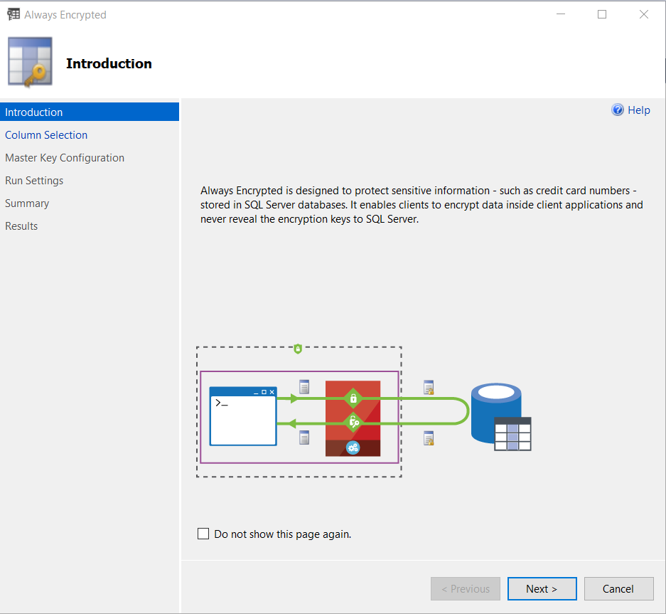
What is Always Encrypted?
Capability
The ADO.NET client library provides transparent client-side encryption
Microsoft SQL Server executes T-SQL queries on encrypted data
Benefits
Sensitive data remains encrypted and can always be queried , on-premises and in the cloud
Unauthorized users never have access to data or keys
No application changes
Notes:
Objective: This slide summarizes Always Encrypted and its benefits.
Always Encrypted: https://docs.microsoft.com/en-us/sql/relational-databases/security/encryption/always-encrypted-database-engine?view=sql-server-ver15
Talking points:
Always Encrypted makes encryption transparent to applications. An Always Encrypted-enabled driver installed on the client’s computer achieves this by automatically encrypting and decrypting sensitive data in the client application. The architecture for Always Encrypted has the application performing the column-level encryption prior to the confidential data being sent to Microsoft SQL Server.
The actual encryption is done by the ADO.NET drivers on an application or client machine. When a .NET application sends plain text data to ADO.NET, it is encrypted prior to sending it to SQL Server. The only change the application needs to make to store encrypted data is to change the connection string to indicate column encryption is enabled.
When column encryption is enabled, ADO.NET will encrypt Always Encrypted columns prior to sending the data to SQL Server and will decrypt Always Encrypted columns when they are read from SQL Server. The diagram on the slide shows this architecture.
Benefits
When it comes to mission-critical security, we have a unique encryption technology that protects data at rest and in motion, allowing data to be fully queried while encrypted. The new ADO.NET library provides transparent, client-side encryption, while SQL Server executes T-SQL queries on encrypted data.
The master keys stay with the application and not with the SQL Server. This can work on-premises or from SQL Server in Microsoft Azure Virtual Machines. So think about the hybrid scenarios in which you want to take advantage of Azure cloud computing, keeping in mind that some databases cannot take advantage of cloud scale due to data security requirements.
Always Encrypted allows organizations to encrypt data at rest and in use for storage in Azure, in order to enable delegation of on-premises database administration to third parties or reduce security clearance requirements for their own DBA staff. As a result, Always Encrypted provides a separation between those who own the data (and can view it) and those who manage the data (but should have no access).

Slide 10
How does Always Encrypted work?
Encrypted sensitive data and corresponding keys are never seen in plain text in SQL Server
SELECT Name FROM Customers WHERE SSN = "111-22-3333"
ADO.NET
SELECT Name FROM Customers WHERE SSN = 0x7ff654ae6d
Ciphertext
Result set
Result set
Name
0x19ca706fbd9a
Name
Wayne Jefferson
Name | SSN | Country/Region
0x19ca706fbd9a | 0x7ff654ae6d | USA
Ciphertext
Notes:
Objective: This slide shows how Always Encrypted works.
How it Works: https://docs.microsoft.com/en-us/sql/relational-databases/security/encryption/always-encrypted-database-engine?view=sql-server-ver15
Talking points
Here is how the feature works:
Users specify the individual columns of particular tables to be encrypted.
After it is encrypted, data appears as an encrypted binary blob at all stages within the SQL Server database—on disk, in memory, during computations, and over the network.
Users employ a certificate store to save the encryption key.
Both encryption and decryption are done by the ADO.NET SqlClient driver for .Net 4.6. This driver will require access to the encryption key (from the certificate store, generally) and thereafter will communicate with the SQL Server directly to effect transparent encryption.
Specifically, when queries are parameterized, SqlClient will handshake with the SQL Server and identify which parameters are encrypted and will manage this process in both directions.
For example, the client code specifies a select statement with the parameter “where SSN = @SSN” and provides the parameter value “@SSN=’123-45-6789′” and the driver itself intercepts the parameter value and properly encrypts it.
Animation <<first click>> “SELECT Name FROM Customers WHERE SSN = @SNN”, “111-22-3333” with arrow
Animation <<second click>> “SELECT Name FROM Customers WHERE SSN = @SNN” encrypted with arrow
Animation <<third click>> Result Set encrypted with arrow
Animation <<fourth click>> Result Set with arrow

Slide 11
Column Keys
CMK – Column Master Key is used to encrypt other keys, always in client’s control, and in an external key store
Azure Key Vault
Windows Certificate Store
Hardware Security Sections
CEK – Column Encryption Key is a content encryption key
Notes:
Objective: This slide highlights the key provisioning steps in Always Encrypted.
Overview of key management for Always Encrypted: https://docs.microsoft.com/en-us/sql/relational-databases/security/encryption/overview-of-key-management-for-always-encrypted?view=sql-server-ver15
Talking points:
Several core concepts are used in Always Encrypted:
Column master key (CMK): Encryption key that protects the column encryption key(s). You must have at least one master key before encrypting any columns.
Column encryption key (CEK): Encryption key that actually protects encrypted columns.
CMK store provider: Client-side software component that encapsulates a key store containing the column master key. Providers for common types of key stores are available in client-side driver libraries from Microsoft or as standalone downloads. You can also implement your own provider. .NET Framework 4.6 must be installed in the machine hosting your client application. .NET Framework 4.6 is available with SQL Server 2016 Community Technology Preview 3 (CTP 3.0) and is installed with SQL Server Management Studio.
Information the driver receives from SQL Server for query parameters that need to be encrypted, and for query results that need to be decrypted, includes:
An encrypted value of a CEK, used to encrypt or decrypt a parameter or result.
The name of a key store provider that encapsulates a key store containing the column master key that was used to encrypt the CEK.
A key path that specifies the location of the CMK in the key store.
The name of the algorithm that was used to encrypt the CMK.
Here are the steps for key provisioning:
Create a local, self-signed certificate on the development machine, which will act as a CMK. Animation <<first click>>
The CMK will be used to protect CEKs, which encrypts the sensitive data. Animation <<second click>>
Create a CMK store definition object in the database, which will store the information about the location of the CMK. Please notice that the certificate will never be copied to the database or SQL Server machine. Animation <<third click>>
Finally, upload the encrypted CEK to the required database. Animation <<fourth click>>

Slide 12
Key provisioning
Column
master key
(CMK)
Generate CEKs and master key
Encrypt CEK
Store master key securely
Upload encrypted CEK to DB
Notes:
Objective: This slide highlights the key provisioning steps in Always Encrypted.
Overview of key management for Always Encrypted: https://docs.microsoft.com/en-us/sql/relational-databases/security/encryption/overview-of-key-management-for-always-encrypted?view=sql-server-ver15
Talking points:
Several core concepts are used in Always Encrypted:
Column master key (CMK): Encryption key that protects the column encryption key(s). You must have at least one master key before encrypting any columns.
Column encryption key (CEK): Encryption key that actually protects encrypted columns.
CMK store provider: Client-side software component that encapsulates a key store containing the column master key. Providers for common types of key stores are available in client-side driver libraries from Microsoft or as standalone downloads. You can also implement your own provider. .NET Framework 4.6 must be installed in the machine hosting your client application. .NET Framework 4.6 is available with SQL Server 2016 Community Technology Preview 3 (CTP 3.0) and is installed with SQL Server Management Studio.
Information the driver receives from SQL Server for query parameters that need to be encrypted, and for query results that need to be decrypted, includes:
An encrypted value of a CEK, used to encrypt or decrypt a parameter or result.
The name of a key store provider that encapsulates a key store containing the column master key that was used to encrypt the CEK.
A key path that specifies the location of the CMK in the key store.
The name of the algorithm that was used to encrypt the CMK.
Here are the steps for key provisioning:
Create a local, self-signed certificate on the development machine, which will act as a CMK. Animation <<first click>>
The CMK will be used to protect CEKs, which encrypts the sensitive data. Animation <<second click>>
Create a CMK store definition object in the database, which will store the information about the location of the CMK. Please notice that the certificate will never be copied to the database or SQL Server machine. Animation <<third click>>
Finally, upload the encrypted CEK to the required database. Animation <<fourth click>>

Slide 13
Encryption Types
Randomized
Unpredictable results, more secure
No support for equality searches, joins, grouping, or indexing
Use for data that is returned, but not queried
Deterministic
Predictable results, less secure
Use for data that must be queried (equality support only)
Easier to guess by examining encryption results
Increased risk for small value sets (True/False)
Notes:
Objective: This slide gives you an overview of the types of encryption for Always Encrypted and the difference between randomized and deterministic encryption.
Talking points:
Always Encrypted supports two types of encryption: randomized encryption and deterministic encryption.
Randomized encryption uses a method that encrypts data in a less predictable manner. Randomized encryption is more secure, but prevents equality searches, grouping, indexing, and joining on encrypted columns.
Deterministic encryption uses a method that always generates the same encrypted value for any given plain text value. Using deterministic encryption allows grouping, filtering by equality, and joining tables based on encrypted values, but can also allow unauthorized users to guess information about encrypted values by examining patterns in the encrypted column. This weakness is increased when there is a small set of possible encrypted values, such as true/false, or north/south/east/west region. Deterministic encryption must use a column collation with a binary2 sort order for character columns.
Use deterministic encryption for columns that will be used as search or grouping parameters, for example, a government ID number. Use randomized encryption for data such as confidential investigation comments—which are not grouped with other records or used to join tables—from the row that contains the encrypted column of interest.
Selecting Deterministic or Randomized Encryption: https://docs.microsoft.com/en-us/sql/relational-databases/security/encryption/always-encrypted-database-engine?view=sql-server-ver15#selecting--deterministic-or-randomized-encryption

Slide 14
Encryption Methodologies
Randomized encryption
Encrypt (‘123-45-6789’) = 0x0123A99C
Repeat: Encrypt (‘123-45-6789’) = 0x01EB449B
Deterministic encryption
Encrypt (‘123-45-6789’) = 0x17cfd50a
Repeat: Encrypt (‘123-45-6789’) = 0x17cfd50a
Notes:
Objective: This slide gives you an overview of the types of encryption for Always Encrypted and the difference between randomized and deterministic encryption.
Talking points:
Always Encrypted supports two types of encryption: randomized encryption and deterministic encryption.
Randomized encryption uses a method that encrypts data in a less predictable manner. Randomized encryption is more secure, but prevents equality searches, grouping, indexing, and joining on encrypted columns.
Deterministic encryption uses a method that always generates the same encrypted value for any given plain text value. Using deterministic encryption allows grouping, filtering by equality, and joining tables based on encrypted values, but can also allow unauthorized users to guess information about encrypted values by examining patterns in the encrypted column. This weakness is increased when there is a small set of possible encrypted values, such as true/false, or north/south/east/west region. Deterministic encryption must use a column collation with a binary2 sort order for character columns.
Use deterministic encryption for columns that will be used as search or grouping parameters, for example, a government ID number. Use randomized encryption for data such as confidential investigation comments—which are not grouped with other records or used to join tables—from the row that contains the encrypted column of interest.
Selecting Deterministic or Randomized Encryption: https://docs.microsoft.com/en-us/sql/relational-databases/security/encryption/always-encrypted-database-engine?view=sql-server-ver15#selecting--deterministic-or-randomized-encryption

Slide 15
Data Encryption Algorithm
Always Encrypted uses the AEAD_AES_256_CBC_HMAC_SHA_256 algorithm to encrypt data in the database
Ciphertext length varies depends on the data type
Notes:
Always Encrypted cryptography: https://docs.microsoft.com/en-us/sql/relational-databases/security/encryption/always-encrypted-cryptography?view=sql-server-ver15
Always Encrypted uses the AEAD_AES_256_CBC_HMAC_SHA_256 algorithm to encrypt data in the database.
AEAD_AES_256_CBC_HMAC_SHA_256 is derived from the specification draft at https://tools.ietf.org/html/draft-mcgrew-aead-aes-cbc-hmac-sha2-05. It uses an Authenticated Encryption scheme with Associated Data, following an Encrypt-then-MAC approach. That is, the plaintext is first encrypted, and the MAC is produced based on the resulting ciphertext.
In order to conceal patterns, AEAD_AES_256_CBC_HMAC_SHA_256 uses the Cipher Block Chaining (CBC) mode of operation, where an initial value is fed into the system named the initialization vector (IV). The full description of the CBC mode can be found at https://csrc.nist.gov/publications/nistpubs/800-38a/sp800-38a.pdf.

Slide 16
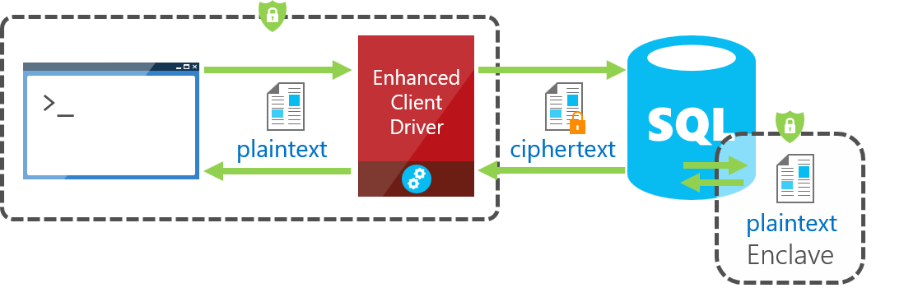
Always Encrypted with Secure Enclaves
Notes:
Always Encrypted with secure enclaves:
https://docs.microsoft.com/en-us/sql/relational-databases/security/encryption/always-encrypted-enclaves?view=sql-server-ver15
Always Encrypted with secure enclaves addresses these limitations by allowing computations on plaintext data inside a secure enclave on the server side. A secure enclave is a protected region of memory within the SQL Server process, and acts as a trusted execution environment for processing sensitive data inside the SQL Server engine. A secure enclave appears as a black box to the rest of the SQL Server and other processes on the hosting machine. There is no way to view any data or code inside the enclave from the outside, even with a debugger.
When parsing an application's query, the SQL Server Engine determines if the query contains any operations on encrypted data that require the use of the secure enclave. For queries where the secure enclave needs to be accessed:
The client driver sends the column encryption keys required for the operations to the secure enclave (over a secure channel).
Then, the client driver submits the query for execution along with the encrypted query parameters.
During query processing, the data or the column encryption keys are not exposed in plaintext in the SQL Server Engine outside of the secure enclave. The SQL Server Engine delegates cryptographic operations and computations on encrypted columns to the secure enclave. If needed, the secure enclave decrypts the query parameters and/or the data stored in encrypted columns and performs the requested operations.
In SQL Server 2019 (15.x), Always Encrypted with secure enclaves uses Virtualization-based Security (VBS) secure memory enclaves (also known as Virtual Secure Mode, or VSM enclaves) in Windows.

Slide 17
Always Encrypted
Demonstration

Slide 18
Always Encrypted Catalog Views
--Always Encypted catalog views
SELECT * FROM sys.column_master_keys
SELECT * FROM sys.column_encryption_keys
SELECT * FROM sys.column_encryption_key_values
Notes:
sys.column_master_keys (Transact-SQL):
https://docs.microsoft.com/en-us/sql/relational-databases/system-catalog-views/sys-column-master-keys-transact-sql?view=sql-server-ver15
sys.column_encryption_keys (Transact-SQL):
https://docs.microsoft.com/en-us/sql/relational-databases/system-catalog-views/sys-column-encryption-keys-transact-sql?view=sql-server-ver15
sys.column_encryption_key_values (Transact-SQL):
https://docs.microsoft.com/en-us/sql/relational-databases/system-catalog-views/sys-column-encryption-key-values-transact-sql?view=sql-server-ver15

Slide 19
Find Always Encrypted Columns
--Find columns protected by Always Encrypted
SELECT c.name as E_Column, c.column_encryption_key_id,
cek.name as E_Key, encryption_type_desc,
encryption_algorithm_name
FROM sys.columns as c
JOIN sys.column_encryption_keys as cek
ON c.column_encryption_key_id =
cek.column_encryption_key_id
WHERE c.column_encryption_key_id IS NOT NULL
Notes:
sys.column_master_keys (Transact-SQL):
https://docs.microsoft.com/en-us/sql/relational-databases/system-catalog-views/sys-column-master-keys-transact-sql?view=sql-server-ver15
sys.column_encryption_keys (Transact-SQL):
https://docs.microsoft.com/en-us/sql/relational-databases/system-catalog-views/sys-column-encryption-keys-transact-sql?view=sql-server-ver15
sys.column_encryption_key_values (Transact-SQL):
https://docs.microsoft.com/en-us/sql/relational-databases/system-catalog-views/sys-column-encryption-key-values-transact-sql?view=sql-server-ver15

Slide 20
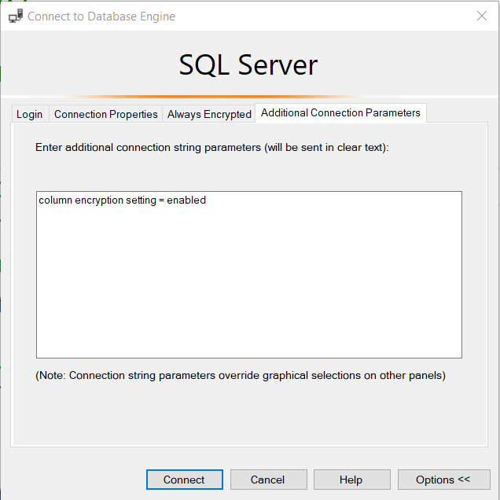
Column Encryption Setting = Enabled
Notes:
Query columns using Always Encrypted with SQL Server Management Studio:
https://docs.microsoft.com/en-us/sql/relational-databases/security/encryption/always-encrypted-query-columns-ssms?view=sql-server-ver15

Slide 21
For the developers
Column Encryption Setting = Enabled (.NET 4.6.1)
String connString = "Data Source=srv16; Integrated Security=true; Column Encryption Setting=enabled";
using (SqlConnection connection = new SqlConnection(connectionString))
{ //... }
Driver Level Parameters
using (SqlCommand cmd = new SqlCommand("SELECT Name FROM Customers WHERE PersonalId = @PersonalId", connection))
{
SqlParameter PersonalId = new SqlParameter("@PersonalId", System.Data.SqlDbType.VarChar, 11);
PersonalId.Value = "111-22-3333";
cmd.Parameters.Add(PersonalId);
cmd.ExecuteReader(); }
Notes:
Using Always Encrypted with the .NET Framework Data Provider for SQL Server:
https://docs.microsoft.com/en-us/sql/relational-databases/security/encryption/develop-using-always-encrypted-with-net-framework-data-provider?view=sql-server-ver15
Always Encrypted allows client applications to encrypt sensitive data and never reveal the data or the encryption keys to SQL Server or Azure SQL Database. An Always Encrypted enabled driver, such as the .NET Framework Data Provider for SQL Server, achieves this by transparently encrypting and decrypting sensitive data in the client application. The driver automatically determines which query parameters correspond to sensitive database columns (protected using Always Encrypted), and encrypts the values of those parameters before passing the data to SQL Server or Azure SQL Database.

Slide 22
Data Migration Scenarios
Recommended settings appropriate for several migration scenarios
Scenario | Source schema | Target schema
Encrypt data on migration | Plaintext | Encrypted
Decrypt data on migration | Encrypted | Plaintext
Re-encrypt data on migration | Encrypted | Encrypted
Copy data without decrypting | Encrypted | Encrypted
Source settings |  | Target settings
Column encryption setting | Allow encrypted values modifications | Column encryption setting | Allow encrypted values modifications
Any (Disabled is recommended) | N/A (OFF is recommended) | Enabled | OFF
Enabled | N/A (OFF is recommended) | N/A (Disabled is recommended) | N/A (OFF is recommended)
Enabled | N/A (OFF is recommended) | Enabled | OFF
Disabled | N/A (OFF is recommended) | Disabled | ON
Notes:
Objective: This slide helps you understand various data migration scenarios and recommended settings.
Bulk load encrypted data to columns using Always Encrypted:
https://docs.microsoft.com/en-us/sql/relational-databases/security/encryption/migrate-sensitive-data-protected-by-always-encrypted?redirectedfrom=MSDN&view=sql-server-ver15
The table shows the recommended settings appropriate for several migration scenarios.
To load encrypted data without performing metadata checks on the server during bulk copy operations, create the user with the ALLOW_ENCRYPTED_VALUE_MODIFICATIONS option.
Both CREATE USER and ALTER USER have an ALLOW_ENCRYPTED_VALUE_MODIFICATIONS option. When set to ON (the default is OFF), this option suppresses cryptographic metadata checks on the server in bulk copy operations, which enables the user to bulk copy encrypted data between tables or databases, without decrypting the data.

Slide 23
ALLOW_ENCRYPTED_VALUE_MODIFICATIONS
Use designated user accounts with this option for long-running workloads
Short-running bulk copy operations that move data without decrypting it, set option to ON and back to OFF after completion
Do not use this option for new applications, use client drivers that offers API for suppressing cryptographic metadata checks
Notes:
Objective: This slide highlights best practices for Always Encrypted.
Data Migration Scenarios:
https://docs.microsoft.com/en-us/sql/relational-databases/security/encryption/migrate-sensitive-data-protected-by-always-encrypted?redirectedfrom=MSDN&view=sql-server-ver15#data-migration-scenarios
Talking points:
Use designated user accounts for long-running workloads employing this option.
For short-running bulk copy applications or tools that need to move encrypted data without decrypting it, set the option to ON immediately before running the application and set it back to OFF immediately after running the operation.
Do not use this option for developing new applications. Instead, use a client driver (such as ADO 4.6.1) that offers an API for suppressing cryptographic metadata checks for a single session.

Slide 24
Feature Details
Ability to perform equality comparison on columns encrypted using deterministic encryption
Cannot query columns encrypted using randomized encryption
Indexing columns encrypted using randomized encryption is not supported
Column encryption key can have up to two different encrypted values
Query parameters that map to encrypted columns must be passed as driver-level parameters
Deterministic encryption requires a column to have one of binary2 collations
Notes:
Objective: This slide explains the details of the types and purpose of encryption in Always Encrypted.
Talking points:
Queries can perform equality comparison on columns encrypted by using deterministic encryption, but no other operations (for example, greater/less than, pattern matching using the LIKE operator, or arithmetical operations). Using deterministic encryption allows grouping, filtering by equality, and joining tables based on encrypted values, but can also allow unauthorized users to guess information about encrypted values by examining patterns in the encrypted column.
Randomized encryption is more secure, but prevents equality searches, grouping, indexing, and joining on encrypted columns. Queries on columns encrypted by using randomized encryption can’t perform operations on any of those columns. Indexing columns encrypted using randomized encryption is not supported.
A column encryption key can have up to two different encrypted values, each encrypted with a different column master key value. This permits column master key rotation.
Deterministic encryption requires a column to have one of the binary2 collations.
Source: https://docs.microsoft.com/en-us/sql/relational-databases/security/encryption/always-encrypted-database-engine?redirectedfrom=MSDN&view=sql-server-ver15

Slide 25
Limitations
Not supported when columns use any of these datatypes
xml, hierarchyid, rowversion, image, text, ntext, geography, geometry, user-defined types, or sql_variant
Clauses that cannot be used for encrypted columns
FOR XML
FOR JSON PATH
Features that do not work on encrypted columns
Transactional or merge replication
Distributed queries (linked servers)
Notes:
Objective: This slide includes some general limitations of Always Encrypted.
Talking points:
If a column is encrypted, then all range-related operations such as greater/less than, pattern matching using LIKE, etc. are disallowed. Furthermore, you can’t pass encrypted values to functions, user-defined or otherwise, because the database doesn’t have access to the unencrypted values.
Unsupported data types include xml, rowversion, image, ntext, text, sql_variant, hierarchyid, geography, geometry, and user defined-types. Always Encrypted is not supported for the columns with the characteristics such as FILESTREAM columns, columns with ROWGUIDCOL property, or string (varchar, char, etc.) columns with non-bin2 collations.
The following clauses cannot be used for encrypted columns:
FOR XML
FOR JSON PATH
The following features do not work on encrypted columns:
Transactional or merge replication
Distributed queries (linked servers)

Slide 26
Considerations
Data corruption
Improper use of the option ALLOW_ENCRYPTED_VALUE_MODIFICATIONS
Accidentally copy data that is not correctly encrypted using the encryption scheme
Tool limitations
Always Encrypted is not supported in SQL Server Data Tools (SSDT)
The only operations supported for databases using Always Encrypted in sqlpackage.exe are Export and Import
Notes:
Objective: This slide shows the potential roadblocks in the Always Encrypted option.
Talking points:
Data corruption
Improper use of the ALLOW_ENCRYPTED_VALUE_MODIFICATIONS option allows the user to insert any data into encrypted columns in the database, including data that is encrypted with different keys, incorrectly encrypted, or not encrypted at all.
If you accidently copy data that is not correctly encrypted using the encryption scheme (column encryption key, algorithm, encryption type) set up for the target column, you will not be able to decrypt the data (the data will be corrupted). This option must be used carefully, as it can lead to corrupting data in the database.
Here the scenario demonstrates how improperly importing data could lead to data corruption:
The option is set to ON for a user. The user runs the application that connects to the database. The application uses bulk APIs to insert plaintext values to encrypted columns. The application expects an Always Encrypted-enabled client driver to encrypt the data on insert. However, the application is misconfigured, so it either ends up using a driver that does not support Always Encrypted or the connection string does not contain column encryption setting=enabled.
The application sends plaintext values to the server. As cryptographic metadata checks are disabled in the server for the user, the server lets the incorrect data (plaintext instead of correctly encrypted ciphertext) be inserted into an encrypted column.
The same or another application connects to the database by using an Always Encrypted-enabled driver with column encryption setting=enabled in the connection string and retrieves the data. The application expects the data to be transparently decrypted. However, the driver fails to decrypt the data because the data is incorrect ciphertext.
Best Practices for Moving Data Encrypted with Always Encrypted:
https://docs.microsoft.com/en-us/archive/blogs/sqlsecurity/best-practices-for-moving-data-encrypted-with-always-encrypted
Tool limitations also include:
Always Encrypted is not supported in SQL Server Data Tools (SSDT).
The only operations supported for databases using Always Encrypted in sqlpackage.exe are Export and Import. Extract, Publish, DeployReport, DiffReport, and Script are not supported. Similarly, only the Import Data-tier Application and Export Data-tier Application operations are supported in Management Studio. Other bacpac/dacpac operations on databases/schemas using Always Encrypted are not supported.

Slide 27
Permissions
ALTER ANY COLUMN MASTER KEY
Required to create and delete a column master key
ALTER ANY COLUMN ENCRYPTION KEY
Required to create and delete a column encryption key
VIEW ANY COLUMN MASTER KEY DEFINITION
Required to access and read column master key metadata objects while managing keys or querying encrypting columns
VIEW ANY COLUMN ENCRYTPION KEY DEFINITION
Required to access and read column encryption key metadata objects while managing keys or querying encrypting columns
Notes:
Database Permissions: https://docs.microsoft.com/en-us/sql/relational-databases/security/encryption/always-encrypted-database-engine?view=sql-server-ver15#database-permissions
The permissions apply to actions using Transact-SQL, Management Studio (dialog boxes and wizard), or Windows PowerShell.
The two view permissions are required when selecting encrypted columns, even if the user does not have permission to decrypt the columns.
In SQL Server, both view permissions are granted by default to the public fixed database role. A database administrator may choose to revoke (or deny) the view permissions to the public role and grant them to specific roles or users to implement more restricted control.
In SQL Database, the view permissions are not granted by default to the public fixed database role. This enables certain existing, legacy tools (using older versions of DaxFx) to work properly. Consequently, to work with encrypted columns (even if not decrypting them) a database administrator must explicitly grant the two view permissions.

Slide 28
Permissions Scenario
Scenario | ALTER ANY COLUMN MASTER KEY | ALTER ANY COLUMN ENCRYPTION KEY | VIEW ANY COLUMN MASTER KEY DEFINITION | VIEW ANY COLUMN ENCRYPTION KEY DEFINITION
Key management | X | X | X | X
Querying encrypted columns |  |  | X | X
Notes:
Database Permissions: https://docs.microsoft.com/en-us/sql/relational-databases/security/encryption/always-encrypted-database-engine?view=sql-server-ver15#database-permissions
The permissions apply to actions using Transact-SQL, Management Studio (dialog boxes and wizard), or Windows PowerShell.
The two view permissions are required when selecting encrypted columns, even if the user does not have permission to decrypt the columns.
In SQL Server, both view permissions are granted by default to the public fixed database role. A database administrator may choose to revoke (or deny) the view permissions to the public role and grant them to specific roles or users to implement more restricted control.
In SQL Database, the view permissions are not granted by default to the public fixed database role. This enables certain existing, legacy tools (using older versions of DaxFx) to work properly. Consequently, to work with encrypted columns (even if not decrypting them) a database administrator must explicitly grant the two view permissions.

Slide 29
Always Encrypted Best Practices
In Azure, complete isolation of data from cloud administrators is only provided when client tier is running on-premises
If the client tier is running in the cloud, moving the encryption/decryption routine to the client tier still leaves data and keys exposed to cloud administrators
Test application workload to ensure that restrictions and limitation do not affect your application
Carefully evaluate randomized vs deterministic encryption
Notes:
Objective: This slide highlights best practices for Always Encrypted.
Always Encrypted: https://docs.microsoft.com/en-us/sql/relational-databases/security/encryption/always-encrypted-database-engine?view=sql-server-ver15
Talking points:
If a database containing sensitive data is hosted in Azure, complete isolation of data from cloud administrators is only provided when the database client tier is running on-premises.
If the client tier is running in the cloud, moving the encryption/decryption routine to the client tier still leaves data and keys exposed to cloud administrators (of the platform hosting the client tier).
Test application workload to ensure that restrictions and limitation do not affect your application
Carefully evaluate randomized vs deterministic encryption

Slide 30
Always Encrypted
Questions?

Slide 31
Notes:
Note: This should be the final slide for each presentation.

