Slide 1
Security Essentials Handout John Deardurff

Slide 2




John Deardurff – Premier Field Engineer
MCSA, MCSD, MCSE, MCDBA, MCITP, MCT
MBA: IT Management
MCT Regional Lead – United States
MVP: Data Platform (2016 – 2018)
John.Deardurff@Microsoft.com
www.SQLMCT.com

Slide 3

The Three AU’s of Security
AUTHENTICATION – Verifies who you are
AUTHORIZATION – Assigns what you can do
AUDITING – Monitors what you did
Notes:
A defense-in-depth strategy, with overlapping layers of security, is the best way to counter security threats. SQL Server provides a security architecture that is designed to allow database administrators and developers to create secure database applications and counter threats. Each version of SQL Server has improved on previous versions of SQL Server with the introduction of new features and functionality. However, security does not ship in the box. Each application is unique in its security requirements. Developers need to understand which combination of features and functionality are most appropriate to counter known threats, and to anticipate threats that may arise in the future.

Slide 4






Principals vs Securables
Tables
Permissions
Views
Sales Role
Sales Schema
Database Users
Stored Procedures
Principals
Securables
Notes:
A defense-in-depth strategy, with overlapping layers of security, is the best way to counter security threats. SQL Server provides a security architecture that is designed to allow database administrators and developers to create secure database applications and counter threats. Each version of SQL Server has improved on previous versions of SQL Server with the introduction of new features and functionality. However, security does not ship in the box. Each application is unique in its security requirements. Developers need to understand which combination of features and functionality are most appropriate to counter known threats, and to anticipate threats that may arise in the future.

Slide 5






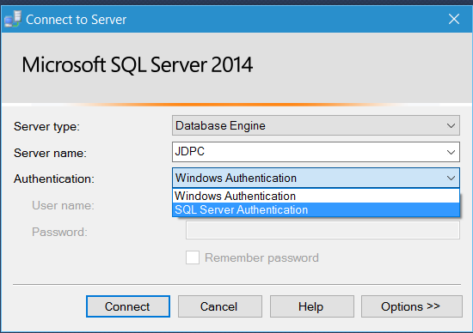





Security Principals
Authenticated by Windows
SQL Server Instance
User name
&
Password
Windows User
Windows Group
Windows Login
SQL Server Login
Authenticated by SQL Server
Server Role
Database
Database User
Database Role
Application Role
Notes:
A defense-in-depth strategy, with overlapping layers of security, is the best way to counter security threats. SQL Server provides a security architecture that is designed to allow database administrators and developers to create secure database applications and counter threats. Each version of SQL Server has improved on previous versions of SQL Server with the introduction of new features and functionality. However, security does not ship in the box. Each application is unique in its security requirements. Developers need to understand which combination of features and functionality are most appropriate to counter known threats, and to anticipate threats that may arise in the future.

Slide 6

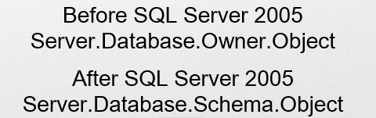

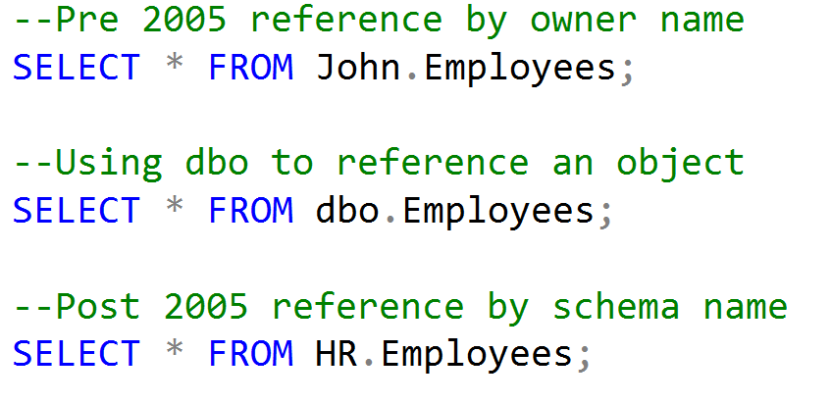


Securables and the Four-Part Name
SQL Server Instance
Server-level objects
Database
Database-level objects
Schema
Schema
Objects
Objects
Notes:
A defense-in-depth strategy, with overlapping layers of security, is the best way to counter security threats. SQL Server provides a security architecture that is designed to allow database administrators and developers to create secure database applications and counter threats. Each version of SQL Server has improved on previous versions of SQL Server with the introduction of new features and functionality. However, security does not ship in the box. Each application is unique in its security requirements. Developers need to understand which combination of features and functionality are most appropriate to counter known threats, and to anticipate threats that may arise in the future.

Slide 7
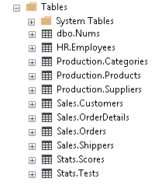
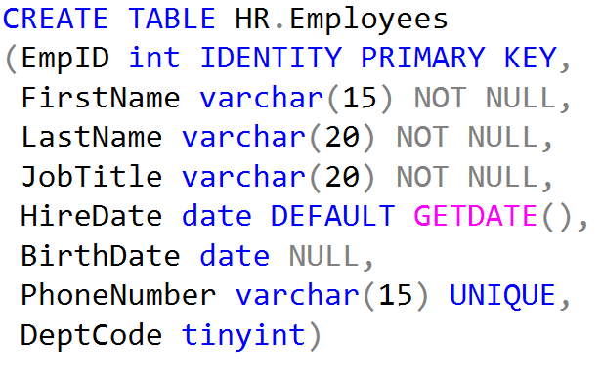
What is a Schema?
Definition of an Object
Organization of Objects
(For Management and Security)
Notes:
A defense-in-depth strategy, with overlapping layers of security, is the best way to counter security threats. SQL Server provides a security architecture that is designed to allow database administrators and developers to create secure database applications and counter threats. Each version of SQL Server has improved on previous versions of SQL Server with the introduction of new features and functionality. However, security does not ship in the box. Each application is unique in its security requirements. Developers need to understand which combination of features and functionality are most appropriate to counter known threats, and to anticipate threats that may arise in the future.

Slide 8
Questions?

