Slide 1
Overview of Always Encrypted
John Deardurff

Slide 2

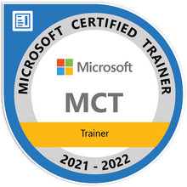

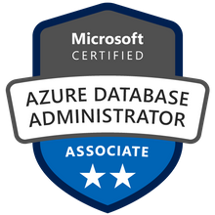



John Deardurff
Microsoft Customer Engineer (Global Technical Team)
Microsoft Certified Trainer (Regional Lead)
MVP: Data Platform (2016 – 2018)
Email: John.Deardurff@Microsoft.com
Twitter: @SQLMCT
Website: www.SQLMCT.com
GitHub: github.com\SQLMCT
Notes:
While all this has been running, several other parts of SQLOS have been active:
Monitoring: DMVs, Extended Events (xEvents), and so on.
Deadlock Monitor thread: Monitors for and deals with deadlocks.
Lazy Writer threads: Clock sweeping the buffer pool to maintain the free lists and responsible for writing dirty pages to disk between checkpoints.
Scheduler Monitor thread: Monitors scheduler health and detects issues such as non-yielding scenarios.
Resource Monitor thread: Monitors available memory from operating system and internal to SQL Server and notifies the Clerks.
The Hosting APIs for external components interface with Microsoft Data Access Components (MDAC) and common language runtime (CLR).
The Storage Engine manages all data access, both through transaction-based commands (with the Transaction Manager) and bulk operations such as backup, bulk insert, and certain Database Console Command (DBCC) commands.
Access Methods is an important component of the Storage Engine, and contains components to open a table, retrieve qualified data, and update data.
The Access Methods code does not actually retrieve the pages, it will make a request to the Buffer Manager, which holds a copy of the requested data pages in memory (and if the requested page is not in memory, it will retrieve it from disk). By memory, we mean specifically the Buffer Pool, which is part of the SQLOS.
The Transaction Manager ensures that transactions adhere to the ACID properties: atomicity, consistency, isolation, and durability.
It also outlines the boundaries of statements that must be grouped together to form an operation, and it allows “nested” transactions by managing savepoints, if any. Furthermore, it also coordinates with the Lock Manager regarding when locks can be released, based on the isolation level in effect. It also coordinates with Access Methods to determine when old versions of rows are no longer needed and can be removed from the version store.
The File Manager handles actual physical access to data and log files, as well as access to backup devices.
Also included in the storage engine are components for controlling utilities such as Bulk Load, DBCC commands, and Backup/Restore operations.
The SQLOS layer handles activities that are normally considered to be operating system-like responsibilities, such as Thread Scheduling, Synchronization services (latching and deadlock detection), Memory management (including the Buffer Pool), Lock management, I/O management (which establish the completion routines for read/write operations from memory to disk and vice-versa) , and Monitoring (such as DMVs and xEvents).
Locking is a crucial function of a multi-user Remote Desktop Management Services (RDMS) such as SQL Server, even if you are operating an optimistic concurrency model such as snapshot isolation level, to help ensure the isolation and consistency properties of ACID. This is handled by the Lock Manager, whose main job is to provide hierarchical access to data in a concurrent fashion (as allowed by the Isolation Level of the transaction), by managing compatibility between the lock types. It also resolves deadlocks (with the aid of the Deadlock Monitor thread), and escalates locks if needed. Other components such as the other threads in the figure will be explained in an upcoming lesson in this module.

Slide 3

Encryption

Slide 4
What is Encryption?
Reversible obfuscation of data
Reversal depends on a key
Plaintext is encrypted using an encryption algorithm to generate ciphertext
Only part of an overall security plan

Slide 5
What are certificates?
Digitally signed documents containing a public/private key pair
Certificates can be used to authenticate and/or encrypt messages between two parties.
Contain information that can either verify the sender of a message or encryption and decryption algorithm
Notes:
SQL Server Certificates and Asymmetric Keys: https://docs.microsoft.com/en-us/sql/relational-databases/security/sql-server-certificates-and-asymmetric-keys?view=sql-server-ver15
Certificates
A certificate is a digitally signed document that consists of a public/private key pair. You make the public part of the key available to anyone with whom you want to securely communicate, but you must keep the private part of the key secure and accessible only by you. You can use digital certificates to authenticate and/or encrypt messages between two parties. These certificates contain information that can either verify the sender of a message or encrypt and decrypt algorithms.
Authentication
Messages signed with your private key identify you as the sender of the message. A third party can use your public key to ensure that the message was signed by the person or organization named in the certificate and not someone impersonating you.
Encryption
You can also use certificates to encrypt and decrypt information. If a message is encrypted by using a public key, it can only be decrypted by using the corresponding private key. Similarly, if data is encrypted by using the private key, it can only be decrypted by using the public key.
This mechanism helps ensure that only services to which you make your public key available can decrypt the messages that you send. For example, if you send information over a public network such as the Internet, that information can be decrypted only by organizations that have a copy of your public key. If they then want to send you secure information, they can encrypt the information by using your public key, and only you can decrypt it by using your private key.

Slide 6
Always Encrypted
Introduced in SQL Server 2016
Client-side encryption/decryption
Based on certificate stored on client machines
Allows encrypting specific columns

Slide 7
Benefits
Allows customers to securely store sensitive data outside of their trust boundary while protecting data from highly privileged users.
Prevention of data disclosure
Client-side encryption of sensitive data using keys that are never given to database system.
Queries on encrypted data
Support for equality comparison, including join, group by, and distinct operators
Application transparency
Minimal application changes through server and client library enhancements
Notes:
Objective: This slide depicts the need for Always Encrypted and the purpose of the feature in SQL Server 2016.
Talking points:
Always Encrypted is a feature designed to protect sensitive data, such as credit card numbers or national identification numbers (for example, U.S. Social Security numbers) stored in Microsoft Azure SQL Database or SQL Server databases.
Always Encrypted allows clients to encrypt sensitive data inside client applications and never reveal the encryption keys to the database engine (SQL Database or SQL Server). As a result, Always Encrypted provides a separation between those who own the data (and can view it) and those who manage the data (but should have no access). In addition, you can query encrypted data and perform various query operations like equality comparison, including join, group by, and distinct operators.
Always Encrypted allows clients to encrypt sensitive data inside client applications and never reveal the encryption keys to the SQL Server. An Always Encrypted-enabled driver installed on the client computer achieves this by automatically encrypting and decrypting sensitive data in the SQL Server client application. The driver encrypts the data in sensitive columns before passing the data to SQL Server, and automatically rewrites queries to preserve the semantics to the application.
Similarly, the driver transparently decrypts data stored in encrypted database columns that are contained in query results. This technology helps to ensure that your data is constantly encrypted and, no application changes are required.

Slide 8
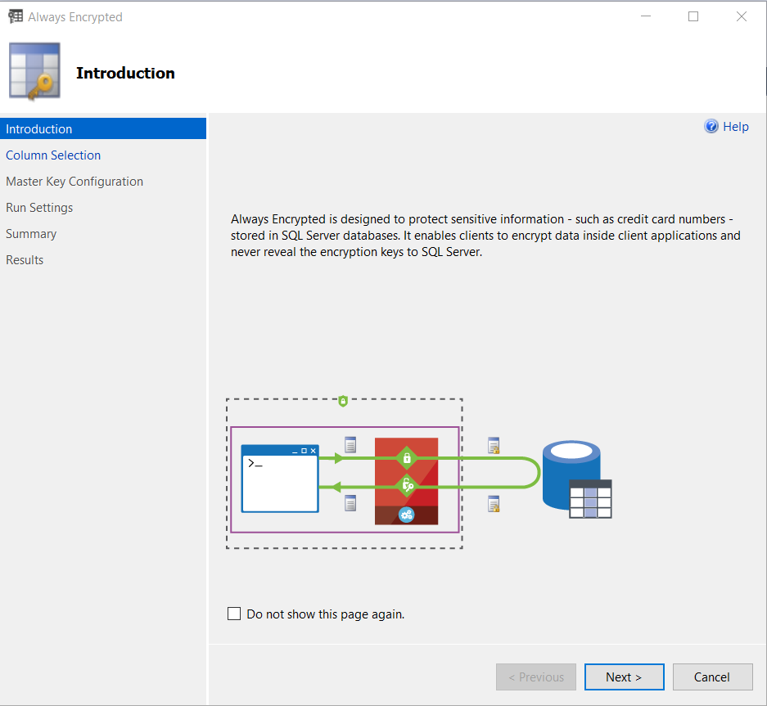
What is Always Encrypted?
Capability
The ADO.NET client library provides transparent client-side encryption
Microsoft SQL Server executes T-SQL queries on encrypted data
Benefits
Sensitive data remains encrypted and can be queried on-premises and in the cloud
Unauthorized users never have access to data or keys
No application changes
Notes:
Objective: This slide summarizes Always Encrypted and its benefits.
Always Encrypted: https://docs.microsoft.com/en-us/sql/relational-databases/security/encryption/always-encrypted-database-engine?view=sql-server-ver15
Talking points:
Always Encrypted makes encryption transparent to applications. An Always Encrypted-enabled driver installed on the client’s computer achieves this by automatically encrypting and decrypting sensitive data in the client application. The architecture for Always Encrypted has the application performing the column-level encryption prior to the confidential data being sent to Microsoft SQL Server.
The actual encryption is done by the ADO.NET drivers on an application or client machine. When a .NET application sends plain text data to ADO.NET, it is encrypted prior to sending it to SQL Server. The only change the application needs to make to store encrypted data is to change the connection string to indicate column encryption is enabled.
When column encryption is enabled, ADO.NET will encrypt Always Encrypted columns prior to sending the data to SQL Server and will decrypt Always Encrypted columns when they are read from SQL Server. The diagram on the slide shows this architecture.
Benefits
When it comes to mission-critical security, we have a unique encryption technology that protects data at rest and in motion, allowing data to be fully queried while encrypted. The new ADO.NET library provides transparent, client-side encryption, while SQL Server executes T-SQL queries on encrypted data.
The master keys stay with the application and not with the SQL Server. This can work on-premises or from SQL Server in Microsoft Azure Virtual Machines. So think about the hybrid scenarios in which you want to take advantage of Azure cloud computing, keeping in mind that some databases cannot take advantage of cloud scale due to data security requirements.
Always Encrypted allows organizations to encrypt data at rest and in use for storage in Azure, in order to enable delegation of on-premises database administration to third parties or reduce security clearance requirements for their own DBA staff. As a result, Always Encrypted provides a separation between those who own the data (and can view it) and those who manage the data (but should have no access).

Slide 9
How does Always Encrypted work?
Encrypted sensitive data and corresponding keys are never seen in plain text in SQL Server
SELECT Name FROM Customers WHERE SSN = "111-22-3333"
ADO.NET
SELECT Name FROM Customers WHERE SSN = 0x7ff654ae6d
Ciphertext
Result set
Result set
Name
0x19ca706fbd9a
Name
Wayne Jefferson
Name | SSN | Country/Region
0x19ca706fbd9a | 0x7ff654ae6d | USA
Ciphertext
Notes:
Objective: This slide shows how Always Encrypted works.
How it Works: https://docs.microsoft.com/en-us/sql/relational-databases/security/encryption/always-encrypted-database-engine?view=sql-server-ver15
Talking points
Here is how the feature works:
Users specify the individual columns of particular tables to be encrypted.
After it is encrypted, data appears as an encrypted binary blob at all stages within the SQL Server database—on disk, in memory, during computations, and over the network.
Users employ a certificate store to save the encryption key.
Both encryption and decryption are done by the ADO.NET SqlClient driver for .Net 4.6. This driver will require access to the encryption key (from the certificate store, generally) and thereafter will communicate with the SQL Server directly to effect transparent encryption.
Specifically, when queries are parameterized, SqlClient will handshake with the SQL Server and identify which parameters are encrypted and will manage this process in both directions.
For example, the client code specifies a select statement with the parameter “where SSN = @SSN” and provides the parameter value “@SSN=’123-45-6789′” and the driver itself intercepts the parameter value and properly encrypts it.
Animation <<first click>> “SELECT Name FROM Customers WHERE SSN = @SNN”, “111-22-3333” with arrow
Animation <<second click>> “SELECT Name FROM Customers WHERE SSN = @SNN” encrypted with arrow
Animation <<third click>> Result Set encrypted with arrow
Animation <<fourth click>> Result Set with arrow

Slide 10
Column Keys
CMK – Column Master Key is used to encrypt other keys, always in client’s control, and in an external key store
Azure Key Vault
Windows Certificate Store
Hardware Security Sections
CEK – Column Encryption Key is a content encryption key
Notes:
Objective: This slide highlights the key provisioning steps in Always Encrypted.
Overview of key management for Always Encrypted: https://docs.microsoft.com/en-us/sql/relational-databases/security/encryption/overview-of-key-management-for-always-encrypted?view=sql-server-ver15
Talking points:
Several core concepts are used in Always Encrypted:
Column master key (CMK): Encryption key that protects the column encryption key(s). You must have at least one master key before encrypting any columns.
Column encryption key (CEK): Encryption key that actually protects encrypted columns.
CMK store provider: Client-side software component that encapsulates a key store containing the column master key. Providers for common types of key stores are available in client-side driver libraries from Microsoft or as standalone downloads. You can also implement your own provider. .NET Framework 4.6 must be installed in the machine hosting your client application. .NET Framework 4.6 is available with SQL Server 2016 Community Technology Preview 3 (CTP 3.0) and is installed with SQL Server Management Studio.
Information the driver receives from SQL Server for query parameters that need to be encrypted, and for query results that need to be decrypted, includes:
An encrypted value of a CEK, used to encrypt or decrypt a parameter or result.
The name of a key store provider that encapsulates a key store containing the column master key that was used to encrypt the CEK.
A key path that specifies the location of the CMK in the key store.
The name of the algorithm that was used to encrypt the CMK.
Here are the steps for key provisioning:
Create a local, self-signed certificate on the development machine, which will act as a CMK. Animation <<first click>>
The CMK will be used to protect CEKs, which encrypts the sensitive data. Animation <<second click>>
Create a CMK store definition object in the database, which will store the information about the location of the CMK. Please notice that the certificate will never be copied to the database or SQL Server machine. Animation <<third click>>
Finally, upload the encrypted CEK to the required database. Animation <<fourth click>>

Slide 11
Key provisioning
Column
master key
(CMK)
Generate CEKs and master key
Encrypt CEK
Store master key securely
Upload encrypted CEK to DB
Notes:
Objective: This slide highlights the key provisioning steps in Always Encrypted.
Overview of key management for Always Encrypted: https://docs.microsoft.com/en-us/sql/relational-databases/security/encryption/overview-of-key-management-for-always-encrypted?view=sql-server-ver15
Talking points:
Several core concepts are used in Always Encrypted:
Column master key (CMK): Encryption key that protects the column encryption key(s). You must have at least one master key before encrypting any columns.
Column encryption key (CEK): Encryption key that actually protects encrypted columns.
CMK store provider: Client-side software component that encapsulates a key store containing the column master key. Providers for common types of key stores are available in client-side driver libraries from Microsoft or as standalone downloads. You can also implement your own provider. .NET Framework 4.6 must be installed in the machine hosting your client application. .NET Framework 4.6 is available with SQL Server 2016 Community Technology Preview 3 (CTP 3.0) and is installed with SQL Server Management Studio.
Information the driver receives from SQL Server for query parameters that need to be encrypted, and for query results that need to be decrypted, includes:
An encrypted value of a CEK, used to encrypt or decrypt a parameter or result.
The name of a key store provider that encapsulates a key store containing the column master key that was used to encrypt the CEK.
A key path that specifies the location of the CMK in the key store.
The name of the algorithm that was used to encrypt the CMK.
Here are the steps for key provisioning:
Create a local, self-signed certificate on the development machine, which will act as a CMK. Animation <<first click>>
The CMK will be used to protect CEKs, which encrypts the sensitive data. Animation <<second click>>
Create a CMK store definition object in the database, which will store the information about the location of the CMK. Please notice that the certificate will never be copied to the database or SQL Server machine. Animation <<third click>>
Finally, upload the encrypted CEK to the required database. Animation <<fourth click>>

Slide 12
Encryption Types
Randomized
Unpredictable results, more secure
No support for equality searches, joins, grouping, or indexing
Use for data that is returned, but not queried
Deterministic
Predictable results, less secure
Use for data that must be queried (equality support only)
Easier to guess by examining encryption results
Increased risk for small value sets (True/False)
Notes:
Objective: This slide gives you an overview of the types of encryption for Always Encrypted and the difference between randomized and deterministic encryption.
Talking points:
Always Encrypted supports two types of encryption: randomized encryption and deterministic encryption.
Randomized encryption uses a method that encrypts data in a less predictable manner. Randomized encryption is more secure, but prevents equality searches, grouping, indexing, and joining on encrypted columns.
Deterministic encryption uses a method that always generates the same encrypted value for any given plain text value. Using deterministic encryption allows grouping, filtering by equality, and joining tables based on encrypted values, but can also allow unauthorized users to guess information about encrypted values by examining patterns in the encrypted column. This weakness is increased when there is a small set of possible encrypted values, such as true/false, or north/south/east/west region. Deterministic encryption must use a column collation with a binary2 sort order for character columns.
Use deterministic encryption for columns that will be used as search or grouping parameters, for example, a government ID number. Use randomized encryption for data such as confidential investigation comments—which are not grouped with other records or used to join tables—from the row that contains the encrypted column of interest.
Selecting Deterministic or Randomized Encryption: https://docs.microsoft.com/en-us/sql/relational-databases/security/encryption/always-encrypted-database-engine?view=sql-server-ver15#selecting--deterministic-or-randomized-encryption

Slide 13
Encryption Methodologies
Randomized encryption
Encrypt (‘123-45-6789’) = 0x0123A99C
Repeat: Encrypt (‘123-45-6789’) = 0x01EB449B
Deterministic encryption
Encrypt (‘123-45-6789’) = 0x17cfd50a
Repeat: Encrypt (‘123-45-6789’) = 0x17cfd50a
Notes:
Objective: This slide gives you an overview of the types of encryption for Always Encrypted and the difference between randomized and deterministic encryption.
Talking points:
Always Encrypted supports two types of encryption: randomized encryption and deterministic encryption.
Randomized encryption uses a method that encrypts data in a less predictable manner. Randomized encryption is more secure, but prevents equality searches, grouping, indexing, and joining on encrypted columns.
Deterministic encryption uses a method that always generates the same encrypted value for any given plain text value. Using deterministic encryption allows grouping, filtering by equality, and joining tables based on encrypted values, but can also allow unauthorized users to guess information about encrypted values by examining patterns in the encrypted column. This weakness is increased when there is a small set of possible encrypted values, such as true/false, or north/south/east/west region. Deterministic encryption must use a column collation with a binary2 sort order for character columns.
Use deterministic encryption for columns that will be used as search or grouping parameters, for example, a government ID number. Use randomized encryption for data such as confidential investigation comments—which are not grouped with other records or used to join tables—from the row that contains the encrypted column of interest.
Selecting Deterministic or Randomized Encryption: https://docs.microsoft.com/en-us/sql/relational-databases/security/encryption/always-encrypted-database-engine?view=sql-server-ver15#selecting--deterministic-or-randomized-encryption

Slide 14
Data Encryption Algorithm
Always Encrypted uses the AEAD_AES_256_CBC_HMAC_SHA_256 algorithm to encrypt data in the database
Ciphertext length varies depends on the data type
Notes:
Always Encrypted cryptography: https://docs.microsoft.com/en-us/sql/relational-databases/security/encryption/always-encrypted-cryptography?view=sql-server-ver15
Always Encrypted uses the AEAD_AES_256_CBC_HMAC_SHA_256 algorithm to encrypt data in the database.
AEAD_AES_256_CBC_HMAC_SHA_256 is derived from the specification draft at https://tools.ietf.org/html/draft-mcgrew-aead-aes-cbc-hmac-sha2-05. It uses an Authenticated Encryption scheme with Associated Data, following an Encrypt-then-MAC approach. That is, the plaintext is first encrypted, and the MAC is produced based on the resulting ciphertext.
In order to conceal patterns, AEAD_AES_256_CBC_HMAC_SHA_256 uses the Cipher Block Chaining (CBC) mode of operation, where an initial value is fed into the system named the initialization vector (IV). The full description of the CBC mode can be found at https://csrc.nist.gov/publications/nistpubs/800-38a/sp800-38a.pdf.

Slide 15
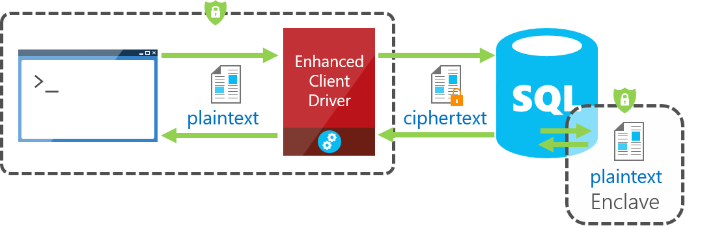
Always Encrypted with Secure Enclaves
Notes:
Always Encrypted with secure enclaves:
https://docs.microsoft.com/en-us/sql/relational-databases/security/encryption/always-encrypted-enclaves?view=sql-server-ver15
Always Encrypted with secure enclaves addresses these limitations by allowing computations on plaintext data inside a secure enclave on the server side. A secure enclave is a protected region of memory within the SQL Server process, and acts as a trusted execution environment for processing sensitive data inside the SQL Server engine. A secure enclave appears as a black box to the rest of the SQL Server and other processes on the hosting machine. There is no way to view any data or code inside the enclave from the outside, even with a debugger.
When parsing an application's query, the SQL Server Engine determines if the query contains any operations on encrypted data that require the use of the secure enclave. For queries where the secure enclave needs to be accessed:
The client driver sends the column encryption keys required for the operations to the secure enclave (over a secure channel).
Then, the client driver submits the query for execution along with the encrypted query parameters.
During query processing, the data or the column encryption keys are not exposed in plaintext in the SQL Server Engine outside of the secure enclave. The SQL Server Engine delegates cryptographic operations and computations on encrypted columns to the secure enclave. If needed, the secure enclave decrypts the query parameters and/or the data stored in encrypted columns and performs the requested operations.
In SQL Server 2019 (15.x), Always Encrypted with secure enclaves uses Virtualization-based Security (VBS) secure memory enclaves (also known as Virtual Secure Mode, or VSM enclaves) in Windows.

Slide 16
Always Encrypted Catalog Views
--Always Encypted catalog views
SELECT * FROM sys.column_master_keys
SELECT * FROM sys.column_encryption_keys
SELECT * FROM sys.column_encryption_key_values
Notes:
sys.column_master_keys (Transact-SQL):
https://docs.microsoft.com/en-us/sql/relational-databases/system-catalog-views/sys-column-master-keys-transact-sql?view=sql-server-ver15
sys.column_encryption_keys (Transact-SQL):
https://docs.microsoft.com/en-us/sql/relational-databases/system-catalog-views/sys-column-encryption-keys-transact-sql?view=sql-server-ver15
sys.column_encryption_key_values (Transact-SQL):
https://docs.microsoft.com/en-us/sql/relational-databases/system-catalog-views/sys-column-encryption-key-values-transact-sql?view=sql-server-ver15

Slide 17
Find Always Encrypted Columns
--Find columns protected by Always Encrypted
SELECT c.name as E_Column, c.column_encryption_key_id,
cek.name as E_Key, encryption_type_desc,
encryption_algorithm_name
FROM sys.columns as c
JOIN sys.column_encryption_keys as cek
ON c.column_encryption_key_id =
cek.column_encryption_key_id
WHERE c.column_encryption_key_id IS NOT NULL
Notes:
sys.column_master_keys (Transact-SQL):
https://docs.microsoft.com/en-us/sql/relational-databases/system-catalog-views/sys-column-master-keys-transact-sql?view=sql-server-ver15
sys.column_encryption_keys (Transact-SQL):
https://docs.microsoft.com/en-us/sql/relational-databases/system-catalog-views/sys-column-encryption-keys-transact-sql?view=sql-server-ver15
sys.column_encryption_key_values (Transact-SQL):
https://docs.microsoft.com/en-us/sql/relational-databases/system-catalog-views/sys-column-encryption-key-values-transact-sql?view=sql-server-ver15

Slide 18
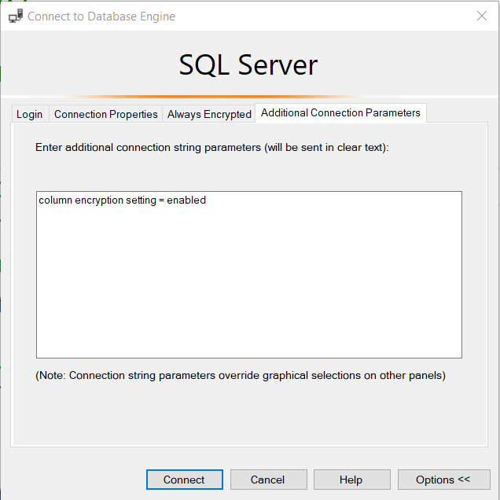
Column Encryption Setting = Enabled
Notes:
Query columns using Always Encrypted with SQL Server Management Studio:
https://docs.microsoft.com/en-us/sql/relational-databases/security/encryption/always-encrypted-query-columns-ssms?view=sql-server-ver15

Slide 19
For the developers
Column Encryption Setting = Enabled (.NET 4.6.1)
String connString = "Data Source=srv16; Integrated Security=true; Column Encryption Setting=enabled";
using (SqlConnection connection = new SqlConnection(connectionString))
{ //... }
Driver Level Parameters
using (SqlCommand cmd = new SqlCommand("SELECT Name FROM Customers WHERE PersonalId = @PersonalId", connection))
{
SqlParameter PersonalId = new SqlParameter("@PersonalId", System.Data.SqlDbType.VarChar, 11);
PersonalId.Value = "111-22-3333";
cmd.Parameters.Add(PersonalId);
cmd.ExecuteReader(); }
Notes:
Using Always Encrypted with the .NET Framework Data Provider for SQL Server:
https://docs.microsoft.com/en-us/sql/relational-databases/security/encryption/develop-using-always-encrypted-with-net-framework-data-provider?view=sql-server-ver15
Always Encrypted allows client applications to encrypt sensitive data and never reveal the data or the encryption keys to SQL Server or Azure SQL Database. An Always Encrypted enabled driver, such as the .NET Framework Data Provider for SQL Server, achieves this by transparently encrypting and decrypting sensitive data in the client application. The driver automatically determines which query parameters correspond to sensitive database columns (protected using Always Encrypted), and encrypts the values of those parameters before passing the data to SQL Server or Azure SQL Database.

Slide 20
Limitations
Not supported when columns use any of these datatypes
xml, hierarchyid, rowversion, image, text, ntext, geography, geometry, user-defined types, or sql_variant
Clauses that cannot be used for encrypted columns
FOR XML
FOR JSON PATH
Features that do not work on encrypted columns
Transactional or merge replication
Distributed queries (linked servers)
Notes:
Objective: This slide includes some general limitations of Always Encrypted.
Talking points:
If a column is encrypted, then all range-related operations such as greater/less than, pattern matching using LIKE, etc. are disallowed. Furthermore, you can’t pass encrypted values to functions, user-defined or otherwise, because the database doesn’t have access to the unencrypted values.
Unsupported data types include xml, rowversion, image, ntext, text, sql_variant, hierarchyid, geography, geometry, and user defined-types. Always Encrypted is not supported for the columns with the characteristics such as FILESTREAM columns, columns with ROWGUIDCOL property, or string (varchar, char, etc.) columns with non-bin2 collations.
The following clauses cannot be used for encrypted columns:
FOR XML
FOR JSON PATH
The following features do not work on encrypted columns:
Transactional or merge replication
Distributed queries (linked servers)

Slide 21
Permissions
ALTER ANY COLUMN MASTER KEY
Required to create and delete a column master key
ALTER ANY COLUMN ENCRYPTION KEY
Required to create and delete a column encryption key
VIEW ANY COLUMN MASTER KEY DEFINITION
Required to access and read column master key metadata objects while managing keys or querying encrypting columns
VIEW ANY COLUMN ENCRYTPION KEY DEFINITION
Required to access and read column encryption key metadata objects while managing keys or querying encrypting columns
Notes:
Database Permissions: https://docs.microsoft.com/en-us/sql/relational-databases/security/encryption/always-encrypted-database-engine?view=sql-server-ver15#database-permissions
The permissions apply to actions using Transact-SQL, Management Studio (dialog boxes and wizard), or Windows PowerShell.
The two view permissions are required when selecting encrypted columns, even if the user does not have permission to decrypt the columns.
In SQL Server, both view permissions are granted by default to the public fixed database role. A database administrator may choose to revoke (or deny) the view permissions to the public role and grant them to specific roles or users to implement more restricted control.
In SQL Database, the view permissions are not granted by default to the public fixed database role. This enables certain existing, legacy tools (using older versions of DaxFx) to work properly. Consequently, to work with encrypted columns (even if not decrypting them) a database administrator must explicitly grant the two view permissions.

Slide 22
Always Encrypted
Demonstration

Slide 23


Slide 24
Microsoft

