Slide 1
Google
Play
App
Predict the rating on Google Play Store Apps for the Android market with machine learning
Xiongfeng Wang, Brown DSI, 10/16/2020
https://github.com/XiongfengWang/1030project
Notes:
Hi everyone, I’m Xiongfeng Wang. Welcome to my midterm project presentation. My project is about predicting the Google Play Store Apps for Android market with machine learning.

Slide 2
01
02
03
04
Introduction
EDA
Preprocessing
Q&A
Notes:
I’ll go thought these four sections.

Slide 3
Introduction
Predict the rating for Google Play Store Apps:
Rating affect App’s success and visibility.
Good prediction on new Apps is beneficial.
Regression: rating scales from 1 to 5 with decile level between each integer.
Dataset: Kaggle https://www.kaggle.com/lava18/google-play-store-apps
Notes:
This project will use machine learning to predict the rating for Apps in Google Play Store. This is a quite interesting problem to solve because rating is an important indicator for user experience, and will affect the App’s success and visibility. With the model we get we may be able to predict the rating so we can have a good expectation for new Apps and some clue for optimizing the existing Apps.
This is a regression problem because the target variable, rating, scales from 1 to 5 with decile level between each integer.
The dataset is downloaded from Kaggle.

Slide 4

Dataset OverView
10,358 samples, 13 columns
Drop duplicate samples
Drop samples missing rating
8,893 samples
missing values in 4 columns
Group structure
Imbalance

Slide 5
EDA
 | Variable | Classificationª | Note
Key | App
Features | Category | Categorical | Imbalance
 | Reviews | Numerical | ‘Varies with device’ kB, MB to Byte
 | Size | Numerical
 | Installs | Categorical
 | Type | Categorical
 | Price | Numerical | Remove $ sign
 | Content Rating | Categorical
Notes:
Heading to EDA. Here’s a table with classification and note for each variable. Please notice that all the classification refers to variable after necessary modification. For the highlighted variables, I’ll talk about them in detail soon.

Slide 6
 | Variable | Classification | Note
Features | Genres | Categorical | Transfer to Subcategory
 | Last Updated | Numerical | Transfer to Days
 | Current Ver | Categorical | Unique format
 | Android Ver | Categorical
 | Subcategory | Categorical | 8446 null value
 | Days | Numerical
Target | Rating | Numerical
Notes:
Genres example: Game;(semicolon)Action

Slide 7
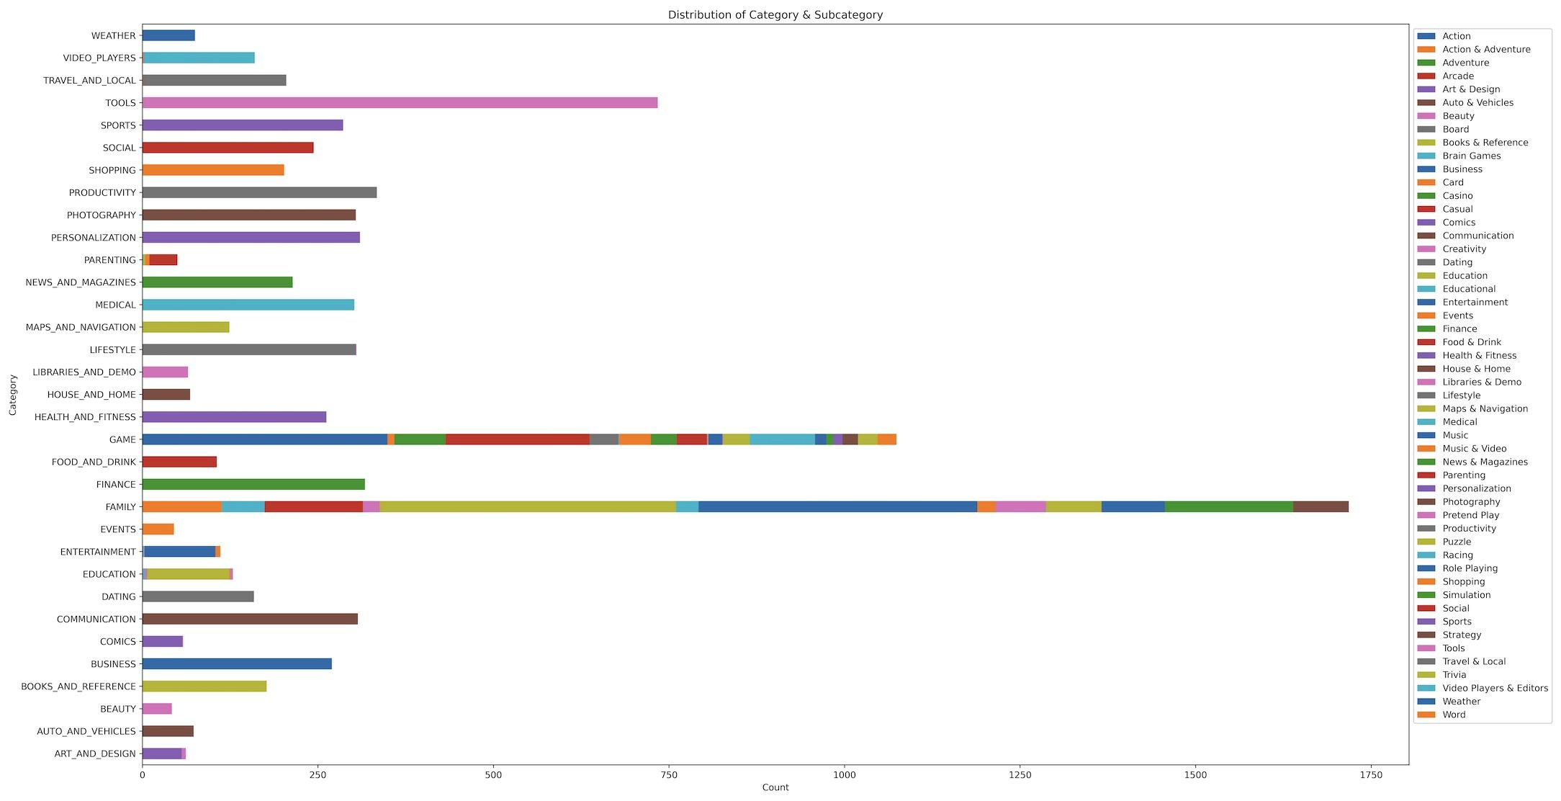
Group Structure: Category and Subcategory
Notes:
To plot this figure I grouped category and subcategory, fill the missing subcategory with main category. Family & Games are newly added samples, subcategory varies a lot.

Slide 8
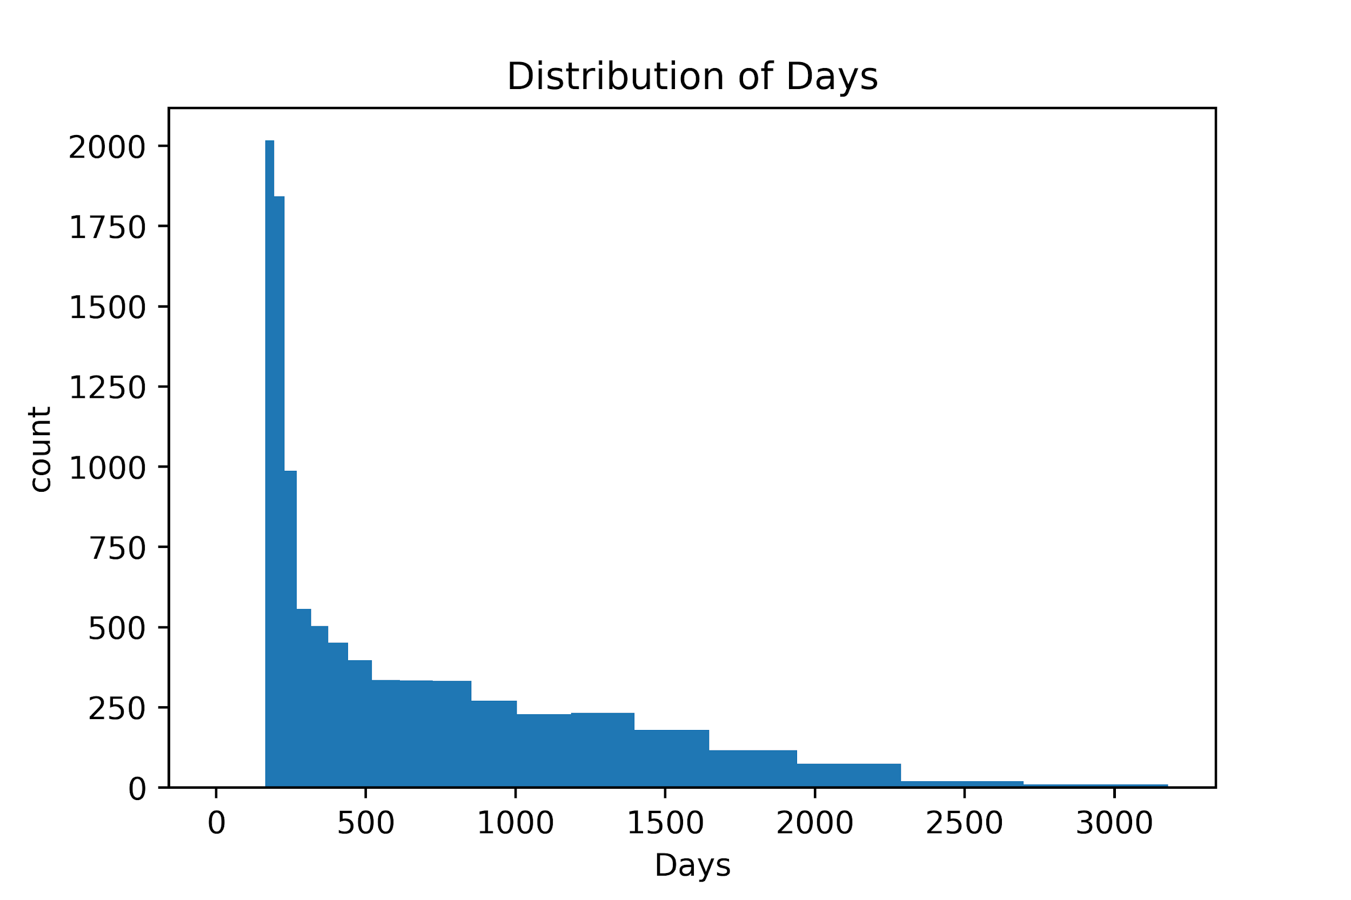
Last Updated -> Days
Difference between last updated date for App and for Dataset
Gap: Dataset last update date is 02/03/2019
Potential new feature: Month

Slide 9
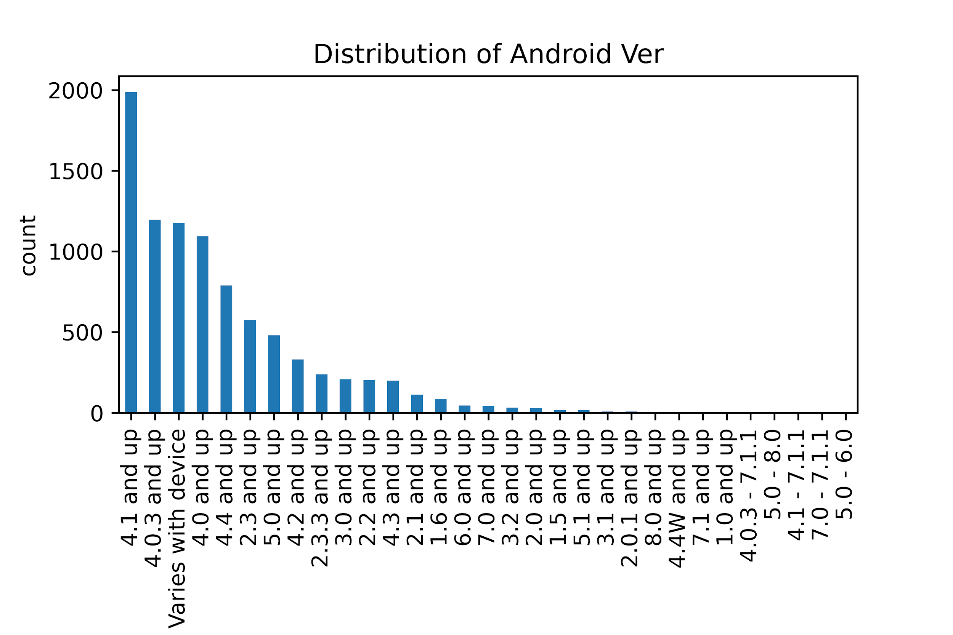
Android Ver
Whether to make it numerical
Different format for newly added samples
Varies with device: potential null value, more missing values to fill

Slide 10
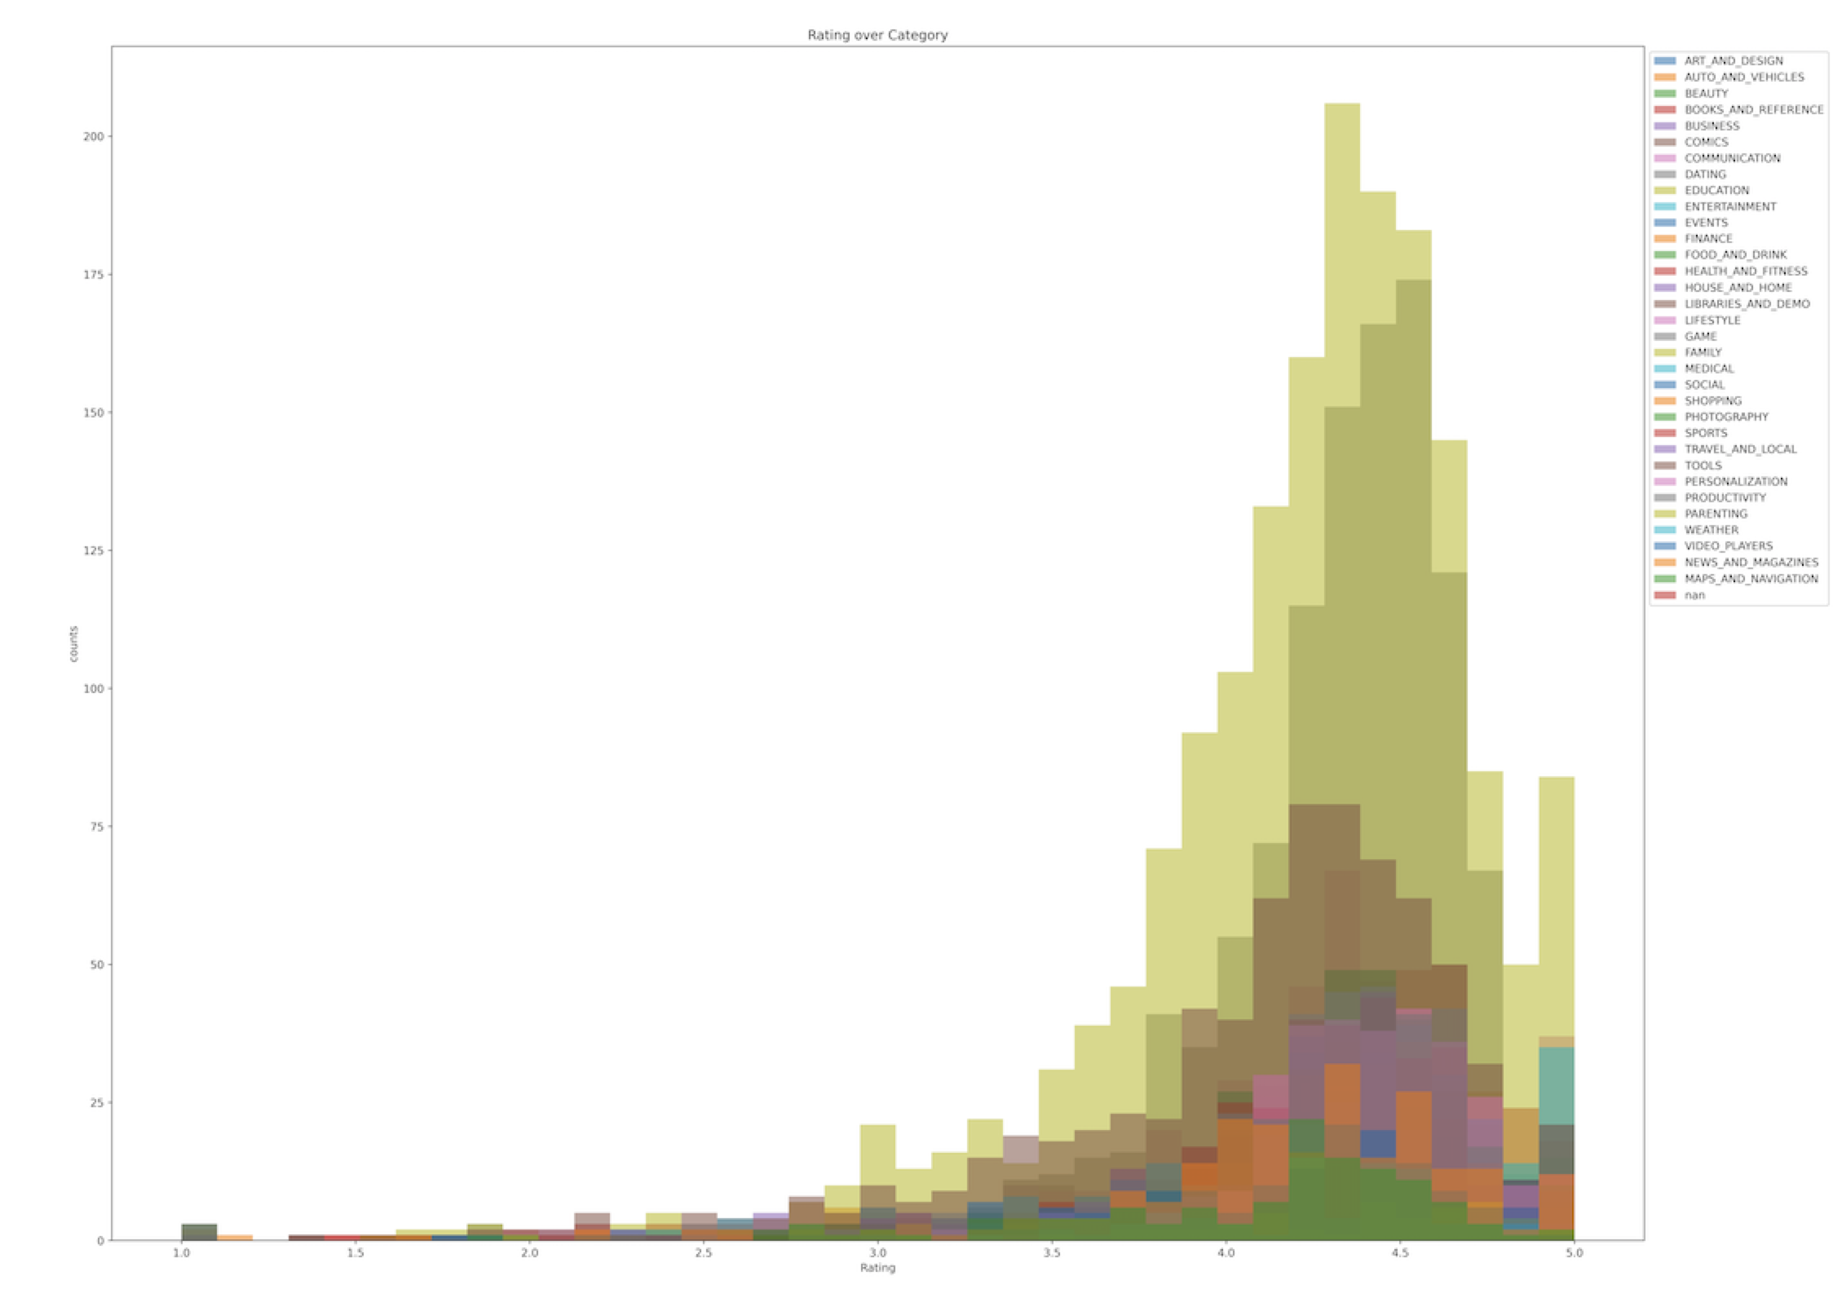
Target: Rating
Normal distribution, left skewed
mean : 4.19
Std: 0.52
25% - 75%: 4 - 4.5
bin = 49

Slide 11
Preprocessing
Group Structure: not I.I.D.
Not time series
Imbalance
GroupShuffleSplit

Slide 12
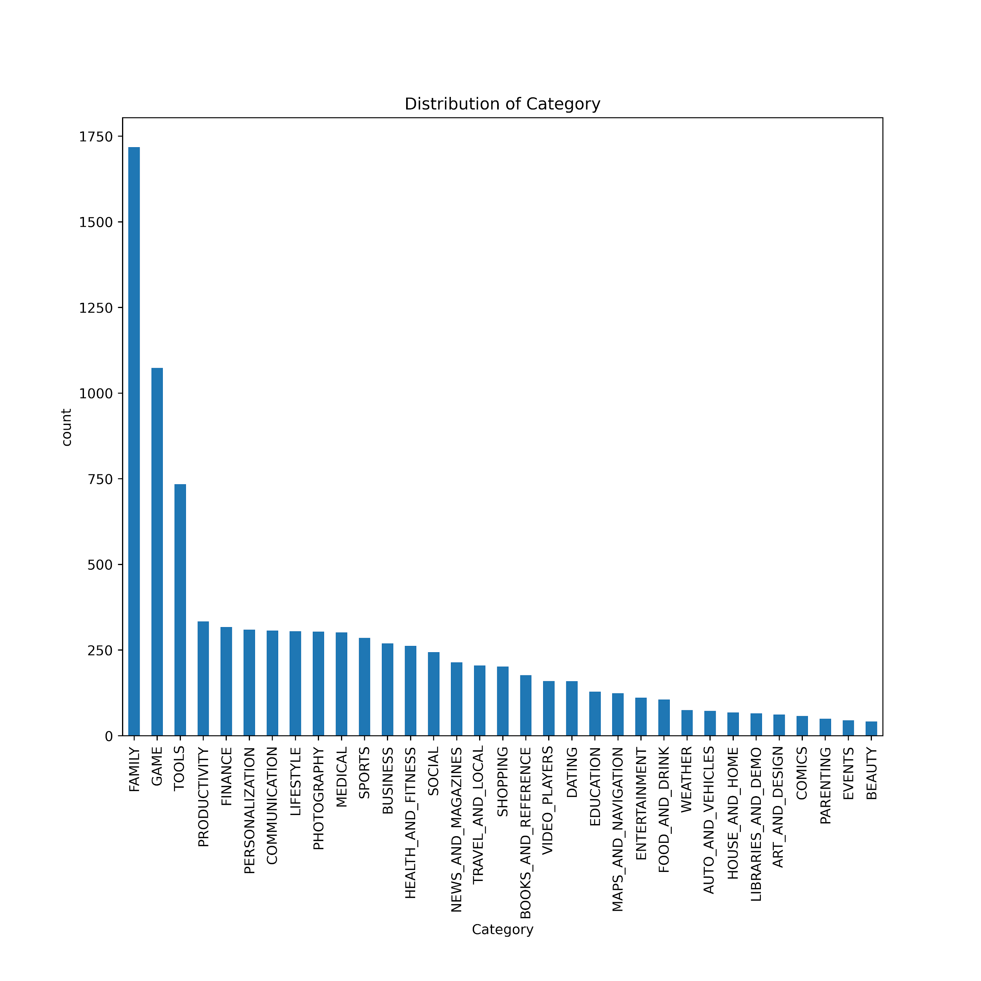
How to split
80%
Train
10%
Validation
10%
Test
Notes:
If I go with category, the 10% of the dataset will be used as test set which is around 900 samples. I think it is pretty good because the group shown in train should not be in test, 900 samples allows pretty much different group distribution.

Slide 13
Encoding
 | Variable | Classification | Encoder
Key | App
Features | Category | Categorical | OneHotEncoder
 | Reviews | Numerical | StandardScaler
 | Size | Numerical | StandardScaler
 | Installs | Categorical | OrdinalEncoder
 | Type | Categorical | OneHotEncoder
 | Price | Numerical | StandardScaler
 | Content Rating | Categorical | OneHotEncoder
Notes:
Most numerical variables are heavily skewed.

Slide 14
 | Variable | Classification | Encoder
Features | Genres | Categorical
 | Last Updated | Numerical
 | Current Ver | Categorical
 | Android Ver | Categorical | OneHotEncoder
 | Subcategory | Categorical | OneHotEncoder
 | Days | Numerical | StandardScaler
Target | Rating | Numerical | StandardScaler
Notes:
9 features 8893 samples

Slide 15
Q&A

Slide 16
Thanks!
Please keep this slide for attribution.

